Slide 1
The test set-up with “real’ solenoid and uniform bias.
Gennady Romanov
2nd Harmonic cavity meeting
November 9, 2017

Slide 2
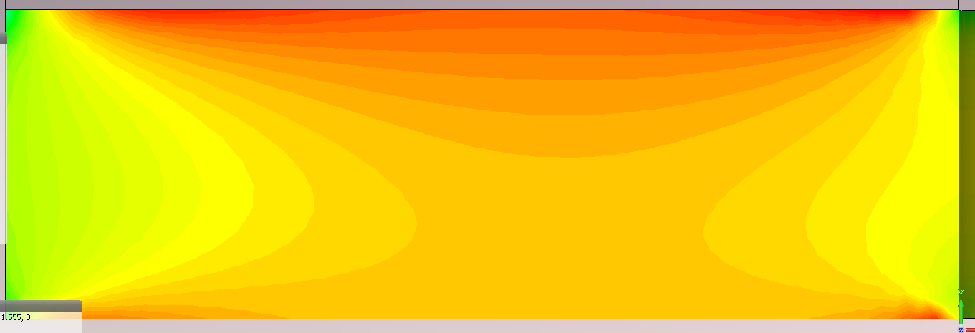
Solenoid model
Yoke
Ceramic
d1
Garnet
Copper
d2
Yoke
Number of turns 224
d1>d2, may be the garnet should be flipped over?
I solenoid = 5 A
H
µ’=2.9÷6
Lowest H ≈ 15000 A/m, while gyromagnetic resonance at 75 MHz is ≈ 2100 A/m

Slide 3
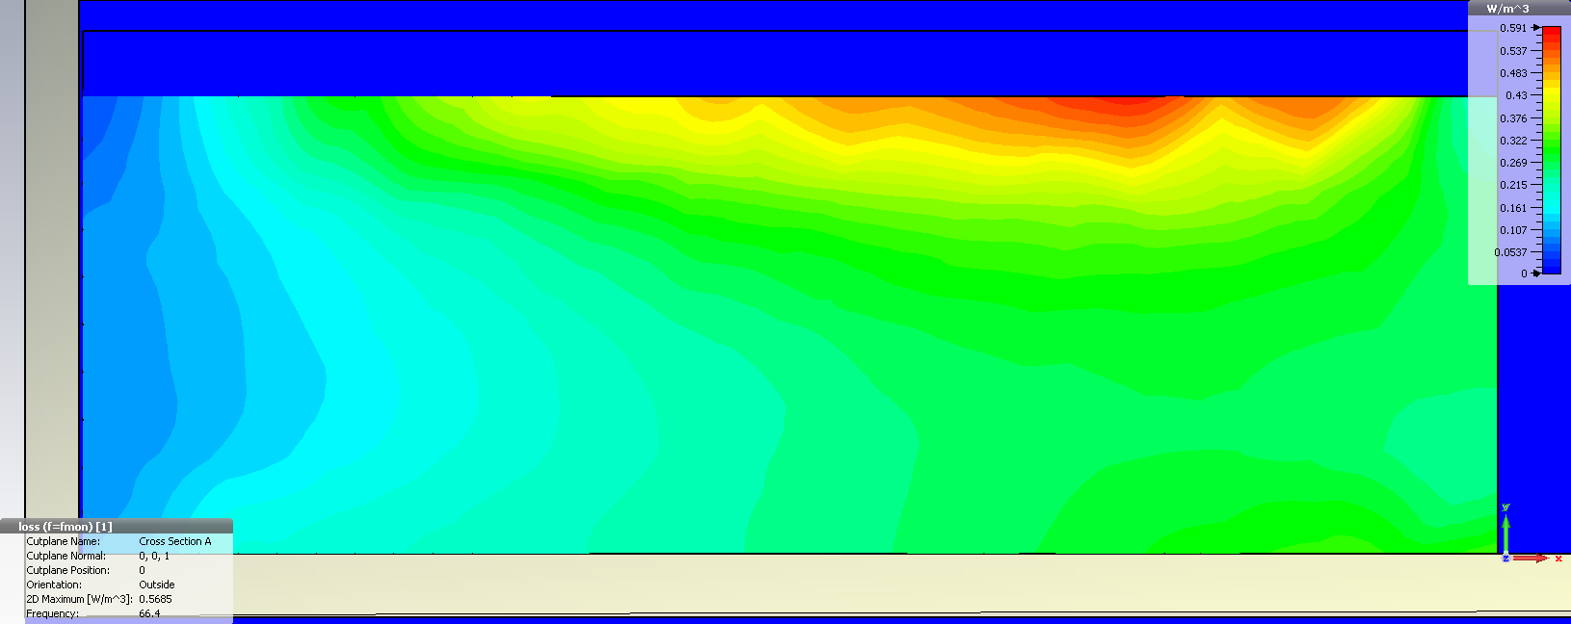
Distribution of RF losses at I_sol = 4.2 A
Normal copper – 5.8e7 S/m
Garnet “Al800_exp4” (our base model)
Shown interval of losses is from 0.07 to 0.6 W/m³

Slide 4
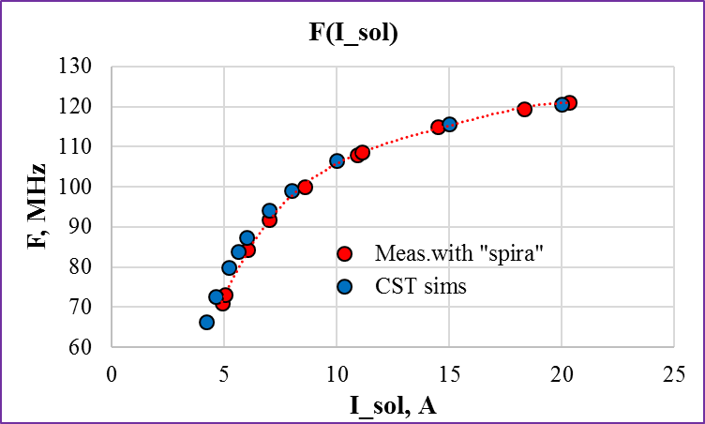
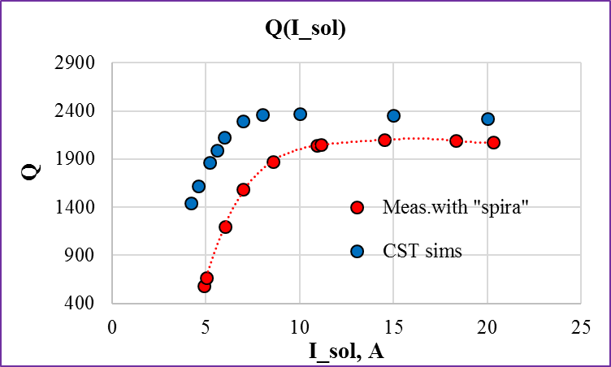
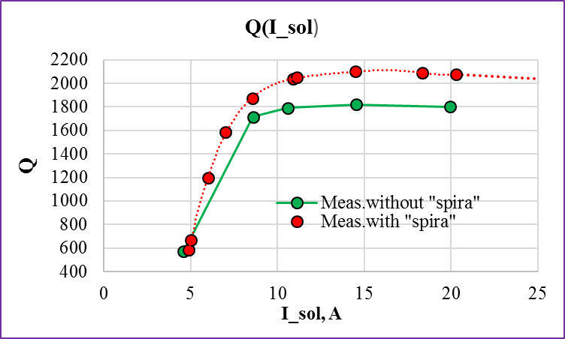
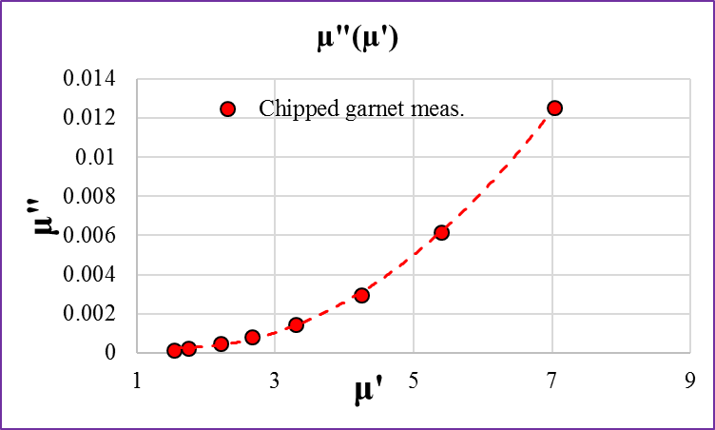
Results with constant α = 0.0036 (ΔH = 24 Oe at f₀ = 9.4 GHz)
Empty
2215
1870
Frequency – excellent agreement
Q – similar general behavior
In the experiments the lowest Q is defined mostly by losses in the garnet
Gyromagnetic resonance is well below lowest internal bias field.
Non-linear α (H_{bias}) ?
Losses in the garnet dominate
- µ is integrated parameter, average over the disk volume, not a material characteristic.

Slide 5
Results with fitted ΔH and two copper conductivities
“Normal copper, fitted ΔH” – ΔH was fitted to get experimental Q at low end and smoothly reach theoretical Q at high end with. Copper conductivity was kept constant (5.7e7 S/m).
“Fitted copper, fitted ΔH, uniform H” – conductivity of copper was chosen to meet experimental Q of empty test set-up and then kept constant (4.7e7 S/m), ΔH and uniform H were fitted to get experimental frequencies and Qs.

Slide 6
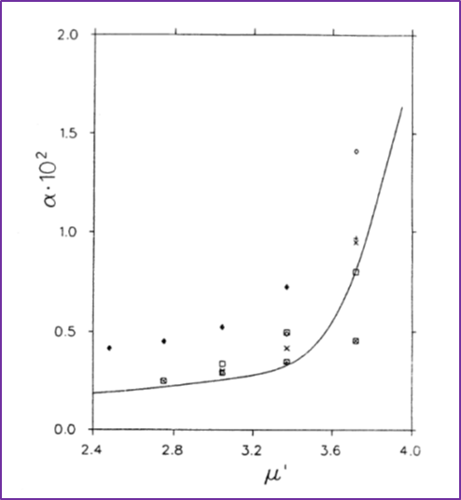
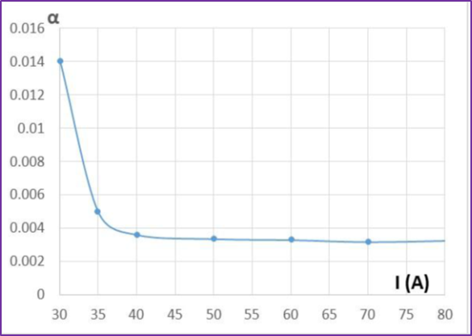
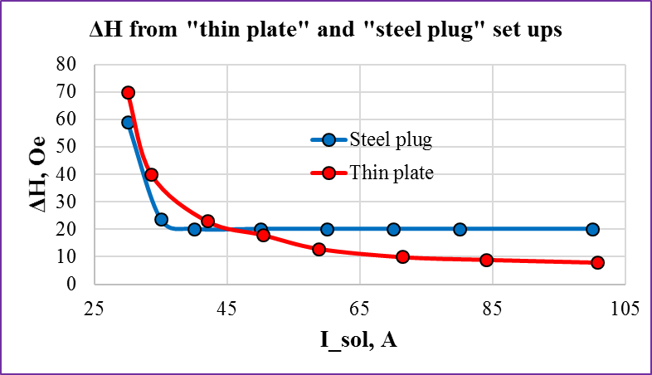
Non-linearity of ΔH

