Slide 1
Status of RF Windows
Ding Sun
Second Harmonic Cavity
12/07/2017

Slide 2
Input Window
Ordered and received 2 input windows from CoorsTek.
Vacuum leak tight (checked by Fermilab) : ~2E-10 mbar-l/s
CMM Inspection (by Fermilab) --- circularity etc. --- okay.
Problem: braze material overflow on the ceramic disks --- may cause sparks. Difficult to completely remove it while keeping the integrity and cleanness.
Spots with non-copper color (2nd input window)?
Ordered/received 2 input windows from Morgan Technical Ceramics --- failed (ceramic disks cracked at 2 – 3 places, gap between ceramic disk and outer ring)

Slide 3
Input Window #1

Slide 4
Input Window #1

Slide 5
Input Window #2

Slide 6
Input Window #2

Slide 7
Conical Window
Ordered and received 2 conical windows from CoorsTek.
Conical window #1:
flange was deformed but can be fixed
Vacuum leak tight (checked by Fermilab) : ~2E-10 mbar-l/s
CMM Inspection (by Fermilab) --- (a) distance between beam pipe tip and copper flange: ~ 0.006 -0.035” shorter than spec. (b) angle of center line of beam pipe to flange plane: ~0.2 degree off 90 degree. etc. --- okay.
Problem: braze material overflow on the ceramic disks (smaller than input window #1, but still a potential problem).
Conical window #2:
flange was deformed more, will be returned to the vendor.

Slide 8
Conical Window #1

Slide 9
Conical Window #1

Slide 10
Conical Window #1

Slide 11
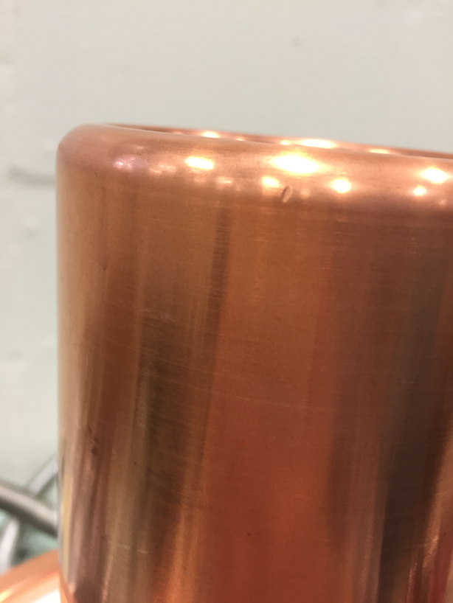
Conical Window #2

