Slide 1
Adding IR sensor to cavity
C.Y. Tan
08 Dec 2017

Slide 2
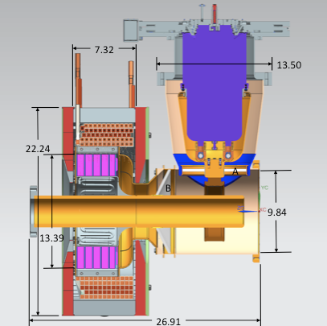
Location of sensor
I want to have the IR sensor looking through the slit at the front face of the garnet.
Since during high power testing, we are not ramping the solenoid, there’s no eddy currents, we can mount sensor on G10 and epoxy it to the tuner.

Slide 3
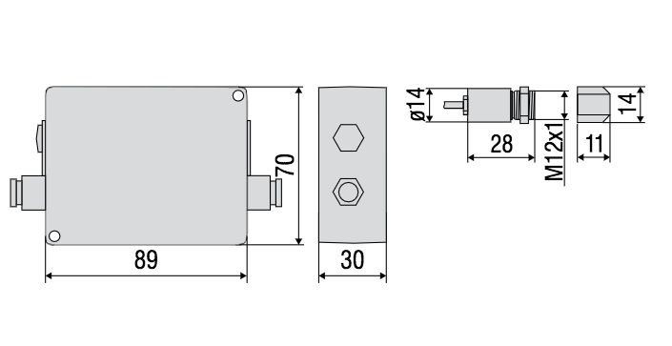
IR sensor
We may need the extra lens (11 mm) to see the hot spot area. Total body length is 35 mm with extra lens attached. (see email dated 14 Dec 2017 from S. Sochowski)
See page 24 of attached datasheet

Slide 4
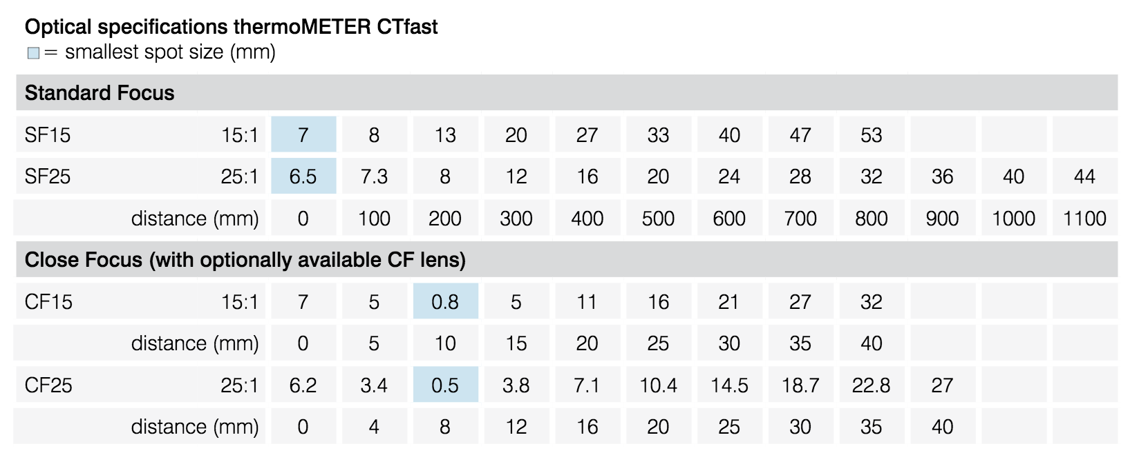
Distances
From Kevin’s email message (dated 08 Dec 2017), distances are ¾” (19 mm) to the OD of the ring and 2.75 inches (70 mm) to the ID of the ring.
Advantage of using lens is to see a bigger spot

Slide 5
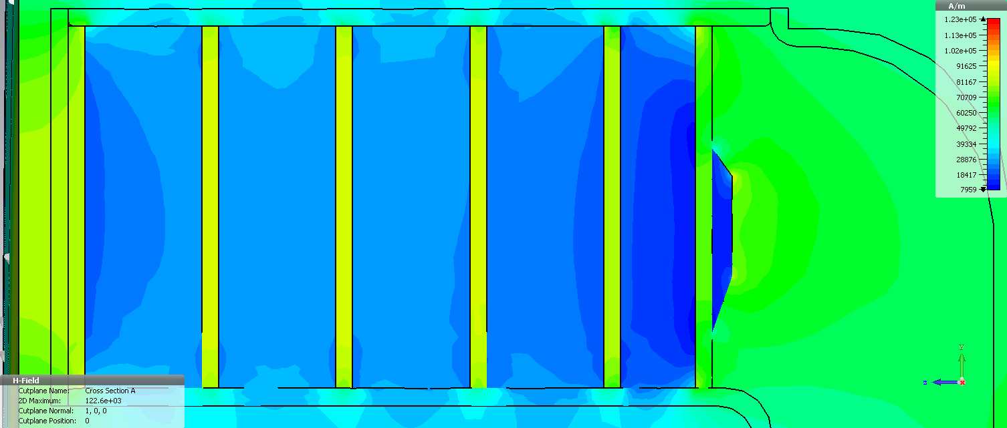
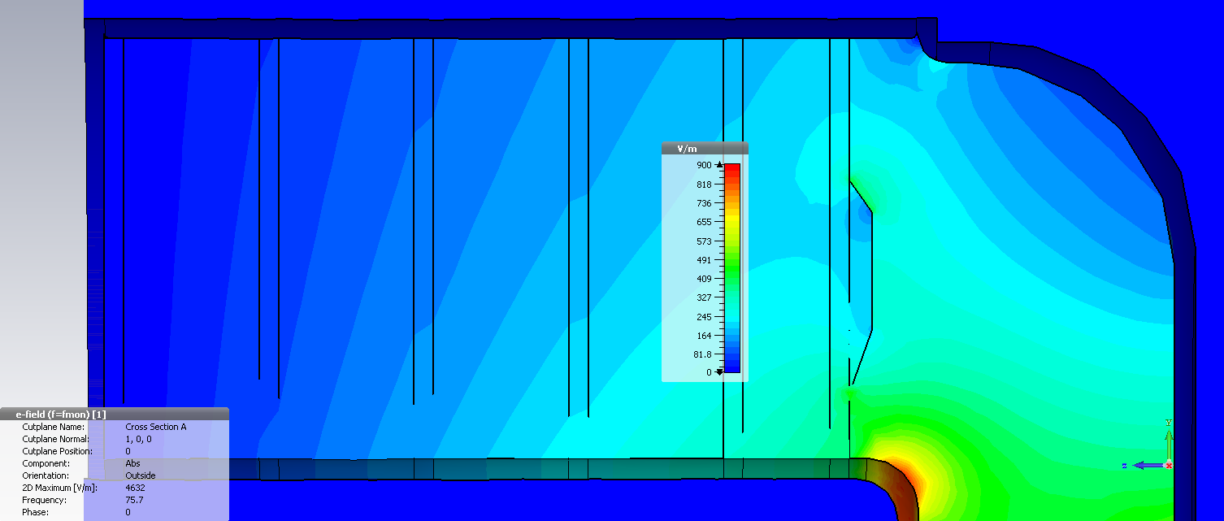
Optimized garnet shim
105 Oe
(COMSOL – 100 Oe)
|H_{bias}|, I_{stat} = 745 A
Kilpatrick limit for 77 MHz: 10.3 MV/m
|E_{rf}|, V_{acc} = 100 kV
≈ 1.3 MV/m
3.9 MV/m

Slide 6
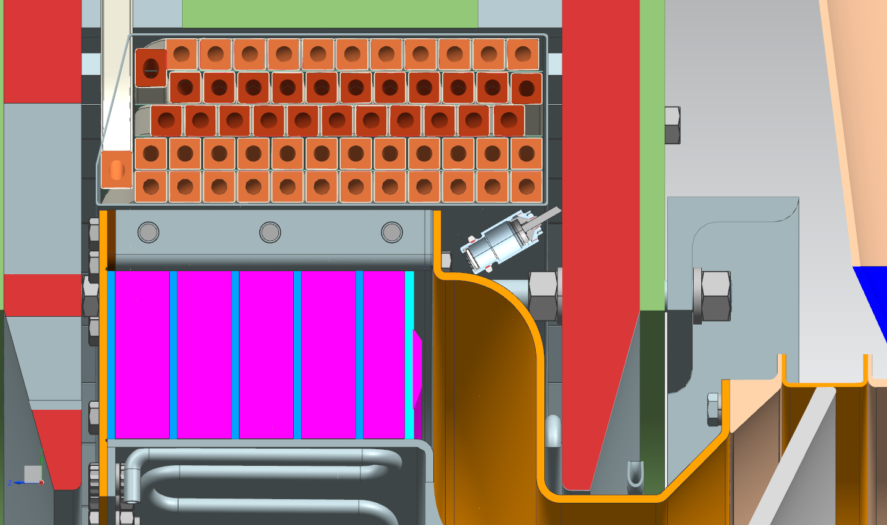
Can it fit?
~1 inch

Slide 7
Conclusion
Cost is $1500 for 2 IR sensors + controller + lens.
Will need to see if the sensor fits with the lens (better) or without lens.
We need to drill a small hole 15 mm diameter to look at the front face.
I don’t think the hole will be a problem for RF.
Need small 3D printed holder for the lens that we can just superglue to the shell.
This sensor will not survive in the tunnel!

