Slide 1
The 5 garnet rings
C.Y. Tan, R. Madrak & J. Kuharik
01 Feb 2018

Slide 2
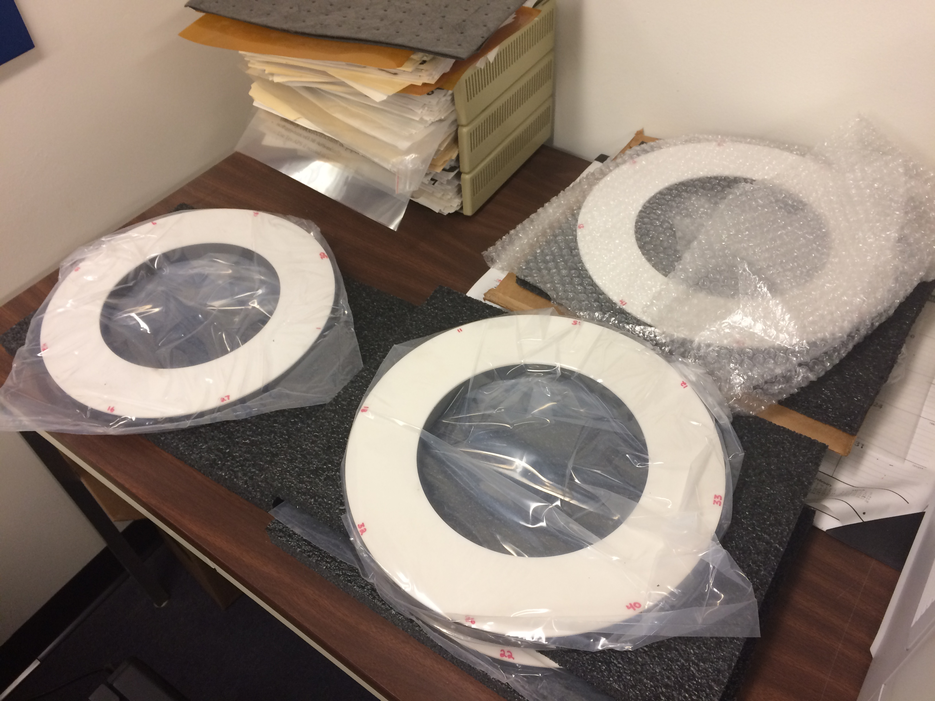
The 5 garnet rings
The 5 rings were received on 23 Jan 2018
Arrived right on time as promised by National!
Witness pieces did not arrive with the rings.
Robyn and Tan did a visual inspection of all the rings

Slide 3
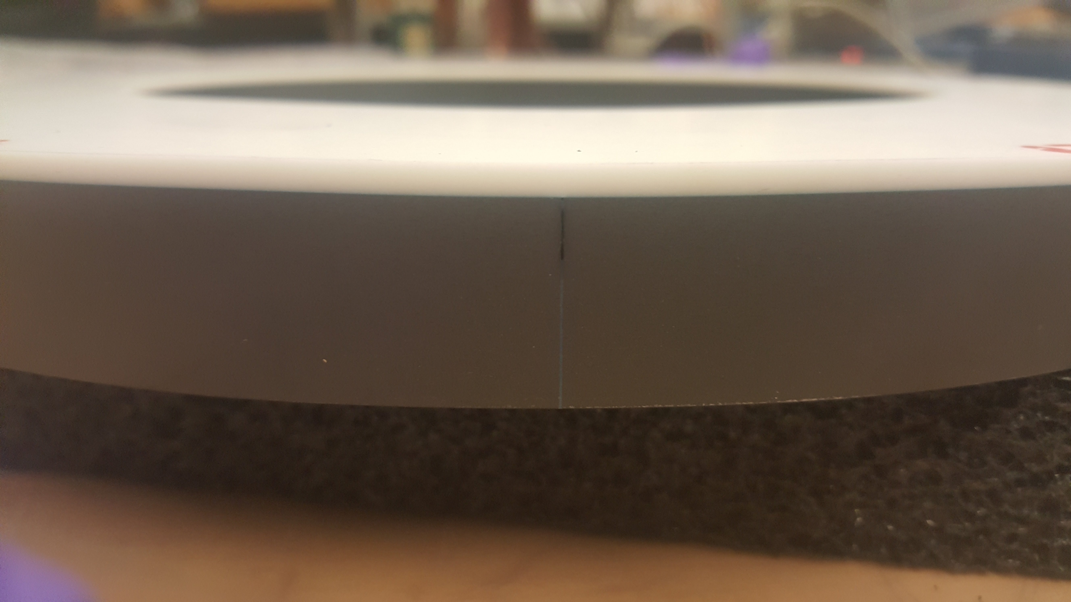
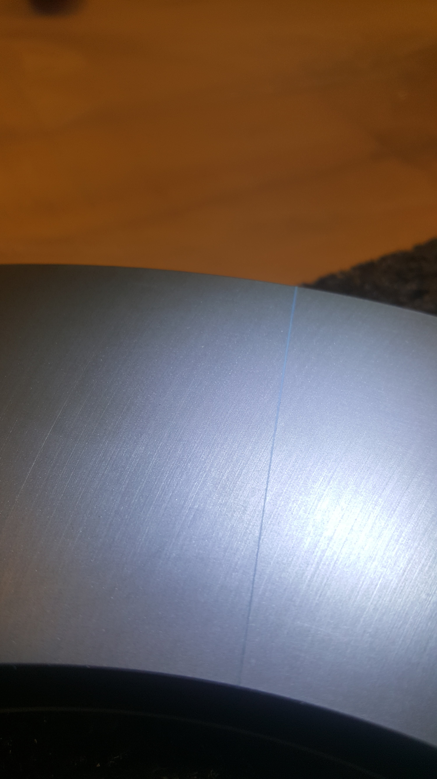
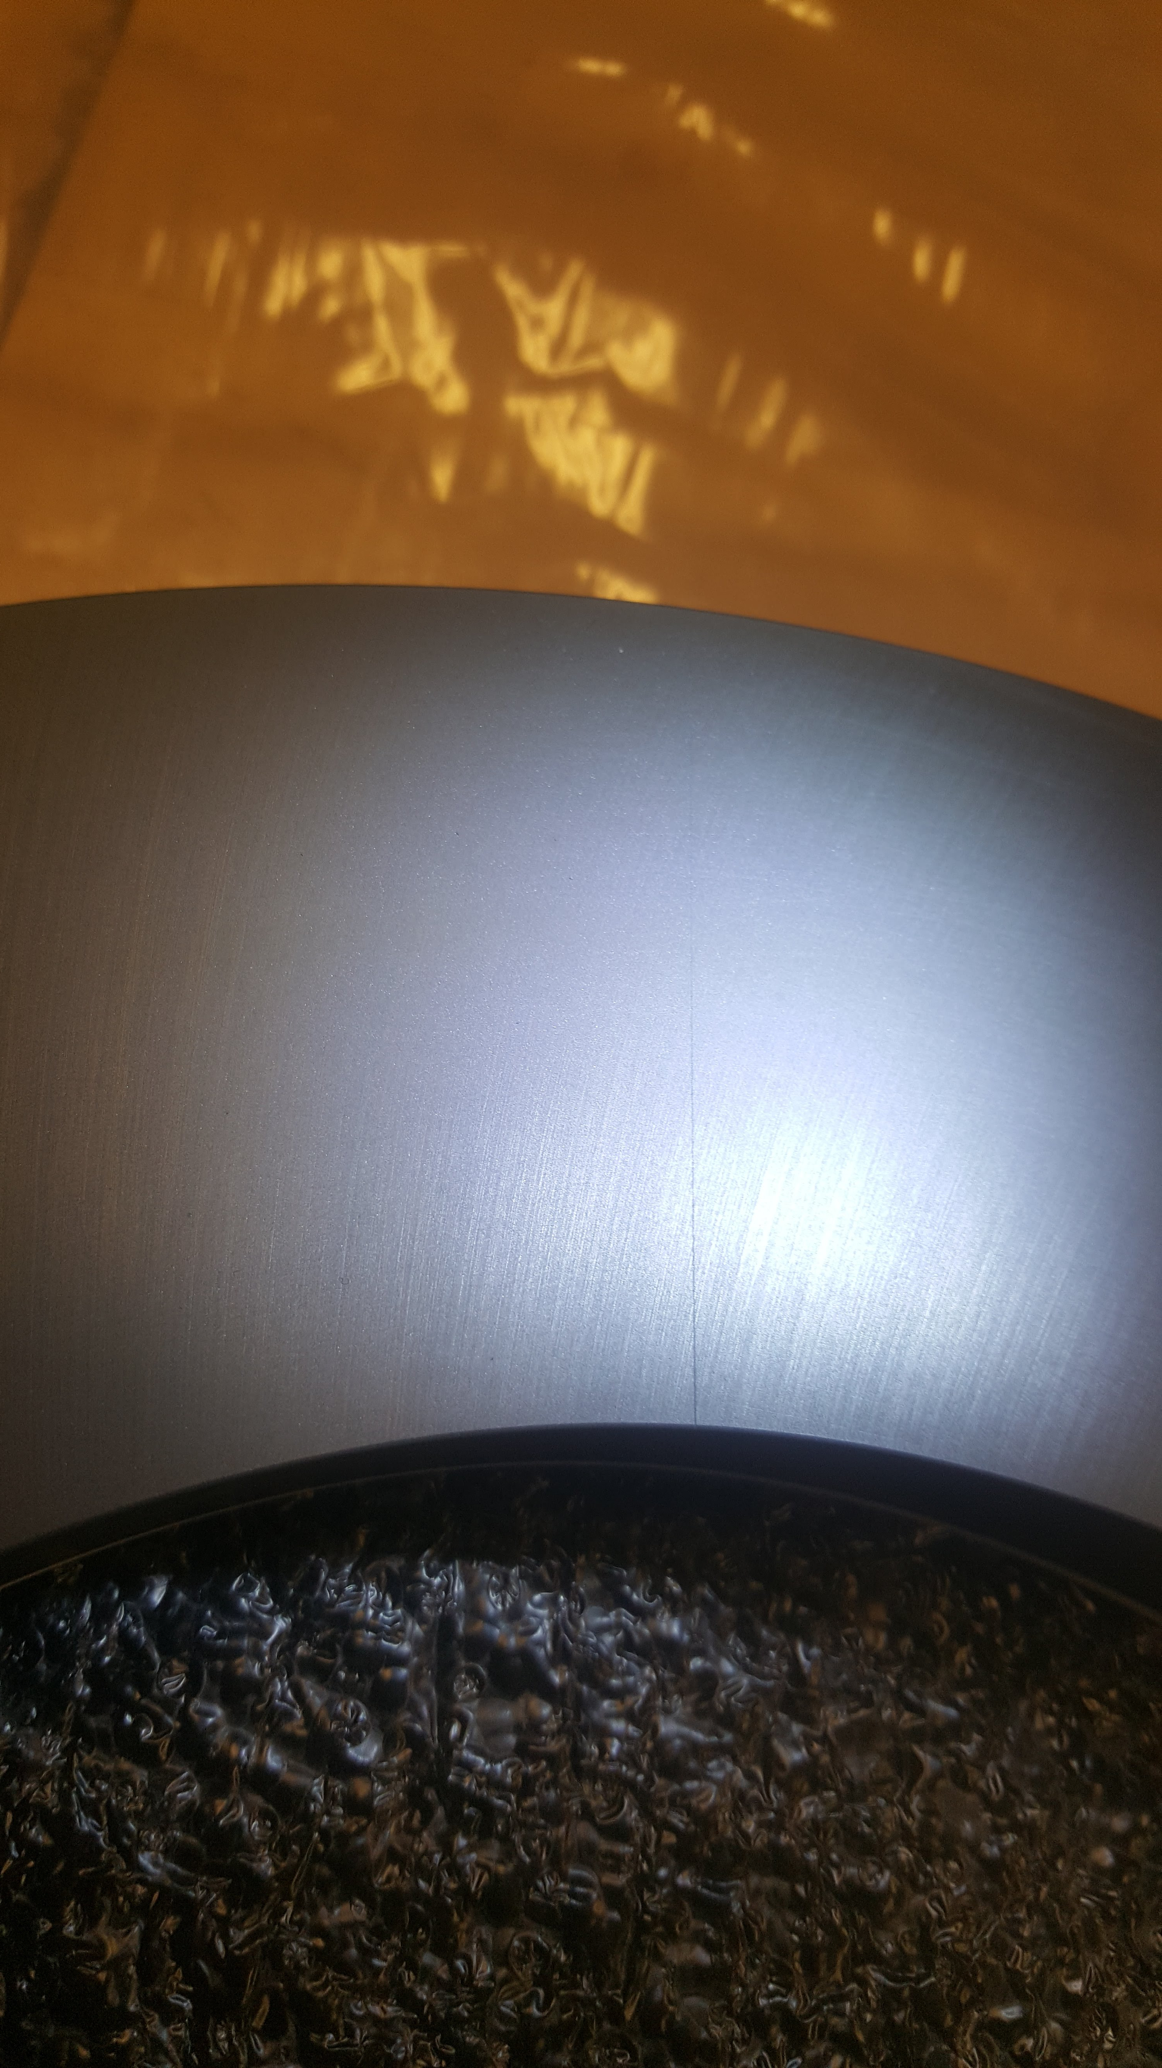
Visual inspection showed minor problems with 3 rings
Numbered the rings by smallest number written on the alumina substrate.
Seam is visibly larger compared to normal seam
1 mm deep void in #1.
Can be easily fixed by filling with glue or grease during install.

Slide 4
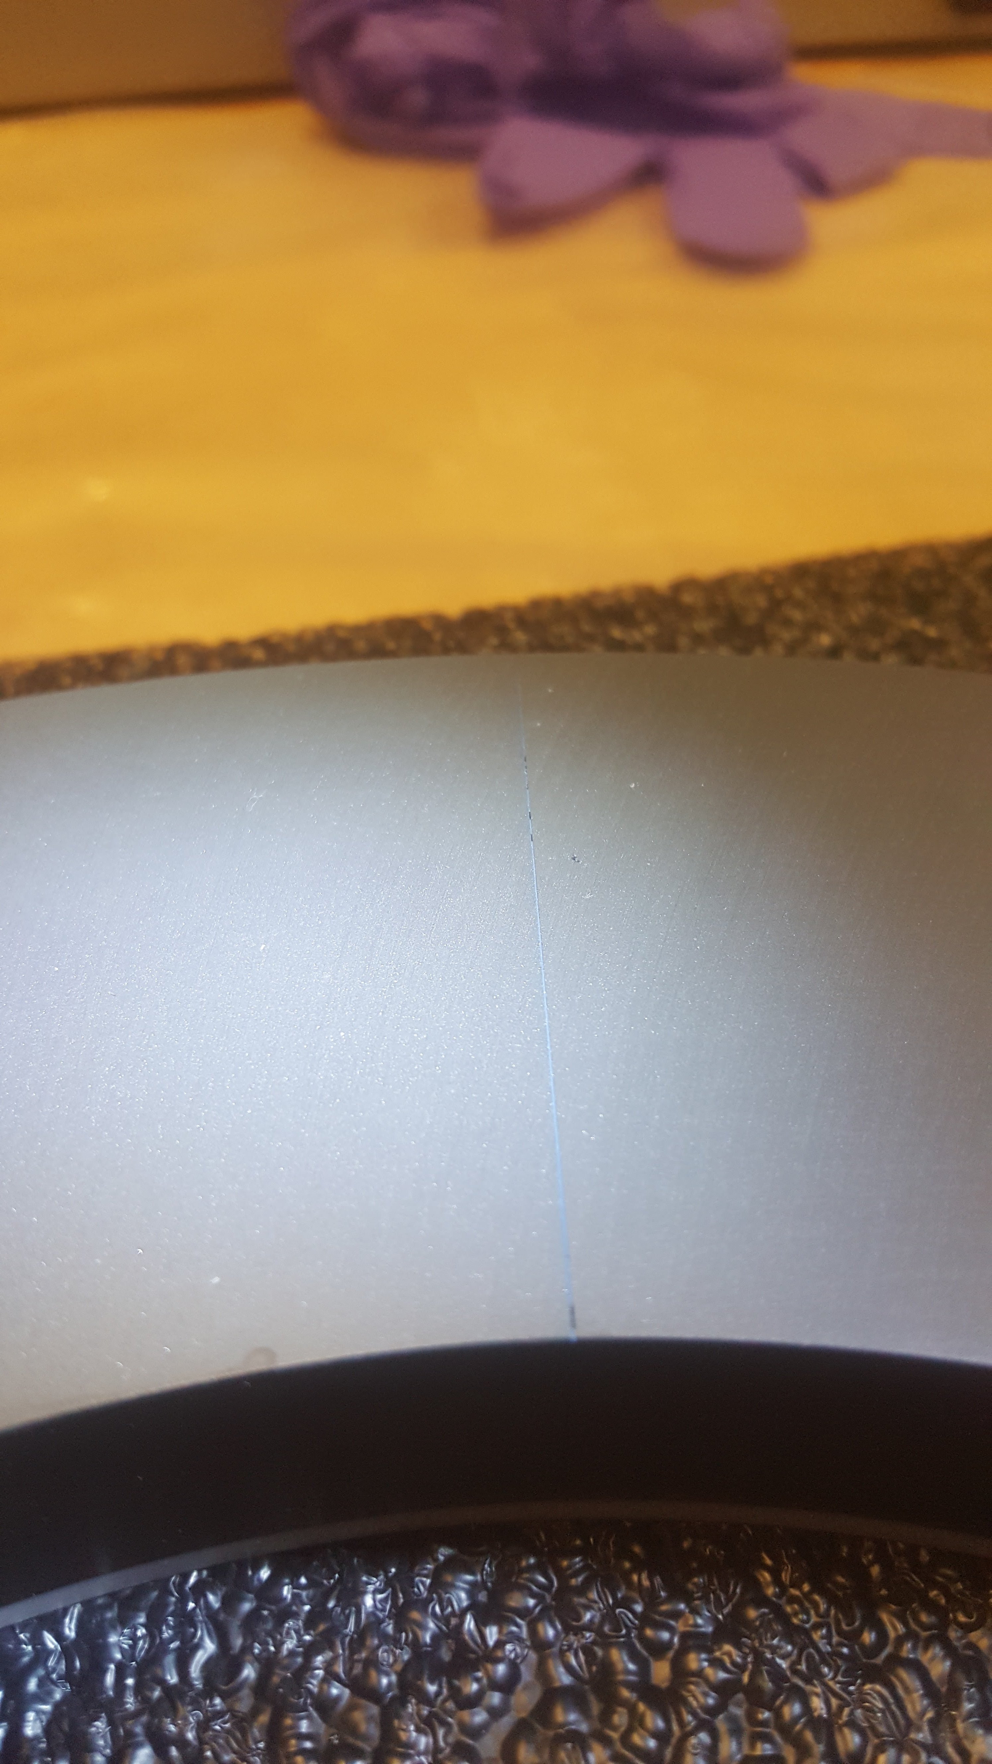
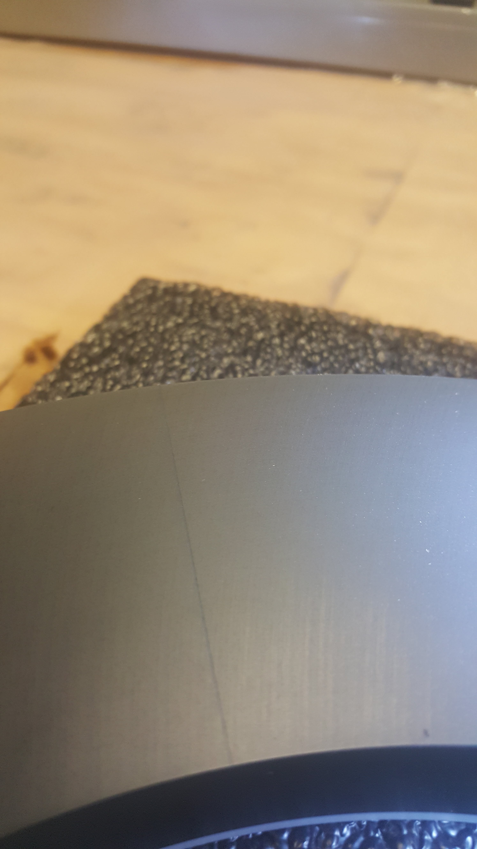
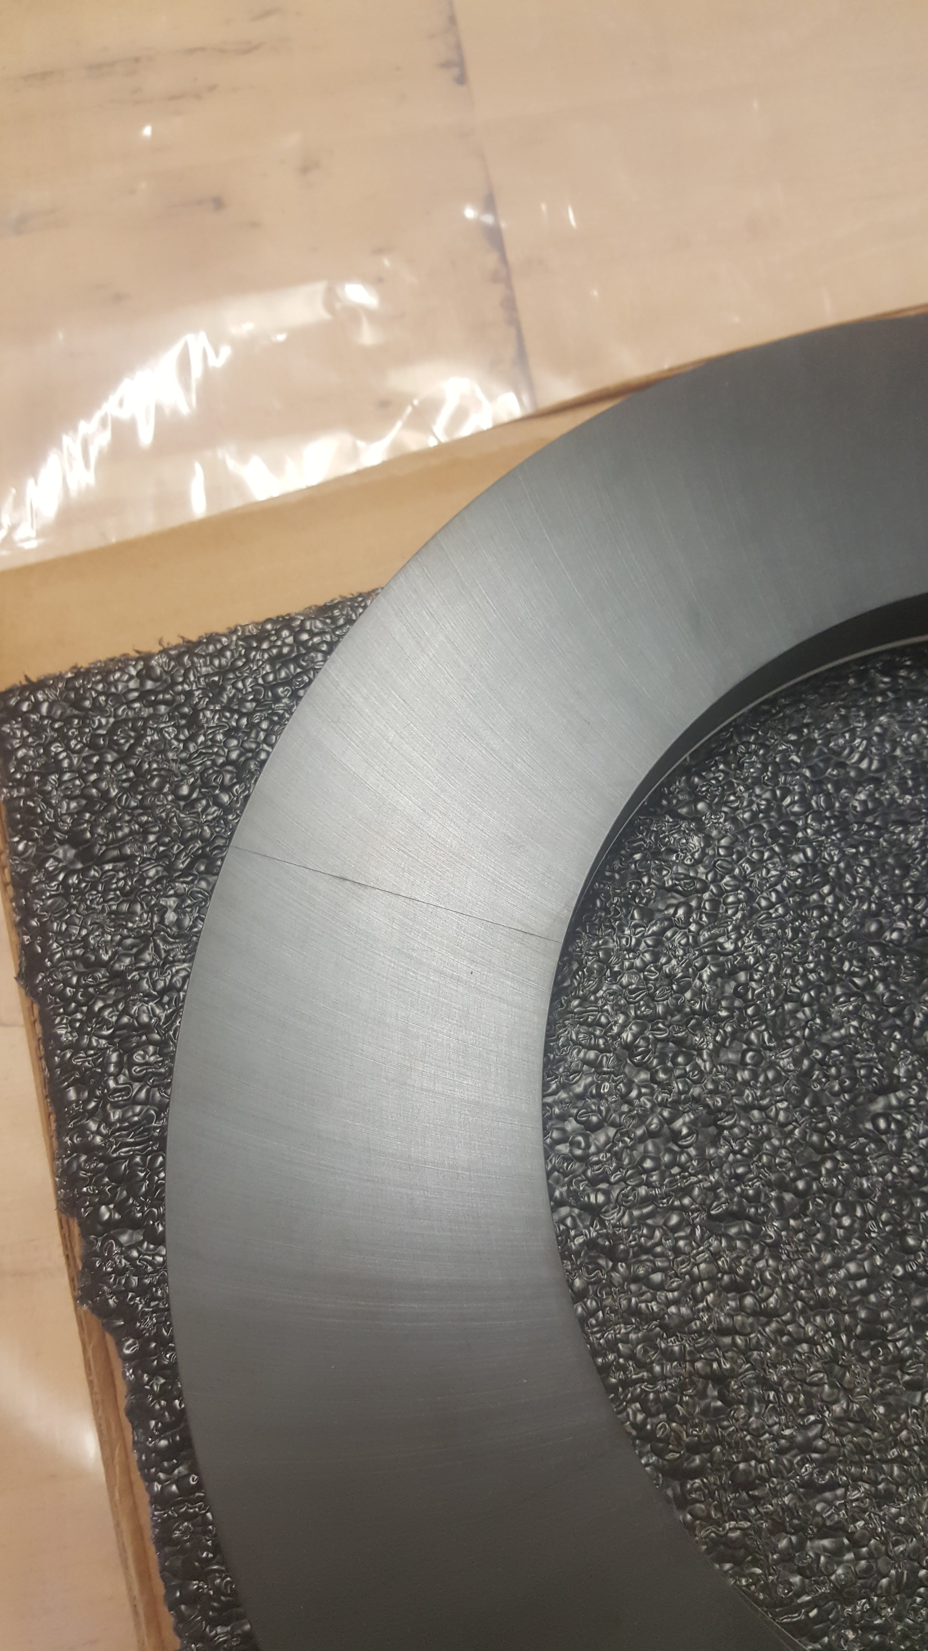
Minor problems (#5 and #13)
#5 small voids and thicker seam.
Small excess of epoxy in #13 in one of the seams.

Slide 5
Dimensions (manufacturer)
All dimensions within tolerance +/- 5 mils

Slide 6
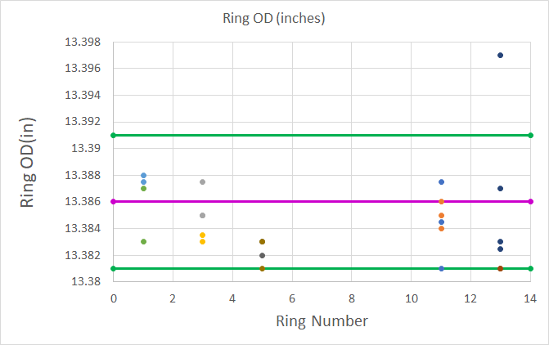
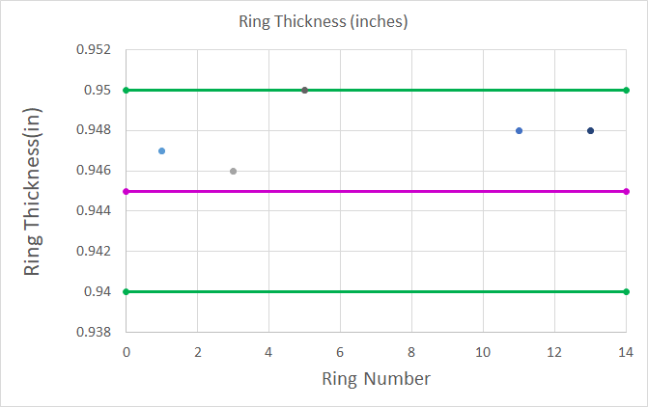
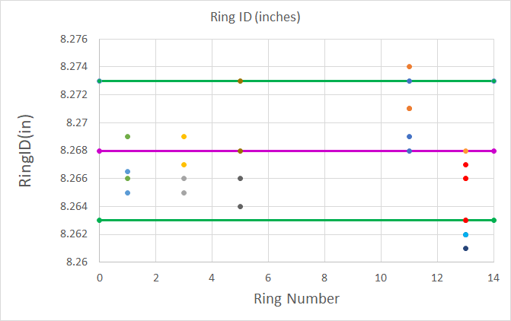
Dimensions (verification)
OD and ID measurements were done with calipers. Thickness measurements were done with micrometers.
All rings within tolerance although the scatter is a lot larger than vendor’s measurements. Need better instrument for ID measurement.

Slide 7
Q measurements

Slide 8
Conclusion
Rings look good.
The ”chipped” ring has been sent back to the vendor
Still need the shim rings to be made.

