Slide 1
Mechanical Update
Kevin Duel
Booster 2nd Harmonic Cavity
15 February 2018

Slide 2
Garnet
Witness pieces received

Slide 3
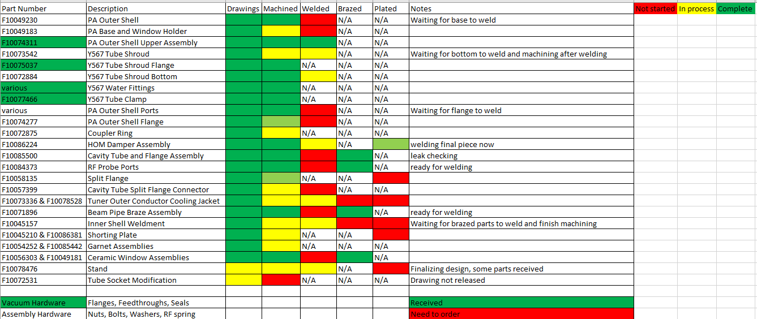
Fabrication and Assembly Status
Waiting for 4 machined parts from 2 vendors
Various welding and plating to be done

Slide 4
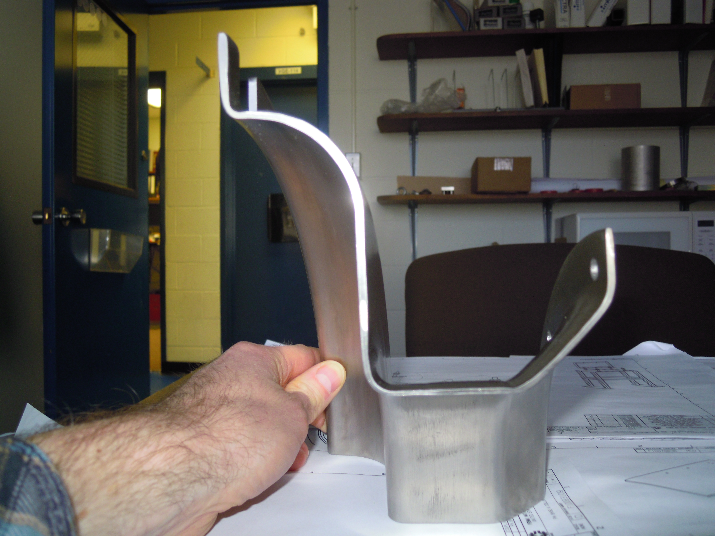
Spinning Part

Slide 5
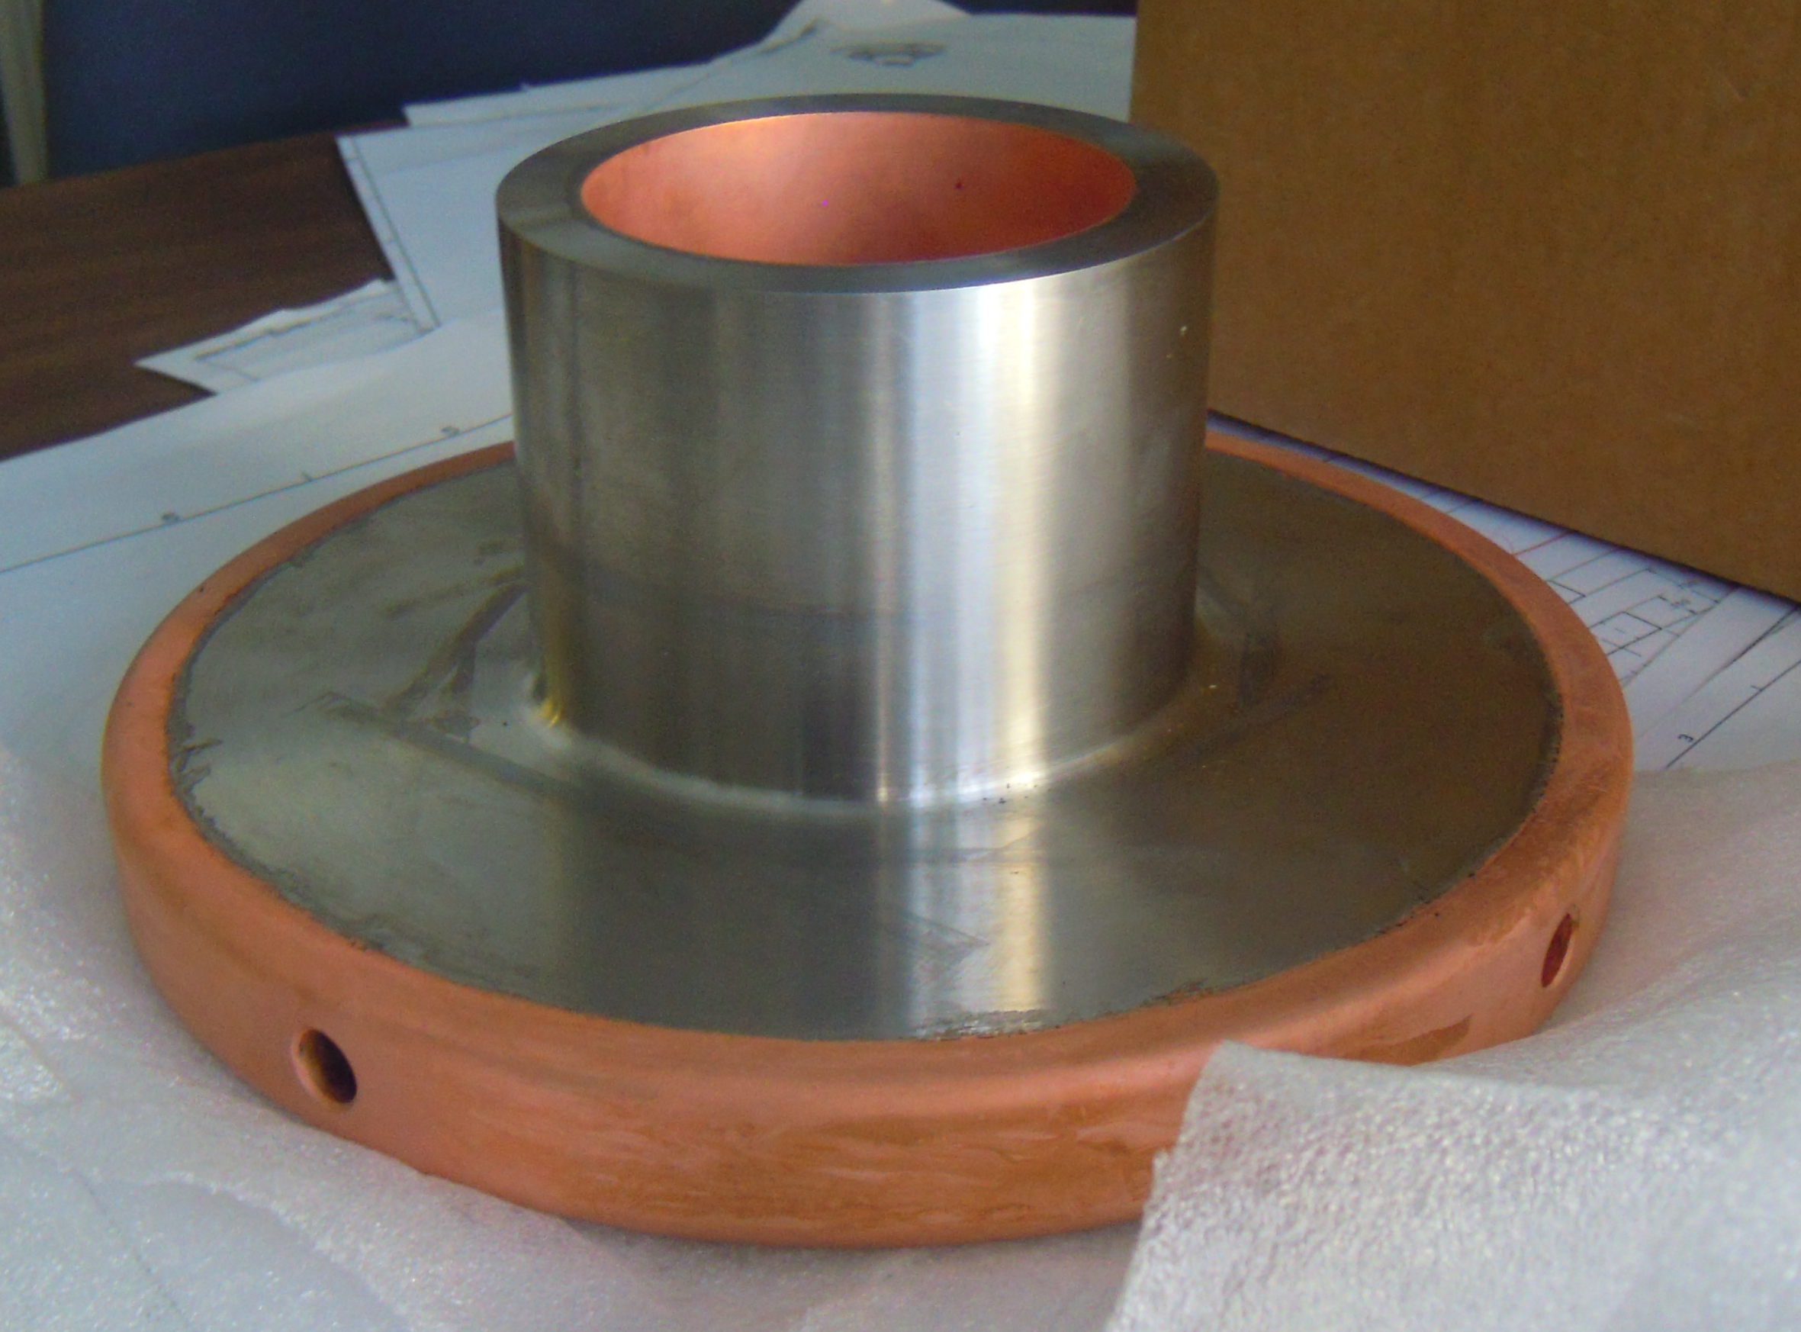
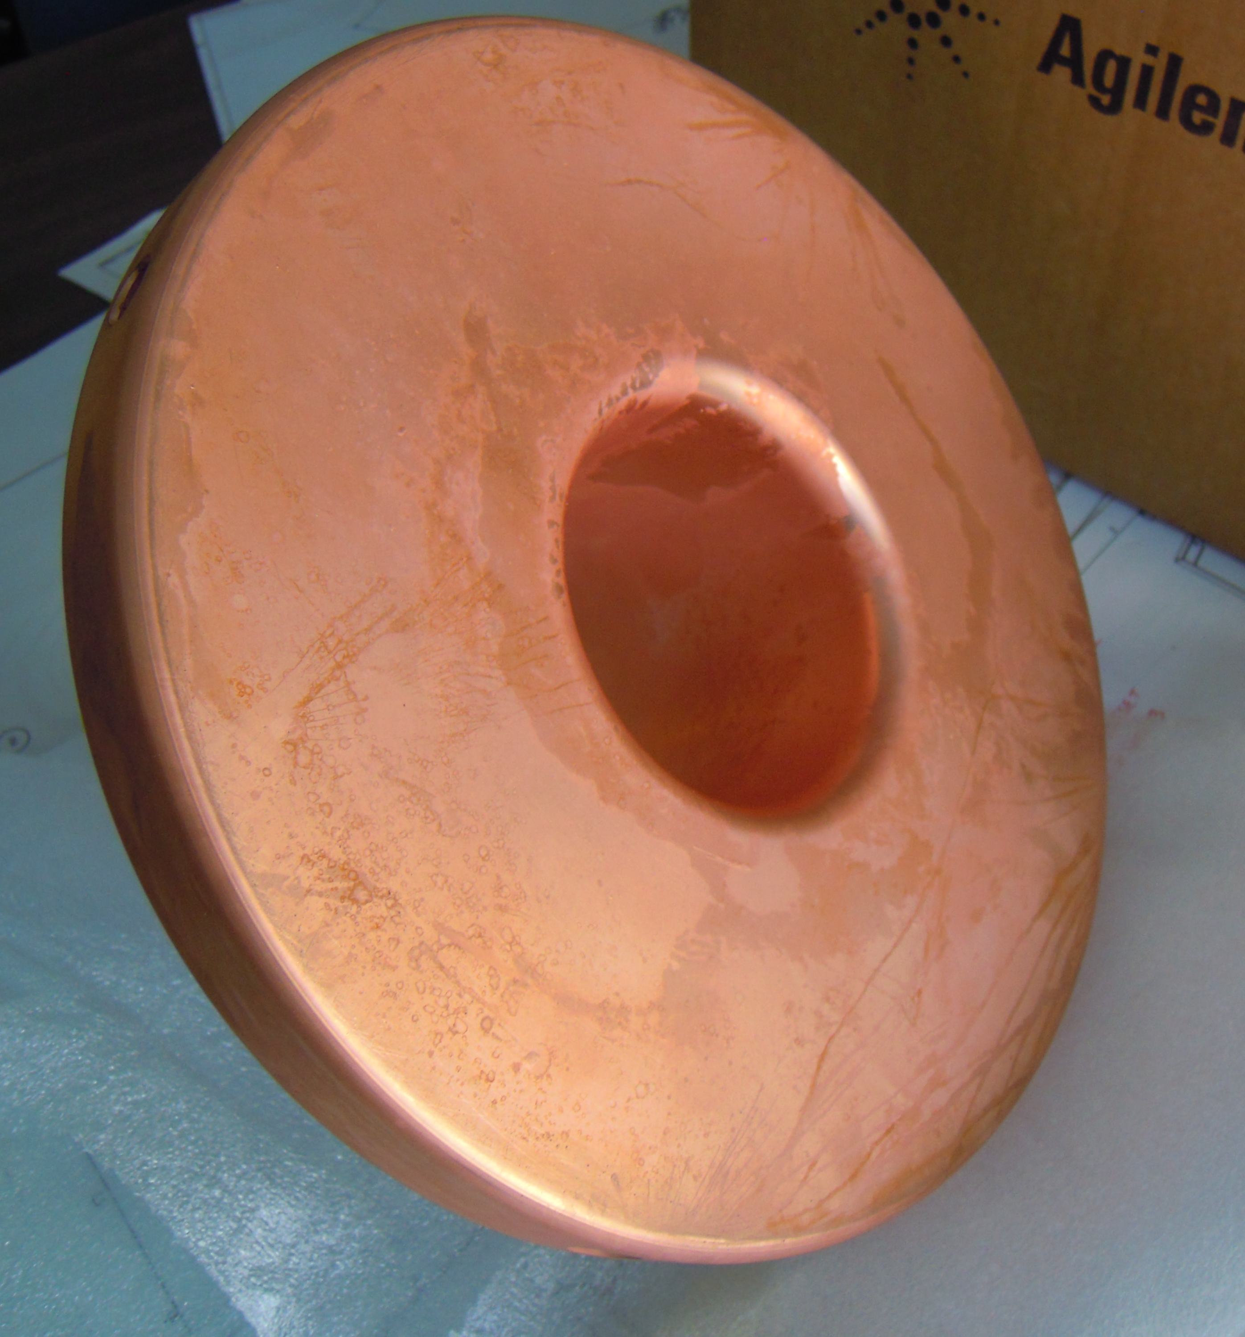
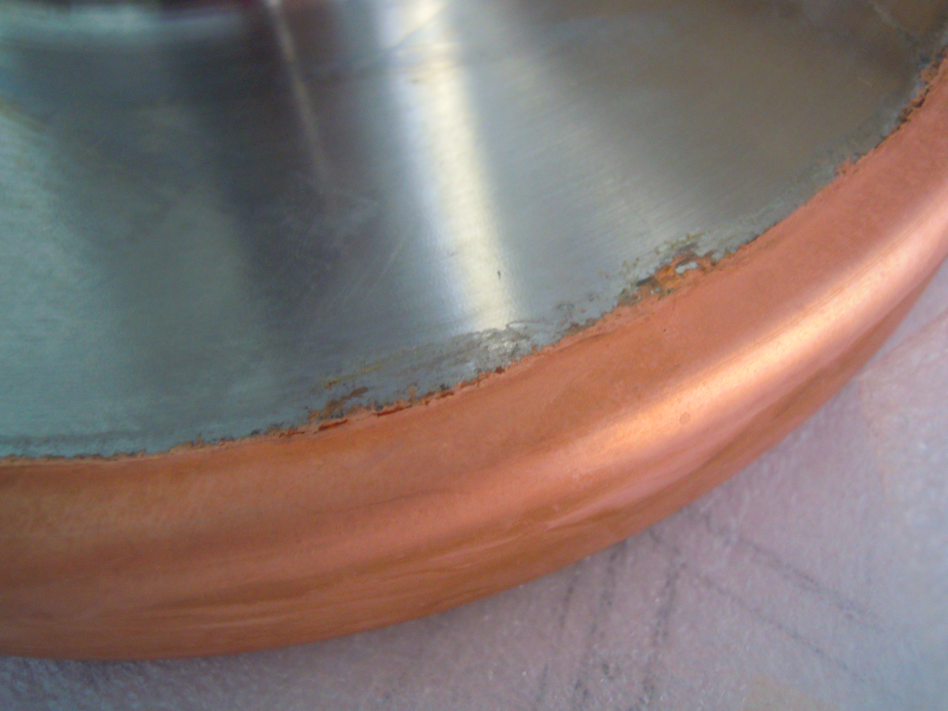
HOM Damper Plating – being welded to flange now

Slide 6
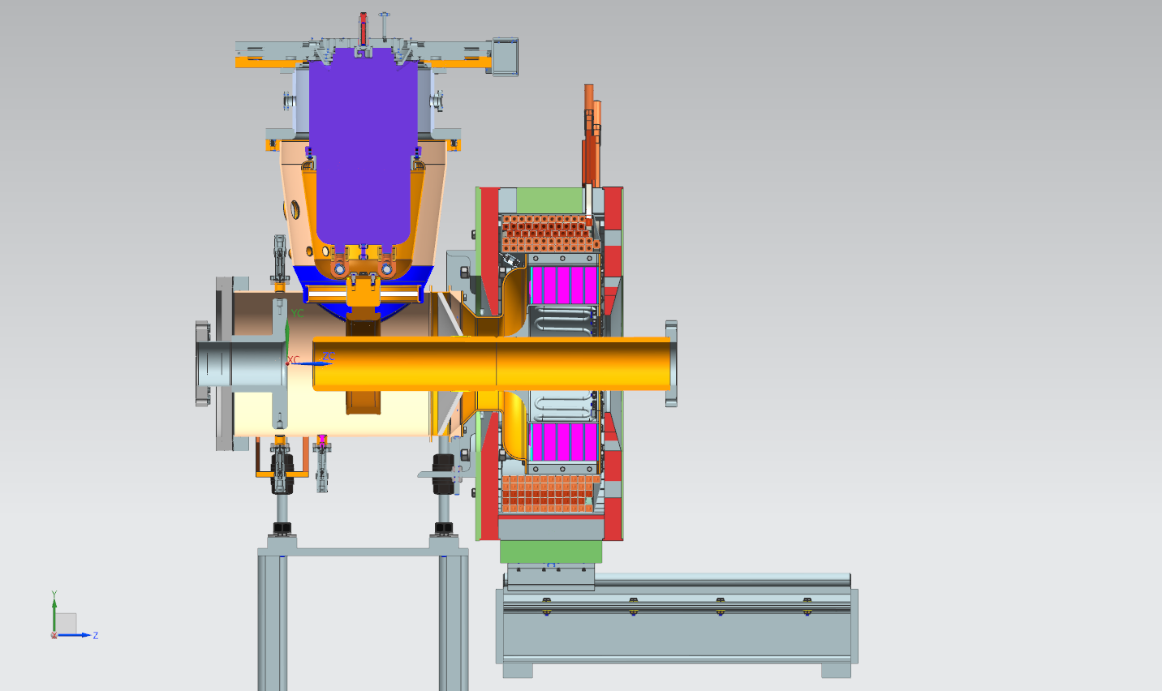

Slide 7
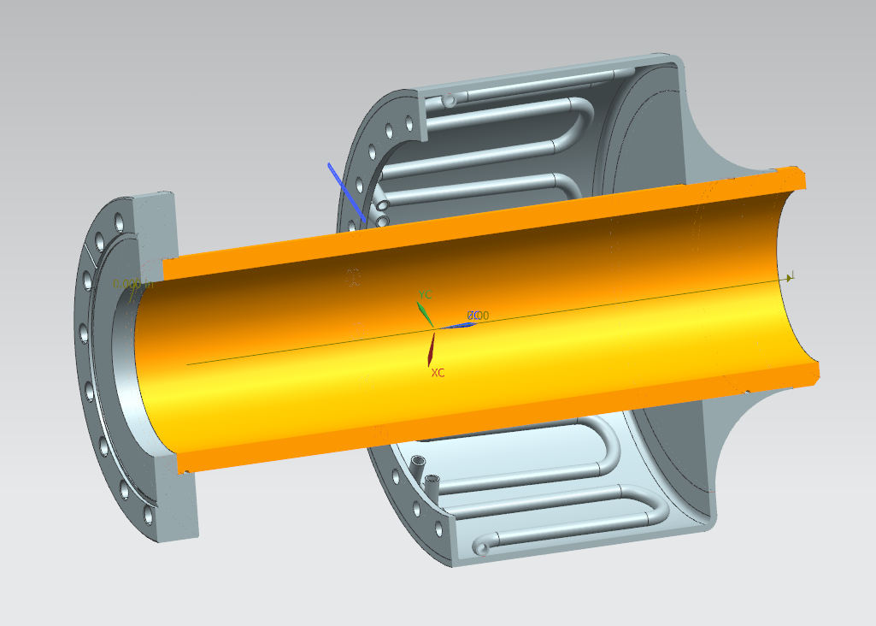
Inner conductor tube soldering and plating difficulty

