Slide 2
LHC Operation & Status
Rende Steerenberg
CERN, BE-OP
With thanks to many colleagues for their input and material

Slide 3
Topics
The CERN Accelerator Complex
Looking Back at the 2017 LHC Run
Beam Variants From Injectors
2018 LHC Schedule
CERN Upgrade Projects (LIU & HL-LHC)

Slide 4
The CERN Accelerator Complex

Slide 5
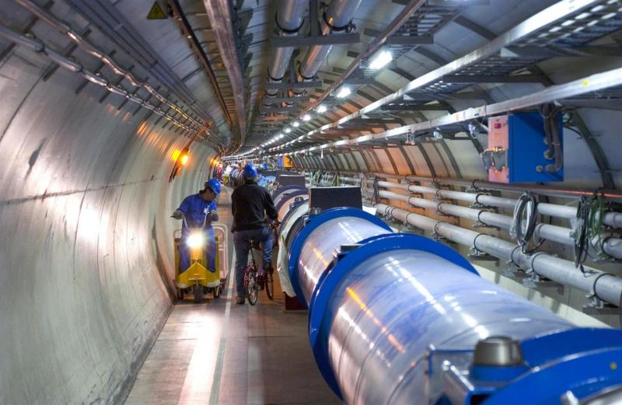
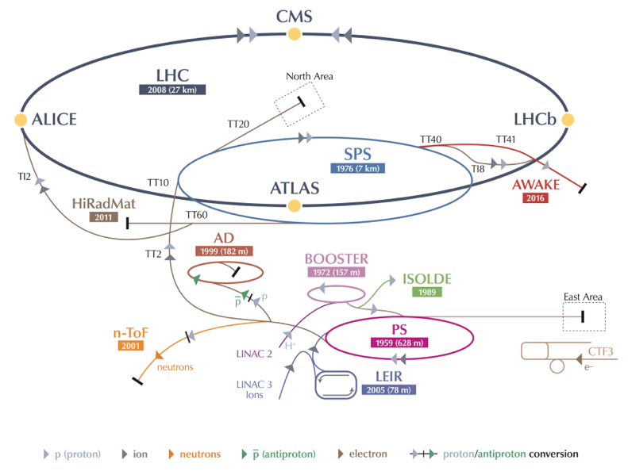
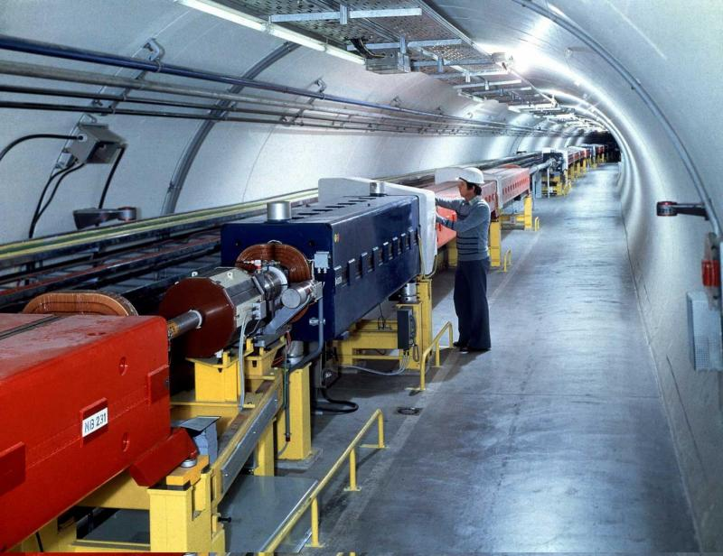
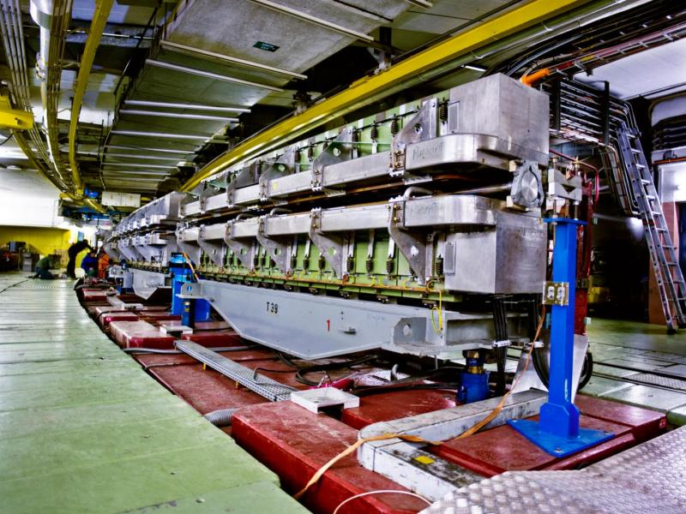
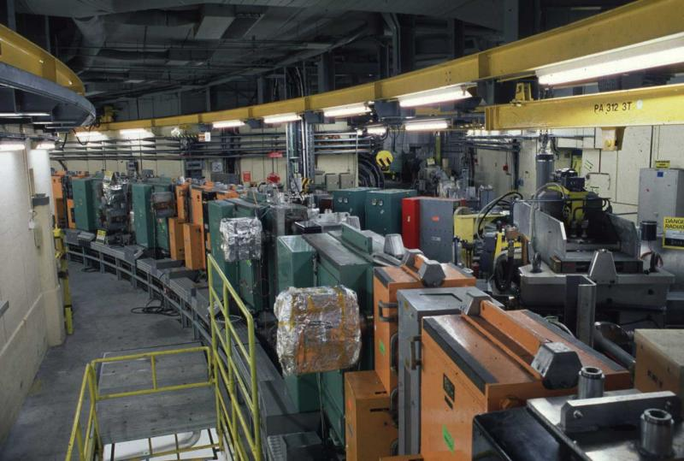
The CERN Accelerator Complex

Slide 6
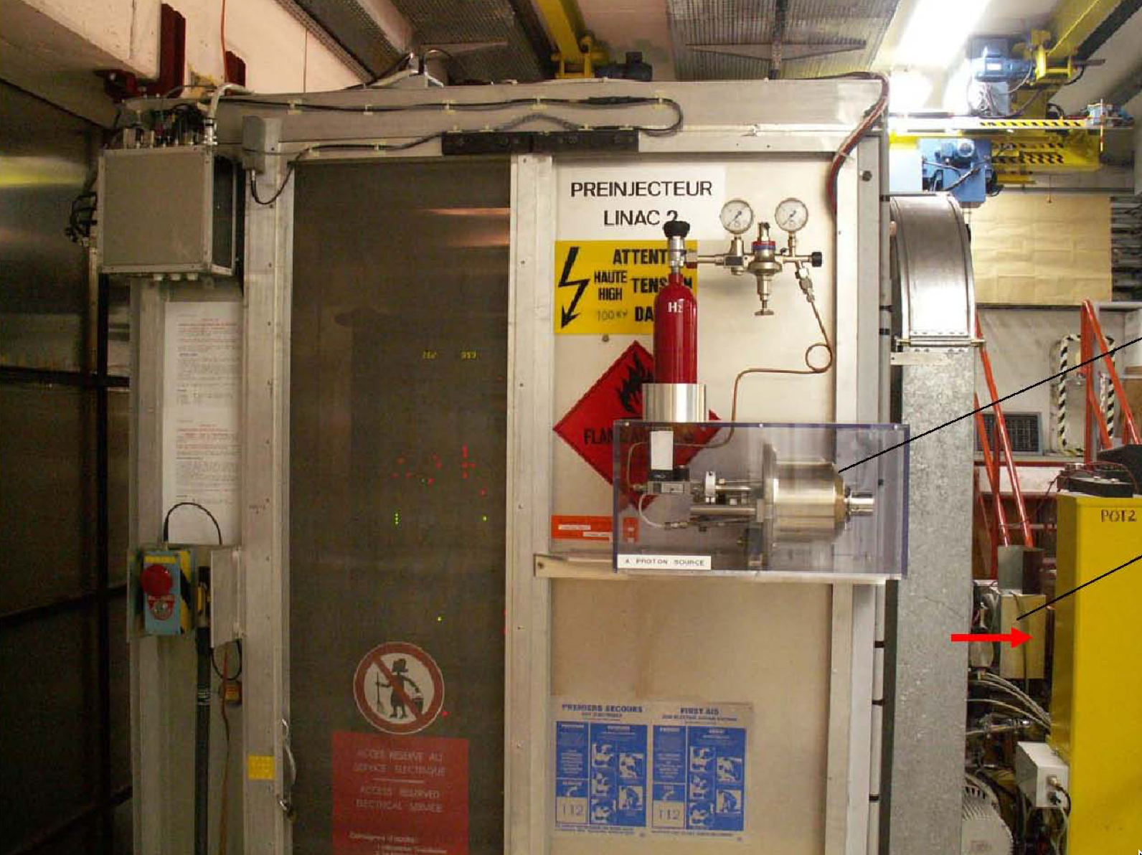
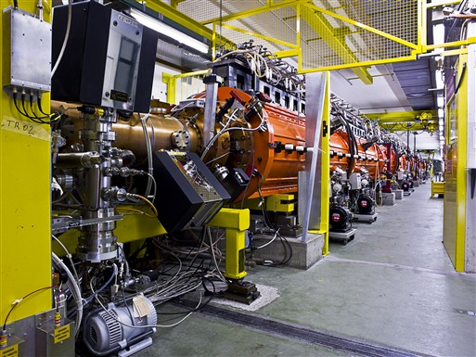
LINAC 2
Duoplasmatron proton source
Extract protons at 90 keV from H₂
Accelerates beam up to 50 MeV over a length of 33m, using Alvarez structures
Provides a beam pulse every 1.2s

Slide 7
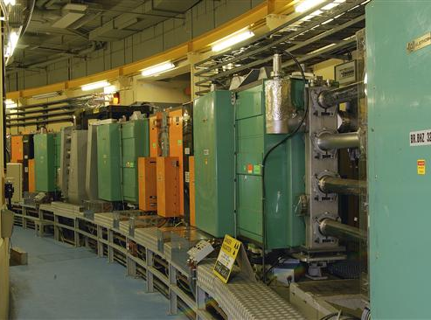
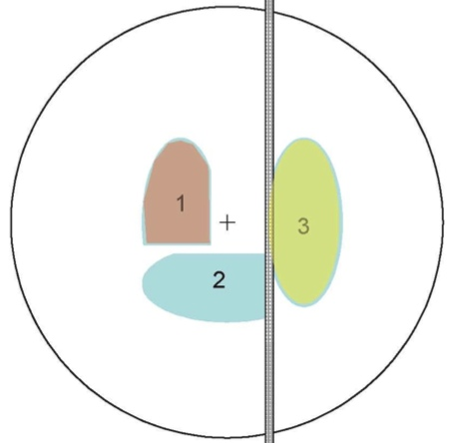
PS Booster
1st Synchrotron in the chain with 4 superposed rings
Circumference of 157m
Increases proton energy from 50 MeV to 1.4 GeV on a 1.2s cycle
The LINAC2 pulse is distributed over the four rings, using kicker magnets
Each ring will inject over multiple turns, accumulating beam in the horizontal phase space
This means that the beam size (transverse emittance) increases when the intensity increases → ~ constant density
The PS Booster determines the transverse Brightness of the LHC beam

Slide 8
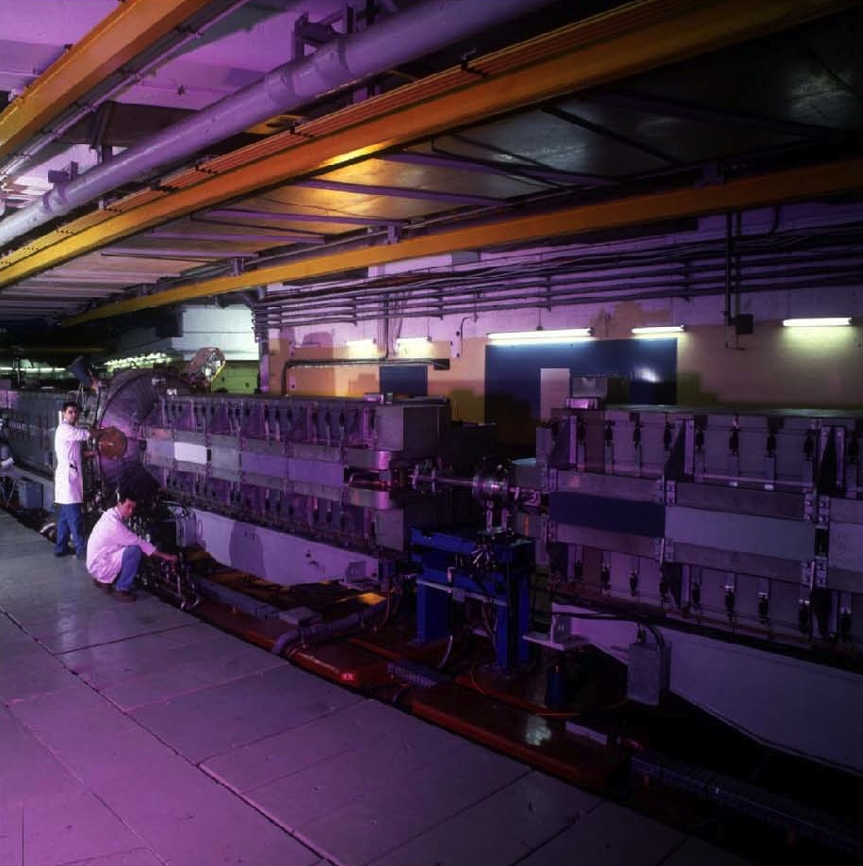
PS
The oldest operating synchrotron at CERN
Circumference of 628m
  4 x PSB circumference
Increases proton energy from 1.4 GeV to a range of energies up to 26 GeV
Cycle length varies depending on the final energy, but ranges from 1.2s to 3.6s
The many different RF systems allow for complex RF gymnastics:
  10 MHz, 13/20 MHz, 40 MHz, 80 MHz, 200 MHz
Various types of extractions:
  Fast extraction
  Multi-turn extraction (MTE)
  Slow extraction
The PS determines the time structure of the LHC beam

Slide 9
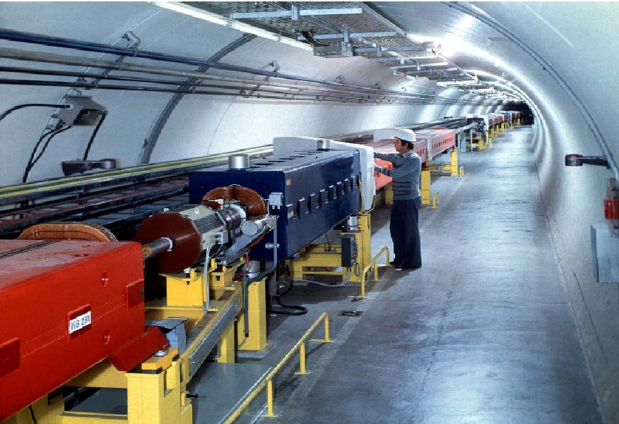
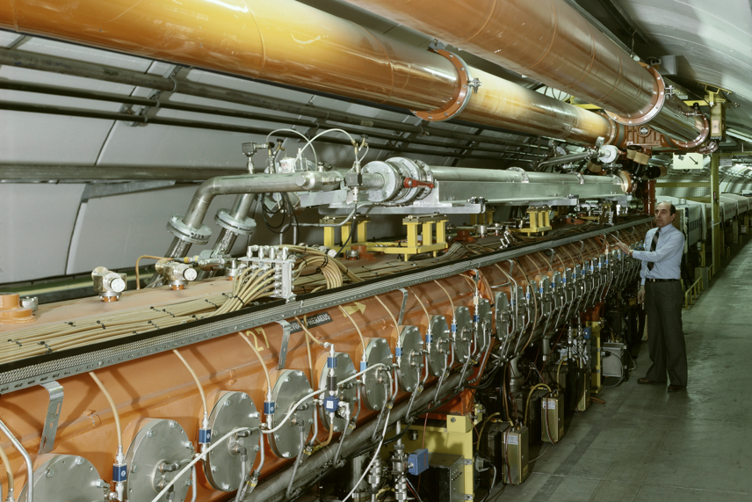
SPS
The first synchrotron in the chain at about 30m under ground
Circumference of 6.9 km
  11 x PS circumference
Increases proton beam energy up to 450 GeV with up to ~5x10¹³ protons per cycle
Provides slow extracted beam to the North Area fixed target experiments
Provides fast extracted beam to LHC, AWAKE and HiRadMat
The SPS accumulates up to 4 batches and being them up to 450 GeV

Slide 10
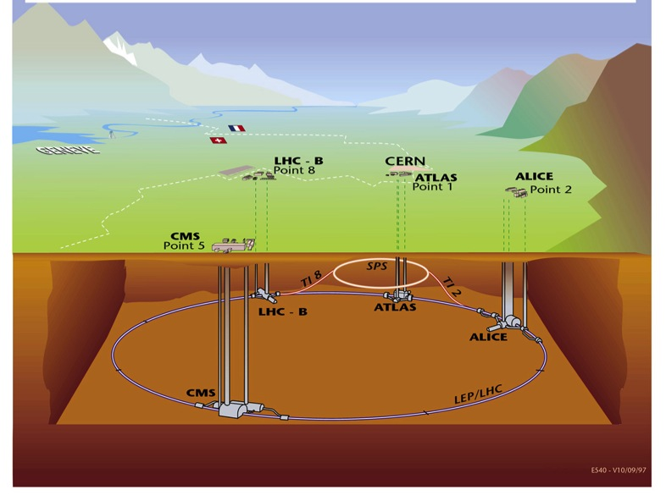
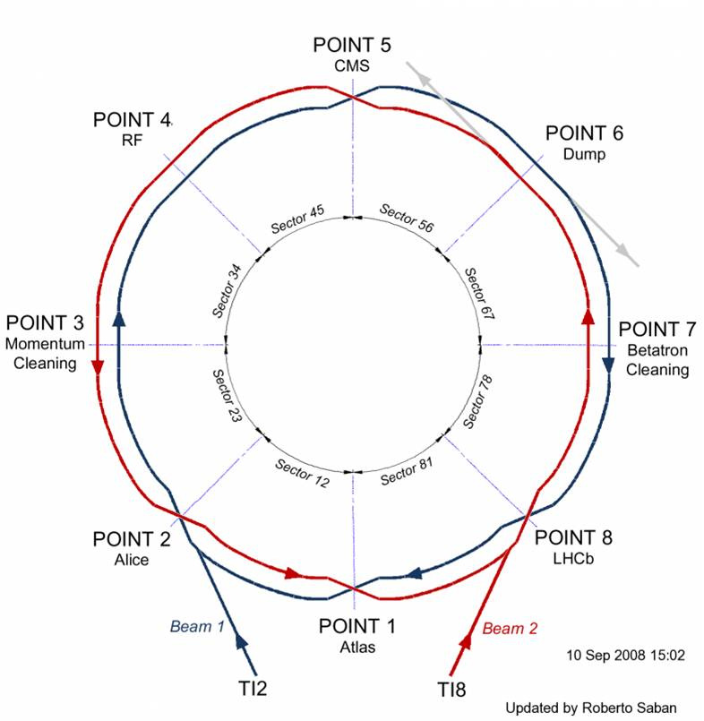
LHC
Situated on average ~100 m under ground
Four major experiments (ATLAS, CMS, ALICE, LHCb)
Circumference 26.7 km
Two separate beam pipes going through the same cold mass 19.4 cm apart
150 tons of liquid helium to keep the magnets cold and superconducting

Slide 11
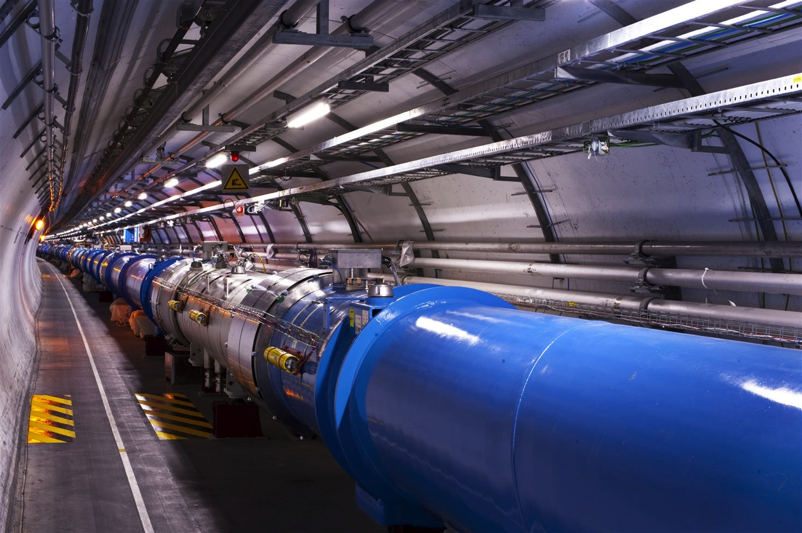
LHC
1232 main dipoles of 15 m each that deviate the beams around the 27 km circumference
858 main quadrupoles that keep the beam focused
6000 corrector magnets to preserve the beam quality
Main magnets use superconducting cables (Cu-cladded Nb-Ti)
12’000 A provides a nominal field of 8.33 Tesla
Operating in superfluid helium at 1.9K

Slide 12
Looking Back at the 2017 LHC Run

Slide 13
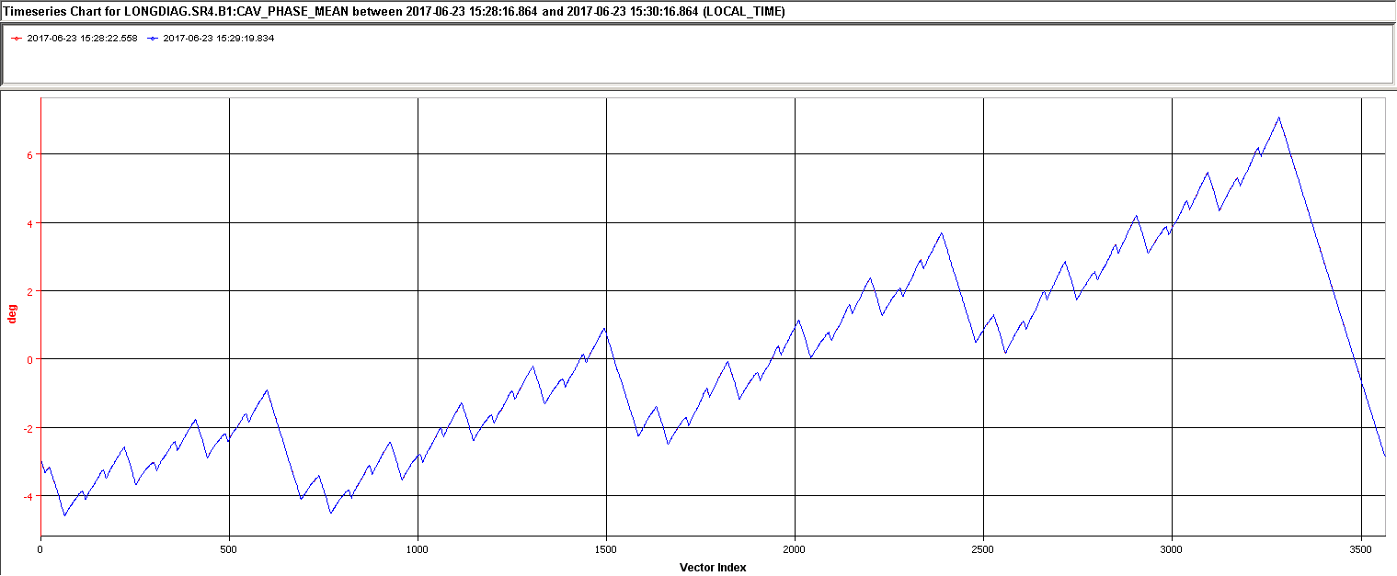
2017,…another eventful year
Jun 3rd
RF full de-tuning
operational
Sep 18th - 20th
TS #2
<100 ps p-p
Extended
Year
End
Technical
Stop
May 23rd
First Stable Beams
Jul 20th
Orbit corrector
mitigation 16L2
Sep 21st
𝛽* 40 cm → 30 cm
Jul 3rd - 7th
TS #1
Oct 2nd
Switch to high
Brightness 8b4e
Dec 4th
End of 2017 run
Apr 29th
First 2017 beam
Aug 9th
Record Peak
Lumi: 1.74x10³⁴
2017
Jan Feb Mar Apr May Jun Jul Aug Sep Oct Nov Dec
Jul 19th
Stable beams
2556 bunches
Nov 11th
Start Special Runs
Sep 4st
Switch to 8b4e
April 1st
Gradual start of powering tests
Aug 12th
16L2 beam induced Quench
Nov 2nd
Record Peak
Lumi: 2.05x10³⁴
Jun 9th
1st time 2820
Bunches at 450 GeV
Magnet exchange in
sector 1-2
June 5th
1 week scrubbing run and1st signs of losses in 16L2
Aug 10th
Planned 16L2 beam screen flushing
Oct 30th
45 fb-1 reached

Slide 14
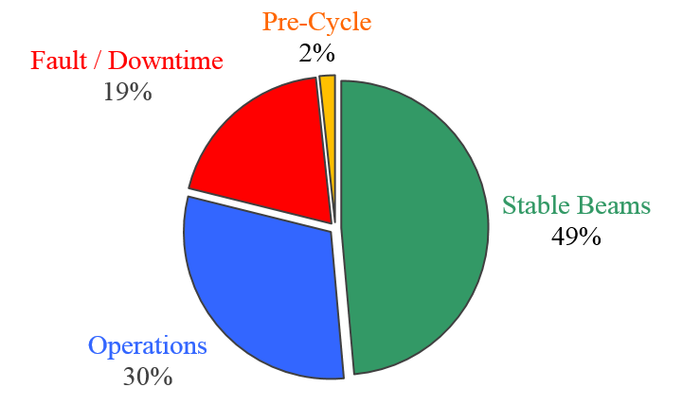
2017 Availability & Stable Beam Time
140 ½ days physics ≈ 3362.1 hours
 | Duration [h]
Stable Beams | 1633.9
Operations | 1018.1
Fault/Downtime | 652.9
Pre-Cycle | 57.2
= 3362.1
Stable beam ratio of previous years:
  2015 → 33%
  2016 → 49%

Slide 15
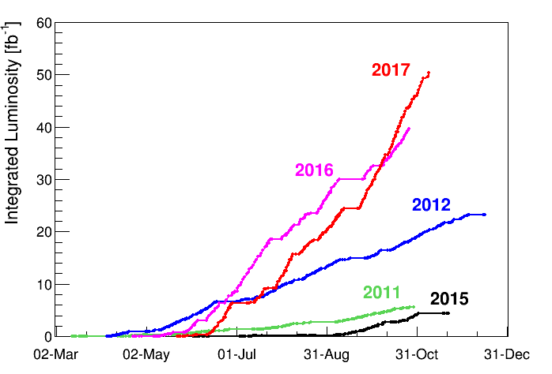
Integrated Performance
ATLAS / CMS : 50 fb⁻¹
LHCb: 2 fb⁻¹ (levelled)
ALICE: 19 pb⁻¹ (levelled)
The total integrated luminosity since the start of LHC is approaching 125 fb⁻¹
Beyond expectations
2017
2017 forecast: ~45 fb⁻¹

Slide 16
LHC Peak Luminosity
The design luminosity of 1x10³⁴ cm⁻²s⁻¹ was reached in 2016
  Despite limitation on number of bunches imposed by the SPS internal dump problem
Fastest peak luminosity ramp up in 2017
  November 2nd 2017, 2.05x10³⁴ cm⁻²s⁻¹ was reached → More than twice the design value
  Despite 16L2 issues

Slide 17
LHC Luminosity 2017
2556 bunches until early August, despite 16L2 induced beam loss
Beam screen flushing failed to mitigate 16L2 issue
Stable operation only with ~1900 bunches could be established with the 8b4e beam
Despite 16L2 the LHC ran well above design peak luminosity, >2x10³⁴ cm⁻²s⁻¹, but no longer visible due to levelling at 1.5x10³⁴ cm⁻²s⁻¹ as requested by ATLAS and CMS
Un-levelled 8b4e
BCMS: Max 2556 bunches
8b4e: Max 1916 bunches
Difficult period with many beam dumps and reduced number of bunches

Slide 18
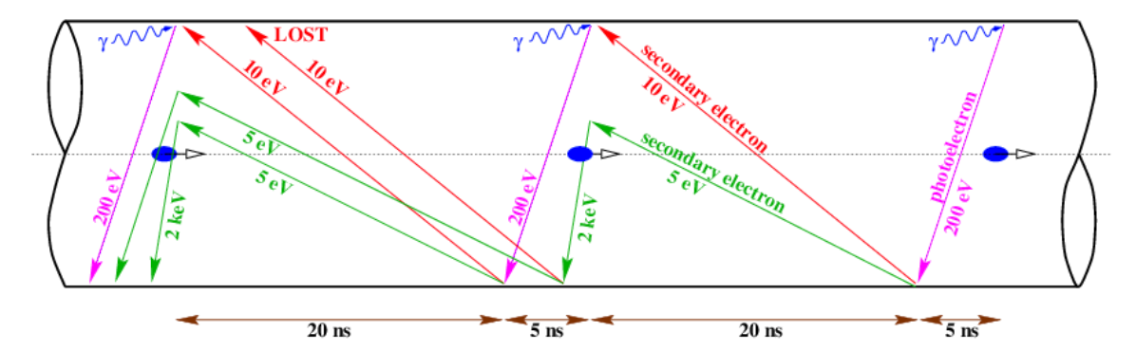
Another strange phenomenon in the LHC
In the lifetime of the LHC until 2017 we found:
  Electrons clouds
By performing scrubbing runs the vacuum chamber’s secondary electron emission yield is reduced

Slide 19
Another strange phenomenon in the LHC
In the lifetime of the LHC until 2017 we found:
  Electrons clouds
  UFOs
Unidentified Falling Objects are tiny dust particles that fall into the beam and cause beam losses and some times beam dumps
By prolonged running they seem to be conditioning away

Slide 20
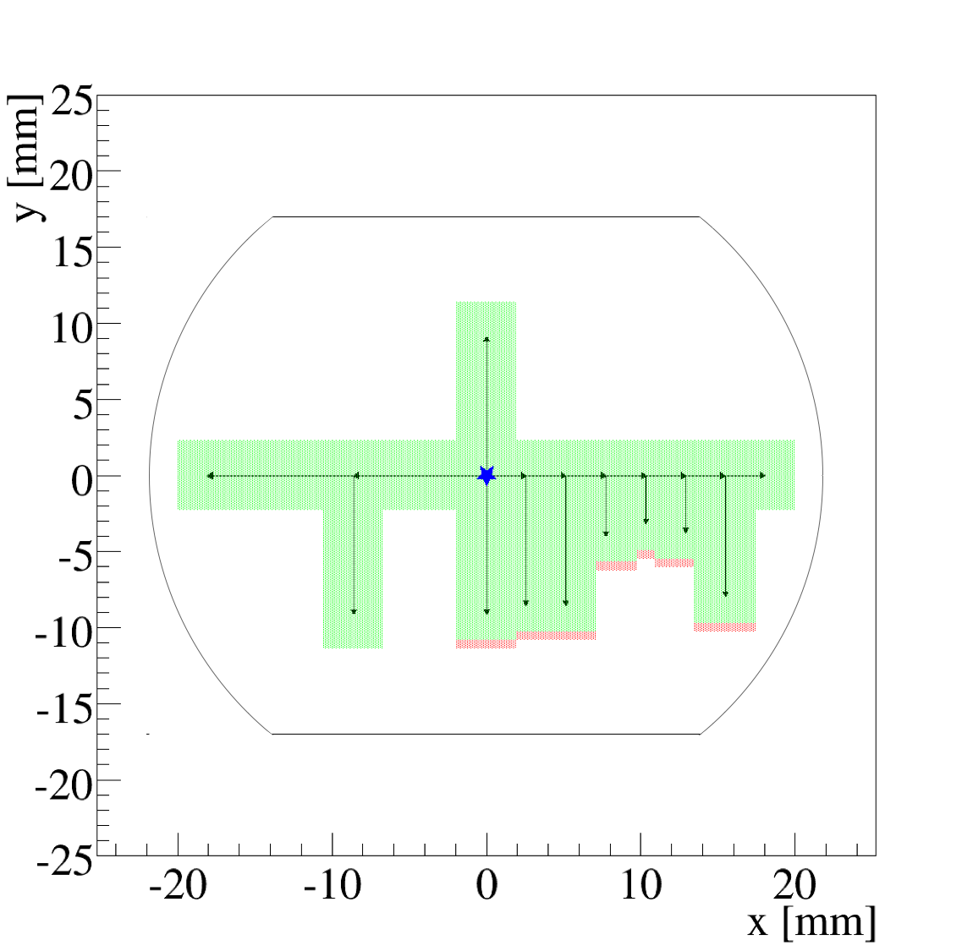
Another strange phenomenon in the LHC
In the lifetime of the LHC until 2017 we found:
  Electrons clouds
  UFOs
  ULO
The Unidentified Lying Object is most likely a small piece of material in one of the vacuum chambers that if the beam hits it causes beam losses and beam dump
By applying a small local orbit bump the object can be avoided

Slide 21
Another strange phenomenon in the LHC
In the lifetime of the LHC until 2017 we had:
  Electrons clouds
  UFOs
  ULOs
  GrUFfalO
New phenomena with sudden beam losses in 16L2, often resulting in beam dumps
  A (friendly) monster than woke up from time to time to bother us
http://www.gruffalo.com

Slide 22
2017 Intensity ramp up (BCMS Beam)
Technical Stop 1
Up to 1741 bunches
Smooth intensity ramp up, increasing the number of bunches
First dumps on 16L2 losses experienced

Slide 23
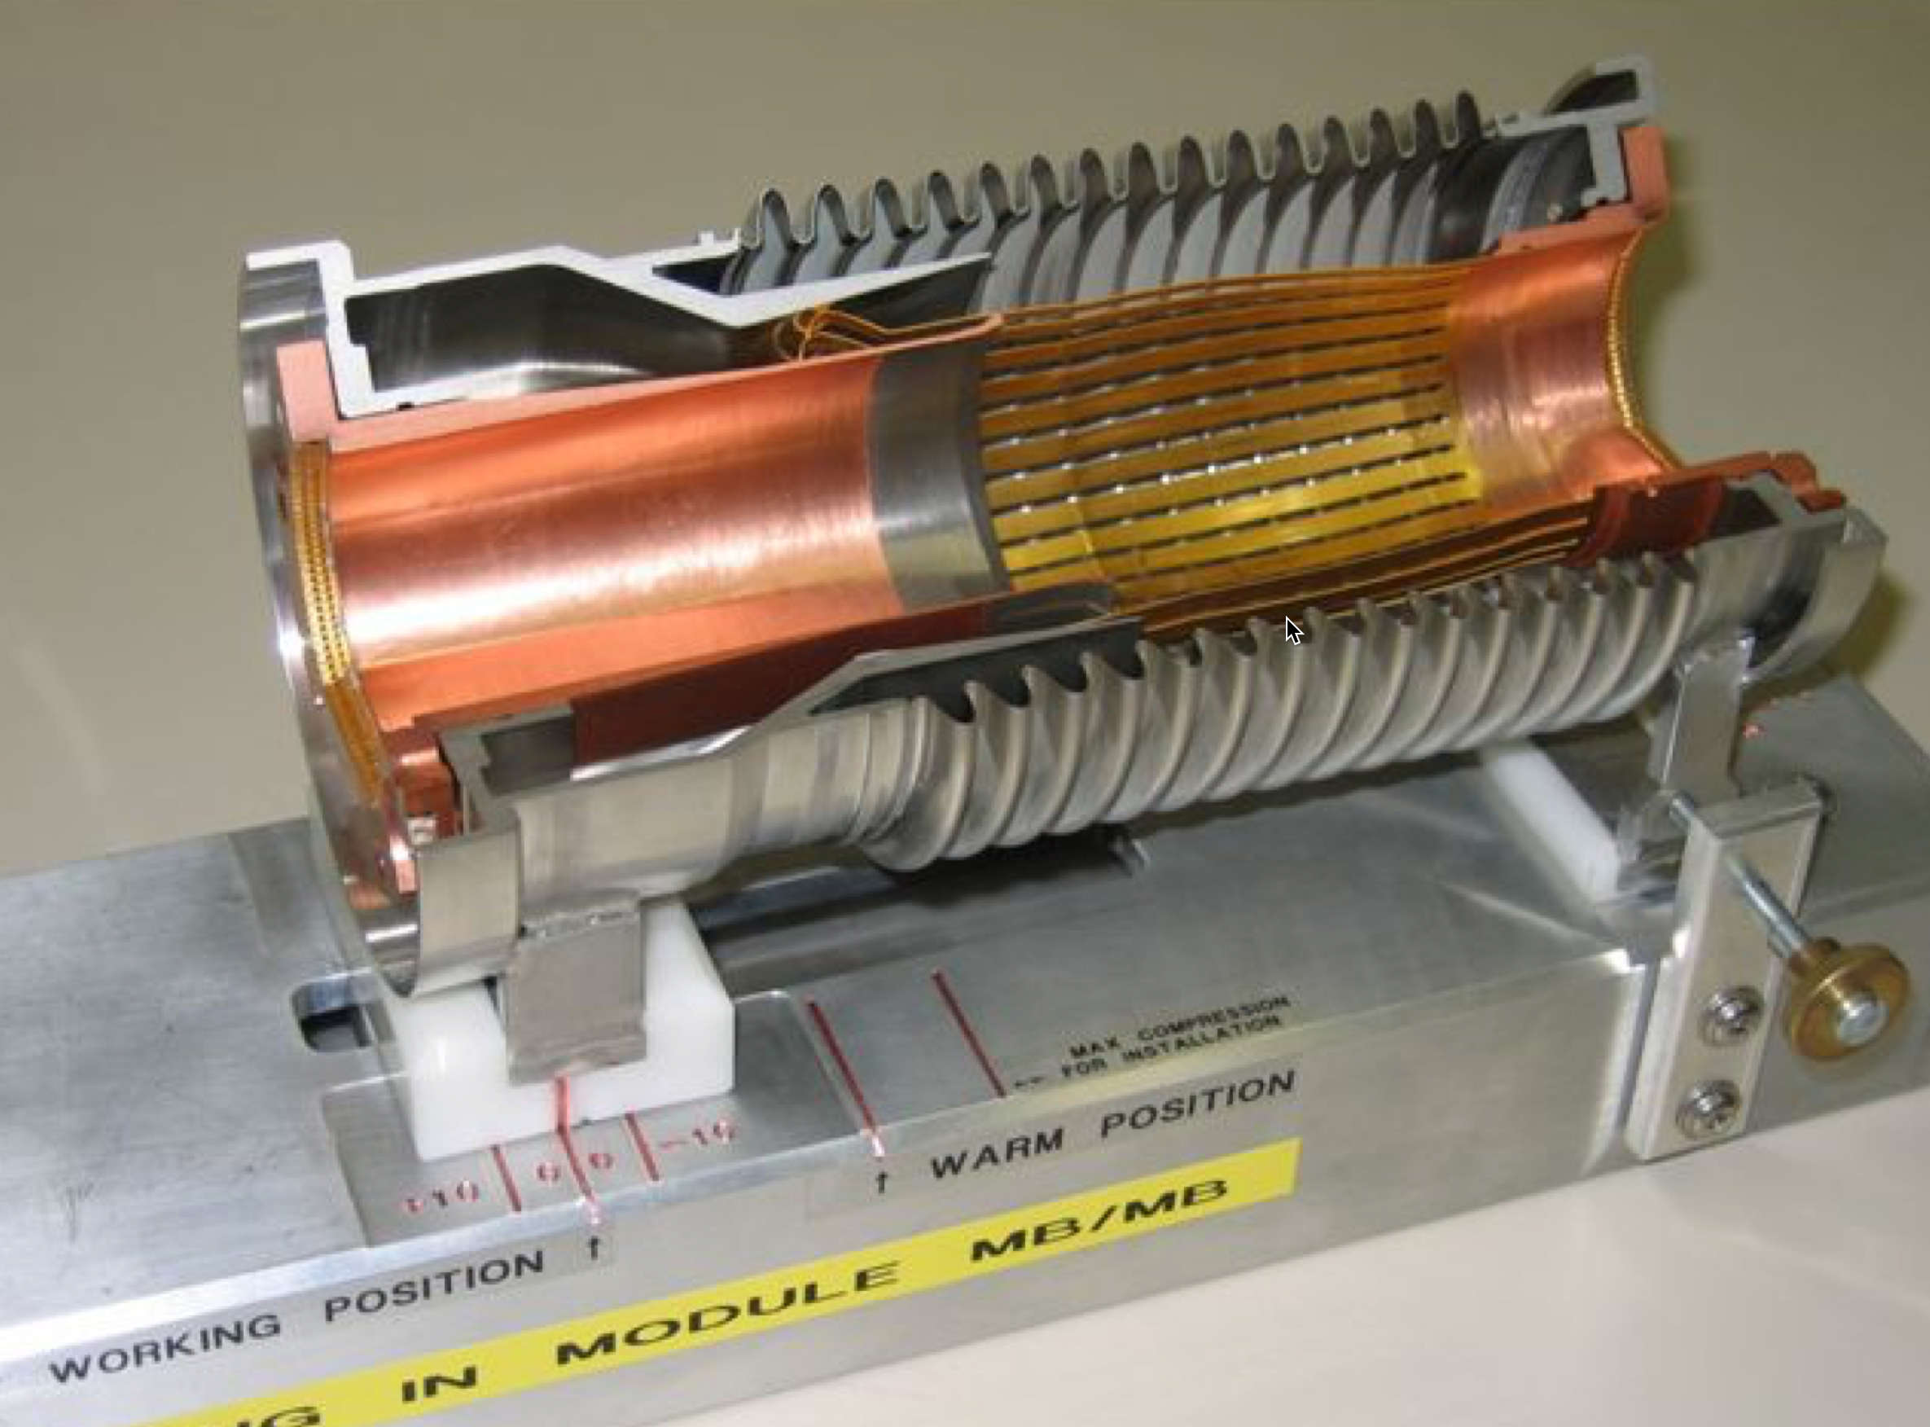
Beam Screen Flushing, August 10th
Warm up the beam screen to 80K such that the gas evaporates and condensates on the cold bore, which remains at 1.9 K.
Elsewhere this has proven to be beneficial
For the 16L2 case the situation actually degraded

Slide 24
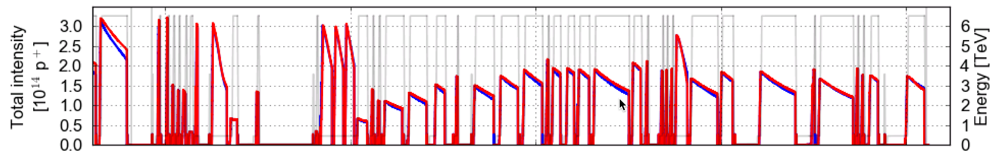
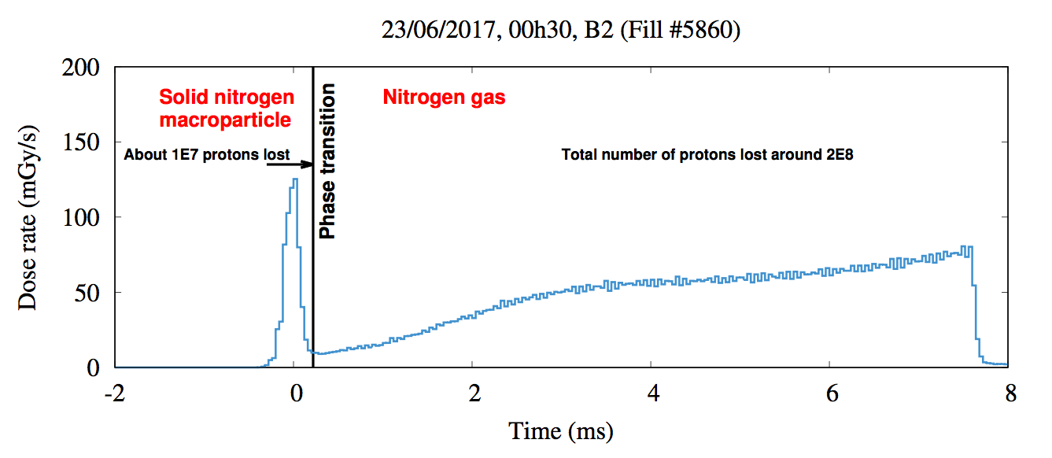
Losing and Reconditioning
Variation of number of bunches during the “struggle” period
Attempting 2556 bunches
Ramp up to 1500 bunches
Running with 1500 bunches & frequent dumps
BS Flush
16L2 Quench
16L2 Beam Loss “signature” that resulted often in beam dumps

Slide 25
16L2, at some point we were puzzled…

Slide 26
Attempts to Defeat the Gruffalo
Increased diagnostics
  Improving the signal to noise ratio
  Understand loss signals
No, this is not dynamite, but these are Beam Loss Monitors
Confirm hypothesis that e-cloud played a role
  Crash program to develop a solenoid to evacuate electrons from the interconnection

Slide 27
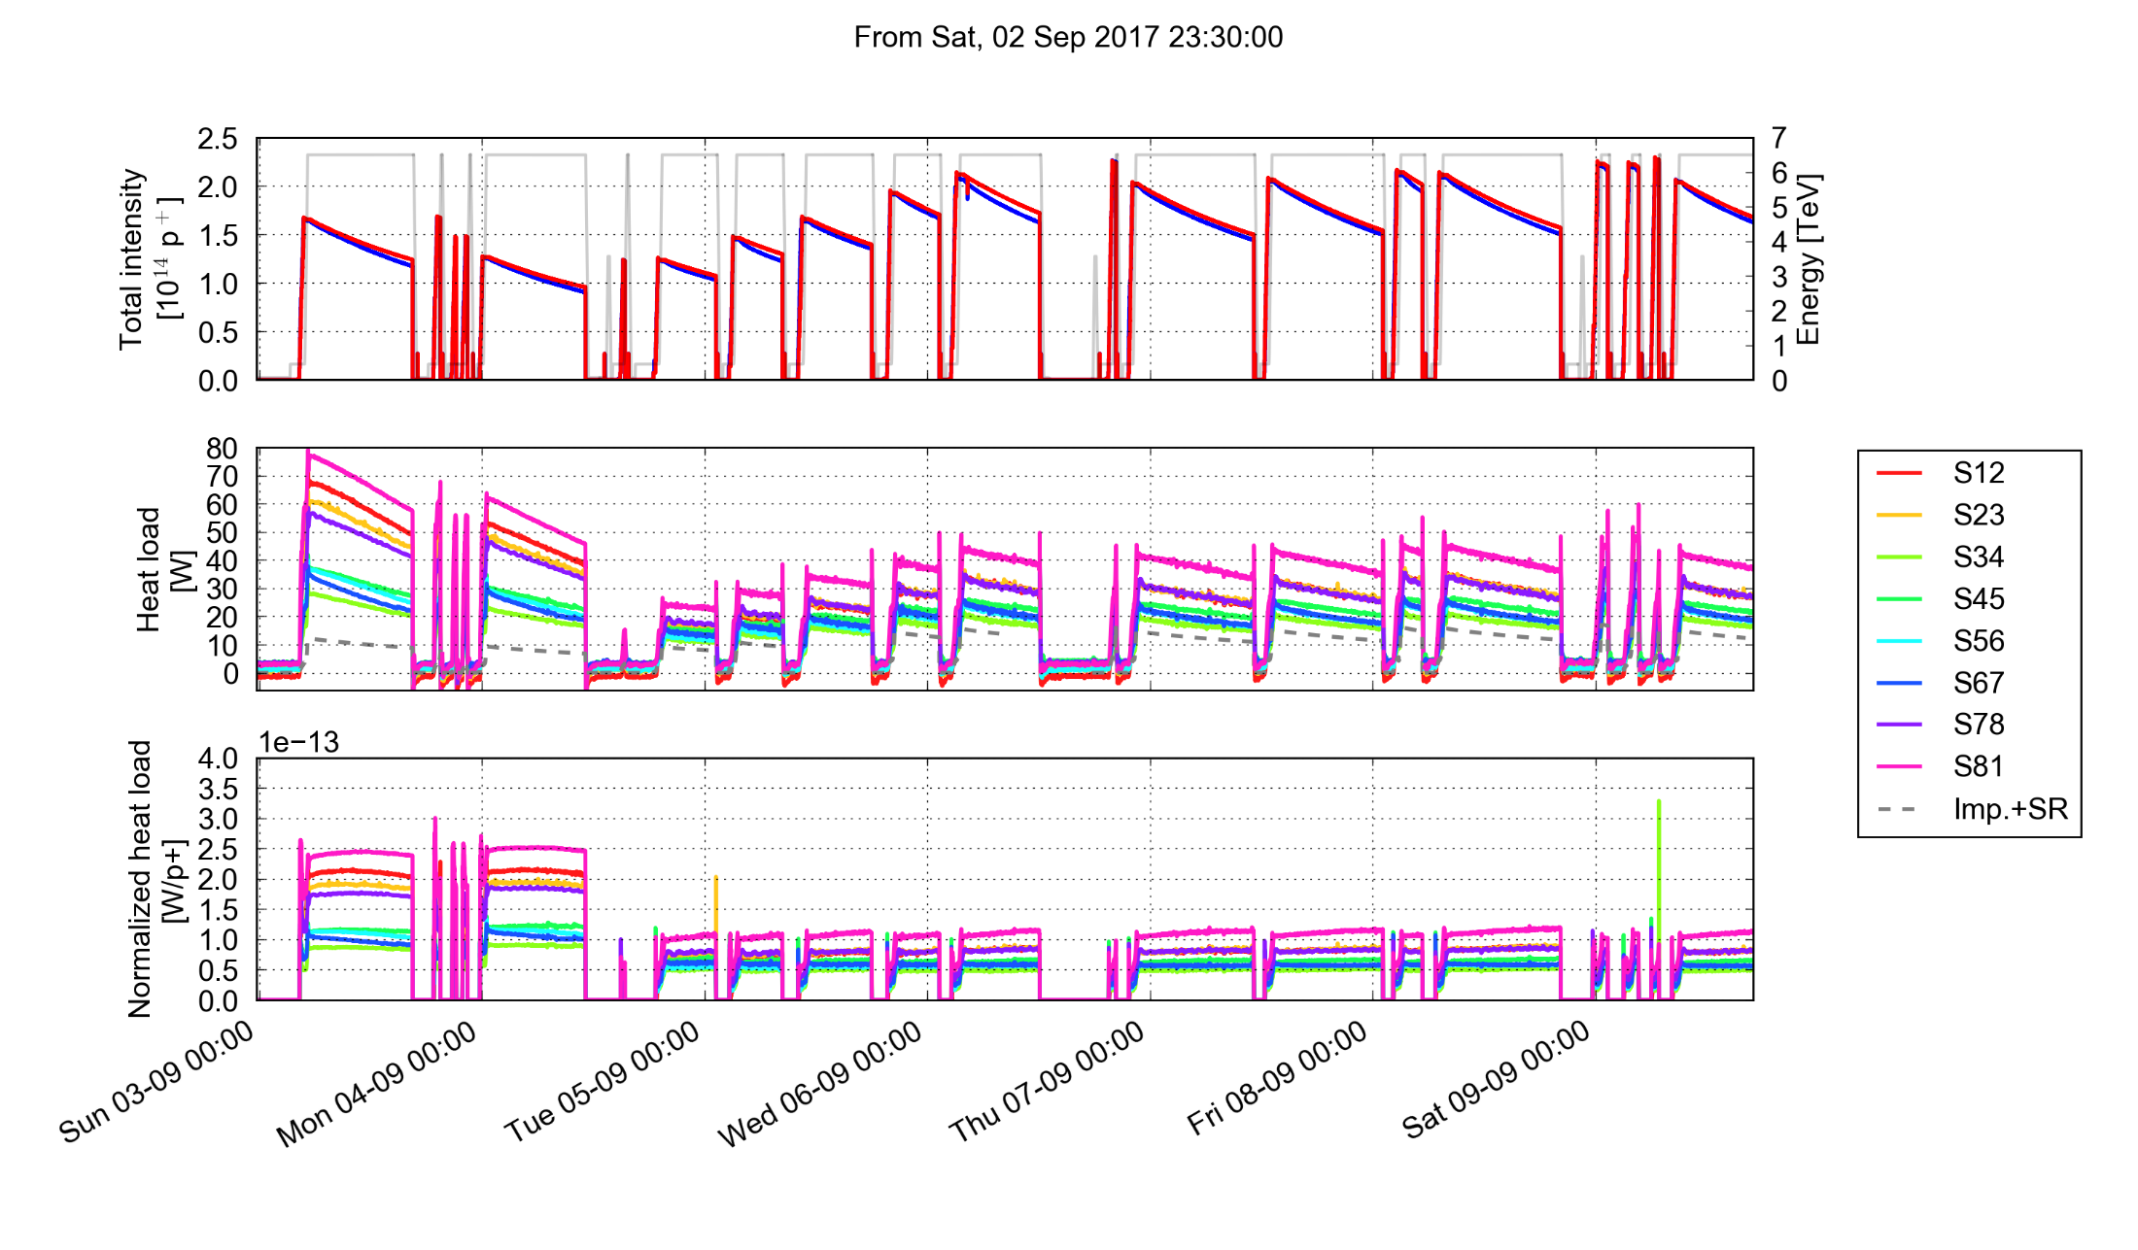
Cryo Heat Load: BCMS vs 8b4E
BCMS 1500 bunches
8b4e intensity ramp up
8b4e running with 1900 bunches
16L2
16L2
16L2
8b+4e

Slide 28
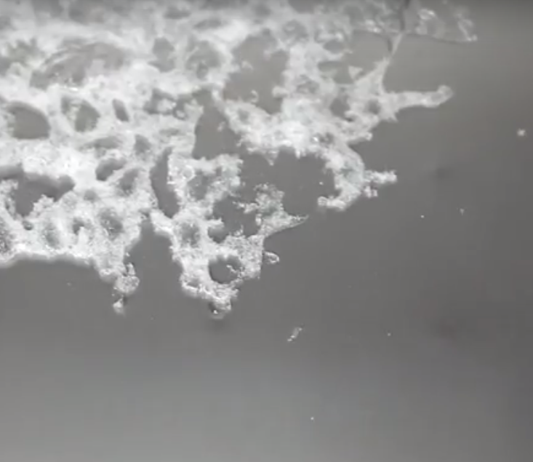
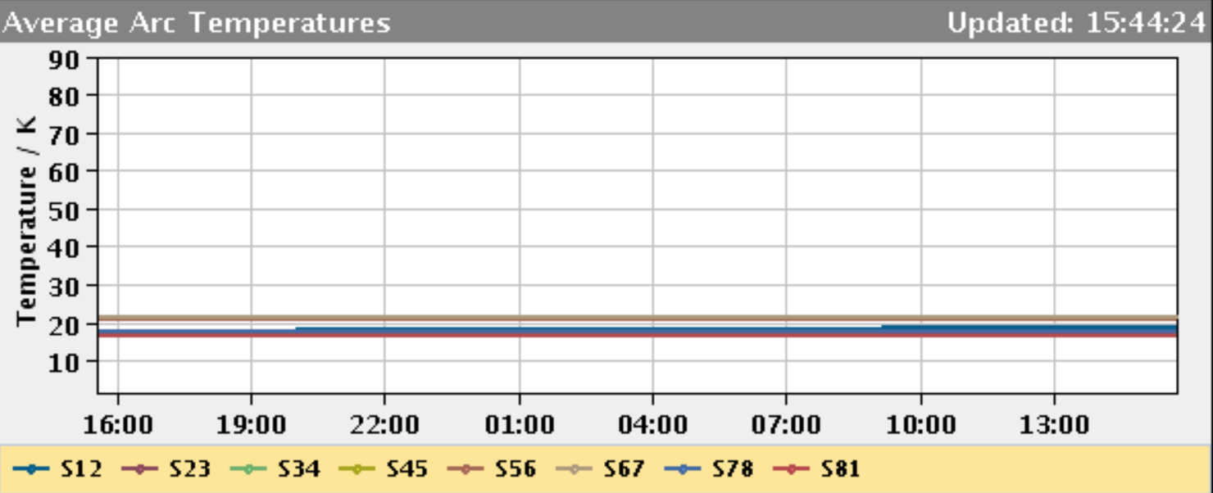
The Origin of the Gruffalo
Recently, sector 1-2 was recenlty warmed up to 80K and the vacuum chambers were pumped
  It was confirmed that air had entered in the vacuum chambers in a phase when the machine was cold (~ 7 liters per aperture)
  Nitrogen, oxygen and water condensate / frost must have appeared on the beam screen & cold bore
Gas analysis during pumping has confirmed the presence of N₂, O₂ and Ar
Sector 1-2 now back at 20K
Frozen nitrogen in vacuum
https://www.youtube.com/watch?v=c0rK2bLTimQ

Slide 29
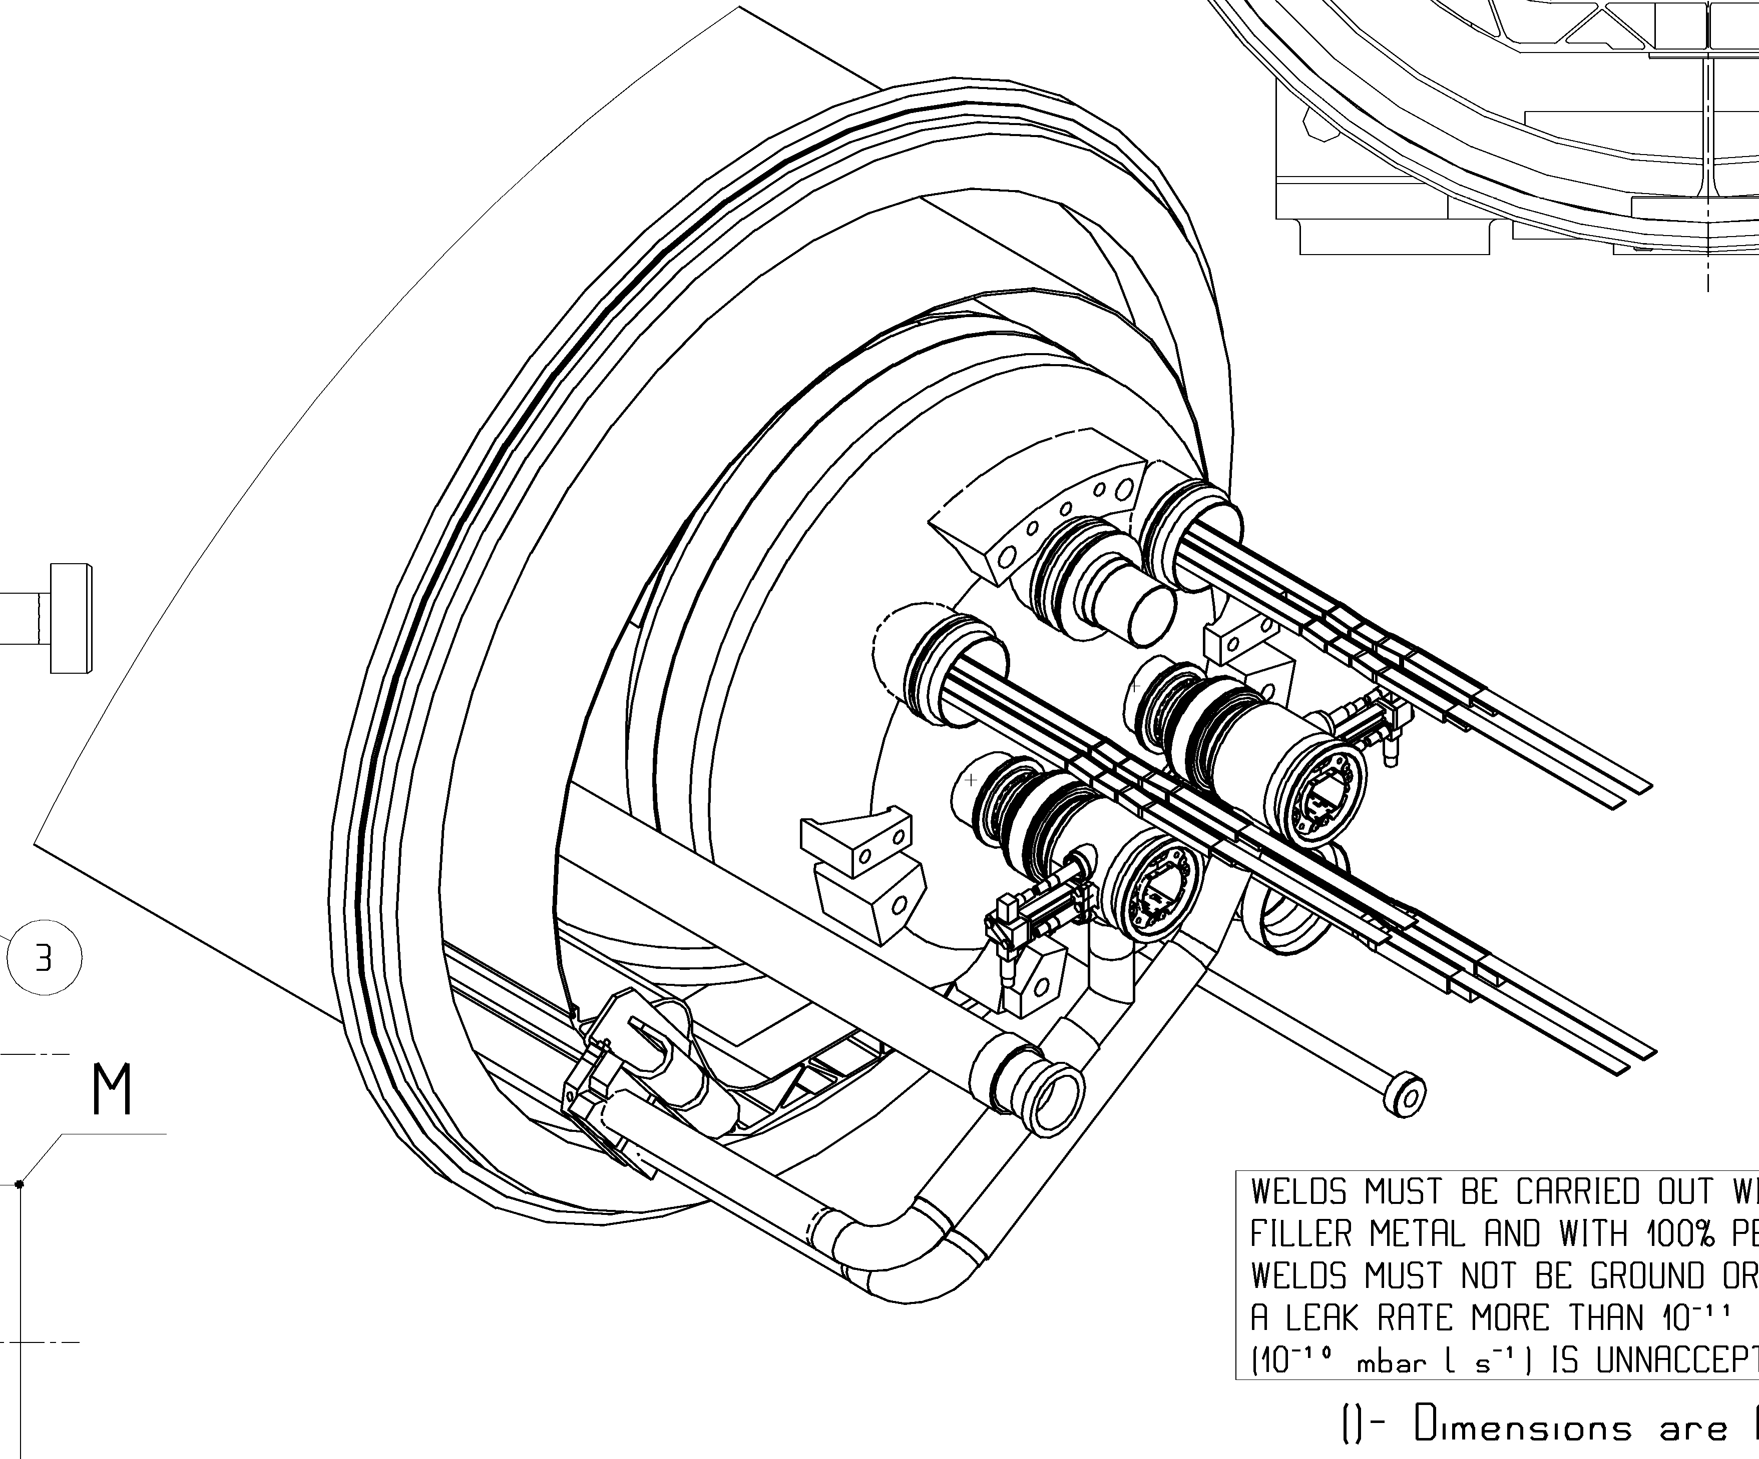
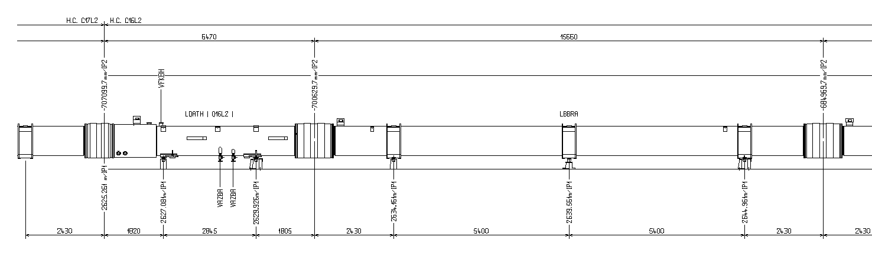
The 16L2 Layout
Interconnection
B1
B2
Thermal shield
at ~50K
P2
P1
MB17L2
Q16L2
MB16L2
P2
P1

Slide 30
Optimisations - Increasing Luminosity
Reduction of 𝛽* from 40 cm to 30 cm
Crossing angle optimisation
  Following initial luminosity burn-off the long range beam-beam effect allows reducing crossing angle, hence increasing instantaneous luminosity
  Was done in 3 steps of 10 𝜇rad each
  ~ 5% gain in integrated luminosity over 16hrs
Continuous crossing angle reduction was also successfully tested and might be used in 2018
Half crossing angle
  150 𝜇rad
  140 𝜇rad
  130 𝜇rad
  120 𝜇rad

Slide 31
Beam Variants From Injectors

Slide 32
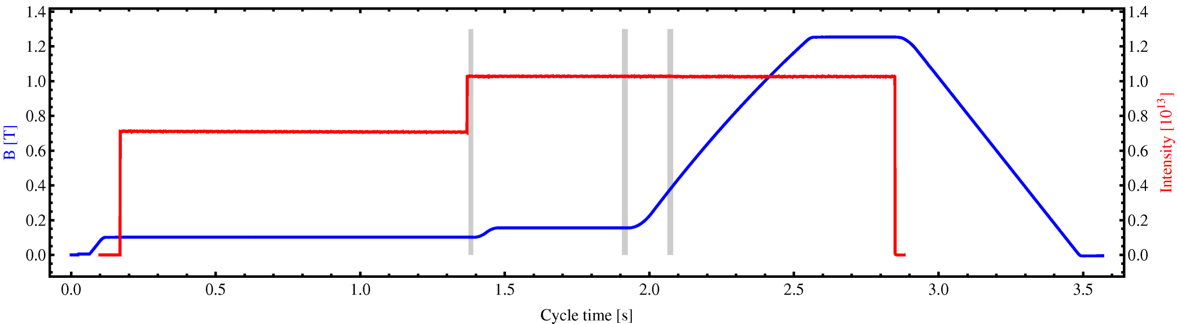
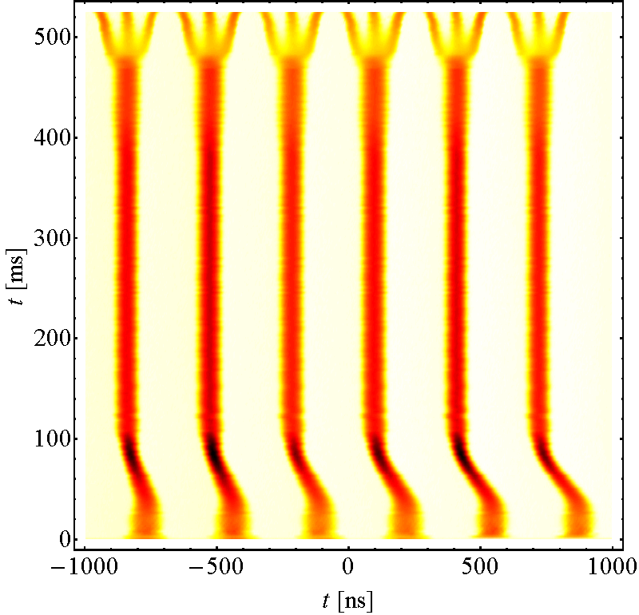
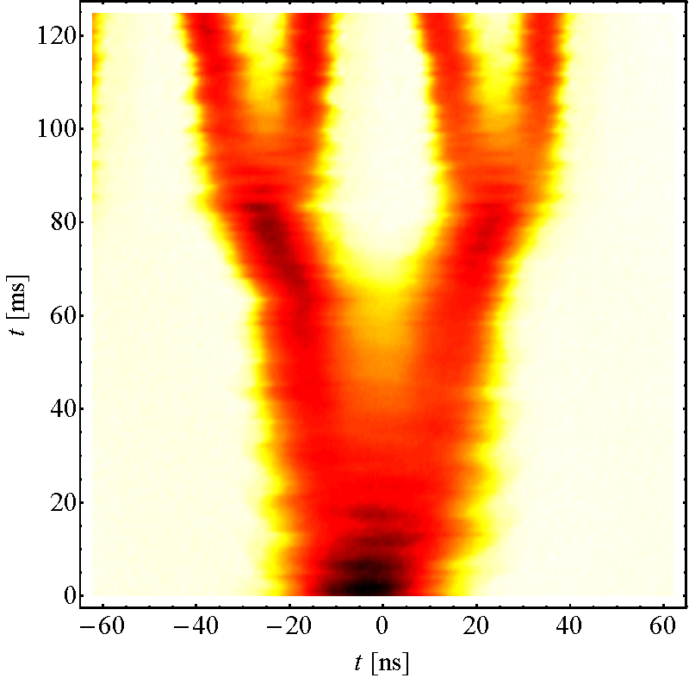
Standard 25 ns Beam
Injection
  1st: 4 bunches
  2nd : 2 bunches
Triple splitting
Acceleration
2 x splitting
  72 bunches at 25 ns
For 25 ns the intensity of a PSB bunches is divided by a factor 12
  I_{LHC} = 1.2x10¹¹ ppb
  I_{PSB} = 14.4x10¹¹ ppb
Inject 4+2 bunches
Controlled blow-ups
Eject 36 or
Eject 36 or
72 bunches
h = 7
h = 21
γ_{tr}
72 bunches
h = 84
Triple splitting at E_{kin} = 2.5 GeV
Split in four at flat top energy
25 ns
E_{kin} = 2.5 GeV
50 ns
2nd injection
26 GeV/c
25 ns: Each PSB bunch divided by: 12 → 6 x 3 x 2 x 2 = 72

Slide 33
PS Booster Multi-turn Injection
The PSB performs a multi-turn injection, accumulating the LINAC beam in the PSB horizontal phase space
  Increasing intensity also increases transverse beam size, hence more or less constant density
x’
1
3
2
x
PSB bunch intensity to be divided by 12 for standard 25 ns beam to reach bunch intensity of 1.1x10¹¹ protons

Slide 34
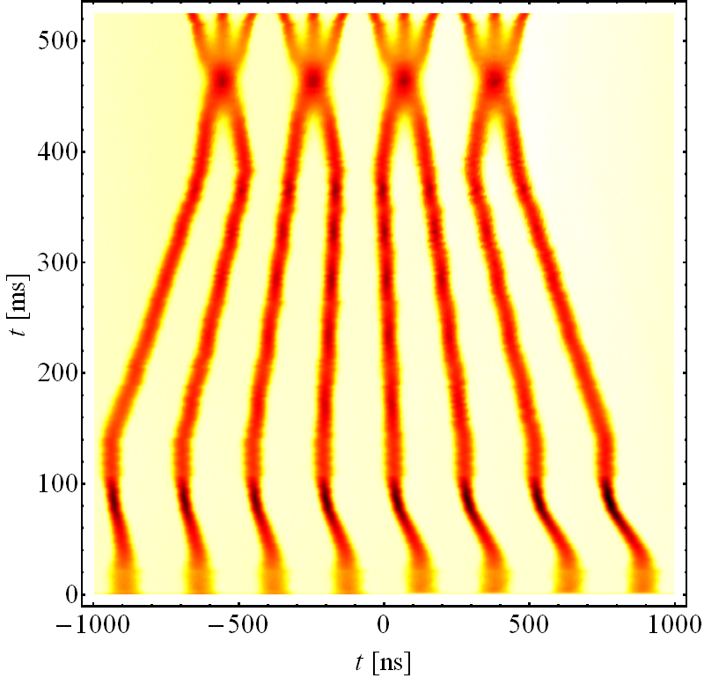
BCMS 25 ns Beam
BCMS = Batch Compression, Merging & Splitting
For same LHC bunch intensity PSB bunch intensity and transverse emittance is ~50% of standard scheme
For 25 ns the intensity of two PSB bunches are divided by a factor 6
  I_{LHC} = 1.2x10¹¹ ppb
  I_{PSB} = 7.2x10¹¹ ppb
Inject 4+4 bunches
Controlled blow-ups
Eject 36 or
Eject 24 or
48 bunches
h = 9
γ_{tr}
h = 21
72 bunches
h = 84
Batch Compression, merging & splitting
Split in four at flat top energy
25 ns
50 ns
2nd injection
E_{kin} = 2.5 GeV
BCMS
26 GeV/c
High brightness
25 ns: PSB bunches ‘divided’ by: 6 → 8/2 x 3 x 2 x 2 = 48

Slide 35
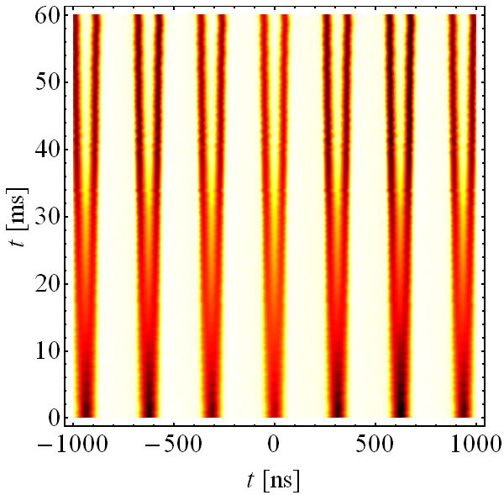
Standard 25 ns 8b4e Beam
8b4e = 8 bunches + 4 empty buckets
Inject 4+2 (3) bunches
Controlled blow-ups
Eject 36 or
Eject 48 or
56 bunches
Due to the gaps in the 25ns bunch trains the electron cloud production is largely suppressed
Similar scheme as for the 25 ns standard beam
At 2.5 GeV triple splitting, populating only two first buckets and leaving 3rd empty
γ_{tr}
72 bunches
h = 7
h = 21
h = 84
Double splitting at E_{kin} = 2.5 GeV
Split in four at flat top energy
25 ns
E_{kin} = 2.5 GeV
26 GeV/c
Empty buckets
High brightness
8b4e 25 ns: PSB bunches divided by : 2 → 7 x 2 x 2 x 2 = 56
Each PSB bunch divided by 2 leaving 1 bucket empty at h=21
At high energy each bunch/bucket split in 4 → 8b4e

Slide 36
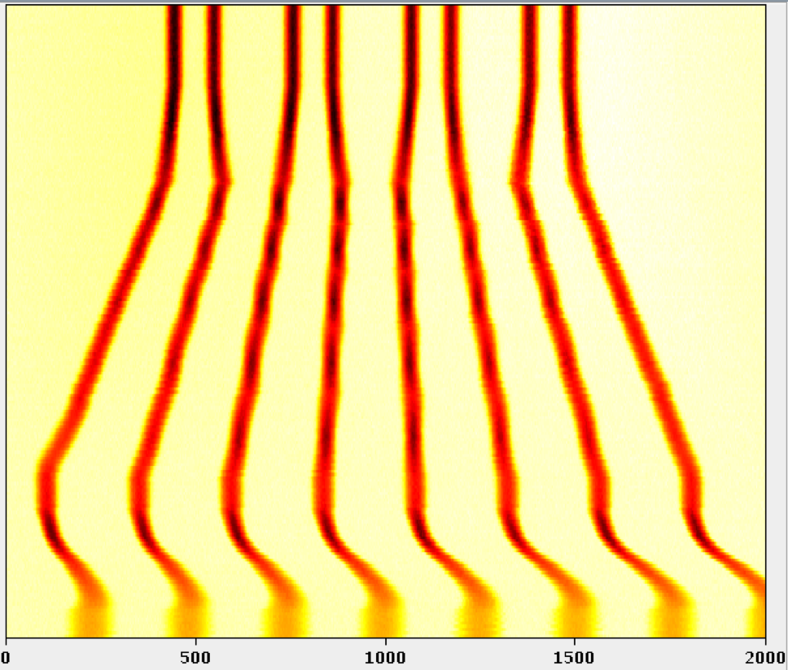
8b4e BCS Beam
8b4e = 8 bunches + 4 empty buckets
Inject 4+4 bunches
Controlled blow-ups
Eject 36 or
Eject 24 or
48 bunches
For same LHC bunch intensity PSB bunch intensity and transverse emittance is ~50% of standard scheme
No longer splitting but batch compression by adding empty buckets
h = 9
γ_{tr}
h = 21
72 bunches
h = 84
Batch
Compression
Batch Compression, merging & splitting
Split in four at flat top energy
25 ns
2nd injection
E_{kin} = 2.5 GeV
26 GeV/c
Empty buckets
High brightness
8b4e 25 ns: PSB bunches only merged: 8 → 8 x 2 x 2 = 32
At high energy each bunch/bucket split in 4 → 8b4e

Slide 37
2018 LHC Schedule

Slide 38
Draft 2018 LHC schedule - Q1 & Q2

Slide 39
Draft 2018 LHC schedule – Q3

Slide 40
Summary Table 2018 - 2017 - 2016
 | 2018 |  | 2017 |  | 2016
Phase | Days | Ratio [%] | Days | Ratio [%] | Days | Ratio [%]
Comm. & Intensity ramp up | 28 | 11.4 | 35 | 16.1 | 28* | 11.3
Scrubbing | 4 | 1.6 | 7 | 3.3 | 2 | 0.8
25 ns Proton Physics | 138 | 56.3 | 127 | 58.5 | 139 | 56.3
Special Physics Runs | 9 | 3.7 | 18 | 8.3 | 10 | 4
Setting up Pb-Pb ion run | 4 | 1.6 | - | - | 6 | 2.4
Pb-Pb ion run | 24 | 9.8 | - | - | 23 | 9.3
Machine Developments (MD) | 20 | 8.2 | 18 | 8.3 | 21 | 8.5
Technical Stops (TS1 & TS2) | 13 | 5.4 | 8 | 3.7 | 12 | 5
Technical Stop Recovery | 5 | 2 | 4 | 1.8 | 6 | 2.4
Total | 245 | 100 | 217 | 100 | 247 | 100
Integrated luminosity [fb⁻¹] | ~ 60 (tbc) |  | 50.2 |  | 39.7
* Did not fully include intensity ramp up – interleaved commissioning and interleaved intensity ramp up was as of 2017

Slide 41
CERN Upgrade Projects
(LIU & HL-LHC)

Slide 42
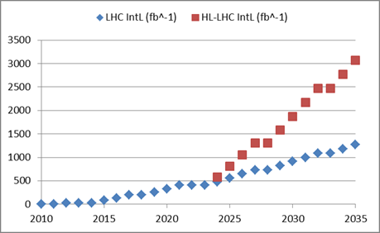
Luminosity, the Figure of Merit
Number of bunches
Intensity per bunch
Geometrical
Correction
factors
Beam dimensions
More or less fixed:
  Revolution period
  Number of bunches
High-Luminosity LHC
Parameters to optimise:
  Number of particles per bunch
  Beam dimensions
  Geometrical correction factors
X 2

Slide 43
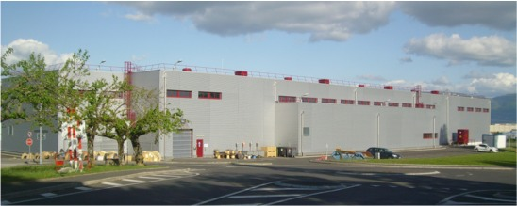
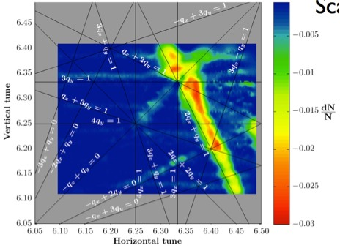
LIU: What will be changed ?
LINAC4 – PS Booster:
  New LINAC 4 with H⁻ injection
  Higher injection energy (160 MeV)
  New Finemet® RF cavity system
  Increase of extraction energy to 2 GeV
PS:
  Injection energy increase from 1.4 GeV to 2 GeV
  New Finemet® RF Longitudinal feedback system
  New RF beam manipulation scheme to increase beam brightness
SPS
  Machine Impedance reduction (instabilities)
  New 200 MHZ RF system
  Vacuum chamber coating against e-cloud
These are only the main modifications and this list is not exhaustive

Slide 44
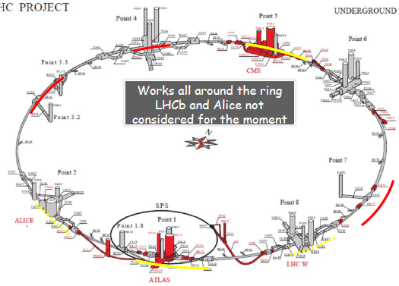
HL-LHC: What will be changed ?
New IR-quads (inner triplets)
  New 11T short dipoles
  Collimation upgrade
  Cryogenics upgrade
  Crab Cavities
  Cold powering
  Machine protection
  …
Major intervention on more than 1.2 km of the LHC
These are only the main modifications and this list is not exhaustive

Slide 45
Some HL-LHC Parameters
HL-LHC main parameters for proton collisions (re-baselining summer 2016)

Slide 46
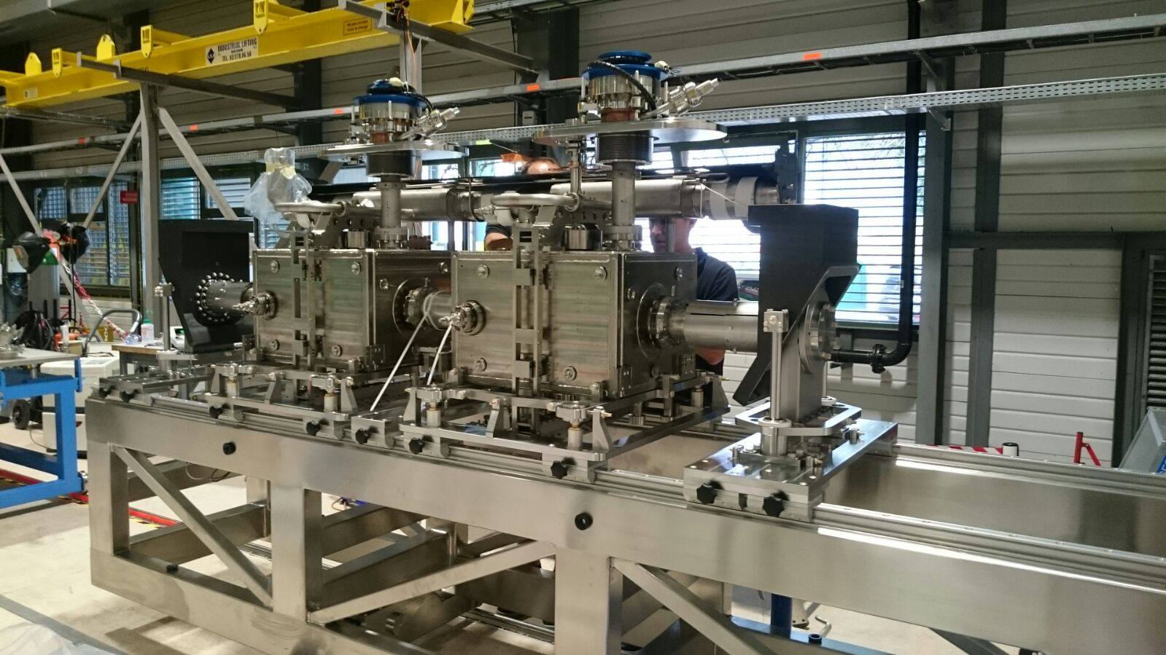
Crab Cavities
Crab cavities will reduce the effect of the geometrical factor on the luminosity and ”compensate” for the larger crossing angle needed with the HL-LHC beams

Slide 47
Luminosity Levelling
In certain conditions and depending on the experiments request, it is required to adapt the luminosity dynamically with beams in collision – levelling
  Each levelling technique has its advantages and drawbacks
Levelling by beam offset / separation
Already tested & Operational
Levelling by crossing angle
Already tested & Operational
Levelling by β* (= beam size at IP)
Complexity
Tested & to be deployed operationally

Slide 48
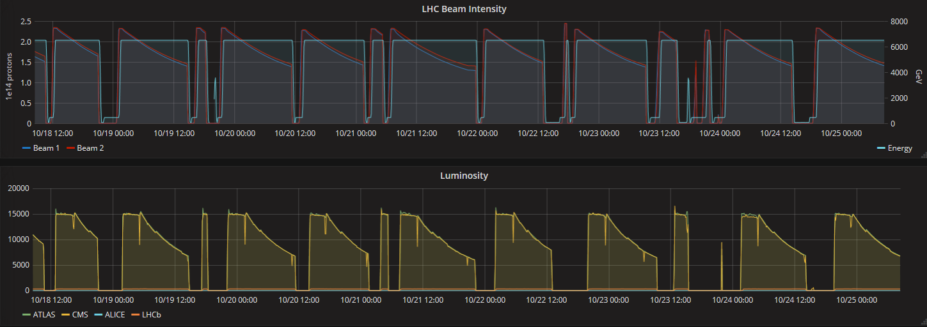
Luminosity Levelling & Anti-Levelling
In 2017 we initially levelled the ATLAS & CMS luminosity down to 1.5x10³⁴ cm⁻²s⁻¹, using beam separation
Once the luminosity burn-off kicks in we apply anti-levelling by reducing the crossing angle and increase the instantaneous luminosity
In 2018 we might add β* anti-levelling to reduce the β* further (< 30 cm) once the beam had sufficient luminosity burn-off

Slide 49
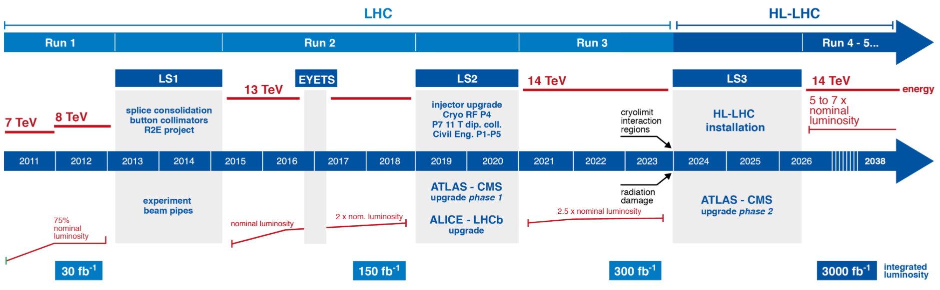
The Long Term Schedule

Slide 50
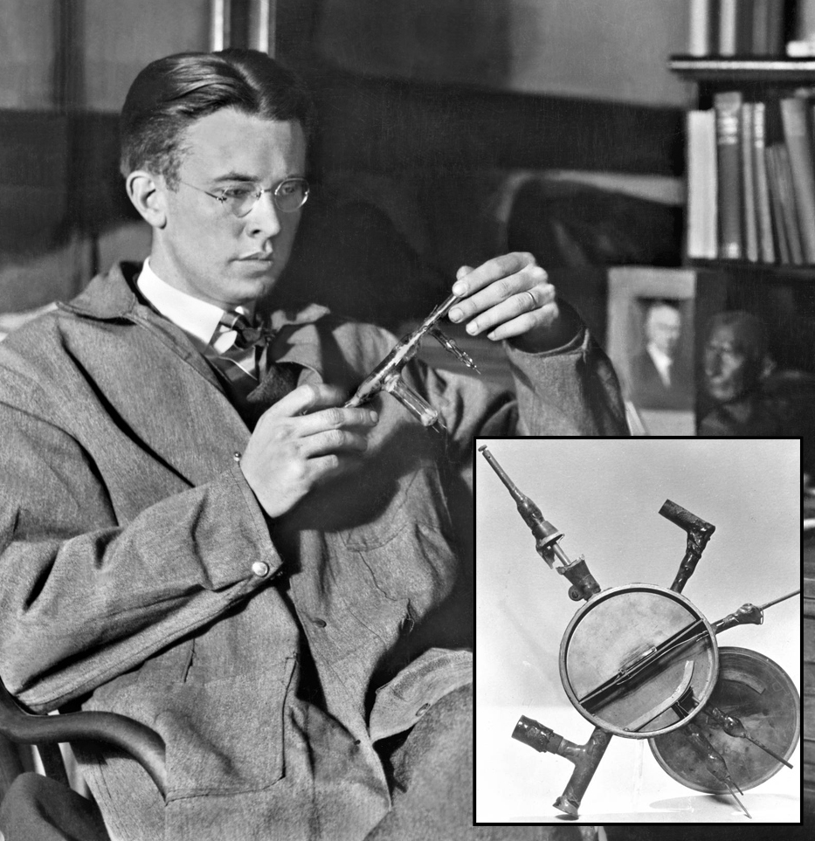
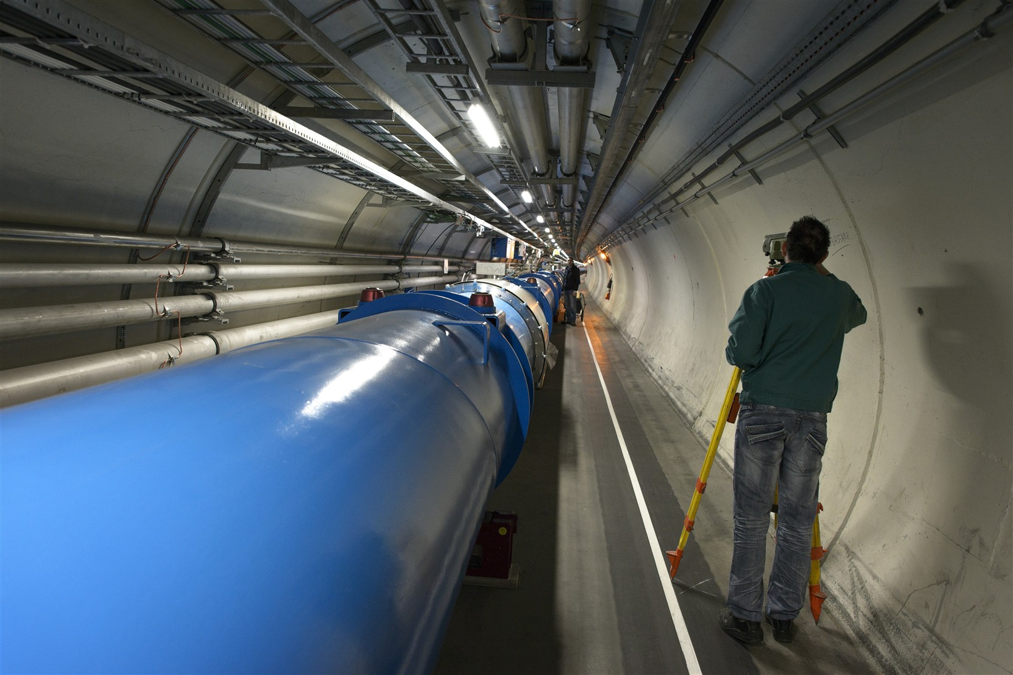
“We shall have no better conditions in the future if we are satisfied with all those which we have at present.”
Thomas A. Edison
Inventor and businessman, 1874 – 1931
E. Lawrence who invented the cyclotron in 1929
The LHC Today
… much has changed ….

Slide 51
Any Questions

Slide 52
Abstract
The CERN Large Hadron Collider continues to provide tremendous amounts of hadron collision data to its experiments. Over the past years the performance of the LHC and its injector chain was gradually increased to largely surpass its nominal performance in terms of luminosity.
In this seminar, the CERN accelerator complex will be recalled, with the focus on the LHC injector chain and the LHC itself. Enhancements in the injectors beam production schemes together with the introduction in the LHC of concepts actually foreseen for HL-LHC and key for the success in 2017, will be discussed.
The seminar will conclude with a brief outline of 2018 plans, the LHC Injector Upgrade (LIU) project and the High Luminosity LHC (HL-LHC) project.

