Slide 1
Beam Injection and Capture
in the Fermilab Booster for PIP
Chandra Bhat
Fermilab Workshop on Megawatt Rings & IOTA/FAST Collaboration Meeting
7 May 2018

Slide 2
Acknowledgements
W. Pellico
S. Chaurize
F. Garcia
C. Tan
K. Seiya
T. Sullivan
K. Triplett
C. Drennan
N. Eddy
V. Grzelak
J. Reid
V. Lebedev
B. Zwaska
D. Johnson
T. Johnson
B. Hendrick,
G. Vogel
A. Waller
S. Bhat
…..

Slide 3
The Proton Improvement Plan
Goals were to achieve
  2.25E17 protons/hour (at 15 Hz) to deliver to HEP programs←
    12 batches of 4.53E12ppBp to RR/MI with
      ε_{L}<0.1 eVs/bunch &
      ε_{T}<16 π-mm-mr
      LINAC/Booster efficiency >85% ←
    Provide beam for Booster Neutrino Program
  Beam power on NuMI target 700kW ←
Have achieved 2.4E17p/hr
Have achieved ~94%
Record Beam power on NuMI target ~730kW
A number of improvements were made in the Proton Source
from injection to extraction to achieve these goals.
I will be talking about some of the
improvements that were not the part of the original PIP plan, which helped the overall success of PIP
some new findings.

Slide 4
Beam Injection in the Booster
Improved Scheme for Adiabatic Capture
“Early Beam Injection”
Bmax
(8 GeV)
(since Dec. 2015)
This scheme gave us
an ability to inject ~30% more Beam
an additional 200 μs for adiabatic beam capture …
Prior to 2016
Booster
Magnet Ramp
15 Hz
Begin Inj.
CBhat, HB2016
~200μs
Bmin (400 MeV)
Bmin (400 MeV)
400 MeV LINAC Beam
>40μs
Inj.
~260μs
for Capture
Beam Acceleration
using 37-52 MHz
RF system
Booster
≈ 40μs
injection
Capture & Acceleration
using 37-52 MHz RF
system in ≈360μs
Booster
Synchrotron
pseudo front-porch
~60μs-200 μs debunching
Energy Acceptance ~5MeV
Beam ΔE ≈ 1.25MeV
1/30Hz ≈ 0.0333 s

Slide 5
Beam Capture
Injected beam has to be captured adiabatically! For an efficient beam capture one needs good understanding of
  Booster Acceptance @Injection
    Momentum Acceptance
    Transverse Acceptance
  Properties of injected beam
    H and V Transverse Emittances
    Beam energy spread, ΔE (full)
  Booster RF System
    How well is amplitude of RF voltage (Vrf) known?
    How well is RF controlled during beam capture?
    How well are the RF stations aligned in phase?
5.4 (±0.4) MeV)
AH: 50 πµm, AV: 30 πµm
Cbhat, Beams Doc. 5014
(KSeiya)
εH=εV= 7 πµm (LINAC)
(F.Garcia)

Slide 6
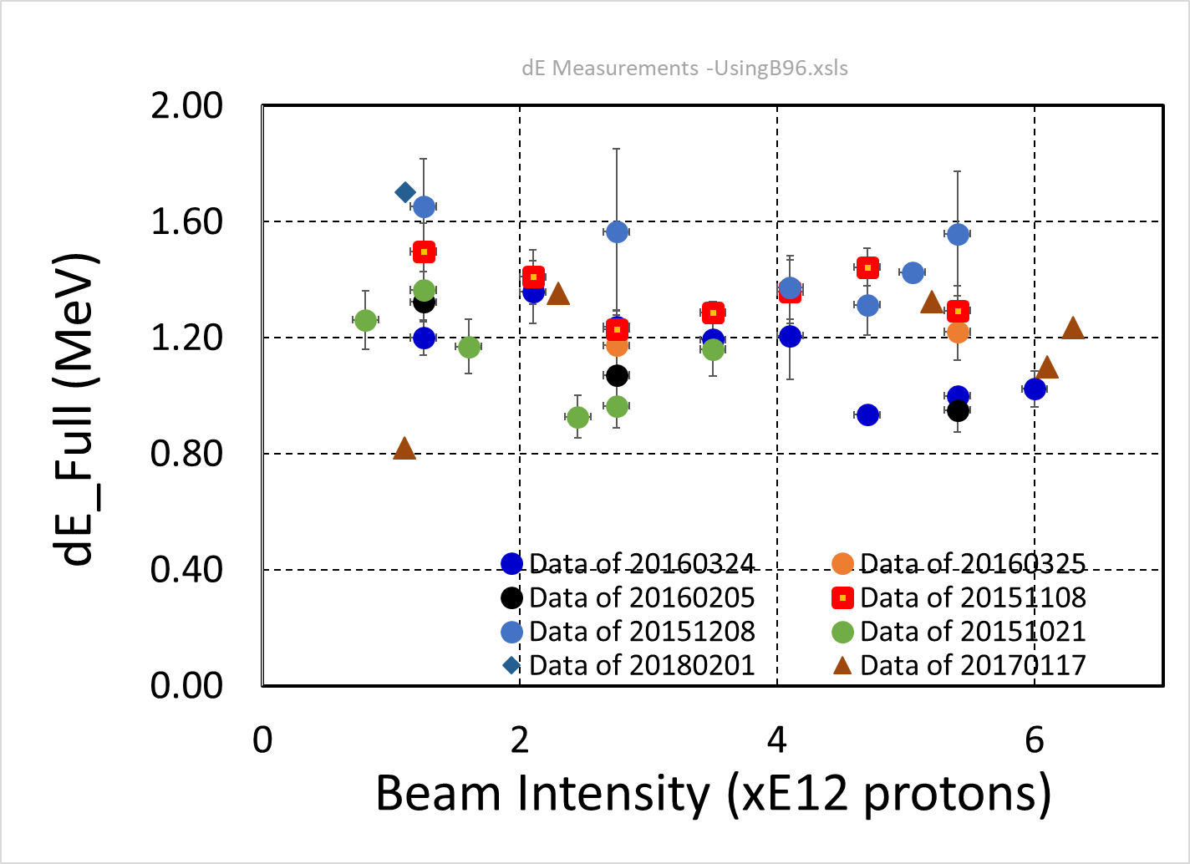
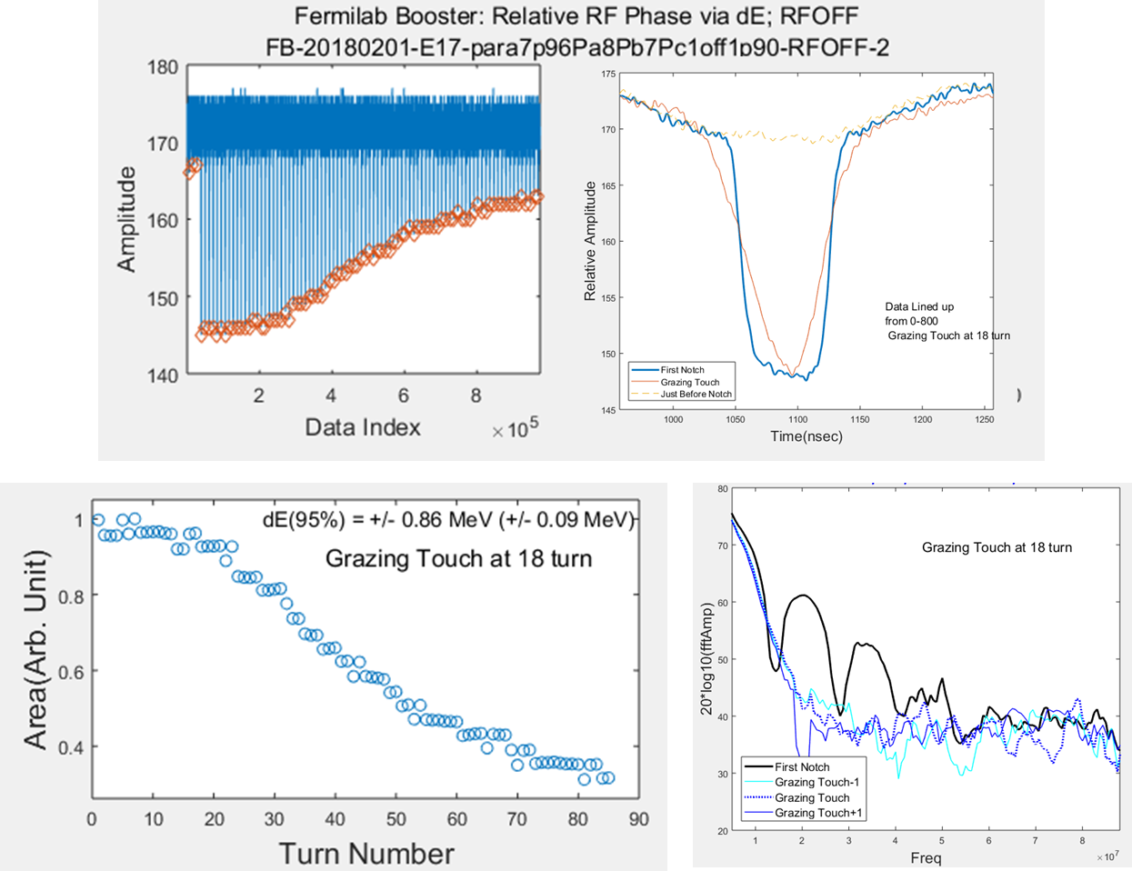
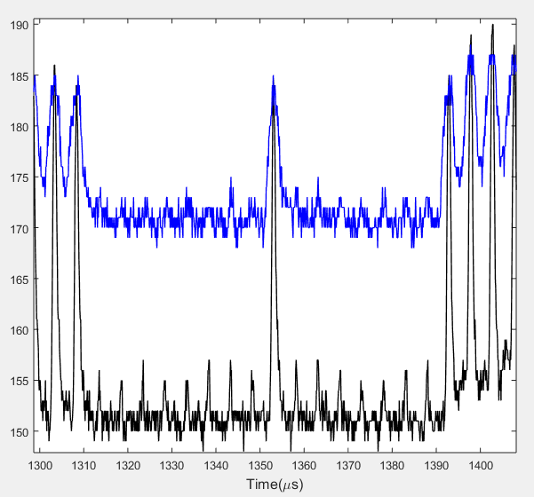
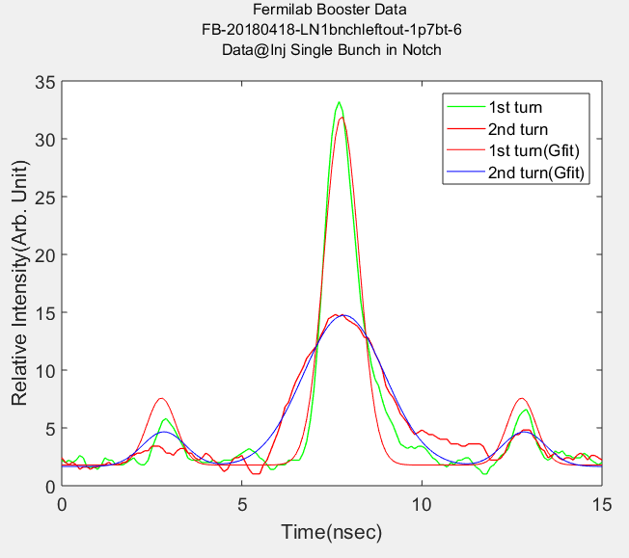
Measurement of dE at Injection
Using Booster Notcher
With Booster RFOFF and RFON
dE(95%) (MeV)
One LINAC bunch
With a single LINAC bunch in
the center of LASER Notcher
Thus, the dE from LINAC did not change over the years
20180418 data
(dE(95%))_{Average}=1.25±0.20 MeV
(1σ dp/p)_{Average} = 0.045%
2nd turn
1st turn
@ Inj. .
2nd turn
1st turn
From an Adiabatic beam Capture
one expects ε_{L}/bunch= 0.03-0.04 eVs at injection
dE=1.51±0.08 MeV

Slide 7
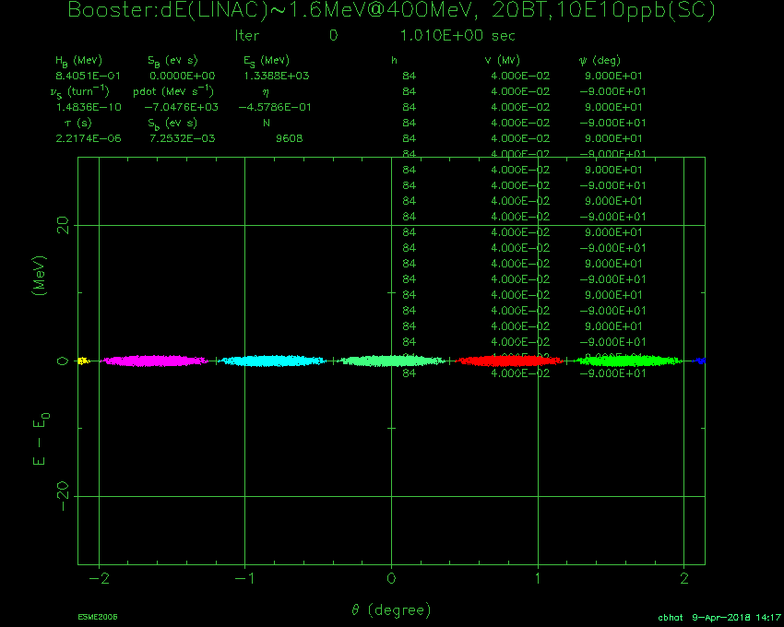
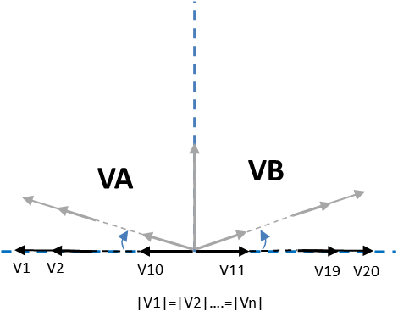
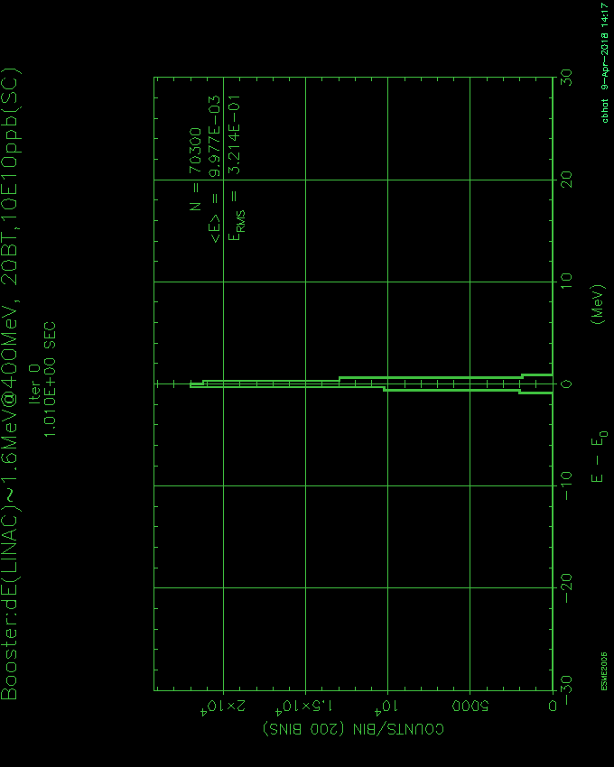
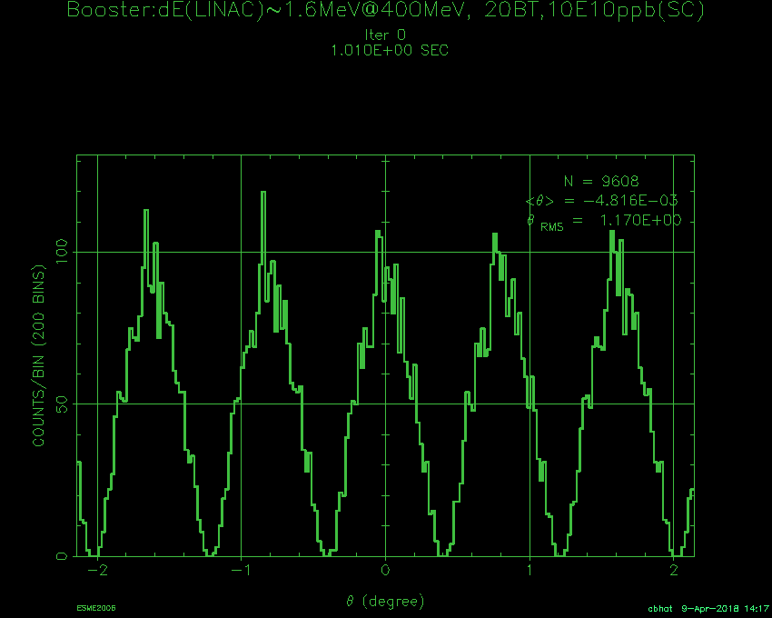
Longitudinal Beam Dynamics Simulations
Beam Injection – Capture – Transition Crossing
Simulation Parameters: with SC
1. LINAC Beam ΔE = 1.2 to 1.6 MeV,
2. Beam Int.= 2-12E12ppBc
Simulations for ideal paraphase
scenario for Beam Capture
3. Booster machine parameters
4. A phase correction after Tran. Crossing
ΔE-Δt Phase space (8.2E12ppBc)
30
Vrf=0 @ Injection
ΔE Dist.
Vrf during
Capture
0
ΔE (MeV)
ΔE@Inj
= 1.5 MeV
ESME
-30
Line-Charge Dist.
Simulations Predict
<20% emittance growth during capture.
ε_{L}(95%) before Tran. Crossing <0.05 eVs.
No particle losses from Inj. to Tran. Crossing
-2
0
2
Azimuthal Angle(deg)

Slide 8
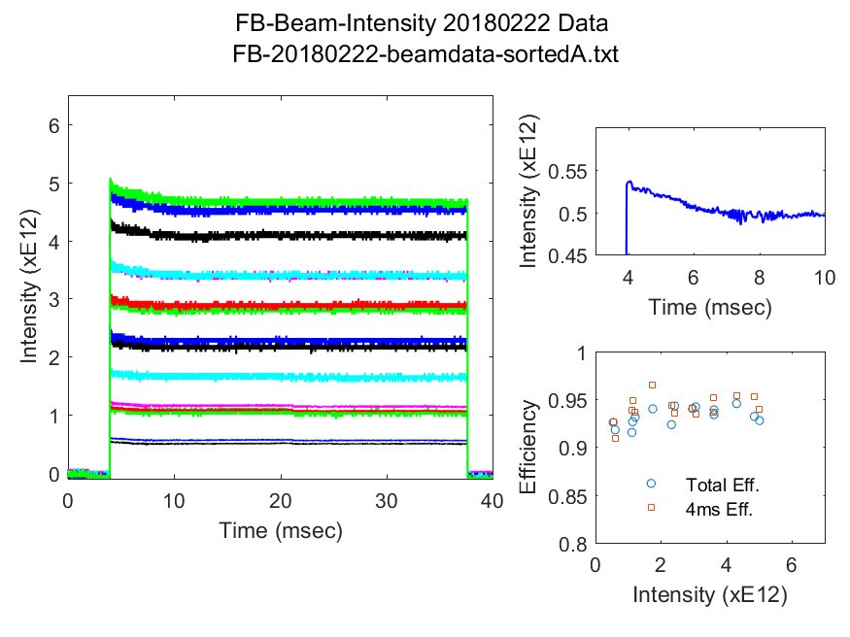
Beam from Injection to Extraction and Early losses
Operational Beam Intensity required for 700 kW on NuMI target
But!
16
Booster Turn
14
12
10
8
6
4
2
SC effect can not explain this early loss at such low intensity

Slide 9
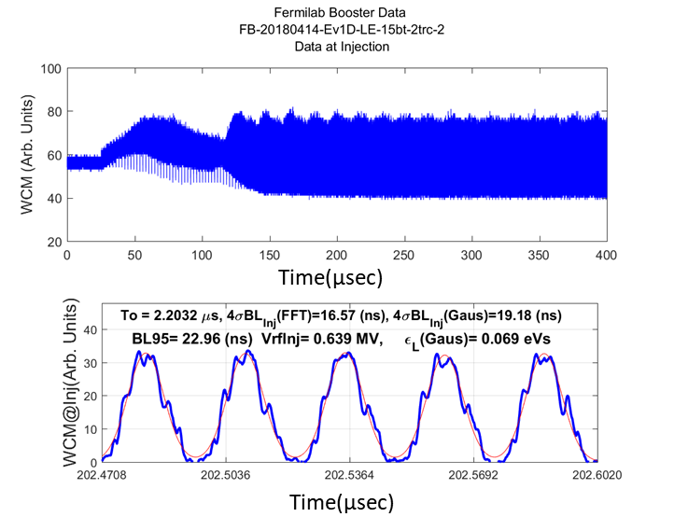
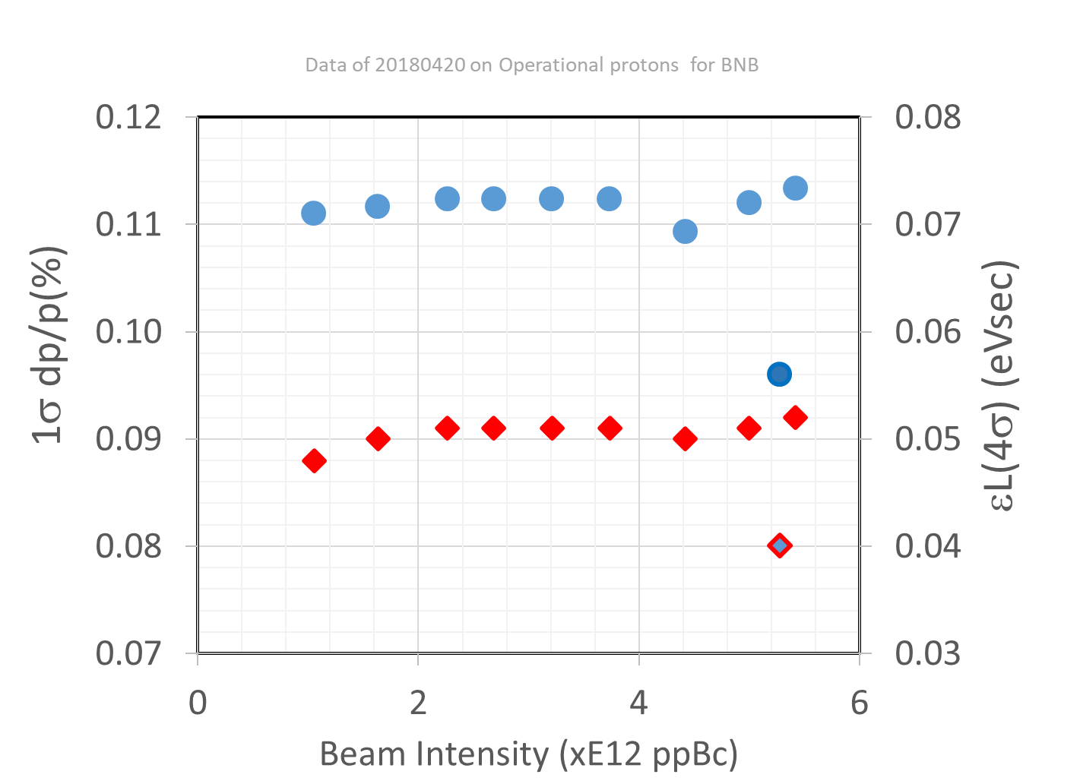
ε_{L} After Beam Capture
4.8E12ppBc@Inj
Eff.(Inj to Ext.) ~94%
ε_{L}(@end of Capture)
WCM data
Debunching phase
dp/p (end of capture)
Adiabatic Capture
In the current operation, the best overall efficiency is seen only if beam is debunched before final capture. ←This is a very strange feature.
2. The above feature is independent of beam intensity.
3. Observed ~90% ε_{L} growth from beam Inj. to end of Capture.
Why?

Slide 10
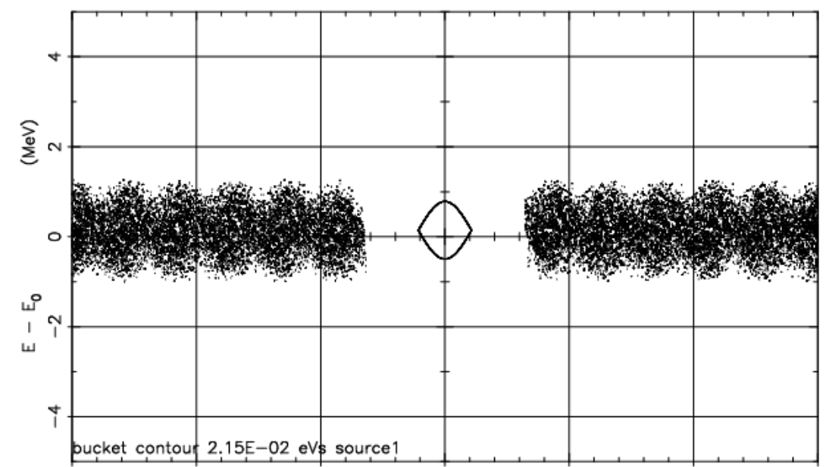
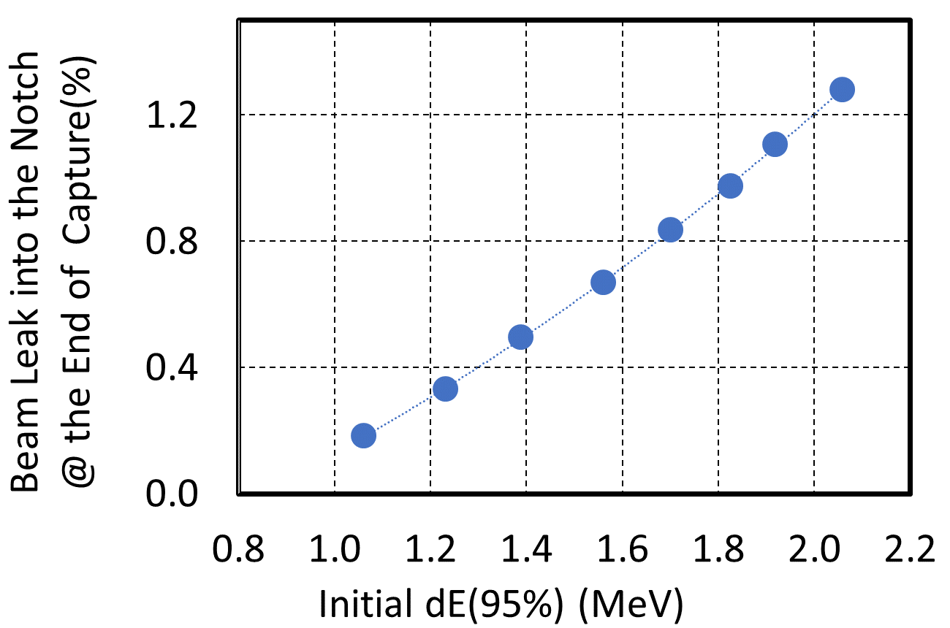
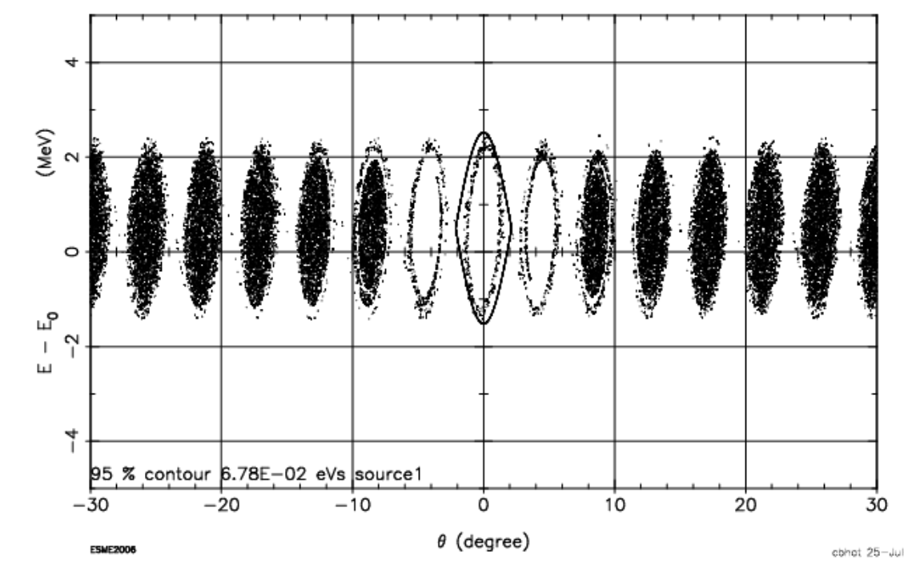
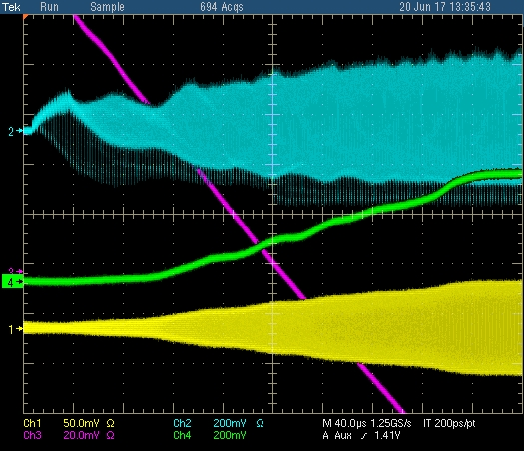
Early Capture with LASER Notcher
Simulations
dE(95%)=1.56 MeV
Particle Leakage is expected to be <0.7% in the notch created by LASER for dE(95%)=1.56 MeV before the end of the beam capture.
dE(95%)=1.56 MeV
14th turn,
start of capture
Leaked particles
20th turn,
end of capture
Early Capture (adiabatic)
with LASER Notcher
WCM data
No Improvement seen in capture efficiency
~8% particles leaked out of the Bucket at acceleration.
Measurement
Vrf for adiabatic capture
Bdot
RF Gap monitor sig.
→ There is some unknown source of emittance growth before the end of capture

Slide 11
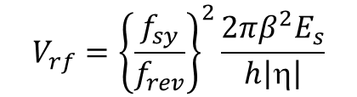

RF Issue
Beam Based RF Voltage Measurement
Measure Vrf by measuring the small angle synchrotron frequency, f_{sy} of the beam in stationary rf bucket.
or
Small angle Synchrotron Oscillations
$$f_{sy}=f_{rev}\sqrt{\frac{V_{rf}h\left|η\right|}{2πβ^{2}E_{s}}}$$
$$V_{rf}={\left\{\frac{f_{sy}}{f_{rev}}\right\}}^{2}\frac{2πβ^{2}E_{s}}{h\left|η\right|}$$
±60⁰
In the case of RCS like the Fermilab Booster, Vrf measurements from f_{sy} is not a trivial task.
  Beam is hardly in stationary buckets in Booster beam cycle. Therefore, to measure f_{sy},
    We have to run the Booster in DC mode or
    Create a pseudo stationary bucket
    We did both; show results from only one of them

Slide 12
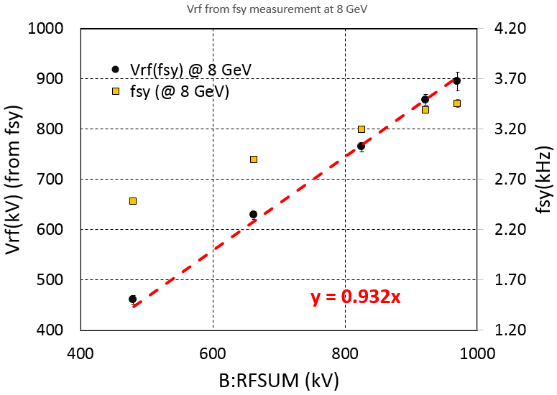
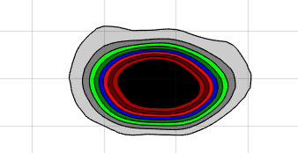
Vrf from f_{sy} and Bunch Tomography
8 GeV
DPF2017
  The beam size was small.
  Small angle synch. oscillations are achieved.
  ∑Vrf measurement up to 1 MV.
0.1 eVs(95%)
Vrf(kV)=0.93×B:RFSUM
Conclusions: Beam based rf voltage measurement showed that ∑Vrf is ~7% smaller than the expected.

Slide 13
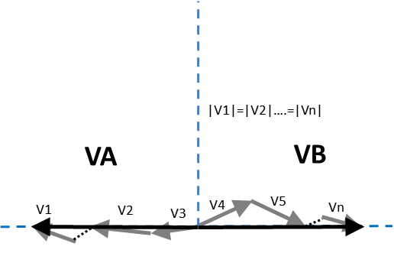
A New Clue for Early Beam Loss
A simple model simulations by CTan using operational paraphase RF curve showed that we can expect beam loss only if beam dE > 2x (measured value at injection).
  ESME simulations showed that the debunching can not explain emittance growth and the beam losses.
  What might make ε_{L} grow so quickly and force particle outside the separatrix during capture?
Hypothesis
  Even if the phase of A and B stations makes the voltages to cancel, a small local phase error between RF stations along with different RF peak voltage can cause emittance blow up.
How do we verify the hypothesis?
  Measure dE for RF OFF and RF ON setting (VA-VB)=0. Then dE must be the same if RF phases are correct.

Slide 14
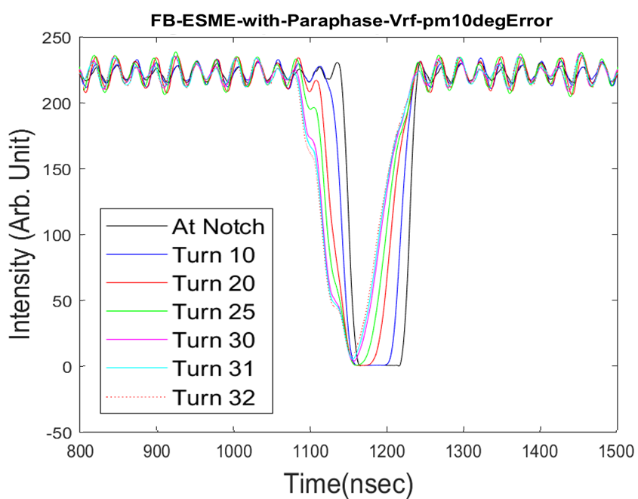
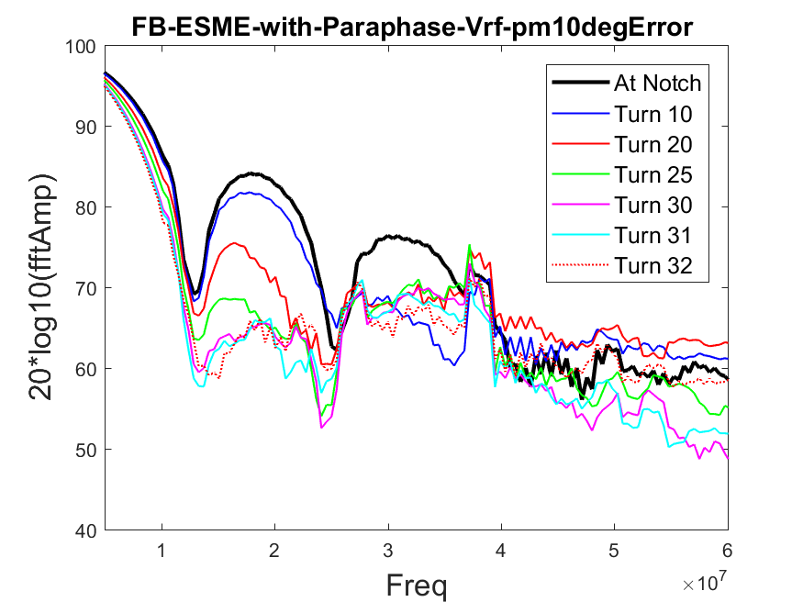
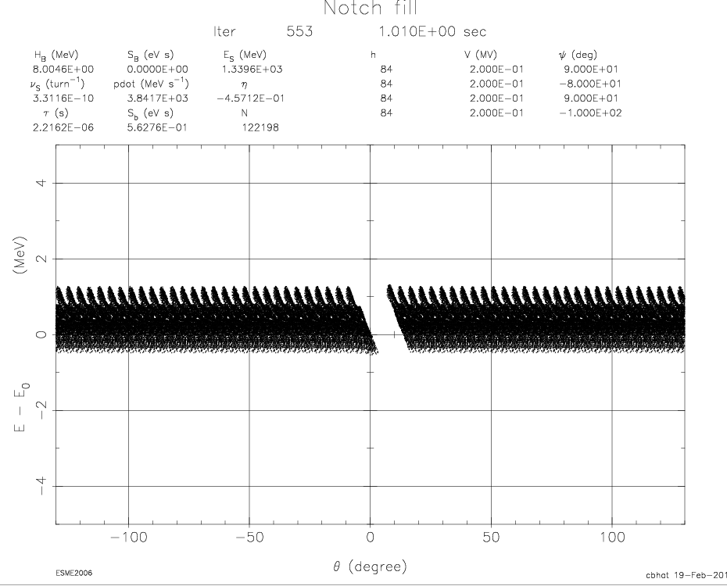
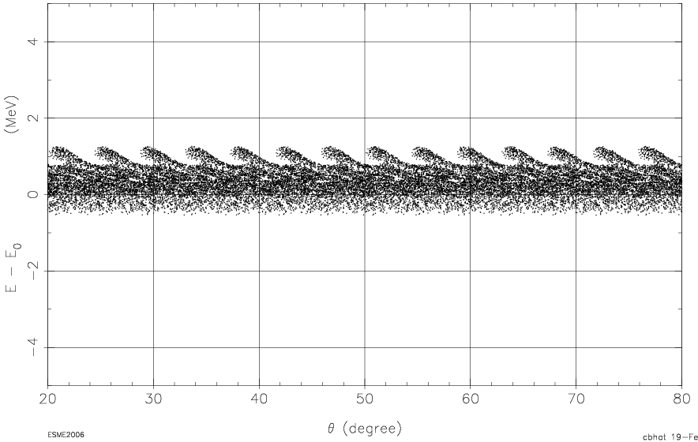
Simulations
Booster Notch with RFON
RF Vectors with cumulative Phase Error=0
|V1|=|V2|
=|V3|=|V4|
Number of RF cavities = 4
Vrf/cavity = 200 kV
RFON = paraphase angle of 90 deg
phase error=+10 deg and -10 deg
V1
V2
V3
V4
10 deg
Simulated
WCM data
Asymmetric filling of the notch
Grazing touch at turn 30
FFT
(dE-dt)
Phase phase distribution
(MHz)

Slide 15
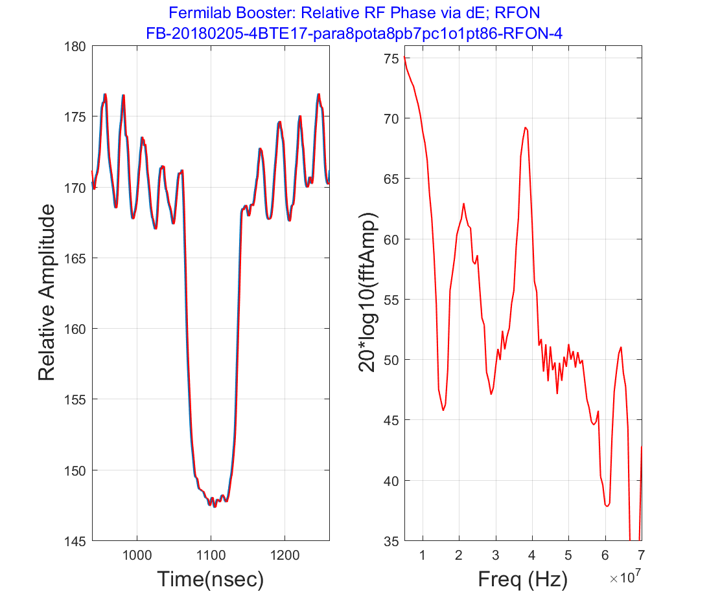
Measurements
Booster Notch with RFON
Number of RF stations used = 4
WCM Data
around the notch
FFT
Asymmetric filling
~70nsec wide notch
in the Booster

Slide 16
Observation that supports our hypothesis on RF Phase Error in the Booster
Observed asymmetric notch filling with RFON
← Implying ε_{L} growth.
Space-charge effects can not explain early ε_{L} growth and beam loss
Further measurements on just four RF cavities proved that RF stations are misaligned (also their amplitudes).
  Therefore, global balancing alone is not sufficient for adiabatic beam capture.
Simulations show that RF phase error can cause the loss pattern which is similar to the one seen in Booster.
A phase map of all the cavities shows presence of a systematic phase error.
Work is in progress to correct phases for all 22 RF stations and see if we can mitigate the early emittance growth and beam loss. ← In about a month this will be tested.

Slide 17
Transition Crossing

Slide 18
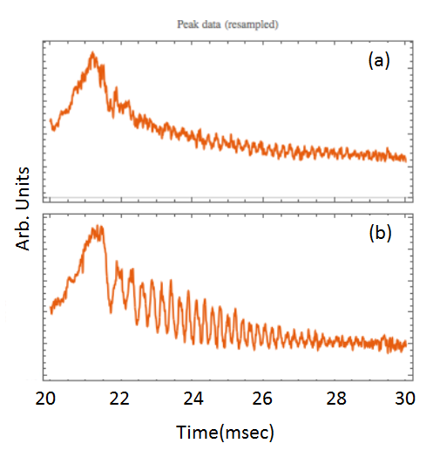
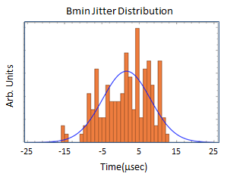
Issues with Transition Crossing
There is a time jitter in the TCLK (beam injection clock) event relative to Bmin. This jitter is >30 μsec and known for a long time (~45 years) and there were no easy fix to this problem.
All these years, the transition crossing phase jump was delayed w.r.t. TCLK event and the time jitter was causing unwanted ε_{L} growth after transition crossing.
No SC effect
10 min data
Trannition
Crossing
Bunch Peak Amplitude
Data under similar conditions
Looks like SC
effect at TXing

Slide 19
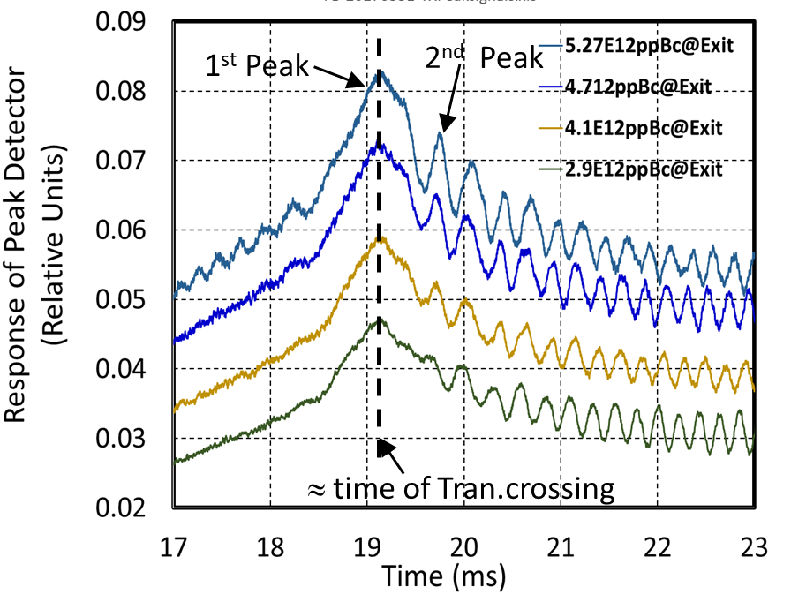
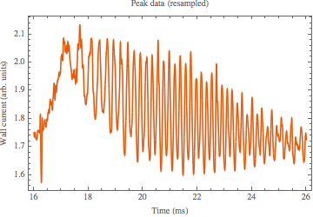
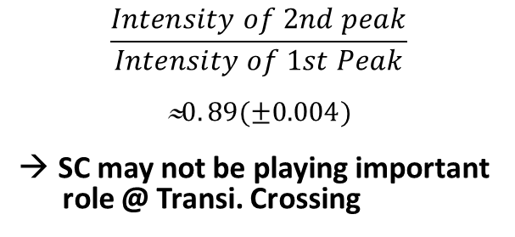
Mitigation of time Jitter at
Transition Crossing in Booster
Early 2017, we changed from TCLOCK based transition crossing to RF frequency based transition crossing.
Pellico et. al.
$$\frac{Intensity of 2nd peak}{Intensity of 1st Peak}$$
≈$0. 89(±0.004)$
SC may not be playing important
role @ Transi. Crossing
With Quad
Damper OFF
After
change
Before
change
Improvements were
Amp. of Oscillation went down
10-15% lower ε_{L} at extraction
Tran. crossing more robust; No cycle-to-cycle dependence.
Simulations showed that the residual oscillations seen after Tran.Crossing are due to Bucket Mismatch.
Mitigation: A circuit will be added to correct the phase at Tran. Crossing.

Slide 20
Summary
& Outlook
All of PIP’s goals are met ahead of schedule by nearly an year due to incessant effort of many people and new ideas. Highlights are
  Booster provides quality beam to the down stream facilities at 15Hz.
  Beam intensity out of the Booster has exceeded 2.25E17/hr.
  RR+MI are providing ~700 kW beam power on NuMI target. A significant part of this success is from the Excellent performance of the Proton Source.
We still observe ~6% beam loss in the first 4 msec of the beam cycle in the Booster. Our studies indicate that the RF system is playing a role in this loss. Efforts are underway to fix this problem.
To reduce the residual beam oscillations after the transition crossing a new LLRF effort is undertaken to match the bunch to bucket.
Planned intensity upgrades in Booster for HEP experiments will be discussed in my talk tomorrow. – stay tuned.

Slide 21
Backup slides

Slide 22
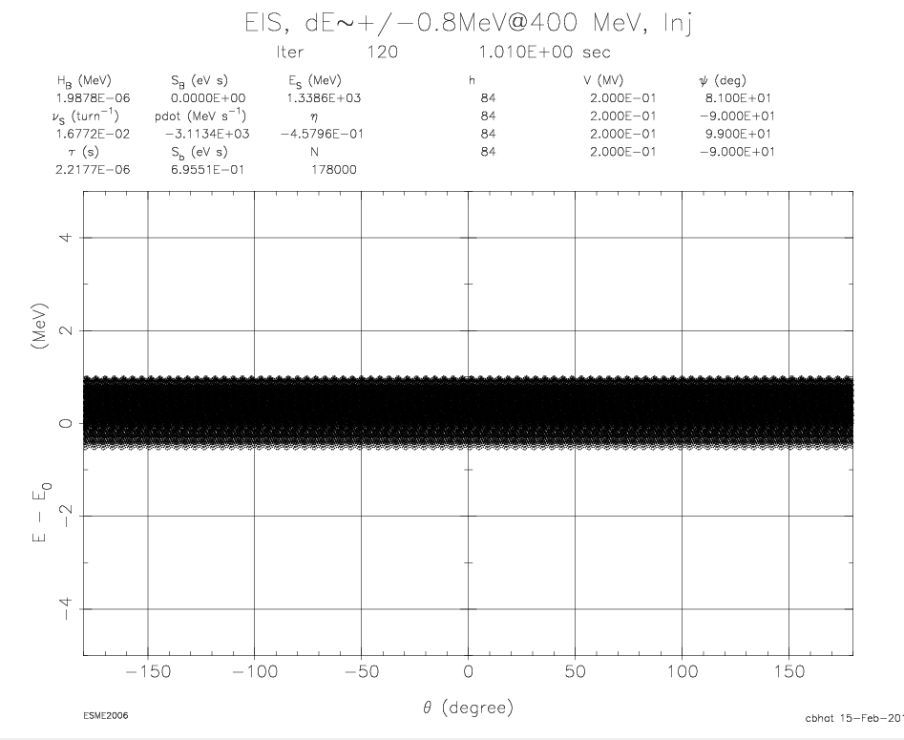
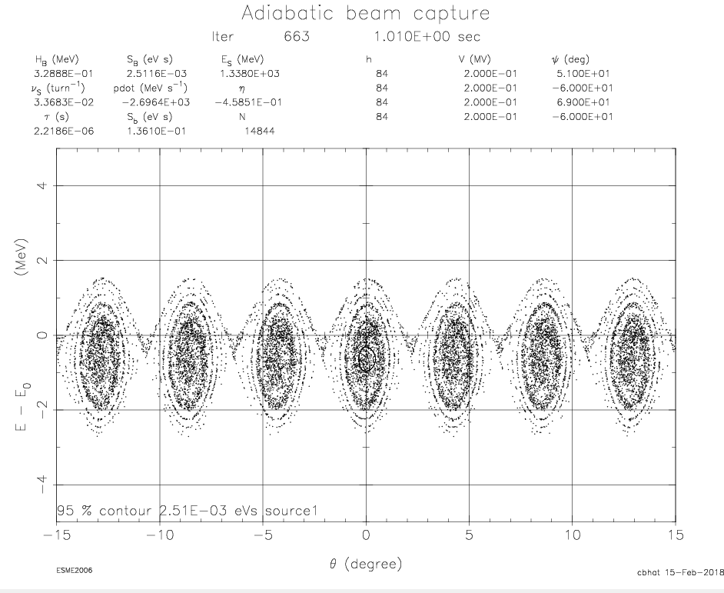
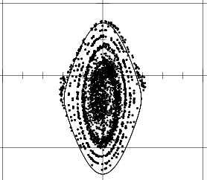
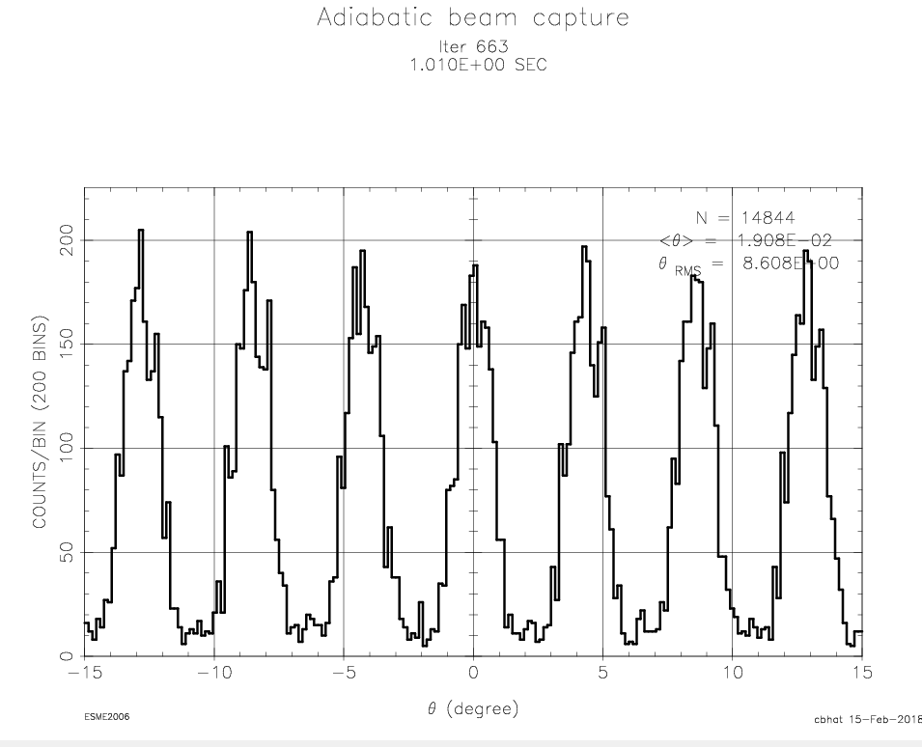
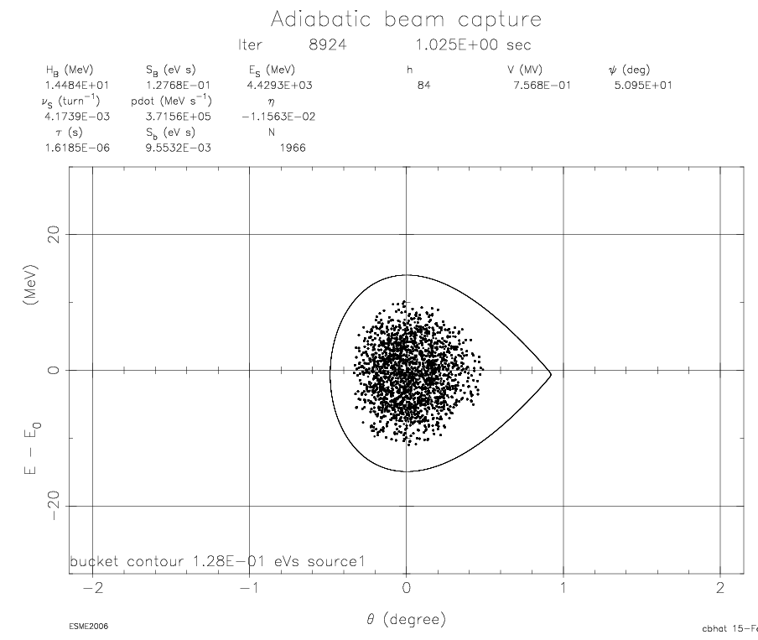
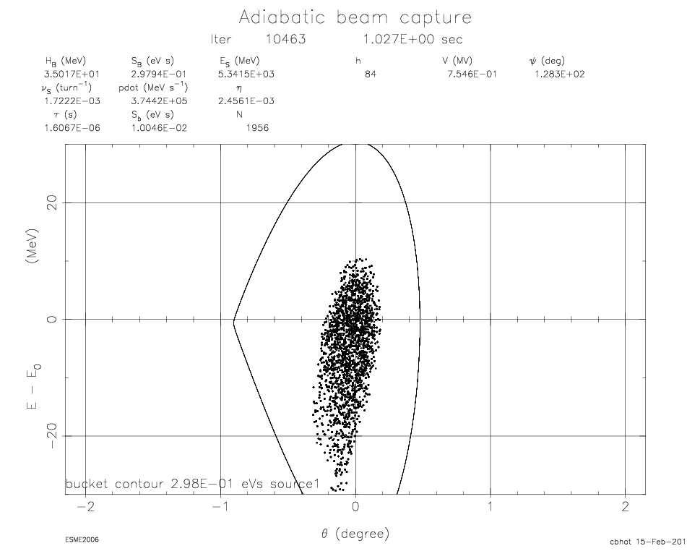
Simulations using ESME
Injection, Capture, Acceleration, TX
RF Paraphase: with 9⁰ phase error with cumulative error=0
Turn 30: ~66 µs from start of Injection
Turn 165: End of Capture
|V1|=|V2|
=|V3|=|V4|
~9% of the particles outside the bucket separatrix
V1
V2
V3
V4
9 deg
Turn 8426 : Acceleration
~14 msec in cycle
Turn 9636 : After TX
<17 msec in cycle
Results:
8% beam loss within a few msec in acceleration. No loss afterwards. Large emittance growth.
Problem gets more complicated if individual RF vector lengths are a not the same.

Slide 23
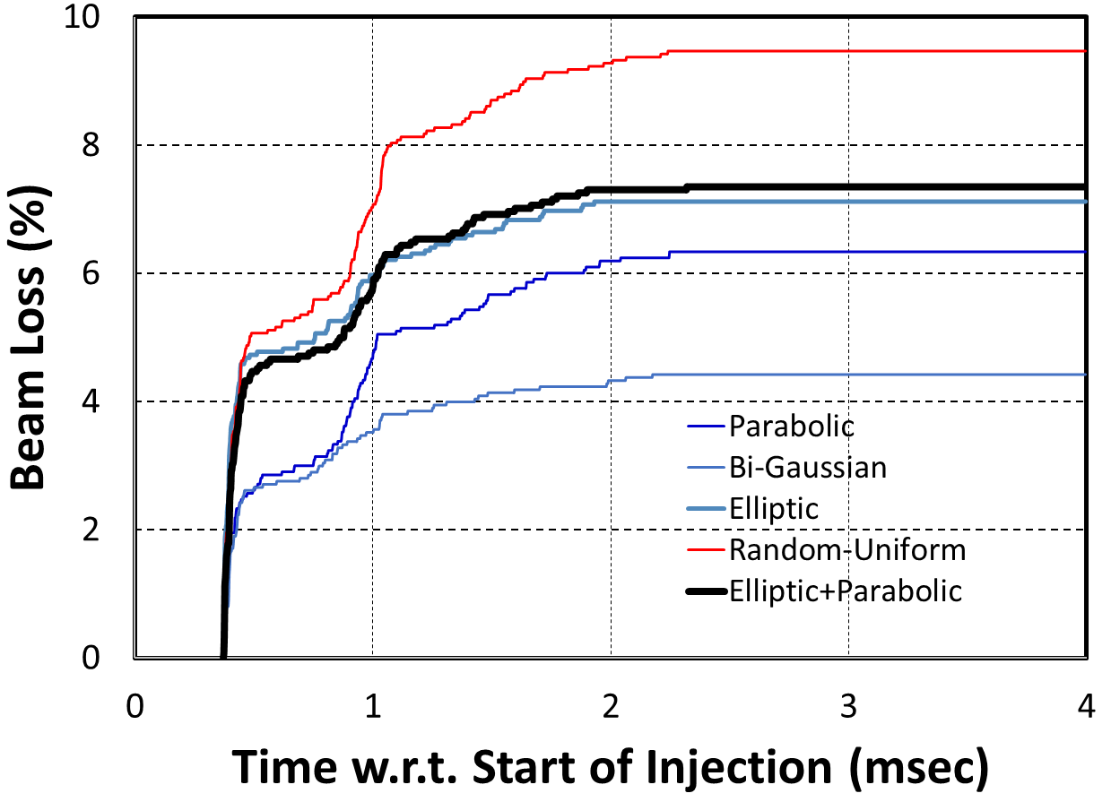
Simulated Booster Beam Loss
This case corresponds to “Injection, Capture, Acceleration, TX, RF Paraphase: with 9⁰ phase error with cumulative error=0 “ (see previous slide)
Note: The energy spread of the LINAC beam of dE(95%)~ 1.5 MeV is assumed in these simulations. Beam loss pattern found to depend on the type of distribution assumed for the LINAC bunches. The beam in RF bucket is somewhere between to elliptic or parabolic distribution or a combination of these. The fast loss for the 1st 100 µsec is coming from loss of uncaptured particles. The rest are captured beam, but, nearer to separatrix. Such beam particles are lost during the first few ms of the acceleration.

Slide 24
Laslett SC tune shift
Δν_{SC} = -0.32 (@4.6E12ppBc) to -0.47 ( @4.6E12ppBc) at injection

