Slide 1
Fixing the cause of beam loss at the start of the Booster ramp with lattice corrections
C.Y. Tan, K. Seiya, & C. Bhat
Fermilab Workshop on Megawatt Rings & IOTA/FAST Collaboration Meeting
7 May 2018

Slide 2
People
Transverse study group
C.Y. Tan & K. Seiya (PS)
C. Bhat (PS) & W. Pellico (PS)
V. Lebedev & Y. Alexahin (APC)
E. Stern, A. Macridin (SC)
Longitudinal study group
C.Y. Tan & C. Bhat (PS)
W. Pellico (PS)
V. Grzelak & J. Reid (RF)
This is the opening act. Chandra will give the results from the longitudinal study group.

Slide 3
Booster Parameters
Circumference = 2PI x 75.47 meters Injection energy = 400 Mev (kinetic) Extraction energy = 8 Gev (kinetic) Cycle time = 1/15 sec Harmonic number, h = 84 Transition gamma = 5.45 Injection Frequency = 37.77 Mhz Extraction Frequency = 52.81 Mhz Maximum RF voltage = 0.86 MV Longitudinal emittance = 0.25 eV sec Horizontal Beta Max = 33.7 meters Vertical Beta max = 20.5 meters Maximum dispersion = 3.2 meters Tune vx = vy = 6.7 Transverse emittance(normalized) = 12PI mm mrad Bend magnet length = 2.9 meters Standard cell length = 19.76 meters Bend magnets per cell = 4 Bend magnets total = 96 Typical intensity = 4.5e12 Phase advance per cell = 96 degs Cell type = FOFDOOD (DOODFOF)

Slide 4
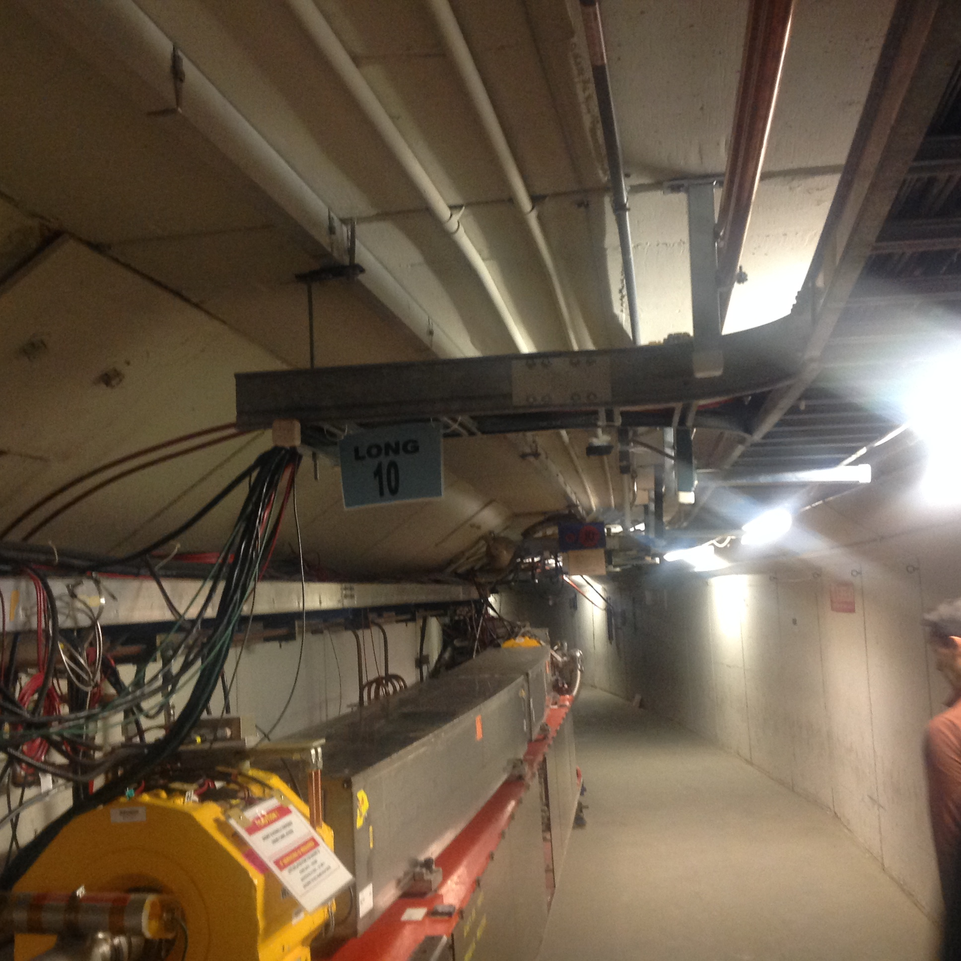
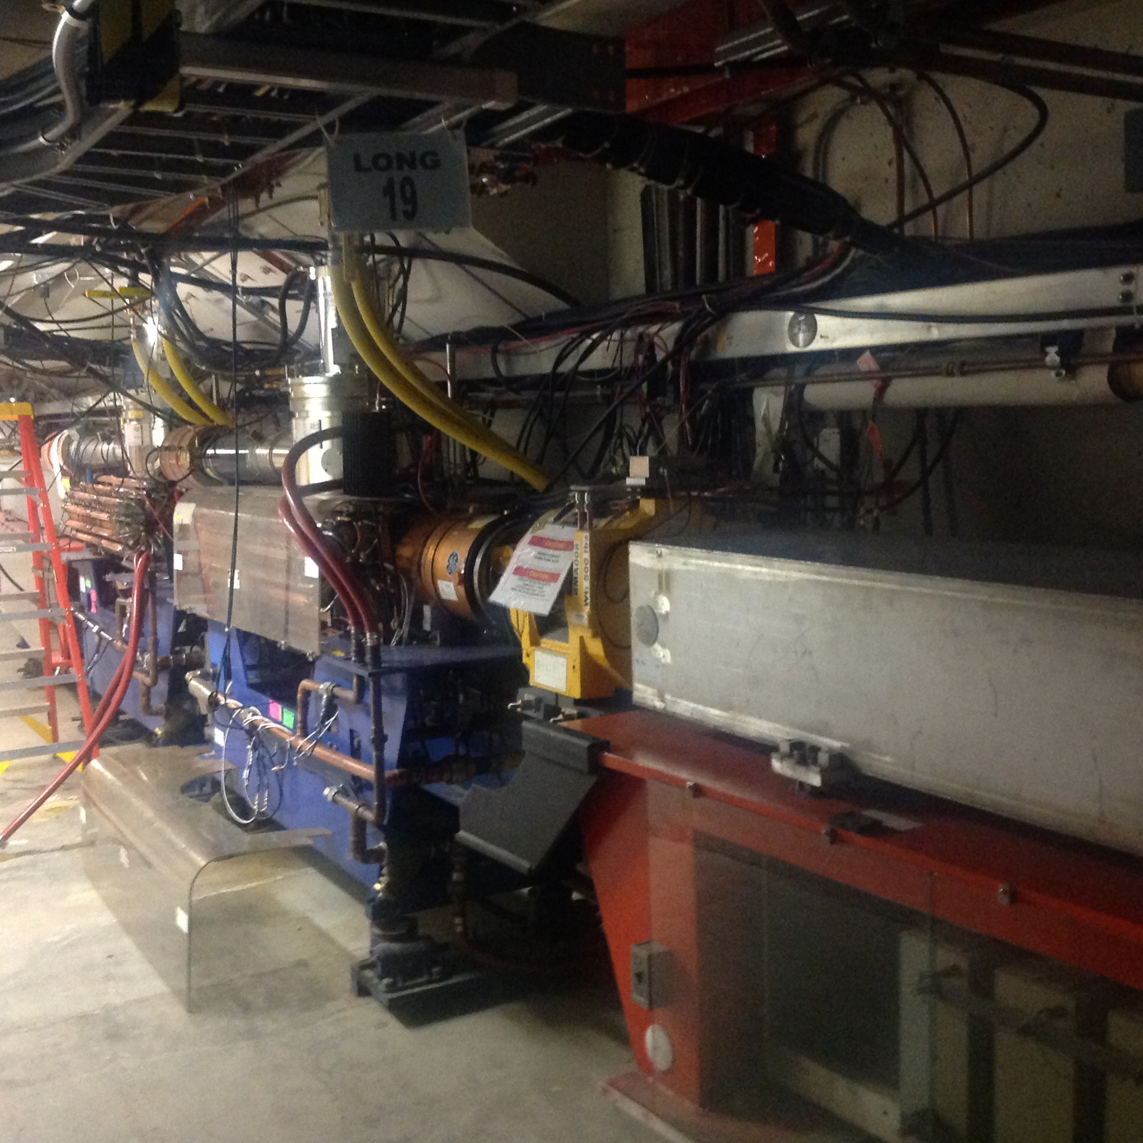
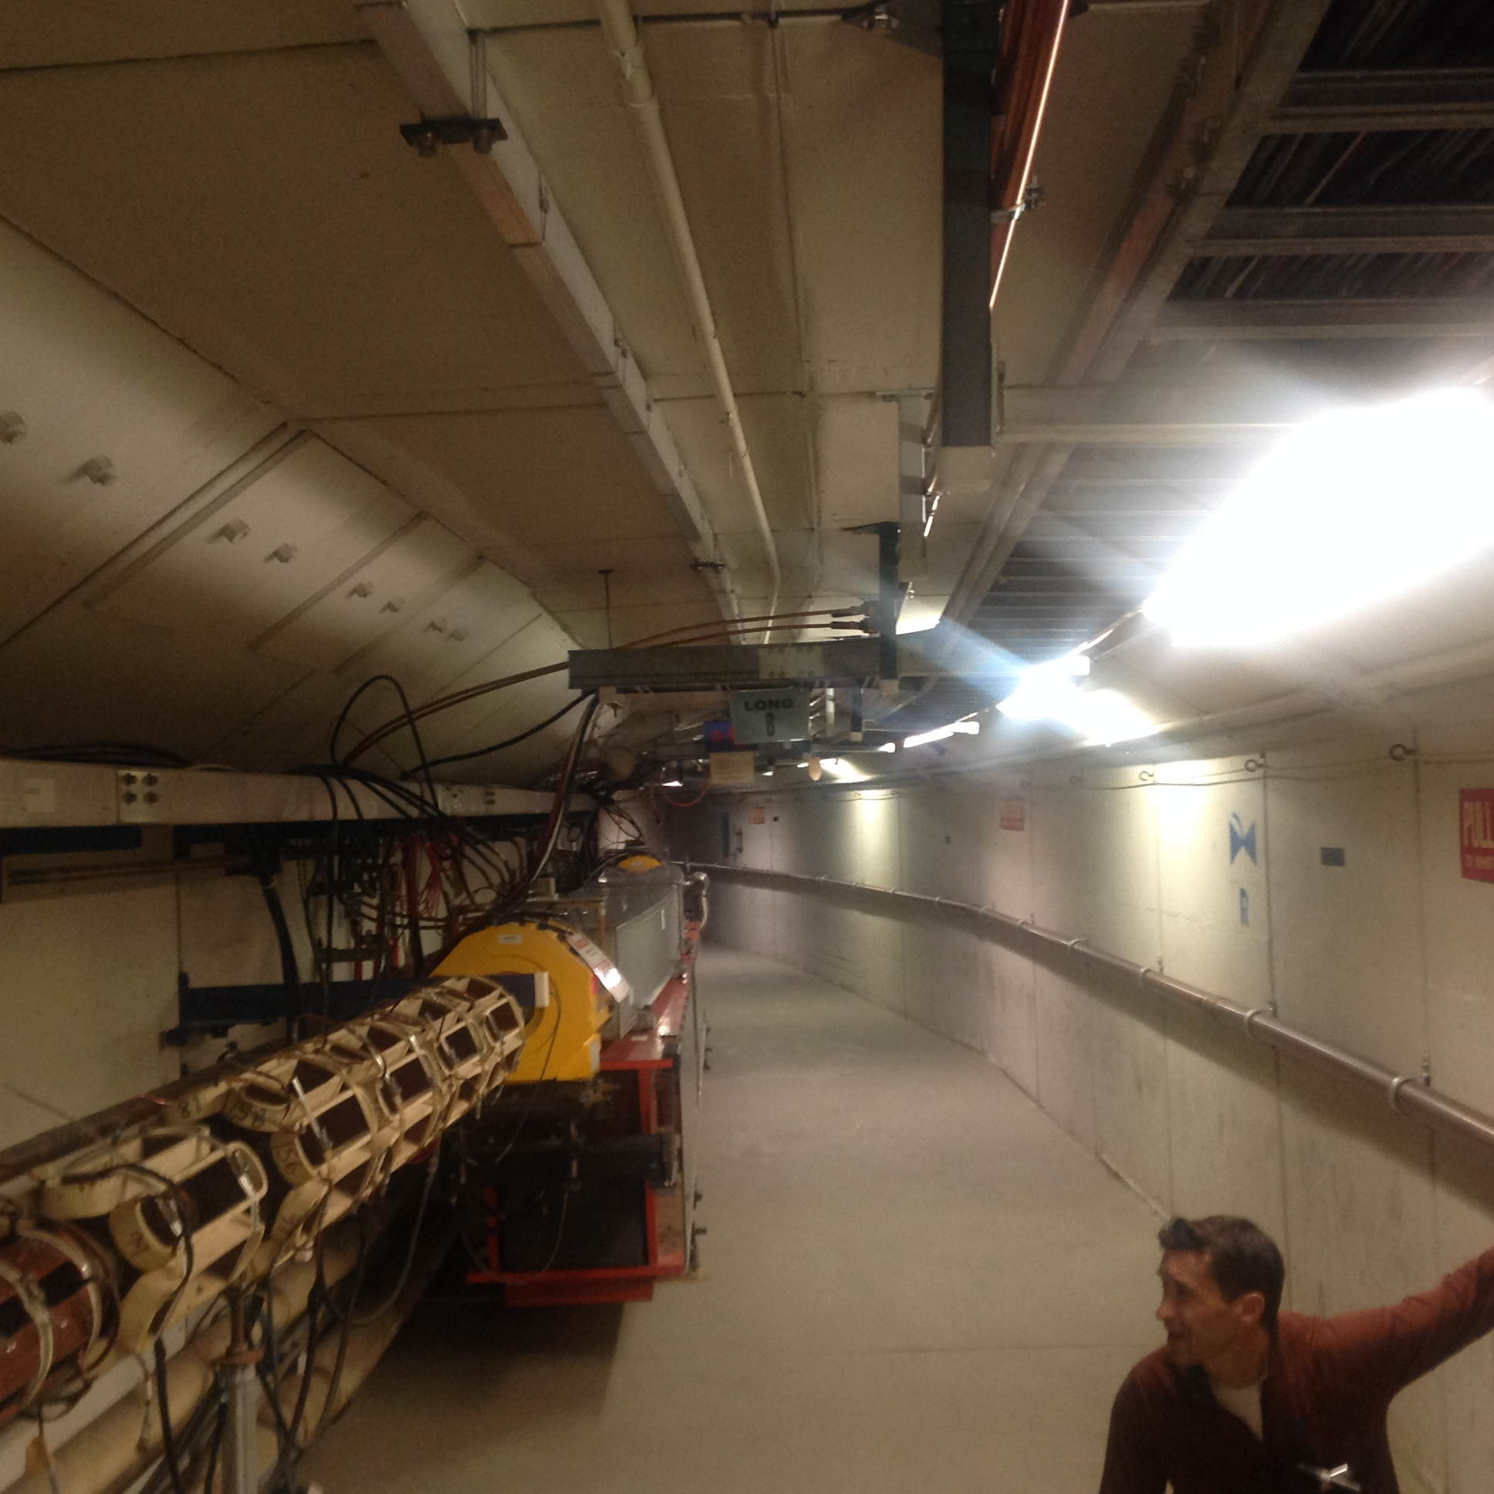
Some elements in Booster
Some photos of the Booster tunnel that show:
Corrector package
Bend magnets
RF cavities
Bill looking for trouble (or lost beam) …

Slide 5
Historical perspective
This loss has been there for at least a decade (or longer).
We have an administrative loss limit of 525W.
Improvements that have been made in PIP:
Opened up aperture restrictions.
Magnetic cogging.
Early capture.
But despite these improvements, beam loss at injection is still there.
Transition losses were, in contrast, fixed by stabilizing where the ramp crosses transition by moving from TCLK based jump to RF frequency based jump.
Data from 21 Jan 2010 (8 years ago).
Losses at injection and at transition.

Slide 6
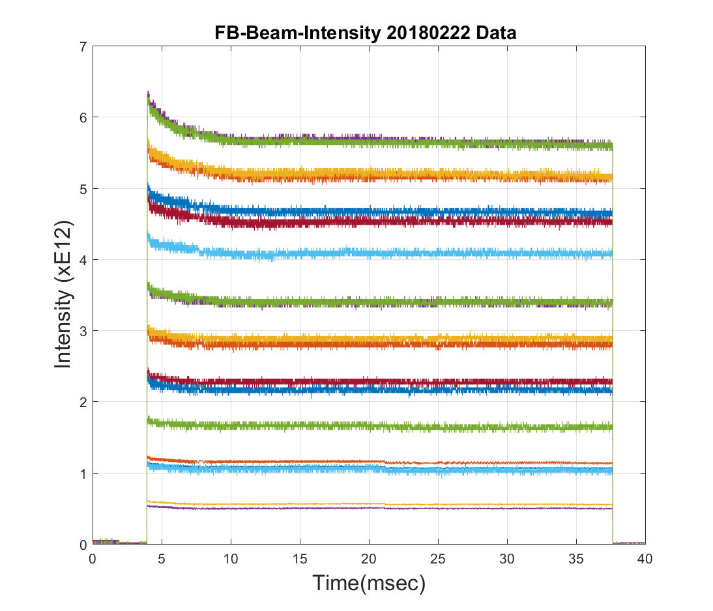
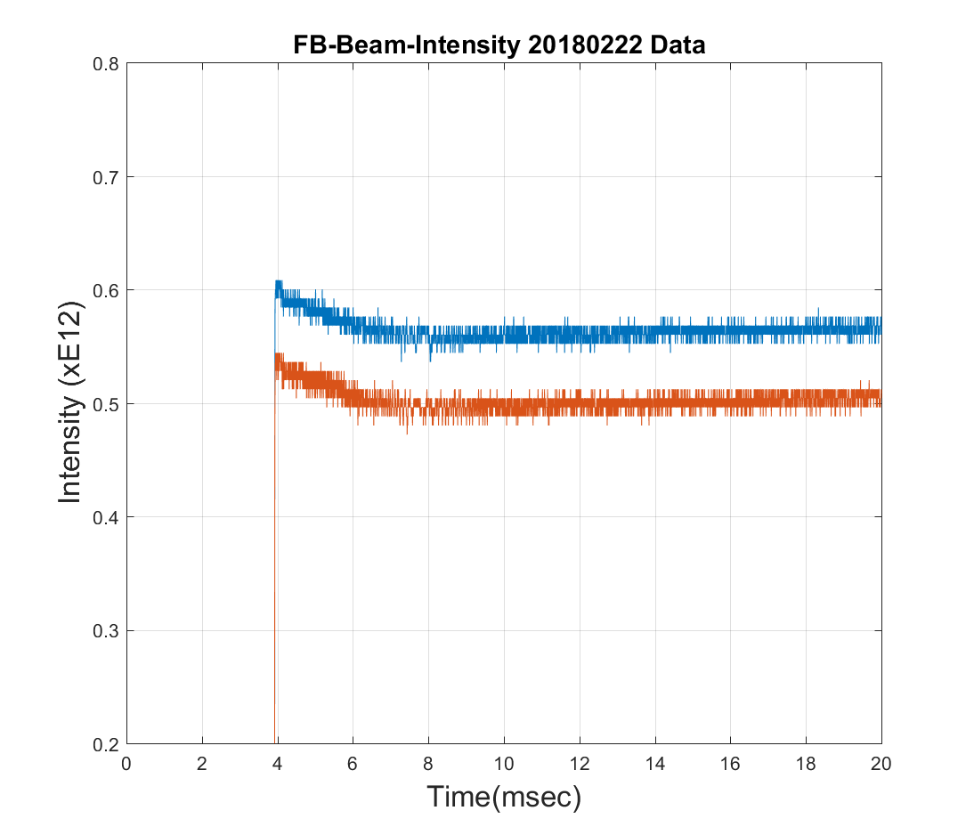
Beam loss occurs in first 2-3 ms after injection
Small fast loss from notching
There is beam loss at the 4-6 ms in the cycle. Time scale for loss is about 2-3 ms after injection.
We see this loss even at low intensity < 0.6e12, ~5-6% loss. Similar to high intensity! Therefore, it is *not* space charge.
This unexplained loss now dominates the losses in Booster.
2 turns at low intensity
20 turns at high intensity

Slide 7
So what is the source of this loss? (start with transverse)
At first we suspected that the loss came from the extraction dogleg at L3.
The dogleg distorted the lattice and the hypothesis was that there were higher order resonances that caused beam loss.
Dogleg OFF
Dogleg ON
Even in the ideal case with no other lattice errors, the dogleg extraction in the vertical plane introduces large horz beta distortions and also spoils dispersion.
This was the reason the dogleg was suspected as the source of beam loss.

Slide 8
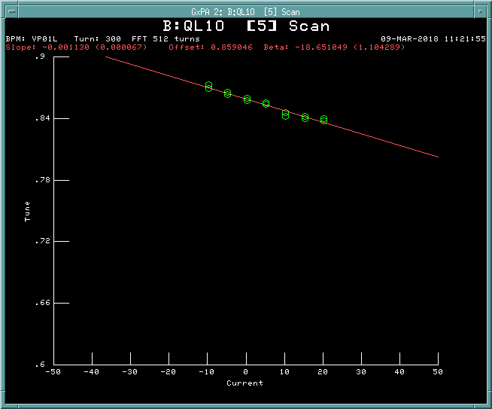
Can we check that the dogleg is really the source of beam loss?
Yes! Let’s make a pseudo-flat lattice to see if there are any improvements in lifetime and tunespace.
Before we can do this, we have to have a method to measure the lattice.
We can measure lattice at the quadrupoles by seeing how the tune moves.
Tune response method:
$\frac{dν}{dI}=\frac{N}{4π}$ $\frac{kl}{Br }$ $β$

Slide 9
Compare measurement with MADX model lattice
The as found Booster lattice (input magnet currents into MADX model) was compared with measurements from tune response method (13 & 14 Feb 2017)
MADX model is verified!

Slide 10
Let’s make a pseudo-flat lattice (v 1)
We can make a pseudo-flat lattice by using corrector quads.
Combined spread in relative error between model and measurement is 14% for βx and 9% for βy.
Note: β relative errors dominated by low β’s.

Slide 11
Tune scan
V1
V2
HEP
V2 pseudo-flat lattice has a smaller vertical ½ integer resonance and slightly larger horizontal ½ integer resonance.
Both pseudo-flat lattices are much improved over HEP lattice.

Slide 12
Efficiency is not improved with pseudo-flat lattice!
Efficiency is always ~1% lower than HEP
Tuned 400 MeV injection line quads. No improvement.
Smoothed 3 ms orbit to HEP orbit. No improvement.
Individual 3 bumps at aperture restrictions. No improvement.
Decoupling. No improvement.
Booster Beam loss ring display

Slide 13
So not dogleg then what?
Synergia simulations show that dogleg is not the problem (confirms observations)
Synergia claims that the displacement of the CPL03 package by 5 m w.r.t. its symmetric location is the source of the problem. (Note: there is also a displacement of CPL01 as well, but smaller)

Slide 14
I would never have guessed … (Lattice doesn’t change very much from CPL03 displacement)
QL=-1.2 A and QS=-0.2 A to get Qx = 6.74 and Qy = 6.83
Very little change in lattice with CPL03 moved 5 m w.r.t. symmetric location:
At the dog leg:
HL03 – DMAGU03 = (47.2759966747 – 44.9563116043) m=2.31968507 m
At L04:
HL04 – DMAGU04 = (71.7538200019–64.7168491019) m = 7.0369709 m
At L05:
HL05 – DMAGU05 = (91.5143447890-84.4773738890) m = 7.0369709 m
That CPL03 is the cause is a very surprising result.
Further analysis showed that if this is the cause of the losses, then losses would come from 3rd order resonance. Candidate is the Qx+2Qy resonance.

Slide 15
Tune scan with high intensity
Are the losses (left pic) from 3rd order resonance or from ½ integer (very wide at high intensity) because they are thicker? Yellow region (left pic) may be intersection of half integer lines.
Intensity: 4.6e12, pseudo-flat lattice v2. Skew quad currents zero for first 5 ms.

Slide 16
Use Qx+2Qy=20 harmonic sextupoles
As found HEP
No obvious improvement in losses.
Tried 3Qx=20 as well, no change
Also used pair of skew sextupoles SSS to correct 2Qx+Qy=20; pairs of SSLs to correct 3Qy=20 and also tuned individual skew sextupoles. No effect.

Slide 17
Does lowering chromaticities help?
Lowering chroms should reduce tune footprint and improve beam lifetime but reduces Landau damping. So must have dampers to keep beam stable
Lowering chroms helped pbar lifetime in Tevatron and beam lifetime in MI. What about Booster?
Transverse dampers commissioned in June 2017. So we can actually do this experiment!

Slide 18
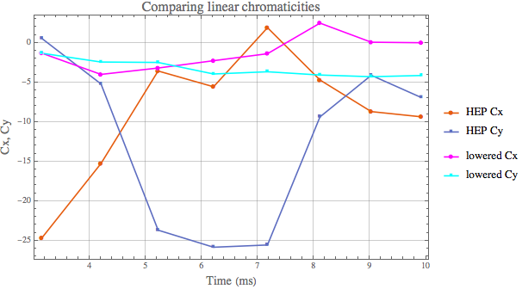
Measured and lowered chromaticity from injection until 10 ms
Moved chroms close much closer to zero.

Slide 19
And the result is …
Used 12.4 turns like in $15.
No visible increase in efficiency ~90%.
No visible decrease in losses.
Moving tunes UP away from ½ integer did not show improvement.
There is a limit of how much tune change is available even with dampers ON at this intensity:
Max horz tune change +0.08
Max ver tune change +0.04
Lowering chromaticity does not improve beam lifetime!
This is the clincher: Source of losses cannot be transverse.

Slide 20
Conclusion (Lead in to Chandra’s talk …)
All our work indicates that the problem is not transverse that is the leading cause of beam loss during at the start of the ramp
The beam loss at the start of injection is not a space charge problem.
Dogleg’s lattice distortions are not the problem.
Displacement of corrector packages are not the problem.
Lowering chromaticity does not improve lifetime
Conclusion: Transverse dynamics is not the dominant problem.
We turned our attention to longitudinal dynamics
Next talk will show our efforts in this area.
We actually have a clue …

