Slide 1
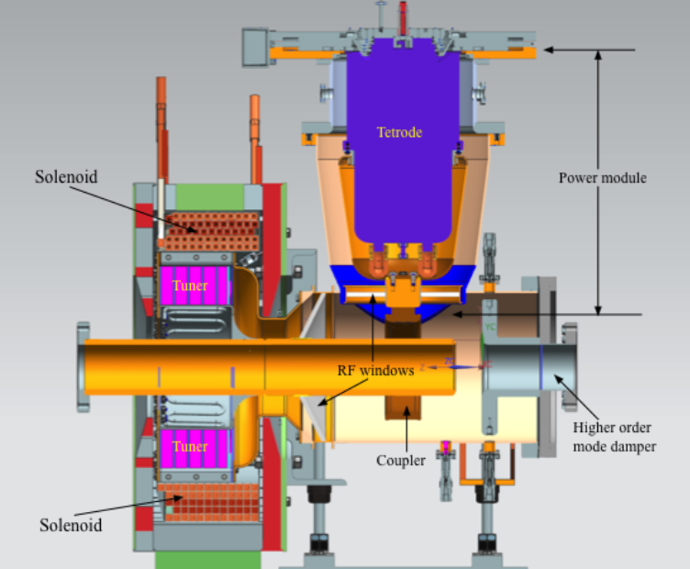
Interlocks based on things in red
PA fan
Tuner Bias Low
#1
PA water leak
Tuner Bias Low
#2
Cavity outer
Conductor
With water
cooling
Solenoid
flux return
ferrite
Cavity inner
Conductor
With water
cooling
Vacuum
(maybe)
Tuner bias
= solenoid
Solenoid
Wire + cooling
RF gap
Spark
Incomplete env.
Has its own
Water cooling
Separate from cavity

Slide 2
Booster MEIU: We would have the same response for these (except first)
Cavity short not out (we have no cavity short)
PA fan
Repeated incomplete gap env
Anode supply off
PA water leak
Vacuum bad (if we can fit tee in beamline; Kevin thought not but is checking)
So we will need an MEIU
Also, same response for spark detector (3 dB/microsec)
So will will need a spark detector box
What we need in addition
Cavity water in center conductor – Same response as PA airflow bad (turn off modulator HV and inhibit SSD
Cavity water in outer conductor - Same response as PA airflow bad (turn off modulator HV and inhibit SSD
Tuner bias below threshold (x 2, redundant interlocks) – see next page
Solenoid water - see next page
So we will either need another box or some way of fitting these into unused inputs

Slide 3
Tuner Bias below threshold
If the tuner bias is below threshold (~< 140 A), the ferrite becomes very lossy and if the RF is on when the bias is low, it could damage the tuner
Currently the plan is that the bias will ALWAYS be on at ~ >140 A
We will supply two 0/5V signals (5 V means bias OK)
One will be supplied by Matt Kufer from bias supply (not sure of details)
One will be supplied by a module Tan is building (current transformer looking at current going to solenoid – into comparator – 5V out if bias is OK)
We want to interlock redundantly. If EITHER of the above signals indicates a problem, turn the modulator off and inhibit the SSD

Slide 4
Solenoid water
Matt Kufer will make sure that the bias supply is interlocked so that if the solenoid water flow is low, the bias supply will turn off
It seems to me that perhaps, we should interlock on solenoid water flow as well, directly turning off the modulator (and inhibit SSD) if the solenoid water flow is low, and not wait until the low flow trips off the bias supply, which eventually trips off the modulator because the bias current is low
because of potential damage to the tuner with RF not turning of fast enough
But I’m not sure how fast all of these signals propagate. Maybe it is fine.
Comments?

Slide 5
Tomco SSD
It can be controlled remotely either through and ethernet interface or a parallel interface
Parallel interface has many outputs and such inputs as
PTT IN – manual description: Pin 16, Digital control input. Pull down to GND (pin 17 to transmit)
It seems this can be used to inhibit?
SHUTDOWN – used to remotely prevent amplifier from transmitting
RESET – reset latching protection circuits
REMOTE ON/OFF – Switches the amplifiers power supplies on and off

