Slide 1
Mechanical Update
Kevin Duel
Booster 2nd Harmonic Cavity
24 May 2018

Slide 2
Tuner Inner Conductor and Beam Pipe at Plater
This part is still the critical path
Needs to be welded to cavity beam tube after plating

Slide 3
Cavity Stand Received

Slide 4
Window Welding
Tack into position on top and bottom

Slide 5
Window Welding
Checked coupler ring orientation and concentricity

Slide 6
Window Welding
Vacuum side weld done 1st
Protective shielding

Slide 7
Window Welding
Top weld done 2nd (non-vacuum)

Slide 8
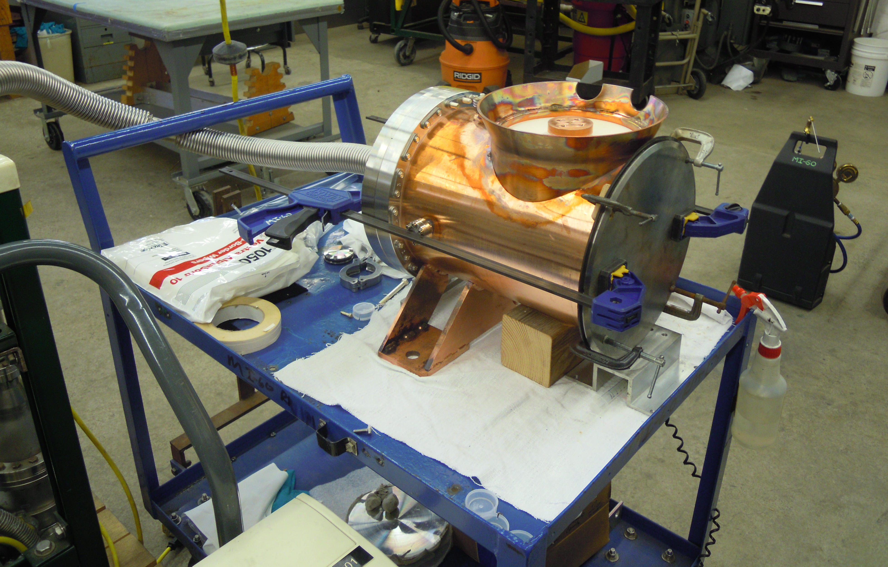
Window Leak Checking
Small vacuum leak discovered on window weld
Location pinpointed this morning
Welder to come Tuesday

Slide 9
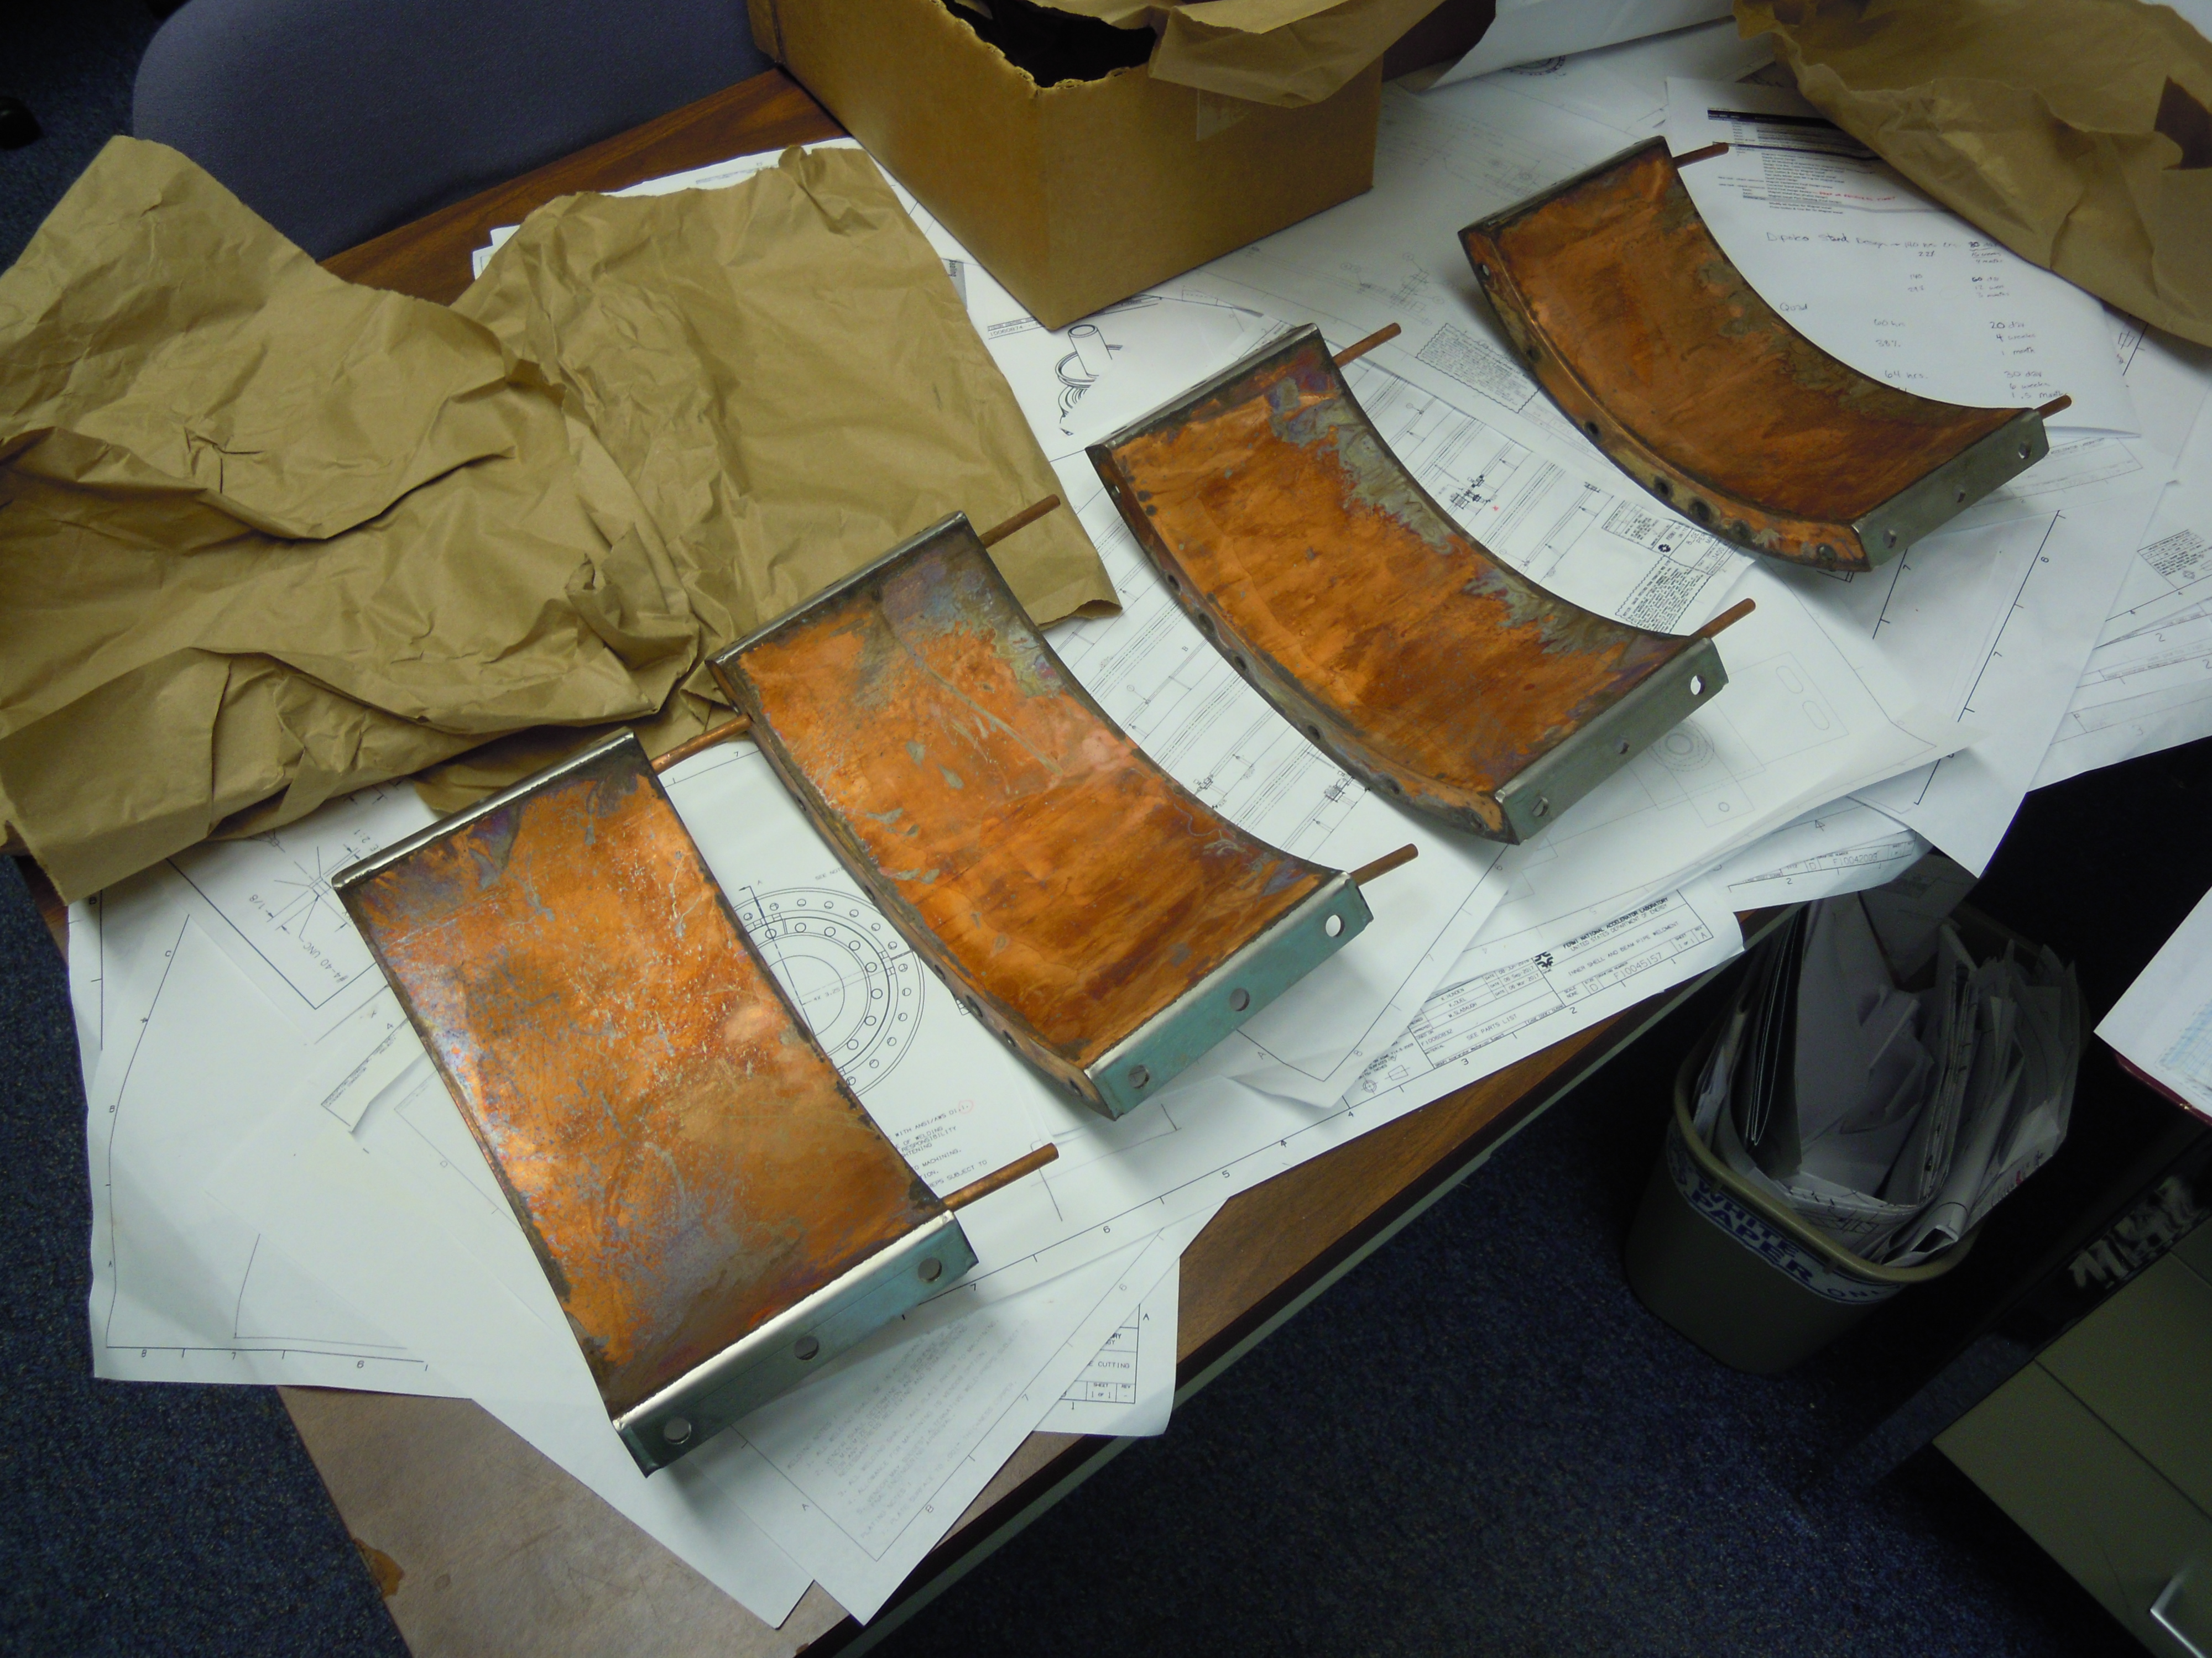
Outer Conductor Parts Plated
Significant amount of oxidation to be removed

Slide 10
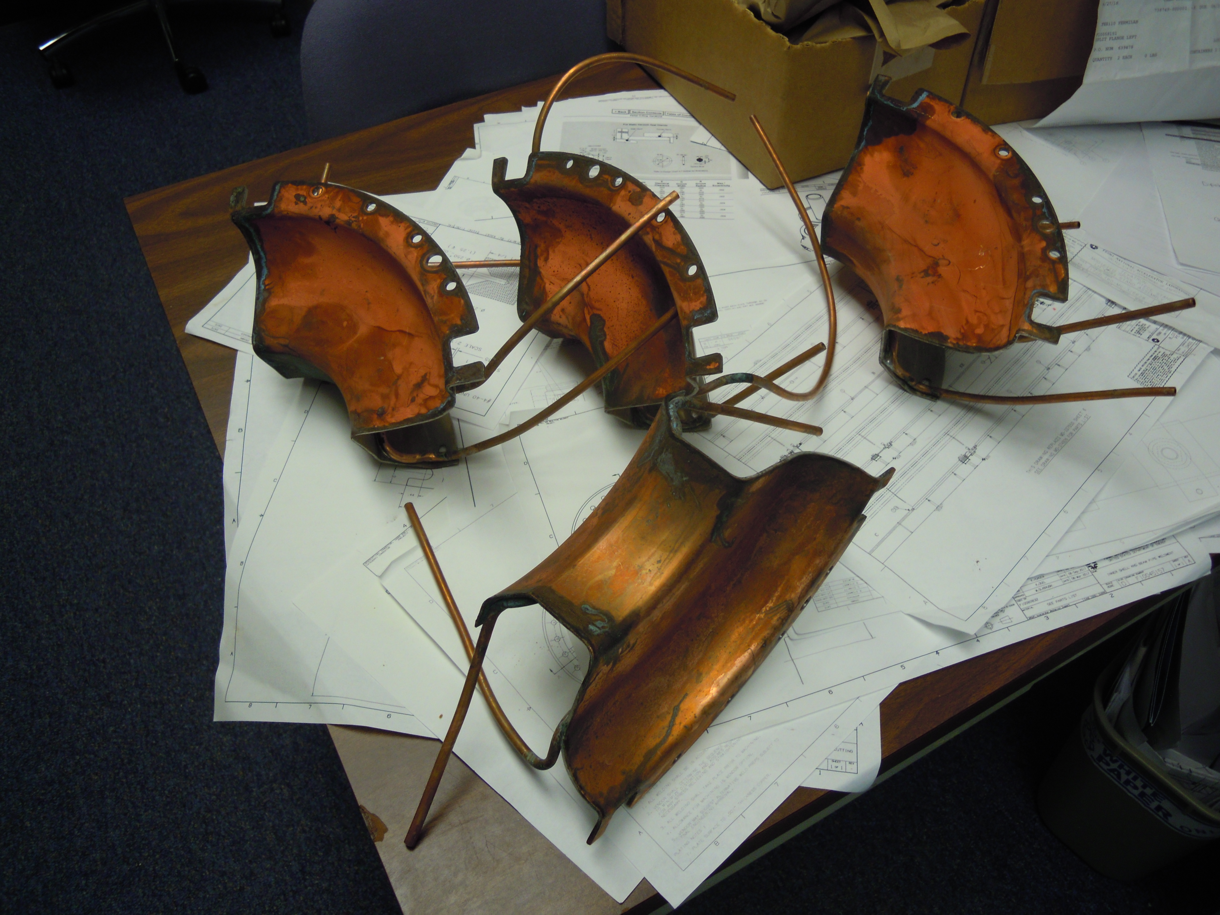
Outer Conductor Parts Plated
Significant amount of oxidation to be removed

