Slide 1
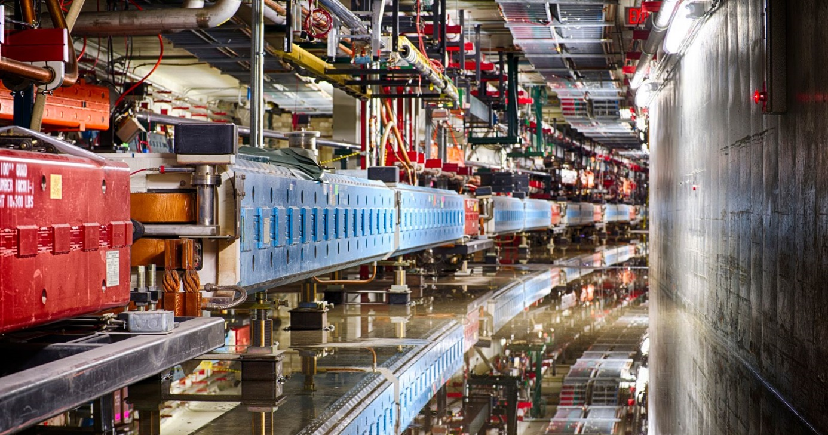
Accelerator Resources for Users
Bob Zwaska
Fermilab Users Meeting
21 June 2018

Slide 2
Introduction
Accelerator Division (AD)
  Vision & Mission
  Accelerator Complex
  Leadership
  Organization
Gaining Access to AD and its Resources
Research and Test Accelerators
Important non-AD Resources for Accelerators

Slide 3
Accelerator Division (AD), by the book
https://ad.fnal.gov/
Fermilab's Accelerator Division operates, maintains, and improves the laboratory's accelerator complex, beam lines and beam targets.
Our vision is to build and operate megawatt particle beams that will enable the science goals outlined in the 2014 Particle Physics Project Prioritization Panel (P5) report.
Our mission is to drive scientific discovery by:
  delivering particle beams for scientific research;
  conducting accelerator physics research;
  designing and building accelerators to extend the scientific reach of existing facilities.

Slide 4
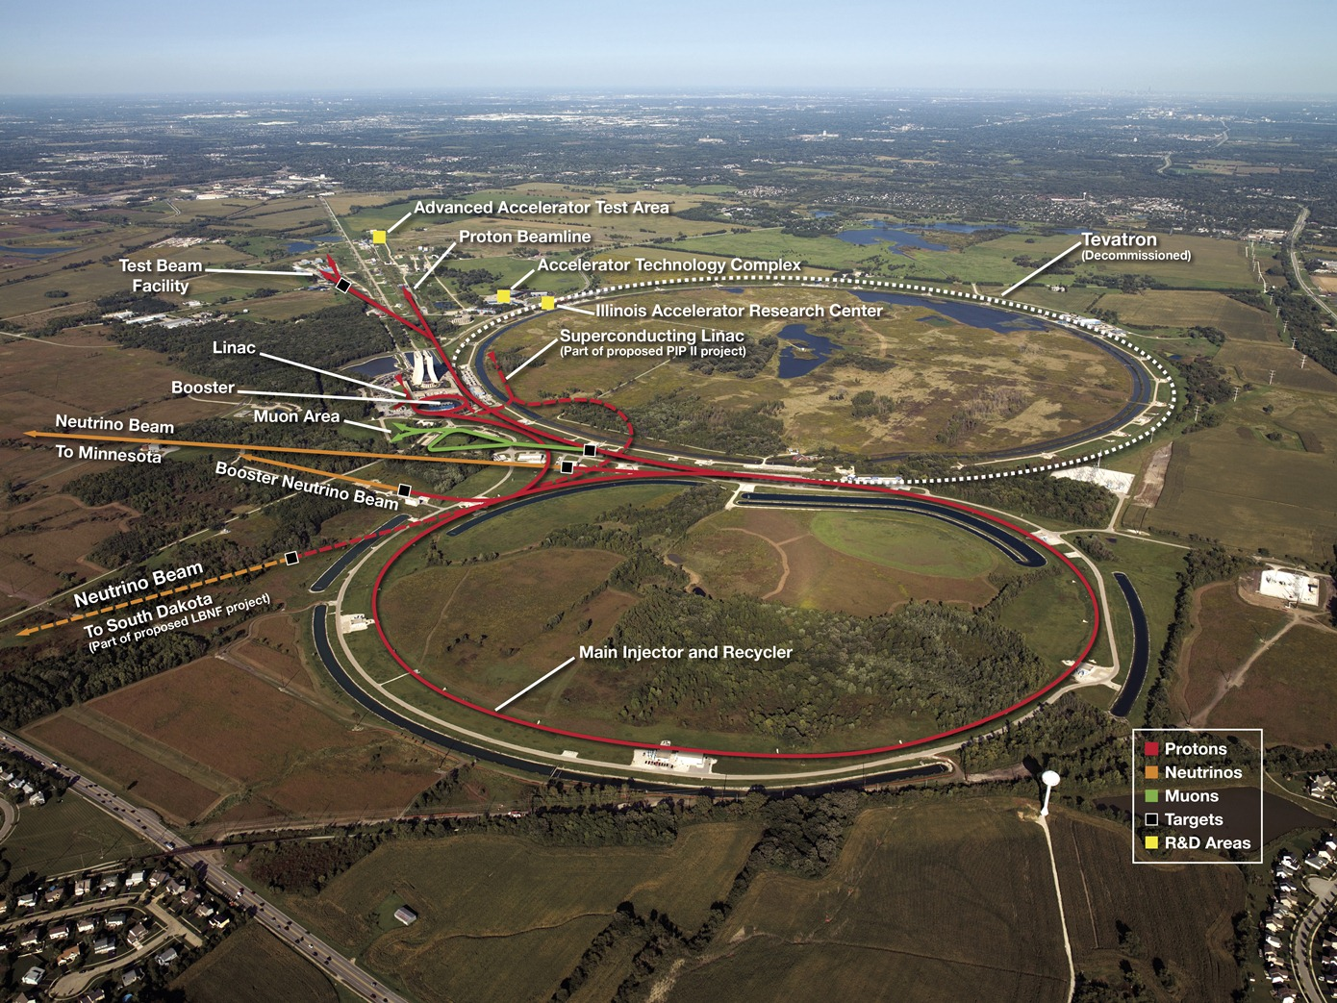
Fermilab Accelerator Complex

Slide 5
Role of the Accelerator Division
Operating the Fermilab accelerator complex
  700 kW NuMI Neutrino beam
  Booster Neutrino Beam
  Muon Source for g-2
  Switchyard program for test beams
Improving the accelerator complex
  Proton Improvement Plan
  Muon Campus projects (4 Accelerator Improvement Projects)
  900kW – 1 MW AIPs
Projects for the future: Mu2e, LBNF, PIP-II
Accelerator Research
Experimental Facility for accelerators (FAST/IOTA)
Commercialization of accelerator technologies (IARC)

Slide 6
Accelerator operations priorities for the next year
Complete the Proton Improvement Plan this shutdown
Deliver beam to NOvA at 700+ kW beam power
Meet beam delivery goals for the g-2 experiment
  Mu2e beam commissioning needs to start in 2020, setting the timescale to achieve a full dataset
Support test beam and E1039
Deliver beam to BNB experiments
Develop and execute Accelerator Improvement Projects (if approved) to increase beam power to NOvA to ~900 kW in 2021 and prepare for PIP-II

Slide 7
Program Planning - Experiments Run Schedule
NOvA will run until long shutdown planned for 2024-26
MicroBooNE may continue running, ICARUS to start in 2020
g-2 approved to run into 2020, when Mu2e starts commissioning
E1039 (SeaQuest with polarized target) starts next year
programplanning.fnal.gov/accelerator-and-experiments-schedule/

Slide 8
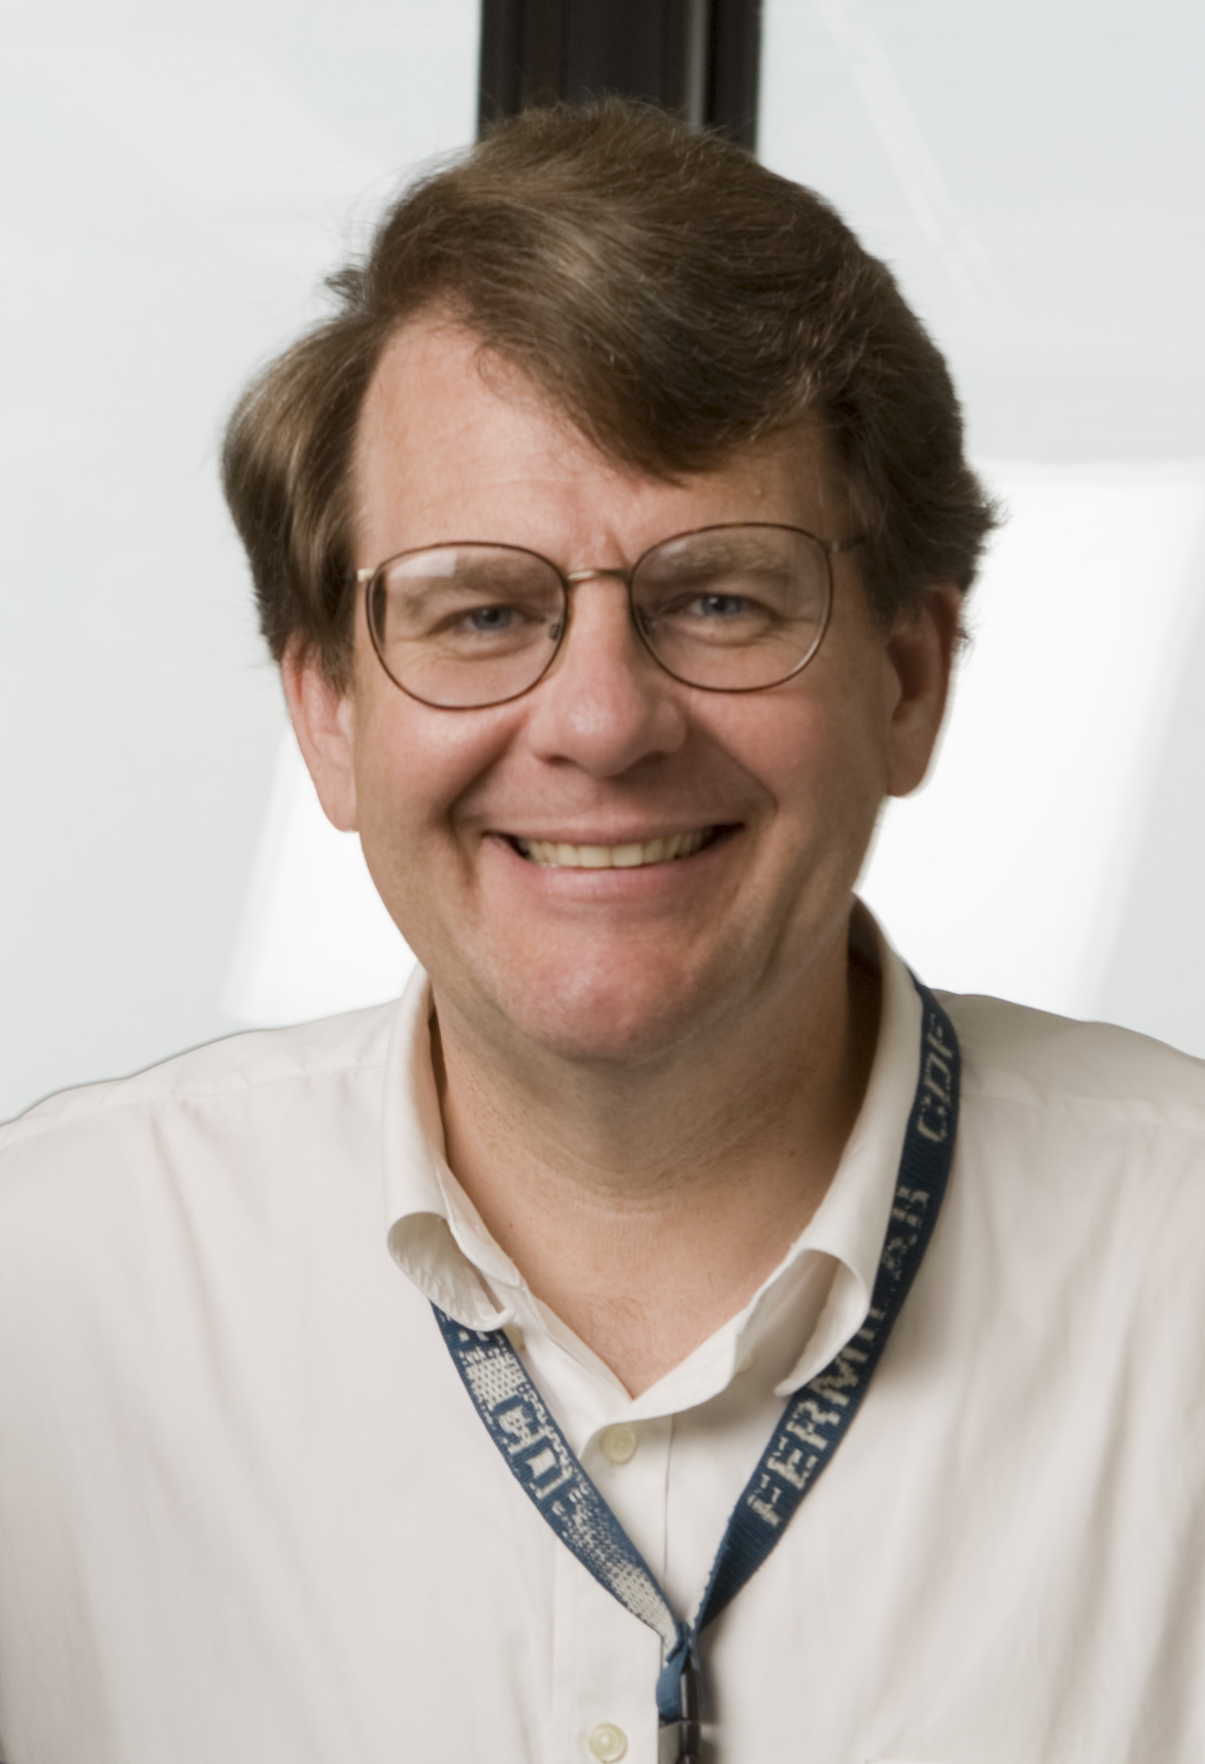
Leadership / HQ
Michael Lindgren
Accelerator Division Head
Previous Chief Project Officer
and PPD Head
Mary Convery, Deputy Head, Accelerator Systems
Paul Czarapata, Assoc Head, Engineering and Support
Vaia Papadimitriou, Assoc Head, LBNF
Vladimir Shiltsev, Assoc Head, Research, APC Director
Recent all-hands meeting: indico.fnal.gov/event/17153/

Slide 9
Division Organization

Slide 10
Division Departments
Accelerator Systems
  External Beamlines
  Main Injector
  Muon
  Operations
  Proton Source
  Target Systems
Accelerator Physics Center
  Host for FAST/IOTA, research, and physics support
Engineering and Support
  Accelerator Controls
  EE Support
  Engineering Support
  Instrumentation
  Mechanical Support
  RF
Projects mostly organized externally
  Mu2e, LBNF, PIP-II, etc.
  Labor matrixed into projects
  Some shared facilities (PIP2IT)

Slide 11
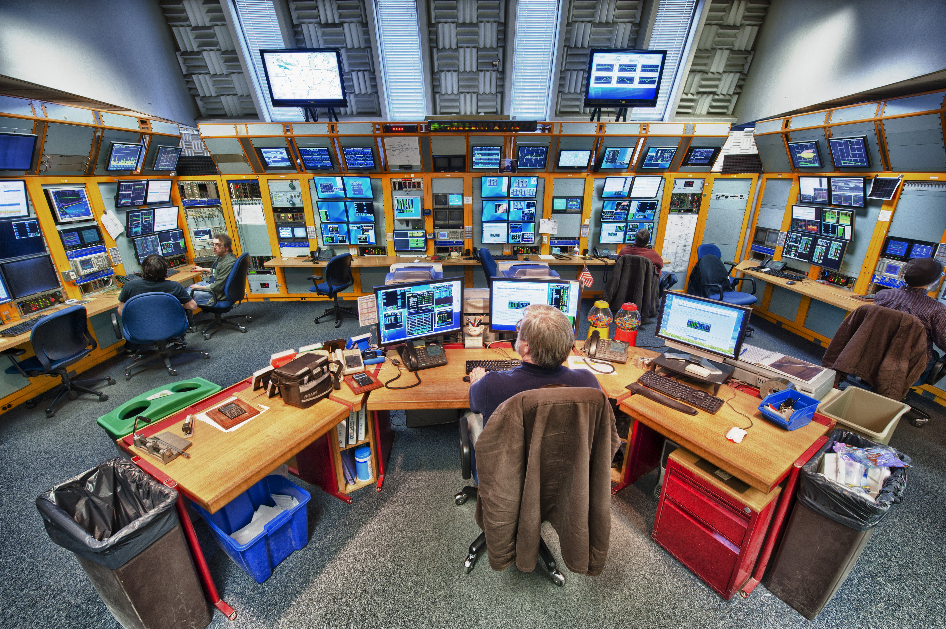
Operations / Main Control Room
operations.fnal.gov
Gateway to AD
  x3721
Key Checkout
LOTO point
Access forms
  RWPs
Best resource for up-to-date information
  Experiments can call if they need updates
Calendars and information on operations web page

Slide 12
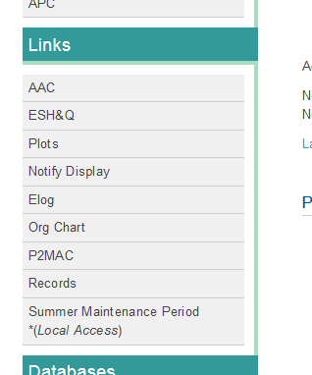
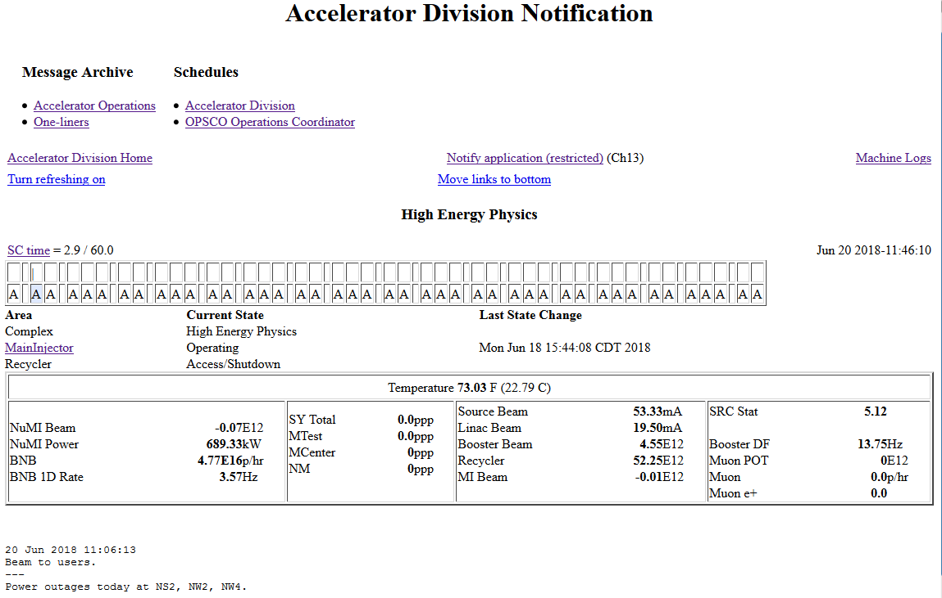
Notify / Channel 13
www-bd.fnal.gov/notifyservlet/www

Slide 13
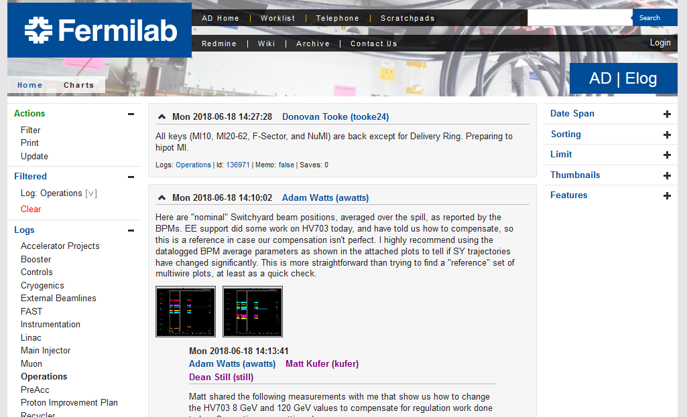
AD Logbook
www-bd.fnal.gov/Elog
One Logbook – click operations

Slide 14
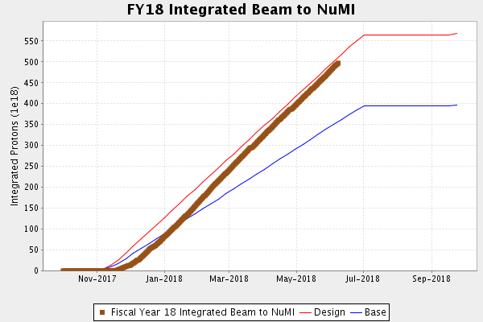
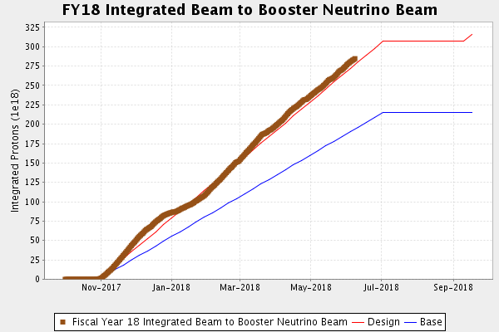
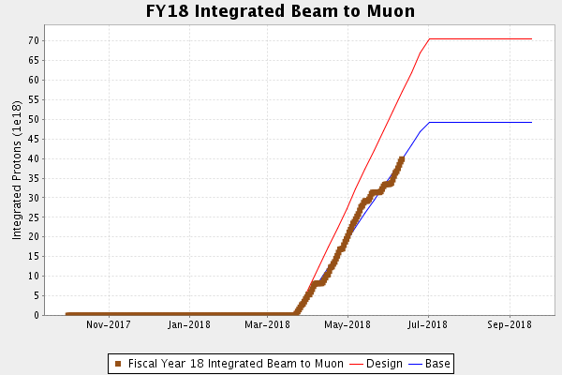
Performance Plots www-bd.fnal.gov/FixedTargetPlots/today/ProtonPlots.html

Slide 15
Meetings to find AD People
AD Operations Meetings
  indico.fnal.gov/category/42
  Weekly open summary meeting, Fridays at 9am, 1 West (usually)
  Internal Planning Meetings
    During beam operations: Mondays and Wednesdays, 9am, Huddle
    During shutdowns Tuesdays at 9am, Huddle
All-Experimenters Meetings, Mondays at 4:00pm, Curia II
  indico.fnal.gov/event/17358
PMGs
  Proton PMG organized around AD issues, 1st Thursday of the month, 1pm
  indico.fnal.gov/category/60
  Numerous project-specific PMGs

Slide 16
FAST/IOTA : Accelerator R&D Facility
fast.fnal.gov
The Fermilab Accelerator Science and Technology (FAST) facility contains 3 components
  150-300 MeV Electron Injector
  70 MeV/c Proton Injector
  IOTA Ring capable of operation with e- and p+
    Integrable Optics Test Accelerator
Platform for accelerator physics research, developing into a user facility

Slide 17
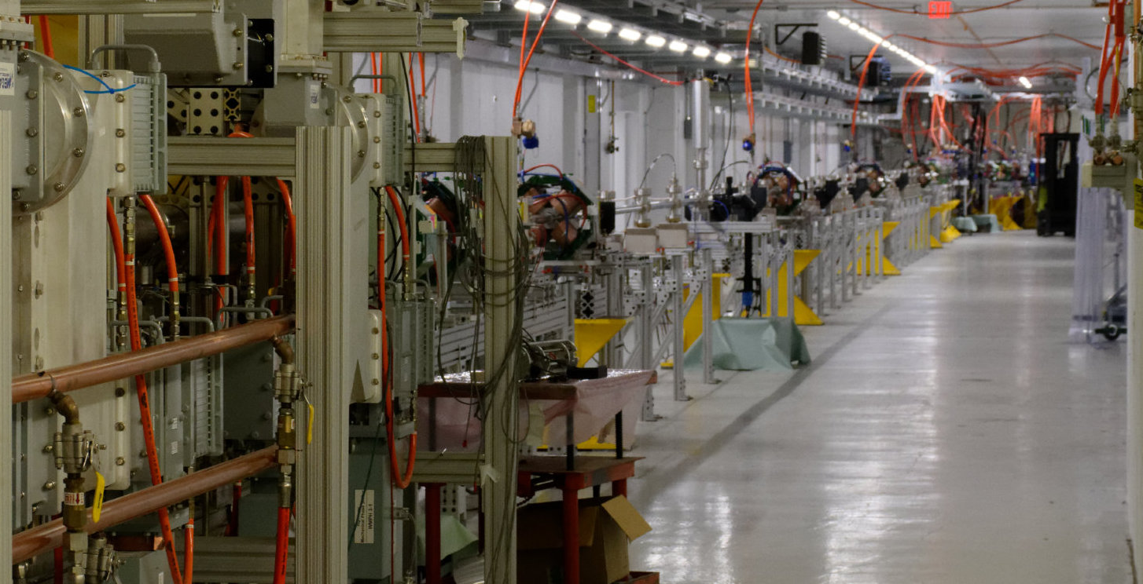
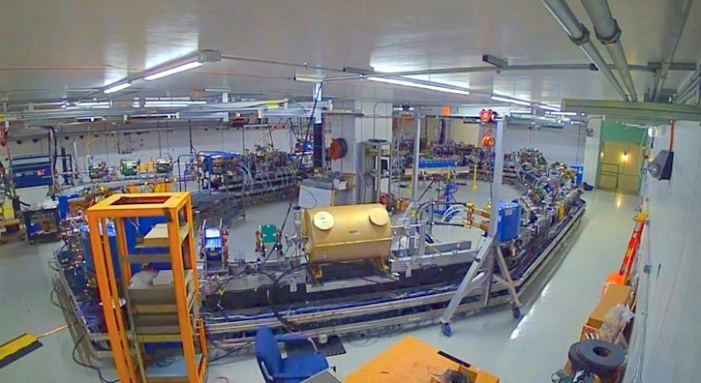
FAST/IOTA
fast.fnal.gov
FAST electron linac complete in 2017, had 2-month experimental run
  IOTA injector commissioning
    For the first time, beam accelerated through ILC-type cryomodule to energy 150 MeV in October 2017
    Achievement of 300 MeV beam in SRF linac
  Collaboration-driven accelerator-physics experimental program with uptime over 85%
IOTA construction near completion with commissioning to begin in July-August
Annual collaboration Meeting (held in conjunction with megawatt workshop)
  indico.fnal.gov/event/16269
IOTA
FAST

Slide 18












RaDIATE
Collaboration
Radiation Damage In Accelerator Target Environments
radiate.fnal.gov
Broad aims are threefold:
to generate new and useful materials data for application within the accelerator and fission/fusion communities
to recruit and develop new scientific and engineering experts who can cross the boundaries between these communities
to initiate and coordinate a continuing synergy between research in these communities, benefitting both proton accelerator applications in science and industry and carbon-free energy technologies

Slide 19
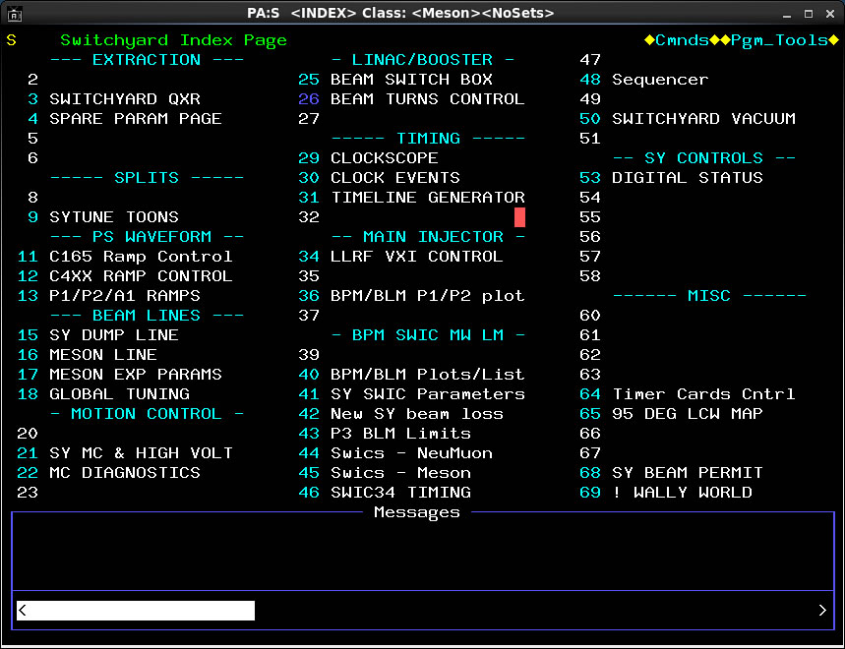
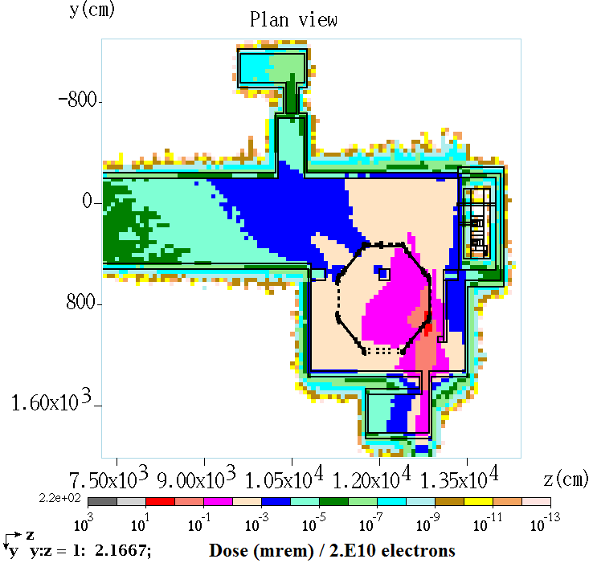
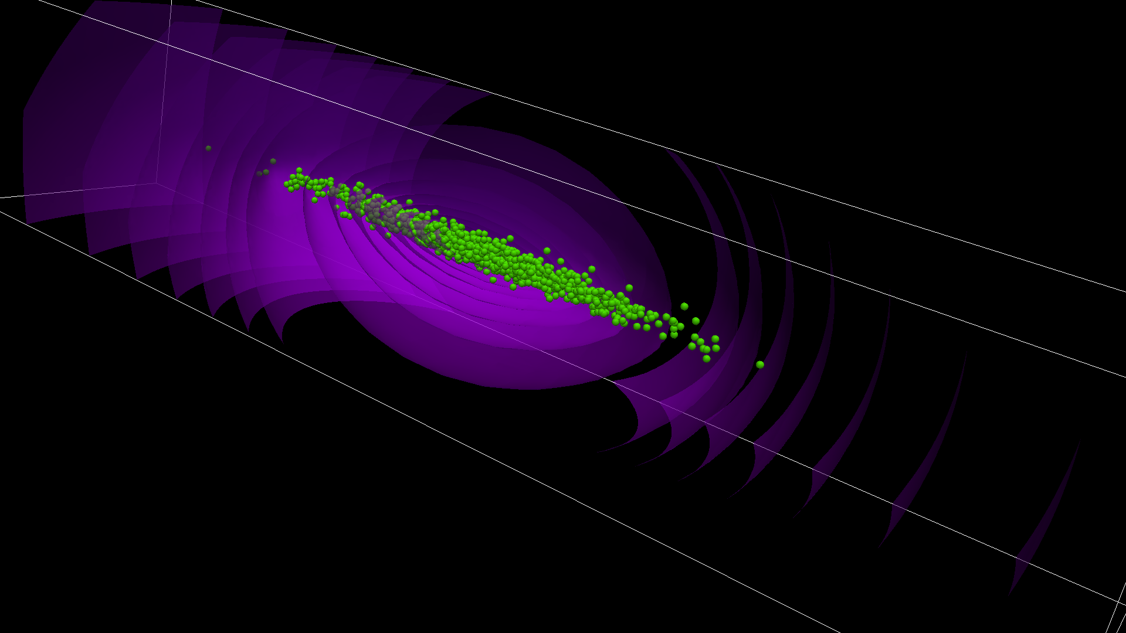
Computing
Accelerator Controls Network (ACNET)
  Expansive system of devices, databases, and interfaces
  Available for experimenters to extract information from AD, or to use directly on experiments
  www-bd.fnal.gov/controls
MARS: Particle production and interaction simulation
Actively used and developed suite for particle interaction simulations
  mars.fnal.gov
Accelerator Simulation
  Many individual sources within AD and SCD
  Synergia is a prepared package of accelerator tools
    web.fnal.gov/sites/Synergia/SitePages/Synergia%20Home.aspx

Slide 20
Accelerator Science and Education
Accelerator Science initiative within the office of the Chief Research Officer
  Headed by Sergei Nagaitsev
  Coordinate Fermilab efforts on accelerator science and technology, and also reach out to non-HEP applications of accelerators
Accelerator Physics and Technology Seminars
  Tuesdays (and sometimes Thursdays) at 4pm in 1 West
  www-bd.fnal.gov/ADSeminars
United States Particle Accelerator School - uspas.fnal.gov
  Two university-credit programs per year
Accelerator PhD Program
  Supports university students to become resident at Fermilab and perform accelerator research
  Budker Seminars to hone our young accelerator professionals
Internship Programs - ed.fnal.gov/interns
  Lee Teng program (joint with Argonne) devoted to accelerator science and engineering

Slide 21
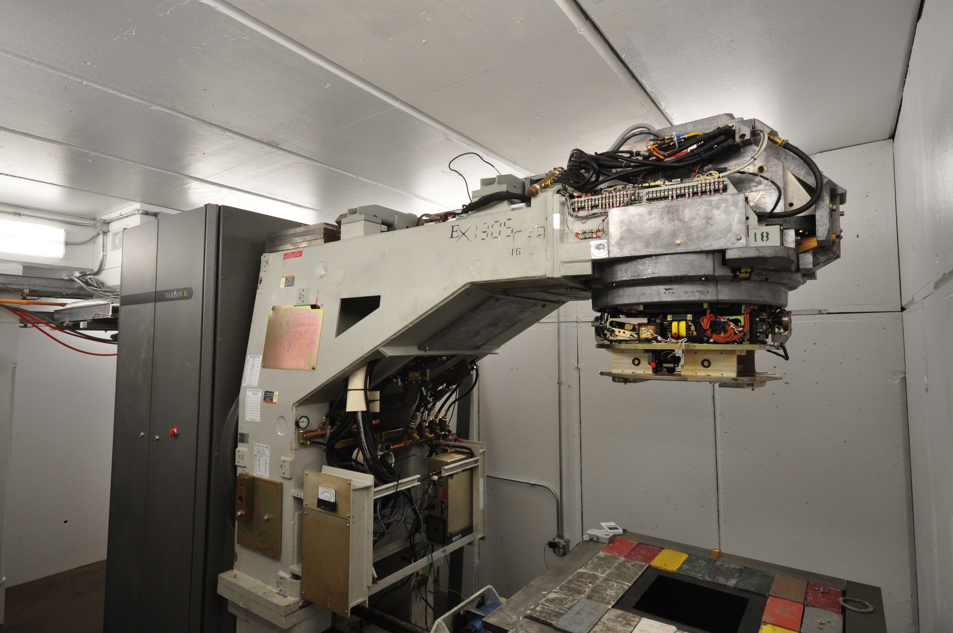
Accelerator Application Development and Demonstration (A2D2):
A 9 MeV electron source at IARC
iarc.fnal.gov
Investigate new uses of electron beams
Flexible beam parameters
Fast turn-around (samples)
X-ray mode available
Collimator (Fully Open)
Position 1
Position 2
Position 3
Demonstrated 1 kW operation @ 1 mA
Contact: Tom Kroc, J. Thangaraj
Position 4
Setting | Power, Watts | Dose, kGy/g
1 | 200 | 0.22
2 | 400 | 0.43
3 | 600 | 0.65
4 | 800 | 0.87
5 | 1000 | 1.08
6 | 1200 | 1.3
Position | Beam Diameter, cm
1 | 4.8
2 | 5.7
3 | 7.1
4 | 10.3
5 | 12.6
Position 5

Slide 22
Accelerator Resources for Users
Bob Zwaska
Fermilab Users Meeting
21 June 2018

