Slide 1
Empty cavity.
Gennady Romanov
2nd Harmonic cavity meeting
July 19, 2018

Slide 2
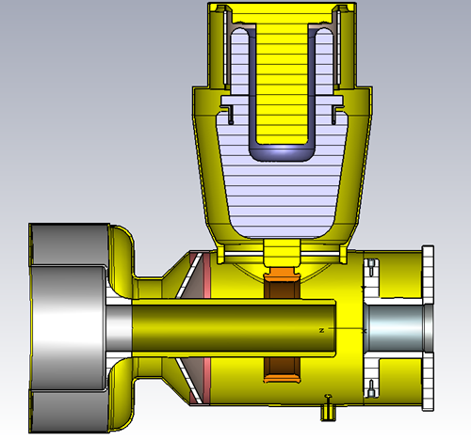
Empty cavity without ports
Model without HOM ports, all is copper except Al₂O₃
Mode | F, MHz | Q
1 | 120.5 | 6070
2 | 171.1 | 5242
3 | 268.1 | 5632
|E|
|H|

Slide 3
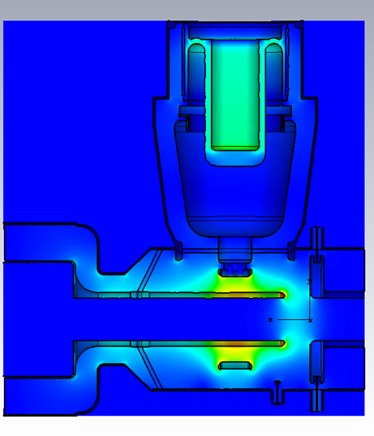
Empty cavity with HOM ports
Model with HOM ports, all is copper except Al₂O₃
Mode | F, MHz | Q | Q_ext
1 | 120.4 | 6079 | 1392
2 | 170.7 | 5225 | 0.6449
4 | 268.3 | 5807 | 862.3

Slide 4
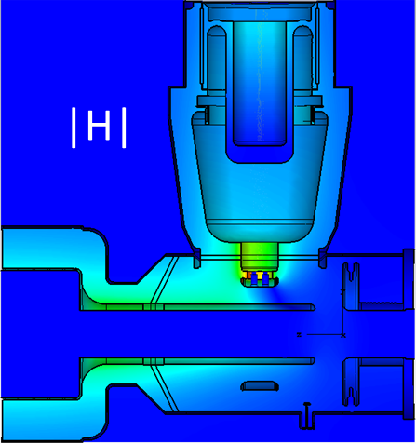
The cavity without ports, operating mode
Empty
With garnet

Slide 5
The cavity without ports, 2nd mode
|E|
Empty
171 MHz
Q=4962
|H|
H
Log scale
|E|
H
|H|
Uniform garnet
µ = 4, tanδ = 0.00026
116 MHz
Q=2969

Slide 6
Tests on July 9:
Rocky and Ryan removed the coupling ring and fruitbowl. So we now have only the cavity center conductor, outer conductor, and empty PA volume (with window). Open end and PA volume are blanked off.
In this case Q ~ 2900. Only loosening the bolts in Joint 2 seems to affect the Q. This is surprising. See ppt for details.
Ding simulated the empty cavity in HFSS:
1.) With coupler ring and with big tapered center conductor, f: 110.87 MHz, Q 7385
2.) Without coupler ring and with big tapered center conductor, f: 141.59 MHz, Q 9002
3.) Without coupler ring and without big tapered center conductor, f: 143.624 MHz, Q 9017
1.) For the first case, the PA geometry is probably not exactly the same as Ding simulated
We measured 120.68 MHz and Q=2000. Gennady had predicted 120.5 MHz and Q=6070.
2.) We didn't measure this case.
3.) f = 147.4 MHz Q=2900. Again 3x too small. (Any difference in PA geometry matters less here)
empty_nopa_7_8.pptx

Slide 7
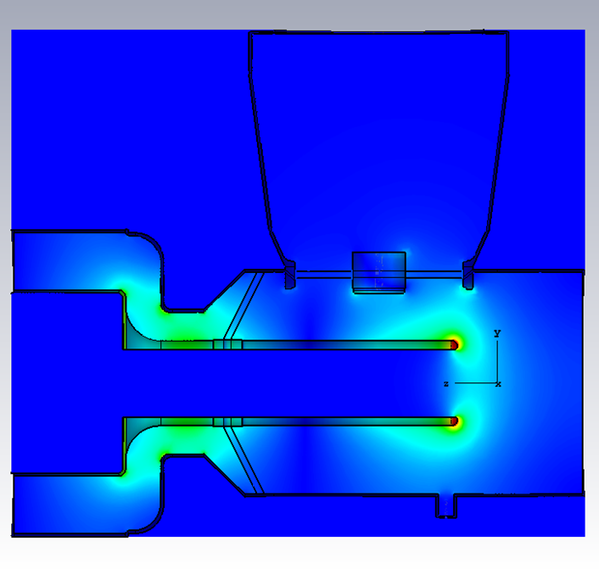
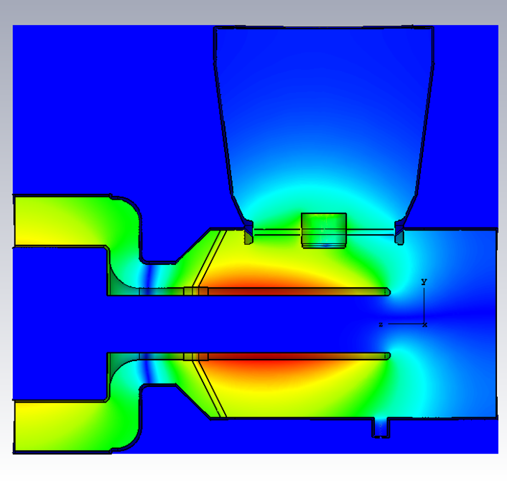
Very empty cavity
Mode 1 |E|
Mode 1 |H|
F1 = 148.04 MHz
Q1 = 8000
(losses in alumina – 7%)
F2 = 345.0 MHz
Q2 = 14600
(losses in alumina – 10.5%)
Mode 2 |E|
Mode 2 |H|

