Slide 1
Where in the world are the relevant BNB accelerator timing signals?
Alyssa R Miller
External Beams Department

Slide 2
Signals BNB cares about and why
BES
BES + delay [? RFC/ns] = beam arrival time
BRF
Used to delay BES by 38-52 MHz cycles (RFC)
Delayed BES
= BES + BRF
TCLK
Events: $1D, sometimes $A9 (reflected MIBS $74) , $1F (reflected BES)
10 MHz, 100 ns instability
MIBS
Events: $74 (MI extraction to NuMI)
Locked to MIRF 52-53 MHz / 7 = ~7.5 MHz
BNB and NuMI RWMs
Leading edge is incoming beam

Slide 3
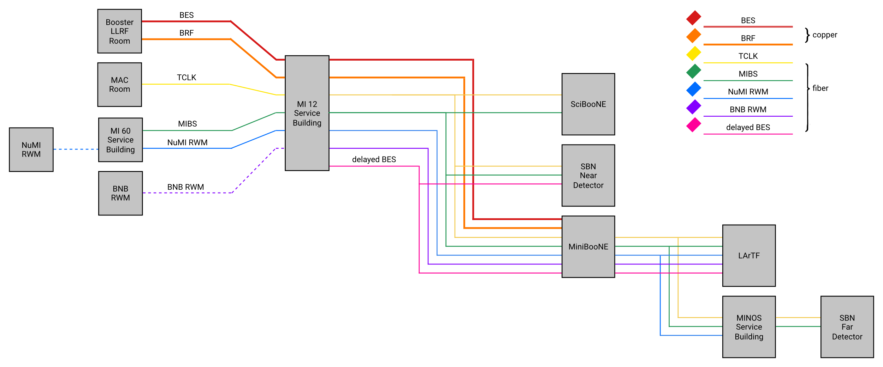
Where are these signals available?
Notes:
SciBooNE has MIBS and TCLK, but needs modules in the IRM to decode the clocks
MiniBooNE has MIBS but needs an IRM module to decode it

Slide 4
How do I use these signals?
TCLK and MIBS can be decoded and delayed by an IRM
Delays are settable on ACNET
All signal carrying modules accept lemo terminated cables
Notes:
Do I need to send a signal from a repeater into another module before using it for logic etc?

Slide 5
What availability is in the future?
BNB RWM, NuMI RWM, BES and BRF at all active experiment service buildings
On fiber
(TCLK and MIBS are already there)
Notes:
Greg says all these signals will be available in all the BNB experiment service buildings in the future, possibly via MFTUs?

Slide 6
What is an MFTU?
Paired with copper to fiber converter
4 inputs
6 outputs for (copies of) each input
MultiFunctional Timing Unit
Take converted fiber signals
4 inputs
+ 1 dedicated TCLK
Notes:
Dedicated clock inputs?
MFTUs taking in
BES, BRF, MIBS, TCLK

Slide 7
MFTU example: Bill Badgett’s setup (version 0x007)
Inputs
BRF
BES
(Unused trigger)
MIBS
TCLK
(1us pulsed HI output when done counting)
Special outputs:
15 A monitors BES
16 A monitors BRF
1
Outputs (Group A)
Channels 1-8
Armed on TCLK $1D
Hard coded
Trigger = BES
Clock = BRF
Count settable in ACNET
Fine delay enabled
0 - 255 ns settable in ACNET
Channels 9-14
Armed on TCLK $1D (presently)
16 different events settable on ACNET
Trigger = $1D
Same as arming signal
Set up like C377 timers
Clock = 1us counter synced with TCLK
Counts settable in ACNET
Fine delay not enabled
Channel 15
Monitor of BES
Channel 16
Monitor of BRF
Outputs (Group B)
Channels 1-8
Always armed
Trigger = MIBS $74
Clock is tick of MIBS CLK
~7.5 MHz
Count settable in ACNET
Fine delay not enabled
Channels 9-16
Armed on $1D
16 different events settable on ACNET
Trigger = $1D
Same as arming signal
Set up like C377 timers
Clock = 1us counter synced with TCLK
Counts settable in ACNET
Fine delay not enabled
Notes:
Others:
LArTF?
Inputs
Delayed BES
MIBS $74
BNB RWM
NuMI RWM
TCLK
IRM
TCLK
MIBS
MI 12 SB?
4 inputs
BES
BRF
MIBS
BNB RWM
+ TCLK
8 outputs (copies)
Each has individual settable delay on ACNET

