Slide 1
Booster DC studies: Adiabatic Beam Capture
Chandra Bhat, C. Y. Tan and V. Grzelak
20190131

Slide 2
Adiabatic Beam Capture Studies prior to Aug 2018
Did capture studies with 8 GeV ramp after correcting RF phase on individual stations. Summary of that study was (Beams Doc 6613).
Many PARAT curves were investigated.
Bill’s non-adiabatic PARAT gave the best efficiency.
Adiabatic PARAT gave smooth decrease in bunch length. But efficiency did not improve.
All PARAT curves showed bunch splitting in the early part of the capture process.
← This was a great puzzle.
Possibly many of these issues can be resolved by measurements on a DC Ramp in the Booster!

Slide 3
Planned Booster DC Study
First revisit the phases to individual RF stations. Next, conduct measurements in the DC mode (400 MeV)
Compare RFSUM responses with NO beam for cases with
Constant frequency, APG & a PARAT curves.
Balance the amplitude for two RF system at a time.
Measure RFSUM for
A1+B1, A1+B2, A1+B3 …etc., and similarly
A2+B1, A2+B1…etc.,
Measurements on beam capture under similar conditions as above, but,
Same number of A & B RF stations
Tune the PARAT curve for best capture
Goal: Response of individual RF system pairs to same para-phase curve
Goal: Understand capture process.

Slide 4
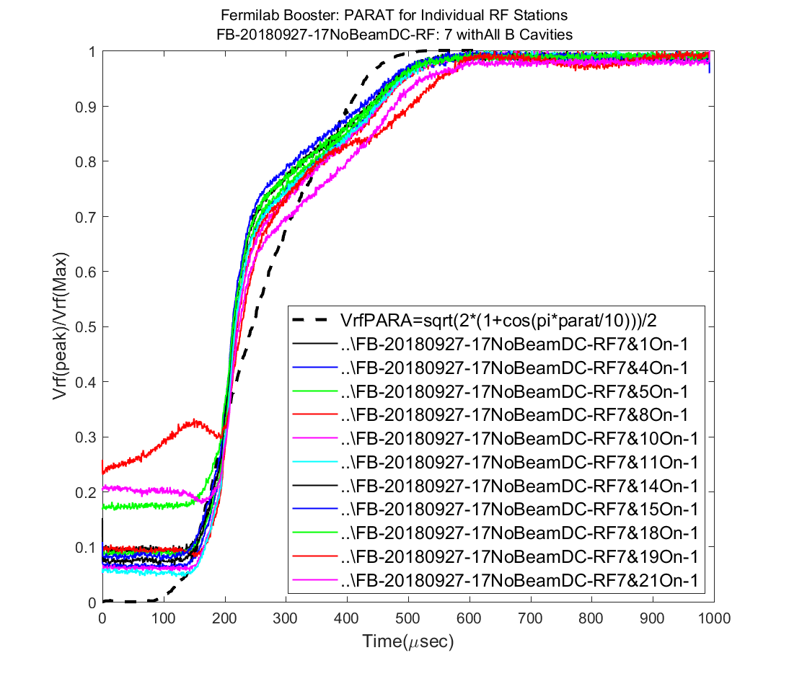
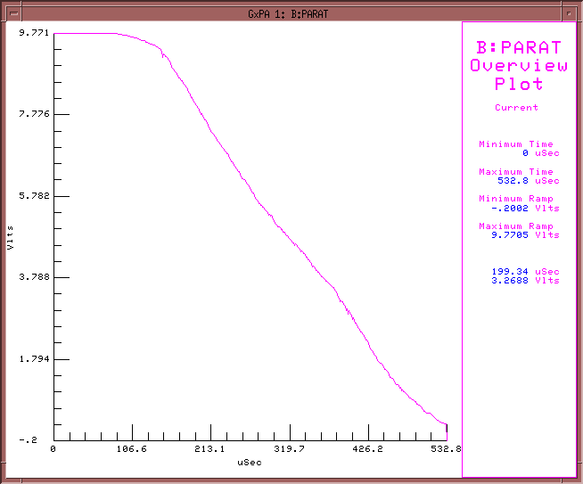
DC Measurements on two RF system at a time with NO Beam
18, 19 and 21 deviate significantly
Master Station 7(A) and 8(B)
Vc
θ
θ
Cavity 7(A) &
All “B” stations
Va
Vb
Vc (Relative Units)
Operational
PARAT

Slide 5
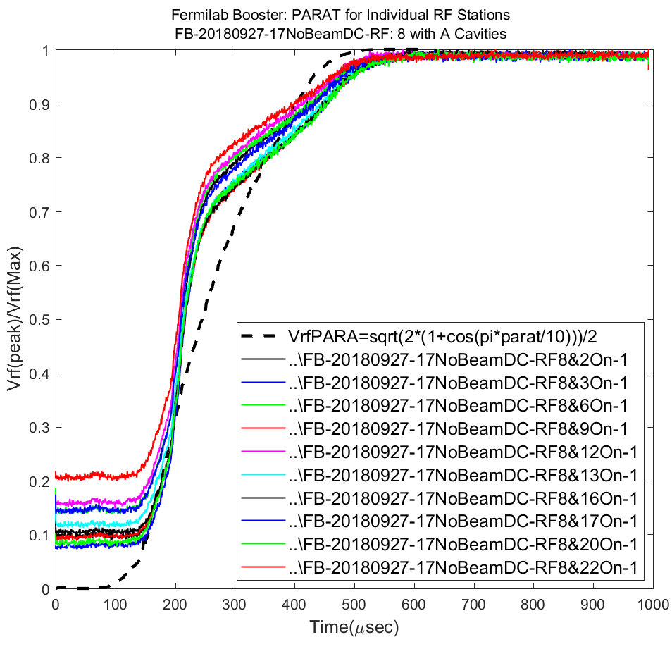
DC Measurements on two RF system at a time with NO Beam (cont.)
Measured Vrf did not follow a simple relation
Vc=Va*√(2*(1+cos(PARAT/PARATmax)))
Stations 18, 19, and 21 deviate noticeably.
Then data showed that implementing a calculated adiabatic PATAT curve in operation is not straight forward.
A PARAT curve developed for a combination of RF stations need not be ideal for some other combinations.
Cavity 8(B) &
All “A” stations
Vc (Relative Units)
Lesson Learnt: Global para-phase control and Vector balancing is not sufficient.
A new hardware is needed to control both locally & globally for adiabatic capture.

Slide 6
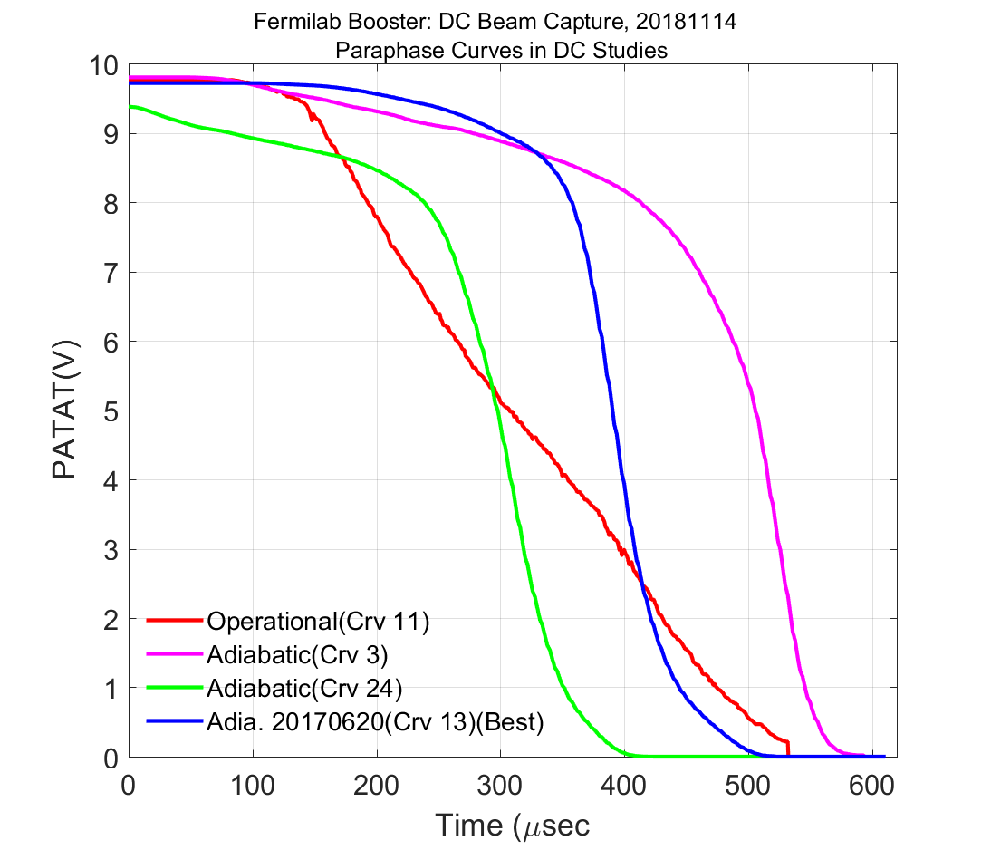
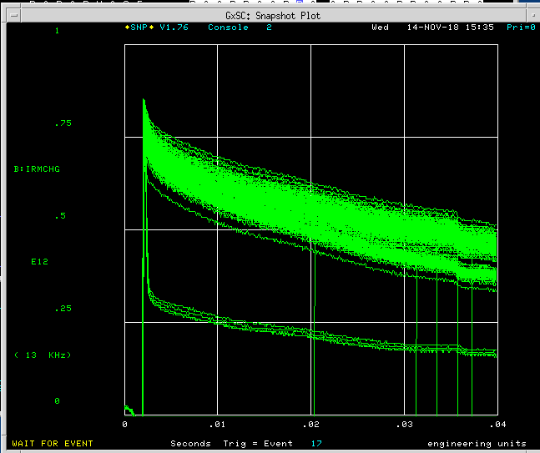
Beam Capture in DC Ramp
20 rf stations:
10 stations each for A & B.
Constant frequency curve
frf =B:INJFRQ
Constant APG curve
Feedback turned off
Disabled B:VAPLON & B:TFBON
Varied
PARAT curves
B:VXTPPP, B:PC1OFF B:CRVDLY, B:POTAIN, B:POTBIN.
Global balancer ON and OFF
Paraphase Curves used for 20181114 DC studies
3 Booster turn

Slide 7
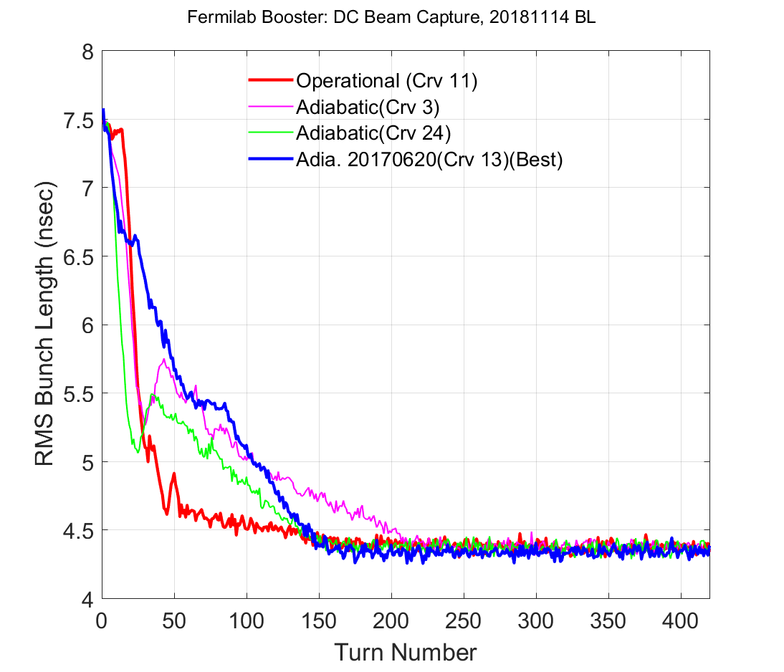
Comparison of Bunch Lengths for different PARAT

Slide 8
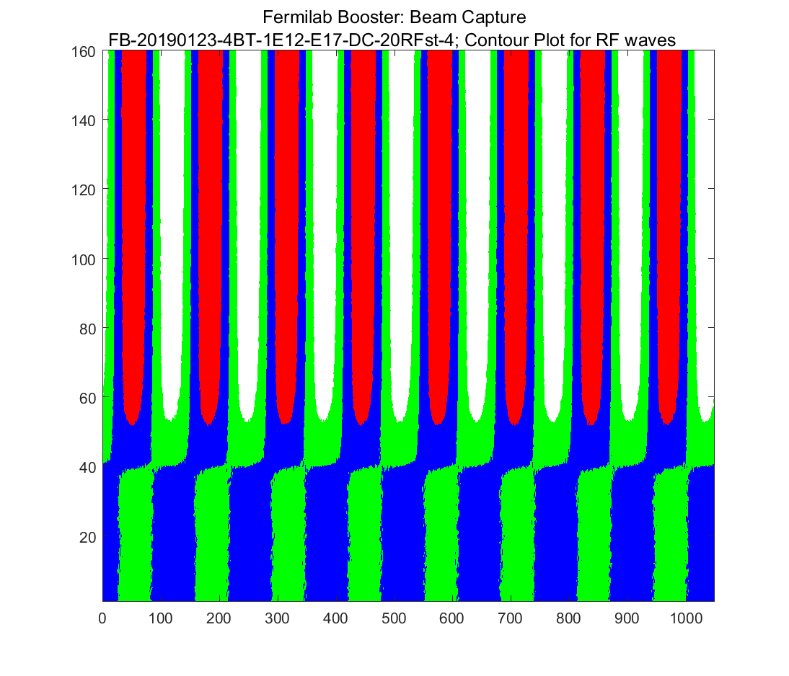
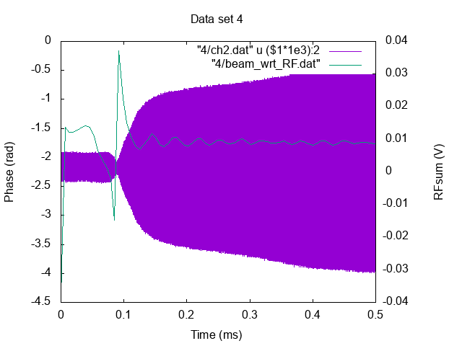
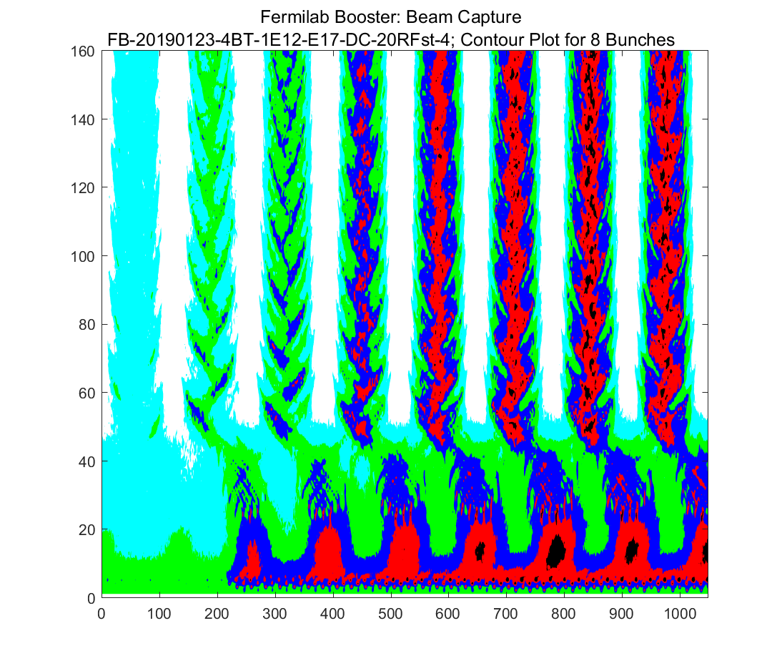
Note: the neck makes a phase jump?
Global balance OFF/ON
Phase jump
Vrf
WCM
For whatever reason, the neck makes the beam take a phase jump.
Is this real? YES! See waterfall plot of injection.
The data without the PC1OFF correction to make it smooth sees this problem.

Slide 9
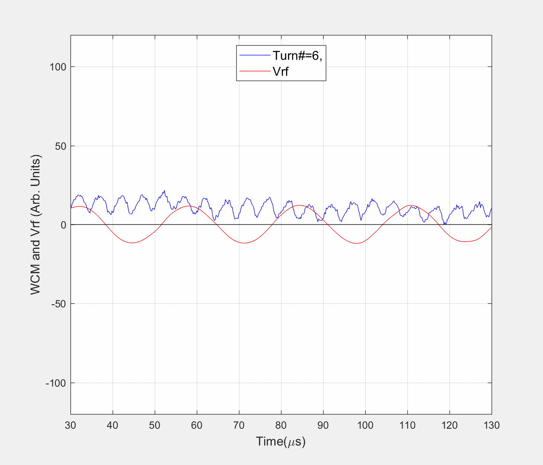
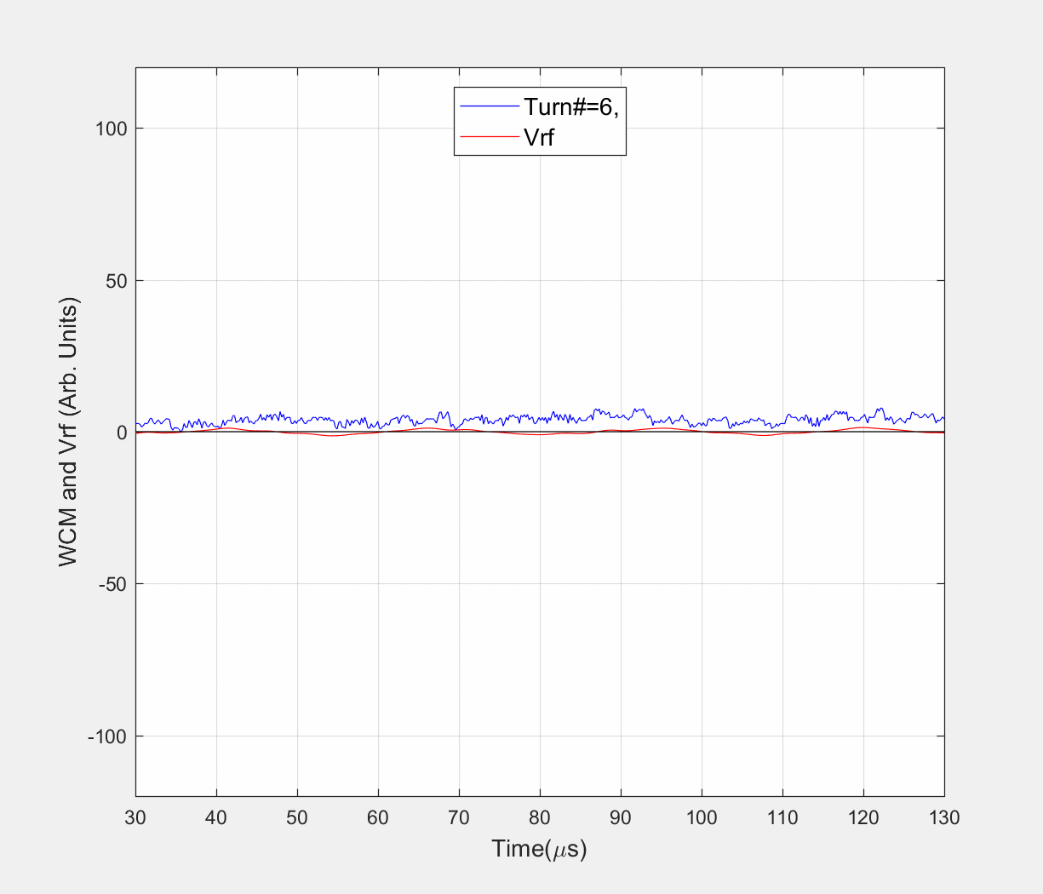
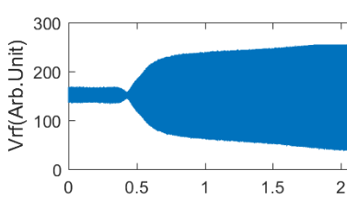
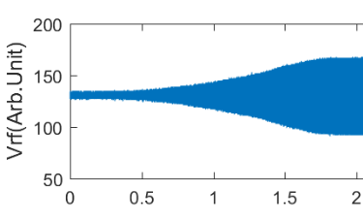
What is going on during the Beam Capture?
Capture with Operational Paraphase Curve
Capture with Adiabatic Paraphase Curve
FB-20190123-4BT-1E12-E17-DC-20RFst-4
FB-20181114-DC-6
No “NECK”
Vrf
Vrf
Time(ns)
Time(ns)
What was Expected?: In an ideal situation beam capture in DC mode the RF phase should not slip relative to bunch centroid.
Observations: We see two types of RF phase slip relative to the bunch centroid
fast and
slow
← How these are possible?

Slide 10
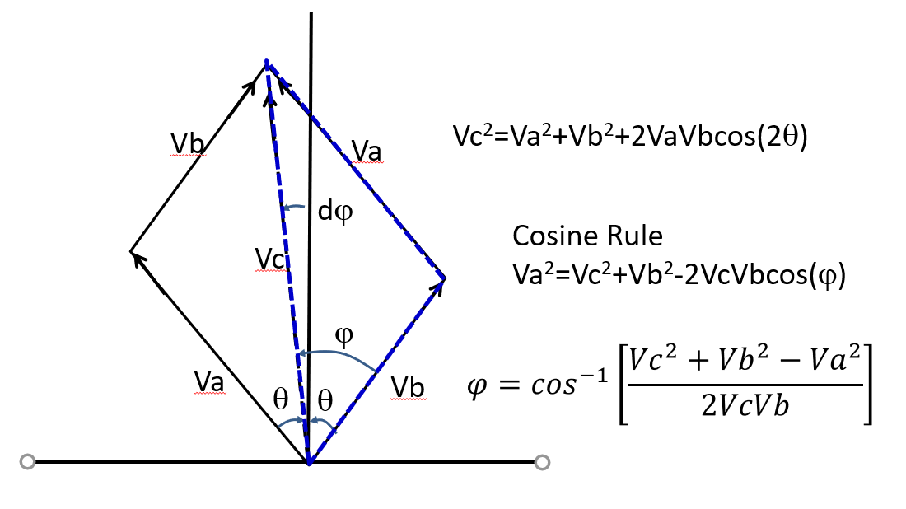
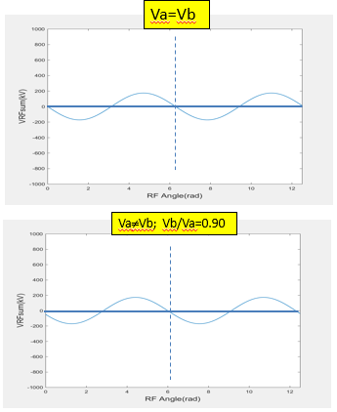
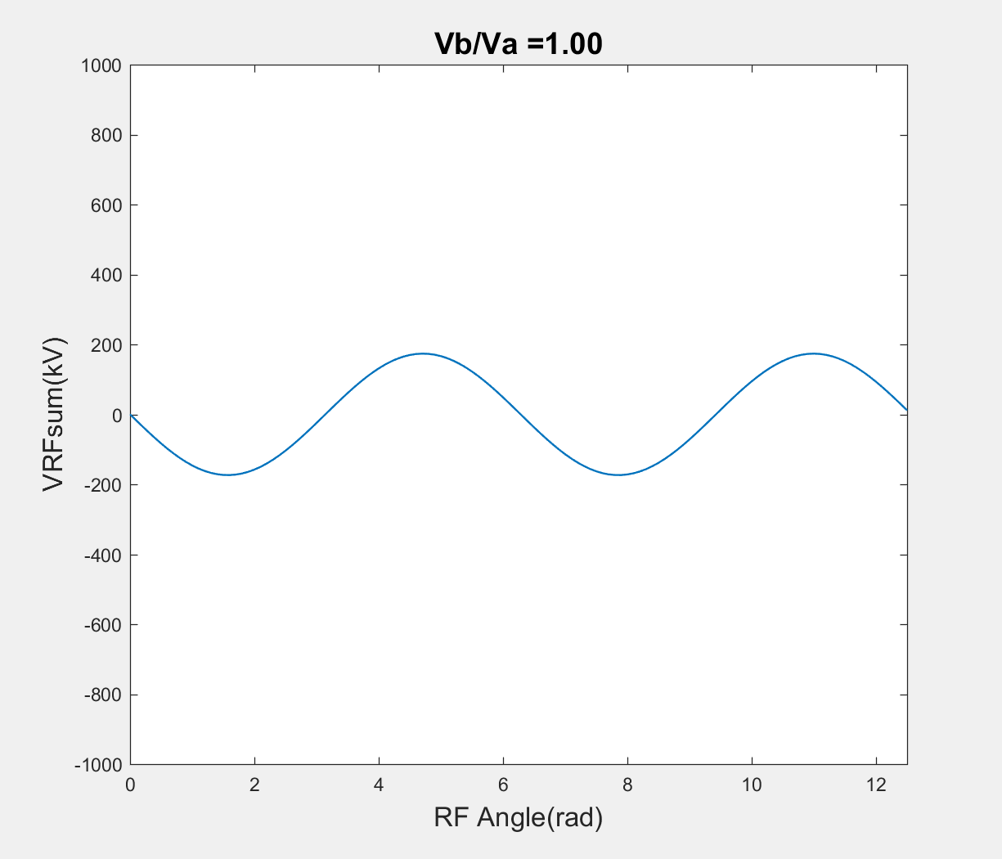
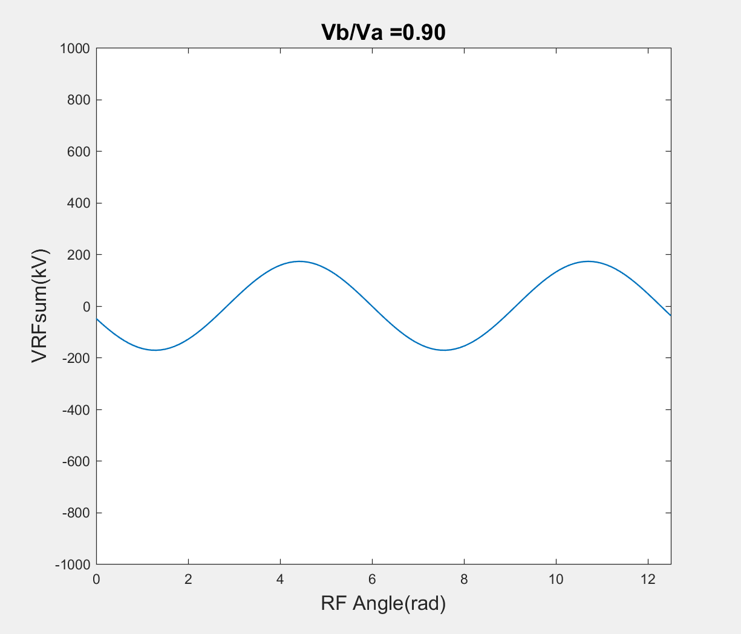
Possible Explanations
Va=Vb
Flipping Phase
Slipping Phase
&
Plipping Phase
If Va=Vb and |θ(start)| >90 deg then RF phase slips by 180 deg.
If Va≠Vb |θ(start)|=90 deg then the RF phase slips slowly by 90 deg and occurs till the end of the capture.
If Va≠Vb |θ(start)|>90 deg then both of these slips happens.
Va≠Vb; Vb/Va=0.90
This undesirable feature has a consequence during early part of the beam capture

Slide 11
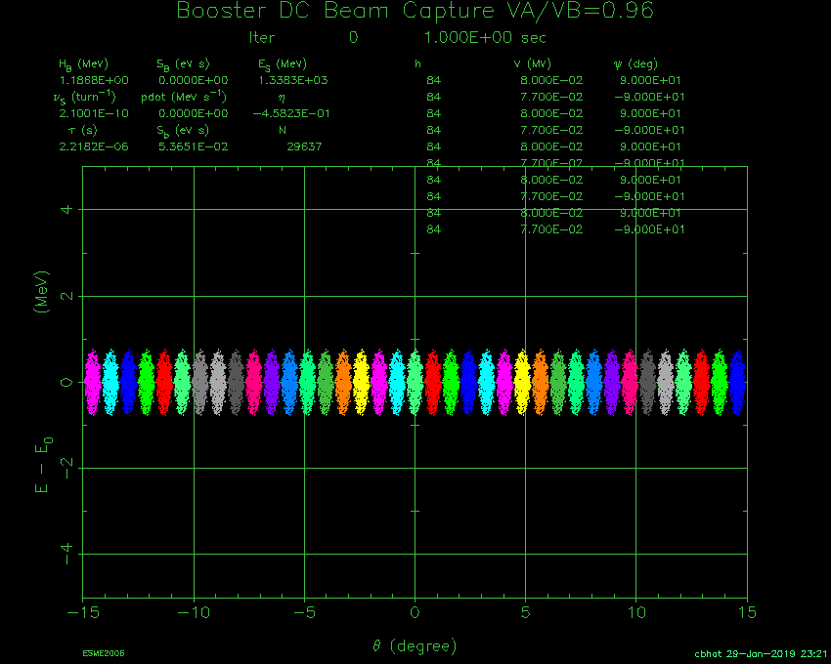
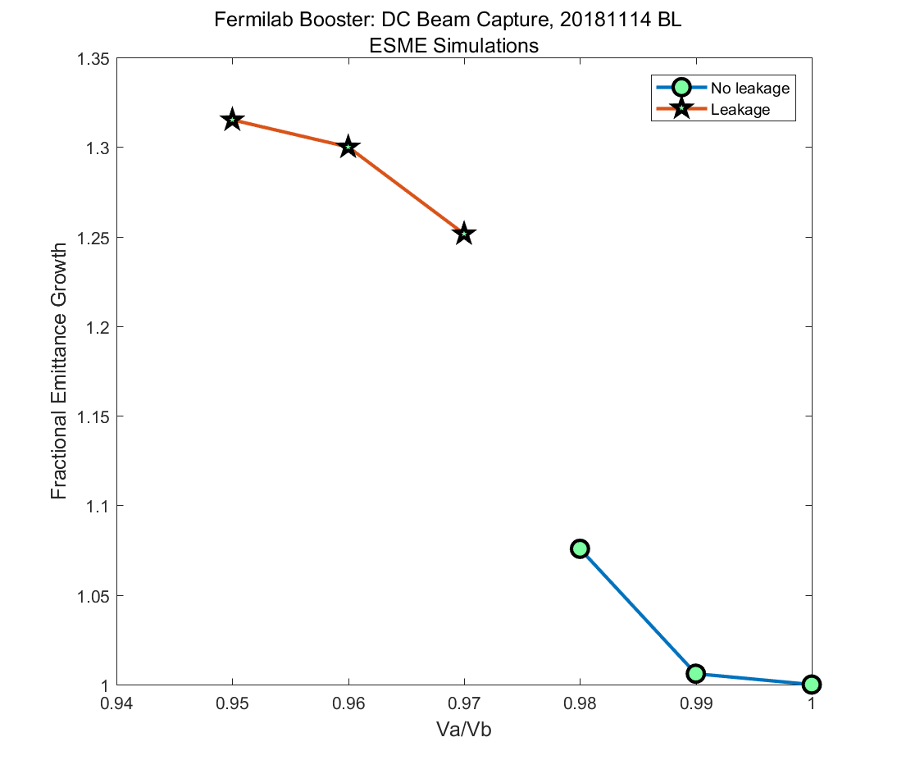
ESME Simulations DC Beam Capture
Va/Vb=1
Leaking beam particles
This result is good only for dE(Inj)~1.8 MeV
Beam acceleration
Va/Vb=0.96
Conclusions: For beam capture and acceleration without any losses one needs
Balancing between vectors A and B better than 1% locally and globally.
|θ(start)|≤90 deg.

Slide 12
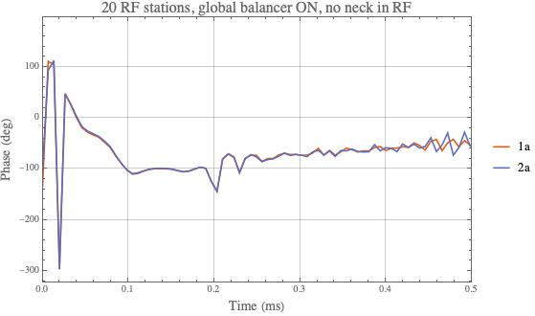
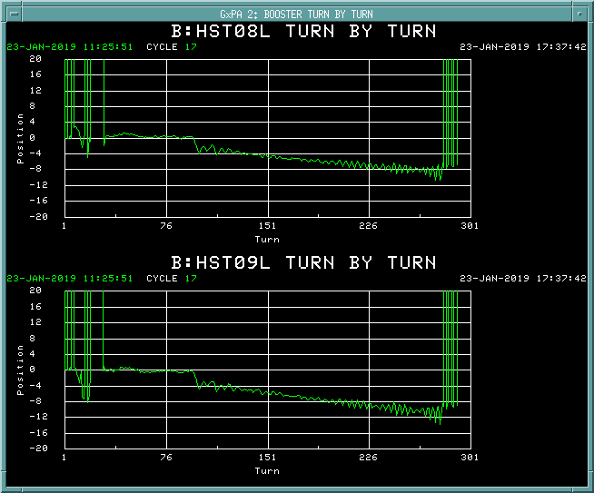
20 RF stations ON with global balancer ON (no neck)
The BPMs don’t seem to see this part of the phase slip. Not enough bunching?
Corroboration with BPM data.

Slide 13
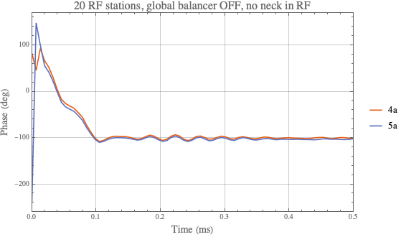
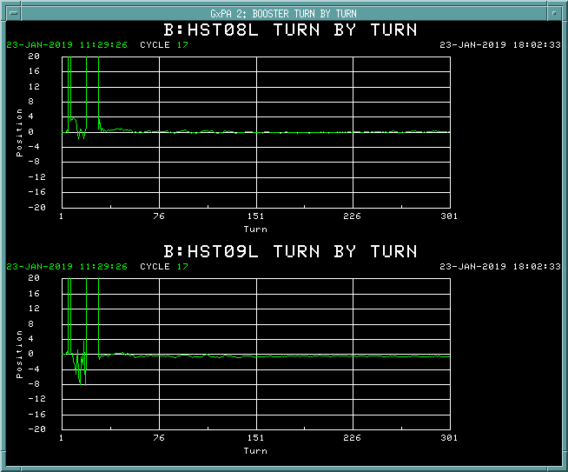
20 RF stations ON with global balancer OFF (no neck)
Note no change in phase or energy (from turn by turn).
But see the ripples that are seen in TBT and the phase measurement!

Slide 14
What Next?
DC studies in the Booster helped us to diagnose
Possible symptom for beam losses in the first 4-5 ms of the beam cycle.
Identifying and mitigating it is critical for the higher intensity operation of the Booster.
Possible issues in emittance dilution in early part of the acceleration cycle.
We need to improve
Balancer circuit for A and B cavities to control voltage and PARAT
Globally &
Locally
Paraphase angle between Vectors A & B should be ≤180 deg, capable of controlling better than 1deg (which depends on dp/p of the incoming beam).

Slide 15
Backup

Slide 16
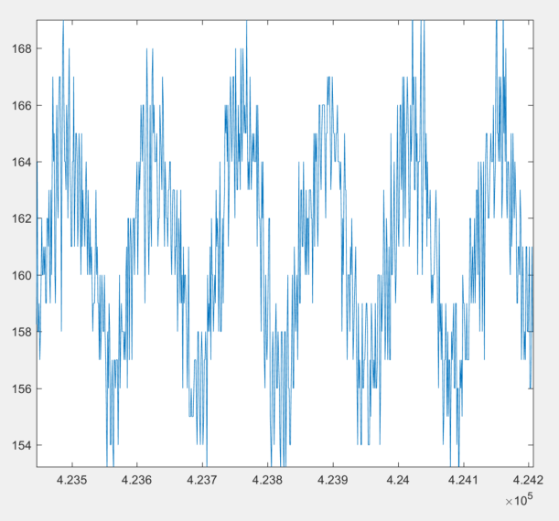
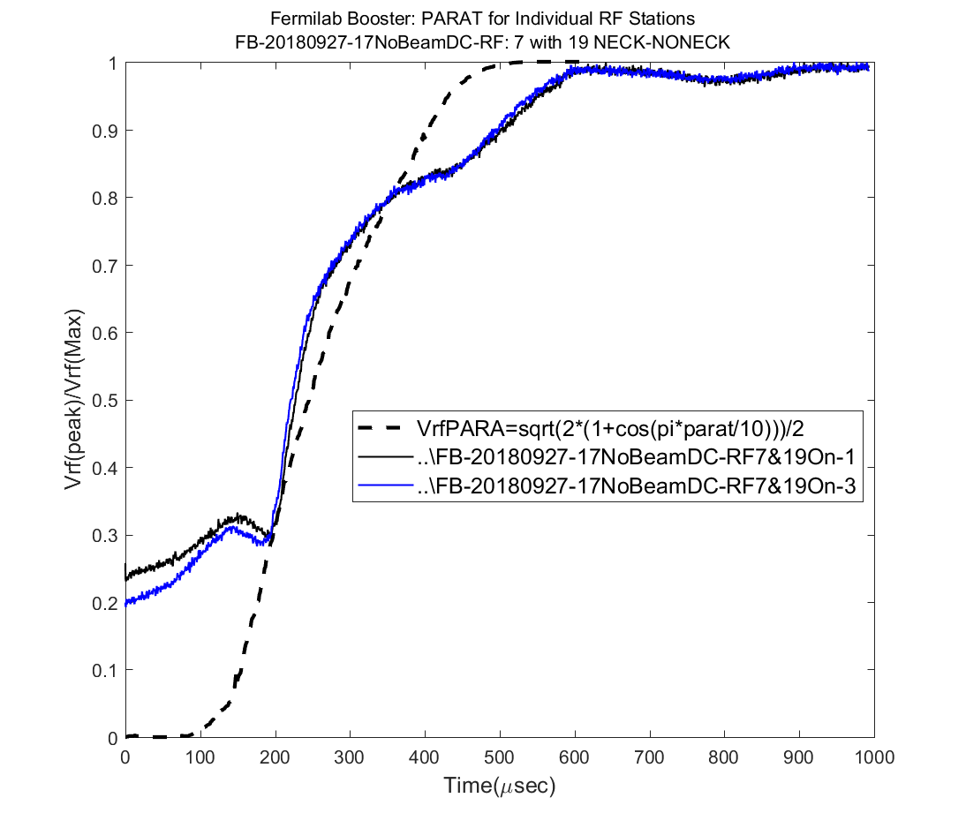
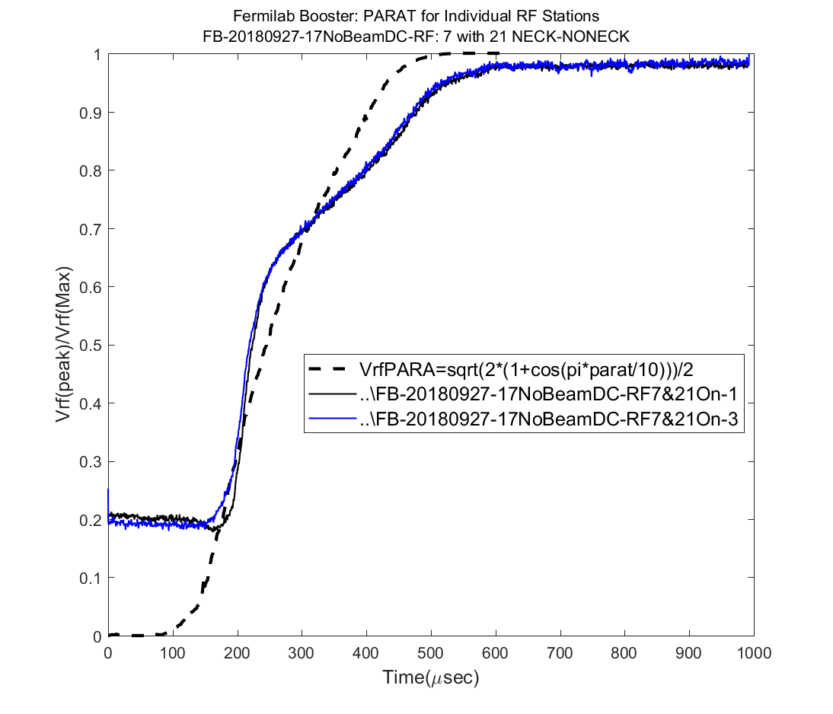
DC Measurements on pair of individual RF stations with NO Beam (cont.)

