Slide 1
RCS for Multi-MW Facility at Fermilab
Jeffrey Eldred
APT Seminar
March 26th 2019

Slide 2
2
Disclaimers & Preambles
This talk expresses what is primarily my own perspective on future intensity upgrades at Fermilab.
This is an LDRD-funded design study:
“A comprehensive investigation…rapid cycling synchrotron for high-intensity beams”
Parametric study
- Trace the impact of RCS design parameters.
- Scenarios should be as realistic as possible.
- Strategic questions that should be answered.
- Other perspectives are welcome input.
2
Jeffrey Eldred | RCS for Multi-MW Facility at Fermilab
Notes:
2
2
2

Slide 3
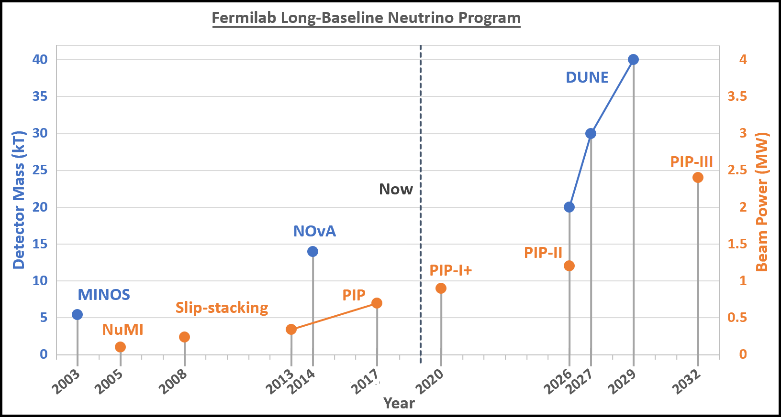
3
Beam Power and Detector Size
DUNE Interim Design Report calls for 2.4 MW by 2032.
3
Jeffrey Eldred | RCS for Multi-MW Facility at Fermilab
Notes:
3
3
3

Slide 4
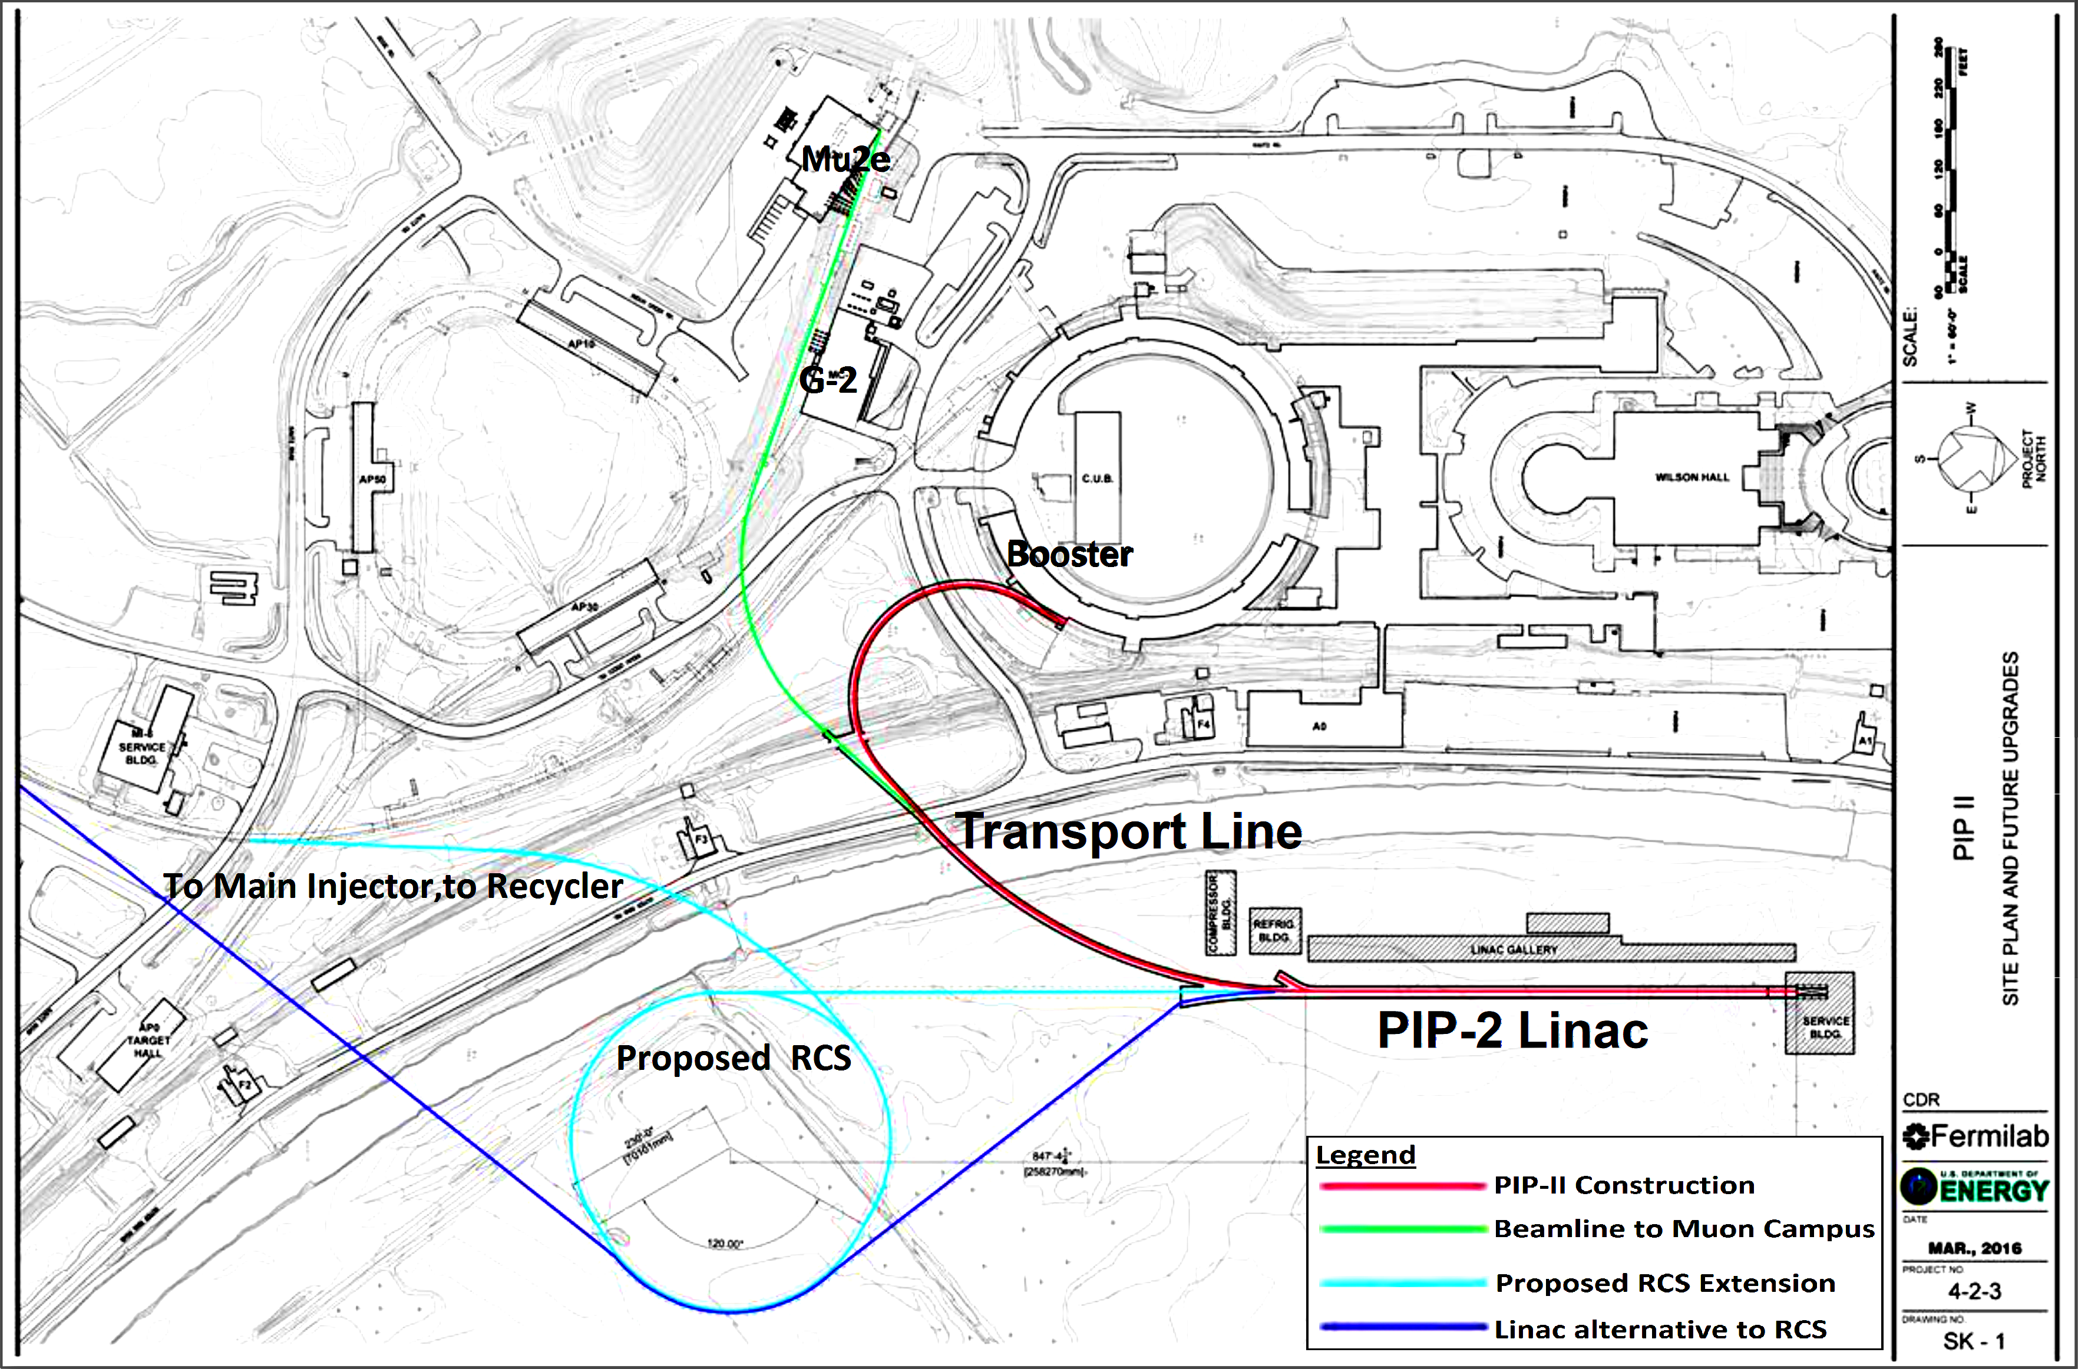
4
4
“ PIP-III ” : Replace Booster with RCS and/or Linac
(Linac and RCS not to scale)
4
Jeffrey Eldred | RCS for Multi-MW Facility at Fermilab
Notes:
4
4
4
4
4
4

Slide 5
5
Limits on Booster at 13e12 protons (or more!)
Some Known Challenges:
Impedance effects from dipole laminations.
Transition-Crossing.
Booster magnets.
Proton Driver Study, 2003 and Project X, 2010:
Both propose multi-MW beam-power in Main Injector by circumventing Booster with an RCS and/or linac.
5
Jeffrey Eldred | RCS for Multi-MW Facility at Fermilab
Notes:
5
5
5

Slide 6
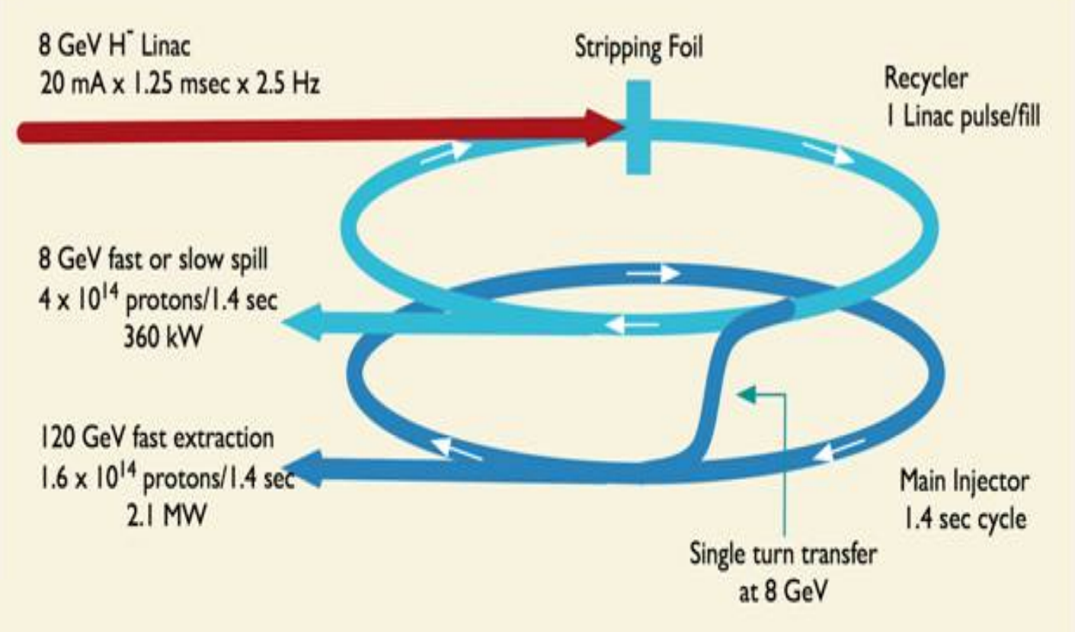
6
Design Strategies for 2+ MW
Project X ICD-1:
6
Jeffrey Eldred | RCS for Multi-MW Facility at Fermilab
Notes:
6
6
6

Slide 7
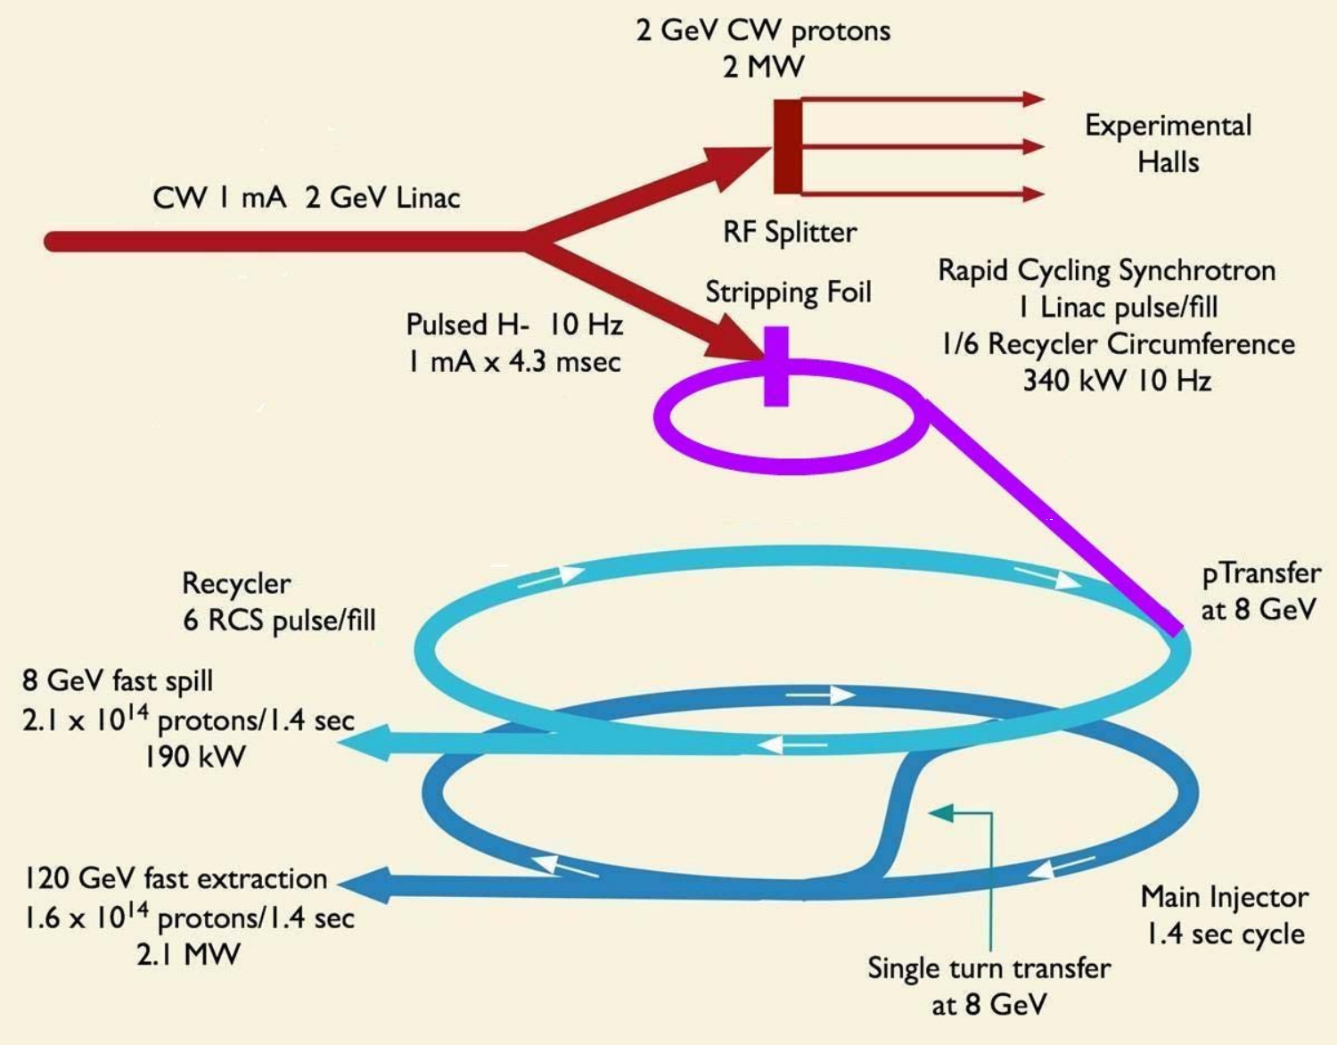
7
Design Strategies for 2+ MW
Project X ICD-2:
7
Jeffrey Eldred | RCS for Multi-MW Facility at Fermilab
Notes:
7
7
7

Slide 8
8
Parametric Design Study
Start with PIP-II era proton facility.
Options to 2.4 MW MI with RCS-based staged upgrade.
Options to achieve 2.4 MW MI with just “RCS Stage”.
Fully Realizable Scenarios
8
Jeffrey Eldred | RCS for Multi-MW Facility at Fermilab
Notes:
8
8
8

Slide 9
9
Parametric Design Study
Start with PIP-II era proton facility.
Options to 2.4 MW MI with RCS-based staged upgrade.
1) RCS + 2 GeV Linac
2) RCS + 0.7 s Main Injector ramp
3) RCS
Options to achieve 2.4 MW MI with just “RCS Stage”.
Fully Realizable Scenarios
9
Jeffrey Eldred | RCS for Multi-MW Facility at Fermilab
Notes:
9
9
9

Slide 10
10
Parametric Design Study
Start with PIP-II era proton facility.
Options to 2.4 MW MI with RCS-based staged upgrade.
Options to achieve 2.4 MW MI with just “RCS Stage”.
2) RCS with exceptional intensity (IOTA?)
1) RCS with slip-stacking in the Main Injector
- Linac energy limited to 1 GeV.
- Main Injector ramp time 1.2 s
Fully Realizable Scenarios
- Use demonstrated accelerator technology.
- Vision for future upgrades to 4.8 MW.
10
Jeffrey Eldred | RCS for Multi-MW Facility at Fermilab
Notes:
10
10
10

Slide 11
11
Parametric Design Study
Start with PIP-II era proton facility.
Options to 2.4 MW MI with RCS-based staged upgrade.
Options to achieve 2.4 MW MI with just “RCS Stage”.
Fully Realizable Scenarios
Outlook
- Achieving 2.4 MW during “RCS stage” looks like a real possibility.
- RCS open many routes to a 3-5 MW future in Main Injector.
- Raising the RCS extraction energy is a good investment.
- Slip-stacking in Main Injector is a tempting option.
11
Jeffrey Eldred | RCS for Multi-MW Facility at Fermilab
Notes:
11
11
11

Slide 12
12
Other RCS Options to get to 2.4 MW
“RCS Stage” Scenarios for 2.4 MW:
(Boxcar stacking at 25e12 -> 2 MW)
12
Jeffrey Eldred | RCS for Multi-MW Facility at Fermilab
Notes:
12
12
12

Slide 13
13
Other RCS Options to get to 2.4 MW
“RCS Stage” Scenarios for 2.4 MW:
“RCS Stage 2” Scenarios for 2.4 MW:
13
Jeffrey Eldred | RCS for Multi-MW Facility at Fermilab
Notes:
13
13
13

Slide 14
14
Other RCS Options to get to 2.4 MW
“RCS Stage” Scenarios for 2.4 MW:
“RCS Stage 2” Scenarios for 2.4 MW:
14
Jeffrey Eldred | RCS for Multi-MW Facility at Fermilab
Notes:
14
14
14

Slide 15
15
Space-charge Limited Rings?
For high-power rings, I think about the space-charge limits.
First, we are talking about a lot of charge. This part is unavoidable.
After PIP-II, we will be doing painted injection. Which means emittance can be varied. We can shrink the beam until we encounter a space-charge limit.
“Space-charge tune-shift” can be used as a generic proxy for intensity of space-charge forces.
I will discuss other important loss mechanisms and intensity limits.
15
Jeffrey Eldred | RCS for Multi-MW Facility at Fermilab
Notes:
15
15
15

Slide 16
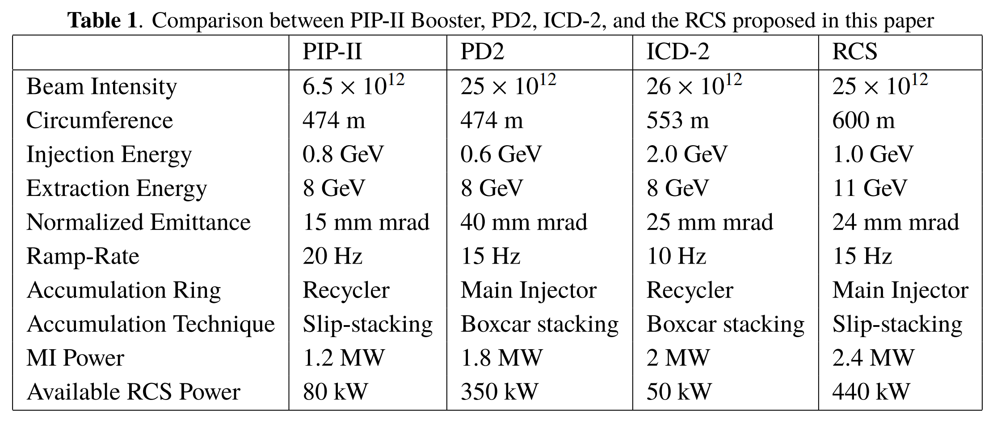
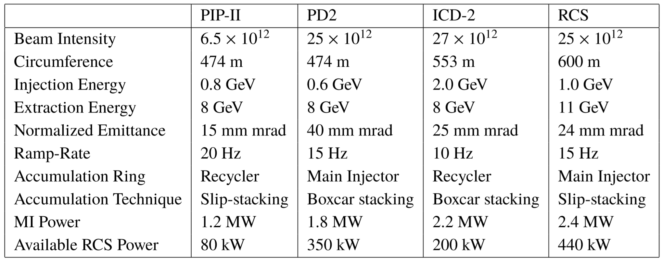
16
Parameter Table for Proposed Rings
16
Jeffrey Eldred | RCS for Multi-MW Facility at Fermilab
Notes:
16
16
16

Slide 17
17
ICD-2 Ring vs. MI SS RCS – Pros and Cons
2.4 MW Beam Power for DUNE
- slip-stacking
Less stress on Main Injector
- higher RCS energy → smaller emittance, less space-charge
Larger RCS Laslett Tune-shift
- aggressive collimation → following J-PARC precedent
- higher superperiodicity → smaller tune-shift per period
440 kW Available RCS Power at 11 GeV
- Is this something experiments can use?
- Using Accumulator/Recycler, ~50 kW 8-GeV slow-extraction
Overall technical design still needs more review.
17
Jeffrey Eldred | RCS for Multi-MW Facility at Fermilab
Notes:
17
17
17

Slide 18
18
18
Slip-Stacking,
Circumference,
& Energy
18
Jeffrey Eldred | RCS for Multi-MW Facility at Fermilab
Notes:
18
18
18
18
18
18

Slide 19
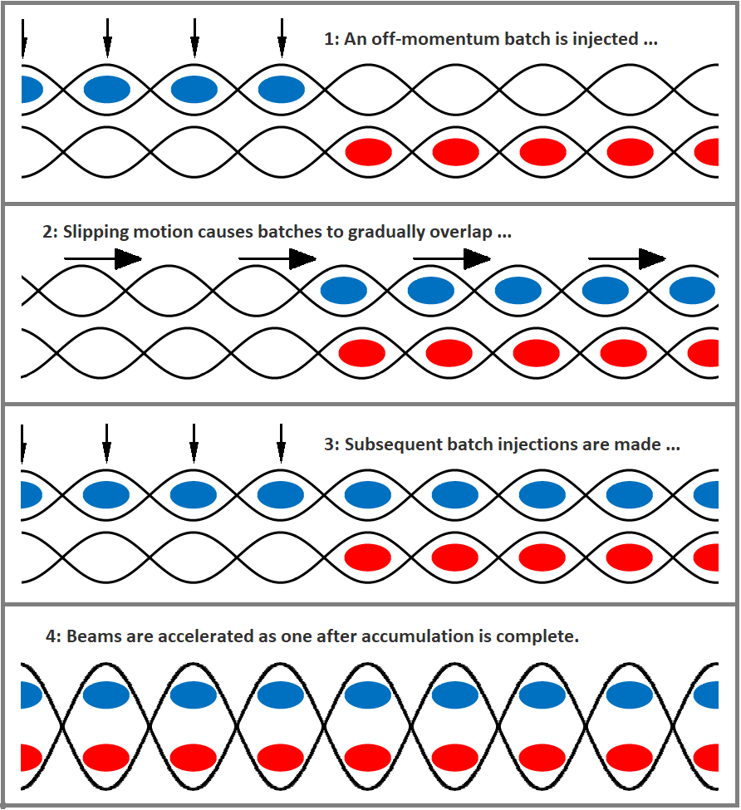
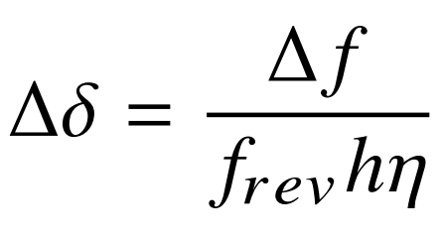
19
Slip-stacking Accumulation
RF frequency separation:
Momentum separation:
19
Jeffrey Eldred | RCS for Multi-MW Facility at Fermilab
Notes:
19
19
19

Slide 20
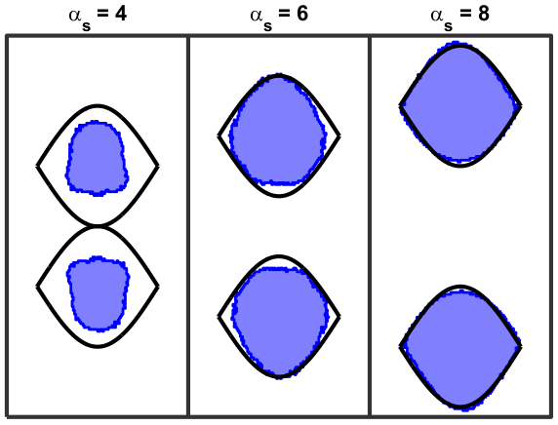
20
Slip-stacking Frequencies
Δf > ~750 Hz
for longitudinal stability
Δf < ~1680 Hz
for PIP-II momentum span
For ~600 m RCS
7 Hz < f_{RCS} < 15 Hz
Eldred, Zwaska PRAB 2016
20
Jeffrey Eldred | RCS for Multi-MW Facility at Fermilab
Notes:
20
20
20

Slide 21
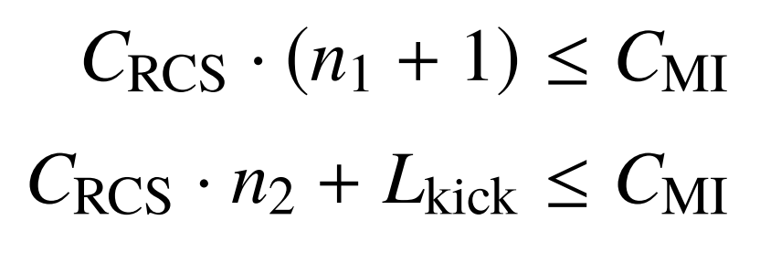
21
Slip-stacking & RCS Circumference
Stacking-Limits:
L_{kick} ~ 300 m or 1μs
or 53 buckets
Even-Batch Slip-stacking:
5
6
7
8
1
2
3
4
Batch-gap
used as kicker-gap
Odd-Batch Slip-stacking
5
6
7
8
9
1
2
3
4
Batch-gap + kicker-gap
21
Jeffrey Eldred | RCS for Multi-MW Facility at Fermilab
Notes:
21
21
21

Slide 22
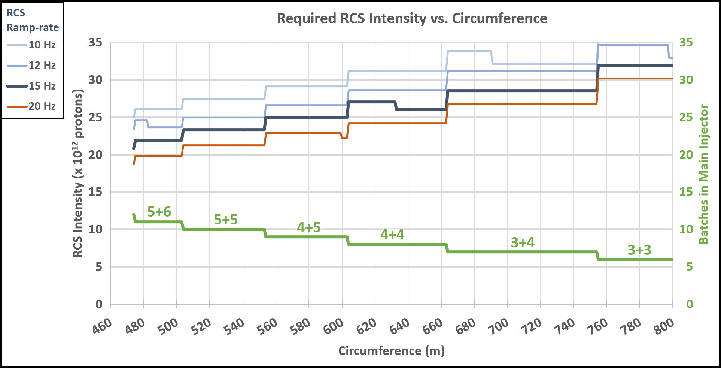
22
Slip-stacking & RCS Circumference
22
Jeffrey Eldred | RCS for Multi-MW Facility at Fermilab
Notes:
22
22
22

Slide 23
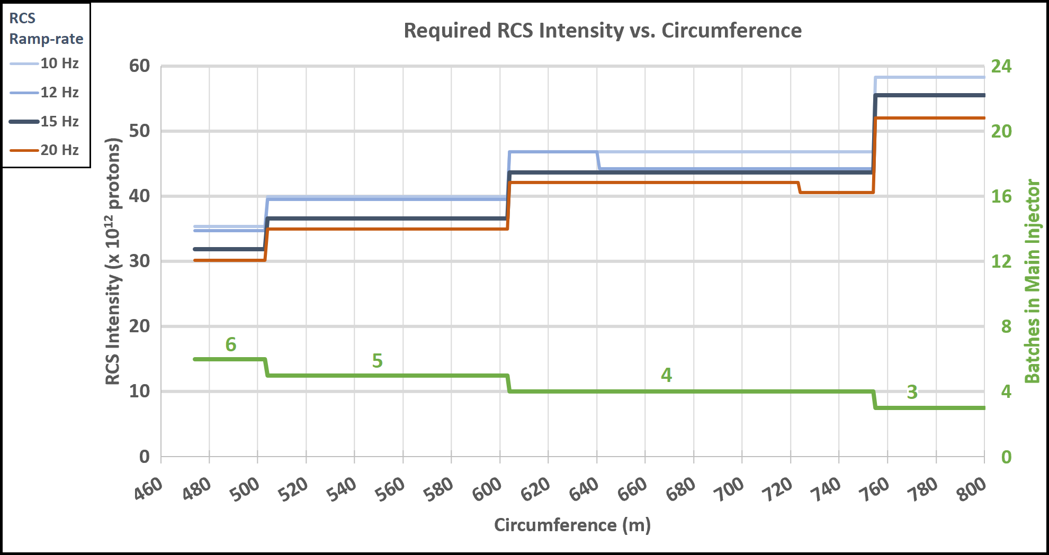
23
Boxcar Stacking & RCS Circumference
Boxcar Stacking requires ~50% more charge
23
Jeffrey Eldred | RCS for Multi-MW Facility at Fermilab
Notes:
23
23
23

Slide 24
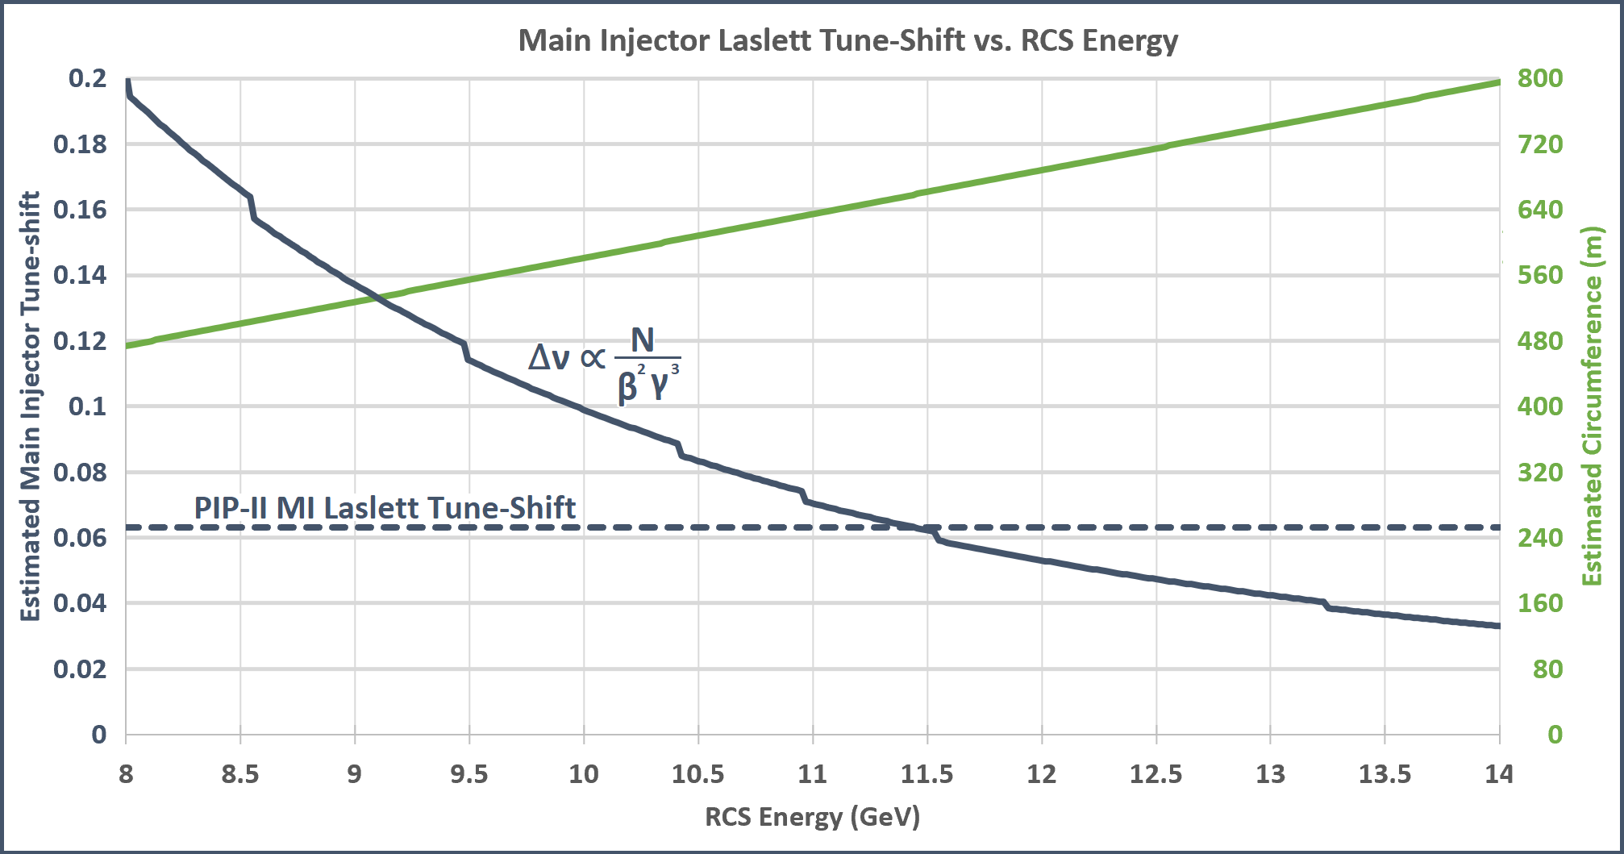
24
RCS Circumference & Main Injector Tune-Shift
24
Jeffrey Eldred | RCS for Multi-MW Facility at Fermilab
Notes:
24
24
24

Slide 25
25
Parameter Table for Efficient Circumferences
Efficient Slip-stacking Circumferences:
(Estimated)
(Estimated)
For MI Tune-shift the RCS energy should be ~11 GeV.
Slip-stacking Frequencies:
600m RCS with 15 Hz ramp: Δf = 1590 Hz
660m RCS with 15 Hz ramp: Δf = 1755 Hz
Δδ ≈ 0.6% ≈ PIP-II
25
Jeffrey Eldred | RCS for Multi-MW Facility at Fermilab
Notes:
25
25
25

Slide 26
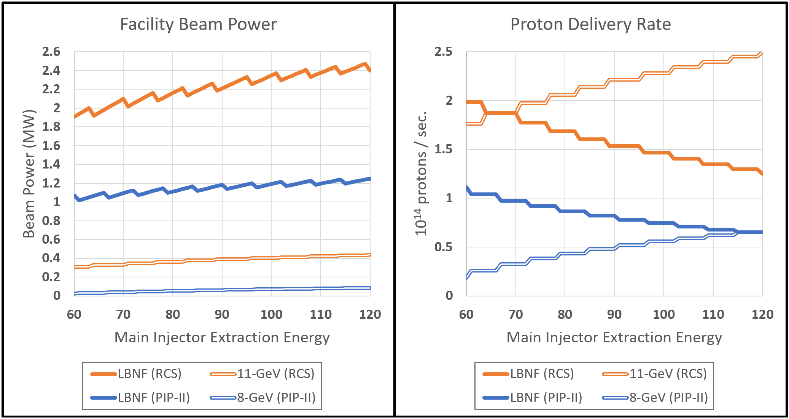
26
Beam Power within 60 GeV to 120 GeV Range
(Assuming Slip-stacking, 11 GeV, 600 m, 15 Hz, 25e12)
26
Jeffrey Eldred | RCS for Multi-MW Facility at Fermilab
Notes:
26
26
26

Slide 27
27
27
RCS Design
27
Jeffrey Eldred | RCS for Multi-MW Facility at Fermilab
Notes:
27
27
27
27
27
27

Slide 28
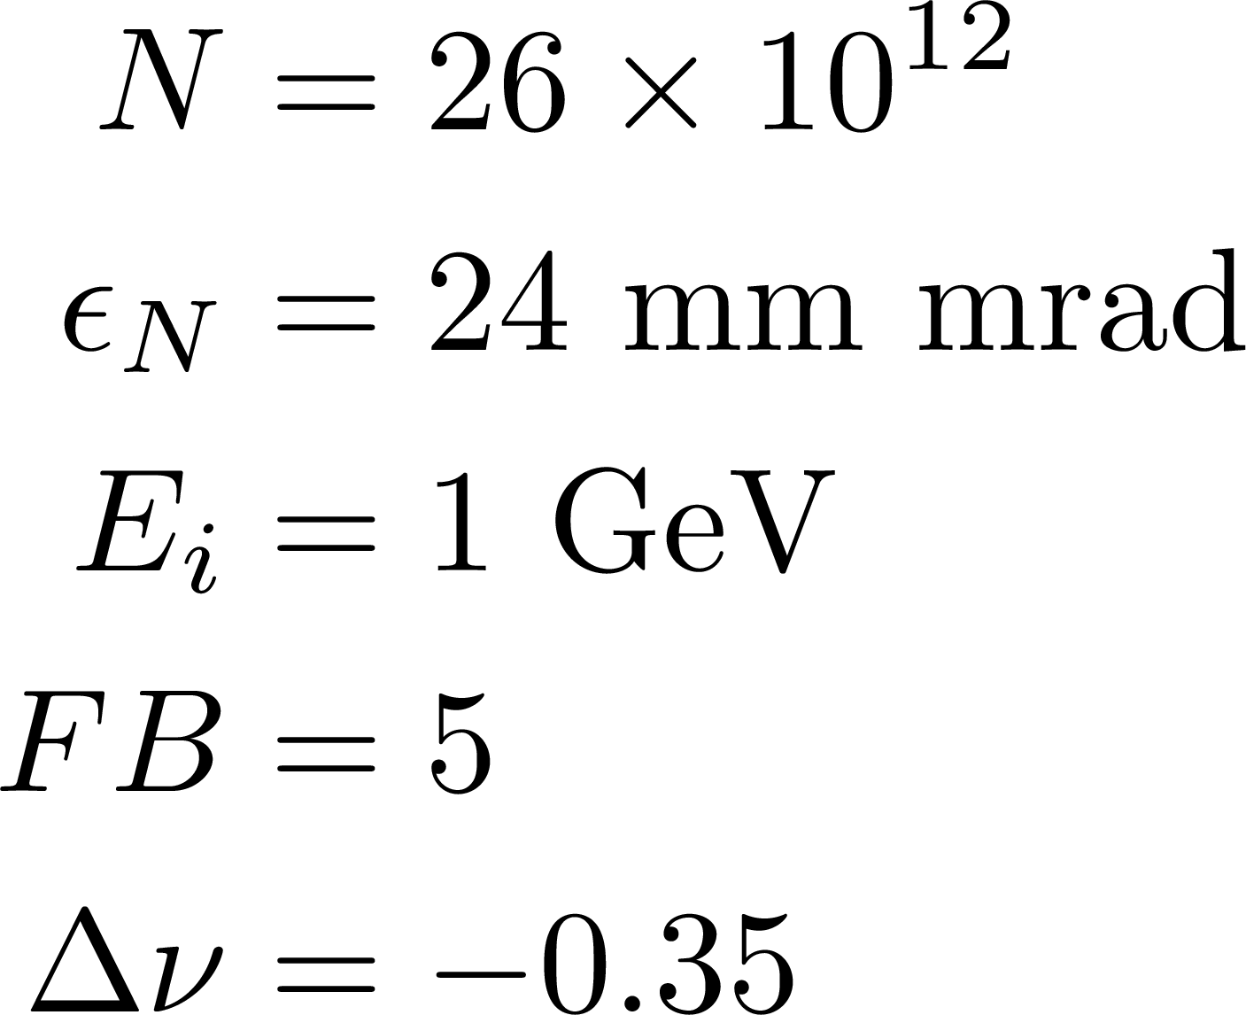
28
RCS Laslett Tune-Shift
The J-PARC RCS shows intensity of 83e12 protons, 1 MW extracted beam power, -0.30 tune-shift, 0.1 tune-shift per super-period.
Hotchi et al. PRAB 2017.
Collimators at 3σ aperture of the beam.
Total ring acceptance factor of 1.5 on collimator acceptance.
We can adopt the same strategy at a much smaller aperture.
RCS with -0.35 tune-shift,
-0.044 tune-shift per super-period.
with 2nd harmonic cavities, ~0.24 tune-shift.
Parameters:
Laslett Tune-shift:
28
Jeffrey Eldred | RCS for Multi-MW Facility at Fermilab
Notes:
28
28
28

Slide 29
29
Eddy Currents in Vacuum Chamber
Vacuum chamber radius a: 2.5 cm
Ramp rate: 15 Hz
Peak Dipole Field: 1.2 T
Vacuum chamber heating power by eddy currents
1.28mm Steel-316: 108 W/m
0.45mm Inconel-625: 33 W/m
Conservative air cooling estimate of convective cooling
heat transfer coefficient 10⁻³ W/cm²/K
1.28mm Steel-316: ΔT = 92 K
0.45mm Inconel-625: ΔT = 21 K
29
Jeffrey Eldred | RCS for Multi-MW Facility at Fermilab
Notes:
29
29
29

Slide 30
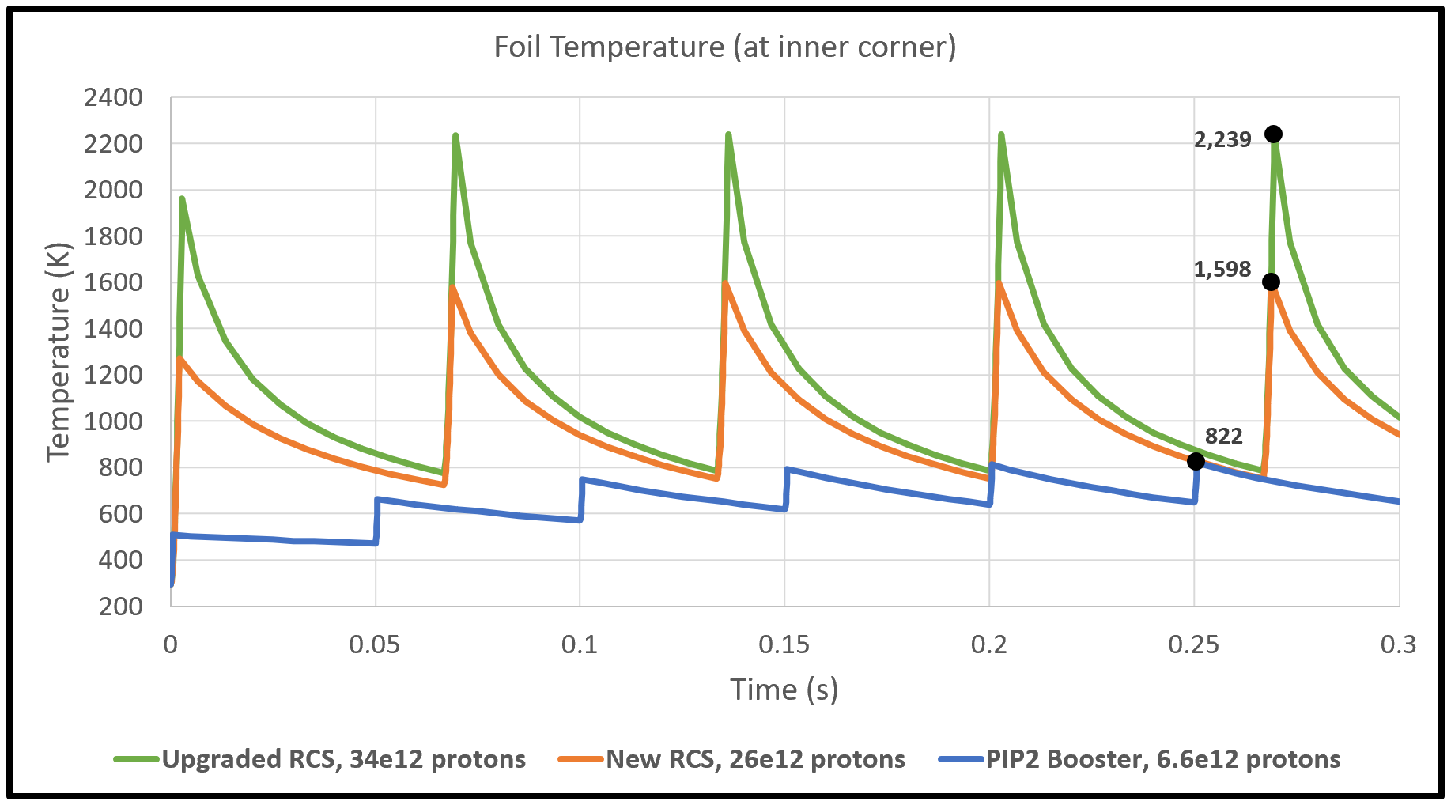
30
H- Foil Heating
30
Jeffrey Eldred | RCS for Multi-MW Facility at Fermilab
Notes:
30
30
30

Slide 31
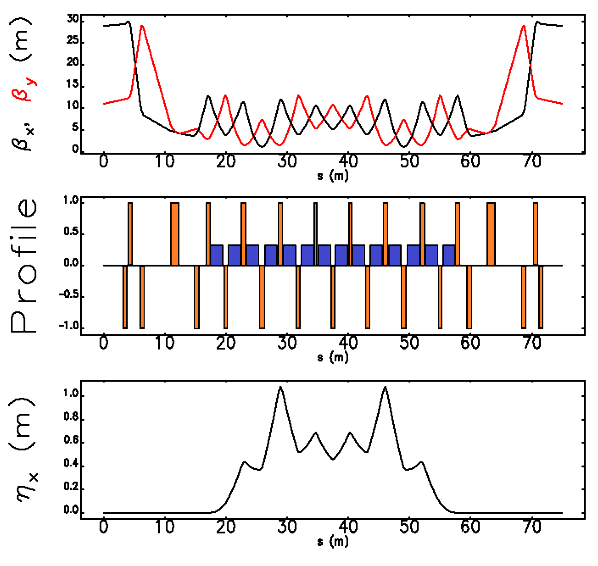
31
Example Lattice Design
8-fold periodicity.
Small betas to large.
Insertion-free drifts.
6.5 m, 2x4.4m
2x2.4 m, 2x1.3m
Adequate injection with 2π/3 collimation.
Length for RF straights.
γ_{T} = 14.3
31
Jeffrey Eldred | RCS for Multi-MW Facility at Fermilab
Notes:
31
31
31

Slide 32
32
Coherent Stability
Mitigation of Electron Cloud:
Avoid combined function magnets.
Use TiN or a-Carbon beampipe coating.
Transverse Instabilities:
Much less impedance than current Booster.
Transverse and longitudinal dampers like Booster.
No transition crossing.
32
Jeffrey Eldred | RCS for Multi-MW Facility at Fermilab
Notes:
32
32
32

Slide 33
33
Main Injector Intensity Upgrade
Reactive power needed to drive RF cavities
For PIP-II we can add new power amplifiers to existing RF cavities.
For 2.4 MW, we need to replace RF cavities and PAs.
Project X RF-cavity design.
γ_{T} -Jump for MI Transition Crossing
γ_{T} -Jump already planned for PIP-II, could be sufficient.
Bigger jump or smaller longitudinal emittance should be possible.
High-Power Neutrino Target
LBNF target hall rated for 2.4 MW.
At least one design for a 2.3 MW neutrino target already exists.
Target development and active area of R&D.
If Slip-Stacking:
RF cavity beam-loading compensation.
~40kV 2nd-harmonic cavity for reduced longitudinal emittance.
Diode-based transverse dampers.
33
Jeffrey Eldred | RCS for Multi-MW Facility at Fermilab
Notes:
33
33
33

Slide 34
34
34
Beyond 2.4 MW
34
Jeffrey Eldred | RCS for Multi-MW Facility at Fermilab
Notes:
34
34
34
34
34
34

Slide 35
35
Multi-MW Main Injector
RCS plus some of the following features:
1) 2-GeV Linac
- includes linac-based physics program.
2) Slip-stacking
- does not involve additional construction.
3) Shorter Main Injector Ramp
- does not increase MI intensity.
4) New Recycler-like Storage Ring
- does not increase MI intensity.
2.4 MW, One of the above (excluding 4)
3.6 MW, Two of the above
4.8 MW, Three of the above (maybe just 1 & 3)
35
Jeffrey Eldred | RCS for Multi-MW Facility at Fermilab
Notes:
35
35
35

Slide 36
36
IOTA Technologies
Nonlinear integrable optics:
Provides incredible nonlinear focusing without the usual loss in dynamic aperture. Mitigates halo formation and collective effects.
Electron lens/column:
Directly compensates space-charge effects, R&D underway to determine the best way to implement.
Both technologies tested at IOTA over the next several years.
For robustness of performance?
Or for upper-bound of performance?
36
Jeffrey Eldred | RCS for Multi-MW Facility at Fermilab
Notes:
36
36
36

Slide 37
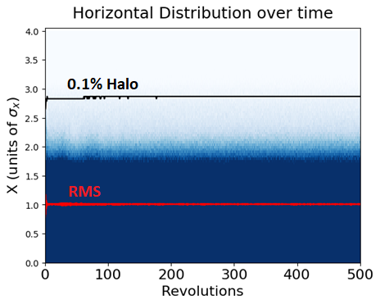
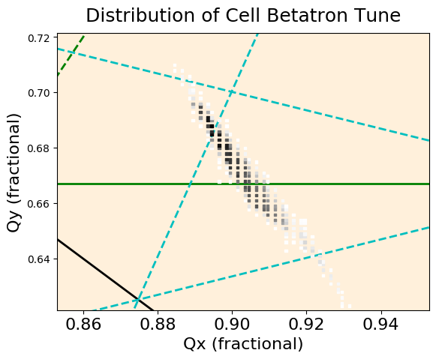
37
Space-charge Simulation of iRCS
Beam injected with 20% mismatch
Laslett tune-shift of 0.4, corresponding to 32e12 protons.
Beam stable 5000 revolutions, halo strongly suppressed.
Eldred,
Valishev
IPAC 2018
37
Jeffrey Eldred | RCS for Multi-MW Facility at Fermilab
Notes:
37
37
37

Slide 38
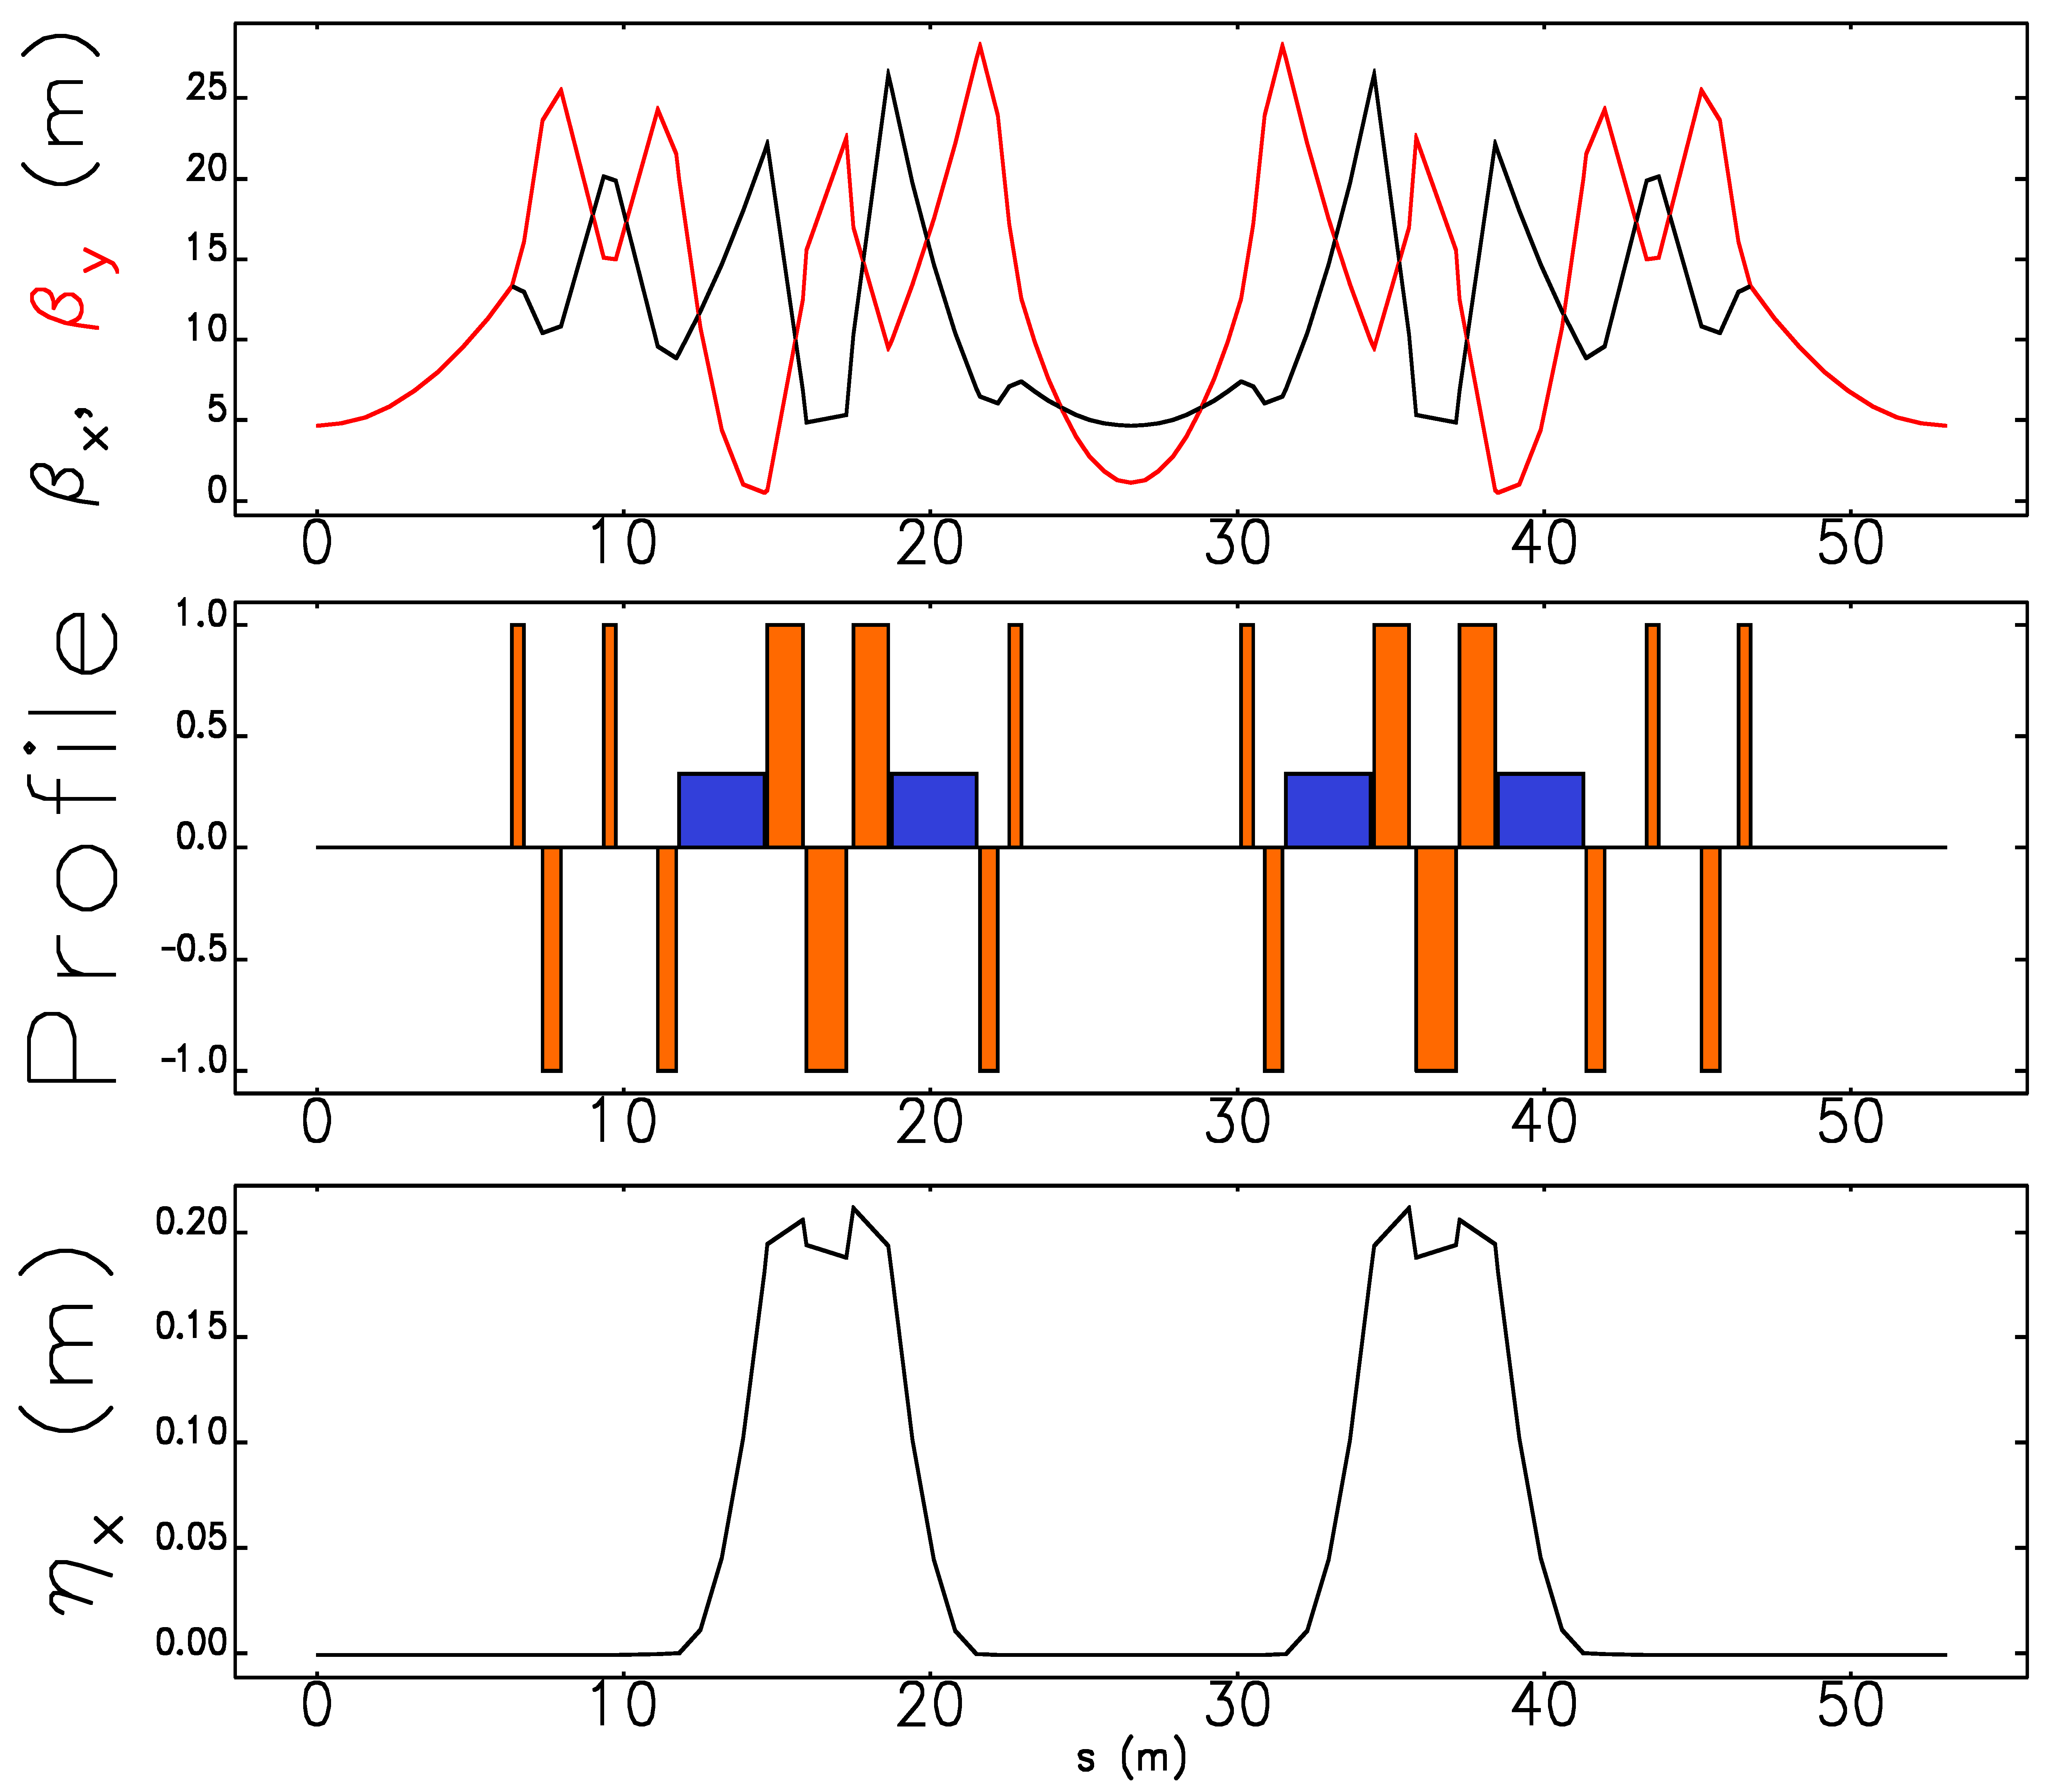
38
Integrable RCS Lattice design
Periodicity: 12
Circumference: 636 m
Bend-radius rho: 15.4 m
Max Beta x,y function: 25 m
Max Dispersion function: 0.22 m
RF Insertion length: 7.2 m, 4x 1.3m
NL Insertion length: 12.7 m
Insert Phase-Advance: 0.4
Minimum c-value: 3 cm
Beta at insert center: 5 m
Betatron Tune: 21.6
Natural Chromaticity: -79
Second-order Chromaticity: 1600
Synchrotron Tune: 0.08
Eldred, Valishev IPAC 2018
38
Jeffrey Eldred | RCS for Multi-MW Facility at Fermilab
Notes:
38
38
38

Slide 39
39
Conclusions
- Wide-ranging technical analysis of RCS-based acc. facilities.
- RCS-based facilities have a clear route to 2.4 MW and beyond.
- There’s a case for raising Main Injector injection energy.
- Slip-stacking at high-power should be under consideration.
Topics for further R&D
- Booster, especially lattice & periodicity.
- Main Injector, especially at high-charge.
- IOTA Technologies, integrable optics & electron lens/column.
- High-Power Targetry, for neutrino beams.
39
Jeffrey Eldred | RCS for Multi-MW Facility at Fermilab
Notes:
39
39
39

Slide 40
40
40
Backup
40
Jeffrey Eldred | RCS for Multi-MW Facility at Fermilab
Notes:
40
40
40
40
40
40

Slide 41
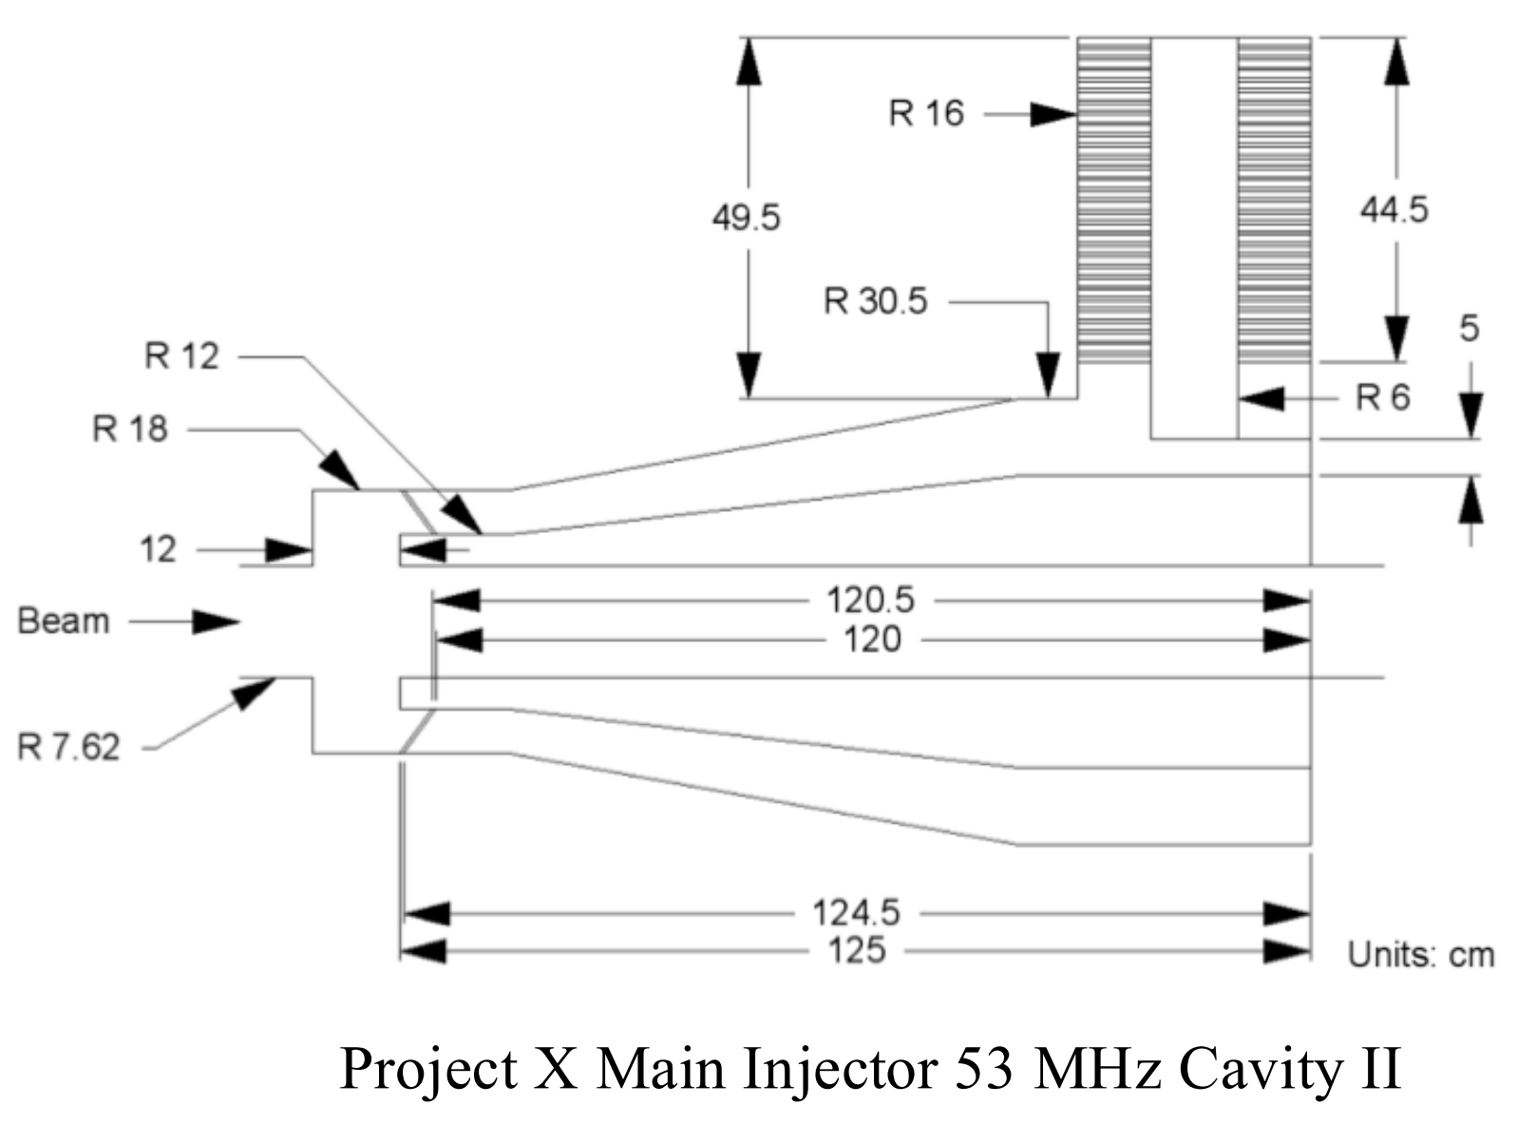
41
Main Injector Intensity Upgrade
High-Power Main Injector Cavities
Dey and Kourbanis IPAC 2011
41
Jeffrey Eldred | RCS for Multi-MW Facility at Fermilab
Notes:
41
41
41

Slide 42
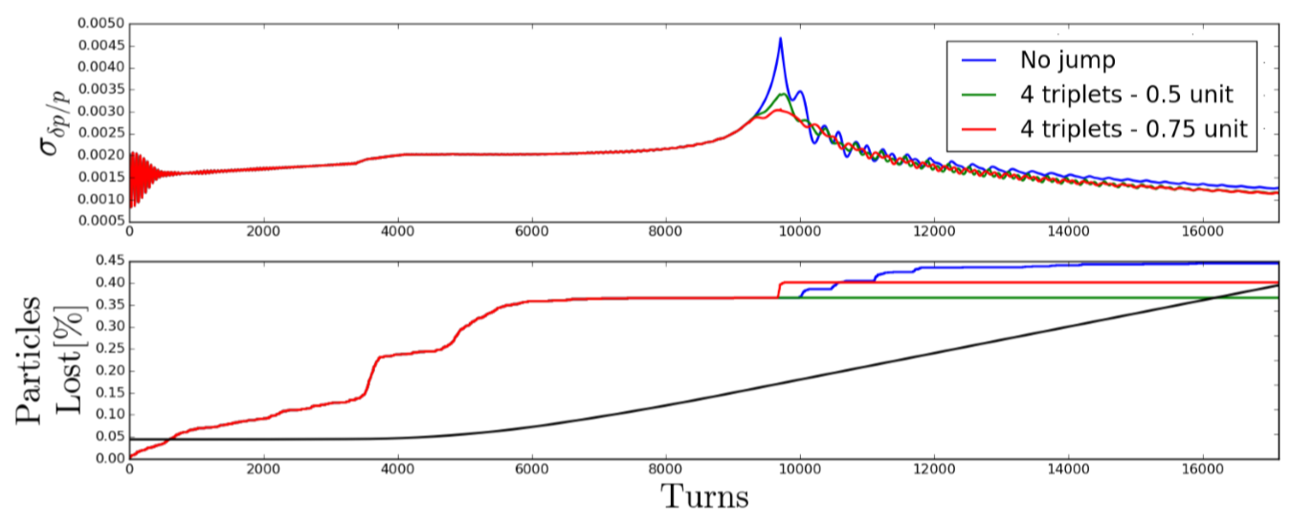
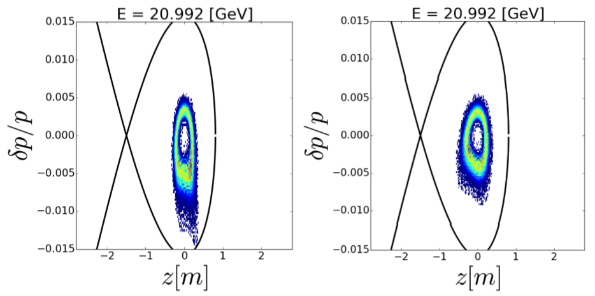
42
Main Injector Intensity Upgrade
γ_{T}-Jump for MI Transition Crossing
Pulsed quads for γ_{T}-jump to be installed for PIP-II.
For 2.4 MW, consider going from negative to positive chromaticity at transition crossing.
R. Ainsworth et al. IPAC 2017
42
Jeffrey Eldred | RCS for Multi-MW Facility at Fermilab
Notes:
42
42
42

Slide 43
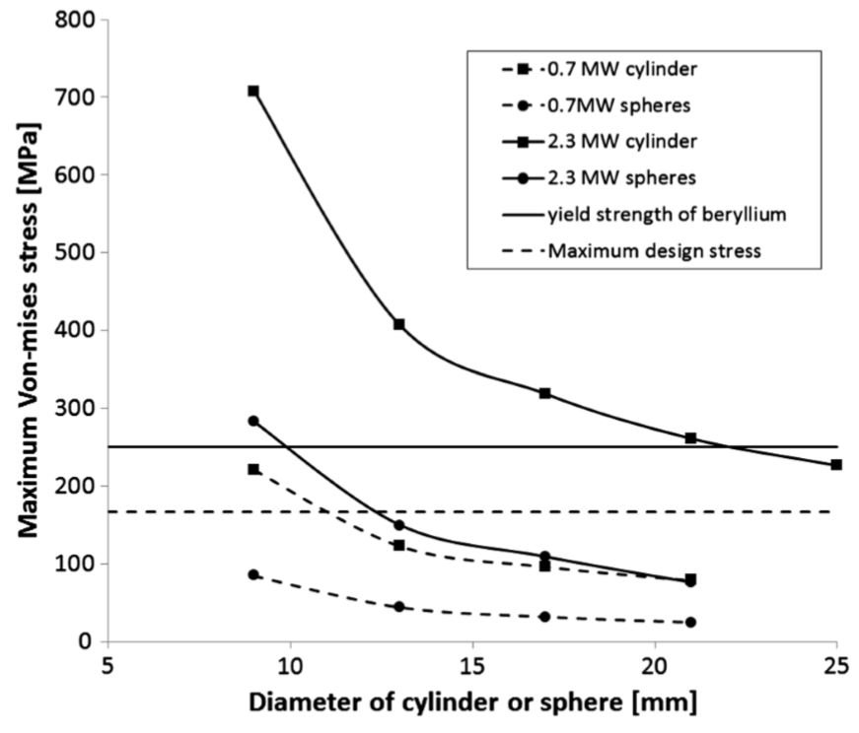
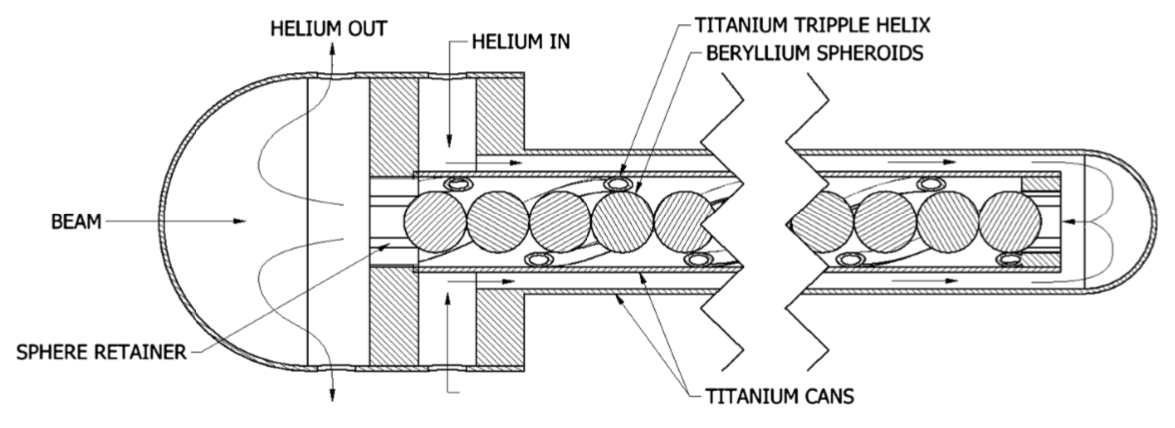
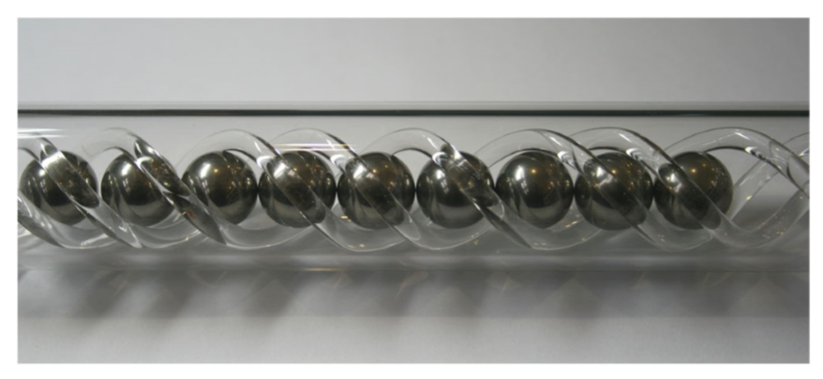
43
Main Injector Intensity Upgrade
High-Power Neutrino Target
Detailed design of 2.3 MW Be target for neutrino beams.
Active area of R&D development – shock test, radiation damage, target design, flux optimization etc.
T. Davenne et al. PRSTAB 2015
43
Jeffrey Eldred | RCS for Multi-MW Facility at Fermilab
Notes:
43
43
43

Slide 44
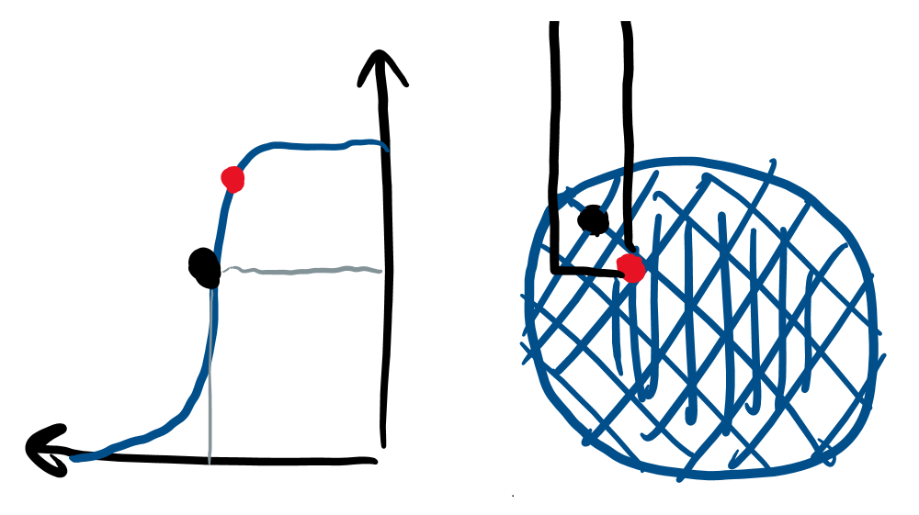
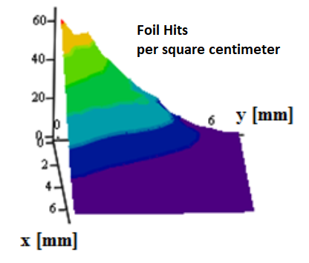
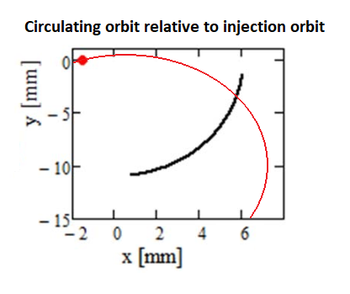
44
Heating associated with H- Foil Painting
Beam Distribution during Injection
Peak Temperature on corner
(PIP-II)
Anti-correlated Painting Injection
Injection painting scheme chosen to:
Minimize foil hits from the circulating beam.
Optimize stability of the beam distribution.
44
Jeffrey Eldred | RCS for Multi-MW Facility at Fermilab
Notes:
44
44
44

Slide 45
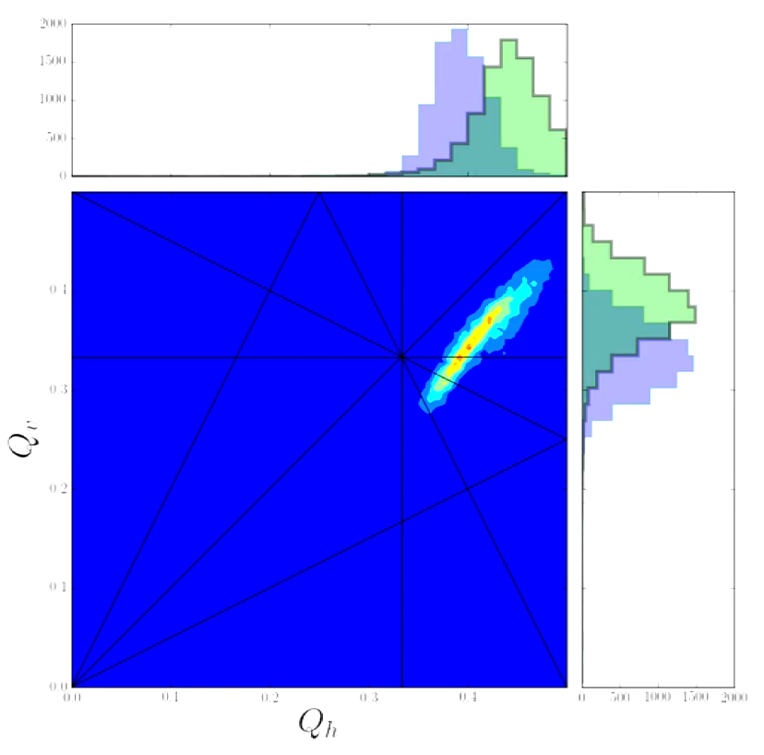
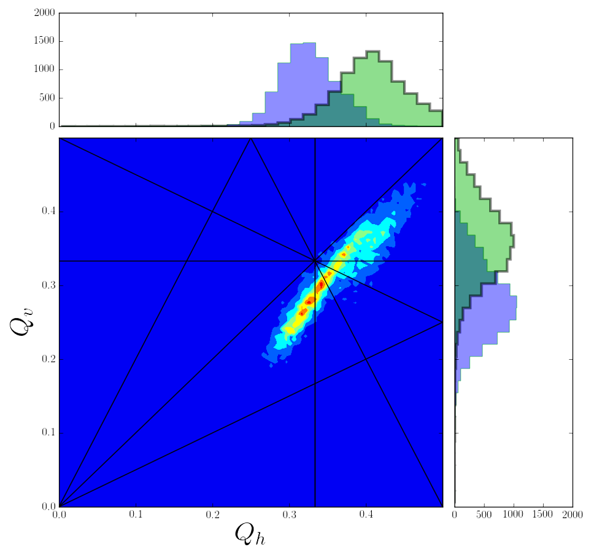
45
Recycler Intensity Limits
Space-charge Tune-spread Losses:
If we go to higher than PIP-II intensity, but without a momentum separation between the beams, we will cross the same res. lines.
How well can we compensate the resonances lines?
Current Tune-Spread
PIP-II Tune-Spread
R. Ainsworth
45
Jeffrey Eldred | RCS for Multi-MW Facility at Fermilab
Notes:
45
45
45

Slide 46
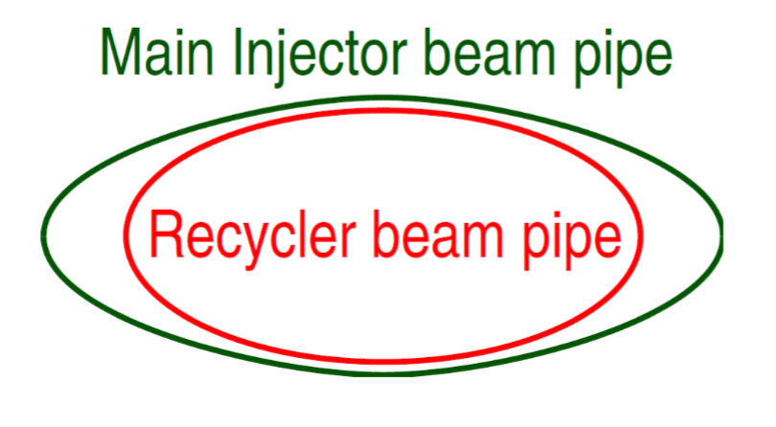
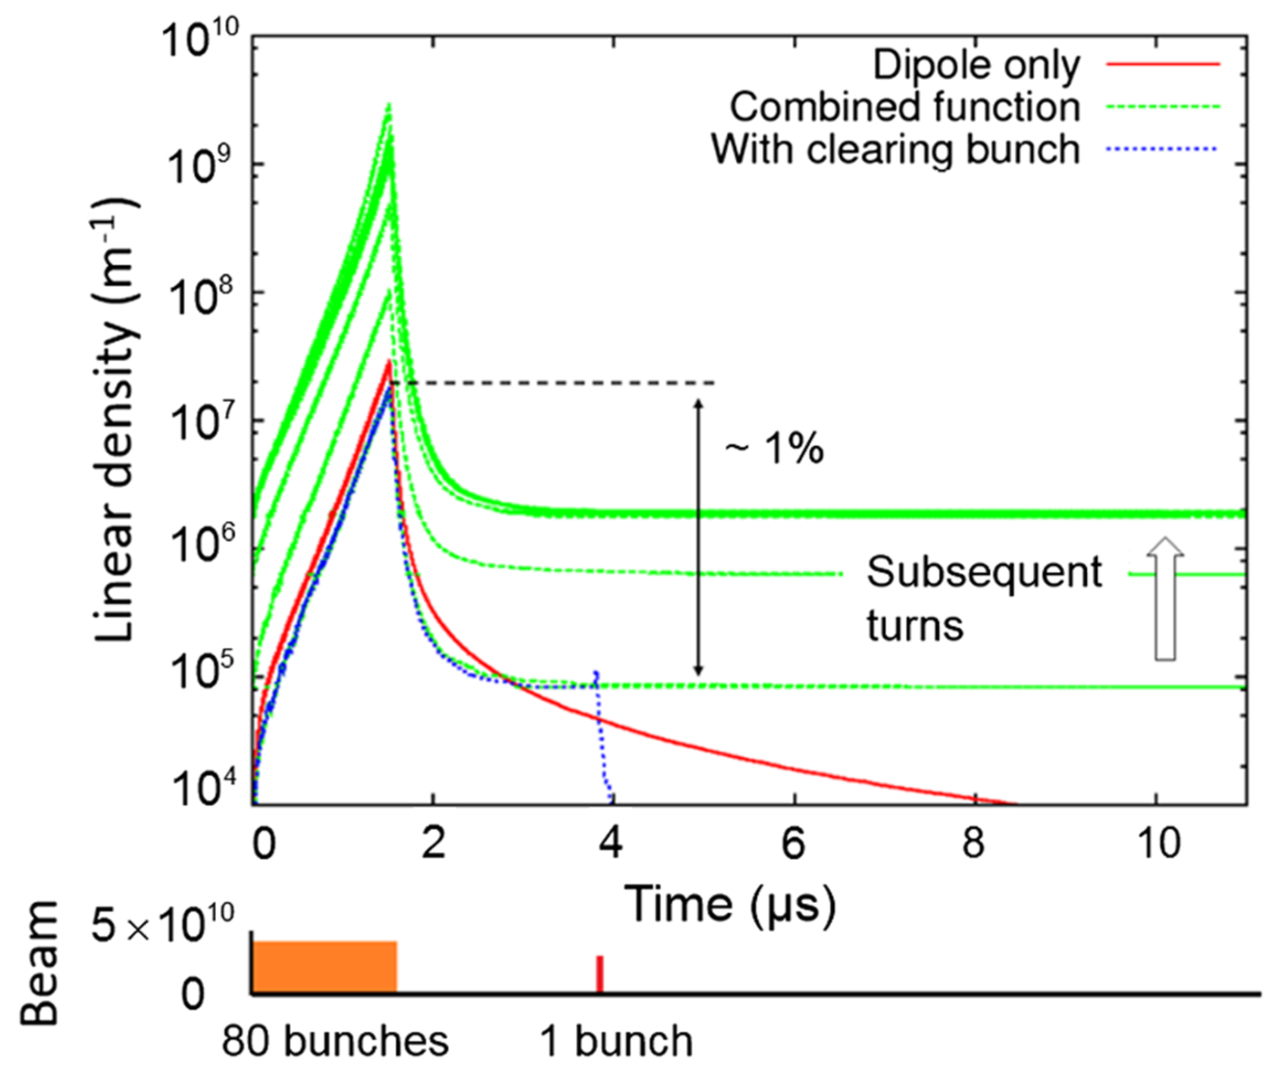
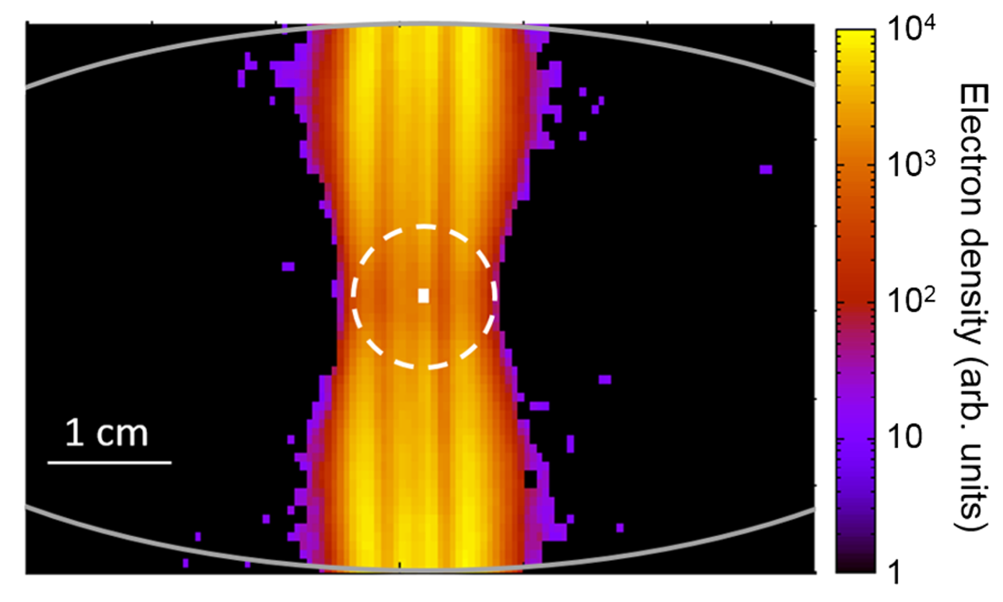
46
Recycler Intensity Limits
Tight Aperture Losses:
For PIP-II era, smaller cleaner beam.
For RCS, limited by RR/MI apertures.
Electron Cloud Instability:
S. Antipov et al. PRSTAB 2017
46
Jeffrey Eldred | RCS for Multi-MW Facility at Fermilab
Notes:
46
46
46

