Slide 1
1
1
Concepts of Integrability in IOTA
Jeffrey Eldred, with Sergei Nagaitsev & Timofey Zolken
Integrable Particle Dynamics in Accelerators
January 2019 USPAS at Knoxville
(This talk owes much to S. Valishev’s HB2018 Talk
& G. Stancari’s 2018 DOE GARD Review Talk)
Notes:
1
1
1
1
1
1

Slide 2
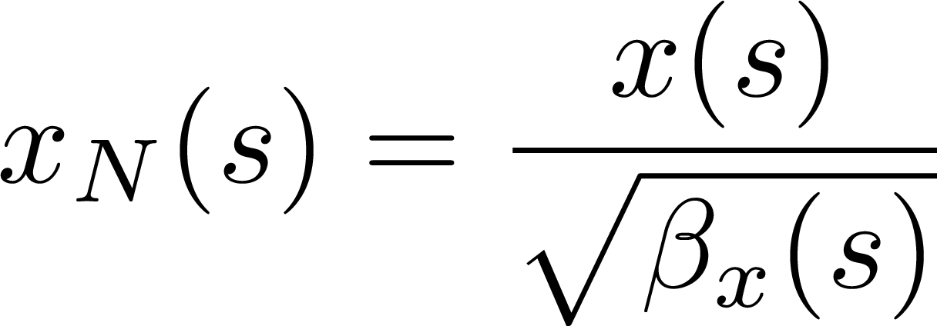
Linearized Particle Accelerator
Most particle accelerators are based around proximity to linear integrable optics. The linear accelerator Hamiltonian:
Each transverse degree of freedom is a linear oscillation with a time-dependent focusing. We can normalize the phase-space coordinates and write in terms of action-angle:
No resonances, two degrees of freedom, two action invariants.
2
Integrable Particle Dynamics in Accelerators | Jan 2019 USPAS
Notes:
2
2
2
2

Slide 3
Aberrations on Linear Accelerator
Particle accelerators aren’t just perfect continuous focusing:
Discrete elements lead to time-dependence (s-dependence).
Sextupoles for chromaticity correction.
Octupoles for nonlinear focusing.
Magnet field quality & fringe-field effects.
There will be many higher-order resonances, tune-shift with amplitude, and x-y coupling.
In the general case, there are no invariants and there is not any guarantee of stable motion for all initial conditions.
Leads to confined operating space called “dynamic aperture”.
3
Integrable Particle Dynamics in Accelerators | Jan 2019 USPAS
Notes:
3
3
3
3

Slide 4
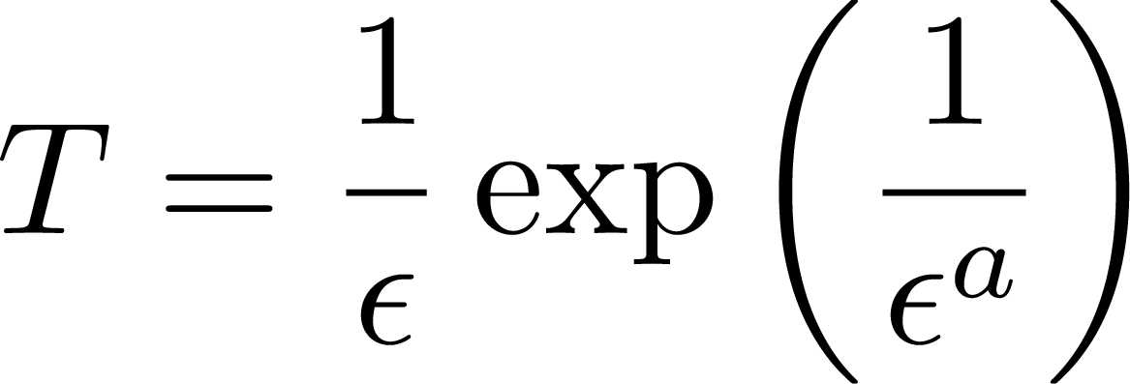
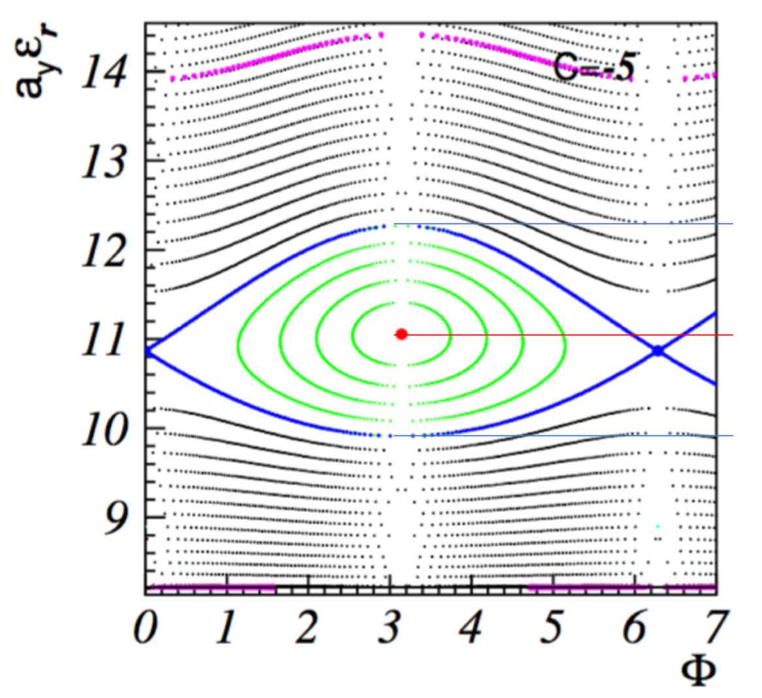
Steepness
Nekhoroshev – Russian Math. Surveys 32:6 (1977), 1-65:
“An Exponential Estimate of the Time of Stability of Nearly Integrable Hamiltonian Systems”
Integrable system with a periodic perturbation:
Then action-invariants are bounded by:
over the time interval:
If H(I) meets a certain criteria called steepness.
1D steepness is given by:
Multi-dimensional similar idea, but not simple
4
Integrable Particle Dynamics in Accelerators | Jan 2019 USPAS
Notes:
4
4
4
4

Slide 5
Collective-Instabilities & Landau Damping
In addition to the single-particle effects from external field, there are collective effects:
The beam itself generates EM fields, which interact with the environment and then back on the beam. Every beam mode represents a feedback loop that can become unstable.
These instabilities can be suppressed by either:
External damping system –an external kickers system which needs to be activated with the requisite gain and bandwidth.
Landau damping – an active decoherent effects from the tune-spread of the betatron oscillation. Nonlinear focusing has an inherently stabilizing effect on the beam!
5
Integrable Particle Dynamics in Accelerators | Jan 2019 USPAS
Notes:
5
5
5
5

Slide 6
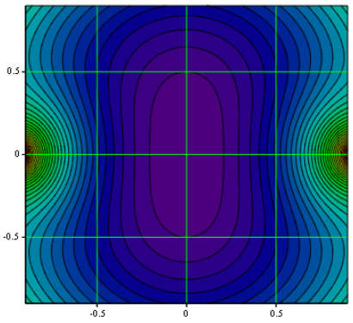
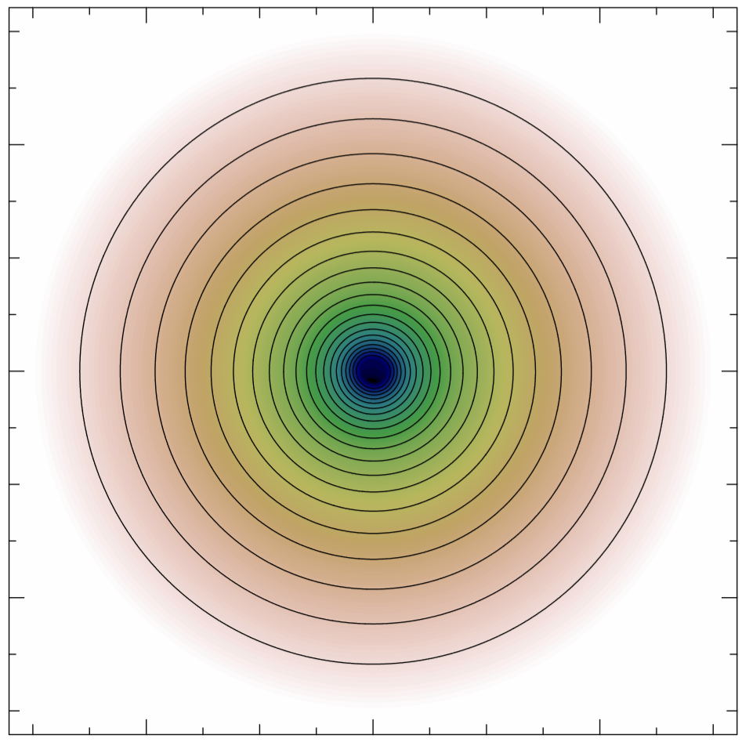
New Paradigm – Nonlinear Integrable Optics
Instead of trying to make a perfect linear system and then compensate all the defects, start from something more robust! The accelerators optics should be:
2D Integrable – no resonances or dynamical chaos.
Widely Stable – no scattering trajectories or separatrices.
Strongly Nonlinear – robust to perturbations, external & collective.
6
Integrable Particle Dynamics in Accelerators | Jan 2019 USPAS
Notes:
6
6
6
6

Slide 7
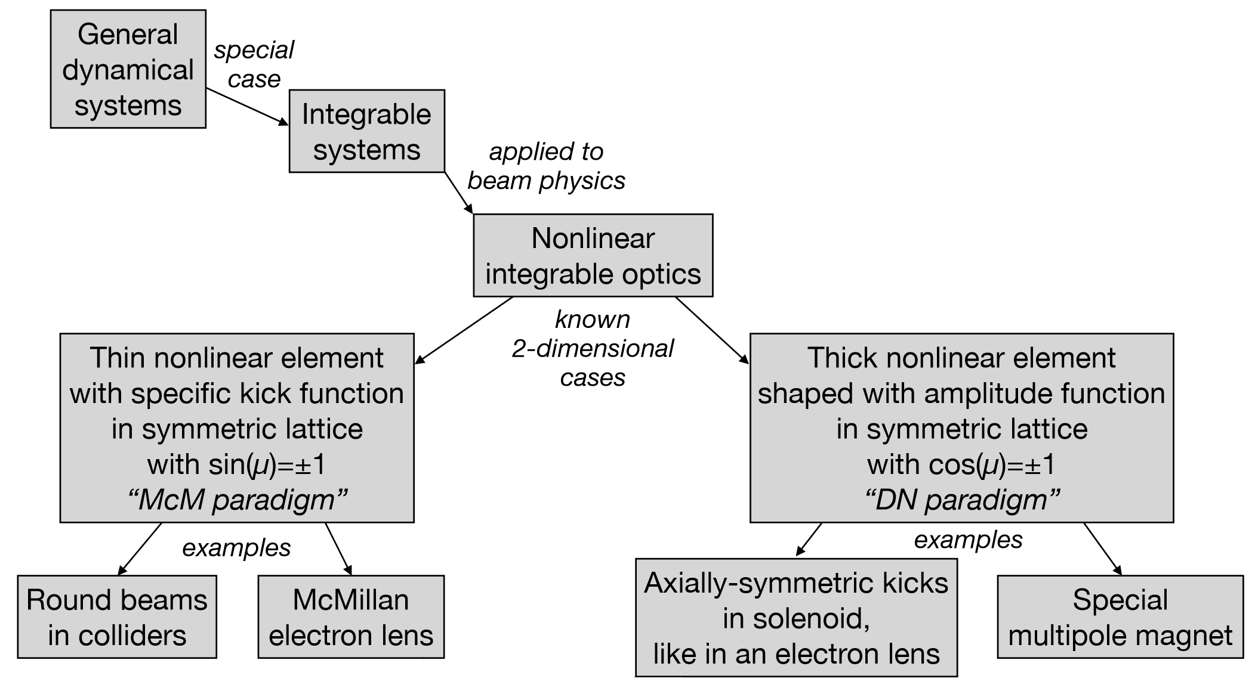
Several Methods for Nonlinear Integrable Optics
7
Integrable Particle Dynamics in Accelerators | Jan 2019 USPAS
Notes:
7
7
7
7

Slide 8
8
8
FAST/IOTA Facility
8
Integrable Particle Dynamics in Accelerators | Jan 2019 USPAS
Notes:
8
8
8
8
8
8

Slide 9
Fermilab AST Facility
FAST: Fermilab Accelerator Science and Technology
300 MeV electron superconducting linac
2.5 MeV proton normal-conducting RFQ (early 2020)
IOTA ring for beam physics experiments
To be operated with either protons or electrons
IOTA: Integrable Optics Test Accelerator
9
Integrable Particle Dynamics in Accelerators | Jan 2019 USPAS
Notes:
9
9
9
9

Slide 10
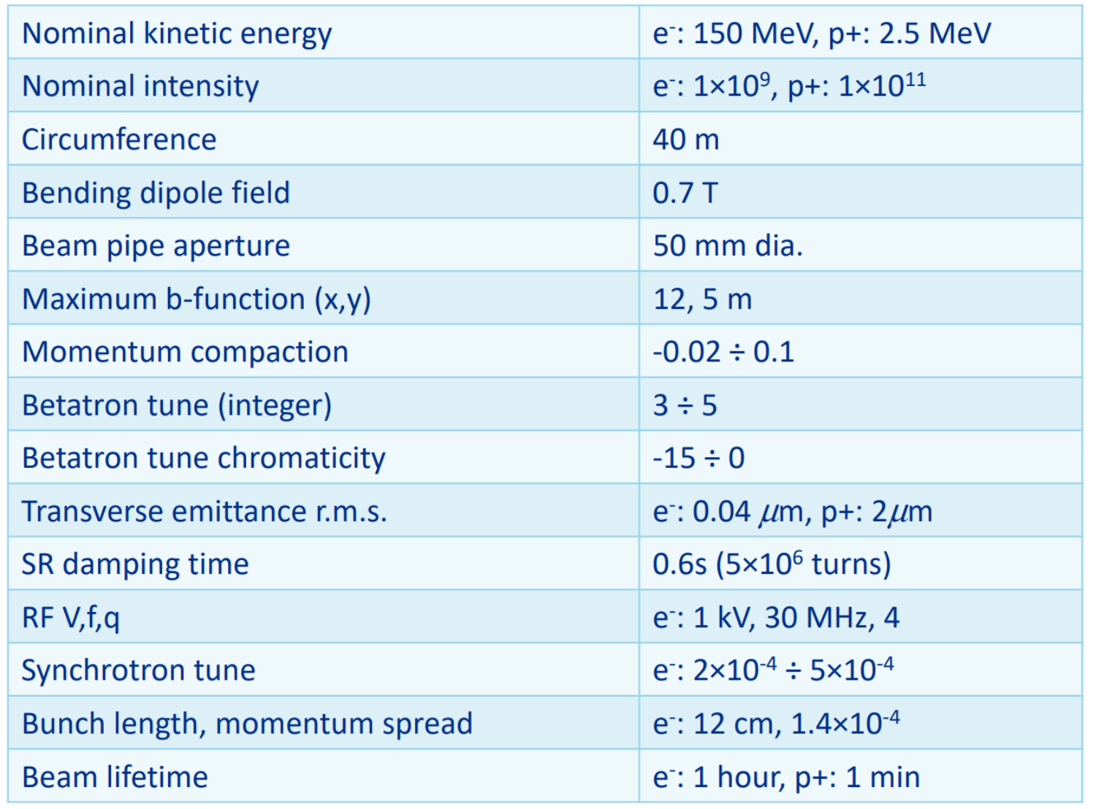
IOTA Parameters
10
Integrable Particle Dynamics in Accelerators | Jan 2019 USPAS
Notes:
10
10
10
10

Slide 11
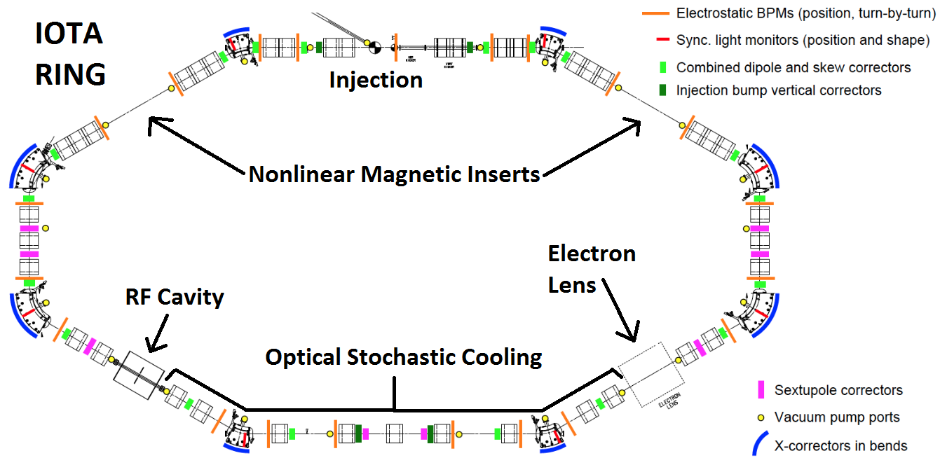
Integrable Optics Test Accelerator
Modular, Flexible, Cost-effective Accelerator
11
Integrable Particle Dynamics in Accelerators | Jan 2019 USPAS
Notes:
11

Slide 12
Integrable Optics Test Accelerator
Nonlinear Integrable Optics Experiments:
Nonlinear Elliptic Magnet for Danilov-Nagaitsev Type
Octupole String for Quasi-Integrable Henon-Heiles Type
Electron Lens for Integrable Optics
- Polar-Coordinate Potential
- McMillan-Type Thin Nonlinear Kick
Other FAST/IOTA Experiments:
Quantum Effects in Single-Electron Storage
Optical Stochastic Cooling for Bright Electron Beams
Electron Column/Lens Space-charge Compensation
FAST Electron Linac as ILC prototype
Inverse Compton Scattering X-Ray Source
12
Integrable Particle Dynamics in Accelerators | Jan 2019 USPAS
Notes:
12
12
12
12

Slide 13
13
13
Nonlinear Magnets
for Integrable Optics
13
Integrable Particle Dynamics in Accelerators | Jan 2019 USPAS
Notes:
13
13
13
13
13
13

Slide 14
Remove Time-Dependence: H becomes invariant
Continuous focusing linear accelerator with equal focusing in horizontal and vertical, then add some potential V:
Transform to normalized coordinates:
Chose V to remove all time-dependence (s, ψ dependence):
The nonlinear potential V varies longitudinally with beam size.
14
Integrable Particle Dynamics in Accelerators | Jan 2019 USPAS
Notes:
14
14
14
14

Slide 15
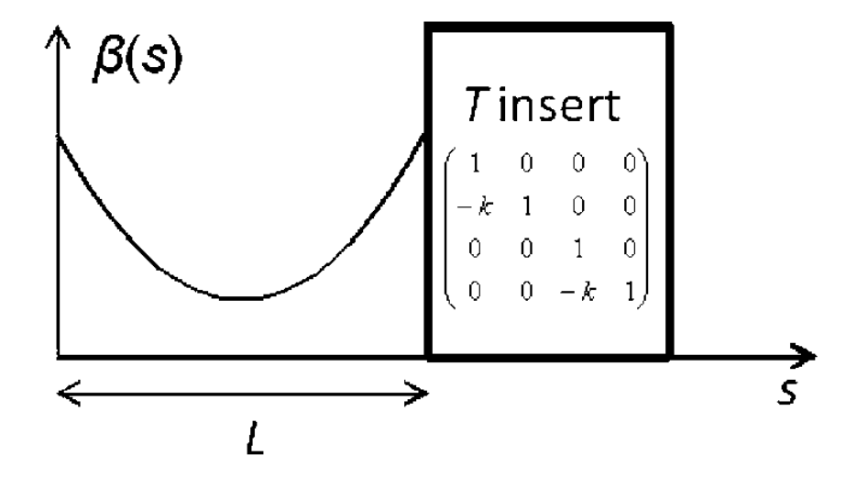
Remove Time-Dependence: H becomes invariant
But we started with a continuous focusing linear accelerator with equal horizontal and vertical optics…
Instead, make a conventional linear accelerator but with nπ phase-advance and matched beta functions, followed by a nonlinear insert:
In the nonlinear insert, the potentials scales with the beam.
In the T-insert, the beam oscillates linearly and the betatron phase is the same at start and end, in both planes.
15
Integrable Particle Dynamics in Accelerators | Jan 2019 USPAS
Notes:
15
15
15
15

Slide 16
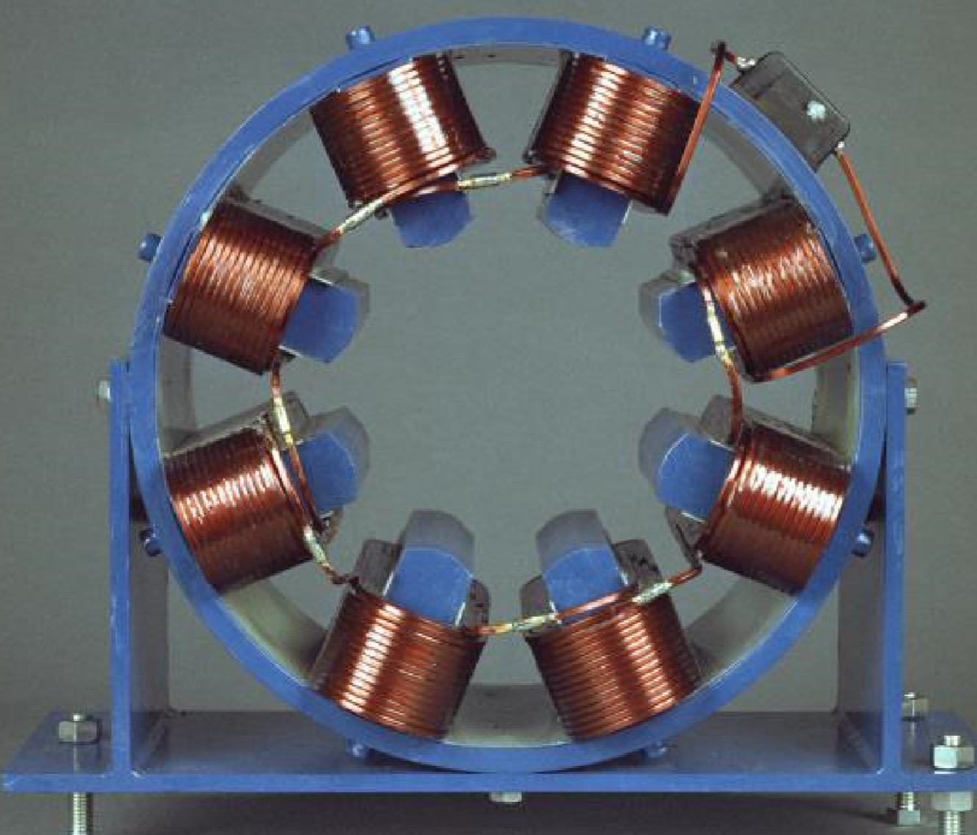
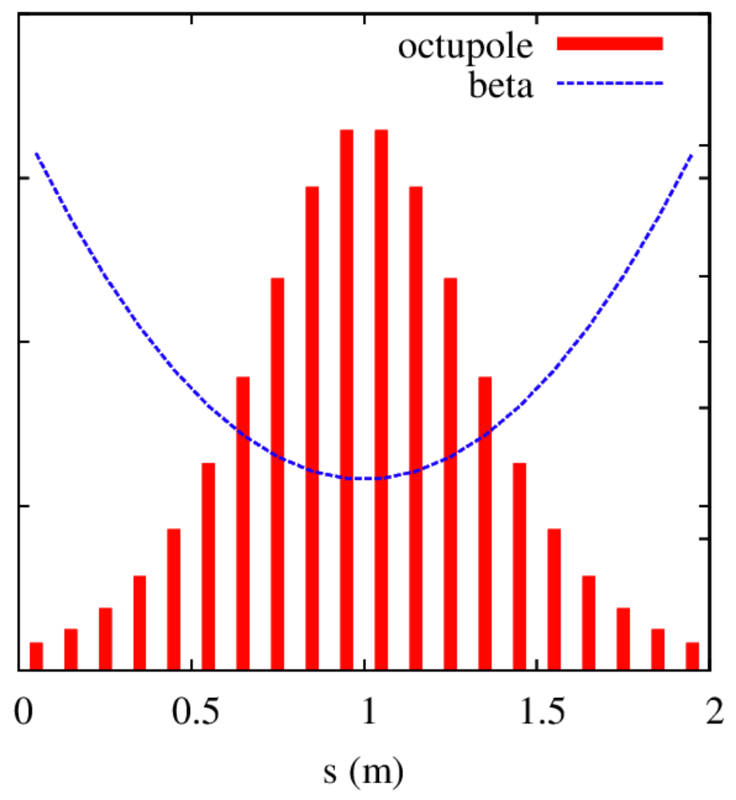
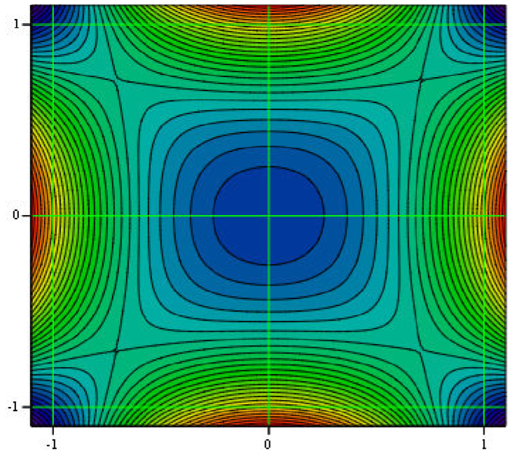
Octupole-String
If we prepare a generic nonlinear potential this way, for example octupoles, there will generally be only invariant of motion.
We may have removed time-dependent resonances, but there will still be coupling resonances between the transverse degrees of freedom. We term this quasi-integrable or Henon-Heiles-type.
16
Integrable Particle Dynamics in Accelerators | Jan 2019 USPAS
Notes:
16
16
16
16

Slide 17
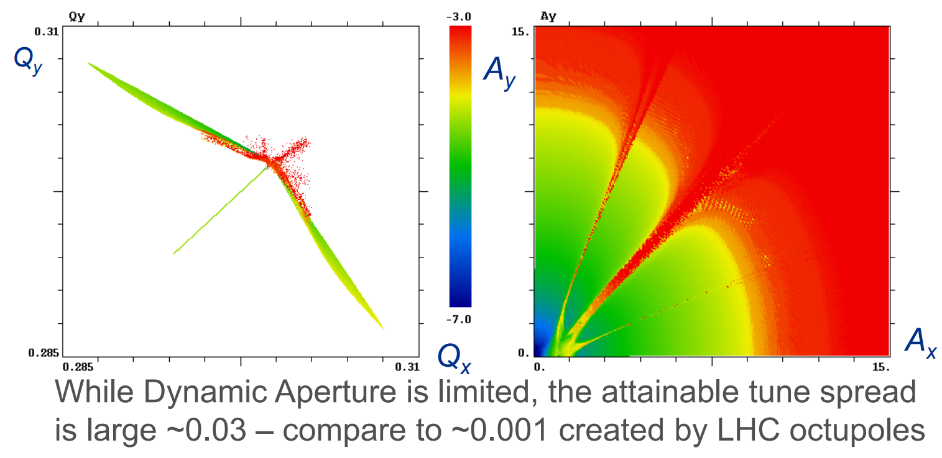
Performance of Octupole Henon-Heiles
What is the tune-spread within the dynamic aperture?
17
Integrable Particle Dynamics in Accelerators | Jan 2019 USPAS
Notes:
17
17
17
17

Slide 18
Second-Invariant
If we know there is a second invariant I for Hamiltonian H,
it is easy to verify it:
So we can assume a generic form of I, impose [H,I] = 0 ,
and see we can find a usable solution:
wlog,
a=1:
18
Integrable Particle Dynamics in Accelerators | Jan 2019 USPAS
Notes:
18
18
18
18

Slide 19
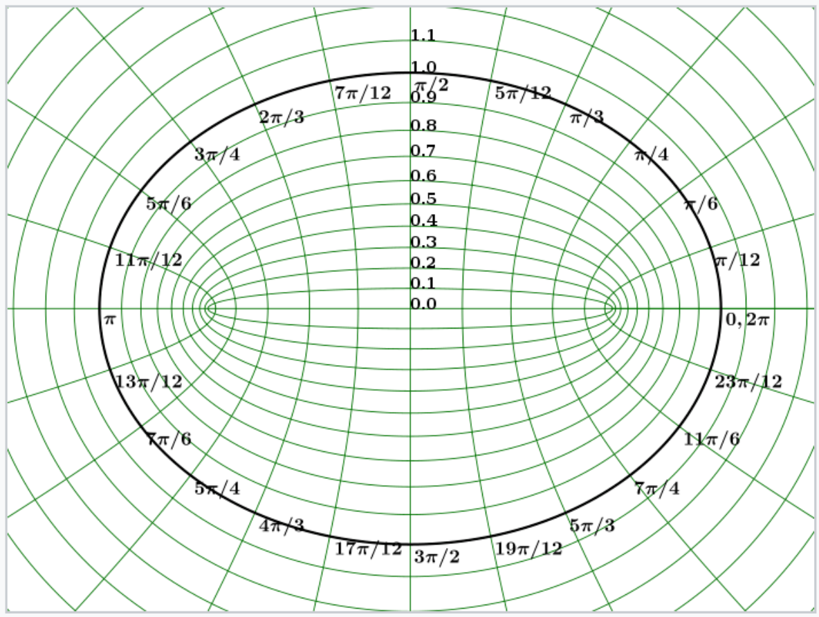
Second-Invariant, elliptic
Bertrand-Darboux Equation:
The solution emerges from elliptic coordinates:
19
Integrable Particle Dynamics in Accelerators | Jan 2019 USPAS
Notes:
19
19
19
19

Slide 20
Second-Invariant with magnets
If we want a potential we can implement with magnets, we have to further impose Laplace’s Equation:
If there is any dipole-term, this will immediately generate dispersion, so we should further impose:
Linear term:
Nonlinear term:
20
Integrable Particle Dynamics in Accelerators | Jan 2019 USPAS
Notes:
20
20
20
20

Slide 21
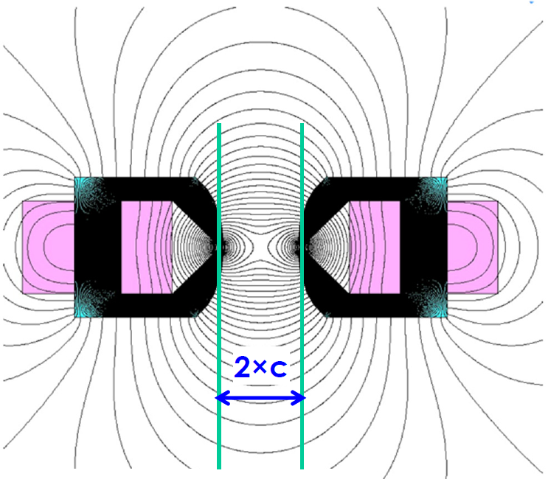
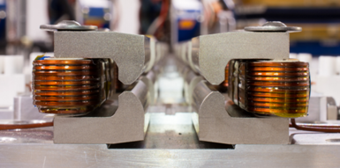
Nonlinear Elliptic Potential
21
Integrable Particle Dynamics in Accelerators | Jan 2019 USPAS
Notes:
21
21
21
21

Slide 22
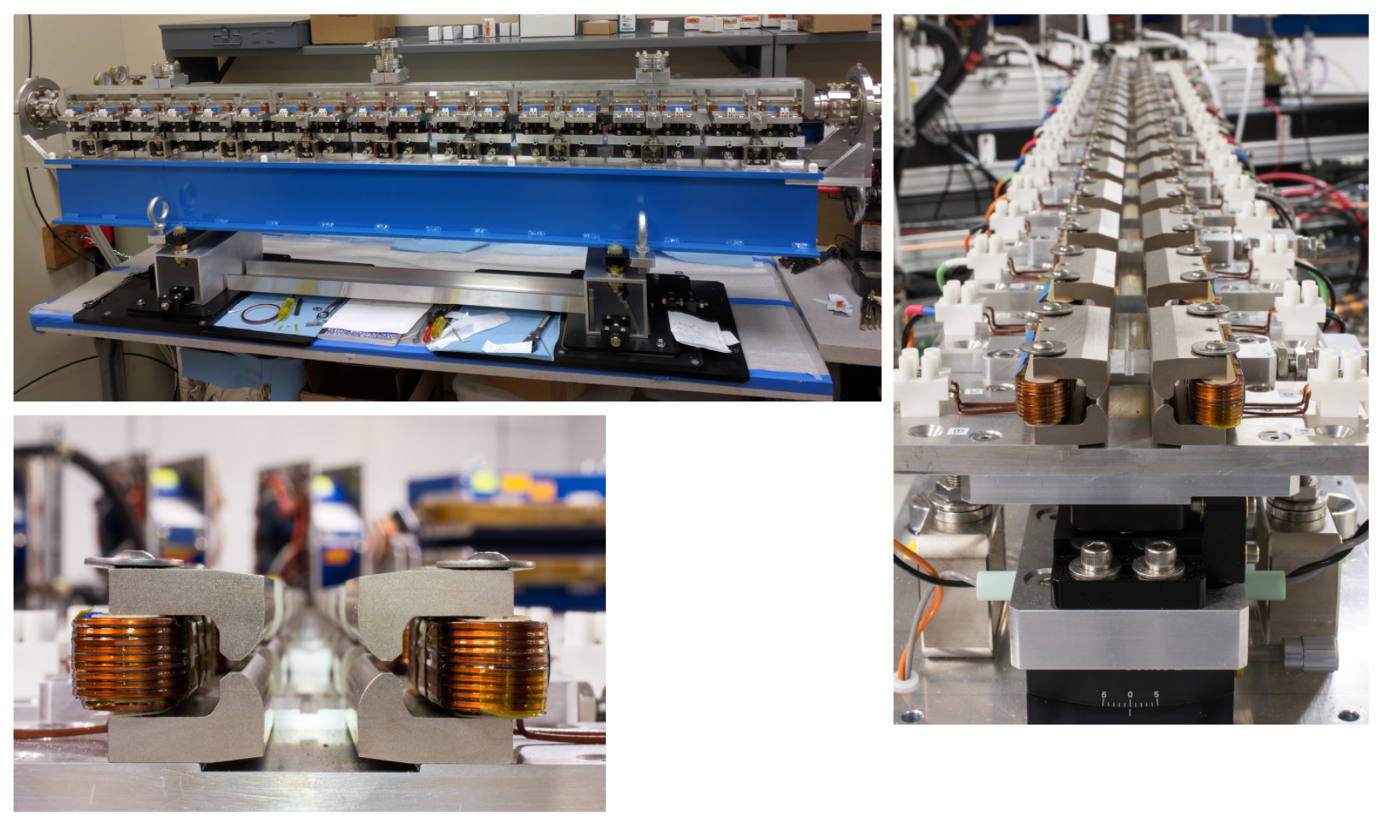
Segmented Elliptic Magnet
22
Integrable Particle Dynamics in Accelerators | Jan 2019 USPAS
Notes:
22
22
22
22

Slide 23
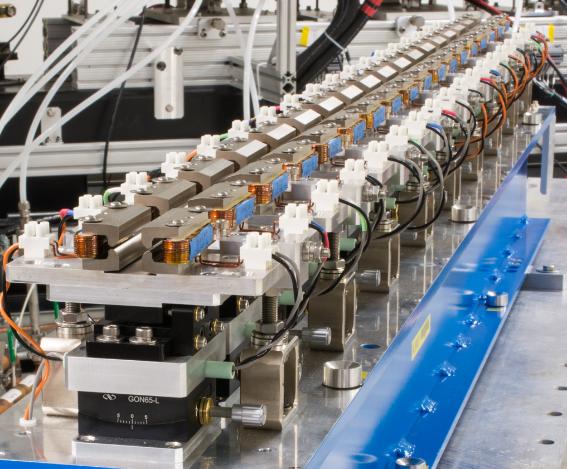
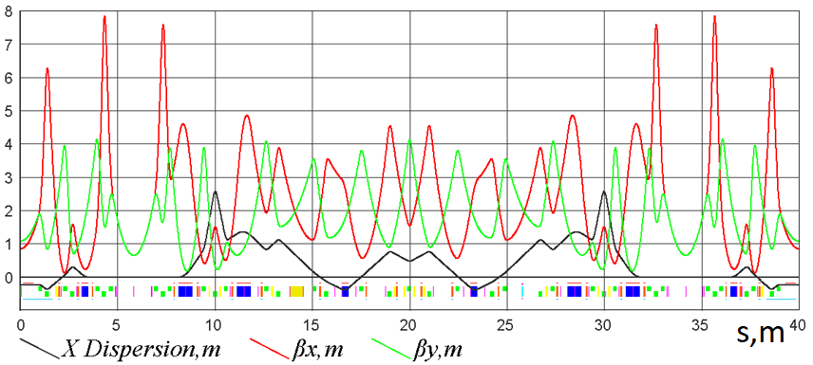
IOTA Lattice with NL Insert
Nonlinear insert:
23
23
Integrable Particle Dynamics in Accelerators | Jan 2019 USPAS
1/30/2019

Slide 24
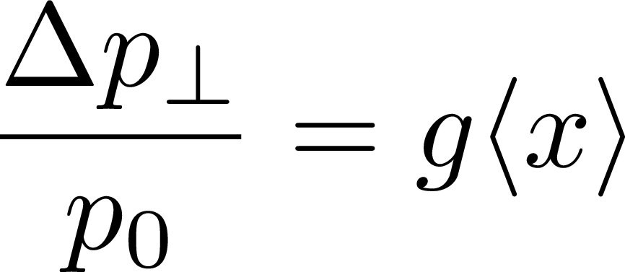
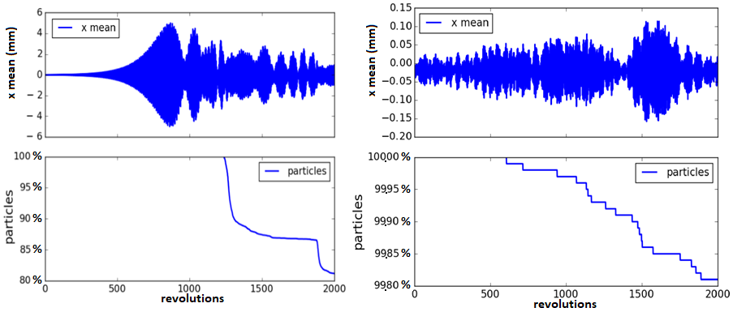
Landau Damping vs. Antidamper
Emulate a collective instability with an anti-damper:
Nonlinear element reduces max centroid oscillation by factor of 50 and reduces particle loss by factor 100.
IOTA with sextupoles IOTA with nonlinear insert
Stern, Amundson, Macridin, IPAC 2018
24
24
Integrable Particle Dynamics in Accelerators | Jan 2019 USPAS
1/30/2019

Slide 25
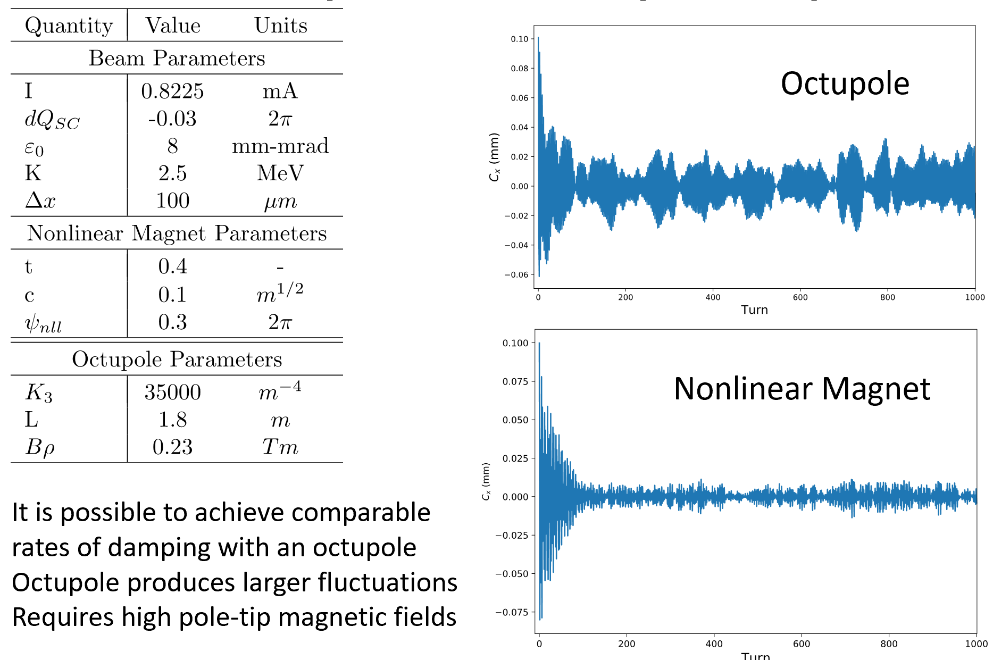
Damping Performance vs. Octupole
For an initially displaced beam:
Chirs Hall, Radiasoft, IOTA 2017
25
Integrable Particle Dynamics in Accelerators | Jan 2019 USPAS
Notes:
25
25
25
25

Slide 26
Damping Animation
Chirs Hall, Radiasoft, IOTA 2017
26
Integrable Particle Dynamics in Accelerators | Jan 2019 USPAS
Notes:
26
26
26
26

Slide 27
27
27
Nonlinear Electron Lens
for Integrable Optics
27
Integrable Particle Dynamics in Accelerators | Jan 2019 USPAS
Notes:
27
27
27
27
27
27

Slide 28
Second-Invariant, Polar coordinates
c=0:
Imposing Laplace’s equation may be too constraining:
So look for solutions without Laplace’s equation.
Use an electron lens to make an arbitrary circular potential f(r).
28
Integrable Particle Dynamics in Accelerators | Jan 2019 USPAS
Notes:
28
28
28
28

Slide 29
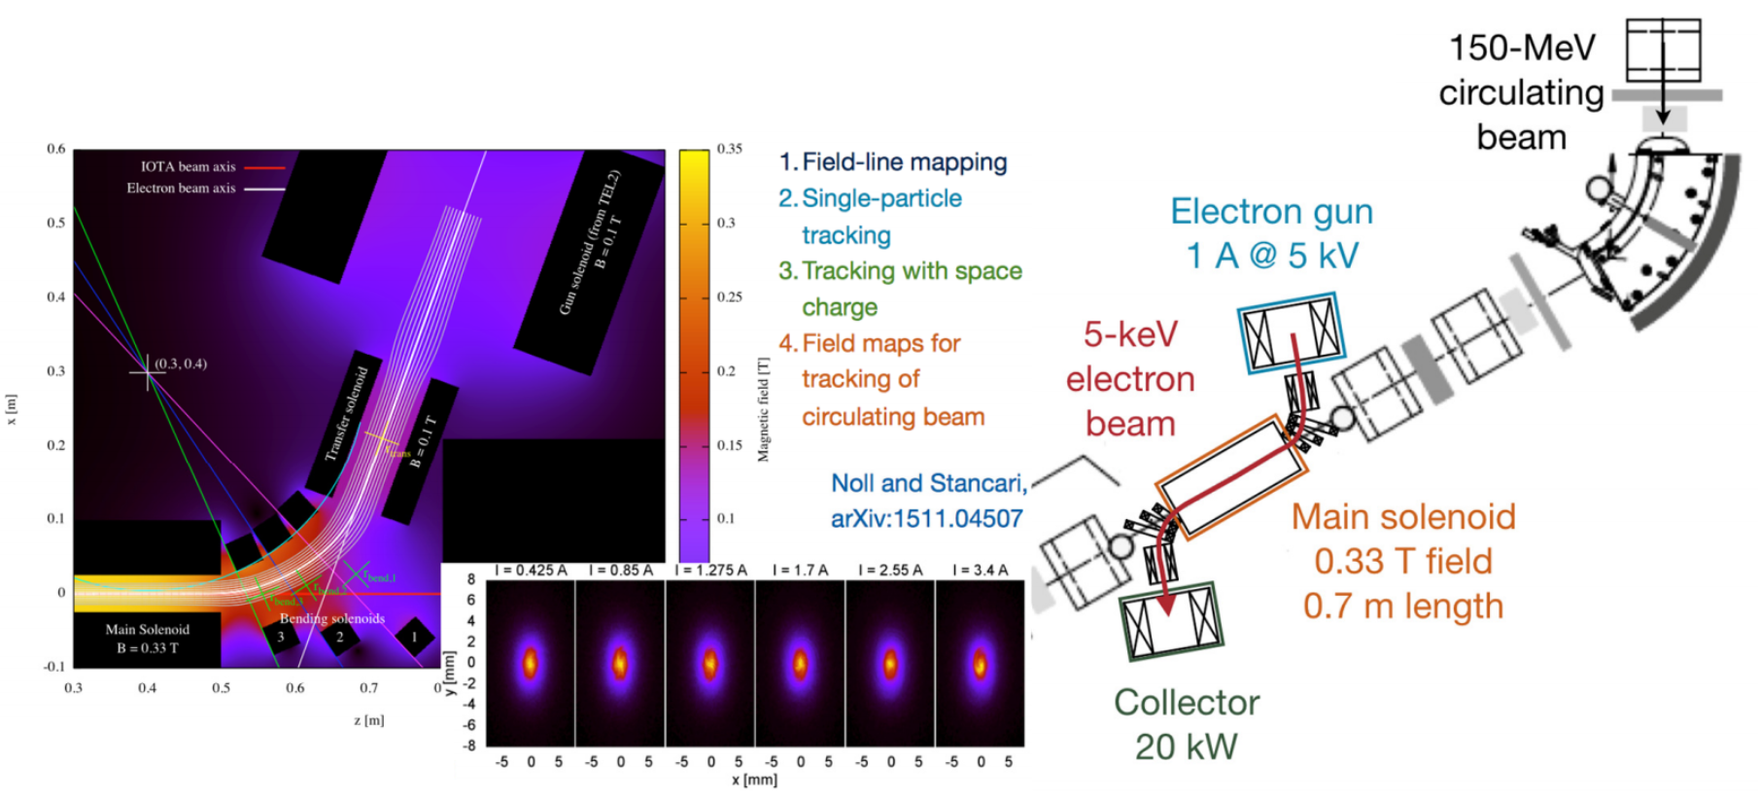
Electron Lens
Intense electron beam created at high voltage.
E-beam profile shaped by electrodes.
E-beam transported with strong solenoid.
Electrons collected after single pass.
Stancari
29
29
Integrable Particle Dynamics in Accelerators | Jan 2019 USPAS
1/30/2019

Slide 30
Round, Thick-Lens Kick
Following the previous recipe, the electron beam should be tapered to match the proton beam size. But this is may be difficult.
Instead, use the solenoid to maintain constant beta functions of the proton beam and then apply a constant electron beam.
The electron beam distribution
can be any round distribution.
e.g. Gaussian profile
30
30
Integrable Particle Dynamics in Accelerators | Jan 2019 USPAS
1/30/2019

Slide 31
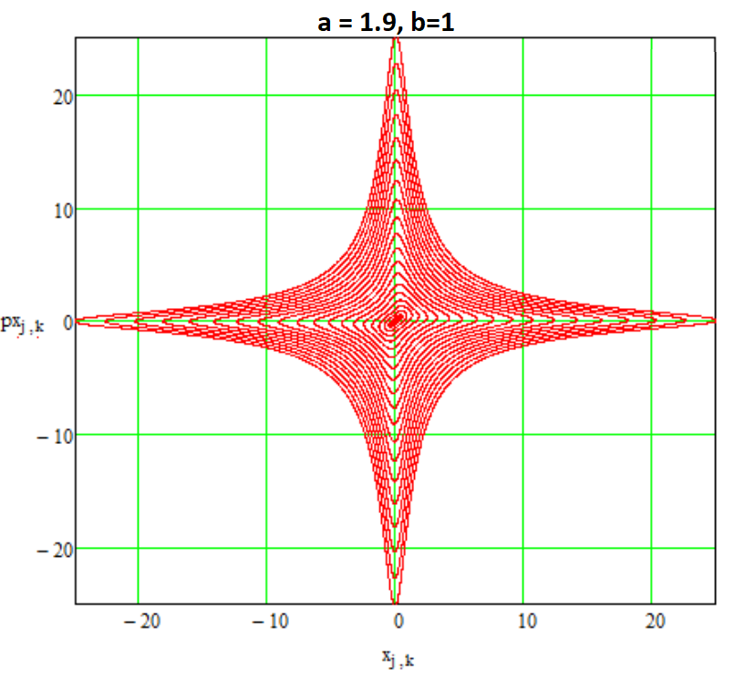
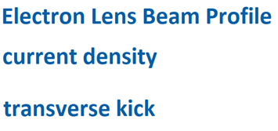
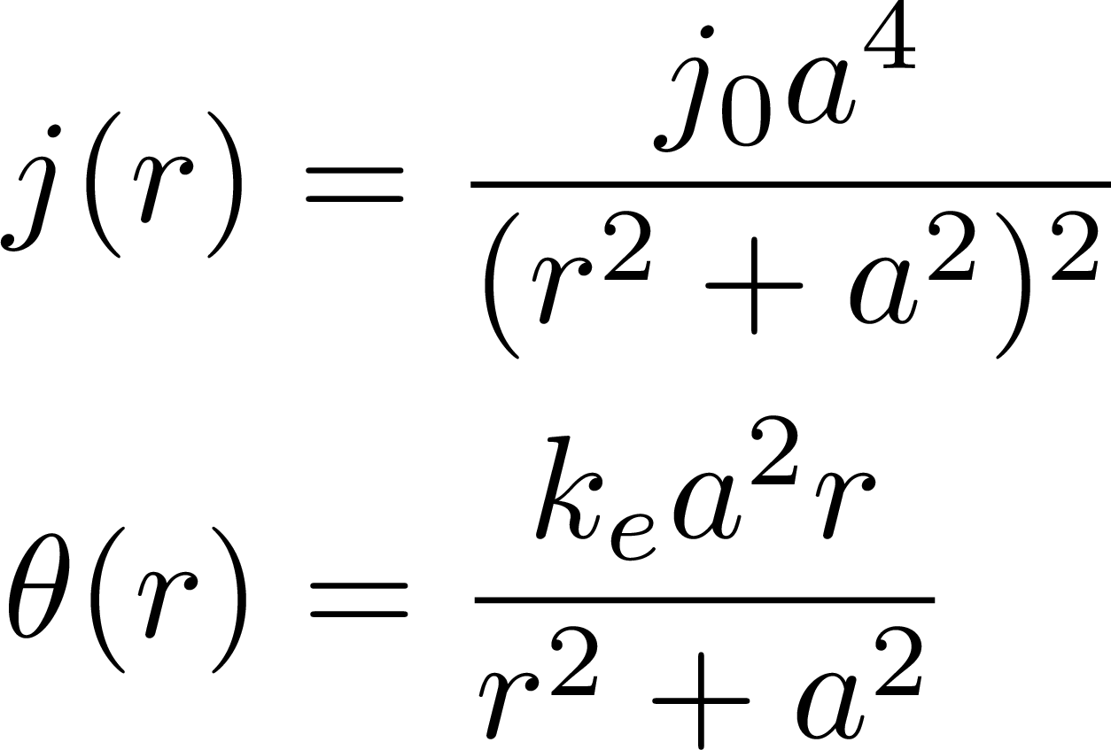
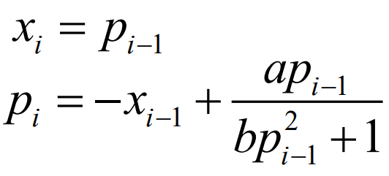
McMillan-Type Thin Kick
We can also use the electron lens to implement the McMillan Map:
The electron lens should be a thin kick, β > L
31
31
Integrable Particle Dynamics in Accelerators | Jan 2019 USPAS
1/30/2019

Slide 32
Implementation in IOTA Ring

Slide 33
Implementation in IOTA Ring
33
33
Integrable Particle Dynamics in Accelerators | Jan 2019 USPAS
1/30/2019

Slide 34
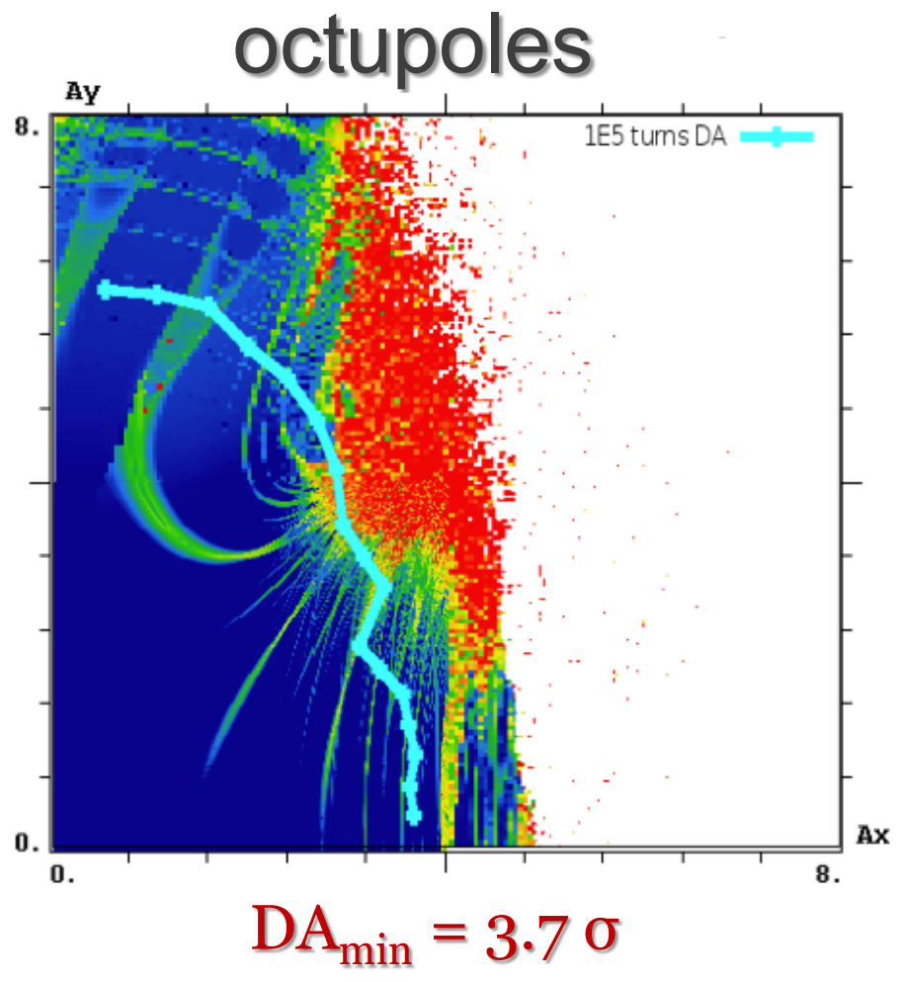
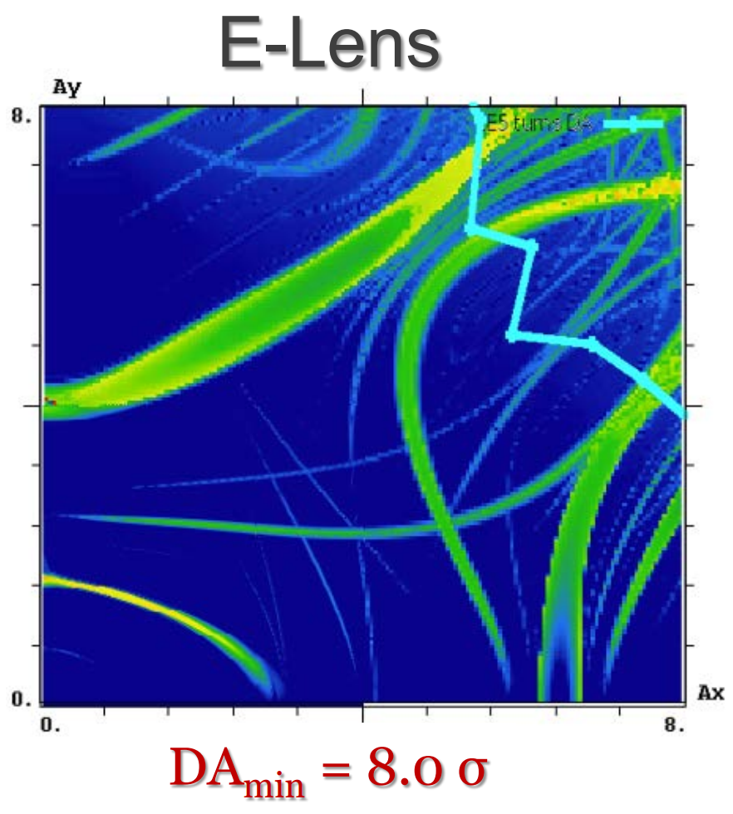
Simulation HL-LHC with Electron Lens Landau Damping
Shiltsev PRL 2017
34
34
Integrable Particle Dynamics in Accelerators | Jan 2019 USPAS
1/30/2019

Slide 35
Several Methods for Nonlinear Integrable Optics
35
Integrable Particle Dynamics in Accelerators | Jan 2019 USPAS
Notes:
35
35
35
35

