Slide 1
1
1
Integrable Ring Design
Jeffrey Eldred, with Sergei Nagaitsev & Timofey Zolken
Integrable Particle Dynamics in Accelerators
January 2019 USPAS at Knoxville
Notes:
1
1
1
1
1
1

Slide 2
Design Challenges
Applications at Fermilab
What goes into an integrable lattice design?
What happens when there is chromaticity & momentum spread?
What happens when there is space-charge forces?
2
Integrable Particle Dynamics in Accelerators | Jan 2019 USPAS
Notes:
2
2
2
2

Slide 3
3
3
Motivation
3
Integrable Particle Dynamics in Accelerators | Jan 2019 USPAS
Notes:
3
3
3
3
3
3

Slide 4
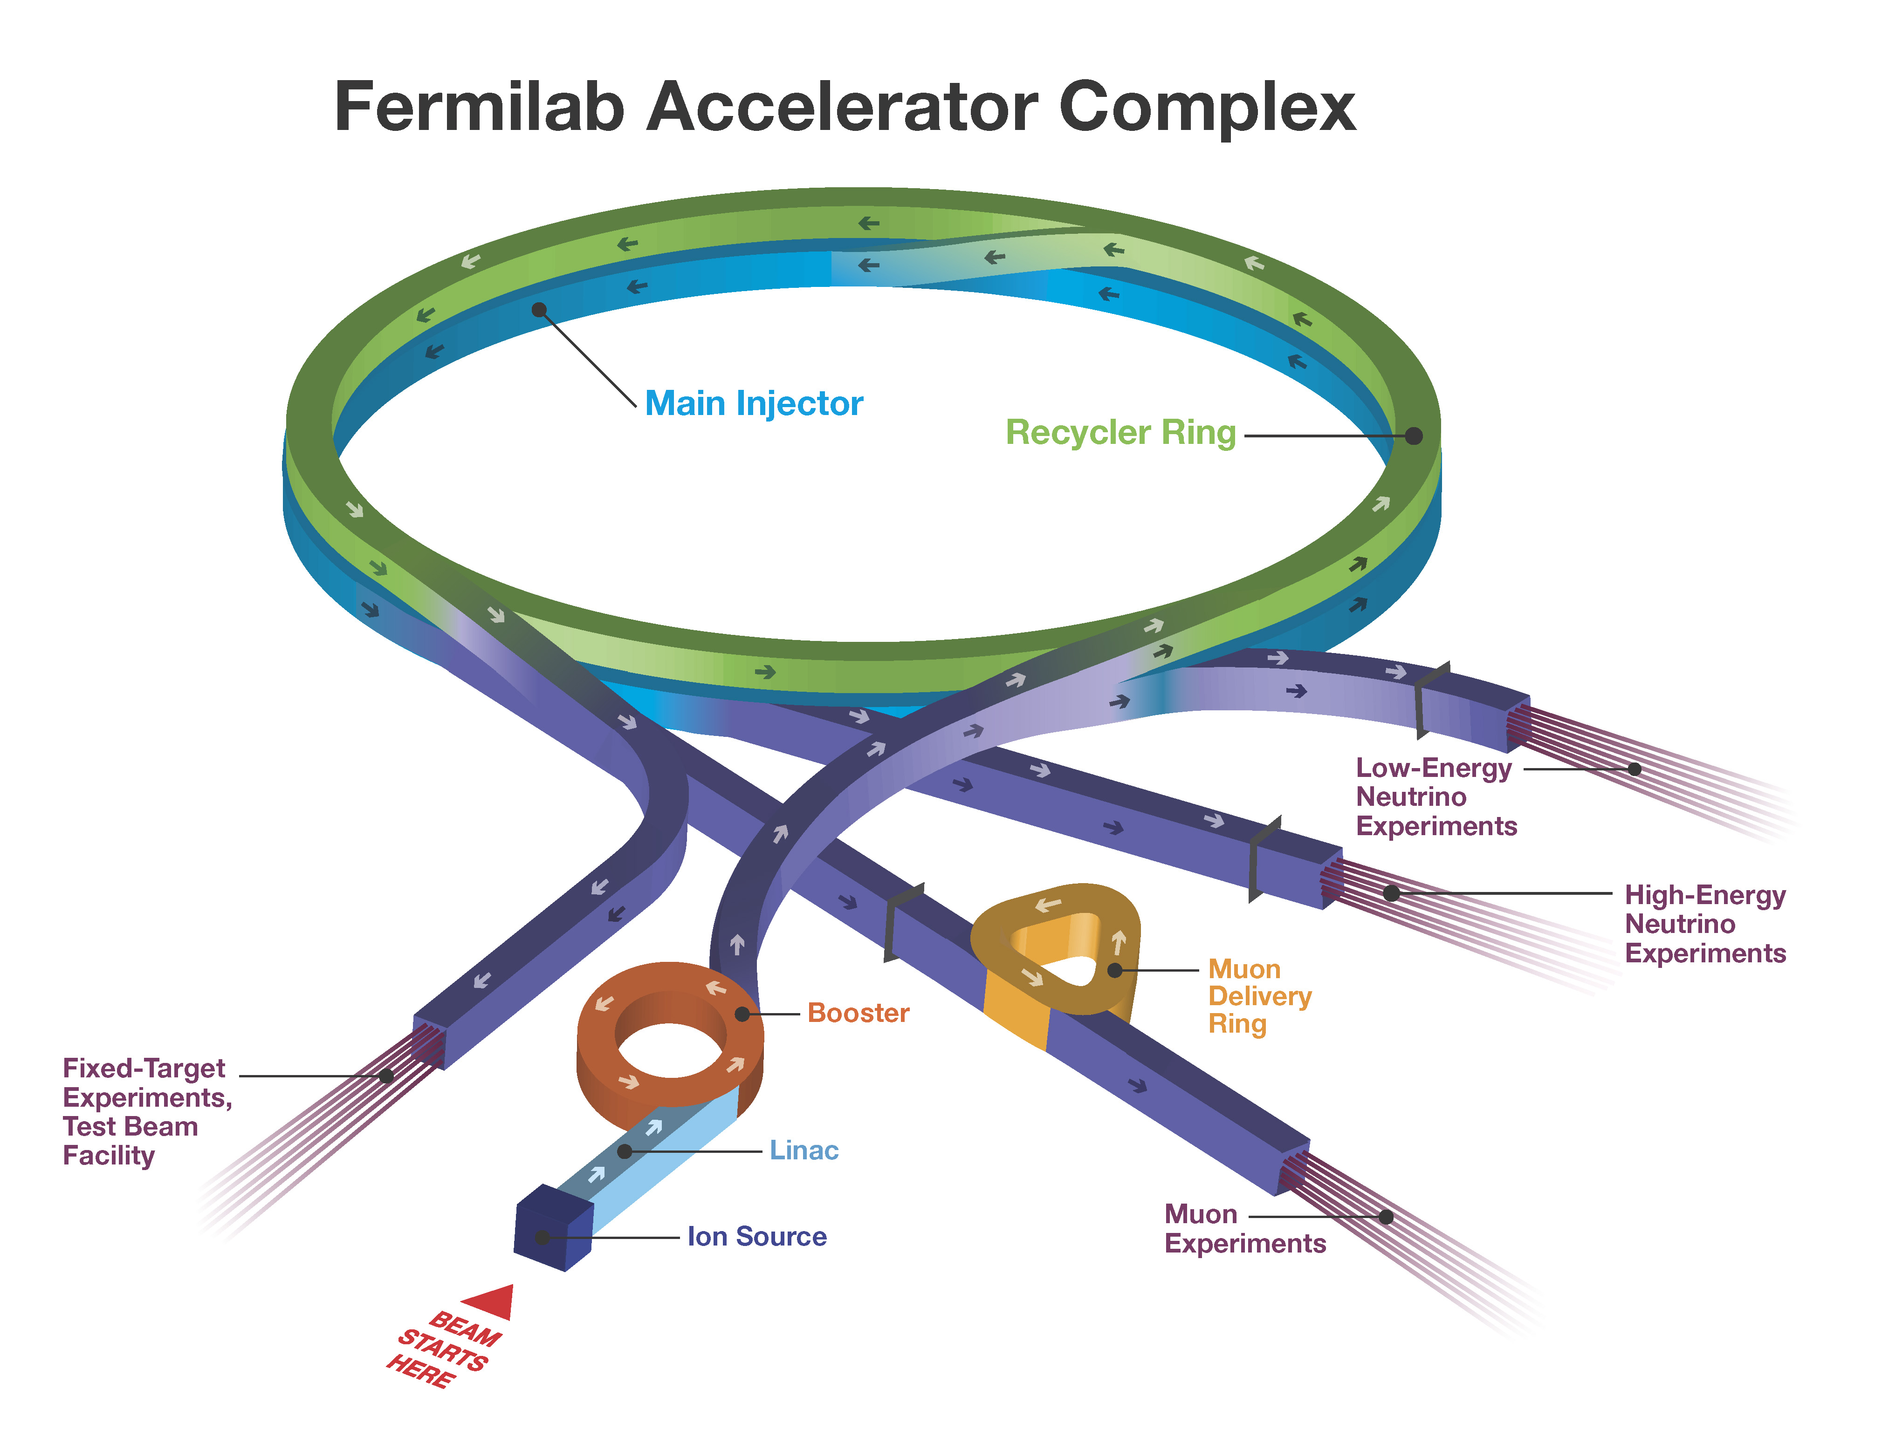
4
4
Fermilab Upcoming Upgrades
4
Integrable Particle Dynamics in Accelerators | Jan 2019 USPAS
Notes:
4
4
4
4
4
4

Slide 5
5
5
Fermilab Upcoming Upgrades 1.2MW, ~2026
1.2 MW LBNF
Neutrinos
to DUNE
PIP-II
SRF Linac
0.8 GeV
5
Integrable Particle Dynamics in Accelerators | Jan 2019 USPAS
Notes:
5
5
5
5
5
5

Slide 6
6
6
Fermilab Upcoming Upgrades 2.4MW, ~2032
2.4 MW LBNF
Neutrinos
to DUNE
PIP-II
SRF Linac
0.8 GeV
Replace
Booster
6
Integrable Particle Dynamics in Accelerators | Jan 2019 USPAS
Notes:
6
6
6
6
6
6

Slide 7
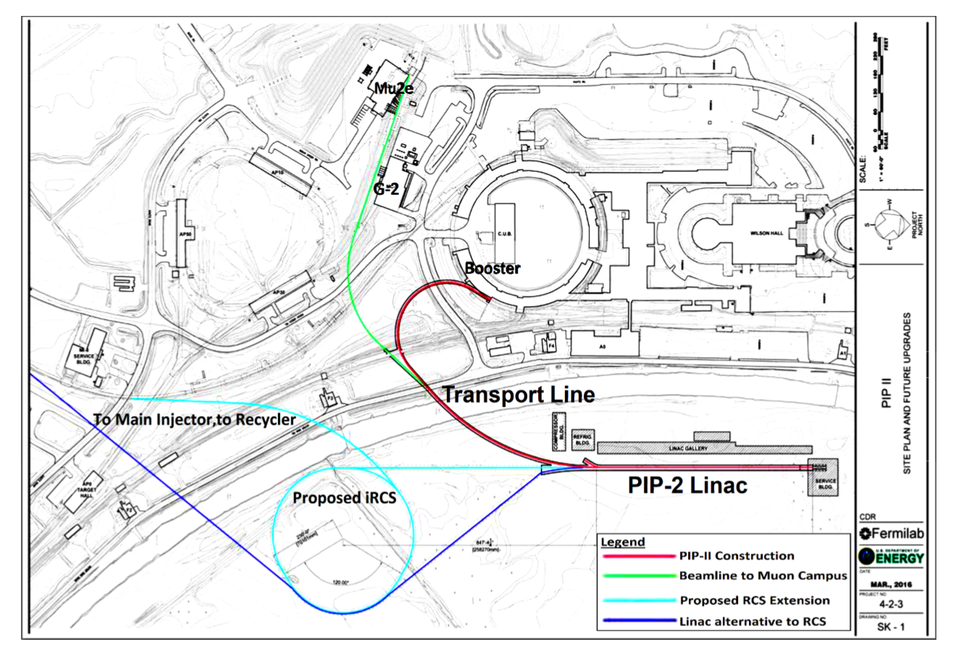
7
7
“PIP-III” New RCS to replace Booster
7
Integrable Particle Dynamics in Accelerators | Jan 2019 USPAS
Notes:
7
7
7
7
7
7

Slide 8
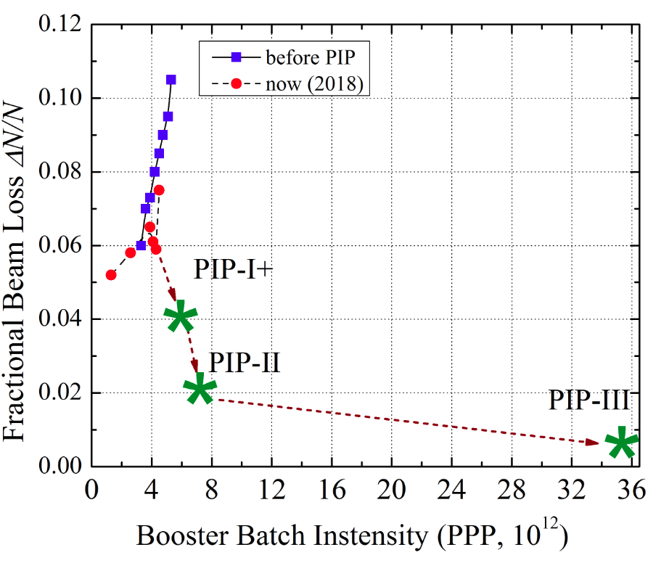
8
8
Fermilab Loss Limits
Shiltsev
Radio-activation of particle accelerator a major operation limits.
Losses must be kept within absolute limits, which mean power increases require a reduction in loss rate.
8
Integrable Particle Dynamics in Accelerators | Jan 2019 USPAS
Notes:
8
8
8
8
8
8

Slide 9
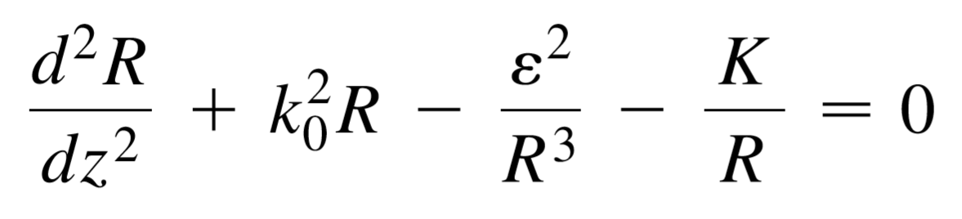
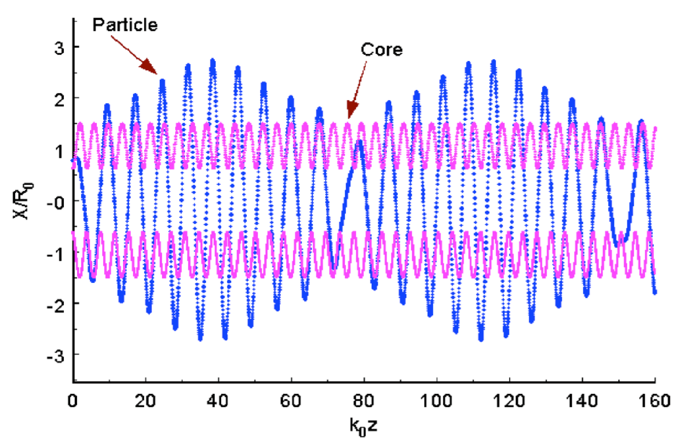
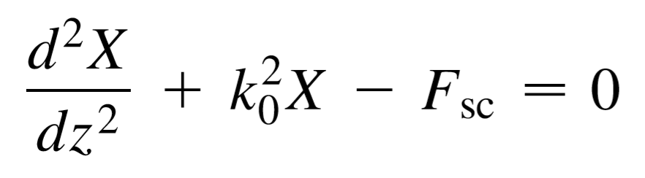
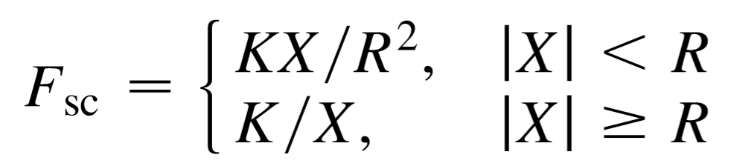
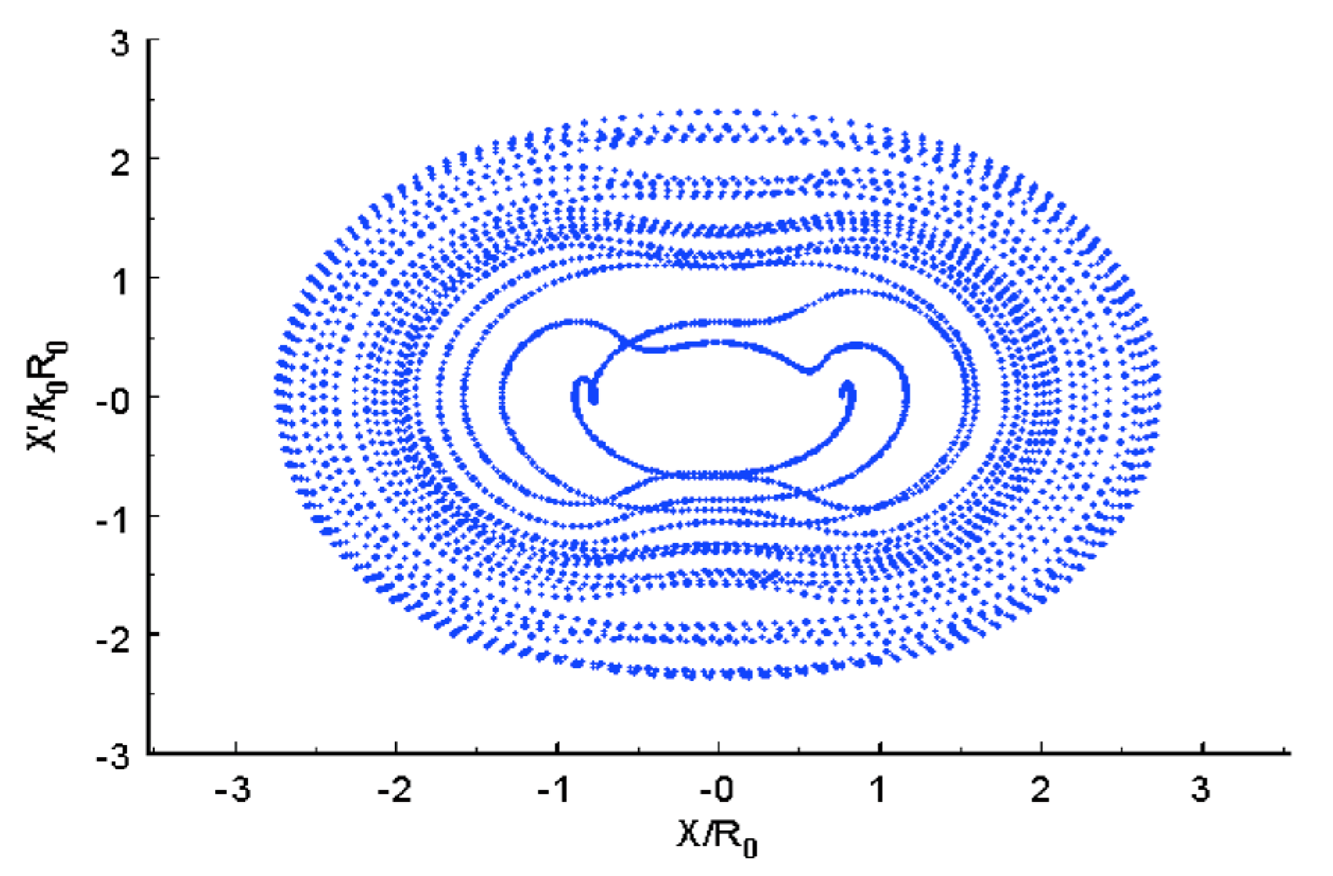
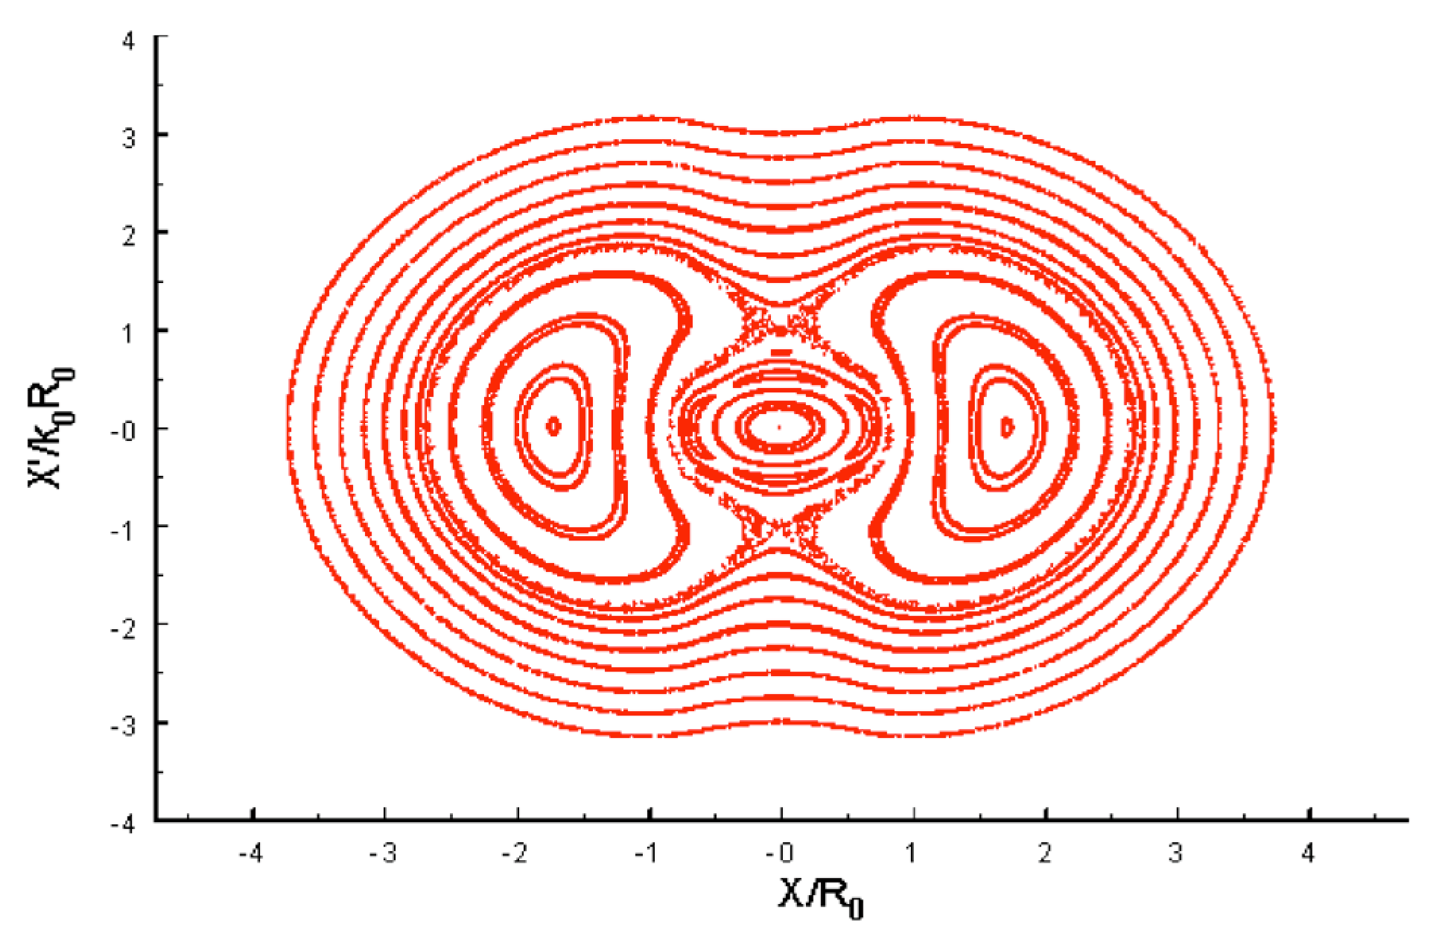
Core-Halo Model
T. Wangler et al. PRSTAB 1998
9
Integrable Particle Dynamics in Accelerators | Jan 2019 USPAS
Notes:
9
9
9
9

Slide 10
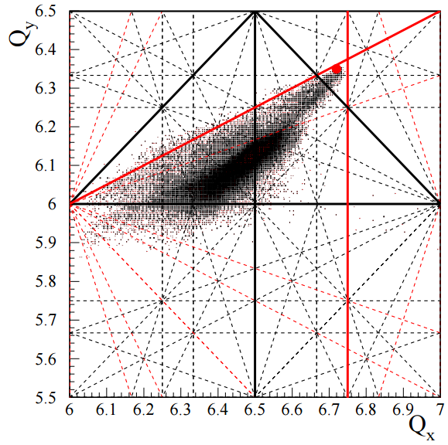

Betatron Tune Spread
Laslett Tune-shift
Solutions:
Increase Injection Energy
Increase Magnet Aperture
Lattice Optics
Instead of avoiding resonance lines, can be reduce the consequences of crossing them.
10
Integrable Particle Dynamics in Accelerators | Jan 2019 USPAS
Notes:
10
10
10
10

Slide 11
11
11
Lattice
11
Integrable Particle Dynamics in Accelerators | Jan 2019 USPAS
Notes:
11
11
11
11
11
11

Slide 12


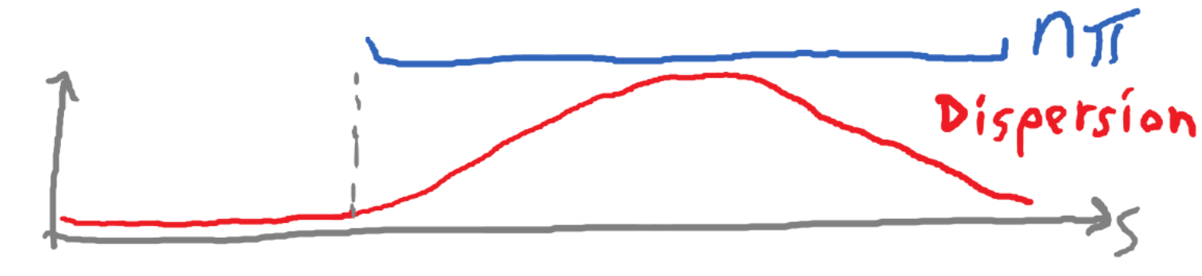
12
Integral Design with Periodicity
Standard FODO Cell:
Q_{F}
Q_{D}
Dip
Q_{F}
Dip
Q_{D}
Dip
Q_{F}
Dip
Q_{D}
Q_{F}
Q_{D}
Q_{F}
NL
Q_{F}
Q_{D}
12
Integrable Particle Dynamics in Accelerators | Jan 2019 USPAS
Notes:
12
12
12

Slide 13
13
13
Lattice Requirements
Requirements for DN Integrability:
- Pi-phase advance between nonlinear inserts
- Insertion regions dispersion-free
- Matched beta functions through nonlinear inserts
Further Criteria related to Nonlinear Integrable Optics:
- Large phase-advance through Nonlinear Insertion
- Matched Horizontal and Vertical Chromaticity
Criteria related to RCS Design:
- Low momentum compaction factor.
- Small maximum beta functions
- High lattice superperiodicity
- Compact circumference
- Insertions for RF, inj/ext., collimation, etc.
- Minimize required magnet strengths
13
Integrable Particle Dynamics in Accelerators | Jan 2019 USPAS
Notes:
13
13
13
13
13
13

Slide 14
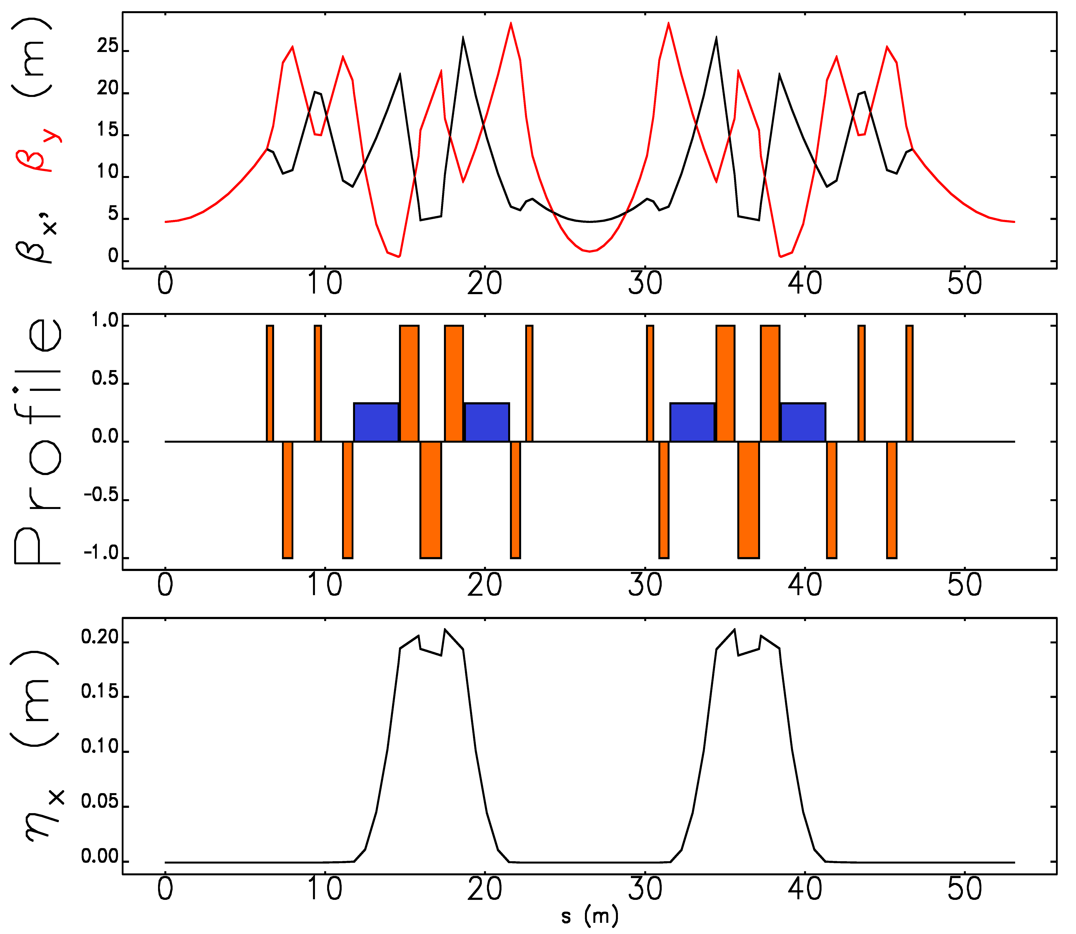
14
Integrable RCS Lattice design
Periodicity: 12
Circumference: 636 m
Bend-radius rho: 15.4 m
Max Beta x,y function: 25 m
Max Dispersion function: 0.22 m
RF Insertion length: 7.2 m, 4x 1.3m
NL Insertion length: 12.7 m
Insert Phase-Advance: 0.3 x 2π
Minimum c-value: 3 cm
Beta at insert center: 5 m
Betatron Tune: 21.6
Natural Chromaticity: -79
Second-order Chromaticity: 1600
Synchrotron Tune: 0.08
NL
NL
14
Eldred, Valishev IPAC 2018
Notes:
14
14
14

Slide 15
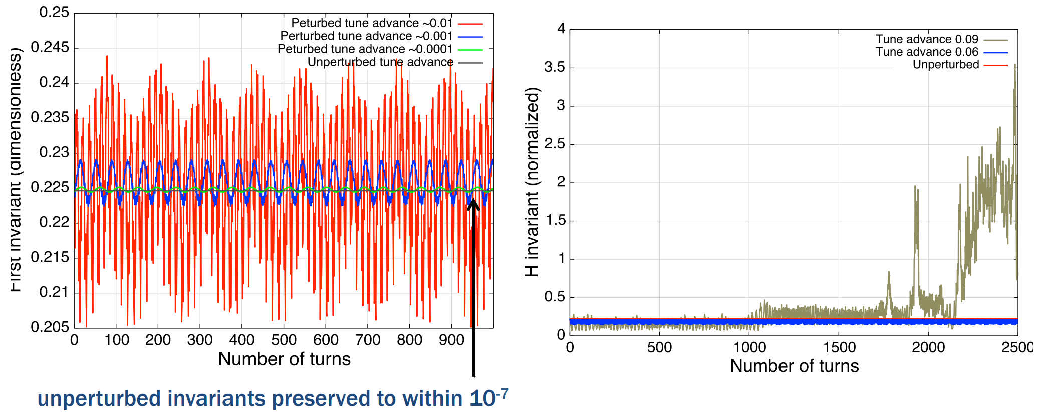
15
Perturbative Approach to Phase-errors
Preservation of invariants, single-particle motion, phase-errors
Perturbation of nonlinear t, phase-advance μ, phase error Δφ
Perceptible: ~0.0001
Behaved: ~0.001
Stable: ~0.05
C. Mitchell, LBL
15
Integrable Particle Dynamics in Accelerators | Jan 2019 USPAS
Notes:
15
15
15

Slide 16
16
16
Chromaticity
16
Integrable Particle Dynamics in Accelerators | Jan 2019 USPAS
Notes:
16
16
16
16
16
16

Slide 17
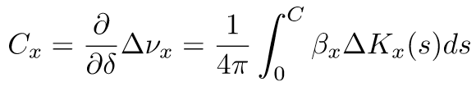



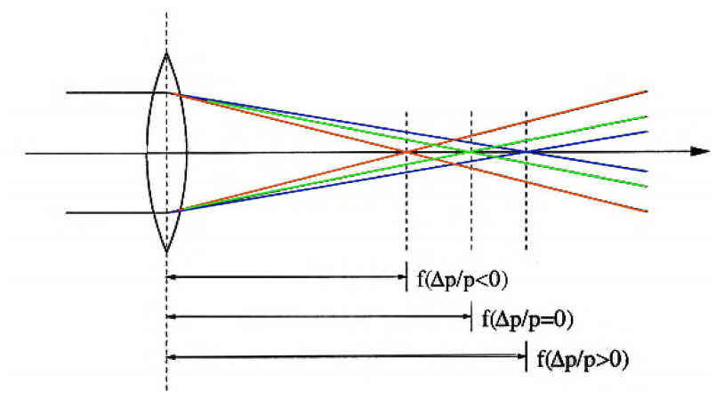
Chromaticity
Change in tune with momentum:
Chromaticity:
Barletta
17
Integrable Particle Dynamics in Accelerators | Jan 2019 USPAS
Notes:
17
17
17
17

Slide 18
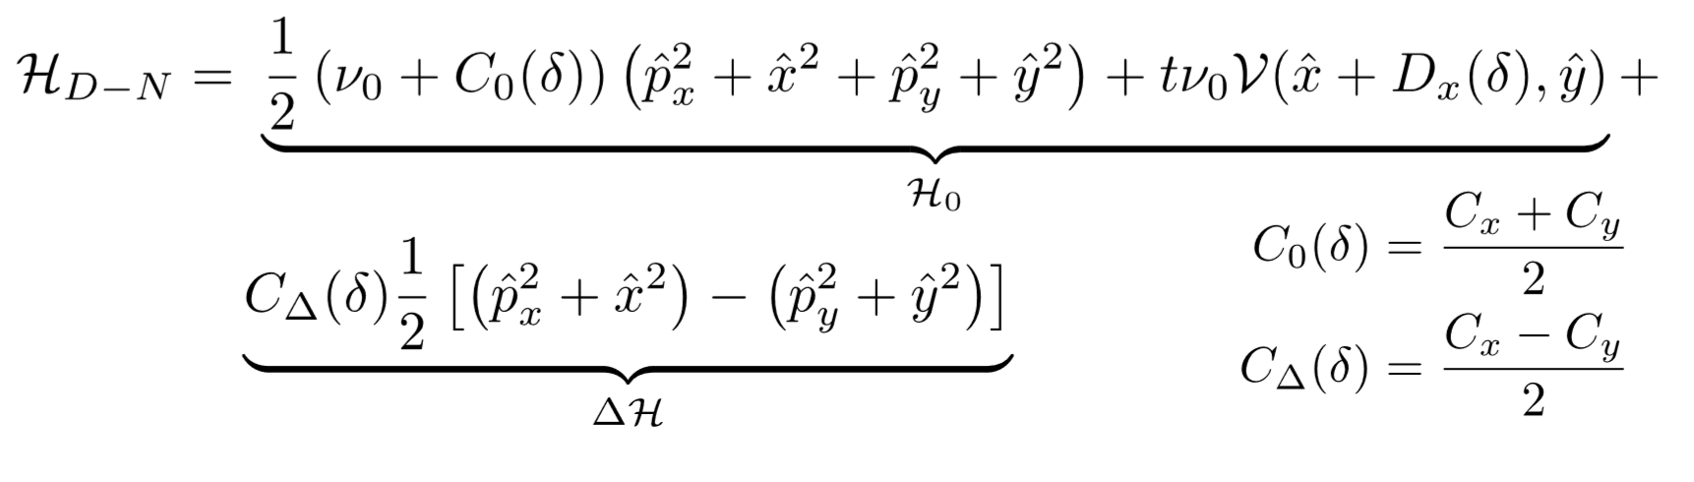
18
18
Chromatic Shifts
S. Webb: Danilov-Nagaitsev Hamiltonian with chromatic shifts
Chromaticity does not have to be zero;
Motion is integrable if horizontal and vertical chromaticity matched.
δ is adiabatic if synchrotron tune (per nonlinear cell) is small.
18
Integrable Particle Dynamics in Accelerators | Jan 2019 USPAS
Notes:
18
18
18
18
18
18

Slide 19
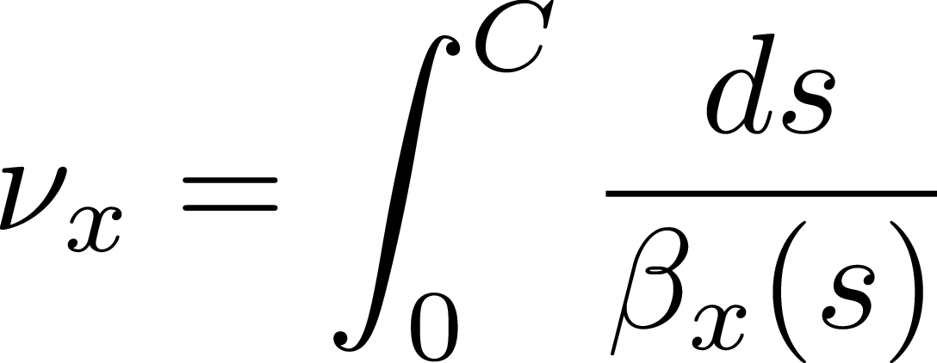
19
19
Natural Chromaticity Matching
Without sextupoles, chromaticity is usually large and negative
But horizontal and vertical chromaticity can still be matched by adjusting peaks in beta functions.
Chromaticity is driven by peak betas and betatron tune is driven by minimum betas, so in principle they can be fine-tuned separately.
The nonlinear chromaticity be as similar as possible
19
Integrable Particle Dynamics in Accelerators | Jan 2019 USPAS
Notes:
19
19
19
19
19
19

Slide 20
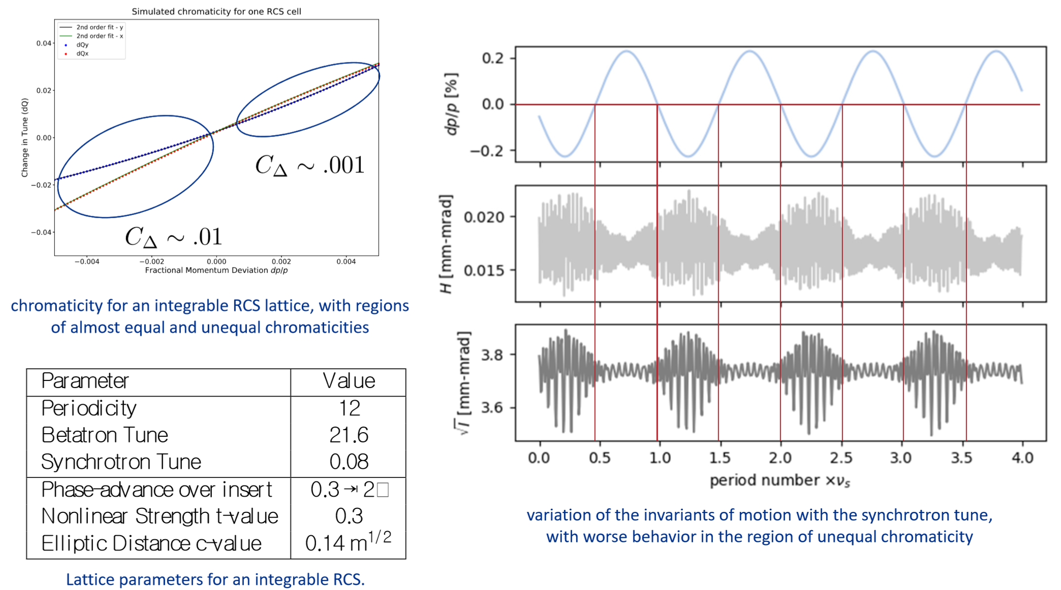
20
20
Chromaticity Matching in simulation
Webb
20
Integrable Particle Dynamics in Accelerators | Jan 2019 USPAS
Notes:
20
20
20
20
20
20

Slide 21
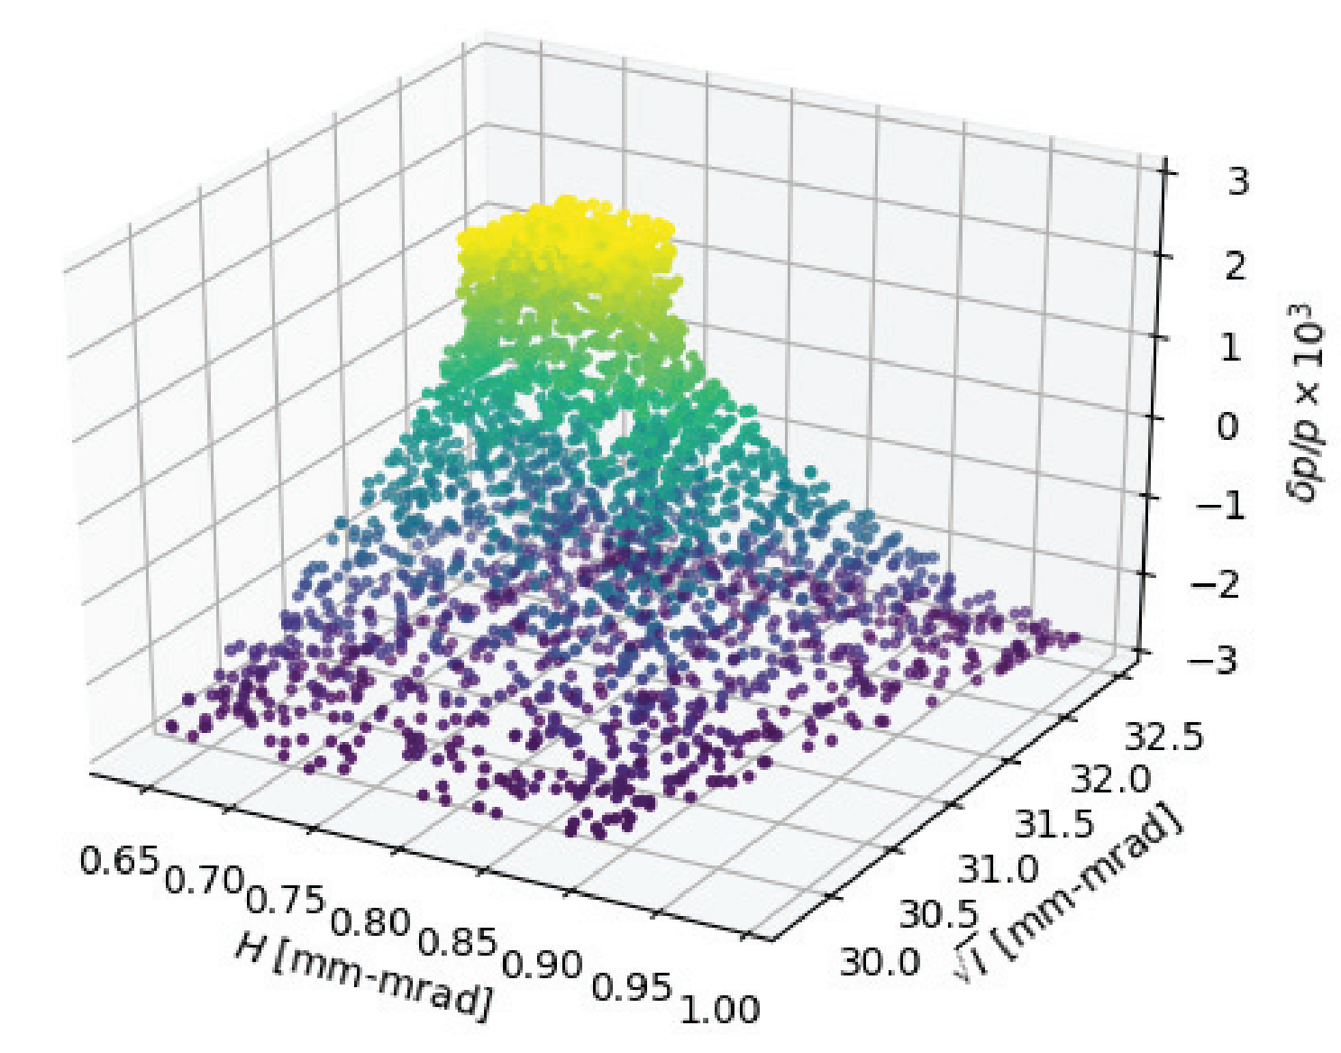
21
21
Chromaticity Matching in simulation
21
Integrable Particle Dynamics in Accelerators | Jan 2019 USPAS
Notes:
21
21
21
21
21
21

Slide 22
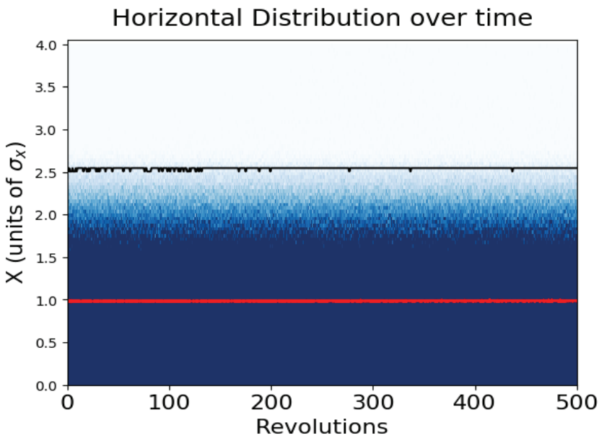
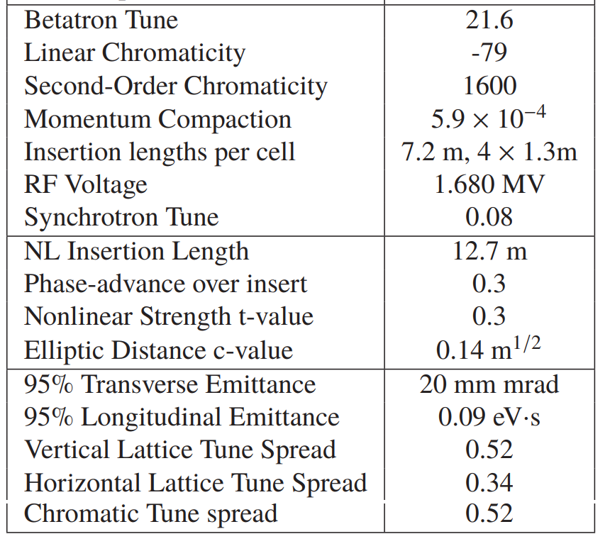
22
22
Stable Motion, Massive Chromatic Tune-Spread
22
Integrable Particle Dynamics in Accelerators | Jan 2019 USPAS
Notes:
22
22
22
22
22
22

Slide 23
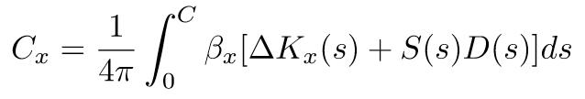
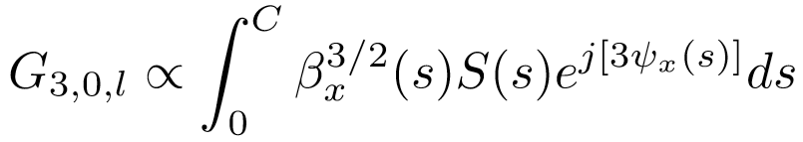
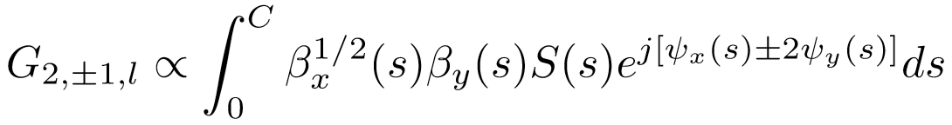
23
23
Can we use Sextupoles? Maybe
Sextupoles are the conventional tool for tackling chromaticity:
Sextupoles create an undesirable nonlinear third-order resonance.
Initial experiments combining strong sextupoles with nonlinear integrable optics were not successful.
Only weak sextupoles are needed to enforce linear chromaticity matching, and no adverse effects observed from this.
Strong sextupoles should be possible with pi-phase interleaving.
23
Integrable Particle Dynamics in Accelerators | Jan 2019 USPAS
Notes:
23
23
23
23
23
23

Slide 24
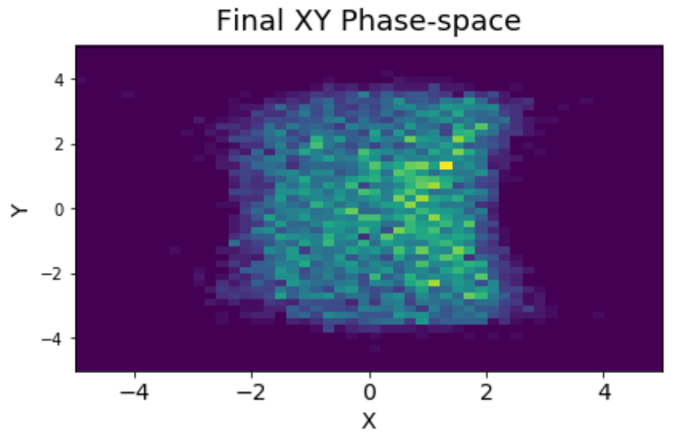
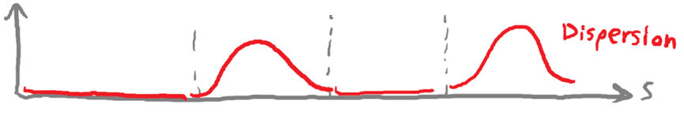
24
24
Sextupoles in Phase-space
We can avoid this:
…by doing this:
Two families of sextupoles:
NL
π
π
kπ
nπ
24
Integrable Particle Dynamics in Accelerators | Jan 2019 USPAS
Notes:
24
24
24
24
24
24

Slide 25
25
25
Space-charge
25
Integrable Particle Dynamics in Accelerators | Jan 2019 USPAS
Notes:
25
25
25
25
25
25

Slide 26
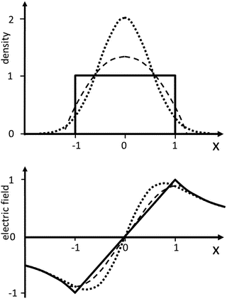
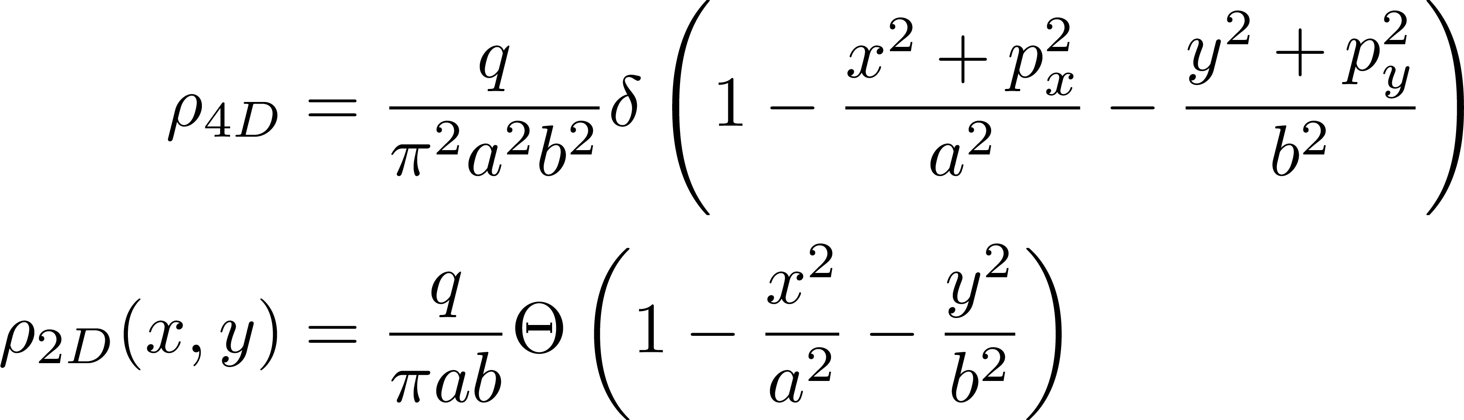
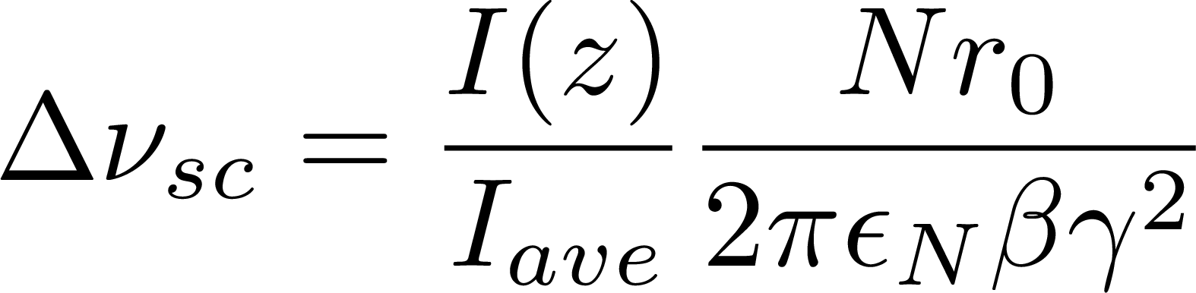
Linear Space-charge Forces
For a KV-beam distribution:
1) All particles have the same H.
2) The 2D projection on the beam is a uniform ellipse.
3) Space-charge forces within the beam are linear.
4) The entire beam will undergo the same tune-shift.
26
Integrable Particle Dynamics in Accelerators | Jan 2019 USPAS
Notes:
26
26
26
26

Slide 27
Space-charge breaks integrability
Singe-particle invariants are broken
Ensemble average is better behaved
With space charge:
‘Time independence’ of Danilov & Nagaitsev theory is broken
Both zero-current invariants now fluctuate significantly at 2 frequencies
Some ensemble properties still appear to be approximately maintained
Question: Is that enough?
C. Hall
27
Integrable Particle Dynamics in Accelerators | Jan 2019 USPAS
Notes:
27
27
27
27

Slide 28
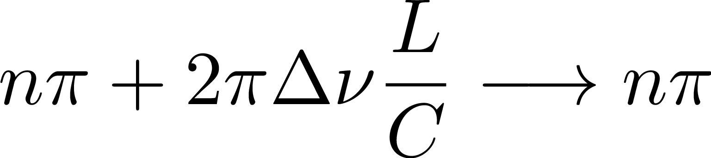
Linear Space-charge Compensation
Rather than use nπ phase-advance between nonlinear inserts, anticipate the space-charge defocusing effect:
This means we will need a separate lattice solution for every operating intensity. But that’s what we do.
For a non-KV beam distribution, we can still compensate the linear part of the space-charge defocusing effect in the core of the beam. But in that case, there will be a tune-spread with some phase-error.
More nonlinear cells help with the space-charge tune-spread, the critical parameter is the space-charge tune-spread per cell.
28
Integrable Particle Dynamics in Accelerators | Jan 2019 USPAS
Notes:
28
28
28
28

Slide 29
Performance: Halo from Mismatch Distribution
T. Wangler et al. PRSTAB 1998
29
Integrable Particle Dynamics in Accelerators | Jan 2019 USPAS
Notes:
29
29
29
29

Slide 30
Performance: Halo from Mismatch Distribution
Induce a 20% quadrupole mismatch, check for halo.
Can the nonlinear decoherence of the mismatch act to mitigate the formation of the beam halo. Trick: Create pre-halo.
Will we encounter any other difficulty from this strong nonlinearity?
1 Conventional Design, Low Intensity Beam (dQ = -0.05)
2 Integrable Design, Low Intensity Beam (dQ = -0.05)
3 Conventional Design, High Intensity Beam (dQ = -0.20)
4 Integrable Design , High Intensity Beam (dQ = -0.20)
30
Integrable Particle Dynamics in Accelerators | Jan 2019 USPAS

Slide 31
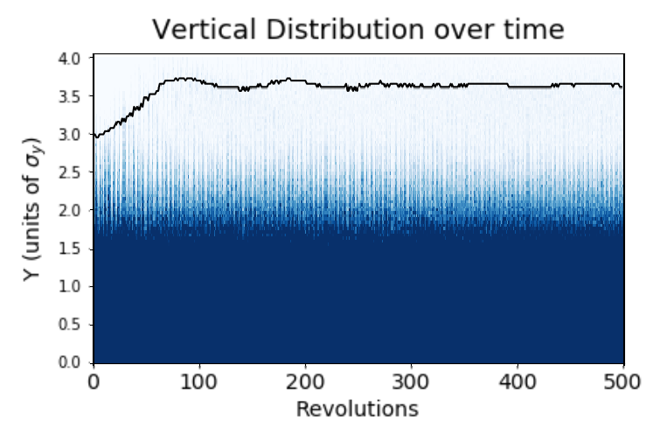
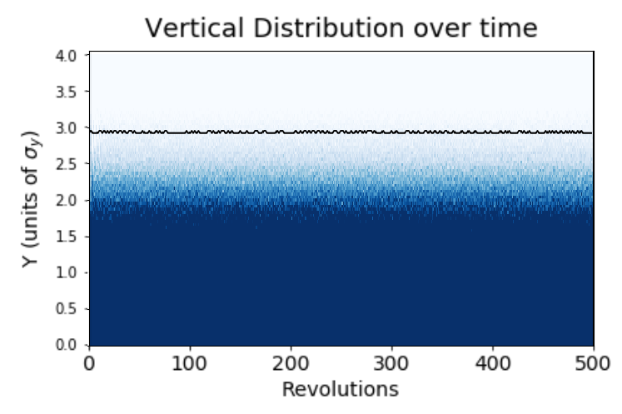
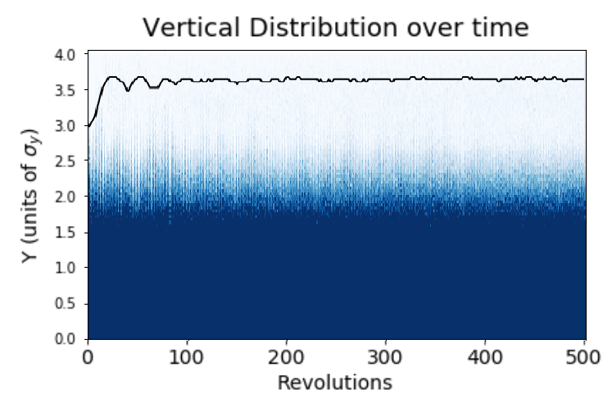
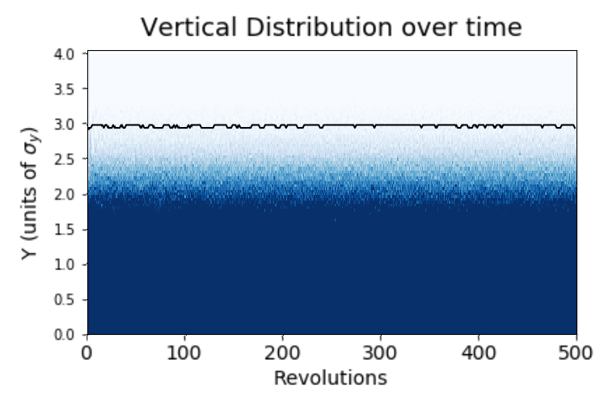
31
Transverse Beam Halo
1 Conventional, Low Int.
2 Integrable, Low Int.
3 Conventional, High Int.
4 Integrable, High Int.
31
Integrable Particle Dynamics in Accelerators | Jan 2019 USPAS
Notes:
31
31
31
31
31
31

Slide 32
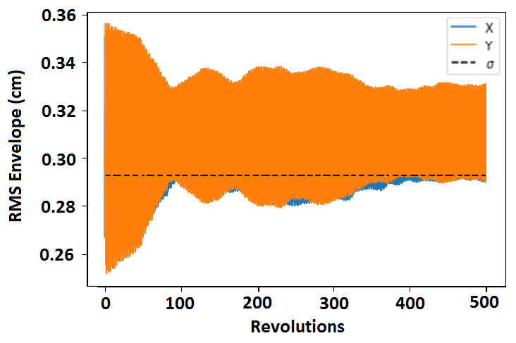
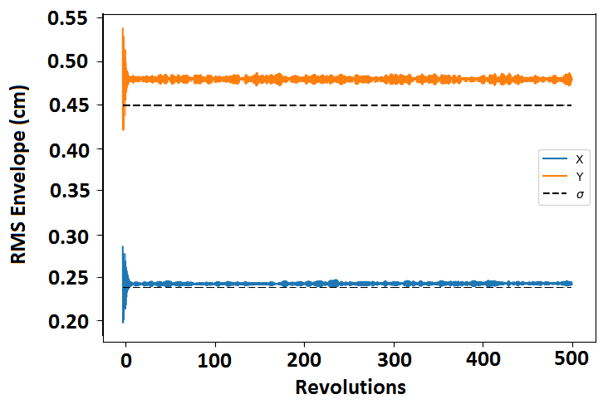
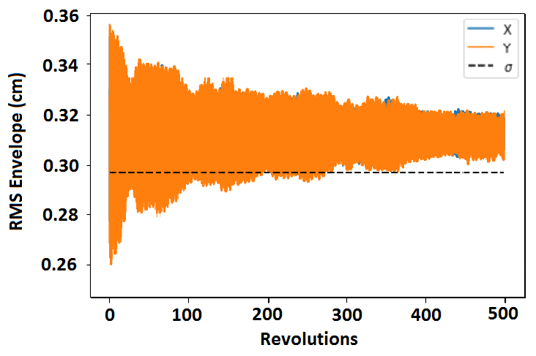
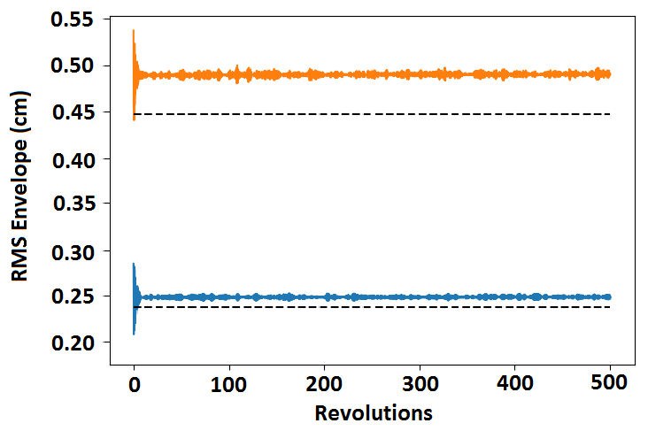
32
RMS Beam Size
1 Conventional, Low Int.
2 Integrable, Low Int.
3 Conventional, High Int.
4 Integrable, High Int.
32
Integrable Particle Dynamics in Accelerators | Jan 2019 USPAS
Notes:
32
32
32
32
32
32

Slide 33
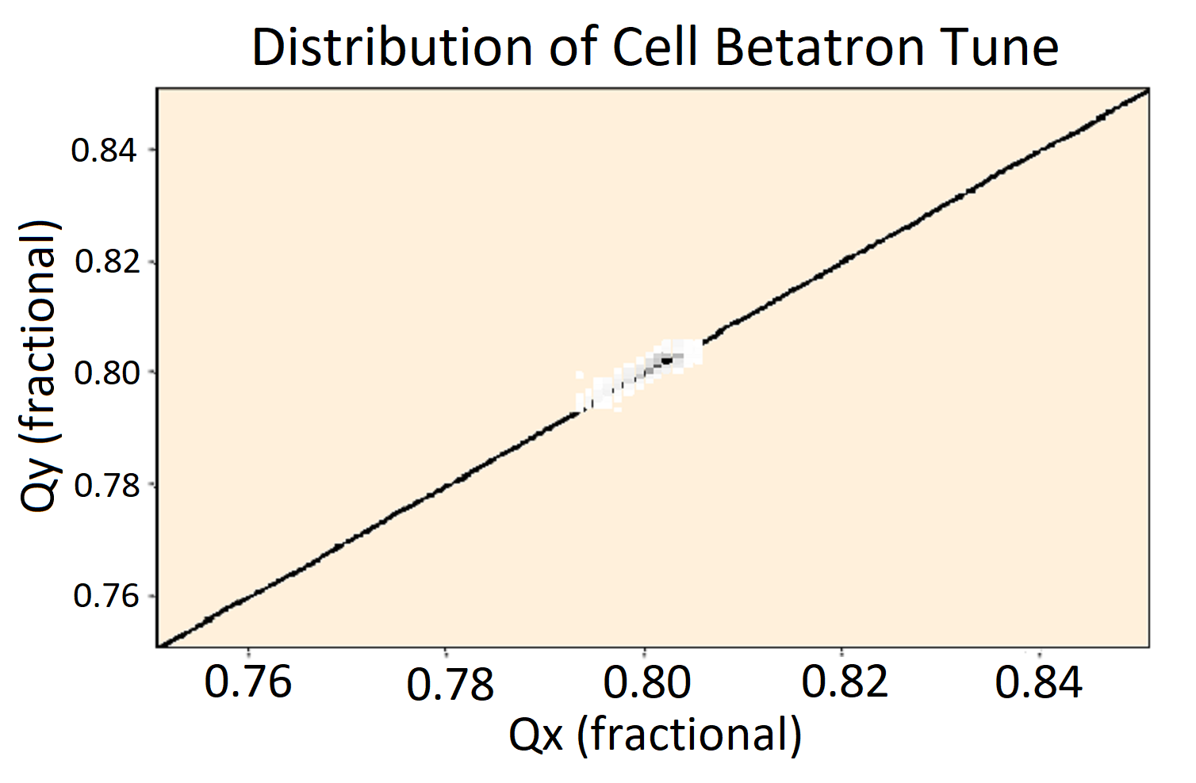
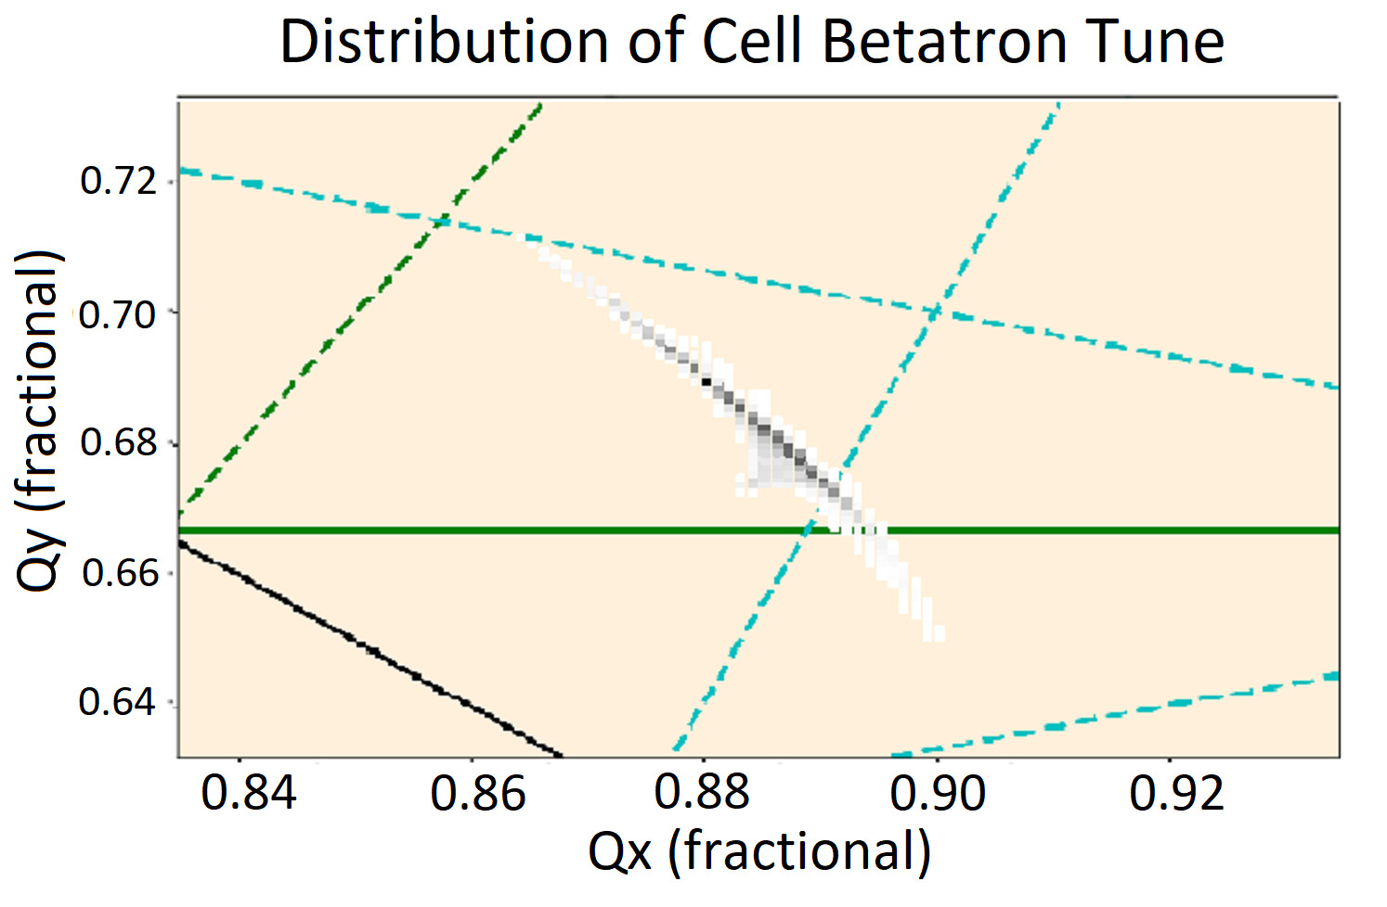
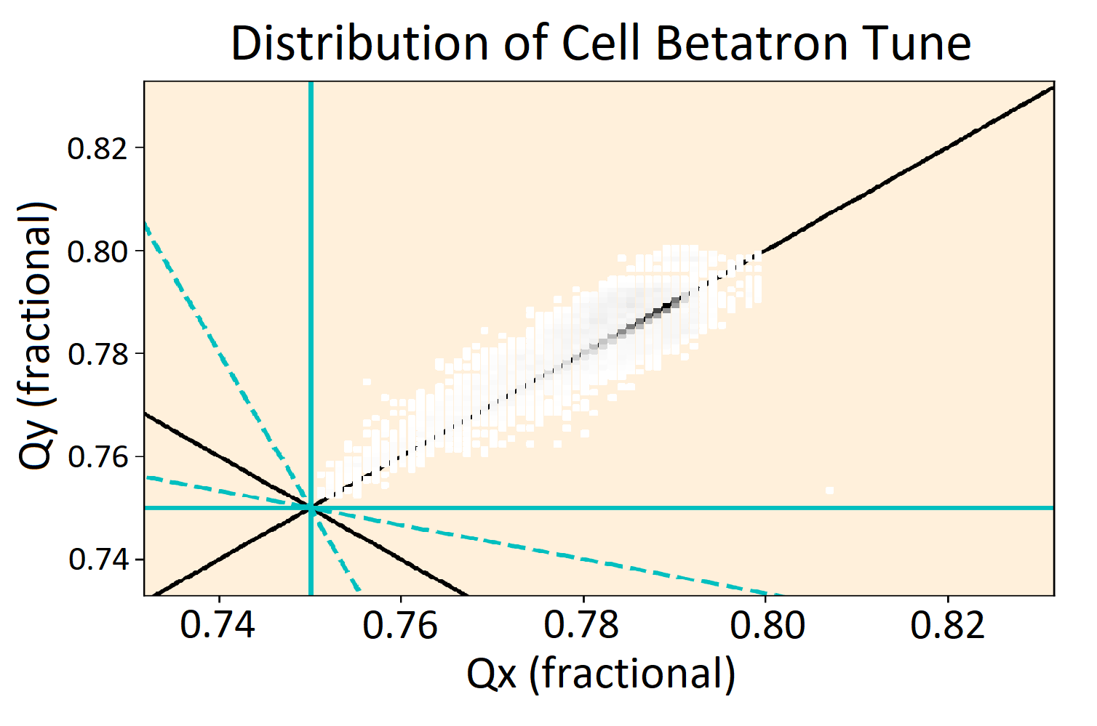
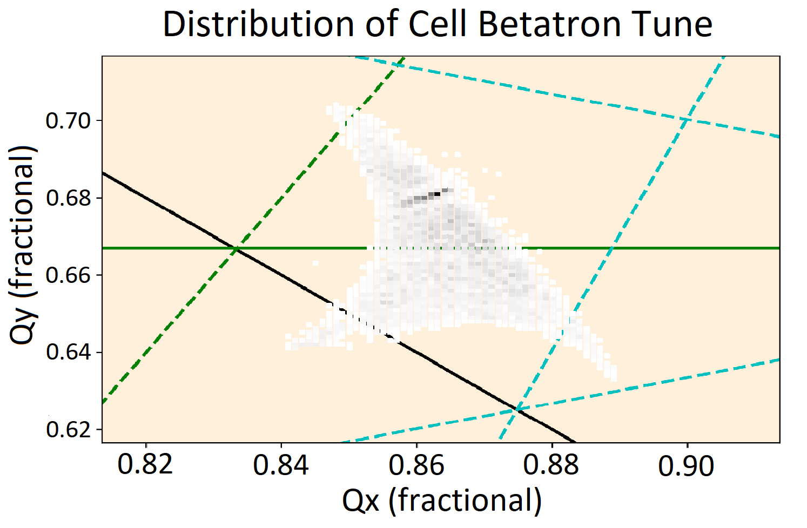
33
Cell Betatron Tune Distribution
1 Conventional, Low Int.
2 Integrable, Low Int.
3 Conventional, High Int.
4 Integrable, High Int.
33
Integrable Particle Dynamics in Accelerators | Jan 2019 USPAS
Notes:
33
33
33
33
33
33

Slide 34
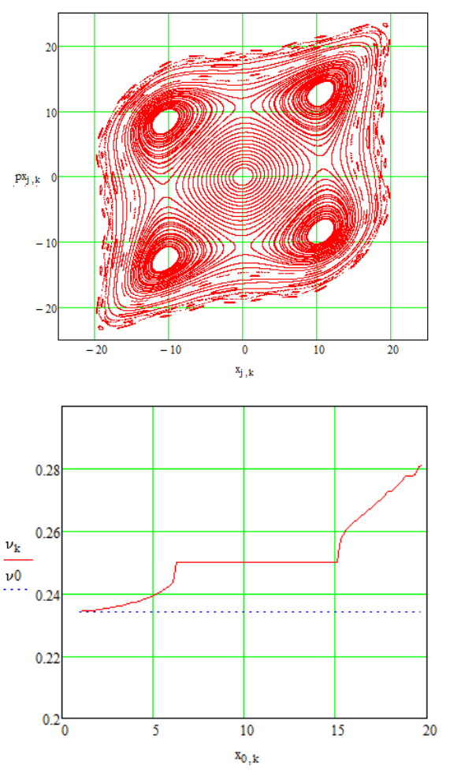
34
Mode-locking
Periodicity 6, dQ = 0.2
Mode Locking
34
Integrable Particle Dynamics in Accelerators | Jan 2019 USPAS
Notes:
34
34
34
34
34
34

Slide 35
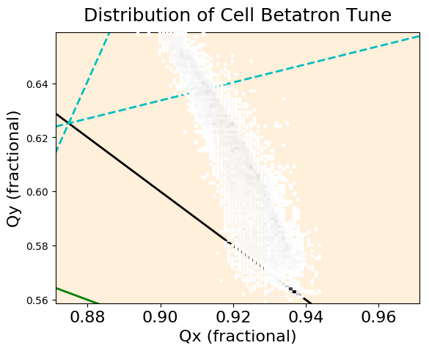
35
Higher Periodicity -> More Nonlinearity -> Higher Charge
Periodicity 6, dQ = 0.2
Periodicity 12, dQ = 0.4
35
Integrable Particle Dynamics in Accelerators | Jan 2019 USPAS
Notes:
35
35
35
35
35
35

Slide 36
36
36
Fermilab Loss Limits
Radio-activation of particle accelerator a major operation limits.
Losses must be kept within absolute limits, which mean power increases require a reduction in loss rate.
36
Integrable Particle Dynamics in Accelerators | Jan 2019 USPAS
Notes:
36
36
36
36
36
36

