Slide 1



The proton Electric Dipole Moment
High Precision physics in storage rings
Yannis K. Semertzidis,
IBS/CAPP & KAIST
April 18, 2019
APT seminar
Fermilab
The pEDM experiment at 10⁻²⁹ e-cm probes SUSY-like New Physics at the 10³ TeV scale!
A new hybrid method, provides adequate symmetries, eliminating B-field systematic error sources

Slide 2
Motivation, why, why here
No clear evidence for New Physics showed up at LHC
New CP-violating source is needed to explain the matter-antimatter asymmetry mystery
Hadronic EDMs are some of the most sensitive probes we have
A natural next, after the muon g-2 experiment concludes; many techniques are similar

Slide 3
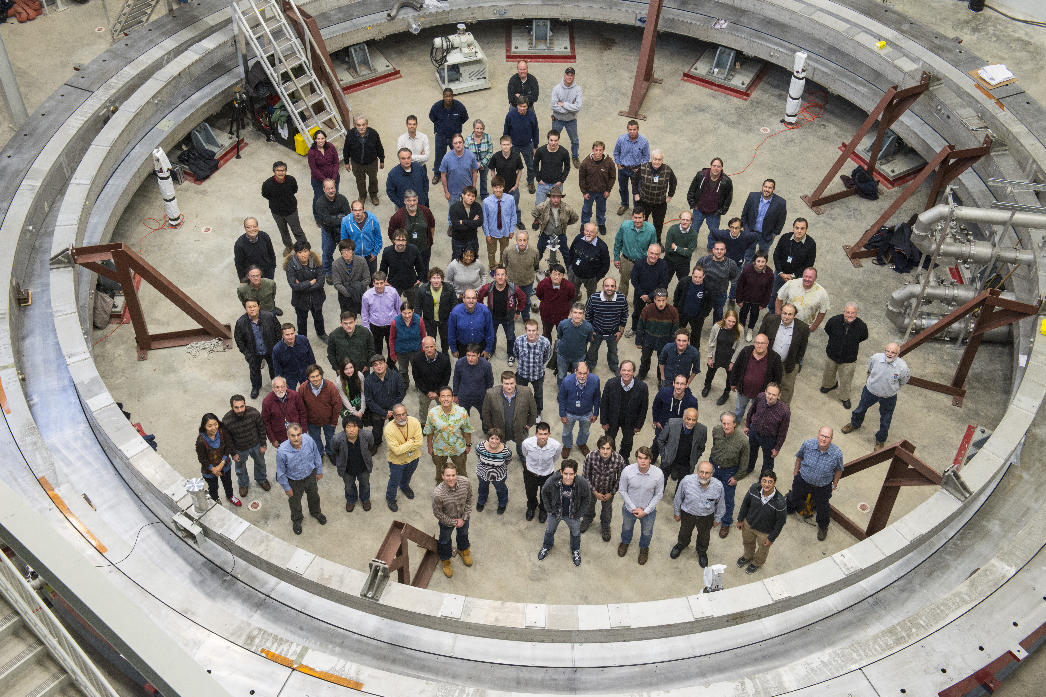
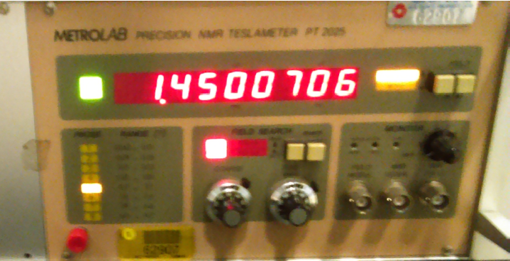
The ring has been reassembled and fully powered to 1.45T!

Slide 4
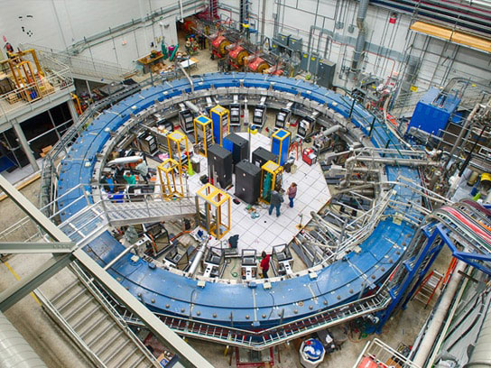
Muon g-2 ring at Fermilab
Precision Physics in storage rings

Slide 5
Muon g-2 ring at Fermilab

Slide 6
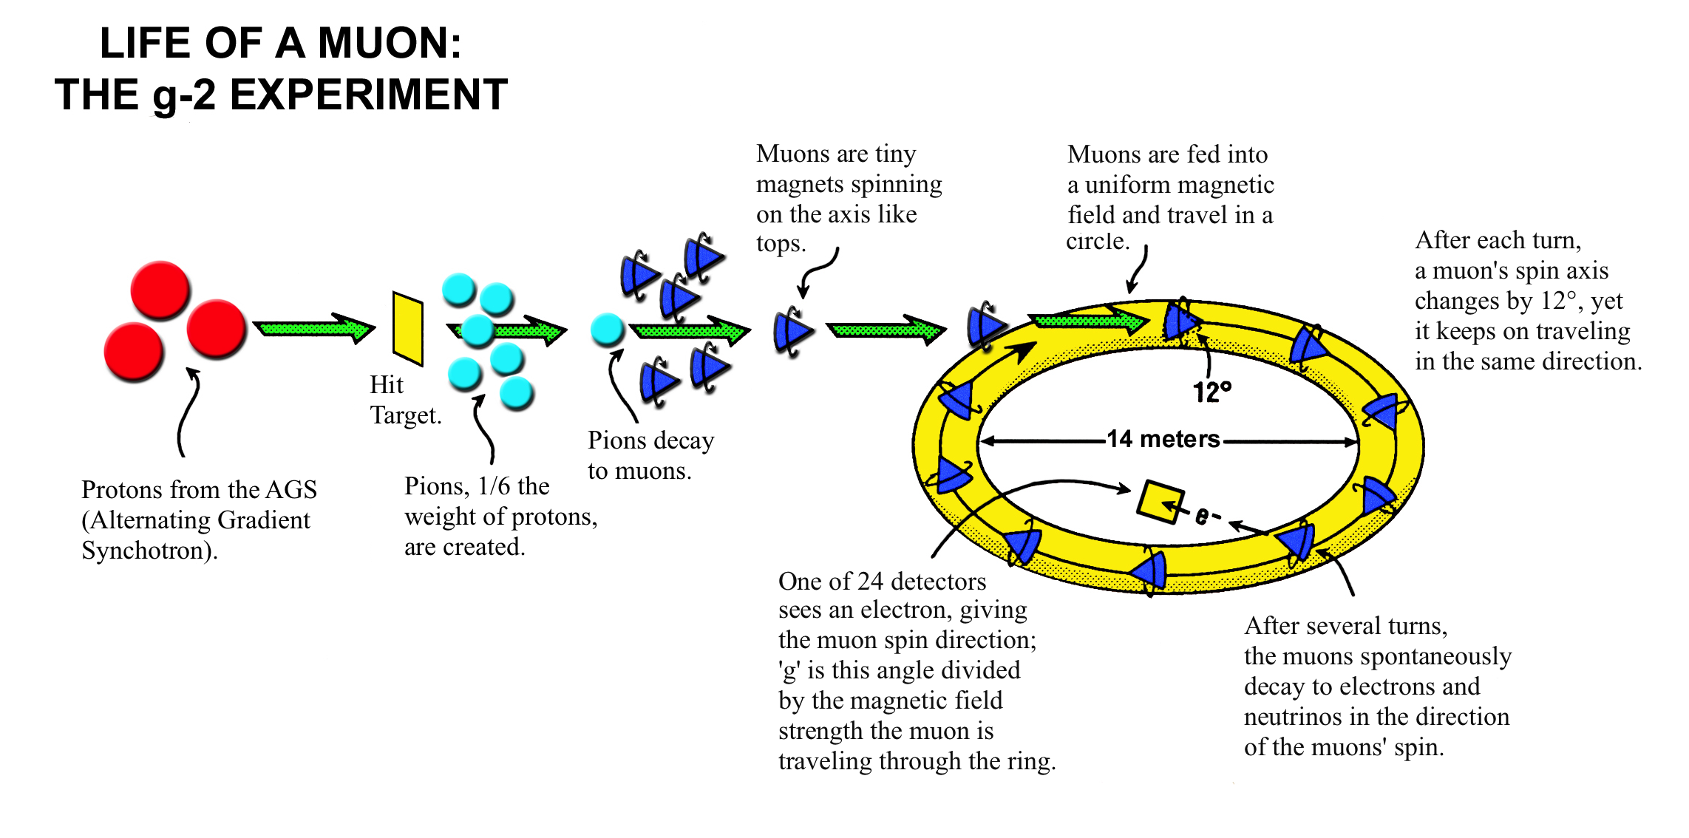
Muon g-2 experiment: Best challenge to the Standard Model
E821 at BNL: 1997-2004
E989 at FNAL: data since 2017

Slide 7
Spin Precession Rate at Rest
Things are more …interesting in storage rings

Slide 8
Spin Precession Rate in a storage ring

Slide 9
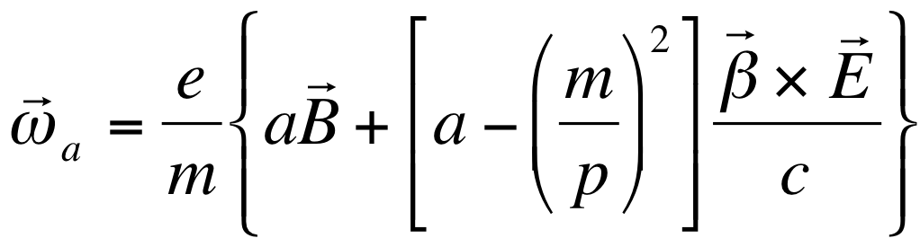
Breakthrough concept: Freezing the horizontal spin precession due to E-field
Muon g-2 focusing is electric: The spin precession due to E-field is zero at “magic” momentum (3.1GeV/c for muons, 0.7 GeV/c for protons,…)
The “magic” momentum concept was used in the muon g-2 experiments at CERN, BNL, and now at FNAL.

Slide 10
The Principle of g-2
Spin vector
Moving: Thomas precession!
Momentum vector
• B
Independent of velocity!

Slide 11
Effect of Radial Electric Field
Spin vector
Low energy particle
…just right
High energy particle
Momentum vector

Slide 12
Spin Precession in g-2 Ring
(Top View)
Momentum
vector
μ
Spin vector

Slide 13
Fundamental particle EDM: study of CP-violation beyond the Standard Model

Slide 14
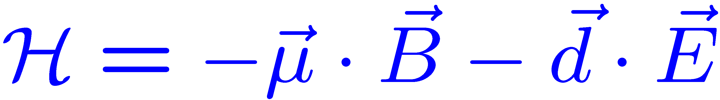
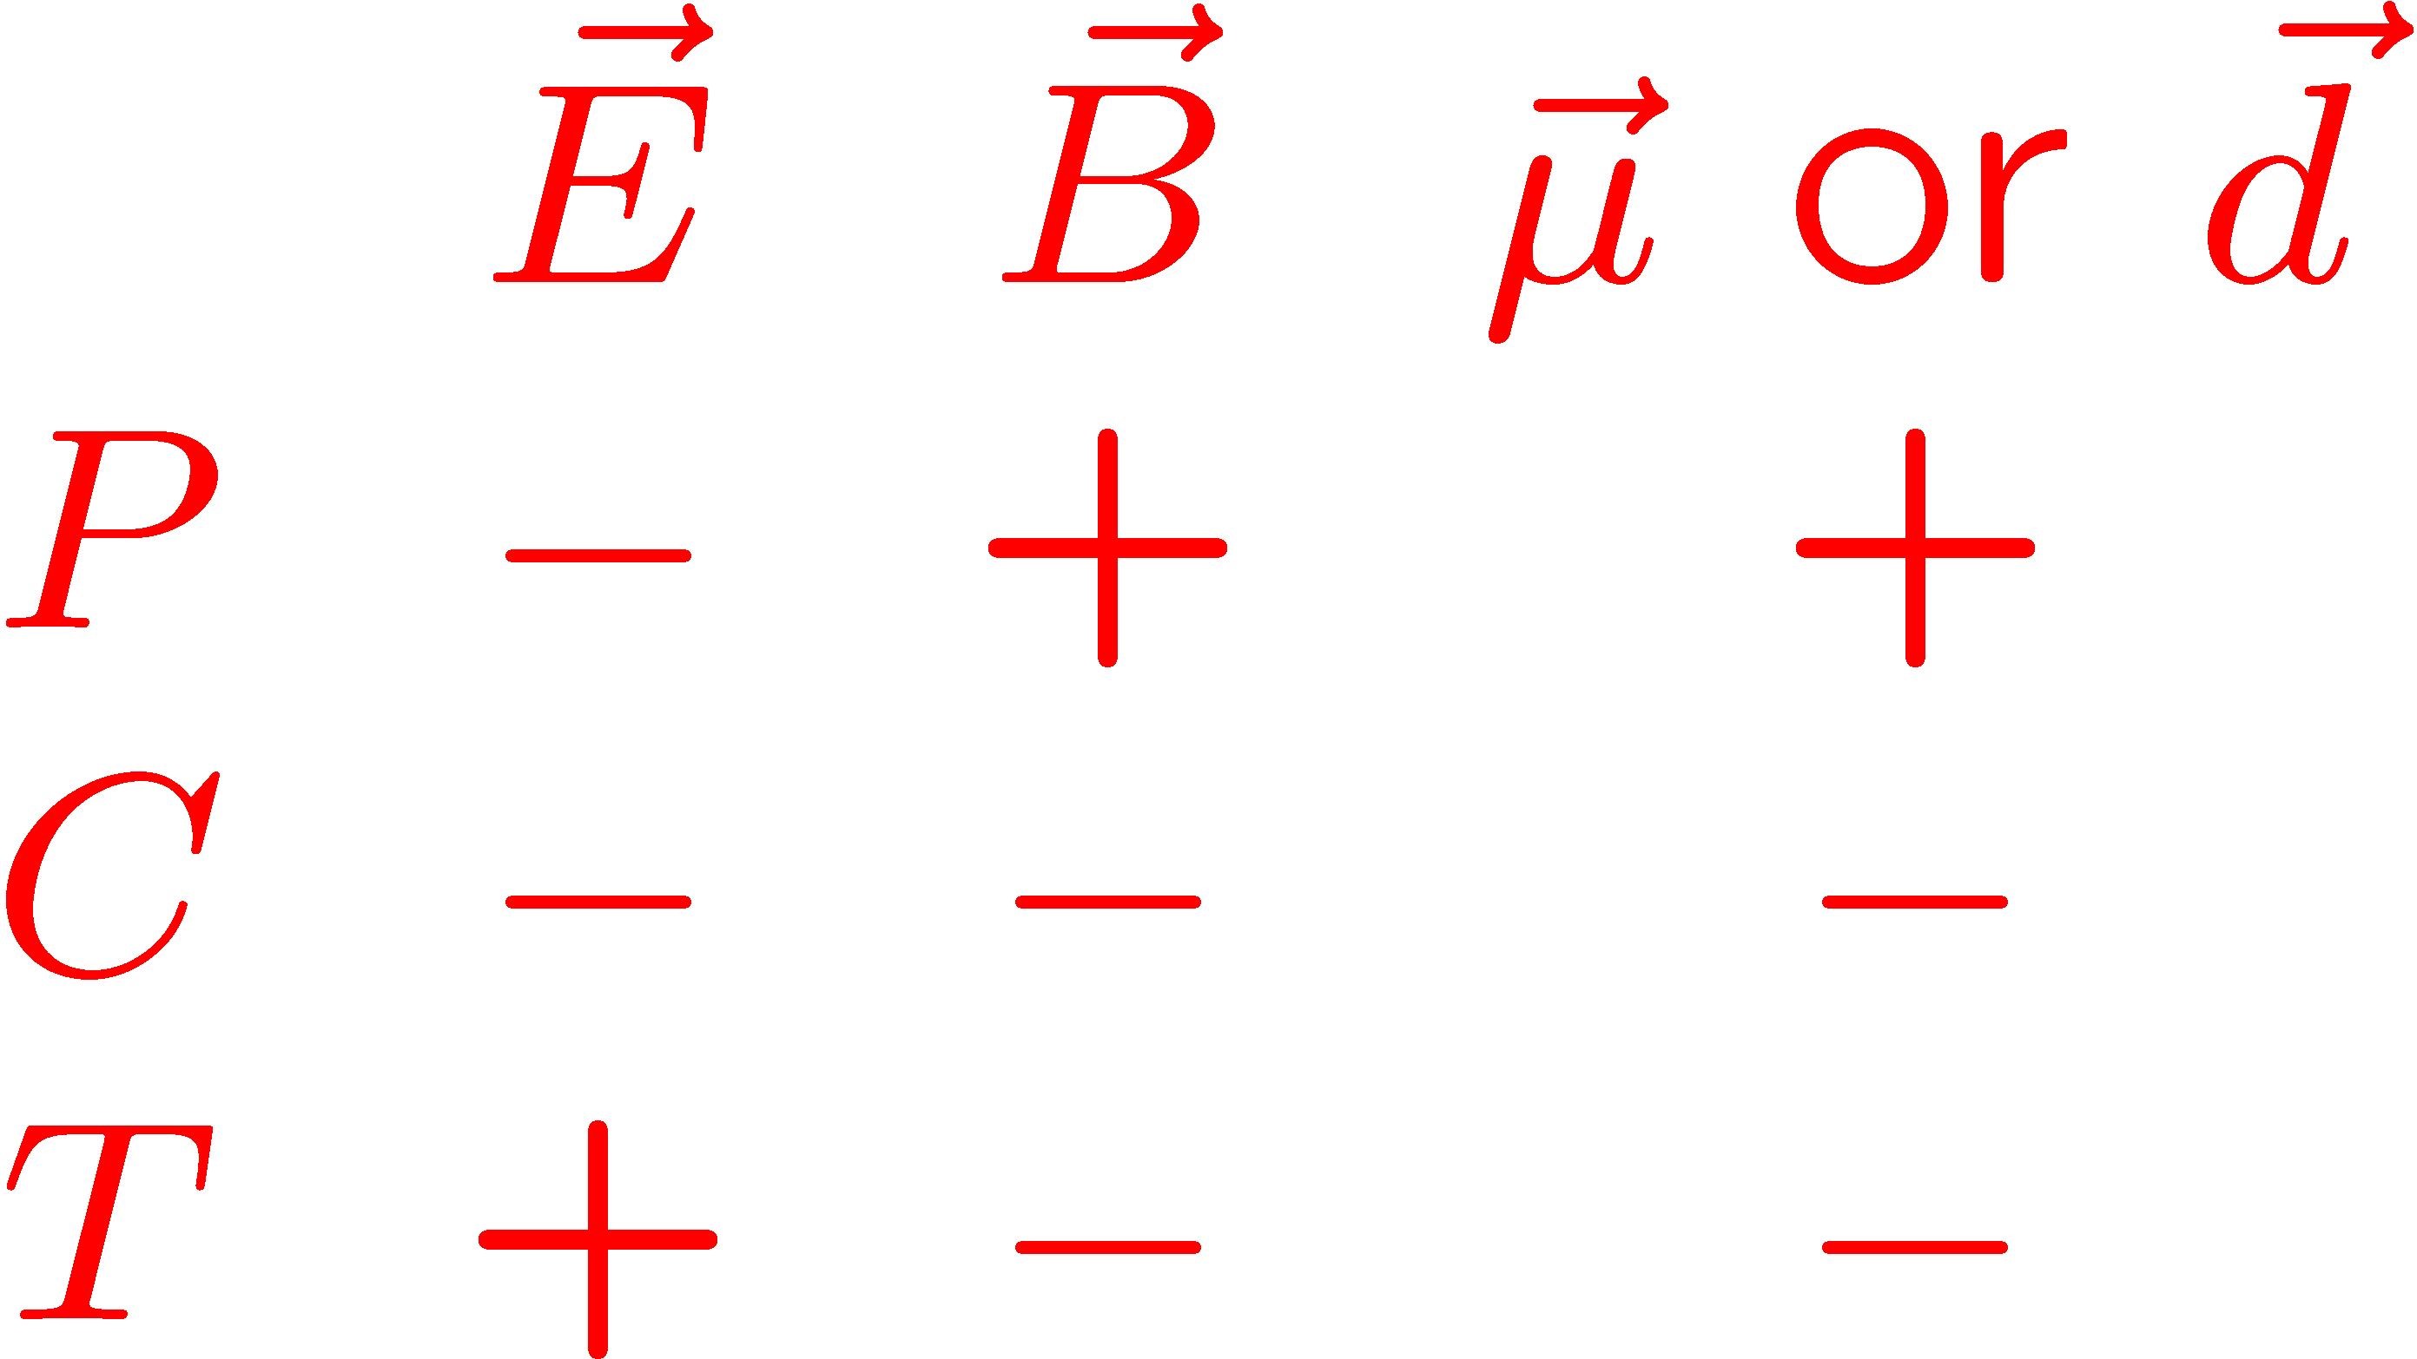
Electric Dipole Moments: P and T-violating when // to spin
T-violation: assuming CPT cons. → CP-violation

Slide 15
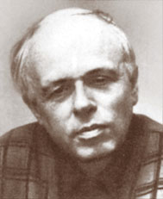
CPT
T-Violation CP-Violation
Andrei Sakharov 1967:
CP-Violation is one of three conditions to enable a universe containing initially equal amounts of matter and antimatter to evolve into a matter-dominated universe, which we see today….
Notes:
Yannis Semertzidis, BNL. ICHEP02, 31 July 2002
15

Slide 16
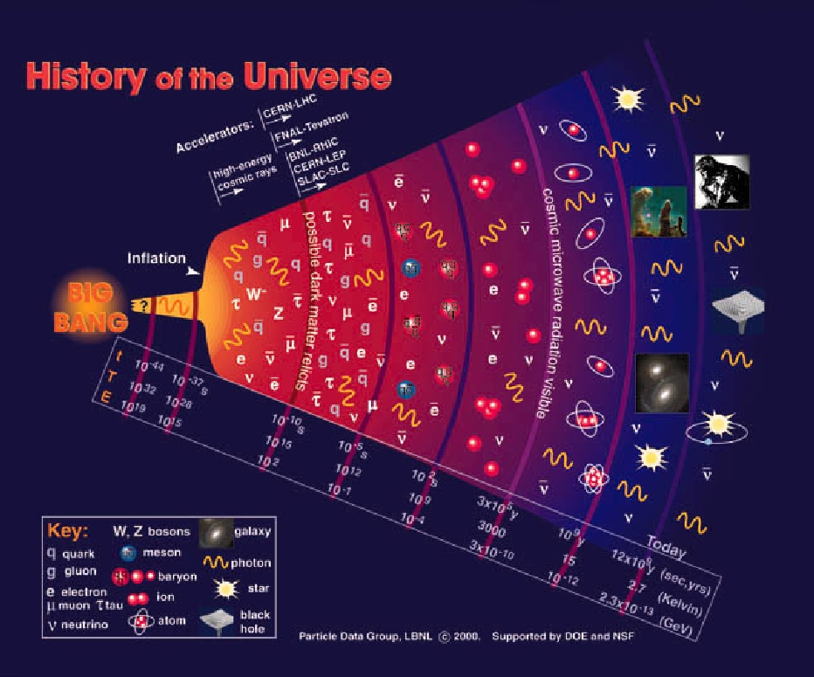
Why is there so much matter after the Big Bang:
We see:
From the SM:

Slide 17

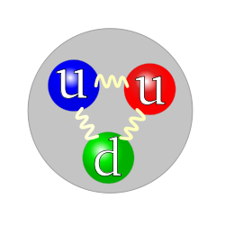
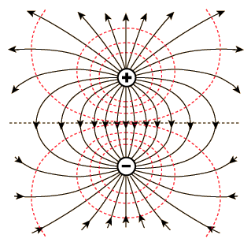
Proton EDM proposal: d=10⁻²⁹e•cm
High sensitivity experiment:
Blowing up the proton to become as large as the sun, the sensitivity to charge separation along N-S would be r < 0.1 μm!
Sun
proton

Slide 18
The Electric Dipole Moment precesses in an Electric field
The EDM vector d is along the particle spin direction
+
-

Slide 19
The Electric Dipole Moment precesses in an Electric field

Slide 20
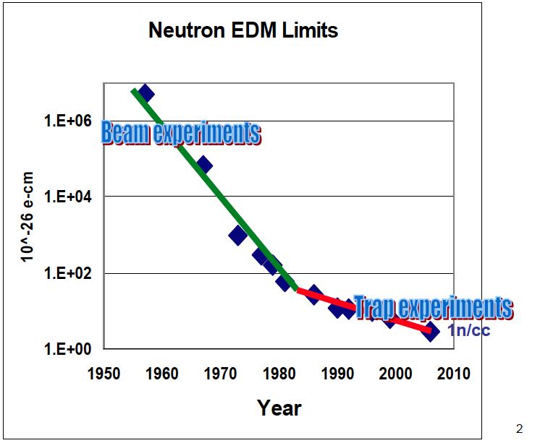
Proton storage ring EDM experiment is combination of beam + a trap
B. Morse

Slide 21
A charged particle between Electric Field plates would be lost right away…
+
-
+
Notes:
Yannis Semertzidis, BNL. ICHEP02, 31 July 2002
21

Slide 22
Stored beam: The radial E-field force is balanced by the centrifugal force.
E
E
E
E
Yannis Semertzidis, IBS/CAPP & KAIST
Notes:
Yannis Semertzidis, BNL
22

Slide 23
The proton EDM uses an ALL-ELECTRIC ring: spin is aligned with the momentum vector
at the magic momentum
Momentum
vector
E
Spin vector
E
E
E
Yannis Semertzidis, IBS/CAPP & KAIST
Notes:
Yannis Semertzidis, BNL
23

Slide 24
Storage Ring Electric Dipole Moments
Fields | Example | EDM term | Comments
Dipole magnetic field (B) | Muon g-2 | Tilt of the spin precession plane. (Limited sensitivity due to spin precession) | Eventually limited by geometrical alignment. Requires CW and CCW injection to eliminate systematic errors
Combination of electric and magnetic fields (E, B) | Deuteron, ³He, proton, etc. | Mainly: | Most powerful. Small ring. Need to build combined B and E-field system. Reduce vertical E-field.
Radial Electric field (E) | Proton, etc. |  | Large ring, CW & CCW storage. Simplest to achieve. Reduce radial B-field.

Slide 25
The proton EDM electric ring, 500m circ.
Two options:
All-electric: radial E-field, plus electric focusing
Hybrid: radial E-field, plus alternating magnetic focusing
We first worked on the all-electric field ring
Review of Scientific Instr. 87 (11), 115116

Slide 26

The proton EDM electric ring, 500m circ.
Current goal 10⁻²⁹e-cm; upgraded: 10⁻³⁰e-cm.
It has been approved as a PBC candidate project at CERN. A comprehensive study is underway with the conclusions to be presented at the European Strategy meeting.

Slide 27
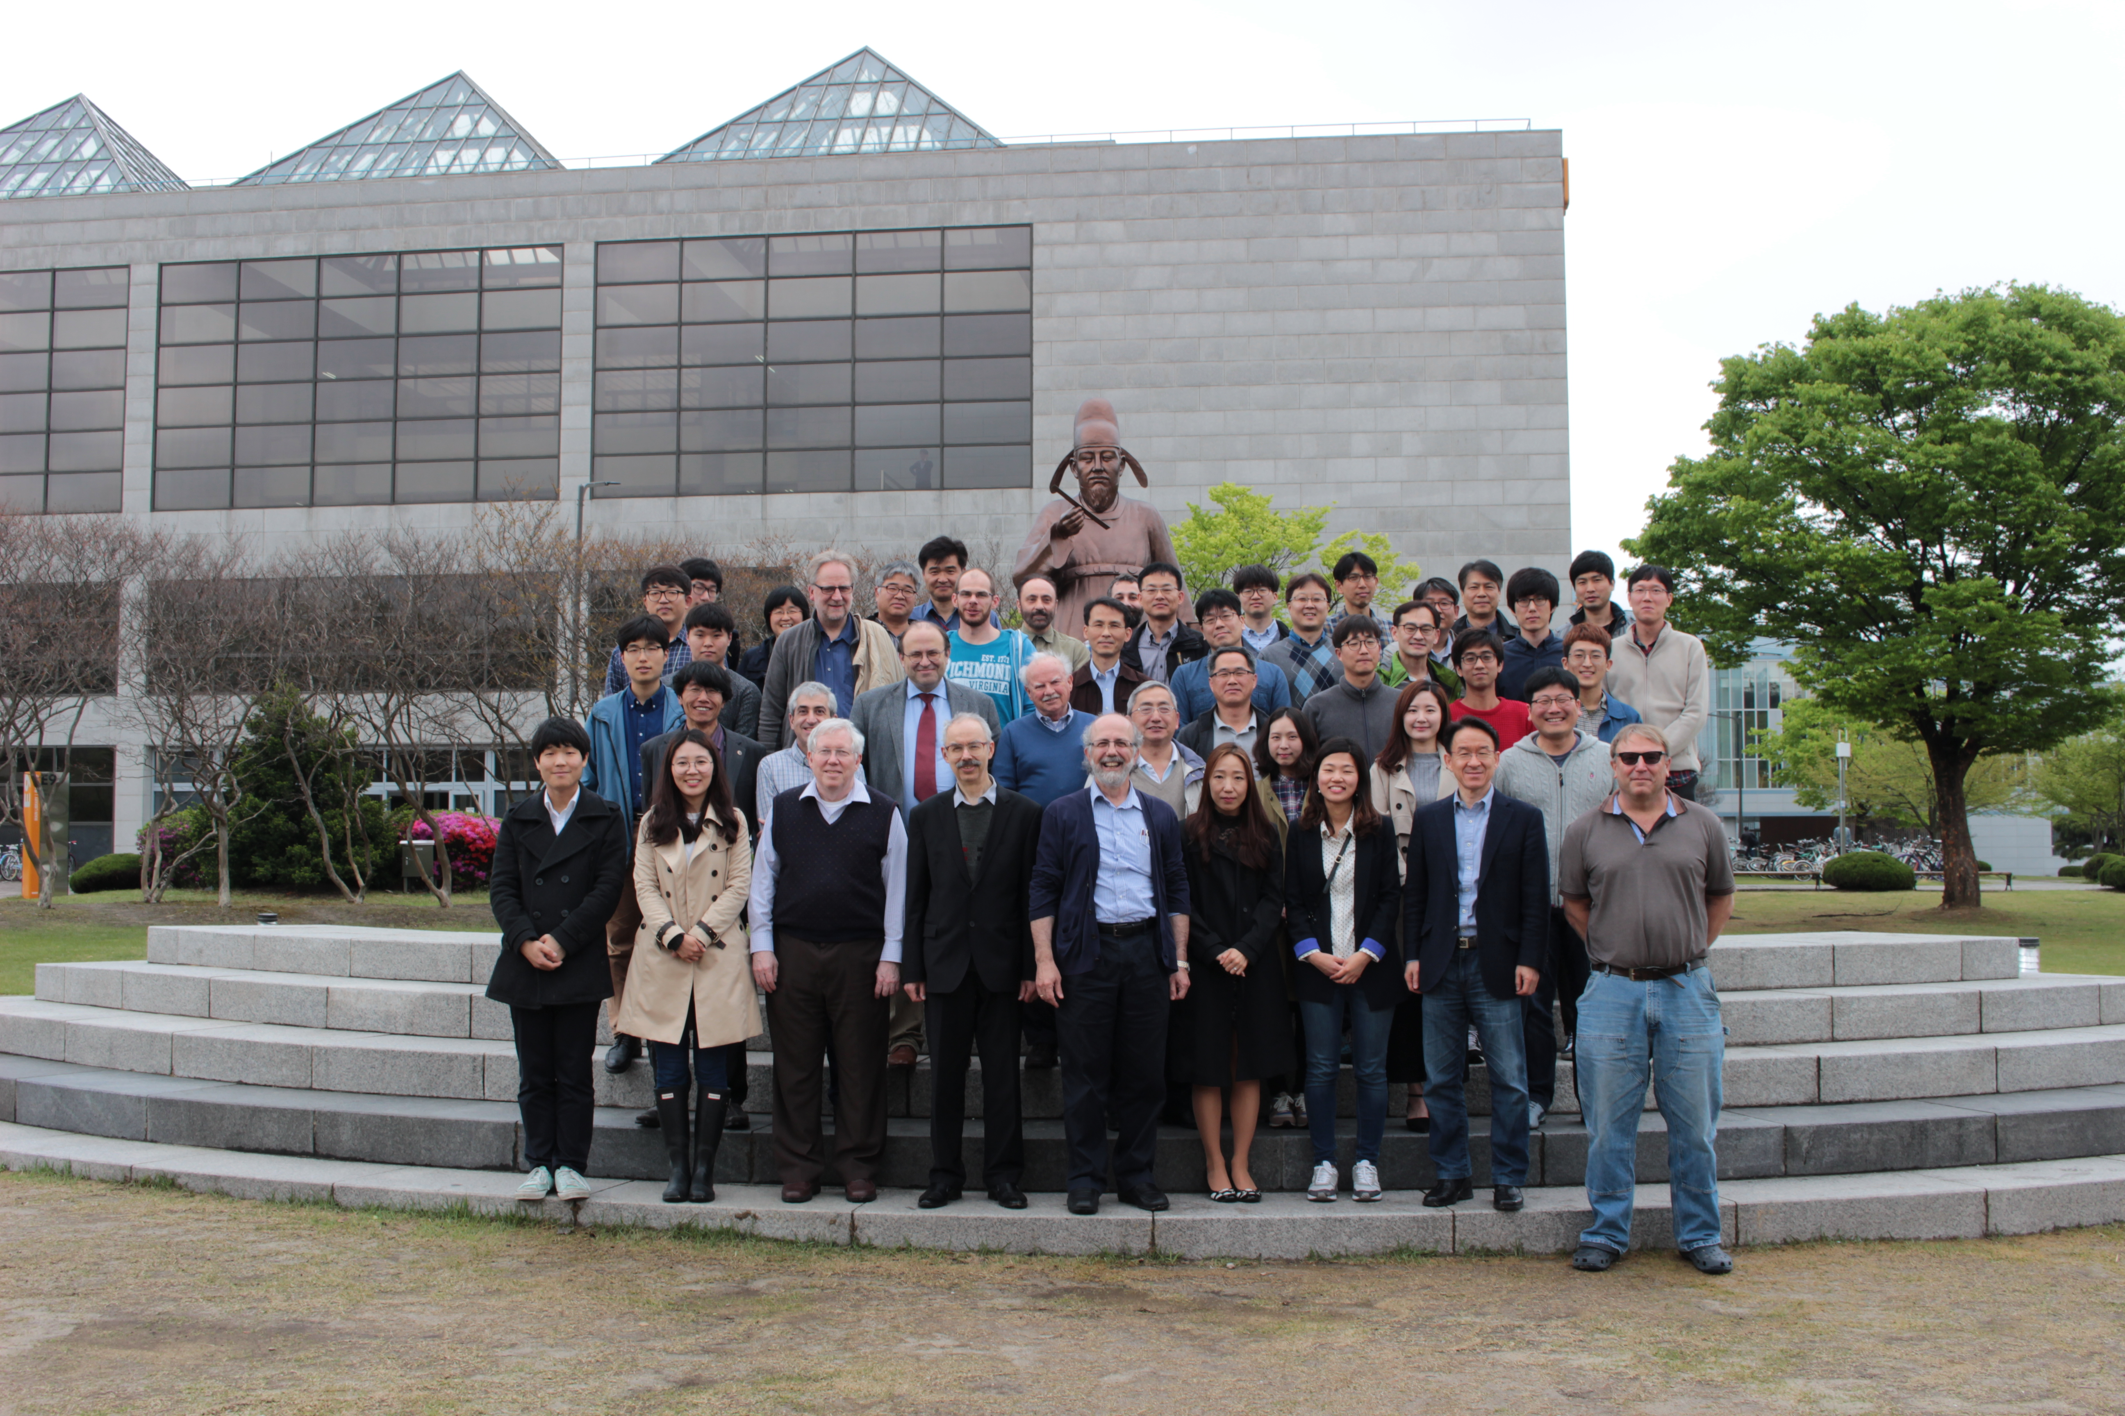
srEDM Collaboration Meeting at KAIST, 21 April, 2016.

Slide 28
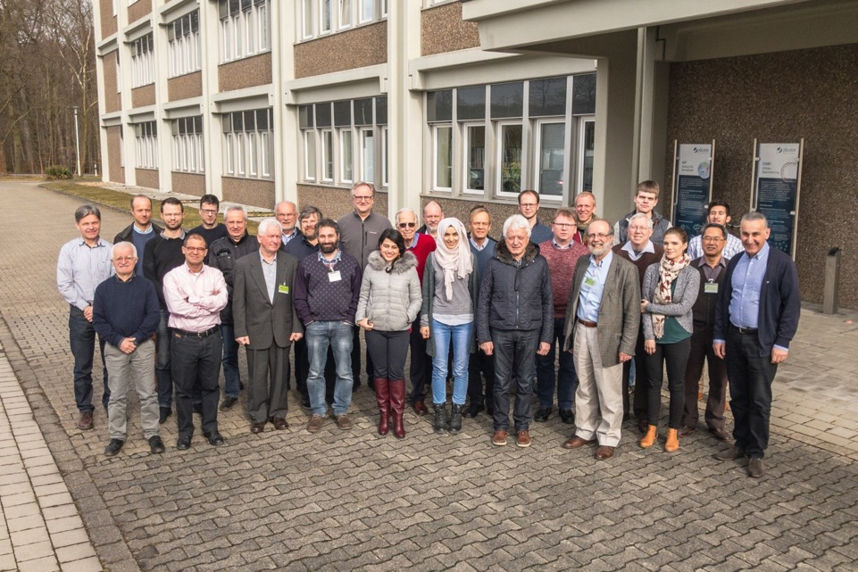
CPEDM collaboration,
Juelich, March 9, 2018

Slide 29
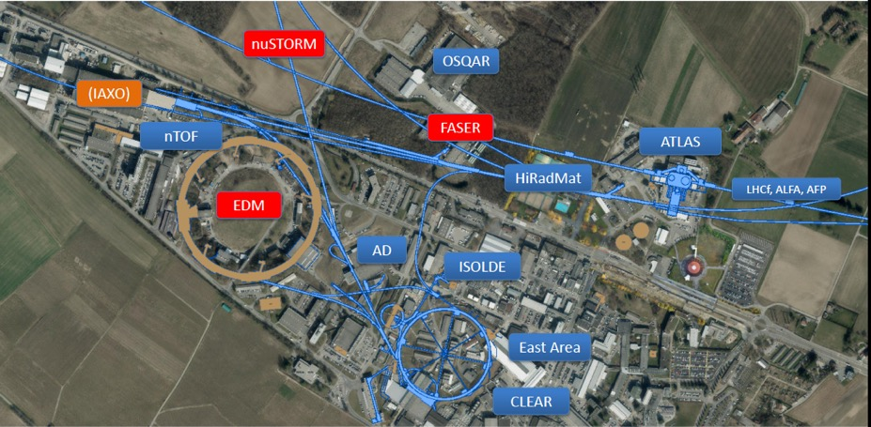
Mike Lamont, CERN

Slide 30
The current plan of CPEDM
Seek endorsement by the European strategy meeting (2018-2020)
Propose to build a combined field (radial electric and dipole magnetic) ring at COSY/Germany for low energy protons and deuterons
The all-electric proton EDM ring is scheduled for CERN after 2027 (most likely to be delayed)

Slide 31
The spin precession relative to momentum in the plane is kept near zero. A vert. spin precession vs. time is an indication of an EDM (d) signal.
E
E
E
E
Yannis Semertzidis
Notes:
Yannis Semertzidis, BNL
31

Slide 32
The spin precession relative to momentum in the plane is kept near zero. A vert. spin precession vs. time is an indication of an EDM (d) signal.
E
E
E
E
Yannis Semertzidis
Notes:
Yannis Semertzidis, BNL
32

Slide 33
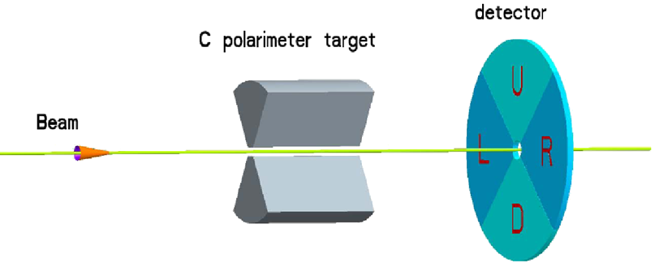
pEDM polarimeter principle (placed in a straight section in the ring): probing the proton spin components as a function of storage time
“defining aperture”
polarimeter target
LISO crystals, GEMs, etc.
Extraction: lowering the vertical focusing
carries EDM signal
increases slowly with time
carries in-plane (g-2) precession signal

Slide 34
Polarimeter principle: The nuclear elastic scattering angle depends on the proton vertical spin component
Proton spin
¹²C nucleus
B. Khazin, 2005
In the rest frame of the proton the ¹²C nucleus is moving towards it creating a current.
This current creates a magnetic field that has opposite sign on either side of the ¹²C
nucleus. The force on the proton spin due to the magnetic field gradient has the same
direction independent of the relative position between the proton and ¹²C nucleus.

Slide 35
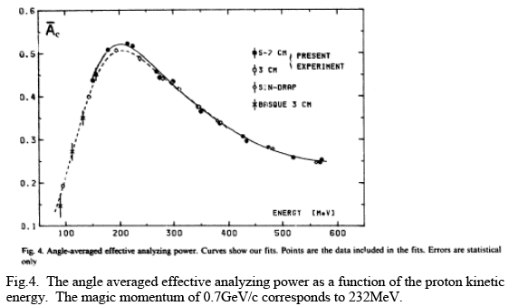
Is the polarimeter analyzing power good at P_{magic}? YES!
Analyzing power can be further optimized

Slide 36
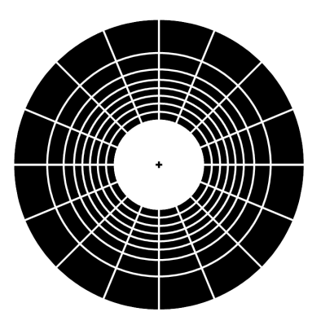
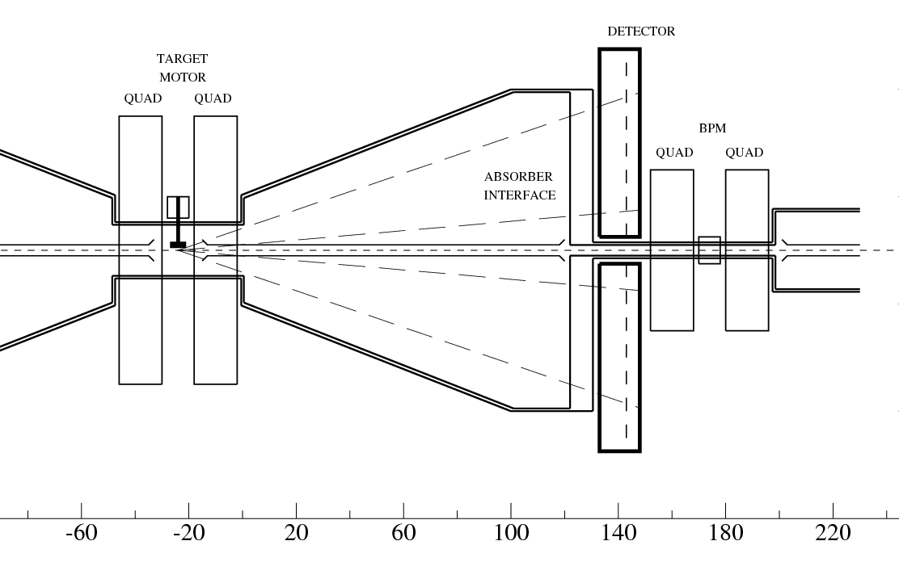
Polarimeter rates:
Beam intensity with 2×10¹⁰ pol. protons/ ~10³s and a detection efficiency of 1% → 200KHz for ~3000cm² area, or ~100Hz/cm² on average but much higher at small radius. Design: ~1KHz/pad.
70 cm

Slide 37
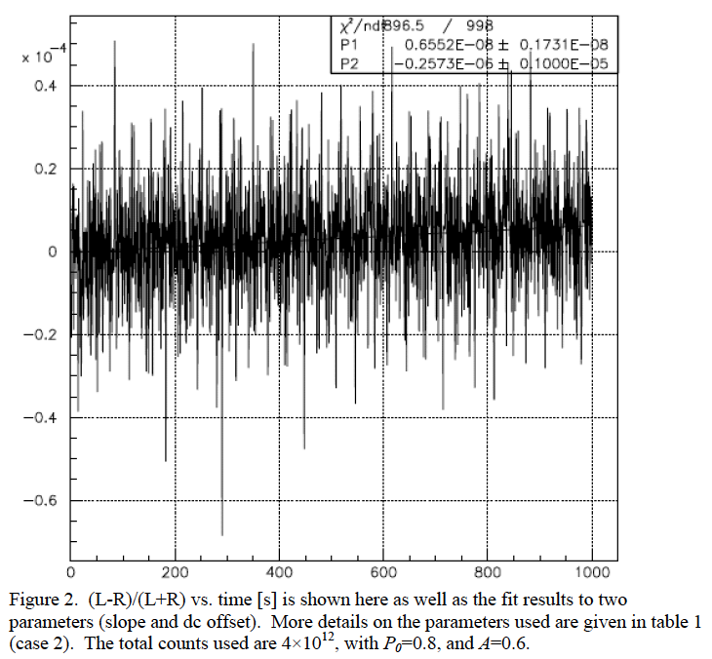
The EDM signal: early to late change
Comparing the (left-right)/(left+right) counts vs. time we monitor the vertical component of spin
M.C. data
(L-R)/(L+R) vs. Time [s]

Slide 38
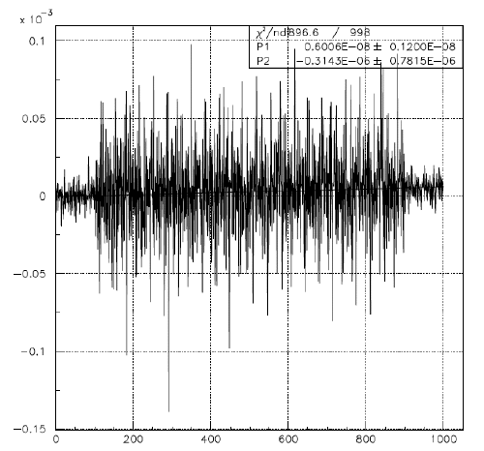
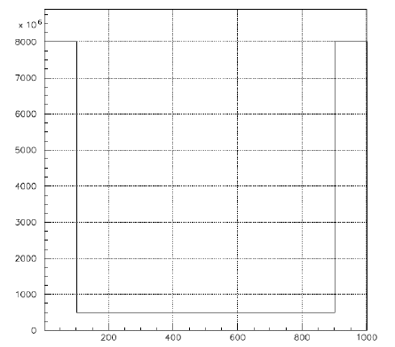
Optimizing the counting rate
We can take most counts at the beginning and the end of the storage time and some in between for spin direction monitoring.
Maximum rate: 4 × the
average rate.
Variable counting rate
as a function of time [s]
(L-R)/(L+R) vs. Time [s]

Slide 39
Storage Ring Proton EDM Breakthrough:
Statistics!
Instead of using the secondary, low intensity beams, use the original proton beam!

Slide 40
The proton EDM electric ring, 500m circ.
Straight sections are instrumented
with quads, BPMs, polarimeters,
injection points, etc, as needed.
Requirements:
Below transition (reduce IBS)

Slide 41
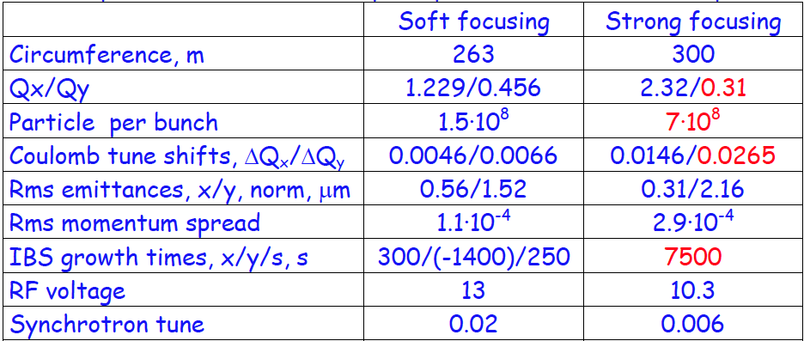
The proton EDM ring evaluation Val Lebedev (Fermilab)
Beam intensity 10¹¹ protons limited by IBS
, kV

Slide 42
Proton Statistical Error (230MeV):
τ_{p} : 10³s Polarization Lifetime (Spin Coherence Time)
A : 0.6 Left/right asymmetry observed by the polarimeter
P : 0.8 Beam polarization
N_{c} : 10¹¹p/cycle Total number of stored particles per cycle
T_{Tot}: 10⁷s Total running time per year
f : 1% Useful event rate fraction (efficiency for EDM)
E_{R} : 7 MV/m Average radial electric field strength
σ_{d} = 1.0×10⁻²⁹ e-cm / year
Notes:
Yannis Semertzidis, BNL
42

Slide 43
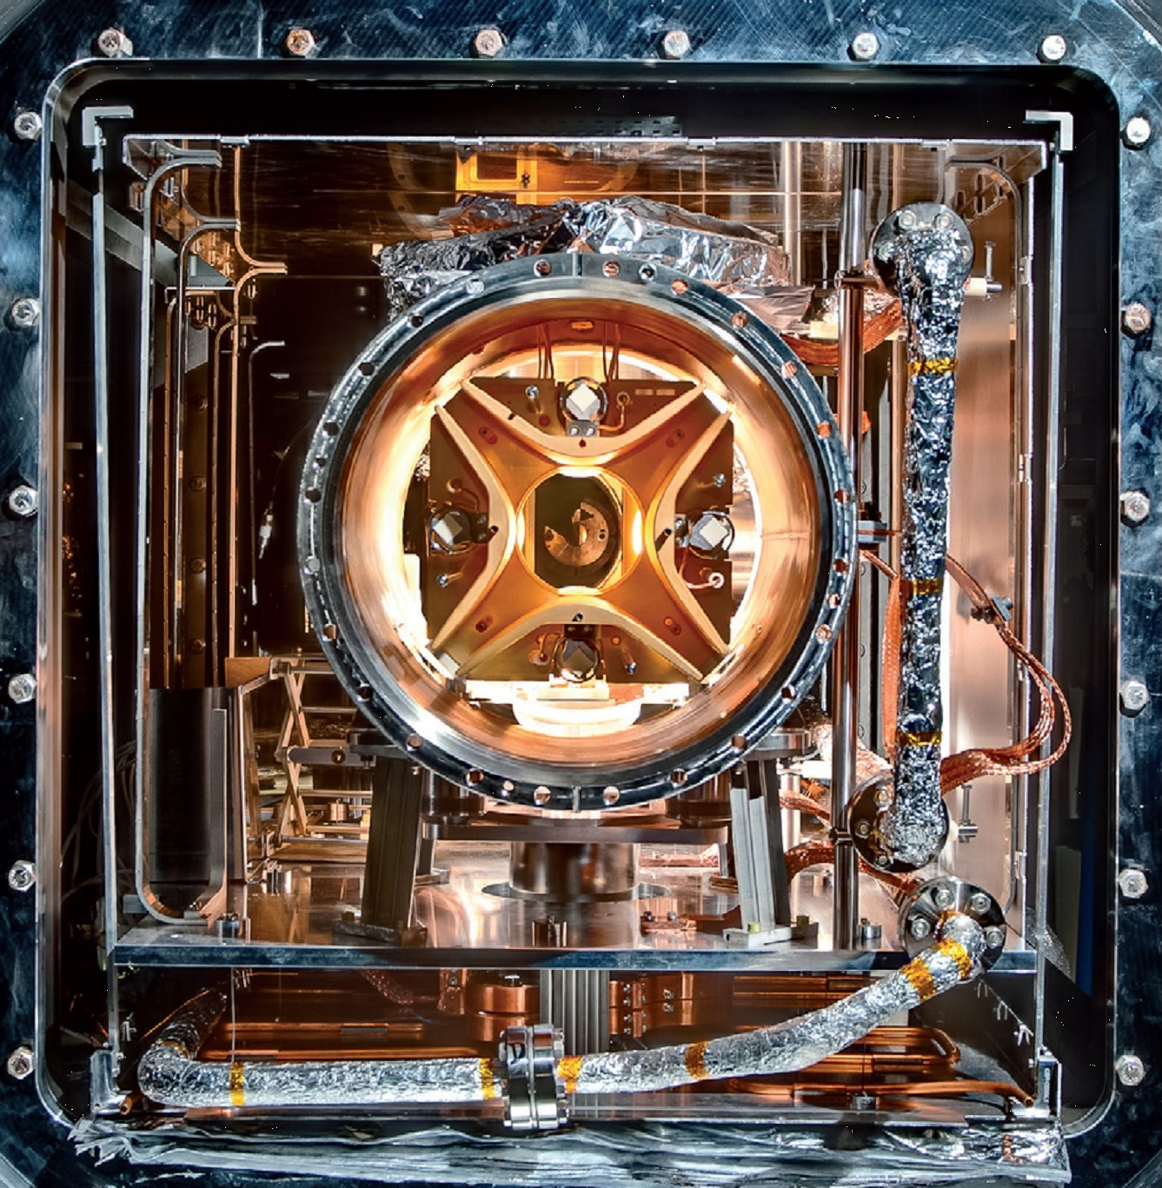
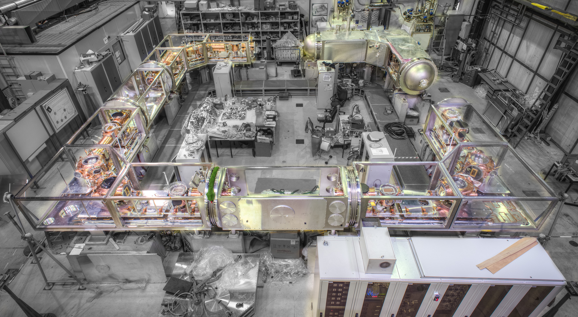
Currently: CSR, Heidelberg,
35 m circ., 10⁻¹³ Torr
1m
1m

Slide 44
Important issues
SQUID-based BPMs, at <10fT/sqrt(Hz) level
Magnetic field shielding <10nT
Geometrical phases: 1. magnetic, 2. electric
Study with precision simulation tools
Clearly define lattice elements specs, what is possible with beam-based alignment

Slide 45
Important issues, con’d
Develop a robust polarimeter: deadtime-less, point back to origin, high efficiency, high analyzing power
what else can we do with this facility? Axion-dark matter: Axion-EDM project
Reliable, cheap E-bending plates: TiN-coated aluminum plates (follow J-LAB work & scale up)

Slide 46
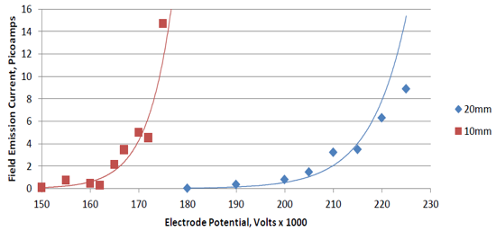
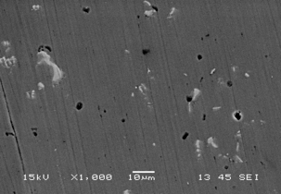
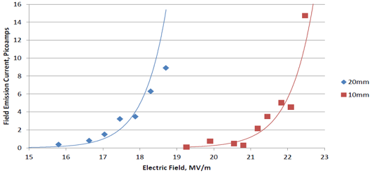
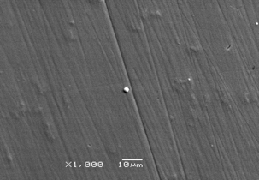
JLab results with TiN-coated Aluminum
No measureable field emission at 225 kV for gaps > 40 mm, happy at high gradient
Bare Al
Matt Poelker, JLab
TiN-coated Al
We need <10 MV/m
for 30mm plate separation
the hard coating covers defects
15 MV/m
20 MV/m
Work of Md. A. Mamun and E. Forman

Slide 47
Major systematic error:
Radial B-field

Slide 48
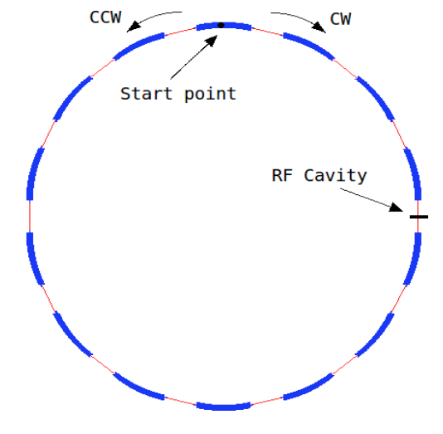
The all-electric proton EDM ring
Total circumference: ~400 m
Bending radius: 40 m
E: 10 MV/m
Allows for simultaneous clock-wise
and counter-clock-wise beam storage
Weak vertical focusing
Stronger horizontal focusing

Slide 49
Clock-wise (CW) & Counter-Clock-wise Storage
Total current: zero. Any radial magnetic field in the ring sensed by the stored particles will cause their vertical splitting.
Simultaneous proton-proton storage
Notes:
49

Slide 50

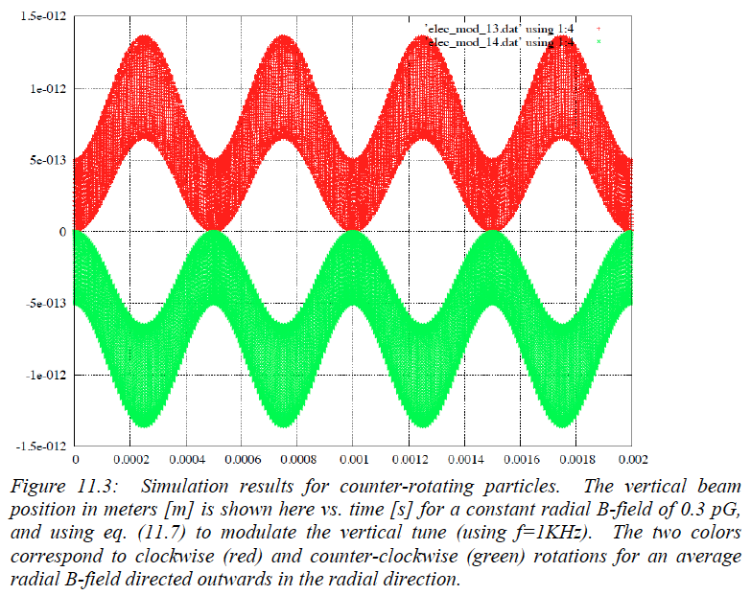
Distortion of the closed orbit due to N^{th}-harmonic of radial B-field
Clockwise beam
Y(ϑ)
The N=0 component
is a first order effect!
Counter-clockwise
beam
Time [s]

Slide 51
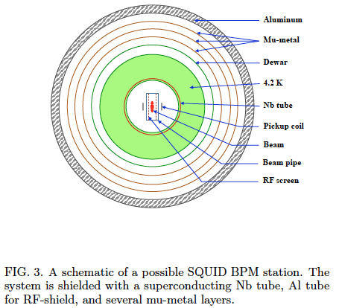
SQUID BPM to sense the vertical beam splitting at 1-10kHz

Slide 52
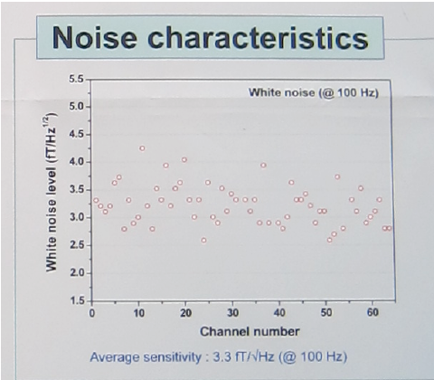
Total noise of (65) commercially available SQUID gradiometers at KRISS
From YongHo Lee’s group
KRISS/South Korea

Slide 53
Projects in Korea
Magnetic field shielding, SQUID-based BPMs, IBS/CAPP, KRISS, TUM, …
Teamleader: Selcuk Haciomeroglu
Goal: develop a SQUID-based BPM at the 1-10fT/sqrt(Hz) level
Characterize it at IBS/CAPP for time stability
Install it at a ring for real-time testing

Slide 54
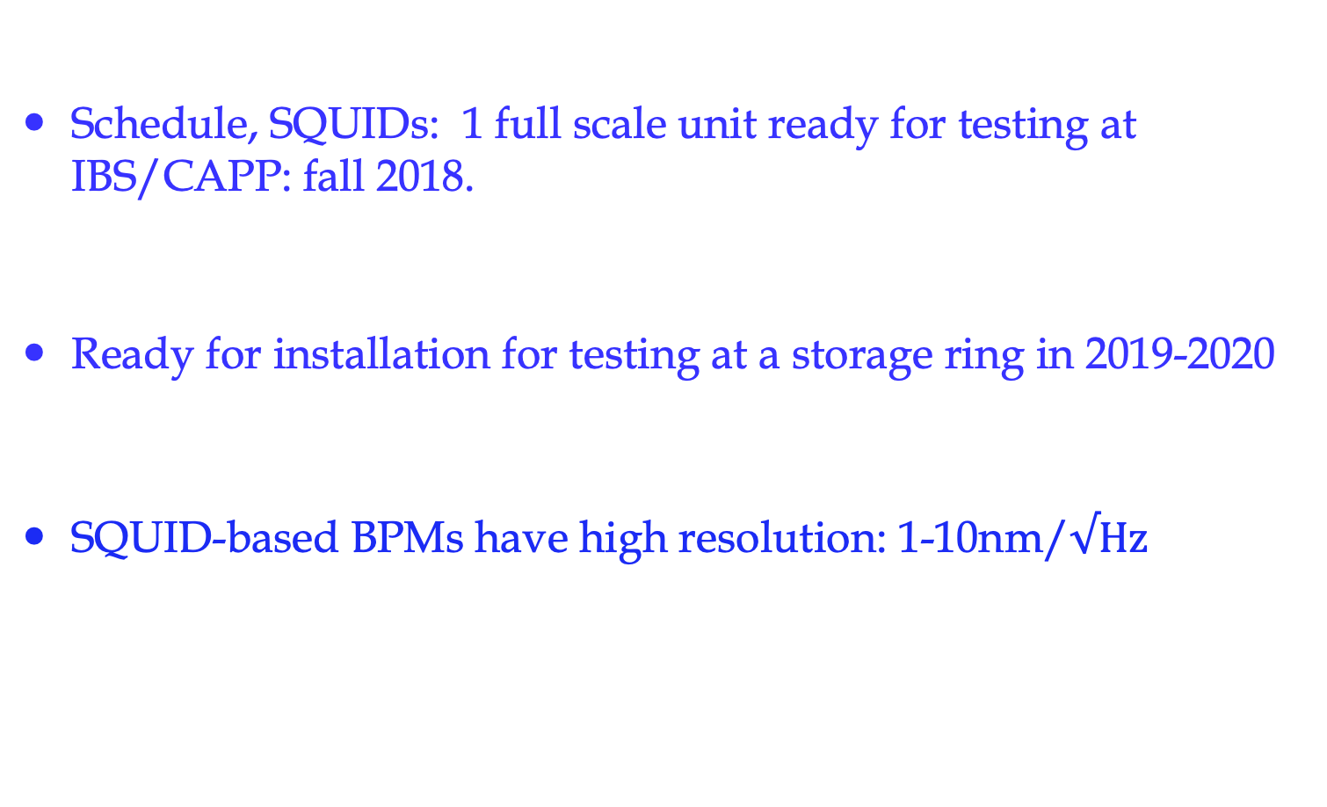
Projects in Korea
Schedule, SQUIDs: 1 full scale unit ready for testing at IBS/CAPP: fall 2018.
Ready for installation for testing at a storage ring in 2019-2020
SQUID-based BPMs have high resolution: 1-10nm/$√Hz$

Slide 55
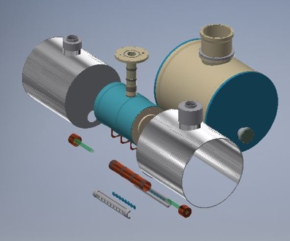
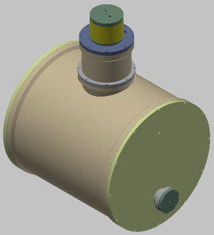
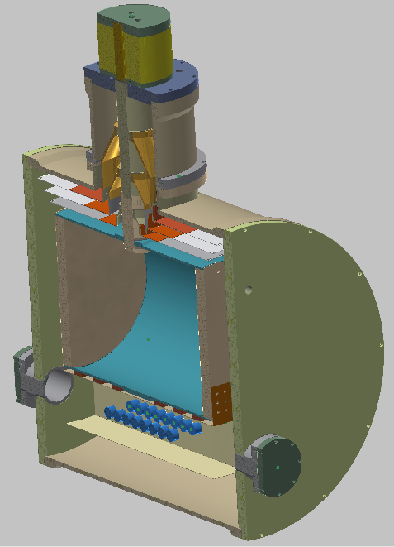
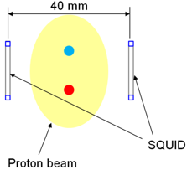
Beam position monitor: SQUID array
Liquid He
Vacuum
SQUID magnetometer
To p-beam line

Slide 56
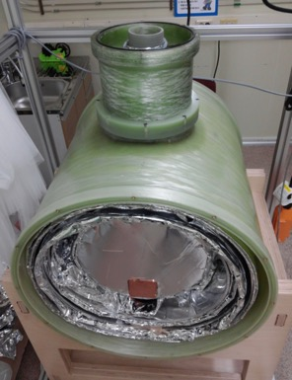
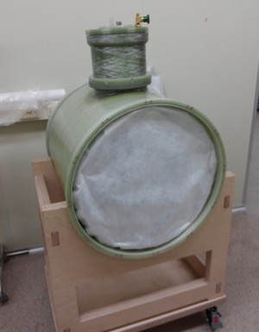
Cylindrical Dewar: under fabrication

Slide 57
SQUID-based BPMs, Korea
Selcuk Haciomeroglu, IBS/CAPP

Slide 58
BMP Systems in the Storage Ring
…
Optical transmission (signal & control)
Storage ring
ADC: 16 bit, 10 kS/s sampling
Data (1000 s/epoch)
16-ch Module
<Control/Acquisition>
<Averaging/Analysis>
Interference-free control
Noise-free acquisition
No time-delay bet. modules
YongHo Lee, KRISS

Slide 59
All-electric field ring weakness: High sensitivity to B-fields
<10nT B-field shielding is adequate when lattice beta-functions are uniform
Much stricter specs when there’s a variation of vertical beta-function.
Confirmed specs with high-precision beam/spin simulations

Slide 60
New breakthrough idea from IBS/CAPP: hybrid storage ring
It eliminates the main systematic error sources: B-fields
Makes the ring construction simpler

Slide 61
New idea: hybrid storage ring
Use E-field for particle bending
Alternate magnetic focusing, allows simultaneous CW/CCW storage (eliminates vertical E-field issues)
It reduces the radial B-field dependence by at least five orders of magnitude

Slide 62
Hybrid storage ring lattice
Use E-field for particle bending, alternate magnetic focusing
Quads: 0.1T/m, 0.4m
Seluck Haciomeroglu’s simulation

Slide 63
Reality check:
What happens with misaligned elements?

Slide 64
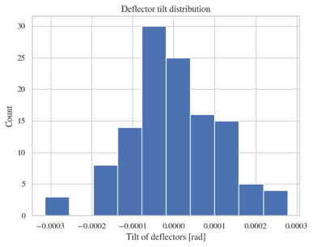
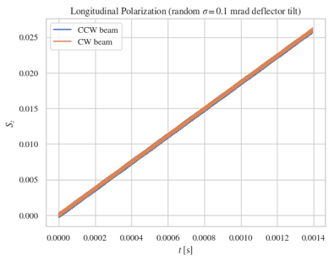
Running the EDM experiment
Potential systematic error: tilted E-field plates
Clock-wise and counter-clock-wise vertical spin precessions are equal and cancel.
Zhanibek Omarov’s simulation

Slide 65
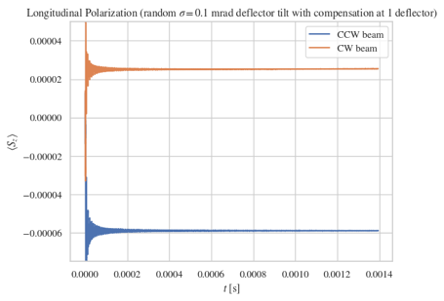
Running the EDM experiment
Potential systematic error: tilted E-field plates
Clock-wise and counter-clock-wise vertical spin precessions are equal, shown here with 1 compensating element.
Zhanibek Omarov’s simulation

Slide 66
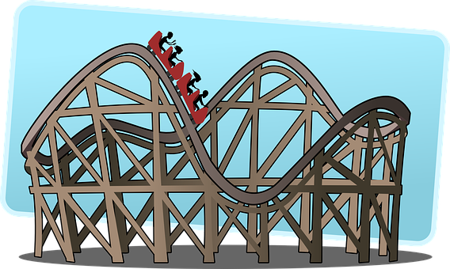
Relevant parameter:
The average vertical speed in deflectors needs to be close to zero!
Quads: 0.1T/m, 0.4m

Slide 67
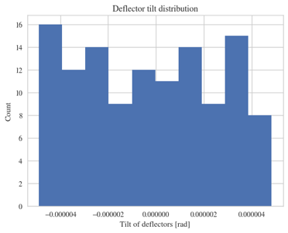
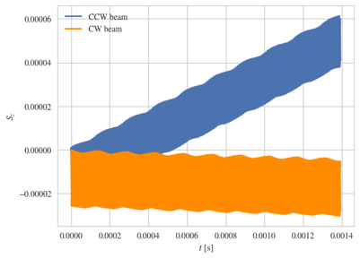
“Flattening” (on average) the ring
Run with radial spin direction.
Cancel both CW and CCW vertical spin precessions with trim dipole fields
Zhanibek Omarov’s simulation

Slide 68
How about quadrupole alignment?

Slide 69
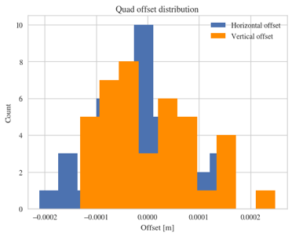
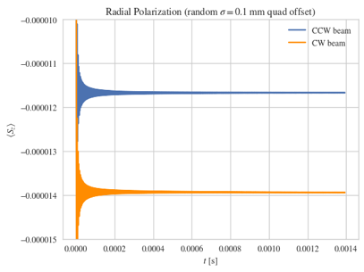
Running the EDM experiment
Potential systematic error: random positioning error of the quads
Clock-wise and counter-clock-wise vertical spin precessions are compatible with zero!
Zhanibek Omarov’s simulation

Slide 70
Our conclusions
According to our simulations all known systematic errors are cancelled
Need to confirm with independent studies by another group

Slide 71
Beam-based alignment:
What is possible?

Slide 72
Beam-based alignment at COSY
Slide by Tim Wagner, COSY/Juelich, March 2018

Slide 73
Beam-based alignment at COSY
Slide by Tim Wagner, COSY/Juelich, March 2018

Slide 74
Beam-based alignment at COSY
Slide by Tim Wagner, COSY/Juelich, March 2018

Slide 75
Beam-based alignment at COSY
Slide by Tim Wagner, COSY/Juelich, March 2018

Slide 76
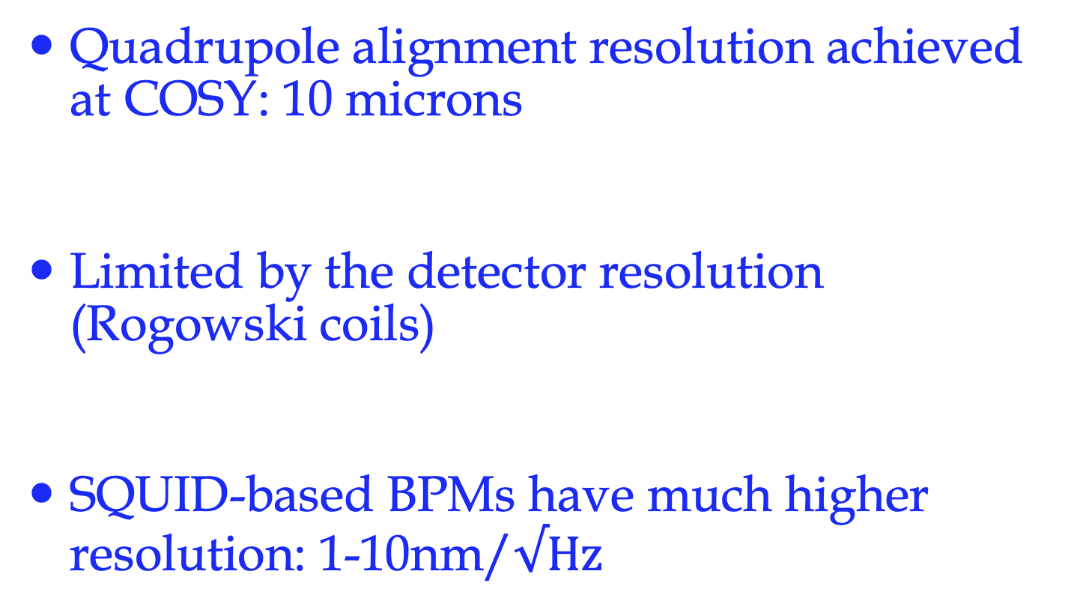
Beam-based alignment
Quadrupole alignment resolution achieved at COSY: 10 microns
Limited by the detector resolution (Rogowski coils)
SQUID-based BPMs have much higher resolution: 1-10nm/$√Hz$

Slide 77
Symmetries during run

Slide 78
Keep it symmetric
Aiming for 1-10 microns using SQUID-based BPMs. We can do better by >10³ if needed (stability?)
Run the experiment with longitudinal and radial spin directions in CW and CCW directions.
Flip the current in the magnetic quadrupoles if needed.

Slide 79
Quadrupole E-field?

Slide 80
Running the EDM experiment
Potential systematic error: electric focusing!
Seluck Haciomeroglu’s simulation
P_{m}=1/Q²_{y}. Run the experiment with different magnetic strengths.
The DC offset corresponds to the EDM.
Magnetic focusing reduces the sensitivity to radial B-field by several orders of magnitude.

Slide 81
Competition?

Slide 82
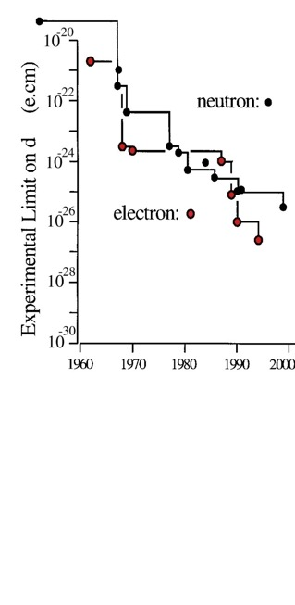


Sensitivity to Rule on Several New Models
Gray: Neutron
Red: Electron
If found it could explain
Baryogenesis
(p, d, n (or ³He))
n current
e current
GUT SUSY
Electroweak
Baryogenises
n target
p, d target
e target
2nd phase target
Statistics limited
If a pEDM is not found it can
eliminate EW-Baryogenesis
e-cm
Adopted from
J.M.Pendlebury and E.A. Hinds, NIMA 440 (2000) 471

Slide 83
What’s next?

Slide 84
What’s next?
Form a working group to study the systematic errors. Confirm the resilience of the hybrid ring to B-fields, alignment requirements
Design a ring lattice, including injection lines
Need a high-intensity (10¹¹ protons/cycle) polarized (>80%) proton source

Slide 85
Summary
New hybrid ring design simplifies the exp.:
Possible and exciting, could explain the matter-antimatter asymmetry mystery!
Sensitive to New Physics at high scales 10³TeV, can be done at Fermilab.
Next: Complete detailed systematic error studies, proposal…

Slide 86
Extra slides

Slide 87

Achieved so far:
Absolute field: <1nT
Gradient field: <1nT/m

Slide 89

Search for axion dark matter in storage rings

Slide 90
Search for axion dark matter in storage rings
SeongTae Park, IBS/CAPP

Slide 91
Search for axion dark matter in storage rings
SeongTae Park, IBS/CAPP

Slide 92
EDMs of hadronic systems are mainly sensitive to
Theta-QCD (part of the SM)
CP-violating sources beyond the SM
Alternative simple systems are needed to be able to differentiate the CP-violating source (e.g. neutron, proton, deuteron,…).
pEDM at 10⁻²⁹e•cm is > an order of magnitude more sens. than the best current nEDM plans

Slide 93



EDMs of different systems
Measure all three: proton, deuteron and neutron EDMs to determine CPV source
Theta_QCD:
Super-Symmetry (SUSY) model predictions:
Theoretical estimation on the lattice?

Slide 94
Physics reach of magic pEDM (Marciano)
Sensitivity to new contact interaction: 3000 TeV
Sensitivity to SUSY-type new Physics:
The proton EDM at 10⁻²⁹e∙cm has a reach of >300TeV or, if new physics exists at the LHC scale, δ<10⁻⁷-10⁻⁶ rad CP-violating phase; an unprecedented sensitivity level.
The deuteron EDM sensitivity is similar.
Notes:
94

Slide 95
Spin is the only vector defining a direction of a “fundamental” particle with spin
-
+

Slide 96
Electric Dipole Moment: two possibilities
-
+
+
-

Slide 97
If we discover that the proton
Has a non-zero EDM value, i.e. prefers only one of the two possible states:
+
-
-
+
Then P and T symmetries are violated and through CPT, CP-symmetry is also violated.
CP-violation is one of three necessary conditions to obtain a matter dominated universe starting from a symmetric one…

Slide 98
A Permanent EDM Violates both T & P Symmetries:
+
T
-
+
-
P
-
+
EDM physics without spins is not important
(batteries are allowed!)

Slide 99
Spin Coherence Time: need ~10³ s
Not all particles have same deviation from magic momentum, or same horizontal and vertical divergence (all second order effects)
They cause a spread in the g-2 frequencies:
Present design parameters allow for 10³ s. Cooling/mixing during storage could prolong SCT (upgrade option?).

Slide 100
Monitoring the proton spin direction as a function of time:
Proton Polarimeter

Slide 101

Martin Gaisser

Slide 102

Martin Gaisser, COSY/Juelich
JEDI Collaboration

Slide 103

Martin Gaisser, COSY/Juelich
JEDI Collaboration
SCT goal accomplished!
Sextupole strength

Slide 104

Systematic errors

