Slide 1

Basic R&D for High gradient ILC SC cavity in KEK-STF
H. Hayano for STF surface R&D team
03102009@FNAL

Slide 2
Gradient limitation in Superconducting Cavities;
Sudden thermal quench
seems to be by defects which have magnetic field enhancement.
detection tools: T-map, Inspection camera
counter-measure (repair): more surface removal (CP, EP, etc),
or barrel polish/local grinding, …
(2) Field emission and slow thermal quench
seems to be by contaminations which will be a field emitter.
detection tools: T-map, X-ray map?, ???
counter-measure : ethanol rinse, degreaser rinse,
or sponge wipe, …
To understand what is residuals on EP’d Nb surface is important.
When we have a tool to observe its residuals,
then development of counter-measure will be easy and scientifically validated.

Slide 3
High Gradient basic R&D in STF
Electro-chemical Polishing Facility in STF
Surface Analysis of EP’d Nb
Sulfur removal
Sponge wipe
Inspection Camera (upgrade)
Local grinding
contaminations
defects

Slide 4
New EP facility at STF
- Introduction -

Slide 5
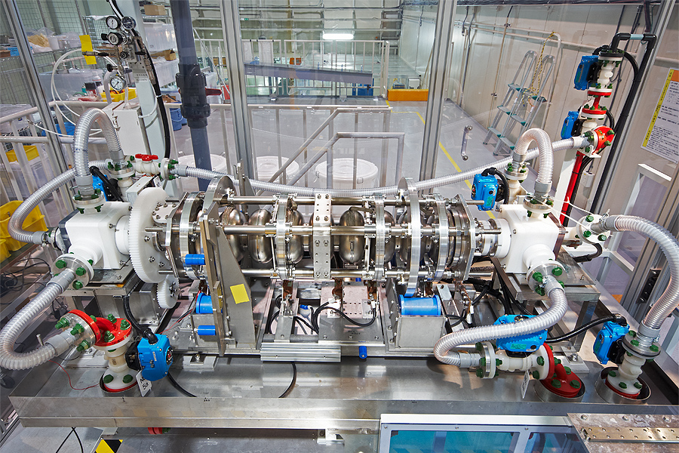
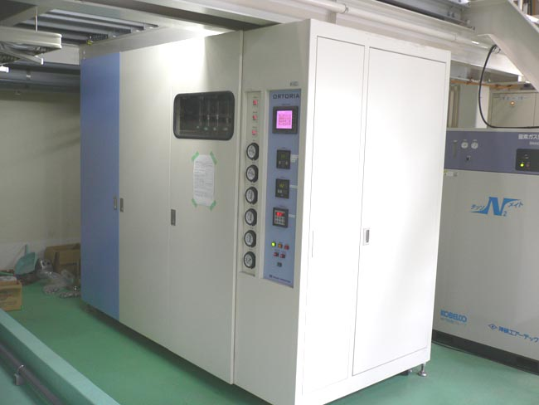
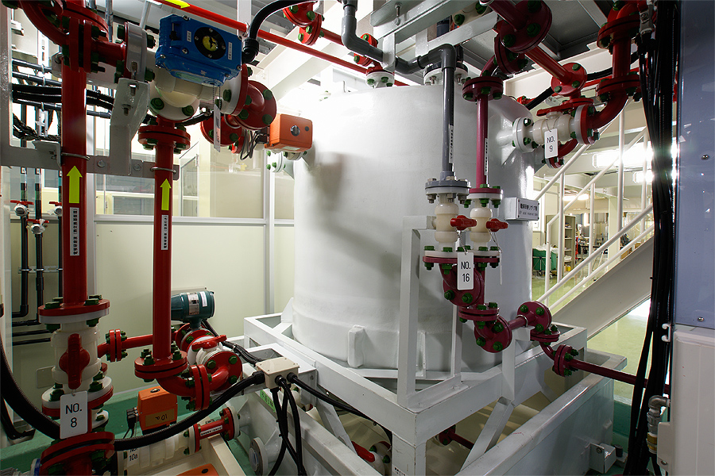
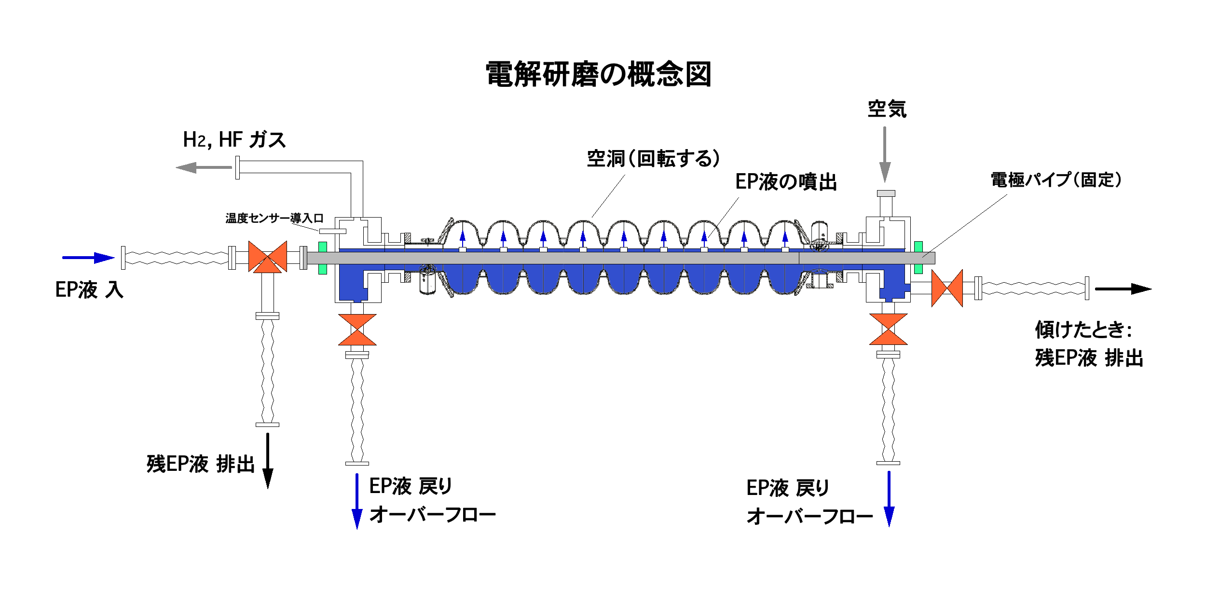
STF EP system
EP bed for 9 cell and 1 cell
EP acid:
HF + H₂SO₄
UPW system
1000L acid tank
H2, HF gas exhaust
Air intake
cavity (rotating)
electrode: Aluminum pipe
(acid supply pipe)
Acid supply flow inlet
Acid drain
outlet
Acid drain
outlet
Acid over-flow
outlet
Acid over-flow
outlet

Slide 6
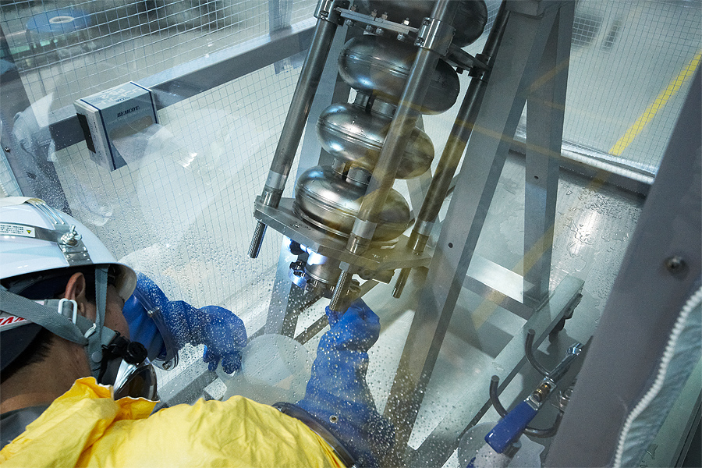
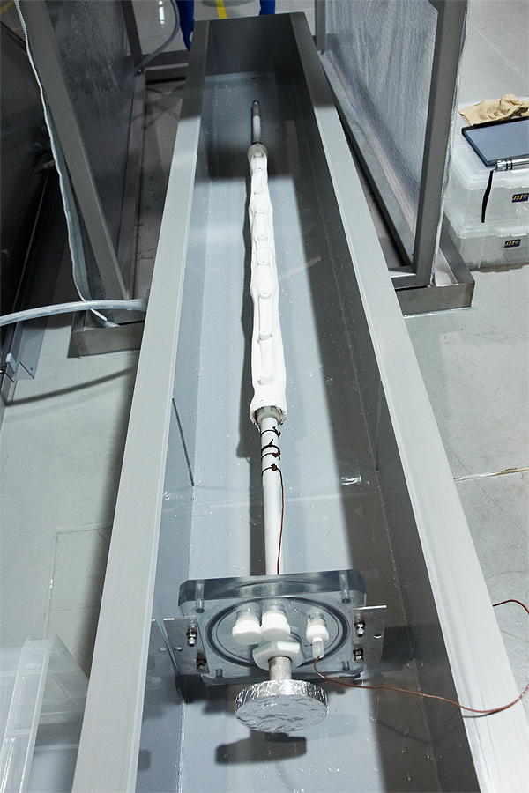
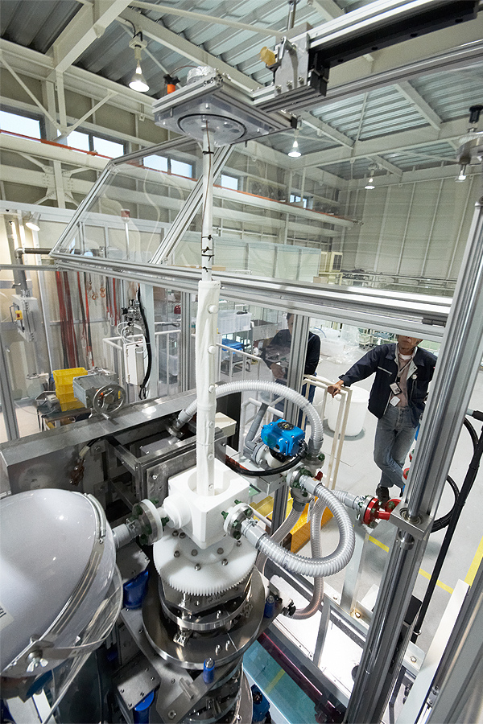
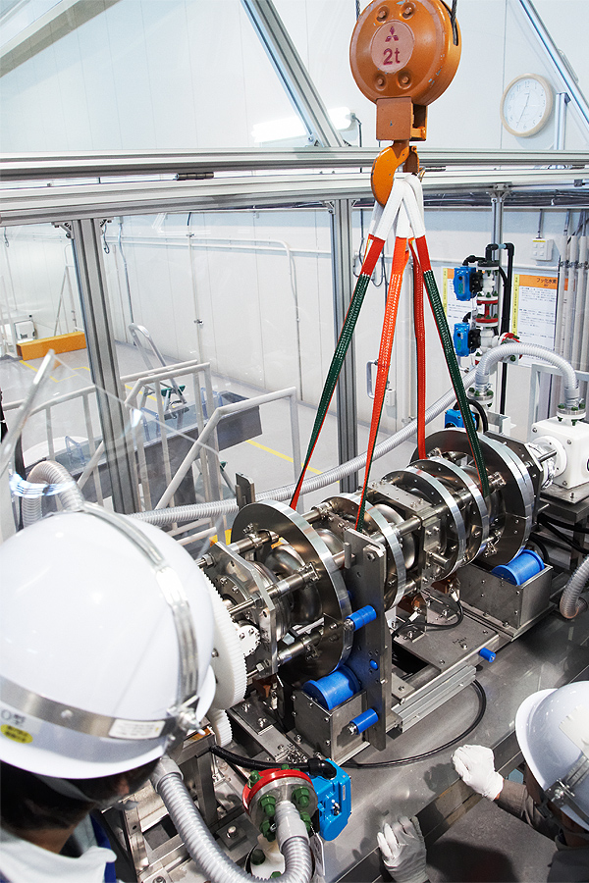
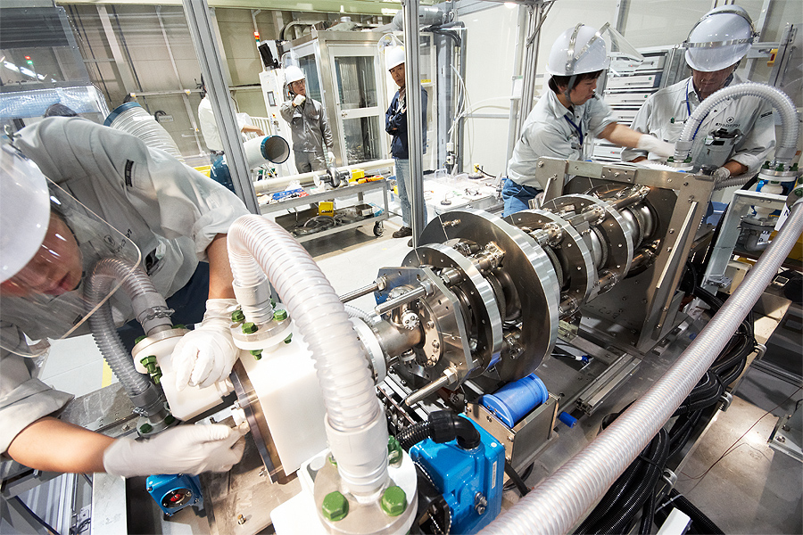
STF EP system commissioning
4. Insert Electrode
1. Flange CP
2. mount cavity
to EP bed
3. Wash Electrode
5. final assembly to EP bed

Slide 7
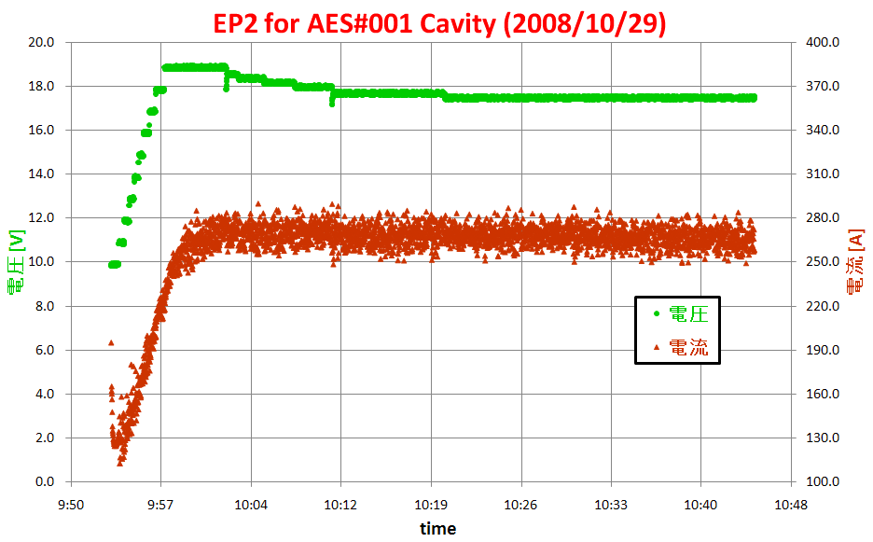
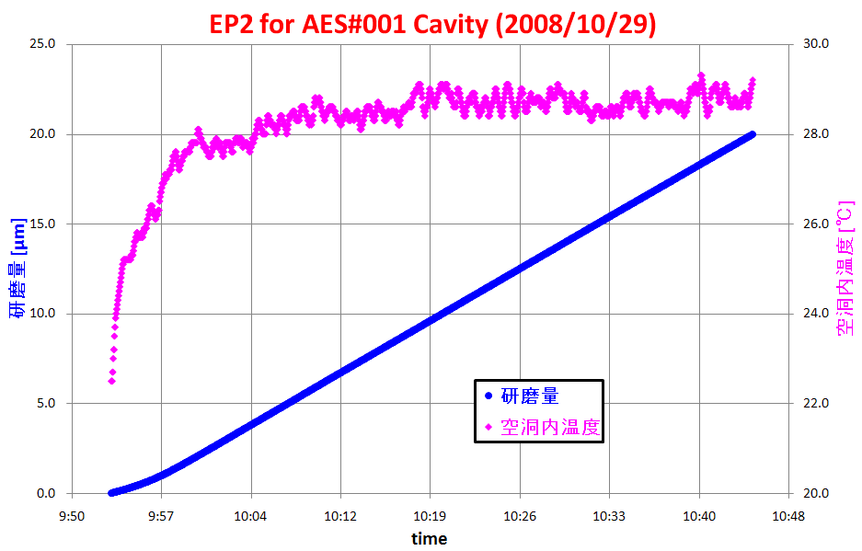
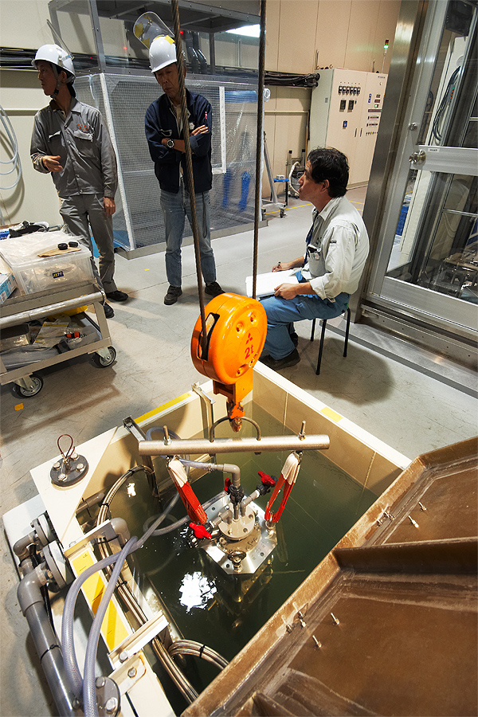
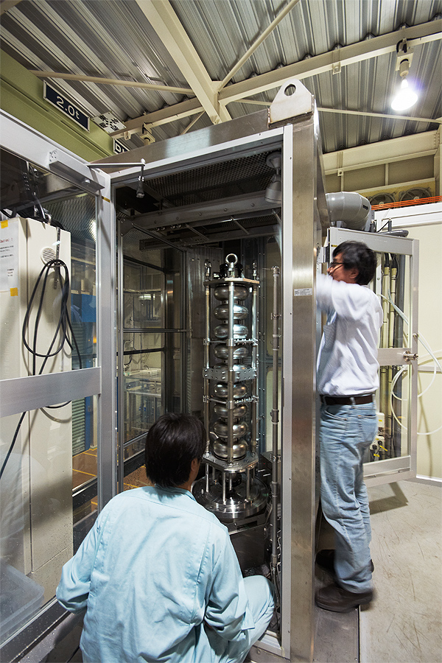
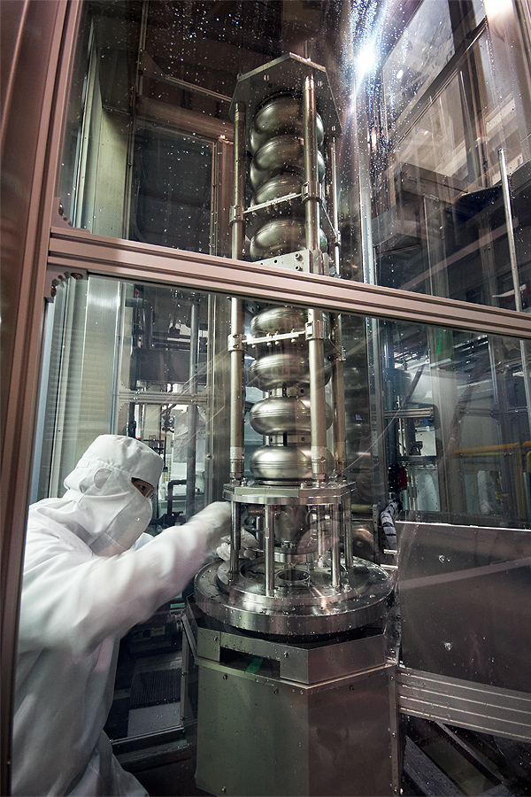
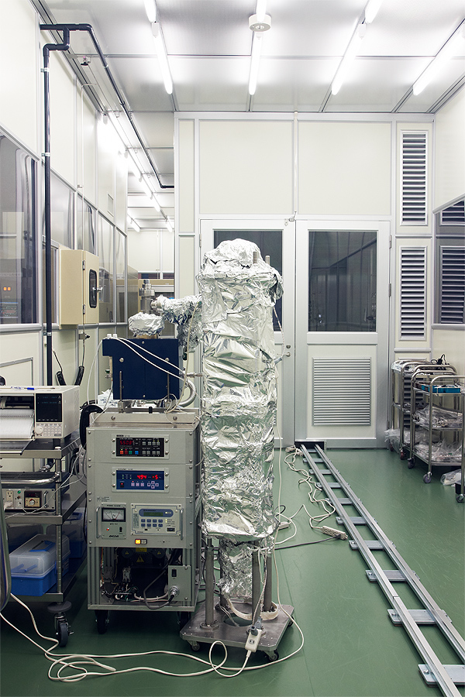
STF EP system commissioning
voltage
acid temperature
current
removal [µm]
ultra-sonic cleaning
HPR installation
HPR dismounting
120C bake

Slide 8
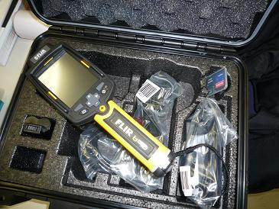
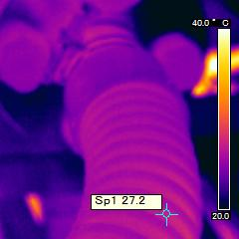
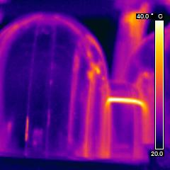
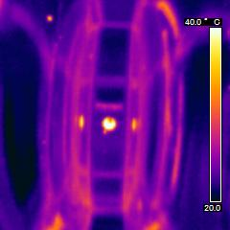
Monitoring cavity surface temperature
Use of infra-red viewer during EP
EP acid over-flow pipe
No.7 Cell
No.2～3 Iris

Slide 9
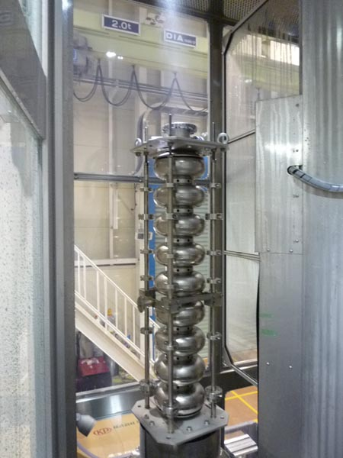
Monitoring particles and TOC
in the wash-out water of HPR
HPR with port open 4Hr.（No.1） 2009/02/18 BL#5
HPR with port close 4Hr.（No.2） 2009/02/19 BL#5
~ 4.5 hours
~ 3.5 hours
HPR

Slide 10
Surface analysis of EP’d Nb
1. using Lab-EP samples
2. using sample tips in the single cell with EP process
To understand surface contamination after EP process

Slide 11
KEK Analysis Tools

Slide 12
KEK Analysis Tools
SEM, EDX
XPS, AES, SIMS, surface conditioners

Slide 13
Nb samples preparation
Prepare four Nb samples, sample-1, -1’, -2, -2’.
Sample-1, -1’: BCP(30um)+EP(70um) + U.P.W. rinse.
Sample-2, -2’: BCP(30um)+EP(70um) + U.P.W. rinse + sponge wipe cleaning.
Compare sample-1 and sample-2 by FS-SEM, AES at Jlab.
Compare sample-1’ and sample-2’ by XPS, AES, SIMS, SEM,EDX at KEK.
* Sponge wipe is a pioneer study of new surface treatment.
This is a proposed physical/mechanical cleaning method
for EP treated Nb surface.

Slide 14
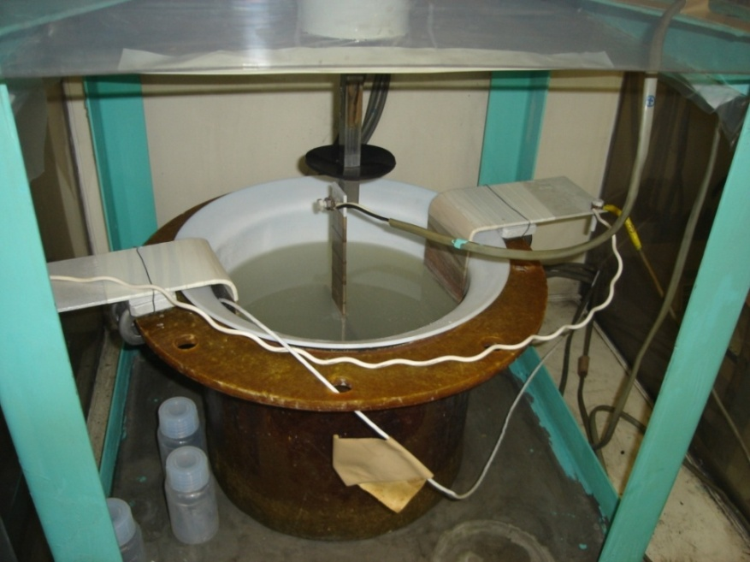
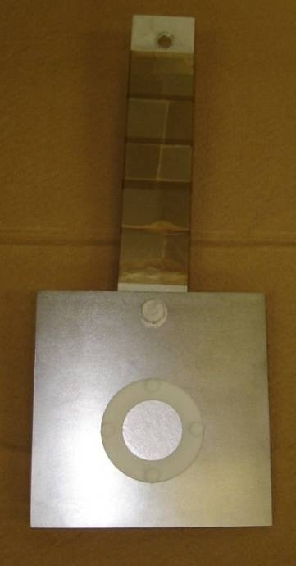
Lab-EP at Nomura-plating co.
Repetition of
EP voltage apply (2 min) + Rotation of sample w/o EP (2 min)
Lab-EP of Nb-plate sample
Nb sample + Teflon fixture
on Nb base-plate (10cm x 10cm)

Slide 15
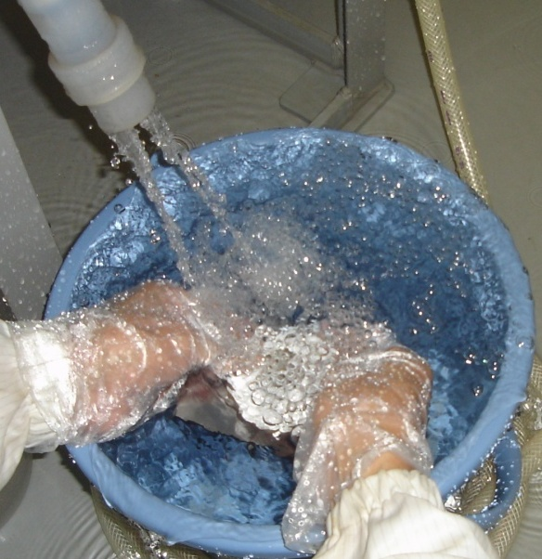
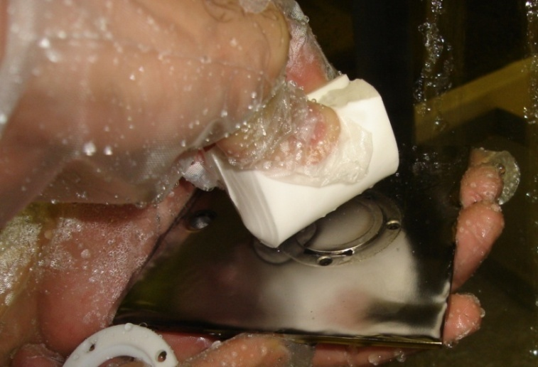
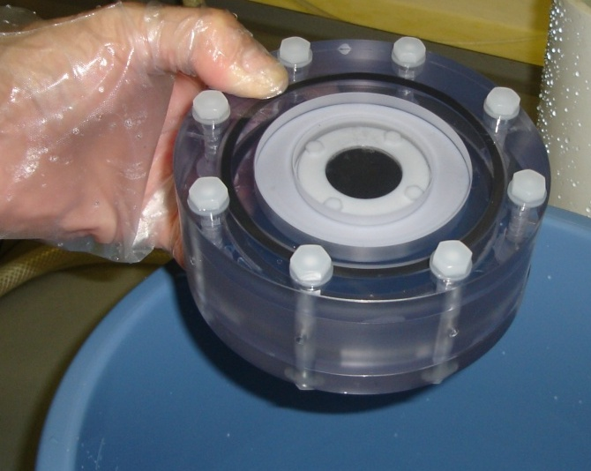
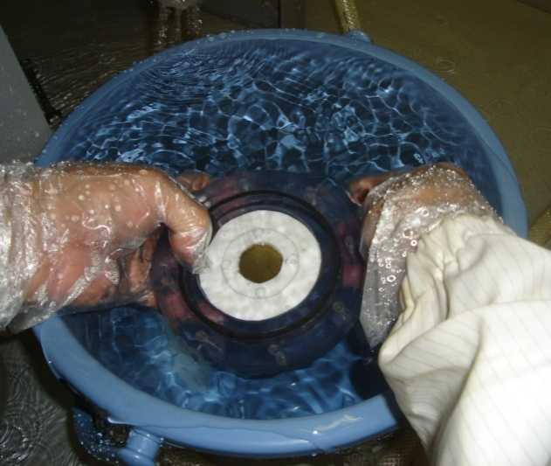
U.P.W. rinse and Sponge wipe
Moving into a clean-room (class-1000) after EP(70 um)
sponge wipe with U.P.W.
Wipe 10 times
for each arrow
= 40-times
wipes in total
Nb-sample-2
Ultra Pure Water rinse (20 min)
+ Ultra Pure Water rinse (5 min)
Nb-sample-1
Packing in transportation container
Packing under U.P.W.

Slide 16
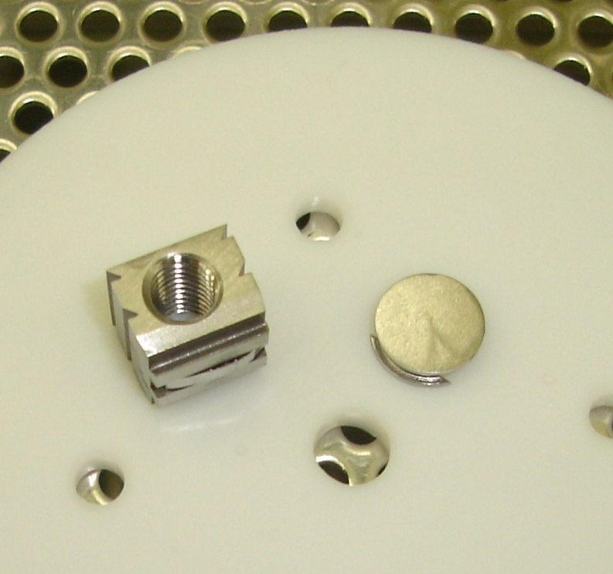
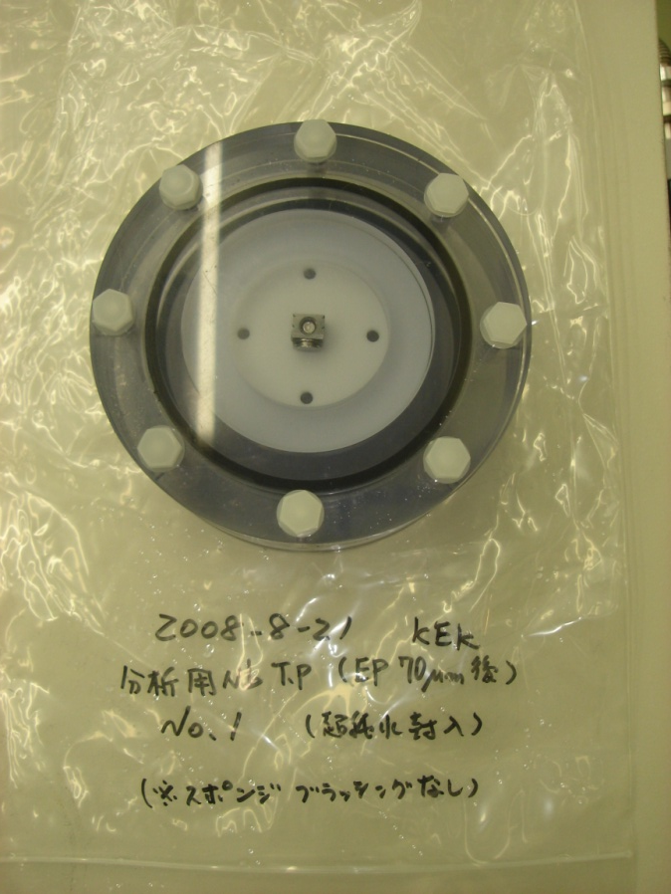
KEK-type Nb-sample 1
10 Sept. 2008
21 Aug 2008
EP 70 um
No sponge cleaning
Move out from the UPW container
Dry Nb-sample 1 in Class-10 C.R.
Nb-sample-1 kept in UPW container for 22 days.

Slide 17
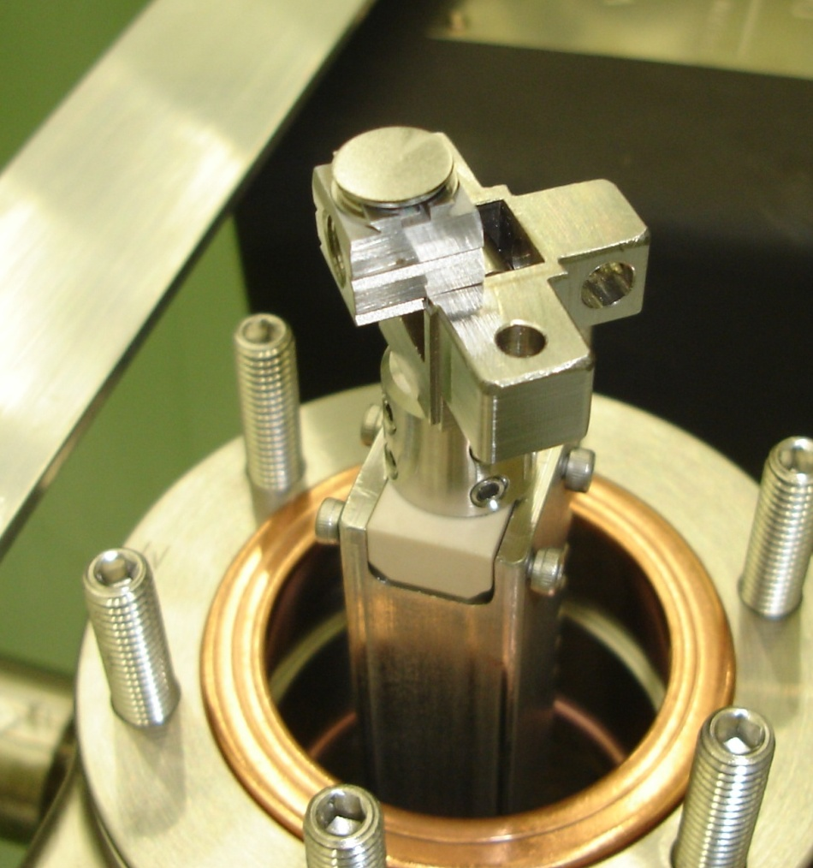
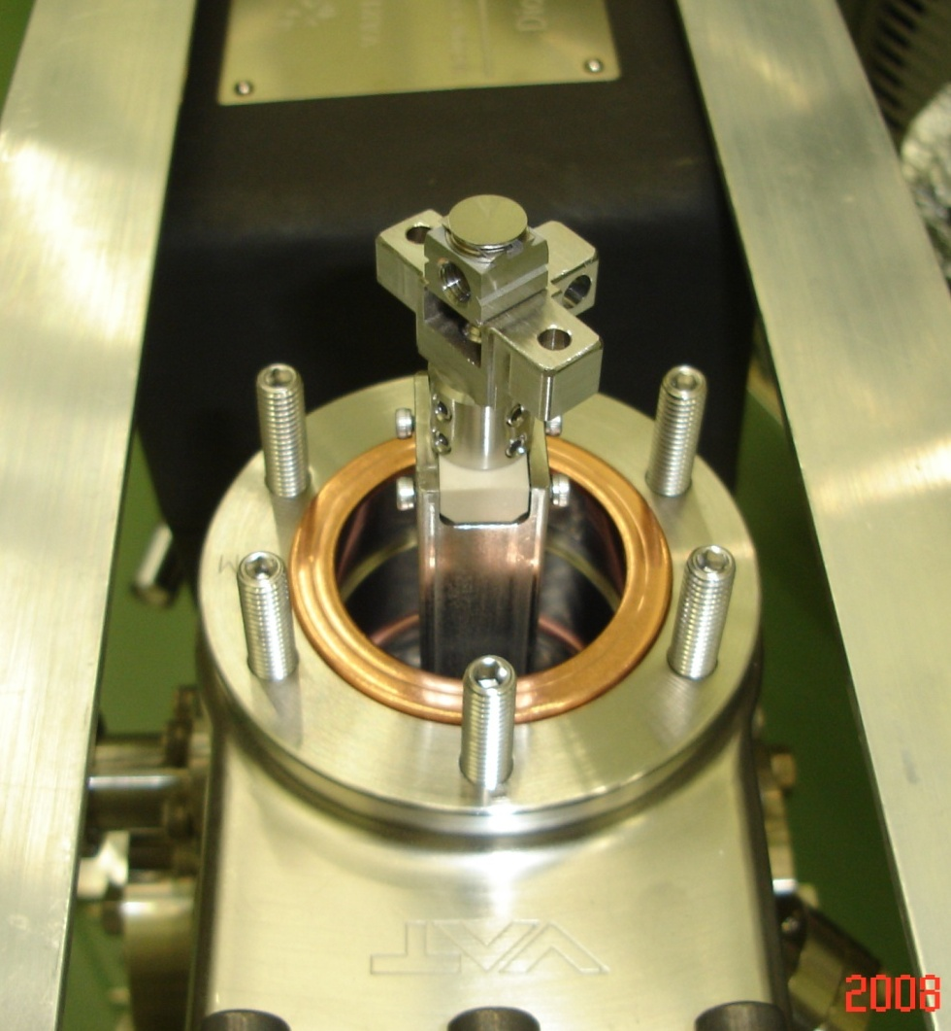
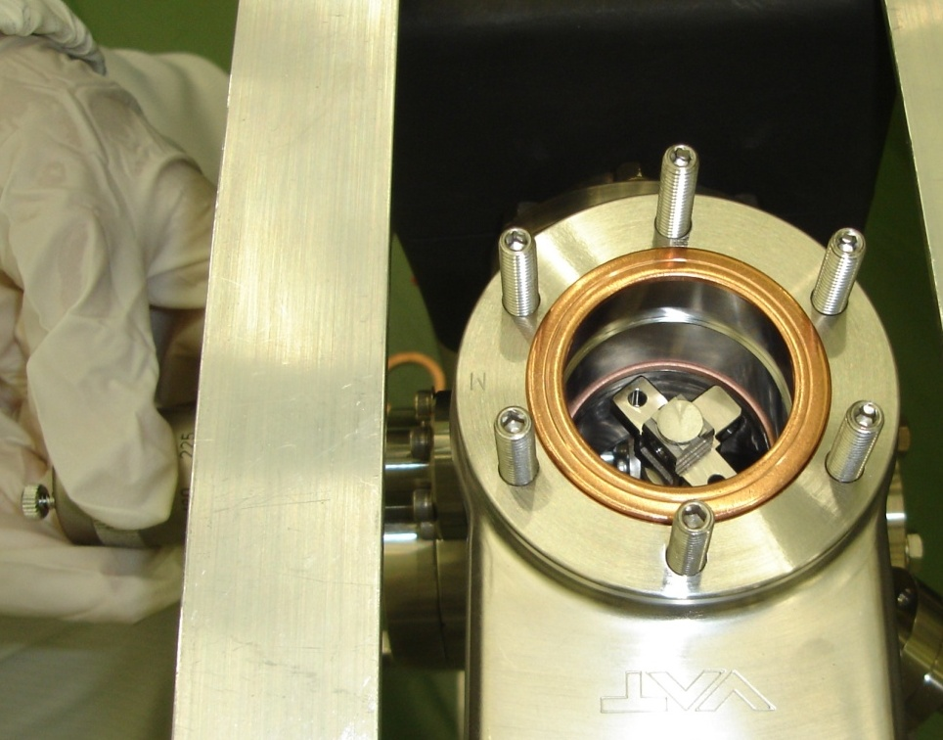
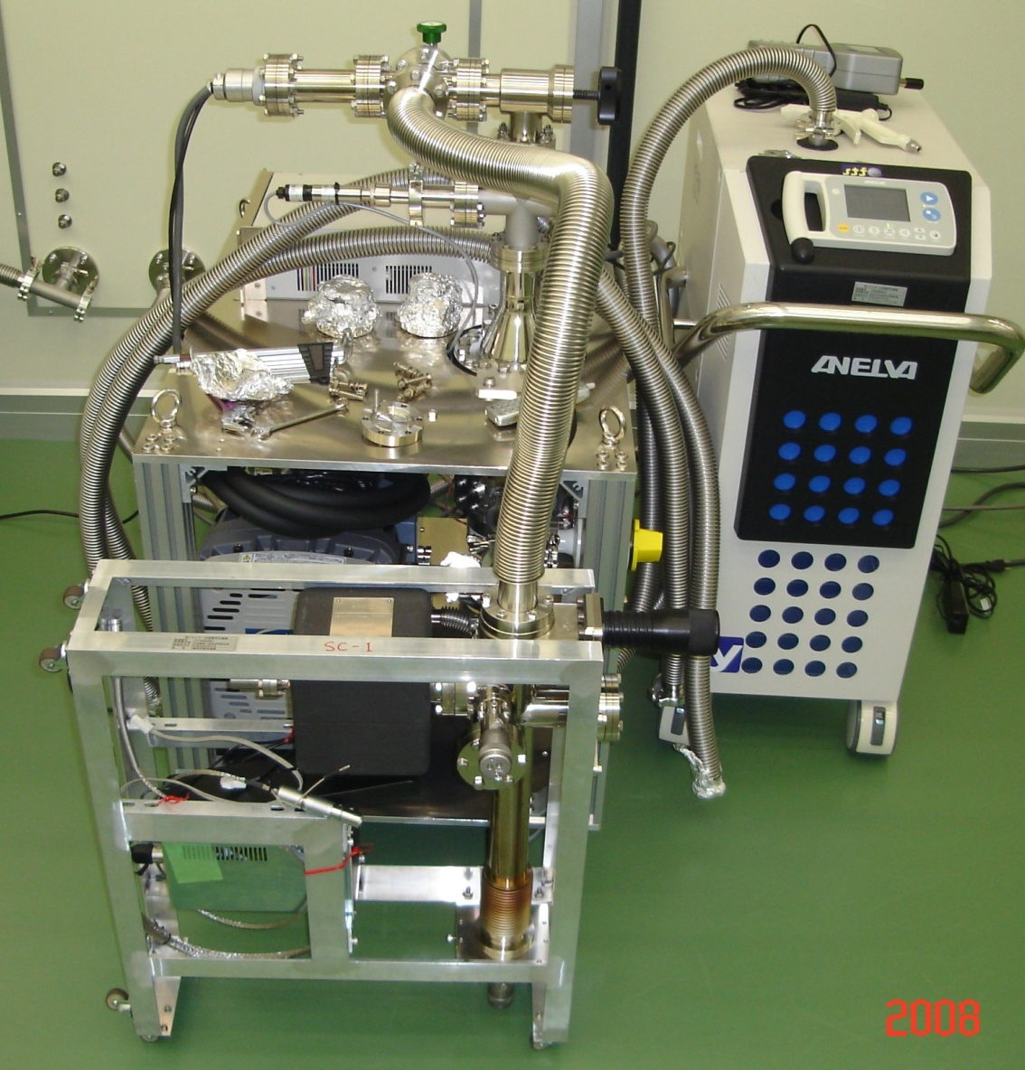
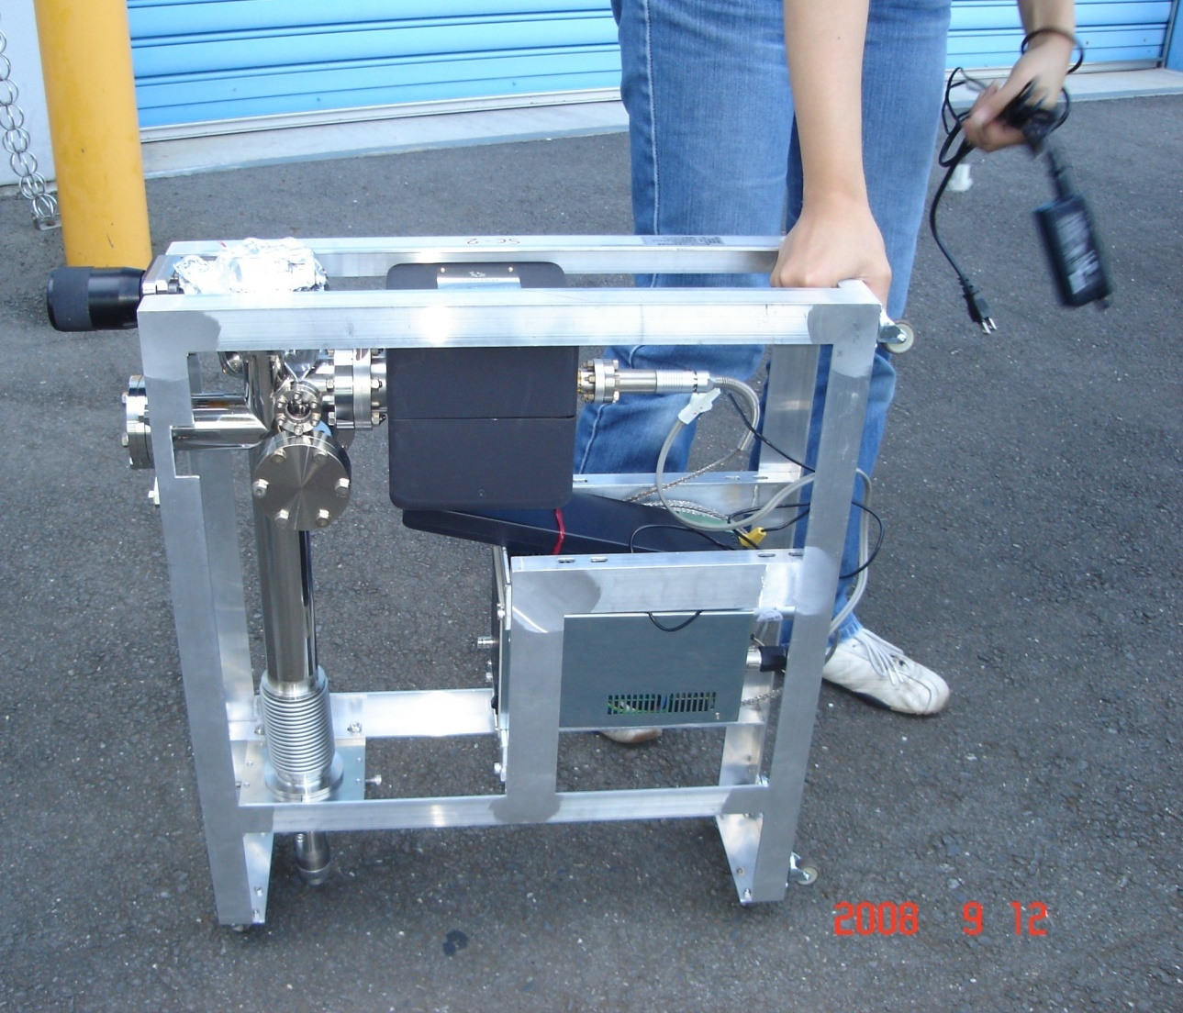
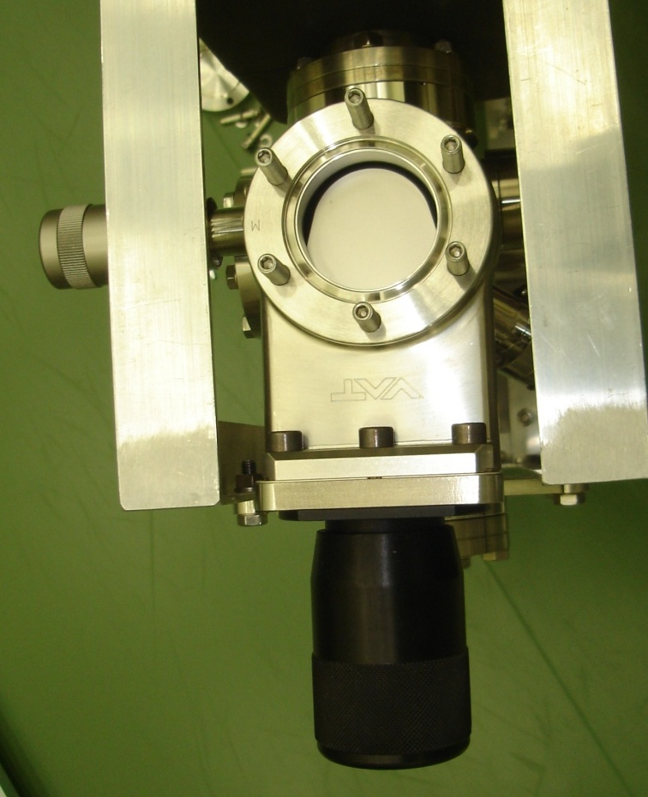
UPW container to vacuum container, then stored in the surface analysis device
store samples in clean-room
shut GV
pump down
transport to XPS

Slide 18
Surface analysis of EP’d Nb
(Lab-EP sample)

Slide 19
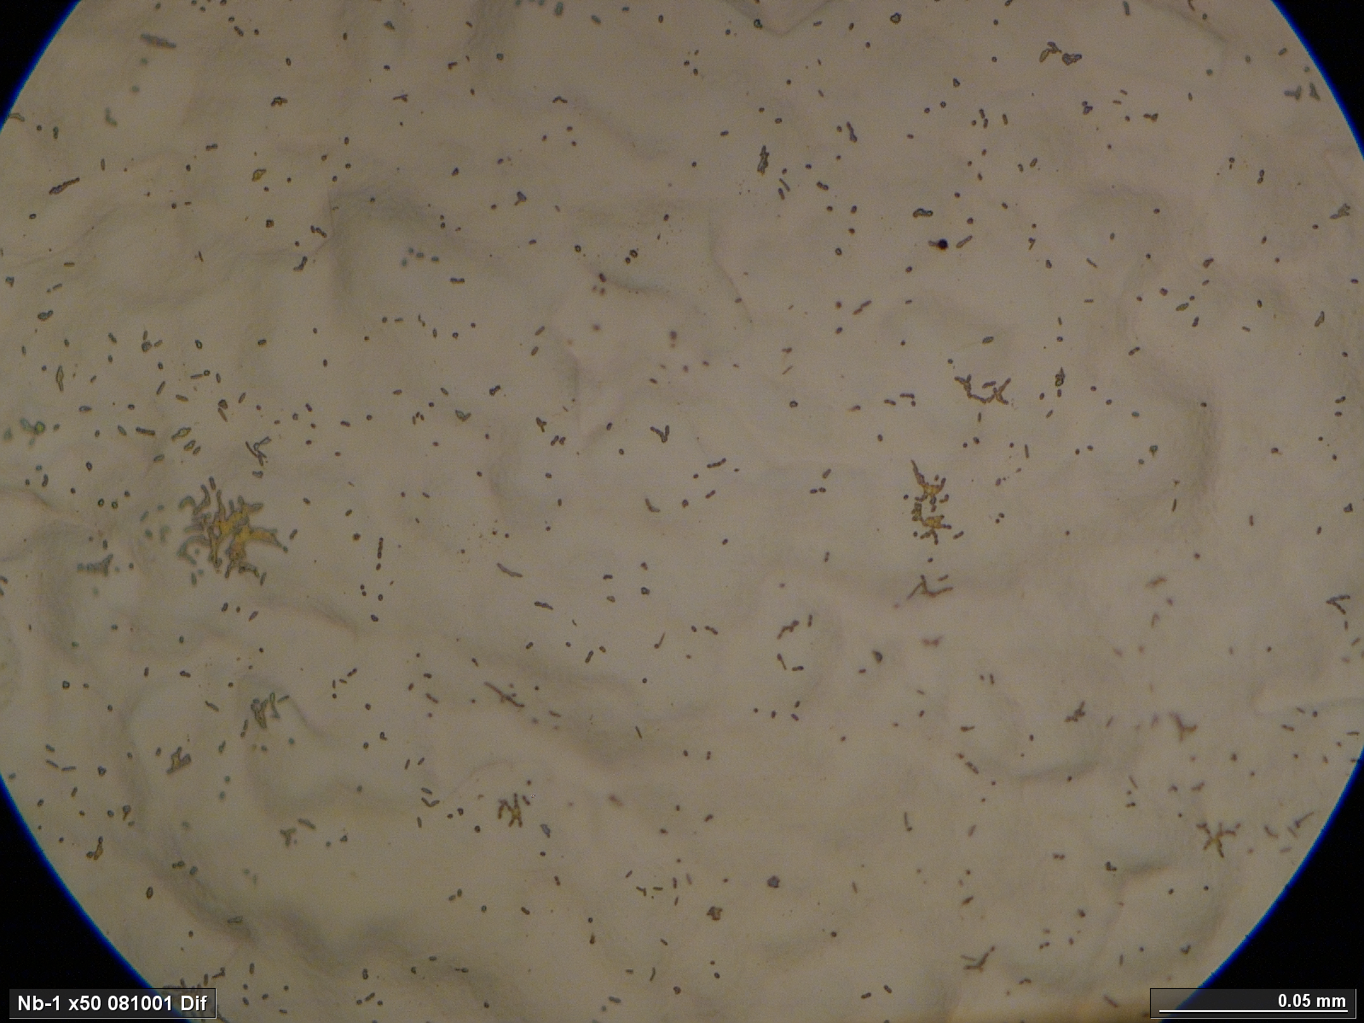
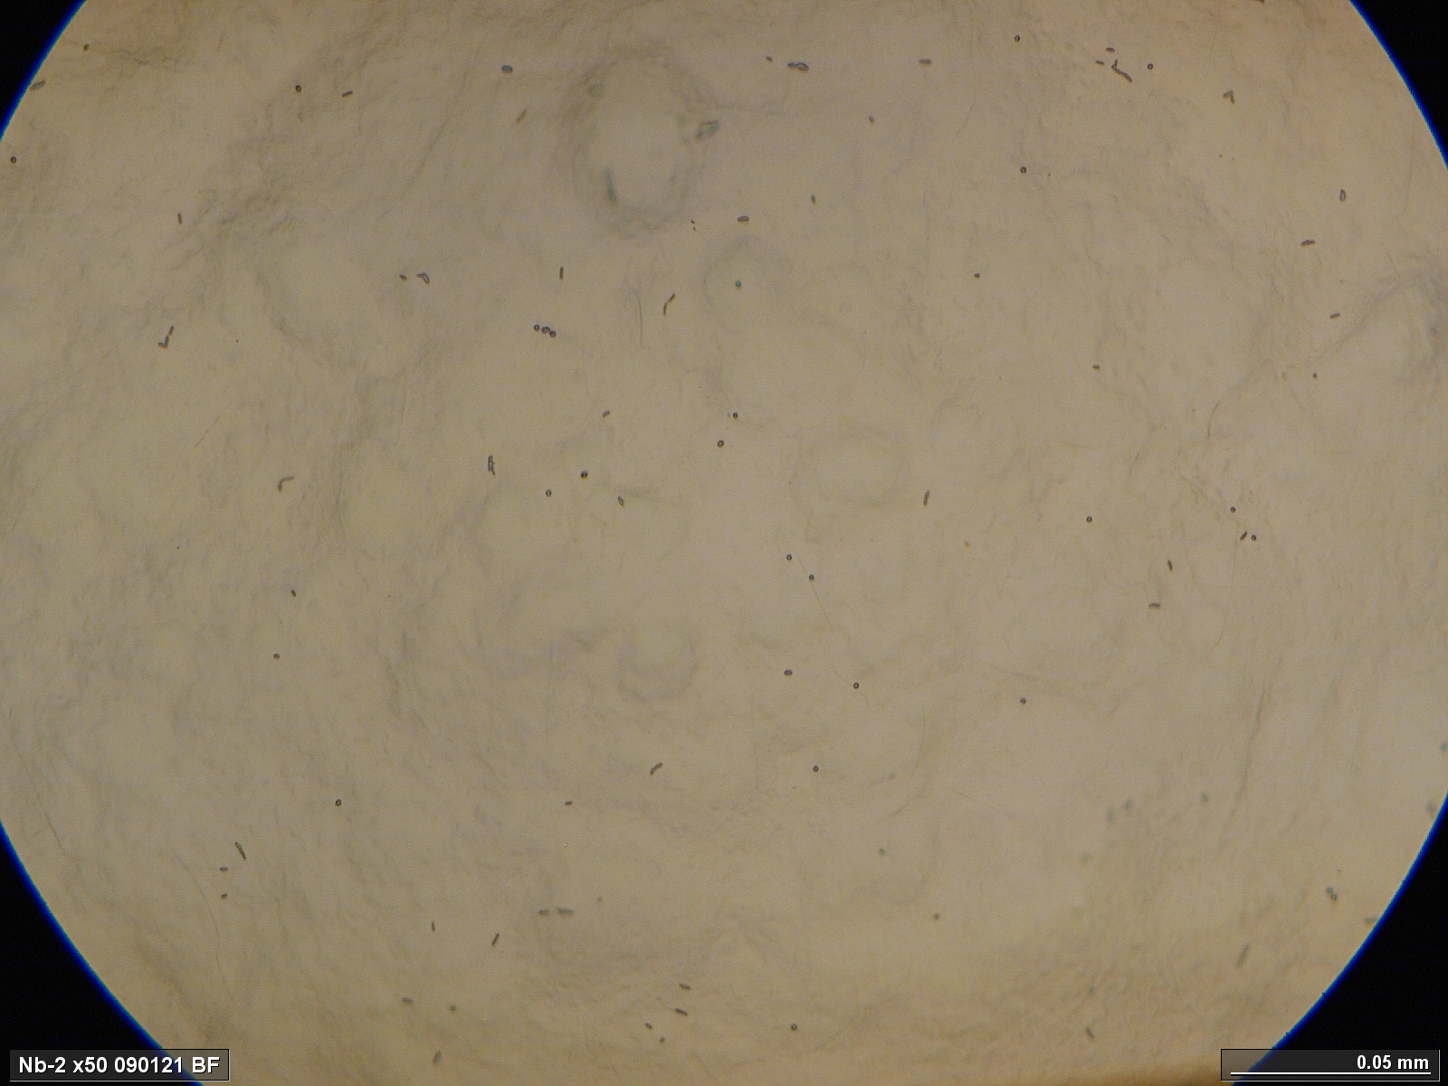
Lab-EP samples with UPW storage
( 22 days )
Optical Microscope
50μm
50μm
Without Wipe
With Sponge Wipe
Bacteria? like objects were found, but it is few in sponge wipe sample.
The reason is not yet understood.

Slide 20
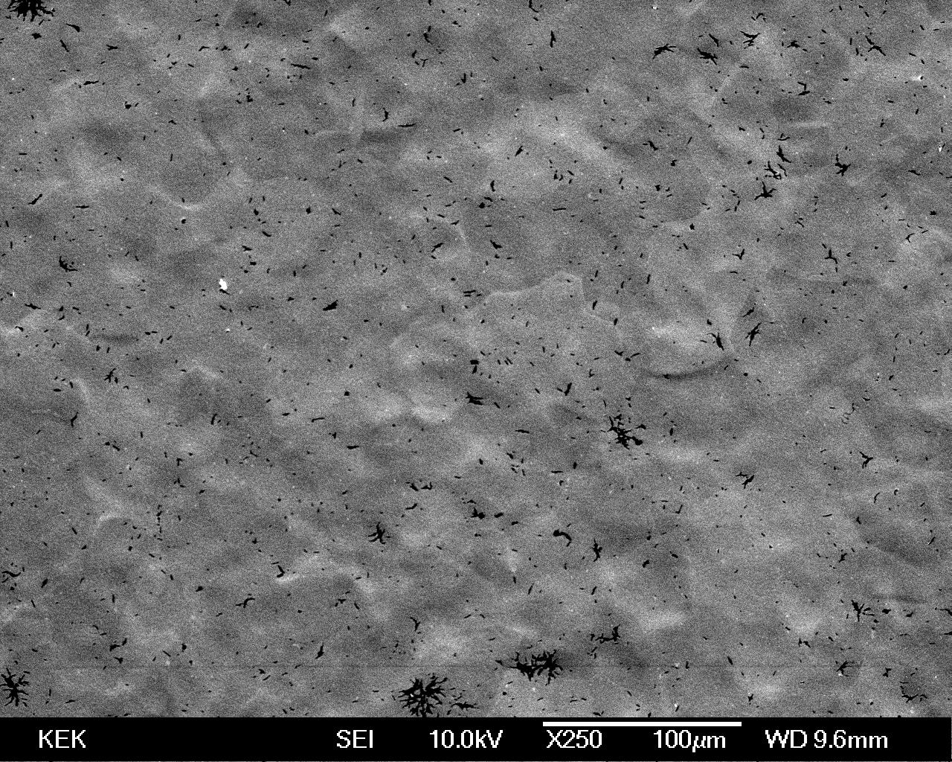
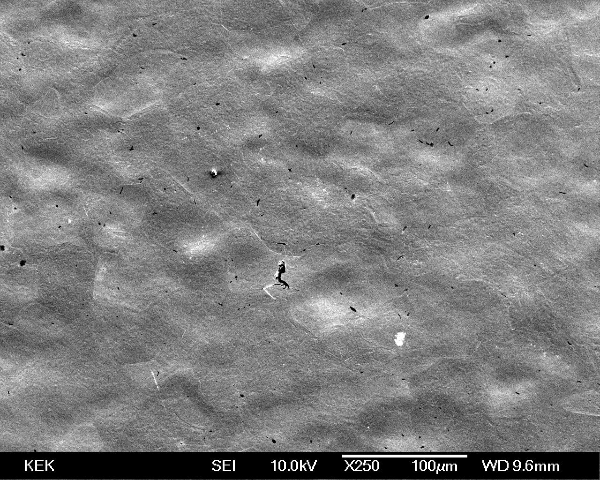
Lab-EP samples with UPW storage
SEM
100μm
100μm
Without Sponge Wipe
With Sponge Wipe
Bacteria? like black objects were found, but it is few in sponge wipe sample.
The reason is not yet understood.
White objects (Nb oxide?) are seen in both.

Slide 21
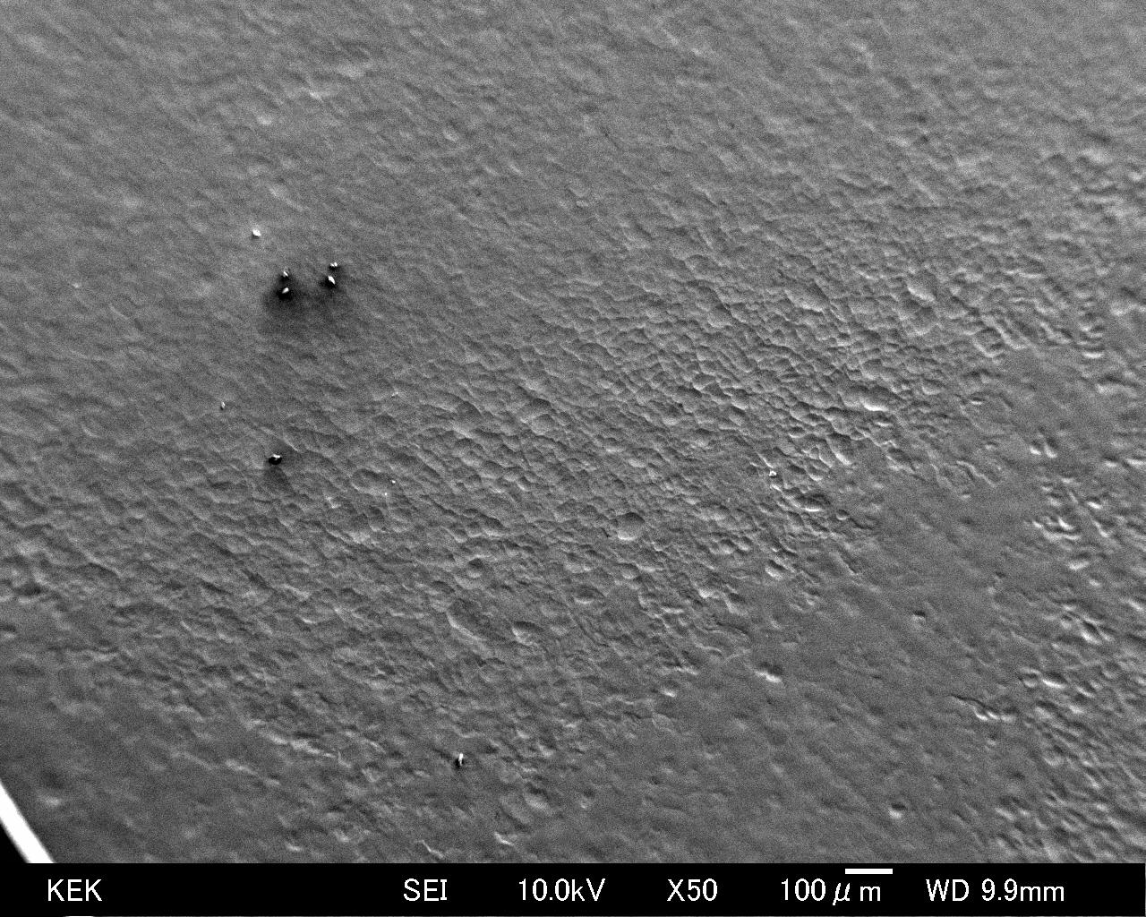
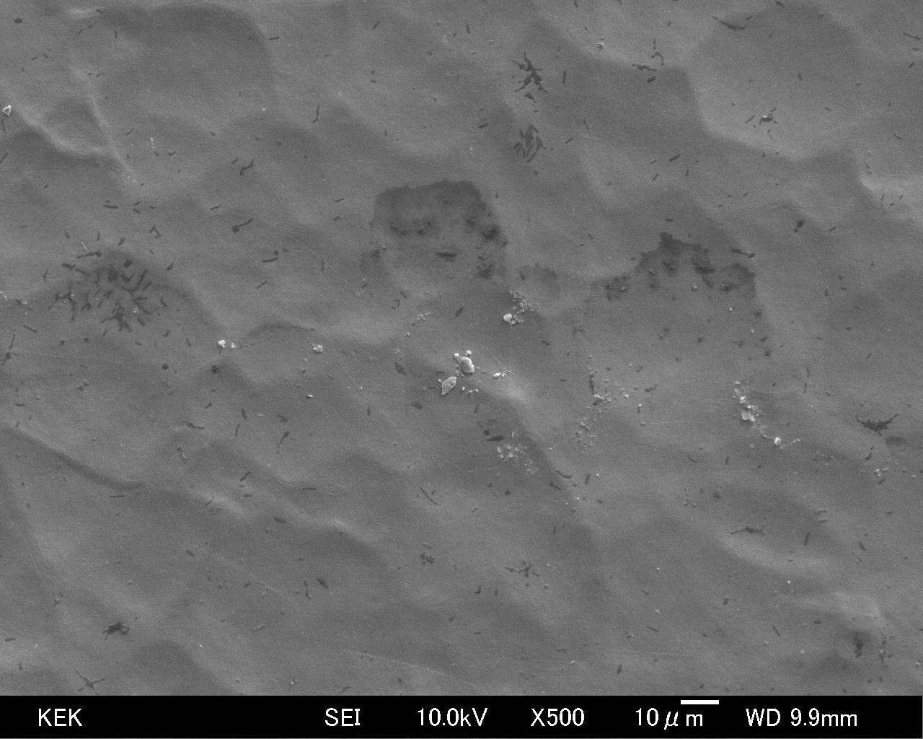
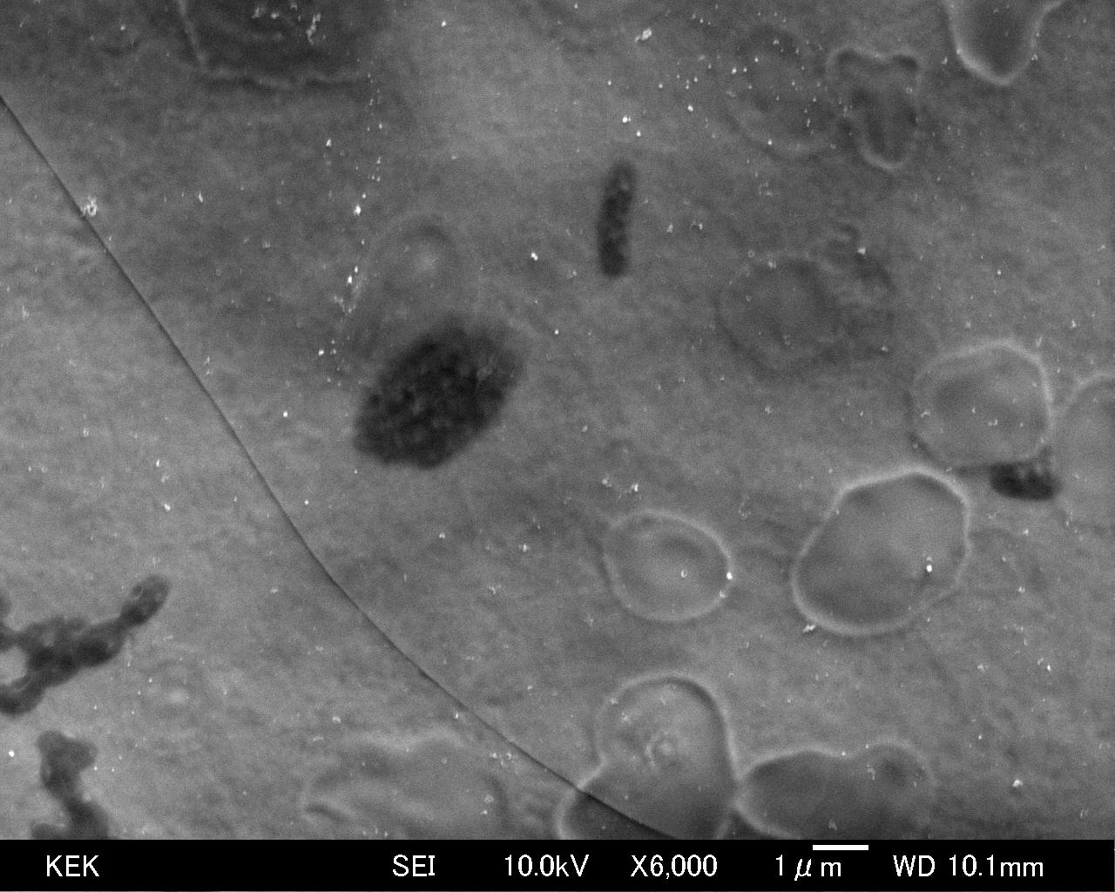
More SEM images
100μm
10μm
Black objects and white objects are seen.
1μm

Slide 22
EDX Analysis for black area
Black object is the same component as the others.
Si signal is seen other than Nb.
No S signal.

Slide 23
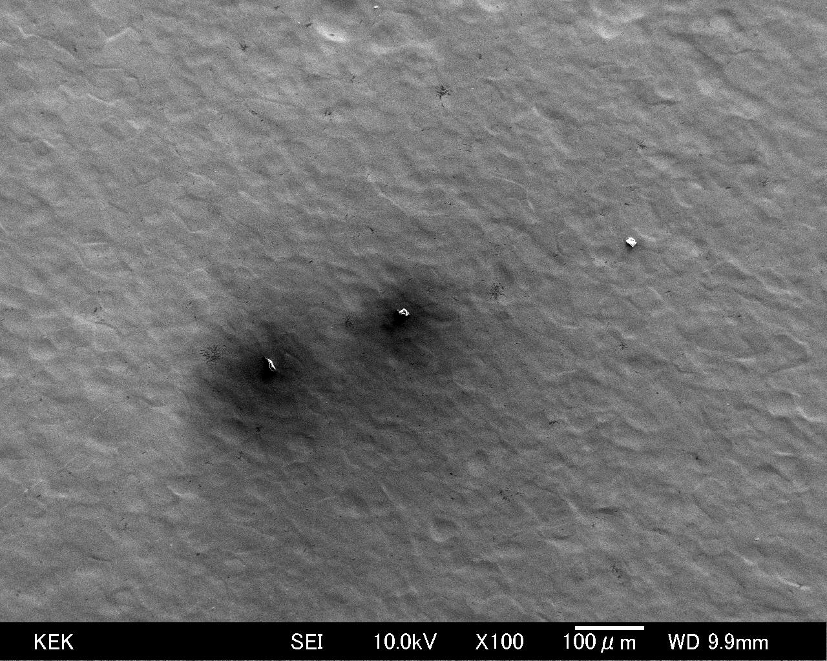
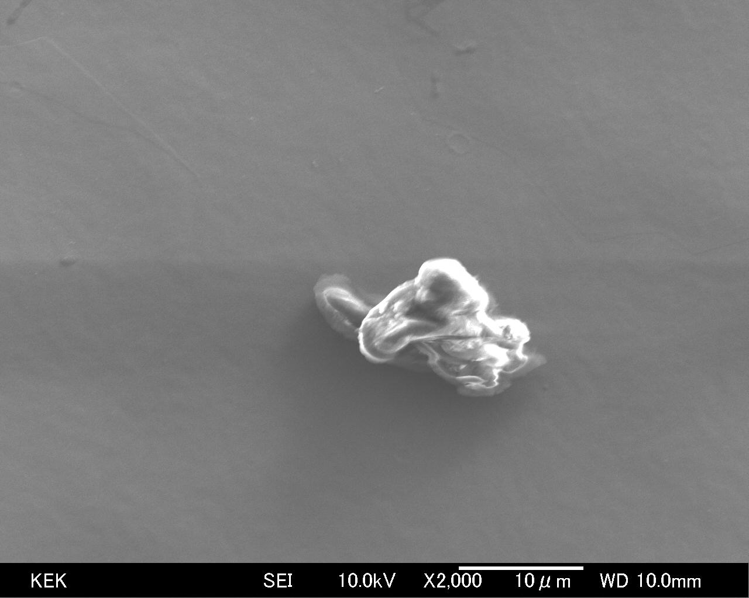
More EDX Analysis for contaminates
10μm
Si?, came from air exposure ?
at the sample transfer from XPS to SEM.

Slide 24
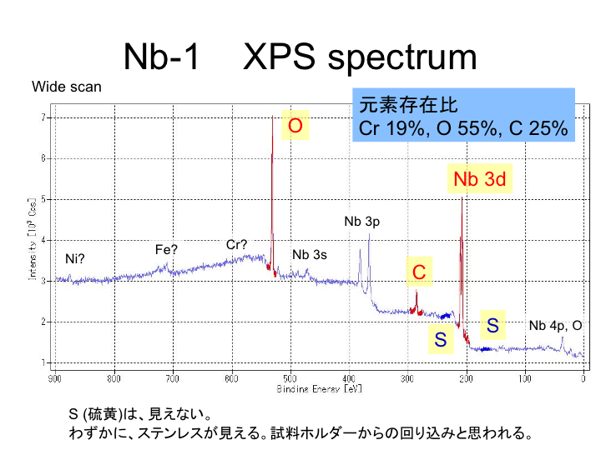
atomic percentage
No observation of S,
We see SUS component contamination, maybe from the sample holder.

Slide 25
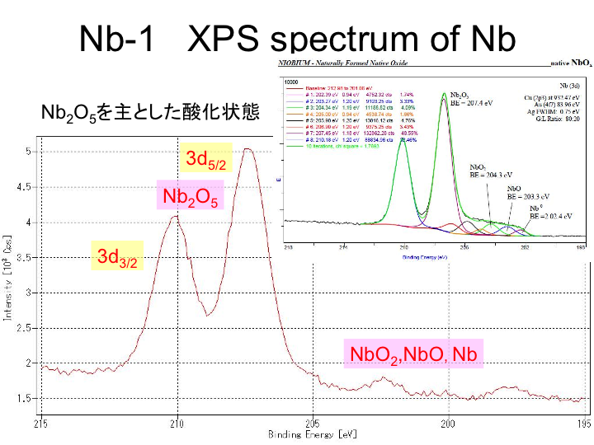
Mainly Nb₂O₅

Slide 26
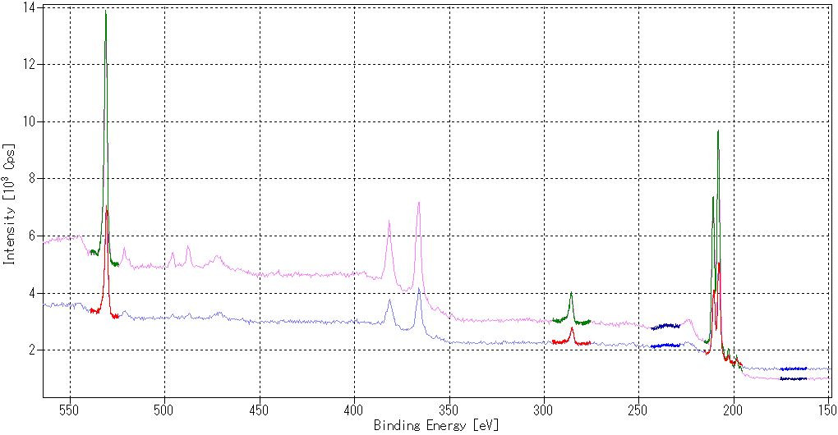
XPS Analysis of KEK-type Nb-sample-1’ & 2’
(BCP+EP w/ & w/o sponge wipe) at KEK
A.P. (Atomic Percentage) was estimated from the colored peaks. (Depth of analysis ~ 0.5 nm)
Oxygen
Nb
Nb
Carbon from the air
Sample-2’ w/ sponge-cleaning
Sulfur
Sample-1’ w/o sponge-cleaning
A.P. for sample-2’ w/ sponge-wipe
= Nb:20%, O:57%, C:23%
Sulfur ~ 0% for both samples
w/ and w/o sponge-wipe.
No significant difference of A.P. for both samples.
A.P. for sample-1’ w/o sponge-wipe
= Nb:19%, O:55%, C:25%

Slide 27
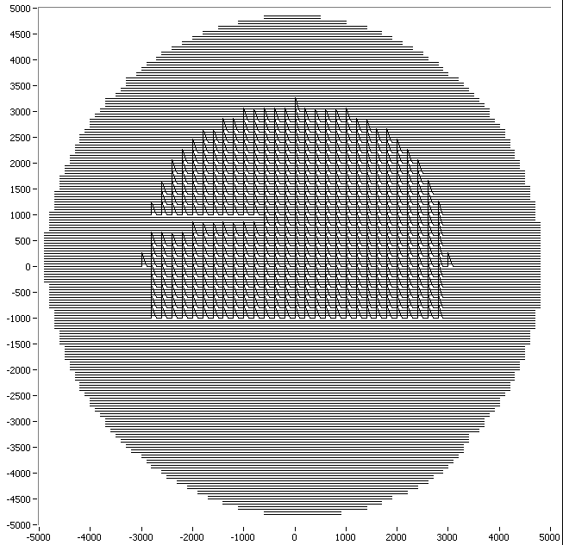
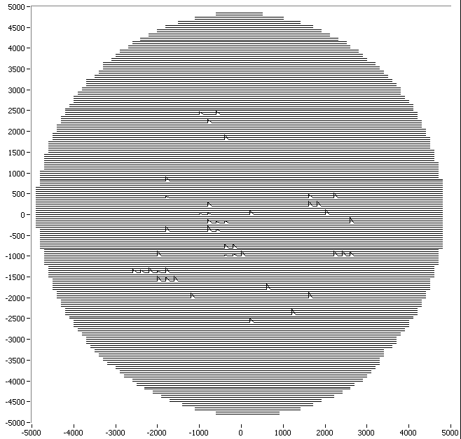
Field Emission Scan by JLab (Jlab sample)
Sample#1: many field emitters
Low FE onset ~ 10 MV/m
Sample#2: much less field emitters
Higher FE onset
EP(70 um)
Area inside circle is scanned
EP(70 um) + sponge wipe
Significant difference in Field emission scan.

Slide 28
EP’d Nb sample in single-cell cavity

Slide 29
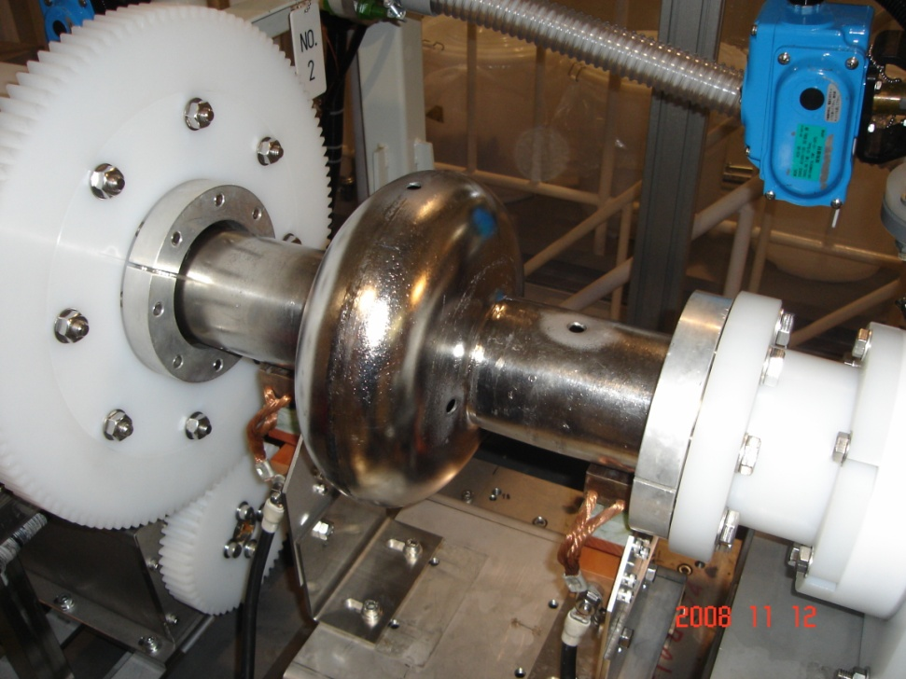
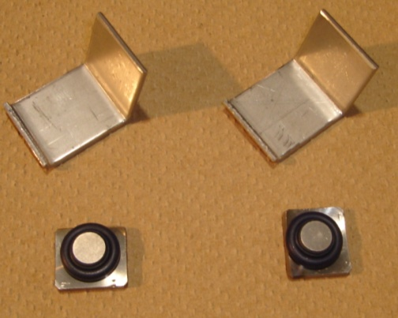

Special single-cell cavity for sample-study
6 Nb-samples
BCP(10um)
Weight and thickness measurements
Special cavity with 6 sample-holes on the EP bed.

Slide 30


Special single-cell cavity for sample-study
2 samples at equator
2 samples at iris
2 samples on a beam-pipe
6 samples were dressed on the special cavity
EP 20 um + UPW rinse
(No ultrasonic-rinse)

Slide 31



Special single-cell cavity for sample-study
6 Nb-samples
A sample
A sample holder
Disassembly in class-10 Clean-Room

Slide 32


Special single-cell cavity for sample-study
6 Nb-samples were stored in the vacuum chamber
A sample
Gate-valve
A sample holder
Ion pump
6 Nb-samples + sample-holders

Slide 33
Surface analysis of EP’d Nb
(Single-cell cavity EP sample)

Slide 34

Nb-1cell-5 XPS spectrum
Wide scan
EP sample (As-received)
Nb 11%, O 39%, C 50%
Nb 3d
Nb 3p
O
Nb 3s
C
S
Nb 4p, O
30nm sputtered
Nb 92%, O 5%, C <3%

Slide 35

Nb-1cell-5 Depth Profile

Slide 36

Nb-1cell equator & iris sample
XPS spectrum
Wide scan
O
Iris (#2), As-received
Nb 17%, O 42%, C 41%
Nb 3d
Nb 3p
C
Nb 3s
Equator (#5), As-received
Nb 11%, O 39%, C 50%
S
Nb 4p, O

Slide 37


Ratio of Nb-oxide
and bulk Nb
Nb 3d _{5/2}
equator
Nb oxide
～6 : 1
iris
～1.8 : 1
more bulk Nb
There will be different EP effect between equator and iris.

Slide 38
XPS Depth Profile of EP’d sample on the single cell
BCP(10μm) + EP(20μm) + UPW rinse (No ultrasonic-rinse)
thickness of oxide layer iris : equator = 2 : 3
There will be a possibility of
the difference of the ratio Nb-oxide and bulk Nb, came from oxide layer thickness.

Slide 39

XPS Depth Profile of EP’d sample on single cell)
BCP(10μm) + EP(20μm) + UPW rinse (No ultrasonic-rinse)
#3 sample has a lot of carbon, the reason is not yet known.
Oxide layer are 2-3nm in all the samples.

Slide 40


Optical Microscope Images sample#2(Iris)
This is a few µm concave.
20μm
20μm
SEM and EDX analysis is underway, now.

Slide 41


Lab-EP samples
Optical Microscope Images
50μm
Without Wipe
With Wipe
50μm
sample in single cell ( iris location (#2) )
Without Wipe
50μm
Without Wipe
50μm
The difference is maybe by water storage (Lab-EP) and by vacuum storage (single cell sample)

Slide 42
Sulfur removal
(captured sulfur on EP cathode bag)

Slide 43


Slide 44


Slide 45


Slide 46


Slide 47



SEM images of Sulfur on the Teflon mesh (1)
5µm
20µm
5µm

Slide 48




SEM images of Sulfur on the Teflon mesh (2)

Slide 49



EDX analysis on the SEM images of Sulfur
It’s sulfur.
23
24

Slide 50


Slide 51






Sulfur Removal Test
Teflon texture
Before rinse
Many white dots are sulfur contamination
U.P.W. ultrasonic rinse
Ethanol ultrasonic rinse
FM-550 (>10%) rinse
After rinse
Sulfur removed
Sulfur removed
 | U.P.W. ultrasonic rinse | Ethanol rinse (vibration) | Ethanol ultrasonic rinse | Detergent FM-550 2 % | Detergent FM-550 5 % | Detergent FM-550 10 % | Detergent FM-550 20 %
Cleaning Result | × | △ | ○ | △ | △ | ○ | ○

Slide 52
Development of sponge wipe
mechanism for cavities

Slide 53



First wiping/fitting test of proto-type sponge-cleaner for single-cell cavity
UPW + detergent outlet
Sponge mechanics
Insertion
PE sponge
UPW + detergent inlet
Poly-Ethylene (PE) sponge
wipe handle
Sponge Expansion
and
Wipe by rotation
Mechanics for 9 cell cavity is under development.

Slide 54




Melting test of sponges for EP solution
20 micro litter of EP solution (no dilution) was dropped on each sponge.
Poly Vinyl Chloride
(PVC)
Poly Vinyl Alcohol
(PVA)
Melamine
July 2008
PVC, cross-section
PVA, cross-section
Melamine, cross-section
We used PVC sponge for the first Nb-sample test (EP + Sponge cleaning).

Slide 55


The single-cell cavity was EP’ed and UPW-rinsed before the sponge-cleaning test.
Insertion of sponges
Expansion and rotation of sponges inside cavity

Slide 56


Feeding UPW during the rotation of sponges for 1 – 2 minutes.
Draining UPW inside the cavity
Drained UPW
to a container
UPW
Drained UPW was kept in a container to analyze the components/contamination.

Slide 57

Ion Chromatography for drained UPW
4.9 mg/L of F－was detected from filtered/condensed UPW (70ml).
Sulfur ion (S, SO4, etc) was not detected. The components were different from that of EP acid.
IC analysis of drained UPW after sponge test
Cl ion is normally contaminated in this kind of analysis. Tap water and sweat contain lots of Cl ions.
Time (minutes)

Slide 58


Residuals on the filter-paper
Residuals look like fibers/particles
1 mm
Problems of sponge wipe? → HPR will help to clean up.

Slide 59
Upgrade of Inspection Camera

Slide 60


Inspection Camera
example of MHI cavity defect
(1) 7µm/pix resolution, 13mm x 9mm view,
several 10µm object observable.
(2)direct LED illumination,
14 EL strip illumination for
wall gradient measurement capability
5µm

Slide 61







cavity
Optics of inspection camera
light path
~100 mm
~45deg
7 EL strips
7 EL strips
white LED
half mirror
to camera
axis
mirror
25 mm
cylinder
70mm
70mm
50mm dia.
camera cylinder
mirror mechanism
14 EL strips

Slide 62
Introduction of camera-cylinder rotation mechanism
for cavity inspection with EP-VT support jigs,
and for jacketed cavity.
motor
rotary encoder
bearing
rotation limiter

Slide 63

Upgraded camera under fabrication
CCD camera upgrade
from 5µm CCD pixel
to 2.2µm CCD pixel camera.
(2) Lens upgrade
more magnification
with more larger aperture.
(3) illumination upgrade
EL panel has limited life with more high voltage
(for more brightness).
-> LED + light guide with scattered surface (twice more light).
light guide
white LED
~7µm/pixel → targeting ~3 µm/pixel

Slide 64
Image capture automation
control of cavity position
being done by VB application.
(2) Image capture and automated file-save
already done by VB application.
(speed is enough fast, but must wait for vibration damping)
(automated focus is the next concern)
(3) defect pattern matching
the software already fabricated in 2007
was tested using recent high quality pictures.
-> no good results, so far.
(match to every bright traces, not suspected defects only)

Slide 65
Development of Local grinding
mechanism for cavities

Slide 66






EP test of intentional pit sample (Jlab made)
Pit3
40 um
BCP (30um)
As received
EP (30um)
Large steps at grain-boundaries after BCP.
EP (120um)
EP (90um)
EP (60um)
Still sharp edge even after BCP(30um)+EP(120um).
EP seems difficult to remove pit sharp edge.

Slide 67





Local Grinder development
Head : Diamond seat
CCD camera＋LED
Material for grind：Diamond seat #400 - #3000
(particle size = 40 ~ 3 um), (POLYMOND)
Grinding machine was delivered,
and tested.

Slide 68






Grind Test Results for Nb plate
Just after grinding (~6mm diameter region)
15min grind by polymond#400
(40-60µm diamond)
15min grind by polymond#1000
(10-20µm diamond)
30min grind by polymond#3000
(3-8µm diamond)
After 50µm EP
NG
Good
excellent

Slide 69

Single cell cavity grind test
grinder cylinder
mover for cavity
Iris location
equator location

Slide 70






Grinding examples at equator
equator(1) new#1000, 15min
equator(2) used #1000, 15min
equator(3) used #1000, 15min
after EP 50µm
after EP 50µm

Slide 71






Grinding examples at iris
Iris(1) new#1000, 15min
Iris(2) new #1000, 15min
Iris(3) used #1000, 15min
step
not good finish,
grinding did not smooth start
after EP 50µm
after EP 50µm
The grinder touches on small area of iris, need to pay attention for smooth start of grind. Otherwise it make scratches.

Slide 72

Grinding test using Cornell Iris weld sample
Before to grind AC71 iris, the grinding test was done using Cornell Iris weld sample,
which was given to Akira Yamamoto last year. Thanks to Cornell people.
The iris is 78mm diameter with flat EBW seam, no surface treatment.
(1) Check of the grinding head fitting to iris EBW seam.
(2) evaluate surface finish for #1000 diamond sheet or #3000 diamond sheet.
(3) estimate grinding time, grinding rotation speed.
(4) use of water injection pipe.
(5) use of pre-installed CCD camera ( grinder camera).
The water should be injected just before
to start rotation.
Otherwise,
rotation head is easy to bite into Nb surface,
and no rotation anymore.

Slide 73




Before scratching (view by Kyoto-camera)
using #3000 diamond sheet
with 110 + 20 + 30 min
①
②
③
After intentional scratch（１）
using #3000 diamond sheet
with 110 + 20 + 30 + 80 min
①
①
②
②
③
③
#3000 sheet ground surface is very smooth!

Slide 74

Surface roughness measurement
Instrument：Mitutoyo SJ-301
sweep scan along beam direction for
(1)ground surface by #3000 sheet
(2)ground surface by #1000 sheet
(3)EBW surface
(4)raw Nb surface

Slide 75







Local grinding for AC71 #1-#2 Iris
As received from DESY
AC71 was local sponge wipe with ethanol,
then, mechanical grinding,
then, sponge wipe and HPR,
then, EP 30µm, ultrasonic UPW rinse, HPR
drying in clean room, inspection,
Then, sent back to DESY.
We thought this, scratch
expanded image
before grinding, we applied sponge wipe with ethanol. Then it went away. Still there is some trace.
Local grinding was applied
(#1000＋#3000 diamond sheet）
Then, EP 30µm was applied.
We could get smooth surface.

Slide 76
Next version of local grinder
for flexibility of angle of grinder surface,
easy to adjust grinder head to cavity surface
Now under fabrication.

Slide 77
Summary of
High Gradient basic R&D in STF
Electro-chemical Polishing Facility in STF
Surface Analysis of EP’d Nb
Sulfur removal
Sponge wipe
Inspection Camera
Local grinding
Commissioned in last summer, 9 cell cavity process is in routine.
First round of analysis is under-going.
Caught Sulfur is utilized for rinse method comparison.
Sponge wipe is proposed to remove contaminations.
Its mechanism is under development.
Inspection camera was demonstrated its capability of defect catch.
For more performance, the camera is under upgrading.
Local grinding is proposed to remove defects in the cavity.
end

Slide 78
Backup slides

Slide 79




UPW filled container for transportation
transparent PVC container
PVD bolts
Use of UPW container is intended
for long distance transport like JPN-US
Nb sample plate
Nb sample and Teflon parts

Slide 80




JLab sample
Sample#1(just EP'd)
SEM@JLab
Sample#2 (EP + sponge wipe)
Lots of Nb-O particles (white)
Significantly reduced Nb-O particles
Suspected bacteria (black worm)
Somehow less bacteria growth, but new type of
Contamination (black particulate)

Slide 81


Slide 82


Slide 83

Nb₂O₅
Nb 3d
Nb
iris
equator
Nb 3d _{3/2}
Nb 3d _{5/2}
Iris と equatorで、酸化ニオブと金属ニオブの比率が違う

Slide 84

Nb 3d
酸化ニオブから金属ニオブへ

Slide 85

Poly-Ethylene (PE) sponge test with EP acid
Almost no corrosion of PE sponge by the EP acid.
EP acid
October 2008
PE sponge
No corrosion after dropping EP acid on PE sponge.
Let’s made a sponge-cleaning tool for single-cell cavity with PE sponge.

Slide 86


Analysis of EP’d surface by using single-cell cavity with de-toutchable button Nb-samples
under fabrication
2 for near iris
back holder
2 for equator
2 for beam pipe
O-ring seals
KEK button sample
for analysis of production-EP

Slide 87


Special single-cell cavity for sample-study
Nb-sample at beam-pipe
Nb-sample at iris

Slide 88







Inspection of AES01 (FNAL)
84µm height bump
60µm height bump
~21mm
43µm height bump
AES01 has hard quench at 15MV/m,
its location was identified by Cernox at FNAL.
5
4
8
7
1
6
2
Kyoto-camera found 3 spots in their exact location
3

Slide 89



Comparison of each EP treatment
#3 cell equator, Z=402mm, t=10 deg
1
Pit exist from the beginning,
and not disappear
After Fabrication
3
2
EP-1 (25 um removed)
EP-1 (25 + 100 um removed)

Slide 90

#3000
③
#1000
Additional grind by #1000 diamond sheet for 2-5min in 4 locations

Slide 91
ILC S0 Feedback Loop
Cavity Incoming QC
Feedback:
Improve
Specification/QC
Huge Irregularities
eg. Scratches
Standard Cavity
Preparation Cycle
Countermeasure
(Guided Repair)
Witness
Samples
Standard Vertical
Test Cavity
< XX
MV/m
Identify Irregularities
eg. pits
> XX MV/m
Understand nature of
high gradient limitation
e.g. does minor EP
move quench location
Additonal Processing Cycle
Standard Vertical Test Cavity
Samples
Single
Cells
Horizontal Tests or Module Assembly
4.4.2008 Lutz Lilje
ILC Project@DESY

