Slide 1
LINAC4 and 3 MeV test stand at CERN
Alessandra M. Lombardi
G. Bellodi,M. Eshraqi,JB Lallement,S. Lanzone , E. Sargsyan
LINAC4 in the framework of CERN injectors
LINAC4 beam dynamics: location of emittance growth, parameters for emittance control
The 3 MeV test stand : preparation for LINAC4
LINAC4 measurements: commissioning, operation

Slide 2
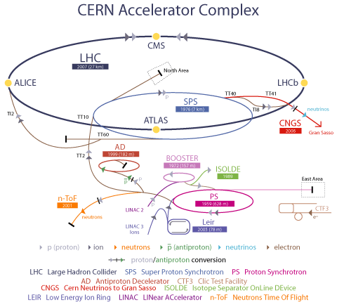
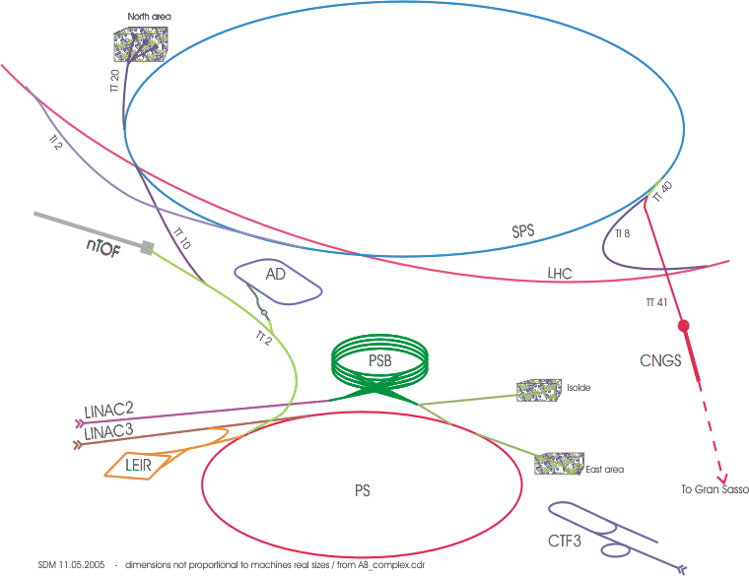
Present

Slide 3

Activities Linac4 (2008-2014)
Goal : operational in 2014
LINAC4 parameters
Ion species | H⁻ | Charge exchange injection
Output kinetic energy | 160 MeV | Halves the space charge detuning at PSB injection
Bunch frequency | 352.2 MHz | LEP klystrons
Max. repetition rate | 1.1 (2) Hz | Ready for LP-SPL operation
Beam pulse duration | 0.4 (1.2) ms | Ready for LP-SPL operation
Chopping factor (beam on) | 65% | Limit the long. Losses at PBS injection
Source current | 80 mA
Linac current | 64 mA | Losses at low energy
Average current during beam pulse | 40 mA | After chopping
Beam power | 2.8 kW
Particles / pulse | 1.0 10¹⁴
Transverse emittance (source) | 0.25 mm mrad
Transverse emittance (linac) | 0.4 mm mrad | Half the emittance of Linac2
Notes:
Input emitt same as linac2, output is half because linac2 is working beyond its design limit. Linac4 for ps booster and linac 4 as a front end for a mw proton driver

Slide 4
Linac4 Layout
45keV
3MeV
3MeV
50MeV
102MeV
160MeV
H-
RFQ
CHOPPER
DTL
CCDTL
PIMS
RF volume
source
(DESY)
45 kV
1.9m
LEBT
Radio
Frequency
Quadrupole
352 MHz
3 m
1 Klystron
0.6 MW
Chopper
352 MHz
3.6 m
11 EMquad
3 cavities
Drift Tube
Linac
352 MHz
18.7 m
3 tanks
5 klystrons
4 MW
111 PMQuad
Cell-Coupled Drift Tube
Linac
352 MHz
25 m
21 tanks
7 klystrons
6.5 MW
21 EMQuads
Pi-Mode Structure
352 MHz
22 m
12 tanks
8 klystrons
~12 MW
12 EMQuads
Total Linac4:
80 m,
21 klystrons
Beam Duty cycle:
0.04% phase 1 (PSB)
0.08% phase 2 (LP-SPL)
3-4% phase 2 (SPL)
(design for losses : 6%)
4 different structures, (RFQ, DTL, CCDTL, PIMS)
Ion current: 40 mA (avg. in pulse), 65 mA (bunch)

Slide 5
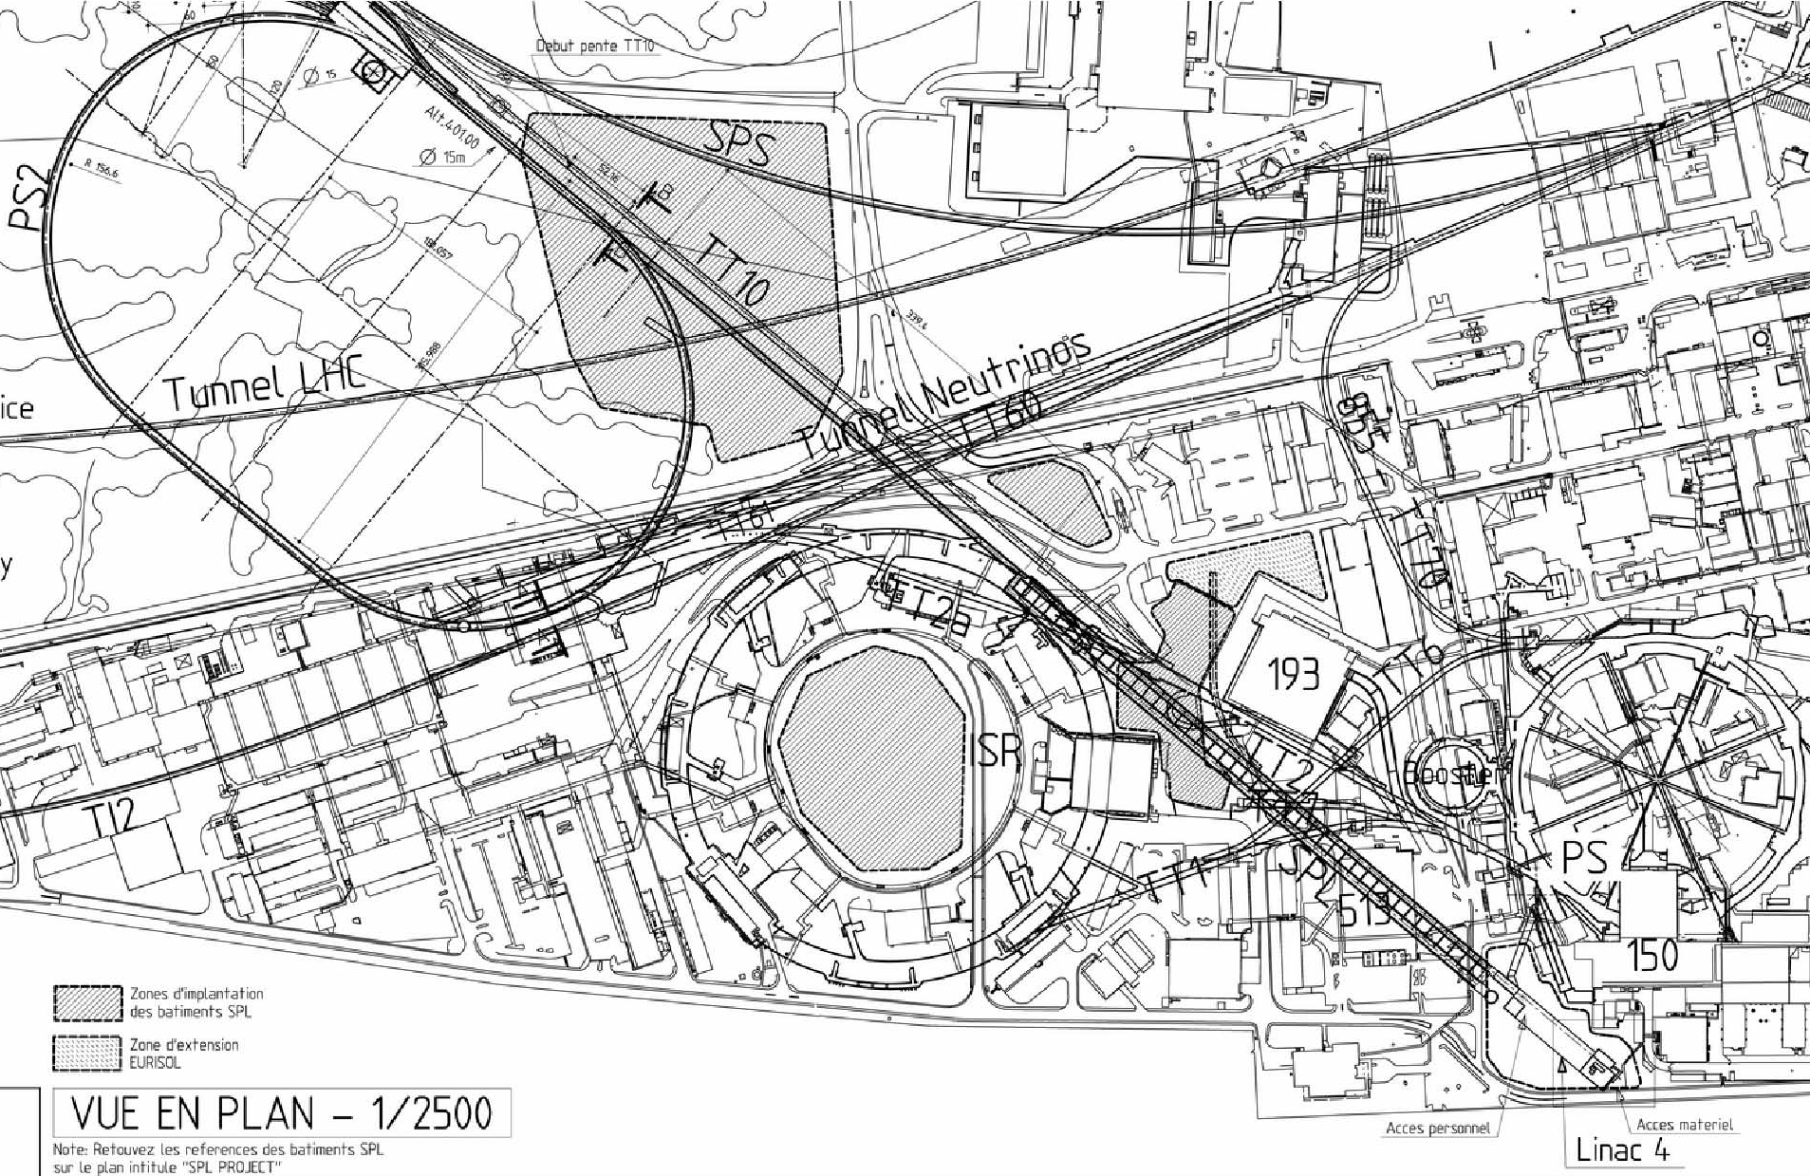
Layout of the new injectors
SPS
PS2
ISOLDE
PS
SPL
LINAC4 to booster transfer line is 180 m long with two horizonthal bendings and one vertical
Linac4

Slide 6
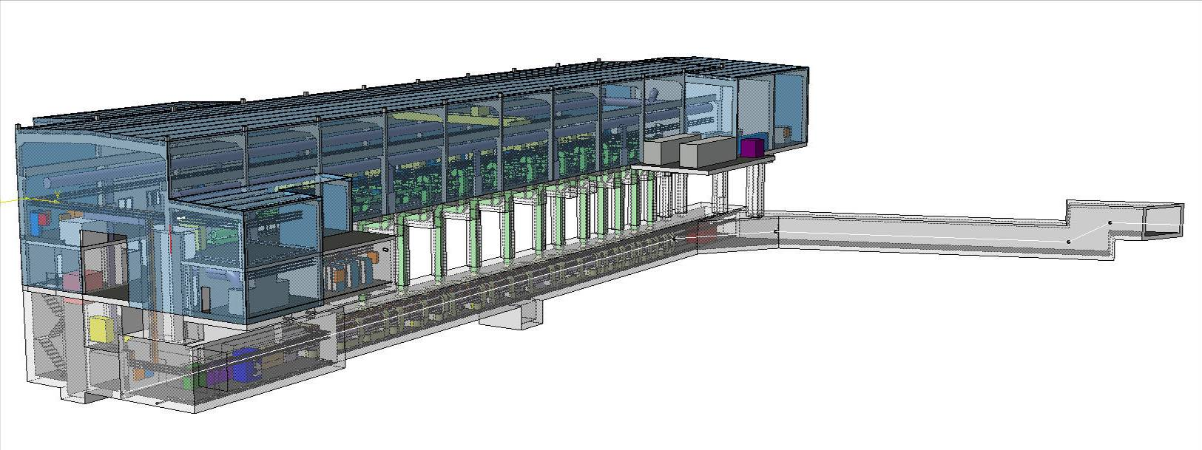
Linac4 Building
Equipment building
Picture of the building
Picture of the the accelerator in the building
Linac4 tunnel
Low-energy injector
Linac4-Linac2 transfer line
Access building
Vertical step (2.5 m) for compatibility with SPL

Slide 7
Beam Dynamics
  generate an ideal layout assuming smooth phase advance, avoid resonances, implementing all the recipes for optimising beam quality
  integrate engineering ,mechanical and cost considerations
  generate a particle beam composed of 50 k to 500 k macroparticles
  Track the motion of the macroparticles under the influence of space charge and electromagnetic fields with the programs PATH-PARMTEQM (CERN-LANL) and TRACEWIN-TOUTATIS (CEA). Independent check of results
  Produce plots of global quantities (emittance, halo, ratio beam size-to-aperture) as well as detailed beam distribution at specified locations
  On the basis of the results reiterate or validate a technical solution and/or mechanical layout
  Perform statistical error studies to give tolerances (alignment , RF) and expected beam performance
  Device measurements and commissioning scenarios (interface with DIAGNOSTICS)

Slide 8
LINAC end-to-end
emittance growth (30-40%) is located before 3 MeV
Bottlenecks : LEBT solenoids, chopper plates and chopped beam dump (wanted)

Slide 9
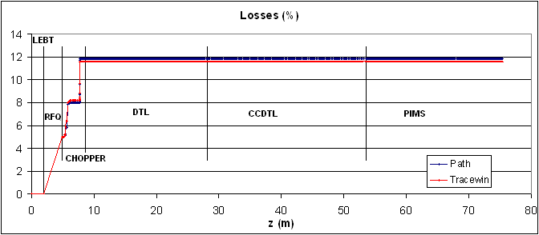

Losses
Most of the losses occur before the beam has reached 3 MeV.
Losses are mainly in the RFQ (5%) and the MEBT (7%).
The total transmission is ~85%.
LOSSES in the 3MeV MEBT

Slide 10
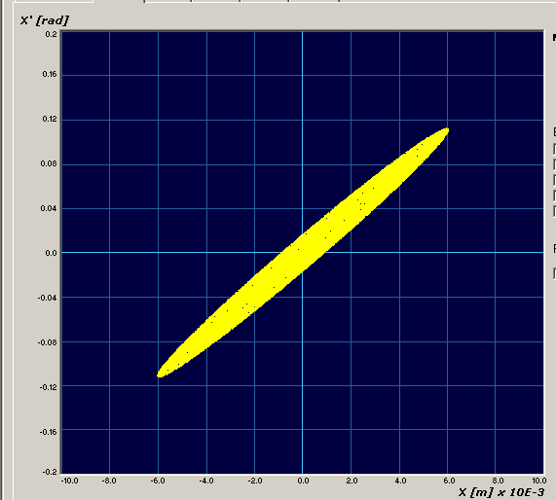
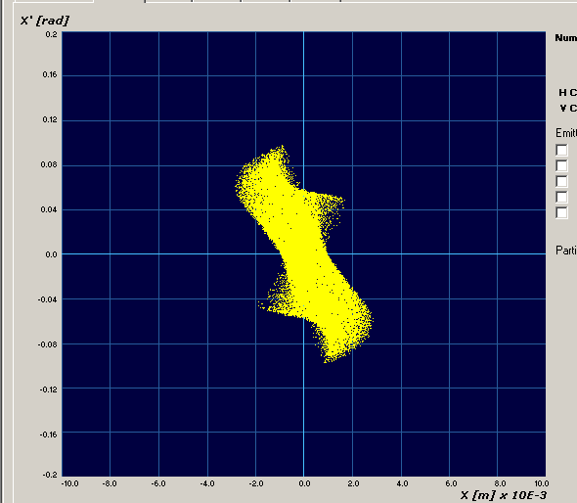
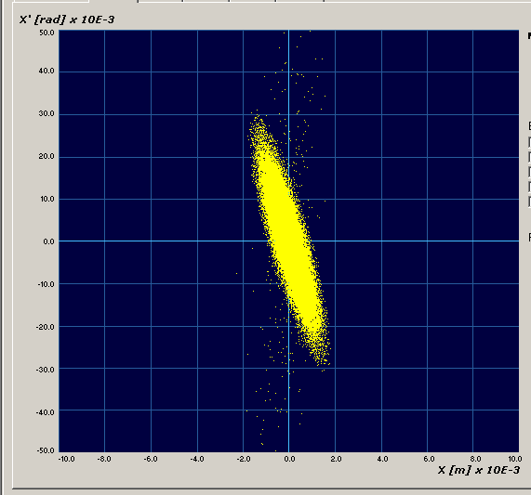
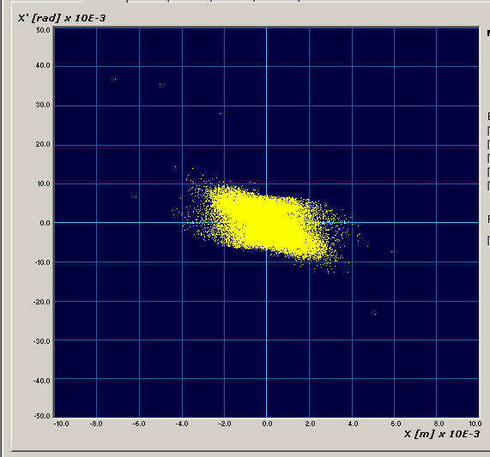
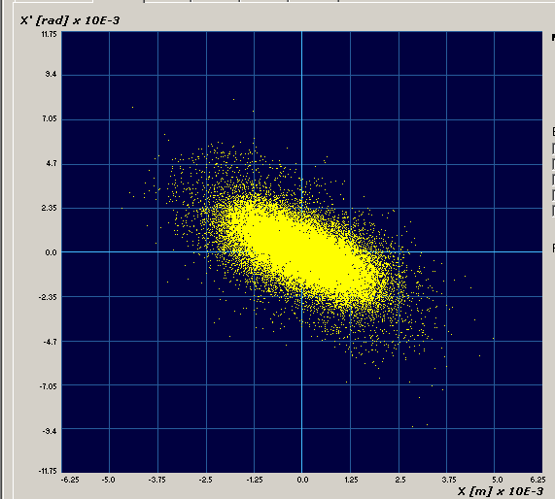
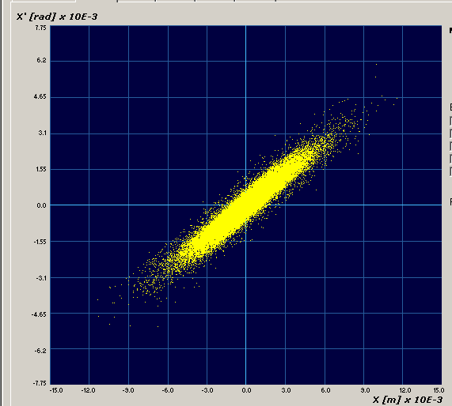

Beam transverse phase space
LEBT in (45keV) RFQ in (45keV) RFQ out (3 MeV) DTL in (3MeV)
CCDTL in (50MeV) PIMS in (100MeV) PIMS out (160MeV)

Slide 11
Emittance 0-3 MeV
Symmetry x,y in LEBT, if source is symmetric
Losses in the RFQ, emittance decreases
Losses and emittance increase when matching to the DTL

Slide 12
Location and causes of e growth and losses
LEBT solenoids (divergent beam from the source). 45 keV
MEBT transport (abrupt change of phase advance). 3 MeV
BOTH ARE UNAVOIDABLE but they must be controlled

Slide 13
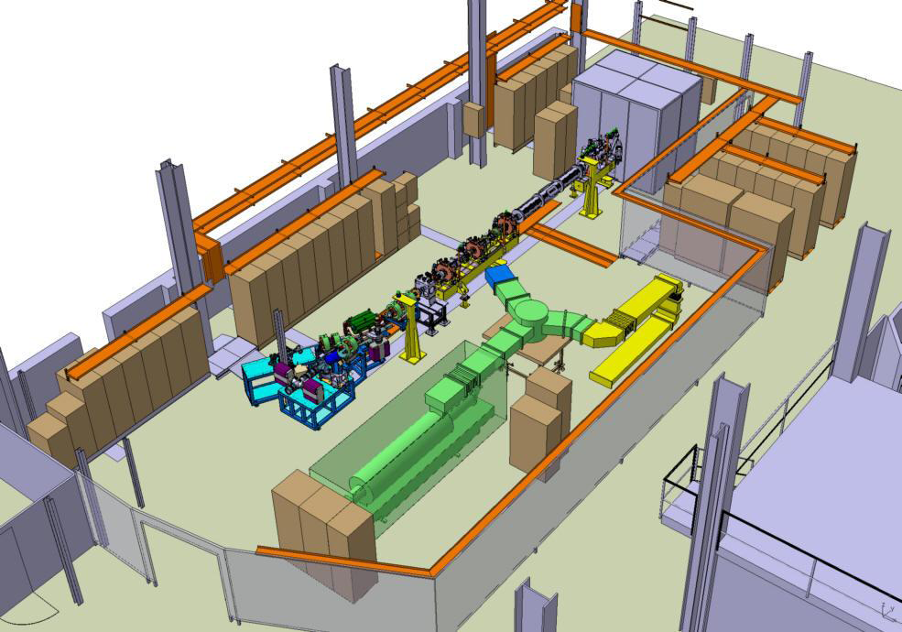
Testing the low energy part
(0-3 MeV) : the 3 MeV test stand
Goals :
Validate by 2010
Source and LEBT design
RFQ design
Chopper (by 2011)
Source 45 keV
Chopper
Diagnostic line
Ultimate goal is to demonstrate
70 mA H-
400 µs
1 Hz
3 MeV
0.4 mm mrad
0.15 deg KeV
Chopped and matched to the DTL
RFQ 3 MeV
Notes:
3 MeV tests stand, program approved in xx ,

Slide 14
Measurements at 45 keV (starting this year)
In steps
      Source emittance
      Source + solenoid emittance
      Source + solenoid spectrometre

Slide 15
Measurements at 3 MeV (starting 09/2010)
Measurement program
    Transport/setting up
    Emittance
    Halo developmnet
                Without the dump
    Chopping
                With the dump

Slide 16
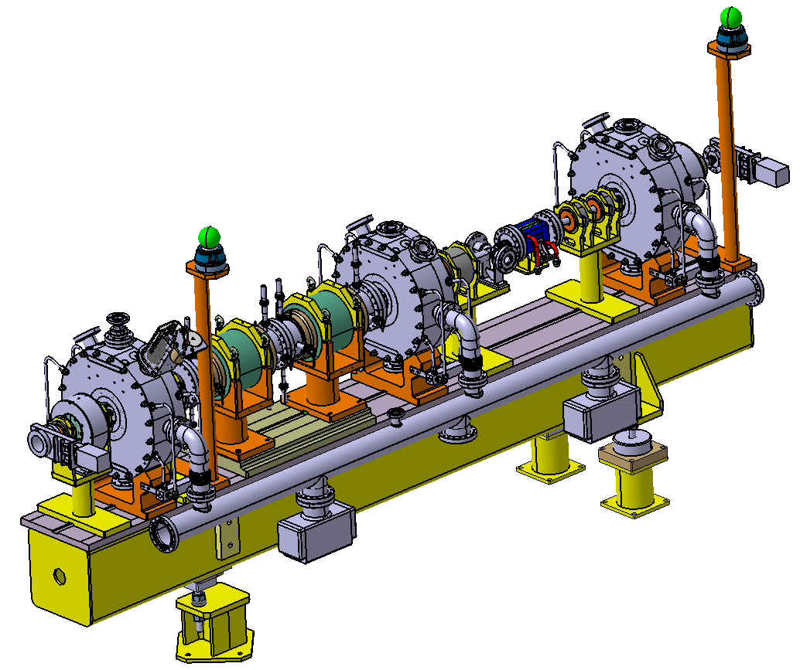
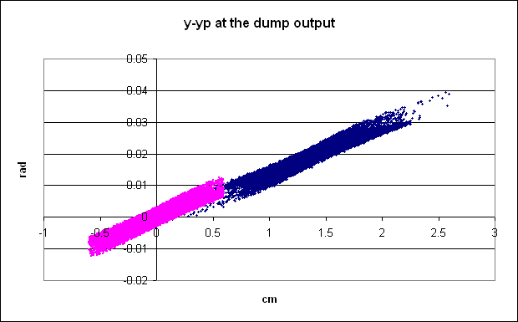
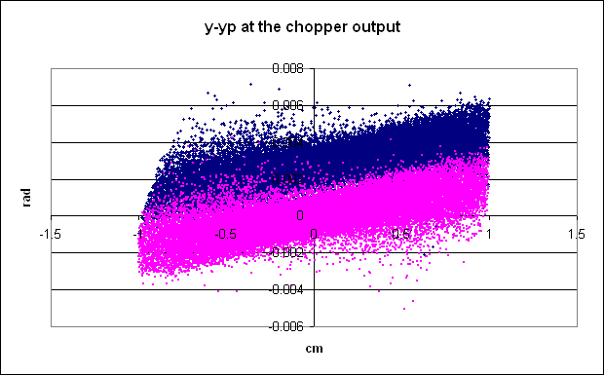
“chopping” removing microbunches (150/352) to adapt the 352MHz linac bunches to the 1 MHz booster frequency
Match to the DTL
Match from the RFQ
Chop
Emittance increase 20-30%
Notes:
Explain the beamdynamics need for matching to the chopper, why the chopper is bulky, how we reduced the chopper voltage.

Slide 17
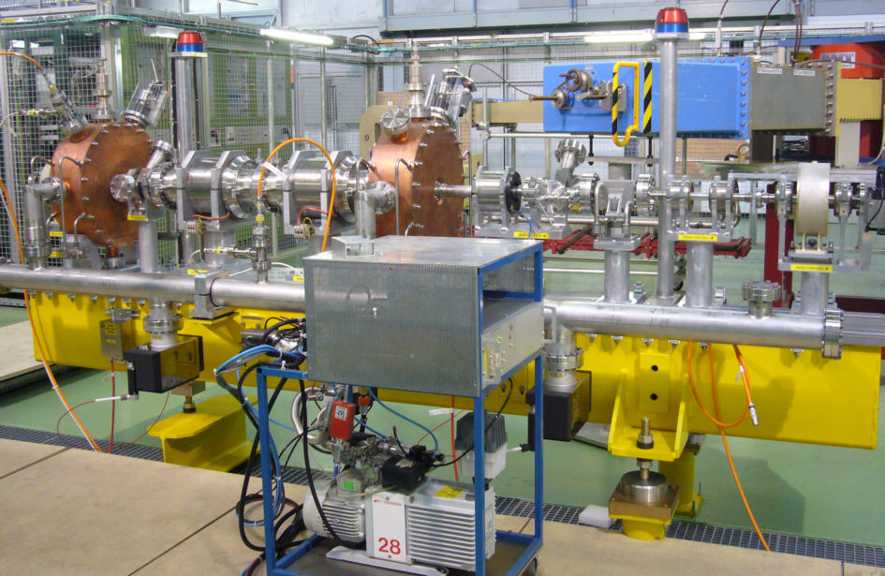
Chopper line layout
Matching section
Chopping section
Matching section
10⁴ ions
1.15×10⁹ ions
2.84 ns
for PSB : suppress 150/352 microbunches (1MHz)
for SPL and Nufact : suppress 3/8 microbunches (40 MHz CERN nufact)

Slide 18
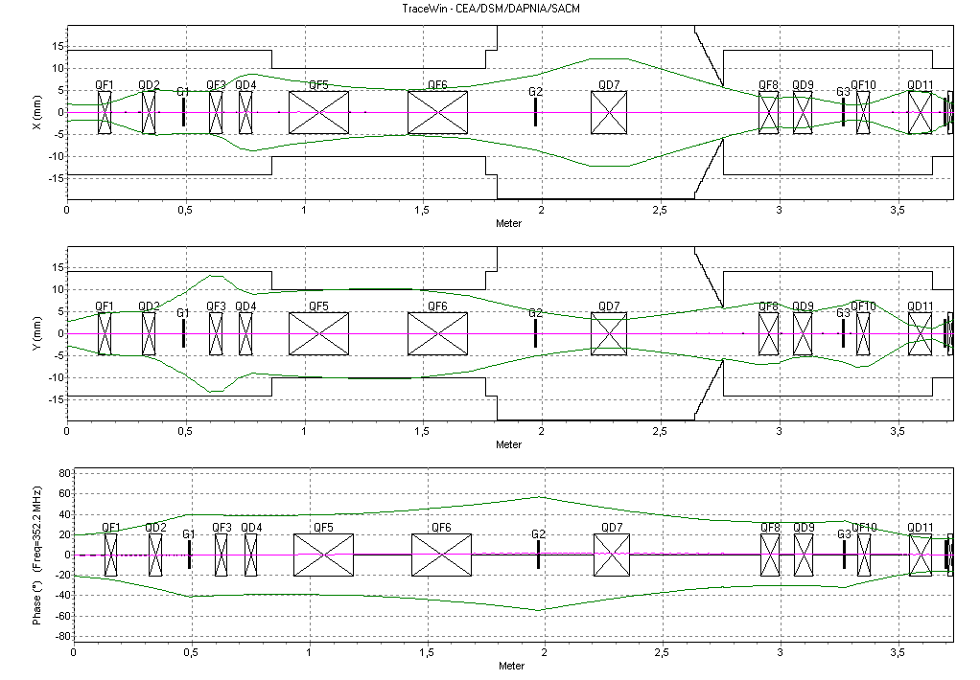
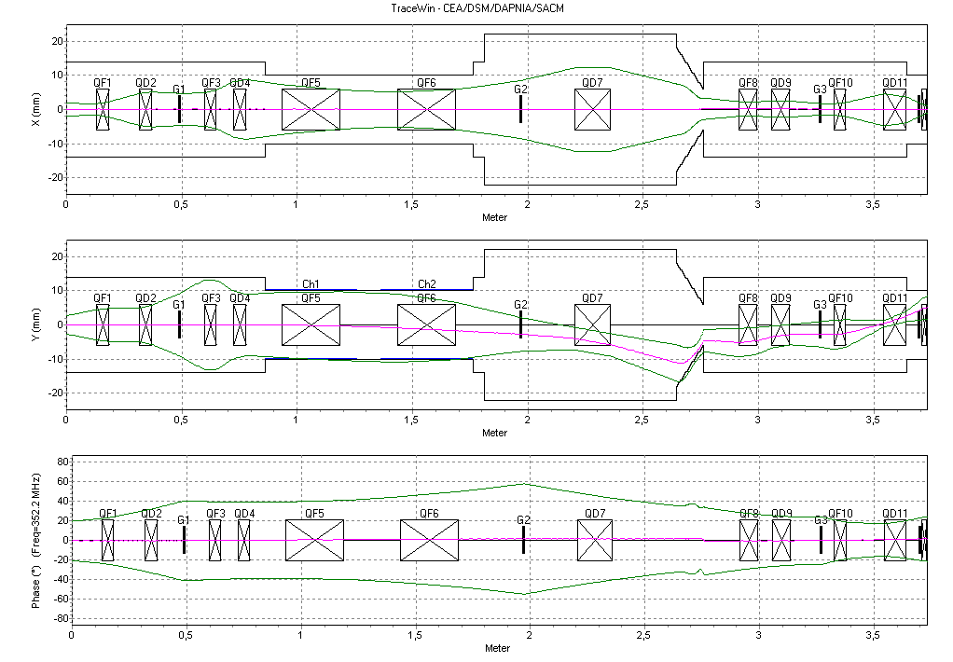
Beam Dynamics

Slide 19
Diagnostics – permanent
(ok for monitoring, not sufficient for setting up)
Wire scanners
Current transformers

Slide 20
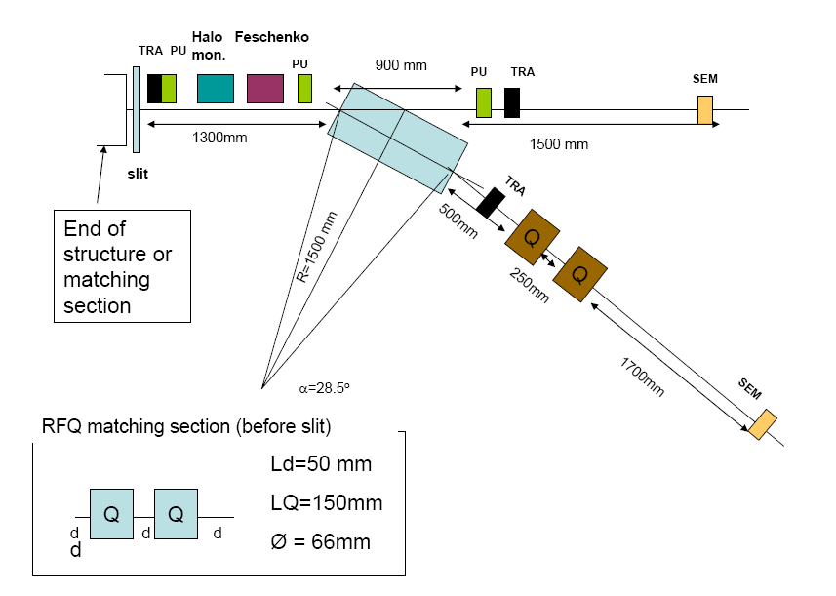
Diagnostics temporary
BSHM + bench

Slide 21
Possibility of making a pencil beam
Diaphragm
Chopper
Screen
H⁻
LEBT
RFQ
Chopper-line
Reduced beam current from 70 to 4 mA
Reduced beam size on the screen

Slide 22
Example : setting buncher phases 1/2
To be done with a pencil beam!
1. All bunchers off. It gives us a reference.
2. First buncher on. Setting the voltage and the phase.
3. Setting the Voltage and the phase of the second buncher.
4. Setting the Voltage and the phase of the third buncher.

Slide 23
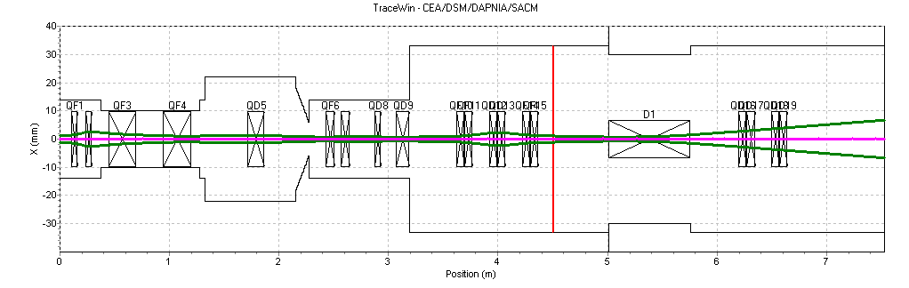
Example : setting buncher phases 2/2
Scanning bunchers phase for different voltages allows us to cross-check buncher calibration and to set the buncher phases wrt the RFQ.

Slide 24
Chopper
10⁴ ions
1.15×10⁹ ions
2.84 ns
LINAC4 for PSB : suppress 113/352 microbunches
LINAC4 for SPL and Nufact : suppress 3/8 microbunches (40 MHz CERN nufact)

Slide 25
Example : validating the chopper 1/4
Static measurements
      Chopper on or off
      Validate the chopper voltage and the optics (based on amplification by quad)
Time resolved measurements
      Validate the rise and fall time of the chopper and its suitability for nufact p driver : 40 MHz and 50 Hz

Slide 26
Example : validating the chopper 2/4
Test separately each component responsible for the chopping
Measurements to be done with a ‘pencil’ beam and without the dump in place
Wire scanner
B1
B2
B3
Q5
Q6
Q7
Q1
Q2
Q3
Q4
Q8
Q9
1.Only Chopper on : Q5, Q6, Q7 and B2 off.
2.Chopper and Q7 on : Q5, Q6 and B2 off.
3.Chopper Q5, Q6 and Q7 On : B2 off.
4.Chopper Q5, Q6, Q7 and B2 on.

Slide 27
Example : validating the chopper 3/4
Static measurements
Pencil beam
All elements on
Chooper on (top)
Chopper off (bottom)
With this
we validate :
Chopper voltage
Optics
we do not validate :
Space charge
Rise/fall time

Slide 28
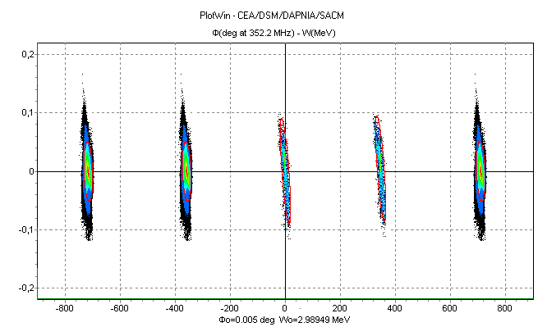
Example : validating the chopper 4/4
Time resolved measurements
BSHM
Measure residual H-in not completely chopped bunches
with a sensitivity of ~ 10⁴ ions, in the vicinity of full bunches ~ 10⁹ ions.
Time resolution and dynamic range tested with a laser
Not completely chopped bunch
Transmitted bunch

Slide 29
Commissioning and Operation of the Linac
Commissioning in step with dedicated measurement line
        Installation in the tunnel of 3 MeV part
        Installation of DTL tank1 – 10 MeV
        Installation of DTL tank2 and 3 -50MeV
        Installation of CCDTL – 100 MeV
        Installation of PIMS – 160 MeV
Operation with minimum diagnostics
        Lack of space

Slide 30
Focusing field
“Locally” irregular due to extra space for intertank and diagnostic
Can match current from 30 to 80 mA

Slide 31
Accelerating field and phase

Slide 32
Layout
 | LEBT | RFQ | CHOPPER | DTL | CCDTL | PIMS | Transfer line
Energy(MeV) | 0.045 | 3 | 3 | 50 | 100 | 160 | 160
Length (m) | 1.9 | 3 | 3.6 | 19 | 25 | 22 | 70 +100
RF |  | 1 tank | 3 cavities | 3 tanks | 21tanks | 12 tanks | 1 cavity
focusing | 2 Solen |  | 11 EMQ | 111 PMQ | 21 EMQ (*) | 12 EMQ | 17 quads 4 bends + old line
To be set/tuned (till BHZ40) :
2 solenoids, 75 quads
48 steerers settings
22 amplitudes and phases
THERE ARE ABOUT 150 PARAMETERS TO SET

Slide 33
Movable Measurement Bench (commissioning only)
instrument | position | energy [MeV] | intensity [mA] | resolution
BPM and Phase probe | 3 positions along the line | 3 MeV to 50 MeV | 80 | 0.1 mm
transformer | End of the line | 3 MeV to 50 MeV | 80 | 0.5 mA
Bunch shape Monitor (Feschenko) |  |  | 80
Spectrometer |  | Up to 10 MeV | 80 | ~30 keV/mm
SEMGrids | 1 hor & ver | 3 MeV to 50 MeV | 80 | 1 mm
Emittance meter |  | 3 MeV to 10 Mev | 80

Slide 34
Example-transverse plane
1) Matching to DTL : transmission at second transformer of the chopper line when changing the gradients of first 4 quadrupoles of the chopper line by 20%
2) DTL matching:
Variation of quad b/w tank1 and tank2 with emittance measurement at end tank2
Variation of quad b/w tank2 and tank3 with emittance measurement at end DTL

Slide 35
Example- longitudinal plane
DTL tank1 amplitude
1) Wide range, meas. with TOF
2) Few percent, meas. with spectro
4) Final setting, measure en spread
3) 1% percent, meas. with phase probe

Slide 36
Emittance 3-160 MeV

Slide 37
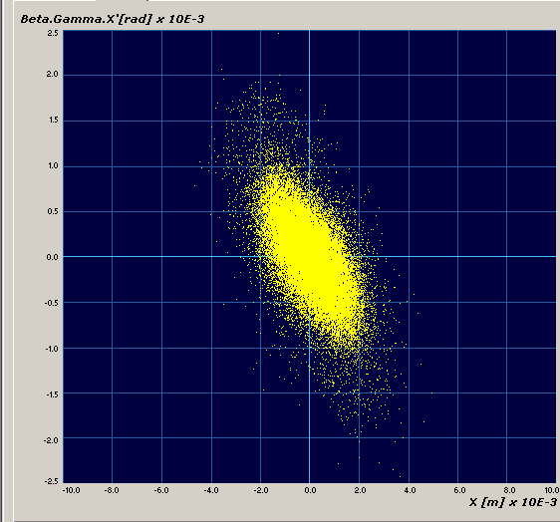
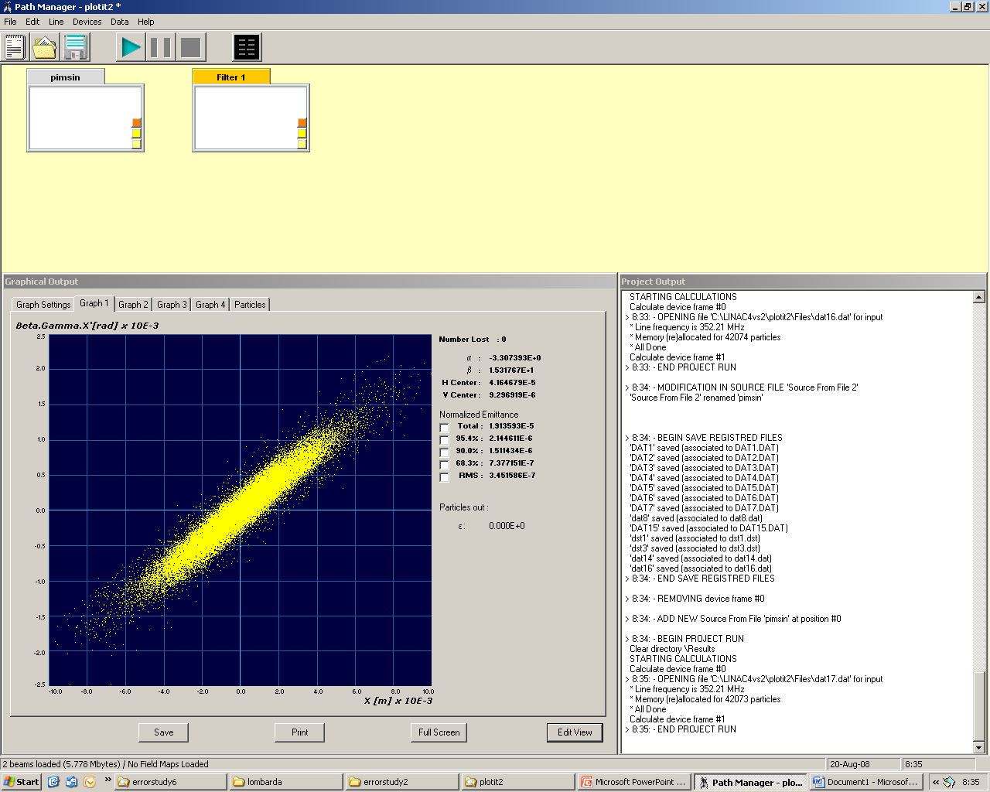
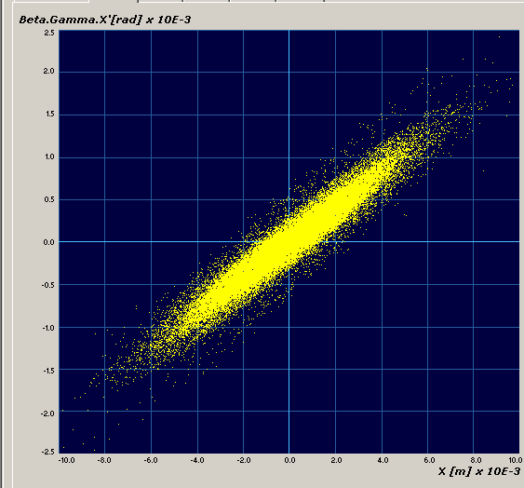
Normalised transverse phase space
Plot scale :
1cm X 2.5mrad
CCDTL in (50MeV) PIMS in (100MeV)
PIMS out (160MeV)

Slide 38
Challenges
The beam distribution is changing. The number of particles in one r.m.s. is changing.
How to quantify emitt increase?
Space charge effects and coupling transverse- longitudinal influence the emittance : emittance depends on machine settings, emittance grows uncontrolled if the beam drifts for 10 X betalambda where βλ= 3.5 cm at 3 MeV ; 40 cm at 160 MeV
We cannot use profiles to measure emitt
Alignment errors and gradient errors as budgeted should give an emittance increase with respect to nominal of 10% at 1 sigma
Transients, jitters : should be able to measure emittance of a slice of the beam in order to distinguish static errors from dynamics errors

Slide 39
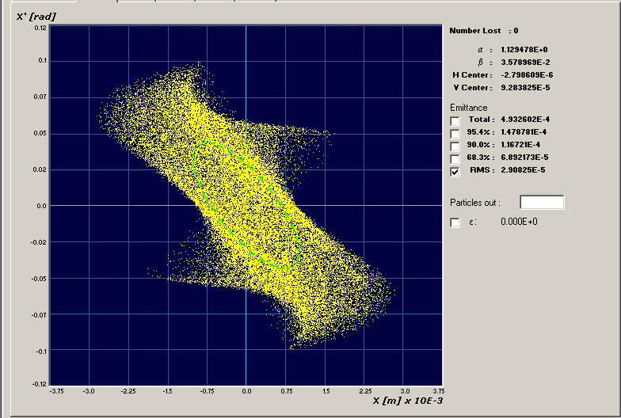
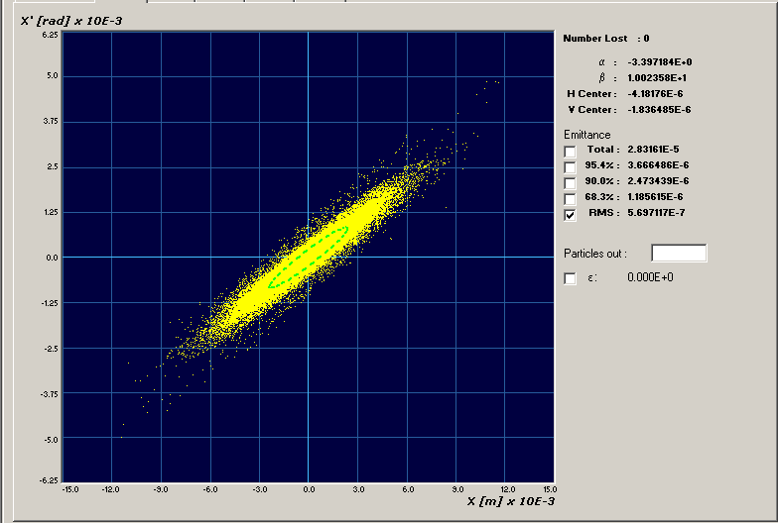
Changing distribution
RFQ input 45 keV
30% of the beam in one rms
PIMS output 160 MeV
50% of the beam in one rms

Slide 40
Permanent Diagnostics
Minimal for lack of space
Phase probe after (almost) every klystron to be able to readjust phase and amplitudes
Position monitor wherever possible to adjust the steering (loss control)
Beam profile monitors at critical points, total of 11.

Slide 41
DTL diagnostics
instrument | position | energy [MeV] | intensity [mA] | resolution
pick-up (phase, position, intensity) | after every tank | 12/32/50 | 80 | 0.1 deg 0.1 mm 0.5 mA
SEM grid | after tank 3 | 50 | 80 | 0.5 mm
transformer | after tank 3 | 50 | 80 | 0.5 mA

Slide 42
CCDTL
CCDTL diagnostics
Summary
instrument | position | energy [MeV] | intensity [mA] | resolution
pick-up (phase, position, intensity) | after every module | 57/64/72/79/ 86/94/100 | 80 | 0.1 deg 0.1 mm 0.5 mA
SEM grid | after modules 4 and 7 | 79/100 | 80 | 0.5 mm
wire scanner | after modules 2&6 | 57/72/ | 80 | 0.1 mm
transformer | after module 7 | 100 | 80 | 0.5 mA

Slide 43
PIMS instrumentation
instrument | position | energy [MeV] | intensity [mA] | resolution
pick-up (phase, position, intensity) | after every other cavity | 110/120/129/ 139/149/160 | 80 | 0.1 deg 0.1 mm 0.5 mA
SEM grid | after cavities 6 and 12 | 129/160 | 80 | 0.5 mm
wire scanner | after cavities 3 and 9 |  | 80 | 0.1 mm
transformer | end of linac | 160 | 80 | 0.5 mA

Slide 44
Summary
The low energy part and the chopper line are the most critical part of the Linac.
The results of the 3 MeV test stand (from 2010) should give an insight on the low energy beam dynamics and validate the choices for Linac4.
The commissioning of Linac4 will be performed with the help of temporary diagnostics to fully characterize the beam and its response to changing parameters.
Operation will (have to) do with minimal diagnostics.

Slide 45
reserve

Slide 46
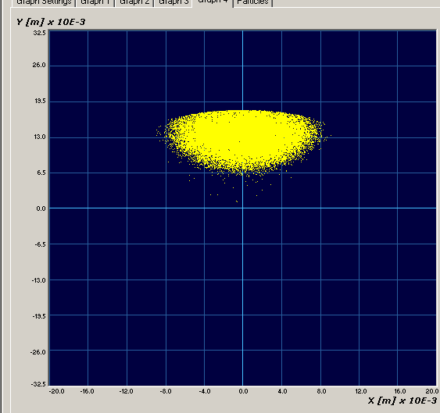
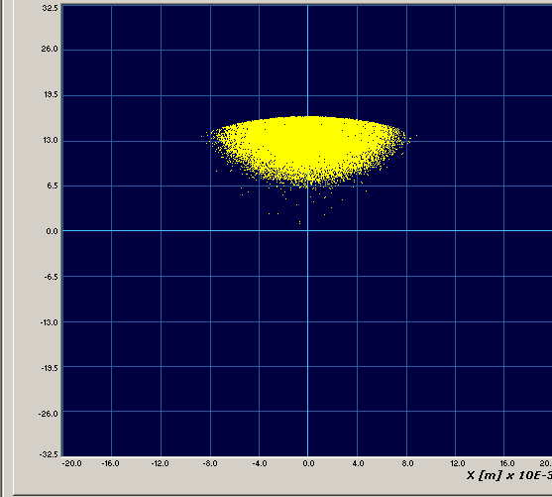
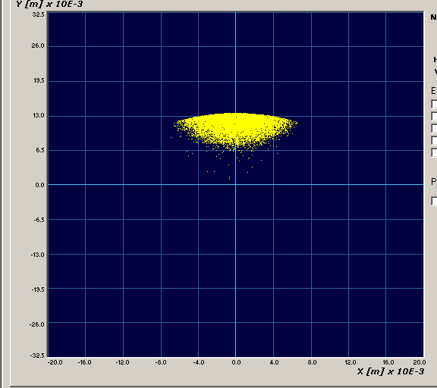
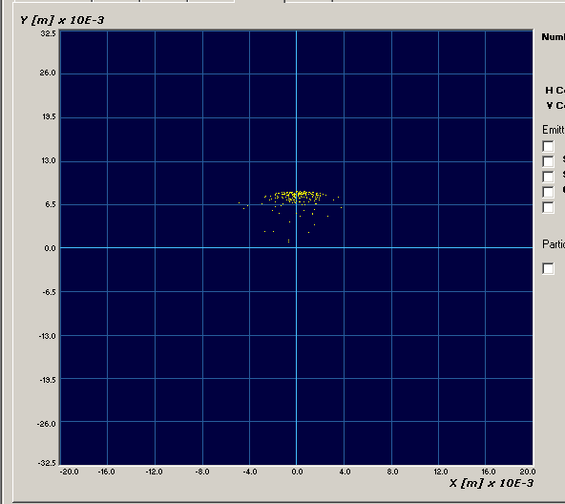
Losses along the dump
After 1 cm
After 3 cm
After 6 cm (halfway)
After 12 cm (end of dump)

Slide 47
Emittance from the source to the injection foil
3 MeV, after chopping
End of acceleration
0.25 µm : from the source

