Slide 1
Recent Upgrades to BBSIM Code
V. H. Ranjbar†
†Tech-X Corporation
We have made several improvements to BBSIM, a parallel beam dynamics simulation code. These include the addition of diffusion characterization routines, dynamic changes in RF frequency, accurate modeling of beam transfer function measurements, ac dipole, single kick measurements and the effects of resistive wall wake fields. These improvements are in the process of being benchmarked against measurements in the Tevatron and RHIC and are being used to better understand the complex interaction of chromaticity and wakefields on chromaticity measurements in the Tevatron, RHIC and LHC as well reveal the character of diffusion in these machines.

Slide 2
Over View
Diffusion Characterization Routines
What is regular Diffusion? What is anomalous Diffusion?
Applications of this technology
Measurement and Instrumentation Modeling
Pickup, kickers and changes in radial loop
Resistive wall wake-field
Benchmarking in Tevatron
Beam Transfer measurements
Coalesced versus Uncoalesced chromaticities? (Or a tail of two chromaticies)
Impedance related or emittance size related?

Slide 3
BBSIM Parallel Beam Dynamics Code
Dr. Tanaji Sen (FNAL) and collaborators have developed BBSIM over the past 6 years. The BBSIM code has the ability to track multiple particles and simulate nonlinear effects in a high energy circular accelerator. The code includes the following features:
6D weak-strong model, including synchrotron oscillations;
nonlinearities, including chromaticity sextupoles, thin lens multipoles--especially those in the IR quadrupoles at collision--and current carrying wire;
gas scattering and noise effects;
head-on and long-range interactions;
parallel I/O and computation;
diffusion coefficient calculator and equation solver.

Slide 4
Why Do We care about Diffusion?
Ultimately we who worry about running Colliders like the Tevatron, RHIC and the LHC want one thing, High integrated Luminosities. This of course is directly related to beam lifetimes. However when I last checked getting a realistic estimate of beam lifetimes from direct multi-particle simulation takes a long time especially if we want to include all the details realistically. Another approach is to instead use our simulations to estimate Diffusion over all of the action space.
Then integrate the diffusion equation to determine the lifetime:

Slide 5
Too good to be True.
Yes as you might guess, there are assumptions here that need to hold, namely that the dynamics can be described by a normal diffusive process. So how do we know if the dynamics follow the rules of diffusion? Actually this is a very deep question which lots of people have spent much time thinking about and is related to the nature of the statistics governing the evolution of the given particle ensemble and whether the transition probability is Gaussian or not.
The simple minded approach is to do many diffusion simulations with the same Diffusion Coefficients that our simulations are producing and see how the actions evolve in our simulation versus a “true” diffusion process. This is what we do in our “Simulated Path Approach”.

Slide 6
Simulated Path Test for Diffusion
One of the more successful approaches we implemented was based on [1]. In this method a C algorithm was developed which tested whether the sample estimates lie inside the confidence bands for all initial actions (J) within M_{max} to M_{min}. To accomplish this, the action moments where calculated using
Here a Gaussian kernel function K was used with the parameter h acting as the bandwidth determining the smoothing behavior of the kernel function. For a continuous diffusion process, M₁ and M₂ are estimates of the drift and squared diffusion coefficient, respectively. Moments are calculated through 4th order and then used to simulate m paths of a continuous diffusion process. Then for each of the m paths, m moments M_{j} ^{(m)} are calculated and then used to generate the median, 10th and 90th percentiles for each moment. These now serve as the confidence bands for some values of initial action J. If the moments lie within the confidence bands then normal diffusion hypothesis is confirmed. However if the sample estimates lie outside the confidence bands for some values of J the normal diffusion hypothesis is rejected.

Slide 7
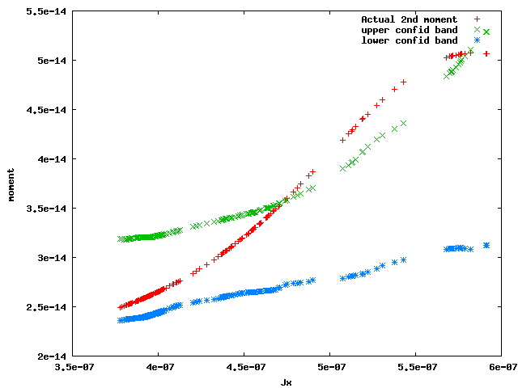
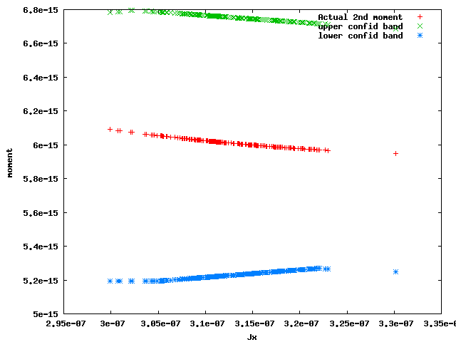
Sample Results for RHIC Lattice
The evolution of the second moment as the action nears the dynamic aperture at 6 initial transverse horizontal (X) action in a RHIC simulation with both long-range and head-on kicks. The diffusion ceases to be regular beyond the dynamic aperture.
The evolution of the second moment below the dynamic aperture at 5 initial transverse horizontal (X) action in a RHIC simulation with both long-range and head-on kicks. The diffusion appears regular.

Slide 8
Future Work and Application of this Technology
Further Characterize Nature of Diffusion
And nature of the underlying statistics.
Can we still estimate lifetimes in those regions where the diffusion is anomalous?
How? Perhaps use an estimated transition probability to estimate lifetimes
Because diffusion is an extremely common type of dynamics. This approach can be applied to a wide variety of systems. The additional code has been written with this in mind to make it capable of testing any series of data to determine if it is driven by normal or anomalous diffusion.

Slide 9
Measurement and Instrumentation Modeling
We also like to be able to simulate several tools used often to characterize the state of the machine during tune-up and studies.
Strip-line pickup
Single Kick
Continuous and frequency sweeping kick.
Changes in  offset used during chromaticity measurements
AC dipole kicker
2nd order Chromaticity

Slide 10
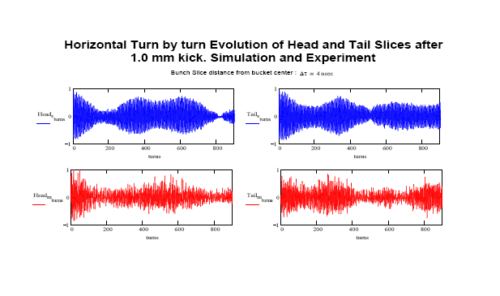
Resistive wall wake-field
Plot of measured and BBSIM simulated data. Shown is the transverse (vertical) turn-by-turn data of the bunch head and tail after a 1mm kick 4ns ahead/behind the bucket center. Actual turn-by-turn data (bottom) compared with 10⁴ macro-particle BBSIM simulation with resistive wall wake W_{1} = 16cm^{1.5} and chromaticity _{y} = 7 and  = 3ns and intensity of 2.44e11 particles-per-bunch.
Plot of measured and BBSIM simulated data. Shown is the transverse (Horizontal) turn-by-turn data of the bunch head and tail after a 1mm kick 4ns ahead/behind the bucket center. Actual turn-by-turn data (bottom) compared with 10⁴ macro-particle BBSIM simulation with resistive wall wake W_{1} = 12cm^{1.5} and chromaticity _{x} = 4 and  = 3ns and intensity of 2.44e11 particles-per-bunch.

Slide 11
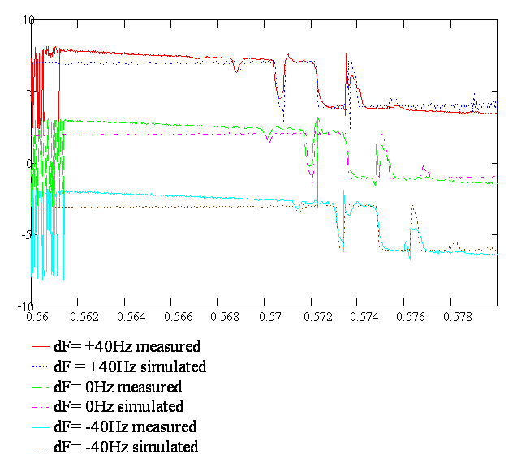
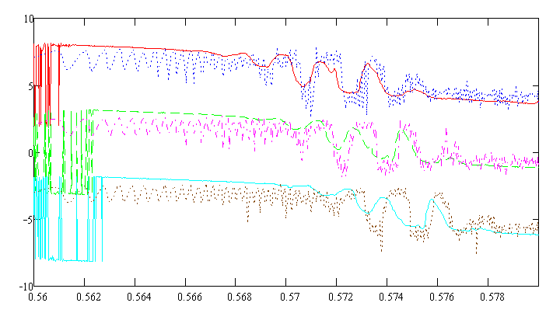
Beam Transfer measurements* (Still work in Progress)
Coalesced proton Phase Measurements in Tevatron No Wakefield in Simulation
Ucoalesced proton Phase Measurements in Tevatron
* Experimental Data from C.Y. Tan at FNAL

Slide 12
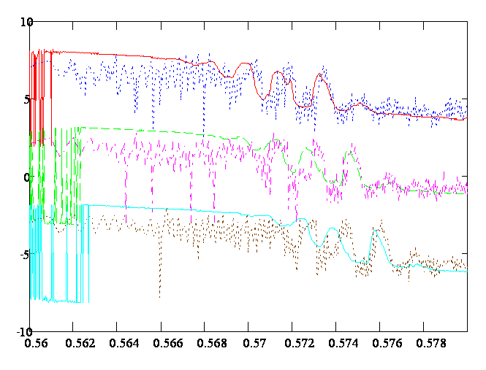
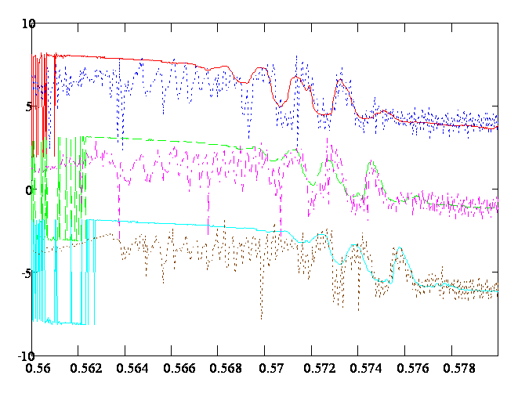
BTF fits..cont (simulation needs more particles..too noisy)
Coalesced proton Phase Measurements in Tevatron with Wakefield and 2nd Order Chrom.
Coalesced proton Phase Measurements in Tevatron With Wakefield in Simulation

Slide 13
Conclusion and Future directions
We have added several powerful tools to BBSIM
Tools for characterizing diffusion in a general fashion
Tools to correctly simulate several common measurements
Upgrades to physics:
Resistive wall wake field effects
Ability to handle changes in  in with the associated longitudinal dynamics
2nd order Chromaticity
Still would like to:
Improve speed of Wake field routines..very slow right now
Develop approach to estimate transition probabilities in anomalous cases

Slide 14
References
[1] G. Fusai and A. Roncoroni, Implementing Models in Quantitative Finance: Methods and Cases. Berlin Heidelberg: Springer-Verlag, 2008.
[2] L. Vlahos et al., “Normal and anomalous diffusion: A tutorial“, http: // arxiv. org/ abs/
0805. 0419v1 , 2008.

Slide 15
Thanks:
Tanaji Sen, Cheng-Yang Tan, Hyung-Jim Kim

