Slide 1
Fermi National Accelerator Laboratory
Proton Source Workshop
Linac Momentum Dump

Slide 2
Linac Momentum Dump
Dump Installation 1969
FESS & AD drawings 1969
Vacuum degradation 2008
Window installed 2008
Photos 2008
Borescope camera tour 2010
Proposed solution
Current status
Future plans

Slide 3
FESS/DUSAF Drawing
Designed by Sahai/Noda 2/6/69, NAL release by Collins
No photo records of the dump either before or during installation could be found.
No purchase records of the dump could be found.
May have been part of the responsibility of the construction contractor

Slide 4
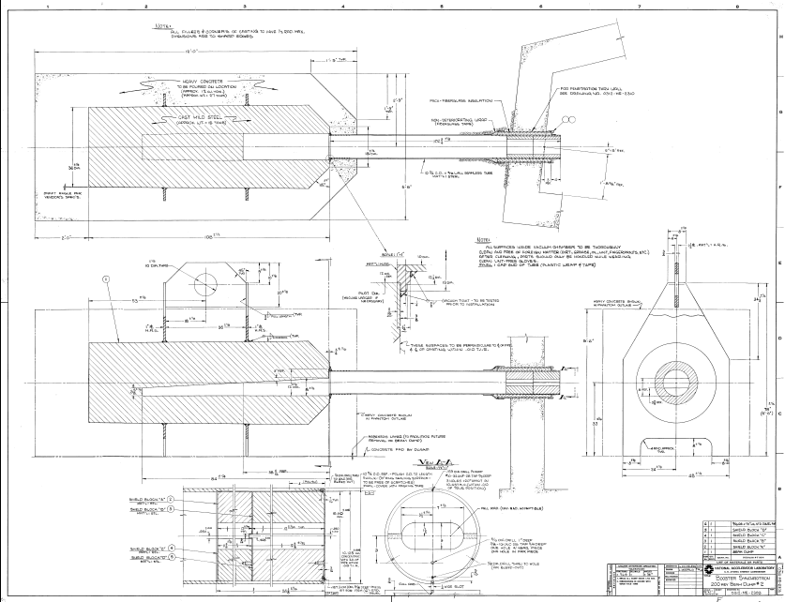
AD Drawing
ME-2303
6/24/69
Michelassi
Mapalo
Steel casting with
sand cored
half-round wedge
shaped internal
cavity, steel tube
welded on
upstream end,
encased in
concrete

Slide 5
Vacuum Degradation
Vacuum becoming poor 12/6/07
High radiation in vicinity
Plan to install titanium vacuum window

Slide 6
Wire in Beam Line
Vacuum let up, beam tube opened 12/6/07
Wire in beam line
Relaxed, no tension
Changed vacuum seals

Slide 7
Window Installation
Vacuum still poor
Opened 12/12/07
Installed .003” thk. titanium window upstream of dump
Installed pumpout port and ion gauge
Separate vacuum from Linac

Slide 8
What’s in the Beam Dump?
Photo taken 12/12/07
Compare with AD dwg ME-2303
Shield blocks A,B,C,D on dwg 2303 are not in dump
Otherwise appears to conform to dwg 2303
Steel casting with sand cored half-round wedge shaped internal cavity, tube welded on upstream end

Slide 9
Additional Complication
Dump is offset from beam line
Don’t know how well we can trust old drawings
Possible defects inside such as casting lumps

Slide 10
Borescope Camera Tour
Opened pumpout port 1/26/10
Fed in borescope on long cable
Video record saved 469Mb
Y:\public\AUGUSTINE\LINAC Dump video 1-26-2010
Confirms that we believe ME-2303 reasonably close to accurate
Some casting lumps observed in cavity

Slide 11
Evaluation of the Problem
Believe tube rusting from outside, ground water contaminating vacuum
Vacuum pump on chamber isolated by window can maintain adequate vacuum for the short term

Slide 12
Ideas Evaluated
Dig up dump and perform in-place repairs
Inject sealant from berm or tunnel wall
Dig up and replace dump
Make a new dump in different place
Backfill with helium
Insert vacuum sleeve inside dump cavity
Vacuum sleeve looks like the best solution to pursue

Slide 13
Vacuum Sleeve Ideas
Long tube and formed shape chamber
Stainless steel
Copper
Stainless with copper plate insert
Welded, bolted, captured, explosion bonded
Heat transfer to cast iron
Changes beam collision point more upstream inside dump
Difficult installation, high radiation area, long heavy chamber, possible interference from casting lumps

Slide 14
Vacuum Sleeve Ideas
Tungsten chamber and block
Stainless steel chamber
Tungsten block inside
Carbon graphite block inside
Length of graphite determinate on radiation and thermal calculations

Slide 15
Current Status
Thermal stress analysis conducted by Ang Lee
Radiation analysis conducted by Diane Reitzner
Design evolving

Slide 16
Future Plans
Final solution will need installation plan, hazard analysis, reviews by Rad Safety and Operations

