Slide 1
Booster Acceptance, Apertures, and Alignment
Kiyomi Seiya

Slide 2
Contents
Magnets in the Booster
Survey and data analysis
Magnet move
Lattice calculation
Aperture scan

Slide 3
Main components in the Booster
F-magnet * 48
D-magnet * 48
Corrector * 48
H & V dipole
Normal & Skew Quad
Normal & Skew Sextupole
BPM @ Long & @Short

Slide 4
FOFDOOD
C
D
F
D
C
F
Long straight section
Short straight section

Slide 5
Survey and data analysis
December, 1993(S. Shukla)
F-magnet, D-magnet
April, 2005 (O. Oshinowo, P. Kasper)
F-magnet, D-magnet
BPM
August , 2009(O. Ohinowo)
F-magnet, D-magnet
Corrector magnet
RF cavity

Slide 6
Magnet move
December, 1993(S. Shukla)
Moved magnets and improved aperture
April, 2005 (J. Lackey)
Moved F & D in horizontal & vertical

Slide 7
Lattice calculation
Shukla’s program - Java application (A. Waller)
Last update was in 2006
MAD v8 – Console application (W. Marsh)
1994 (C. Johnstone)
Calculated with alignment error on F & D magnet and compared with ideal lattice
2001-2003 (A. Drozhdin)
Calculated Dog leg magnet at injection and compared with measurement.
2010 (J. Lackey)
Put all components including new correctors

Slide 8
Aperture scan
November, 1994 (D. McGinnis, S.Shukla)
B75
Moved magnets
December, 2003 (B. Pellico)
Before septa was moved to MI-8 from L13.
December, 2004 (B. Pellico)
Measured lager aperture after septa was moved.

Slide 9
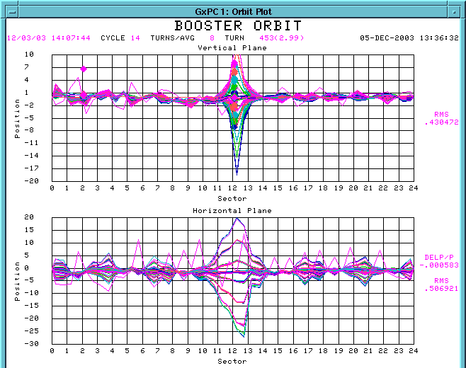
Orbit data with 3 bump

Slide 10
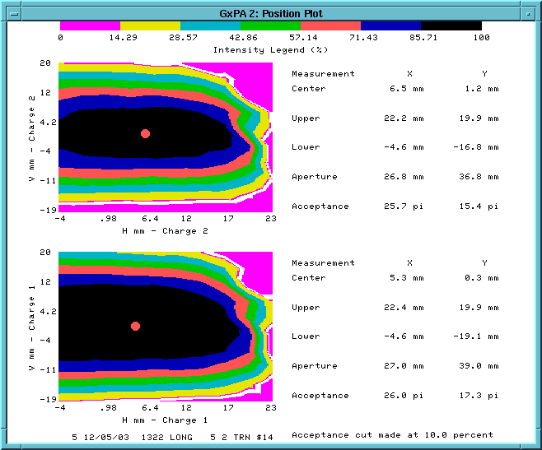
Aperture scan with B75
Using 3bump
DCCT
Need to be modified for the new correctors
CAMAC card (465 → 473)
Bump ratios
Current limit

Slide 11
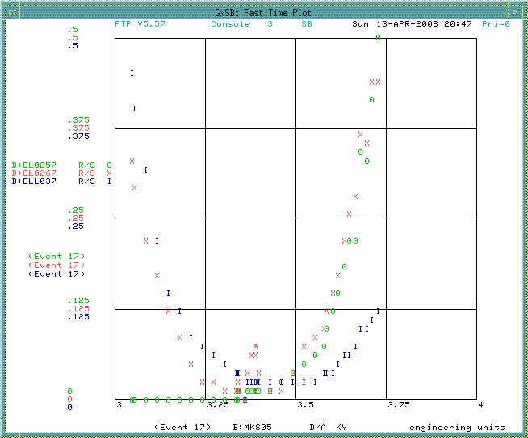
Aperture scan on current operation
Using 3bump
Loss monitor
H: F-magnet
V: D-magnet

Slide 12
Loss monitor
V Loss monitor
H Loss monitor

Slide 13
Next…
Aperture scan
1 bump, 3 bump or 5 bump
Modified B75
Survey data analysis
Data from August, 2009
Lattice calculation
Make sure that all elements are in MAD file.
Put in alignment error.
Compare with Shukla’s.

