Slide 1
FNAL Linac
Beam Status
Proton Source Workshop
Fernanda G. Garcia
Accelerator Division
Proton Source Department
December 7-8, 2010
fgarcia@fnal.gov
X 3798

Slide 2
Outline
Introduction to 400MeV Linac
Low Energy Linac
High Energy Linac
Operations Overview
Radiation Issues
Operational Concerns
Summary
Linac Beam Status Proton Source Workshop
Fernanda G. Garcia December 7-8, 2010

Slide 3
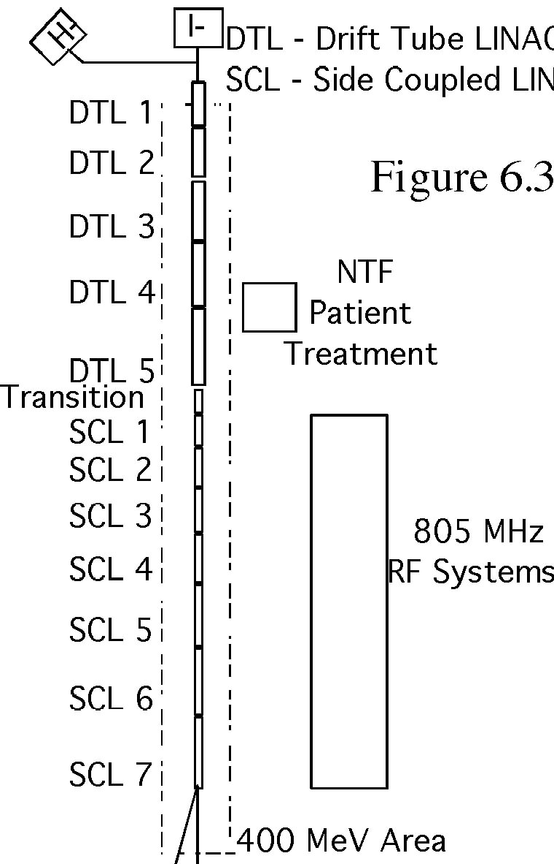
Introduction to Linac
Linac has been in operation since 1970
~ 90% availability
Linac operates at 15 Hz
NTF takes spare cycles when available
Management decision: priority during treatment
There are two difference sections:
201.25 MHz Low Energy (LE) (β < 0.45)
805 MHz High Energy (HE) (0.45 < β < 0.71)
There are two 750 keV injectors (I⁻/H⁻)
80 μsec beam pulse @ ~ 50 mA peak current
Linac accelerates beam only when requested
Normal operation
34-mA macropulse average current
HEP: ~ 7.0 Hz, 22.2 μsec macropulse length
NTF: 15 Hz, 64.0 μsec macropulse length
Studies: up to 15 Hz, 20 μsec macropulse length
MTA: variety of beam demands
Linac Beam Status Proton Source Workshop
Fernanda G. Garcia December 7-8, 2010

Slide 4
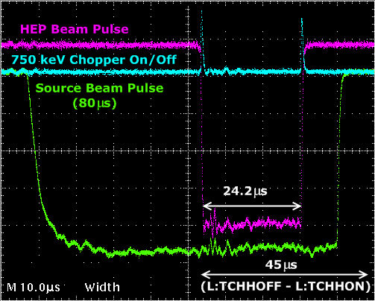
Beam transmitted through Linac
HEP/Studies/MTA beam pulses are requested by the Beam Switch Sum Box (BSSB) from MCR
Request is received by the Beam Enable Pulse Shifter Chassis
if all the requests/status are in order beam is transmitted to Linac
if not source timing is shifted 1msec and beam dies at Tank 1.
In the case of HEP, beam is chopped by the low energy (750 keV) and high energy (400 MeV) chopper systems.
Linac Beam Status Proton Source Workshop
Fernanda G. Garcia December 7-8, 2010

Slide 5
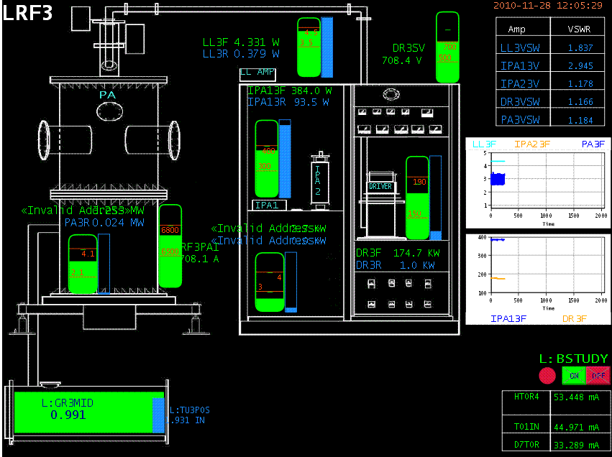
Introduction to Linac - LE Linac (DTL)
5 cylindrical, electrical resonant,
OFHC cavities,
~ two thirds of 200 DTs are located at the
low-β region,
Each cavity is powered by a single
5MW PA @ 201.25 MHz
~ 1.5 MV/m with an Average Power 20 KW
Space between tanks are occupied either by beam valves, dipole trim packages or beam position monitors.
Total length: ~ 75 m
Beam direction
10.42 37.54 66.18 92.6 116.5
Eout (MeV)
β 0.148 β 0.275 β 0.375 β 0.414 β 0.457
Linac Beam Status Proton Source Workshop
Fernanda G. Garcia December 7-8, 2010

Slide 6
Introduction to Linac - HE Linac (SCL)
7 805 MHz SCL modules, 4 sections with 16 accelerating cells,
independent 12 MW Klystrons @ ~7.0 MV/m
Linac Beam Status Proton Source Workshop
Fernanda G. Garcia December 7-8, 2010

Slide 7
Beam Operations
Linac Beam Status Proton Source Workshop
Fernanda G. Garcia December 7-8, 2010

Slide 8
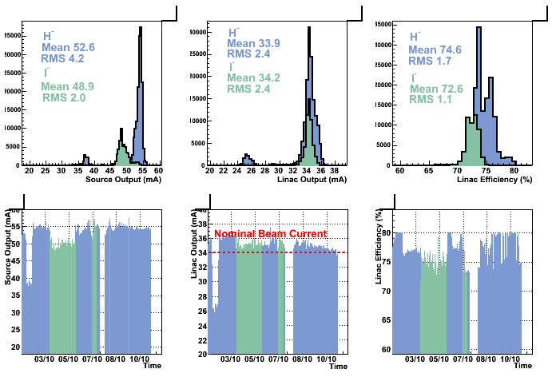
Operational Beam Parameters (2010)
Source Output
Linac Output
Linac Efficiency
30% running I⁻
Shutdown’10
Shutdown’10
Shutdown’10
Shutdown’10
Shutdown’10
Shutdown’10
Linac Beam Status Proton Source Workshop
Fernanda G. Garcia December 7-8, 2010

Slide 9
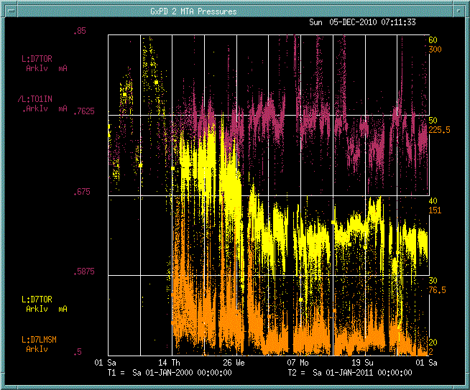
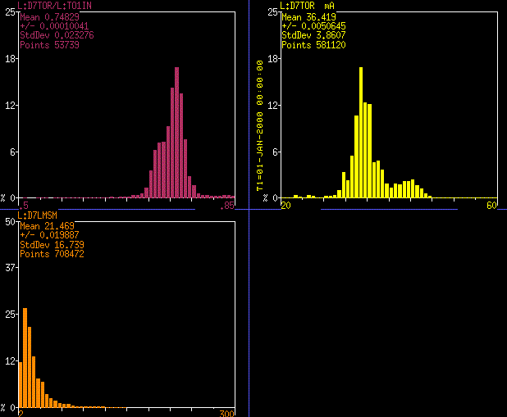
Operational Beam Parameters (2000-2010)
Efficiency
Linac Output
D7LMSM
Linac output ~ 36.5 mA
Losses ~ 21.5 mV
Efficiency ~ 75%
‘00 ‘02 ‘04 ‘06 ‘08 ‘10
Linac Beam Status Proton Source Workshop
Fernanda G. Garcia December 7-8, 2010

Slide 10
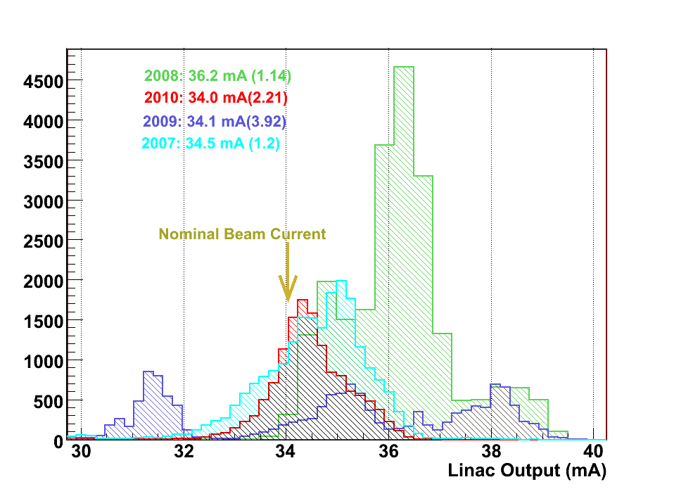
LE Beam losses
Nominal range < 200 mR/h
Remnant radiation at energies < 10 MeV is negligible.
TK1RAD and TUNRAD are chipmunks located inside the
Linac tunnel by TK1 and TK4-5 respectively.
Daily tuning to minimize these devices while maintaining the required Linac output.
There is other instrumentation (chipmunks) in Linac.
Minimizing these at the front end produce positive
results through out the low energy region.
Nominal range < 20 mR/h
Linac Beam Status Proton Source Workshop
Fernanda G. Garcia December 7-8, 2010

Slide 11
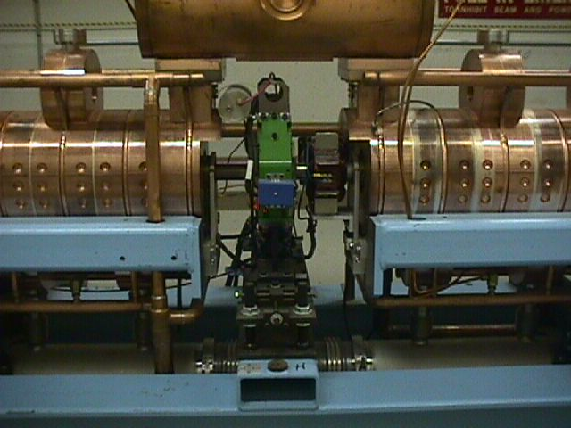
HE Beam Loss Monitoring
SCL cavities
Loss monitors are located between each module section
D7LMSM is a sum of the readings of 36 loss of the monitors
400 MeV Area
400SCA is a chipmunk located at the entrance of the 400MeV area (labyrinth)
There are also loss monitors located in the dump line area
D7LMSM
Dump area
400SCA
Linac Beam Status Proton Source Workshop
Fernanda G. Garcia December 7-8, 2010

Slide 12
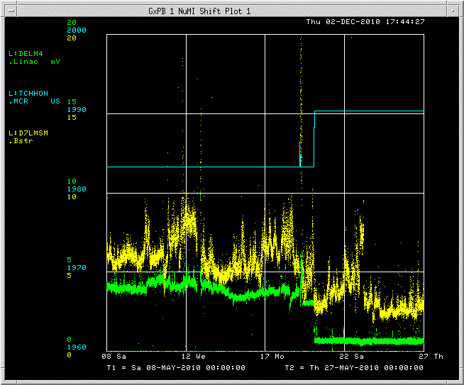
HE Beam losses
D7LMSM
Proton Plan funded an important project for Linac,
the LE LLRF Upgrade
Nominal range < 10
Improve amplitude regulation
Provide phase stability and
Reduce beam losses
May’10
Beam sent to dump was reduced from 10 to 2 μsec
Chopper
Timing
change
May’10
Losses Reduction
~ 80%
Linac Beam Status Proton Source Workshop
Fernanda G. Garcia December 7-8, 2010

Slide 13
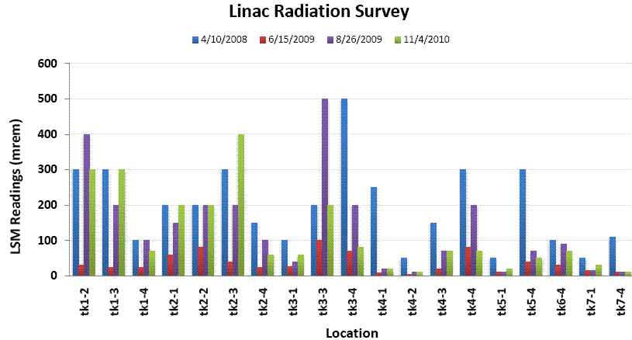
HE Radiation issues
During the rare occasion of access in Linac, a radiation survey has regularly been performed since 2008.
SCL front end remains unchanged
Improvement in equipment activation at region > 230 MeV
Linac Beam Status Proton Source Workshop
Fernanda G. Garcia December 7-8, 2010

Slide 14
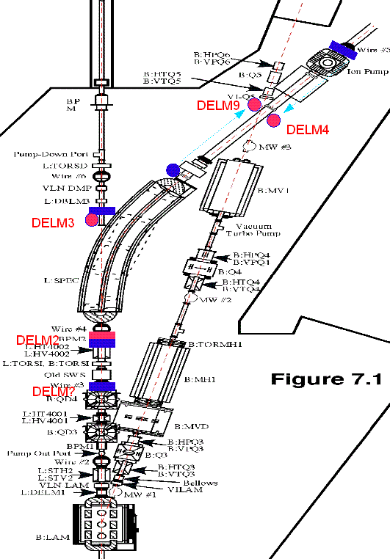
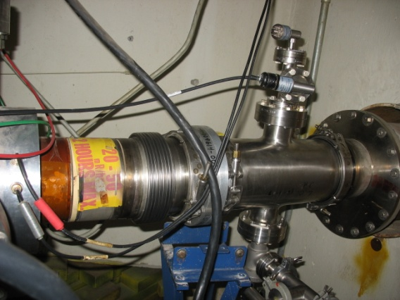
Quick background
A leak developed in the Linac Momentum dump in Dec’07. A Ti window was installed to isolate the rough vacuum at the dump from the beamline vacuum.
Vacuum at the momentum dump area started degrading on January 7th, 2009. Suspect the original leak got worse.
A Working Group was initiated in Feb’09 to formulate a long term solution for the Linac dump#2 area.
See R. Reilly’s talk at this WS.
Operation Concerns I
Momentum Dump Vacuum
Impact to Operations:
~ 8 hrs downtime when the seal on the window failed
Area became radiological hot.
Current Eff: > 90%
Linac Beam Status Proton Source Workshop
Fernanda G. Garcia December 7-8, 2010

Slide 15
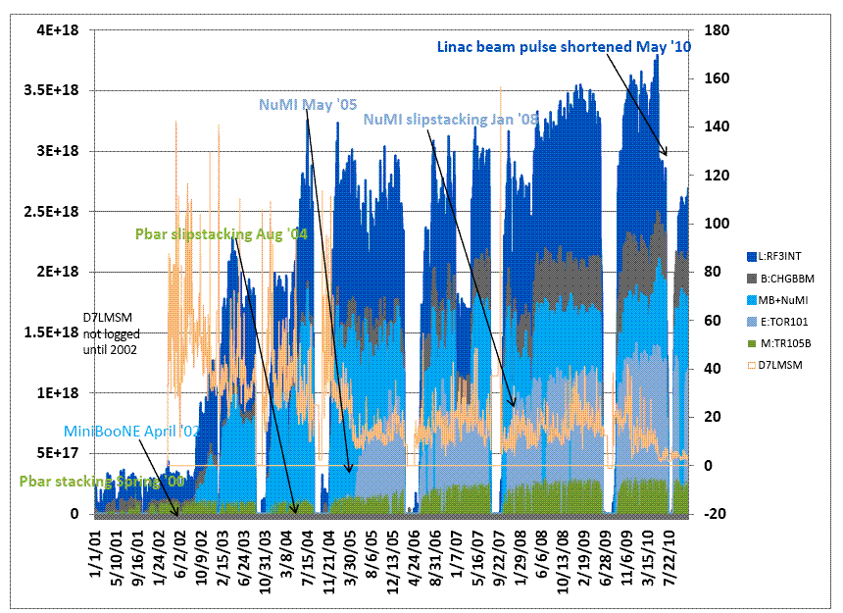
Beam throughput over the past decade
Linac Beam Status Proton Source Workshop
Fernanda G. Garcia December 7-8, 2010

Slide 16
Final Remarks
All protons for the laboratory program until Project X comes
online depend on this machine
200 MHz Linac and some power systems are 40 years old
Linac runs at 15Hz regardless of beam demand or not
Current HEP rate is ~ 7.0 Hz
Present RF power availability is not a limitation for 15 Hz operations
@ 15 Hz Average RF Power is ~ 20 KW
7835 max plate dissipation : average=150KW
Concerns going to 15 Hz
Activation levels
201 MHz system reliability?
How much will the modulator failure/downtime increase?
Linac Beam Status Proton Source Workshop
Fernanda G. Garcia December 7-8, 2010

Slide 17
BACKUP SLIDES
Linac BeamStatus Proton Source Workshop
Fernanda G. Garcia December 7-8, 2010

Slide 18
Operation Concerns
Linac Beam Status Proton Source Workshop
Fernanda G. Garcia December 7-8, 2010

Slide 19
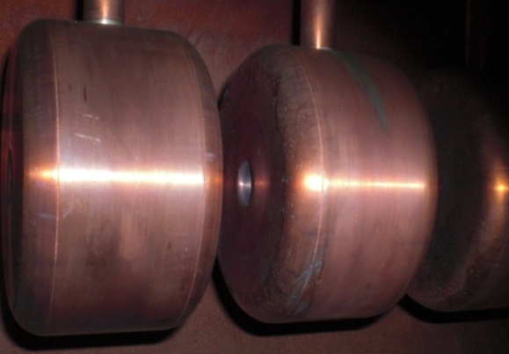
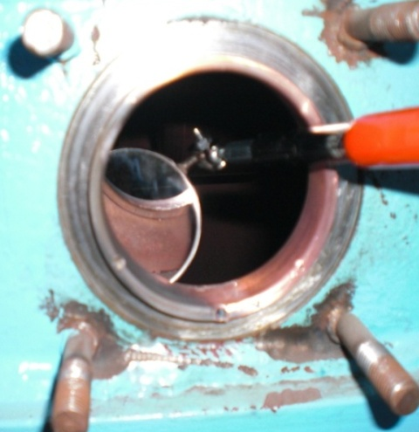
Operation Concerns I
Oscillations in Tank 1
~ 2% Energy Variation
Tuning Slug possibly contributing to oscillations. Why?
Years ago the finger stock/spring ring was removed due to concerns that is was causing sparking in the cavity and causing the tuning slug to bind and wearing out the drive screw.
Absence of finger stock/spring ring may allow slug to vibrate
Shutdown 2010: Re-Install contact finger stock/spring ring
Plan was developed using existing drawings of the tuner slug and port.
Installed system has different port as stated on the drawings.
Work was not complete. Back to white board...
Signs of sparking
July 17, 2010
Linac Beam Status Proton Source Workshop
Fernanda G. Garcia December 7-8, 2010
Notes:
19

Slide 20
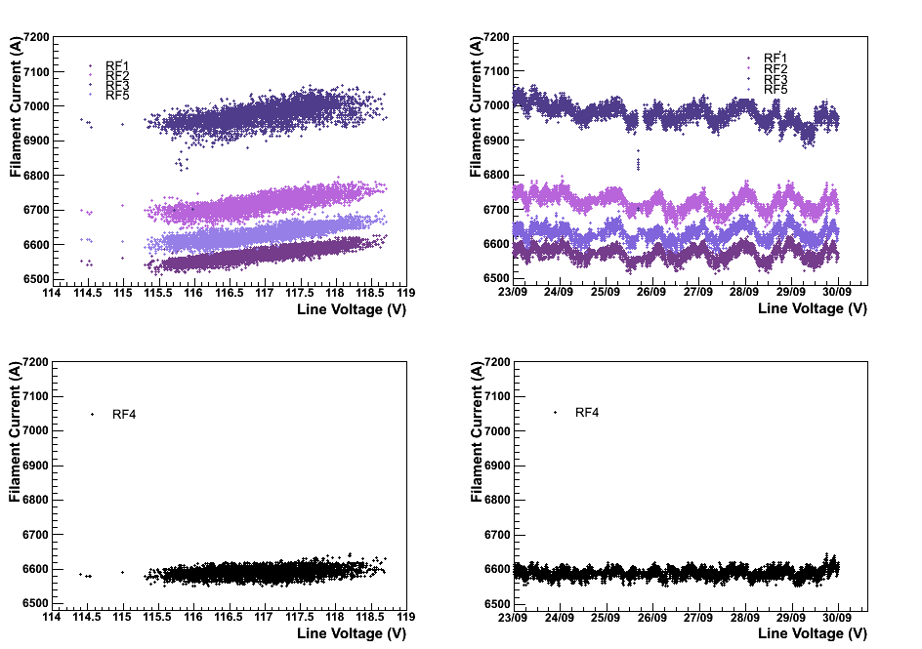
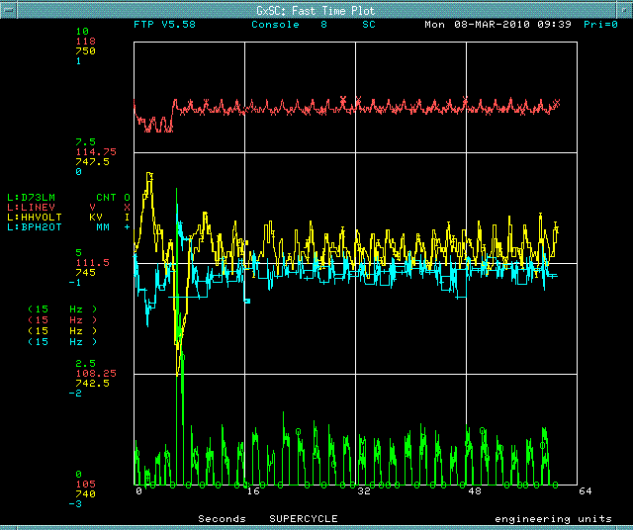
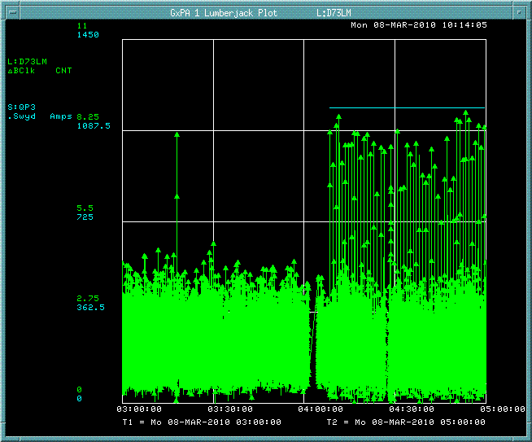
Operation Concerns II
Line Voltage Sensitivity
Direct effects on Linac equipment from line voltage variation are observed in low energy PA filament currents
Results in operating the filaments at a higher current than necessary and reducing tube lifetime.
Possible mitigation: New regulation system
See T. Butler’s talk
Large variations effect Haefley High Voltage changing the source output energy
Triggered by SWYD ramp event
Linac beam loss increase
Linac Beam Status Proton Source Workshop
Fernanda G. Garcia December 7-8, 2010
+/- 1% day/night variation
Notes:
20

Slide 21
Linac Running at 15 Hz
LINAC PARAMETERS | Beam to HEP |  | Beam to Dump
Linac Peak Current | 34 | ma | 34 | mA
Linac HEP Pulse Repetition Rate | 15 | Hz | 15 | Hz
Linac HEP Beam Width | 24 | usec | 2 | usec
Linac HEP Particles per pulse | 5.1E+12 | ppp | 4.25E+11 | ppp
Linac HEP Particles per second | 7.65E+13 | pps | 6.375E+12 | pps
Linac HEP Particles per hour | 2.754E+17 | pph | 2.295E+16 | pph
Linac HEP Peak Beam Power | 4.896 | kW | 0.408 | kW
Linac HEP Peak Beam Power | 0.3264 | kJ | 0.0272 | kJ
Linac BeamStatus Proton Source Workshop
Fernanda G. Garcia December 7-8, 2010

Slide 22
Cavity number | Units | 1 | 2 | 3 | 4 | 5
Proton Energy In | MeV | 0.75 | 10.42 | 37.54 | 66.2 | 92.6
Proton Energy Out | MeV | 10.42 | 37.54 | 66.18 | 92.6 | 116.5
β Proton velocityOUT of Tank | 0.04 into Tk1 | 0.148 | 0.275 | 0.375 | 0.414 | 0.457
Cavity Length | m | 7.44 | 19.02 | 16.53 | 16.68 | 15.58
Cavity Diameter | cm | 94 | 90 | 88 | 88 | 84
Drift-Tube Diameter | cm | 18 | 16 | 16 | 16 | 16
Bore-Hole Diameter | cm | 2.0 - 2.5* | 3 | 3 | 3 | 4
Cell Length (L) (First cell) | cm | 6.04 | 12.2 | 41.1 | 53.3 | 61.8
Cell Length (L) (Last cell) | cm | 21.8 | 40.8 | 53 | 61.5 | 67.9
Gap Length (G) (First cell) | cm | 1.3 | 4.4 | 12.2 | 19.5 | 22.6
Gap Length (G) (Last cell) | cm | 6.7 | 12.7 | 19.3 | 25.1 | 26.9
G/L (First cell) |  | 0.21 | 0.2 | 0.3 | 0.37 | 0.37
G/L (Last cell) |  | 0.31 | 0.31 | 0.36 | 0.41 | 0.4
Axial transit-time factor (First Cell) |  | 0.64 | 0.86 | 0.82 | 0.75 | 0.73
Effective Shunt Impedance (First cell) | Mohm/m | 27 | 53.5 | 44.6 | 35 | 29.6
Effective Shunt Impedance (Last cell) | Mohm/m | 47.97 | 44.8 | 35.2 | 28.5 | 25
Drift Space Following Cavity | m | 0.22 | 0.6 | 0.75 | 1.175 | 0.825
Number of Full Drift Tubes |  | 55 | 59 | 34 | 28 | 23
Average Axial Field | MV/m | 1.60-2.31 | 2 | 2.6 | 2.6 | 2.56
Average Gap Field (First cell) | MV/m | 7.62 | 10 | 8.7 | 7.03 | 6.9
Average Gap Field (Last cell) | MV/m | 7.45 | 6.45 | 7.2 | 6.3 | 6.4
Peak Surface Field (First cell) | MV/m | 8.9 | 12.6 | 13.1 | 12.9 | 14
Peak Surface Field (Last cell) | MV/m | 10.2 | 9.7 | 12.9 | 13.2 | 14.1
Linac Beam Status Proton Source Workshop
Fernanda G. Garcia December 7-8, 2010

Slide 23
LINAC PARAMETERS | Capable of |  | TYPICAL
Linac Peak Current | 52 | ma | 34 | mA
Linac HEP Pulse Repetition Rate | 15 | Hz | 7.5 | Hz
Linac HEP Beam Width | 10 | usec | 24.2 | usec
Linac HEP Particles per pulse | 3.25E+12 | ppp | 5.14E+12 | ppp
Linac HEP Particles per second | 4.88E+13 | pps | 3.86E+13 | pps
Linac HEP Particles per hour | 1.76E+17 | pph | 1.39E+17 | pph
Linac HEP Beam Power | 3.12 | kW | 2.47 | kW
Linac Study Pulse Repetition Rate | 15 | Hz | 3 | Hz
Linac Study Beam Width | 20 | usec | 20 | usec
Linac Study Particles per pulse | 6.50E+12 | ppp | 4.25E+12 | ppp
Linac Study Particles per second | 9.75E+13 | pps | 1.28E+13 | pps
Linac Study Particles per hour | 3.51E+17 | pph | 4.59E+16 | pph
Linac Study Beam Power | 6.24 | kW | 0.82 | kW
Linac Beam Status Proton Source Workshop
Fernanda G. Garcia December 7-8, 2010

Slide 24
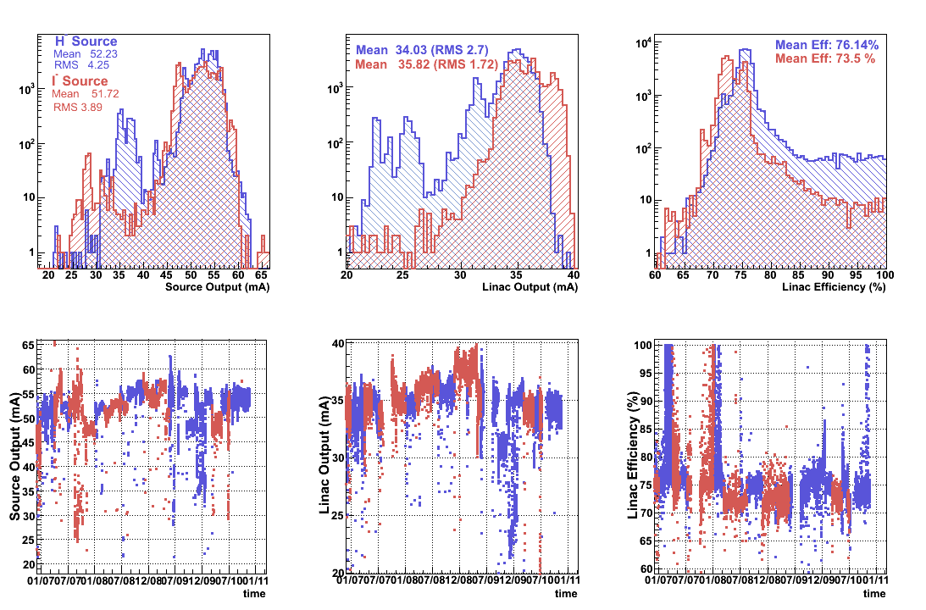
Beam Parameters (Dec’06-Dec’10)
Linac BeamStatus Proton Source Workshop
Fernanda G. Garcia December 7-8, 2010

Slide 25
Linac Low-Level RF Upgrade
All Experimenters Meeting
April 20th 2009
Presenters: Ed Cullerton (AD/RF Dept)
& Trevor Butler (AD/Proton Source Dept)
Contributors: Larry Allen, Fernanda Garcia (AD/PS),
Brian Chase, Paul Joireman,
Vitali Tupikov, Philip Varghese (AD/RF),
Michael Kucera (AD/Controls)

Slide 26
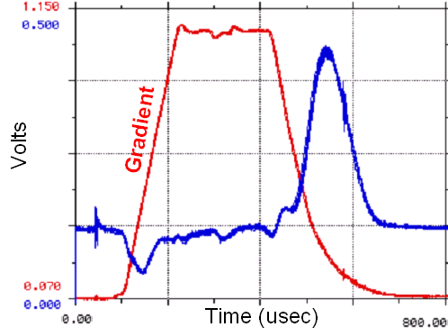
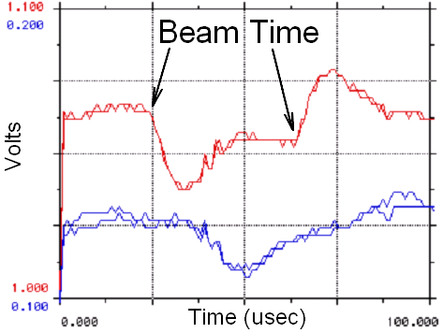
Linac LLRF Design Goals
Generate 201.25 MHz RF from 805 MHz reference line to provide a phase reference for each station.
Improve RF Amplitude and Phase regulation during the beam pulse.
Improve beam injection into the Booster.
Expand working knowledge of the low energy Linac RF system.
Design Specification | Previous LLRF System | New LLRF System Goals
Cavity Gradient Beam Loading | ~1% | < ±0.2%
Cavity RF Phase Stability | ~2° | < ±0.5°
Beam Settling Time | 10 μs | < 2 μs

Slide 27
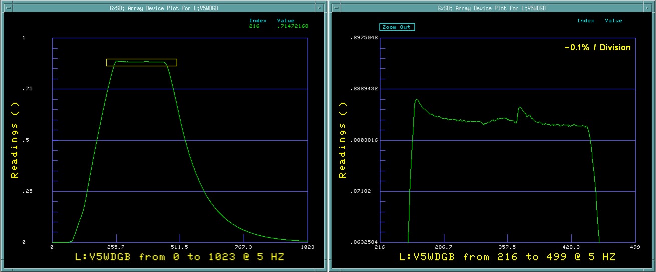
Operational Effects on RF Gradient
0.034% Gradient Flatness on Station 5 LLRF (Goal < ±0.2%)
The LLRF amplitude feed-forward loop is able to achieve design specifications for HEP gradient flatness.

Slide 28
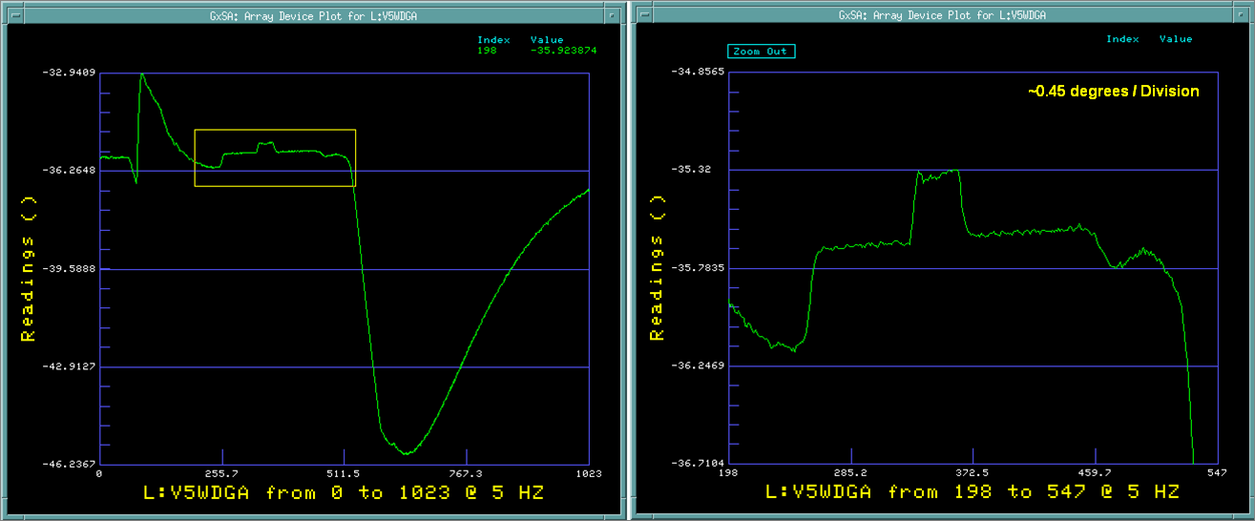
Operational Effects on RF Phase
0.06° Phase Flatness on Station 5 LLRF (Goal < ±0.5°)

Slide 29
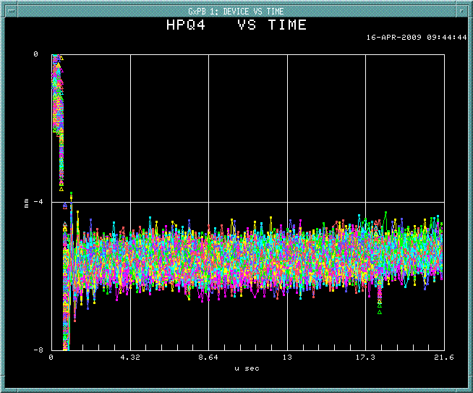
Operational Effects on Beam Stability
A BPM, located in a high dispersion region of the 400 MeV beam line, shows the beam position variation. This variation is partially due to momentum shifts caused by instabilities of the Linac RF phase and gradient. After a combination of High Energy and Low Energy Linac LLRF work, a reduction of beam position fluctuation from 4mm to 2mm is seen in the BPM monitor plots below.
Previous LLRF (11/30/07)
~4 mm variation
New LLRF (04/13/09)
~2 mm variation
4mm
0mm
0mm
-4mm
-4mm
-8mm

