Slide 1
Proton Improvement Plan Overview
Bob Webber
July 13, 2011

Slide 2
Proton Source Improvement Plan Overview
Objectives
Increase the beam repetition rate from ~7 Hz to 15 Hz
Eliminate major reliability vulnerabilities and maintain reliability at present levels (>85%) at the full repetition rate
Eliminate major obsolescence issues
Increase the proton source throughput, with a goal of reaching > 2E17 pph
Ensure a useful operating life of the proton source through at least 2025
The timeframe will depend on the funding profile. The desired proton throughput goals are:
1.8E17 protons/hour (at 12 Hz) by May 1, 2013
>2.2E17 protons/hour (at 15 Hz) by January 1, 2016

Slide 3
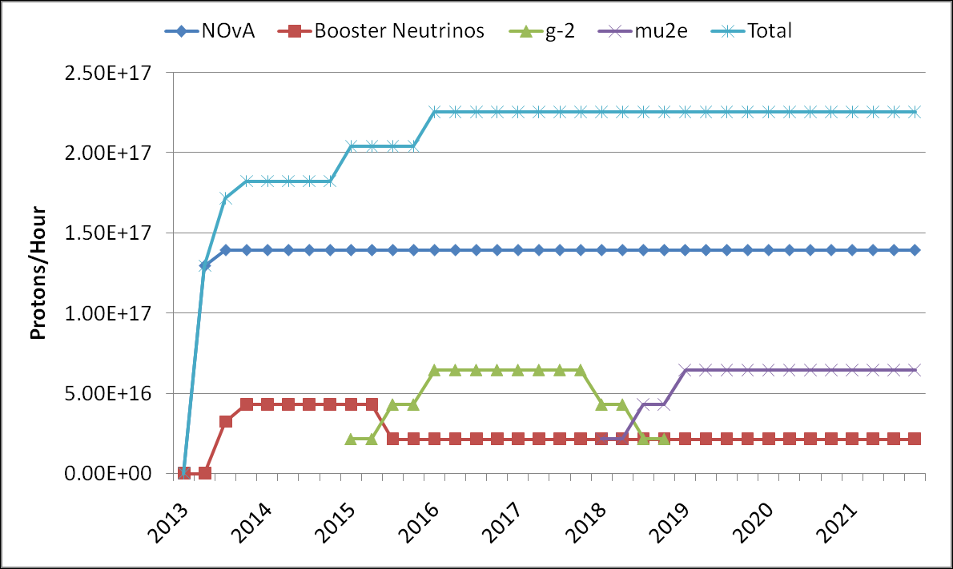
8 GeV Proton Expectations

Slide 4
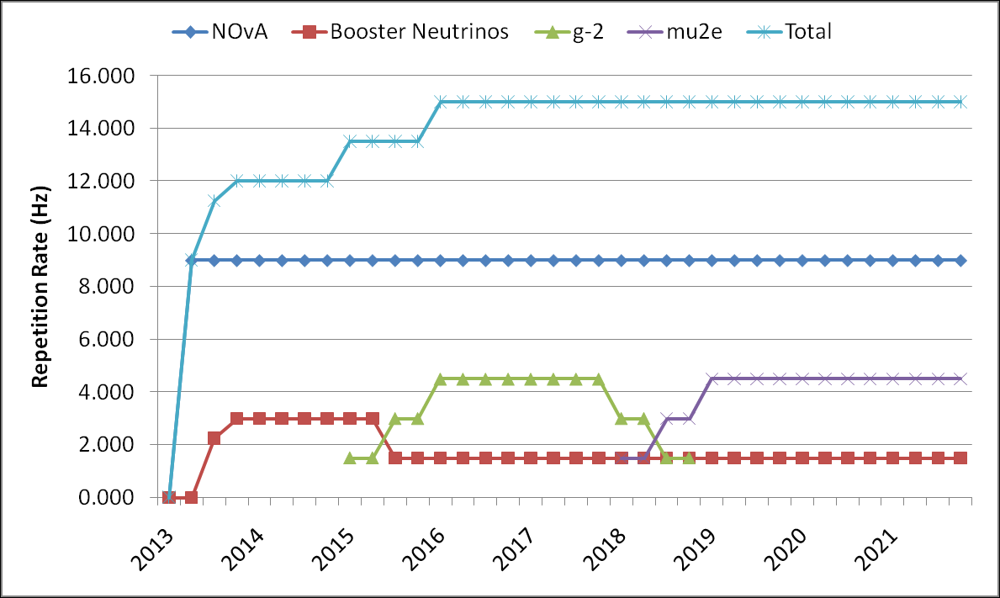
Beam Rep Rate Expectations

Slide 5
DOE Document Task Table

Slide 6
M&S Funding Guidance
FY11 --- $0 to 1.4M
FY12 --- $6.2M
FY13 --- $6.4M
FY14 --- $13.3M
FY15 --- $12.3M
FY16 --- $6.4M
TOTAL M&S --- $44.6M

Slide 7
Where are we plan-wise?
We do not have a comprehensive, technically coherent plan written for the $44M program
Major elements were defined in Proton Source Task Force Report
We have draft organization chart
Meeting Series is set with tentative, incomplete list of topics

Slide 8
Draft Org Chart – Top Levels
Proton Improvement Plan
Bill Pellico
Bob Webber, Deputy
Bob Zwaska, Deputy
Booster RF
John Reid
Power Distribution
Steve Hayes
Proton Source Utilities
Todd Sullivan
Linac RF
Ralph Pasquinelli
Instrumentation & Controls
Craig Drennan
Beam Physics
Valeri Lebedev

Slide 9
Draft Org Chart – Booster RF
Booster RF
John Reid
Solid State Driver Amps
Tom Kubicki
Anode PS
Rene Padilla
Cavities
TBD/McGinnis
Tuners
Ralph Pasquinelli
Bias Supplies
TBD
Spare Cavity
Matt Slabaugh
Cavity Test Stand
TBD/ Reid

Slide 10
Draft Org Chart – Linac RF
Linac RF
Ralph Pasquinelli
200 MHz HLRF
Ralph Pasquinelli
PreAccelerator
C. Y. Tan

Slide 11
Draft Org Chart – Power, Utilities, and Controls
lan
Power Distribution
Steve Hayes
Proton Source Utilities
Todd Sullivan
Instrumentation & Controls
Craig Drennan
Linac Vacuum Systems
Dave Augustine
Linac Controls
Craig Drennan
Booster Vacuum Systems
Dave Augustine
Booster Controls
Craig Drennan
Linac and Booster Power Distribution Equipment
Steve Hayes
Booster Power Distribution Duct
Steve Hayes
95LCW System
Maurice Ball
Other Utilities / FESS
Todd Sullivan

Slide 12
Draft Org Chart – Beam Physics
Booster Cogging
Kiyomi Seiya
Booster Collimation
Nikolai Mokhov
Linac Lattice and Collimation
Dave McGinnis
Linac Front End and Emittance Control
C. Y. Tan
400 MeV
Linac Notch Creation
Tan
Linac
Booster
Optics Matching
Fernanda Garcia
400 MeV Collimation
Valeri Lebedev
Booster Notcher
Salah
Booster Orbit and Alignment
Kiyomi Seiya
Injection Painting
Radiation Shielding
Peter Kasper
Beam Physics
Valeri Lebedev
Booster Instabilities & Feedback

Slide 13
Meetings
PIP Management Meetings Mondays at 1:00 in Penthouse
Limited attendance
PIP Technical Topical Meetings Wednesdays 10:30 in Penthouse
The purpose of presentations at the meeting is to inform PIP management and staff of technical details of the topics, status of work, work plans, perceived schedules with both delivery and ‘needed by’ dates, resource needs (both money and people), and issues and concerns.
RFQ Meetings Wednesdays at 2:30 in Penthouse
This meeting has been ongoing for some time
PIP Special Purpose Meetings Wednesdays at 1:00 in Huddle
Called as necessary

Slide 14
Draft Order of Technical Meeting Topics
Modulators for Booster RF Solid State Upgrade – Renee Padilla
Solid State Drivers for Booster RF Solid State Upgrade – Tom Kubicki
Power Amplifiers for Booster RF Solid State Upgrade – Steve Kotz
Installation infrastructure and planning for Booster RF Solid State Upgrade – Steve Kotz
Cost Estimate for Building New Booster Tuners – T J Gardner
Ferrite testing for Booster RF Tuners – Ralph Pasquinelli
Plans and Status for 15 Hz Cavity Testing in Test Station – John Reid
The Path to a Second Cavity Test Stand at MI60/F0 – Steve Kotz
Controls Issues for Booster RF Solid State Upgrade and BRF 15 Hz Operations – Mike Kucera
95 LCW System – Dave Hixson

Slide 15
Linac Task Names for FY12 Manpower Assignment
Linac PIP 200 MHz RF Power System
Linac PIP Accelerator Physics and Studies
Linac PIP Beam Instrumentation
Linac PIP Controls
Linac PIP Conventional Power Utilities
Linac PIP Momentum Dump Repair
Linac PIP RFQ Injector
Linac PIP Shielding and Collimation
Linac PIP Vacuum Improvements

Slide 16
Booster Task Names for FY12 Manpower Assignment
Booster PIP 95LCW Improvements
Booster PIP Accelerator Physics and Studies
Booster PIP Aperture and Alignment
Booster PIP Beam Instrumentation
Booster PIP Cogging and Notching
Booster PIP Controls
Booster PIP Conventional Power Utilities
Booster PIP Magnet Spares Maintenance
Booster PIP RF Anode Power Supplies
Booster PIP RF Bias Supplies
Booster PIP RF Cavities and Tuners
Booster PIP RF Solid State Conversion
Booster PIP RF Test Stand
Booster PIP Shielding and Collimation
Booster PIP Vacuum Improvements

Slide 17
What is Happening
RFQ Injector
Booster Solid State Conversion
Spare Booster RF cavity is being assembled
Standard Booster RF cavity to be removed from tunnel this month for instrumented high rep rate tests
Investigations into Booster RF tuner needs
TD Cost Estimate for building new Booster RF tuners
TD simulation of existing Booster RF Cavity
All the normal maintenance operational and maintenance activities

Slide 18
FY11
Possibility remains for $1.4M M&S funding
Need to have requisitions prepared for:
As much of the remaining Booster Solid State procurements as possible
95 LCW improvement components
Linac house power transformer
These funds, if they become available, must be obligated (i.e. become actual purchase orders) by end of September

Slide 19
PIP FY12 Priorities
Complete RFQ Injector Program
Complete Booster RF Solid State Conversion Program
Sufficient work on Booster RF tuners to permit 12 Hz beam operations by end of 2012 shutdown
Develop a plan for proceeding with 200MHz RF power system replacement

Slide 20
There is much to do
Develop comprehensive resource-loaded $44M plan
Some items (Booster and Linac RF) require much preliminary work to gather fundamental information
Get manpower identified and assigned
See the money…
Do all the technical work!

