Slide 1
Proton Source Vacuum Plan
By
David B. Augustine
Ben Ogert Jr.
August 30, 2011

Slide 2
Linac and Booster
The vacuum system in the Proton Source is mostly original. Ie. Vacuum valves, Ion pumps, mechanical pumps, Ion pumps, etc
In several cases
  Vacuum valves are worn beyond repair
  Will not lock closed with out air pressure
  Mechanical pumps are obsolete
  N2 gas systems in need of repair
  Ion pump bodies worn

Slide 3
Linac and Booster
About a year ago
A detailed cost estimate created for
  PreAcc
  Linac
  Booster
  This estimate just shy of 800K in FY10 dollars

Slide 4
Linac
MSD funds used to purchase newer equipment in FY11 to mitigate operational liability
  New gate valves were purchased for the old Linac RF ~ 5K not installed
  One LN2 dewar was repaired at A-0 ~40K, completed in May 2011
  One left to repair

Slide 5
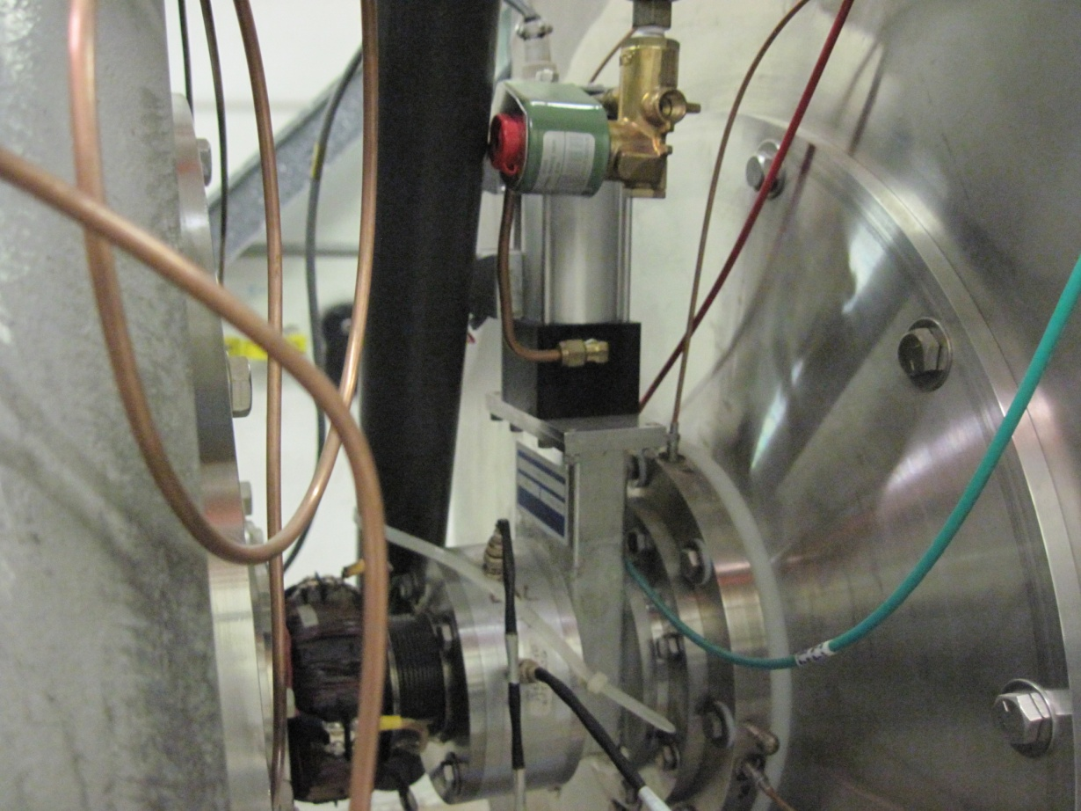
Linac Low Energy
This is a example of on of the four gate valves that will be replaced during a long shutdown or a large failure.

Slide 6
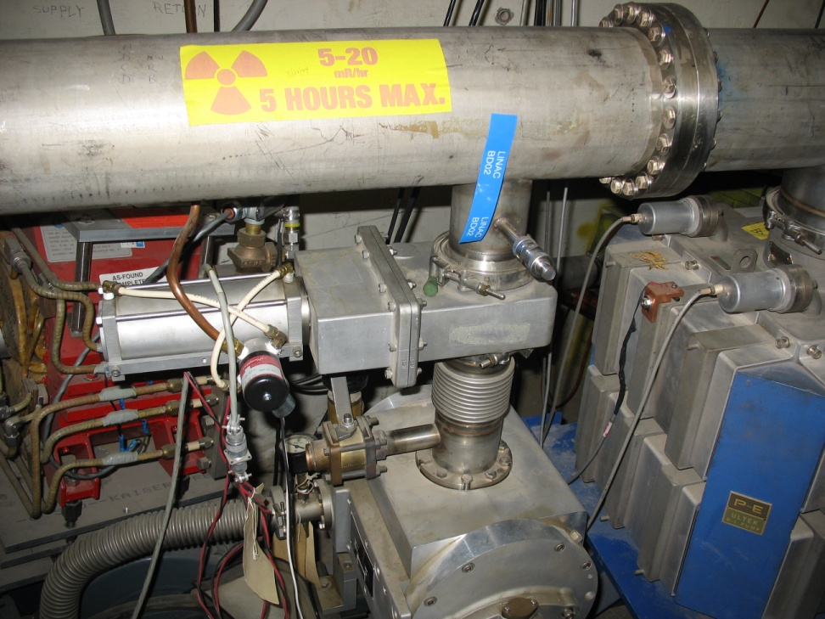
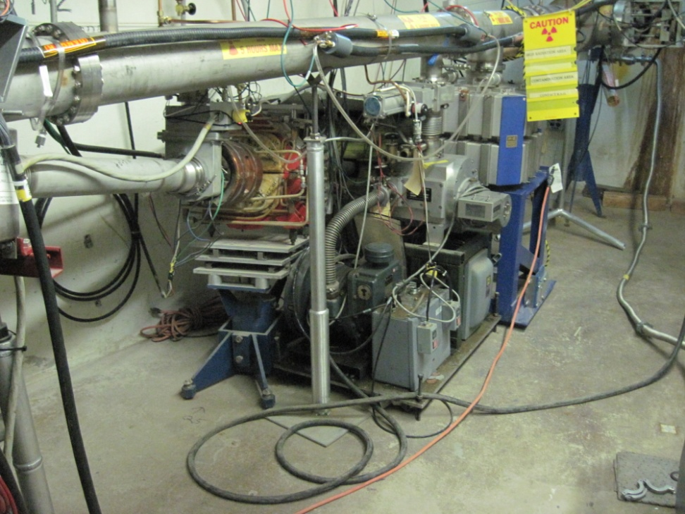
Linac
400 MeV Area
Four of these each or 48K

Slide 7
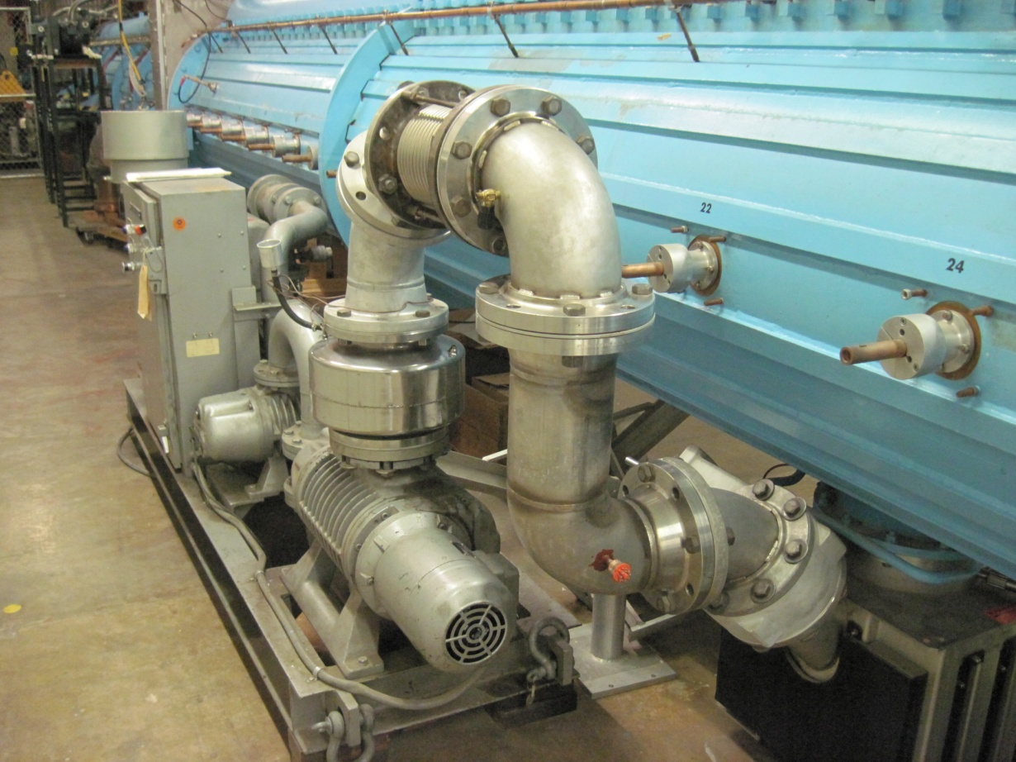
Linac Low Energy
Existing high capacity Roots Blower station on tanks one and two in the Linac tunnel. Used to pump out the low energy Linac ~50K

Slide 8
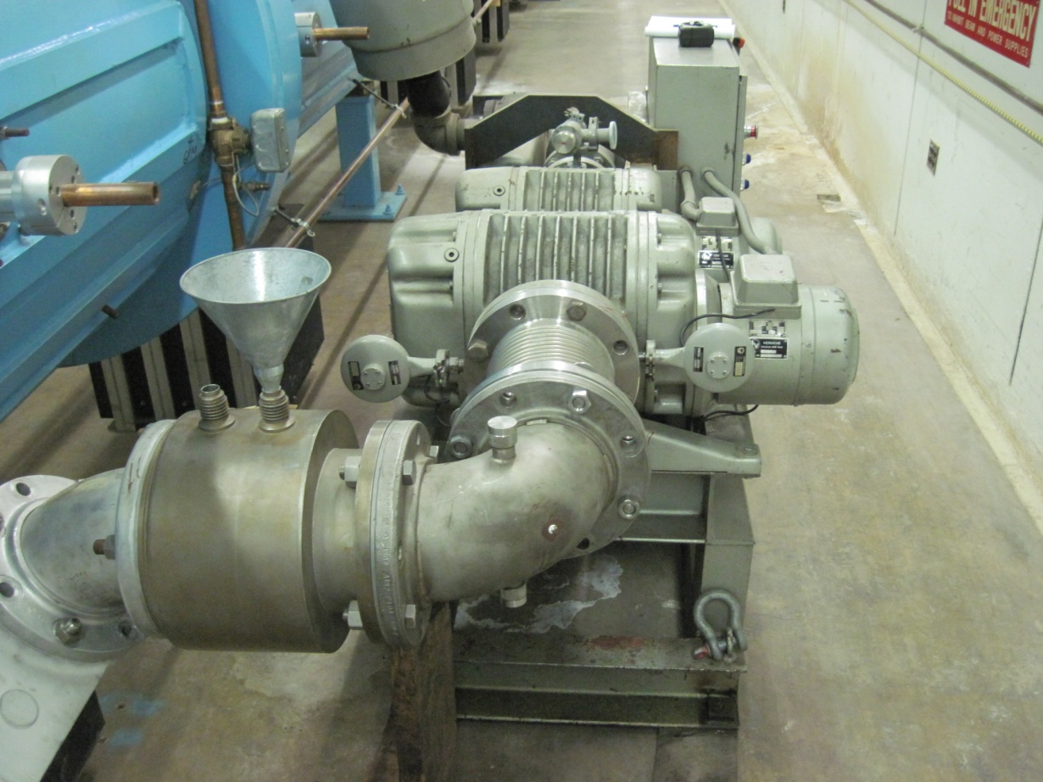
Linac Low Energy
Existing high capacity Roots Blower station on tanks three and four in the Linac tunnel. Used to pump out the low energy Linac ~40K
This is a floater station

Slide 9
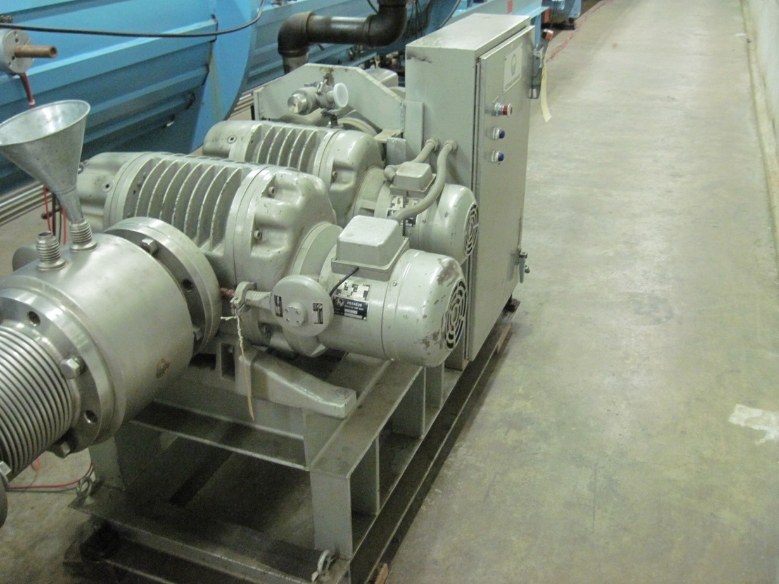
Linac Low Energy
Existing high capacity Roots Blower station on tank five in the Linac tunnel. Used to pump out the low energy Linac ~40K
This is a floater station

Slide 10
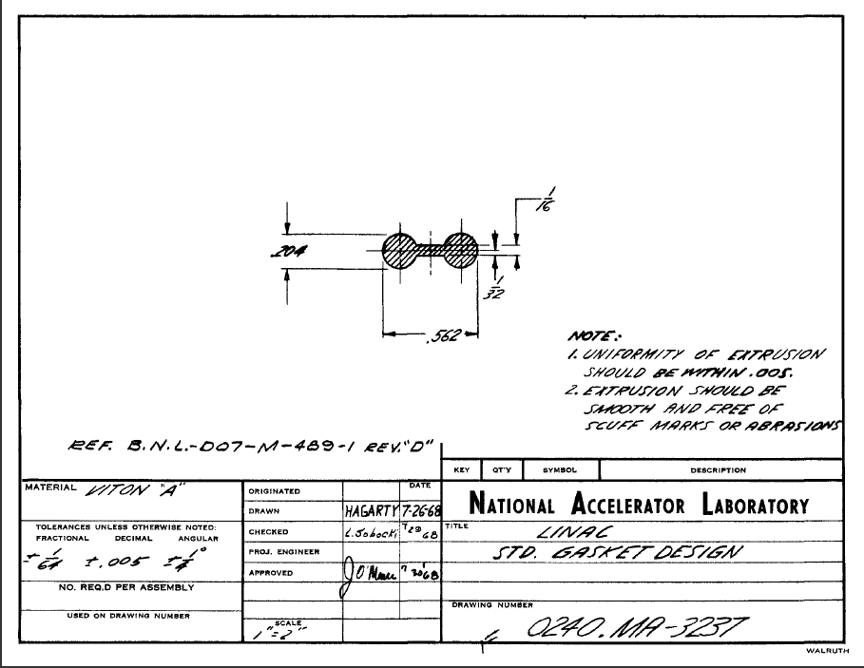
Linac
The o-rings used in the Linac low energy tanks are custom. We do have some minor amount of spares. It is assumed that these are beyond there shelf life. A manufacturer should be investigated and these o-ring made. I have no cost estimate. They would be a custom extrusion

Slide 11
Linac High Energy
The Linac High Energy does not need extensive work
  Spare vacuum equipment should be understood i.e valves, ion pumps, solenoids, etc

Slide 12
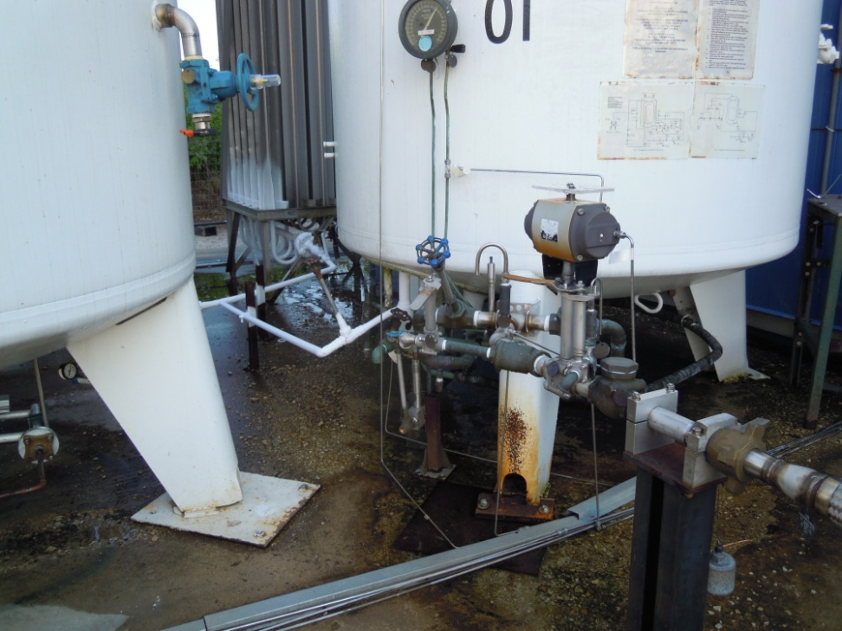
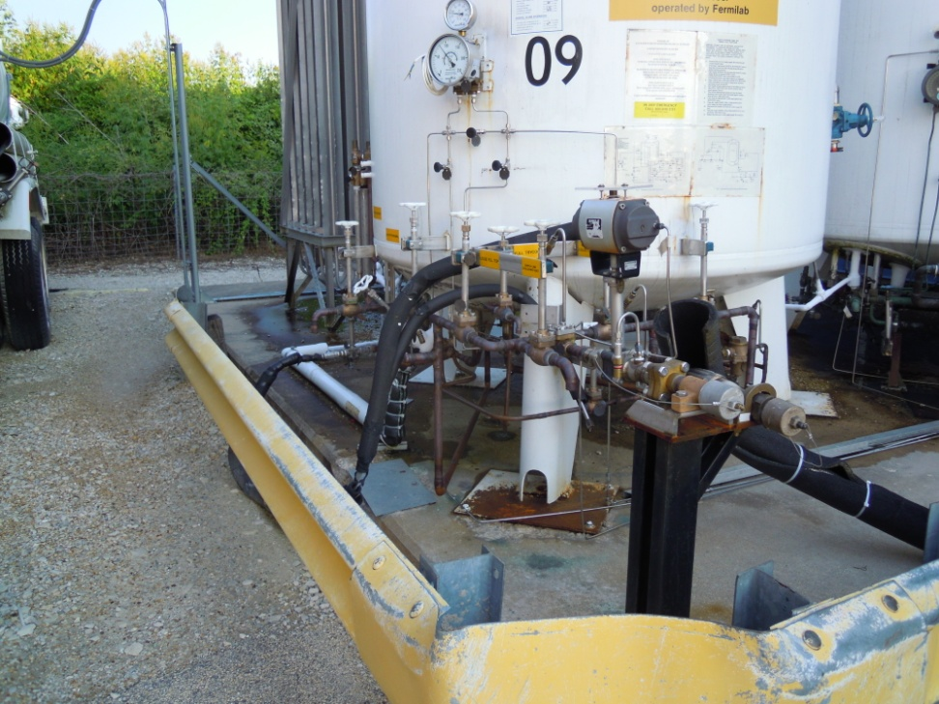
Liquid Nitrogen Dewars
Dewar Before Repair
Dewar After Repair

Slide 13
Booster
MSD funds used to mitigate operational liability
  Purchased two Roots blower stations.
  Purchased some replacement vacuum valves at these stations.

Slide 14
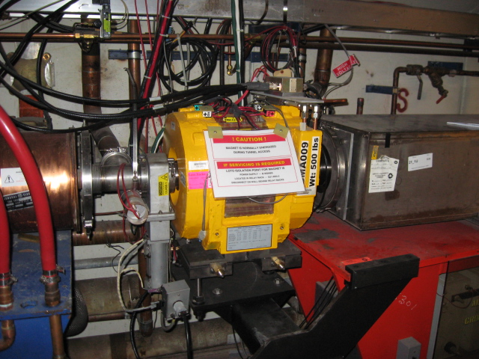
Booster
Vacuum Valves in the ring are mostly the non-locking type when closed. They all will open upon loss of gas pressure. There are approximately 8 of these, 3K each ~ 24K. This does not include flange changes in the tunnel, seals, welding, etc

Slide 15
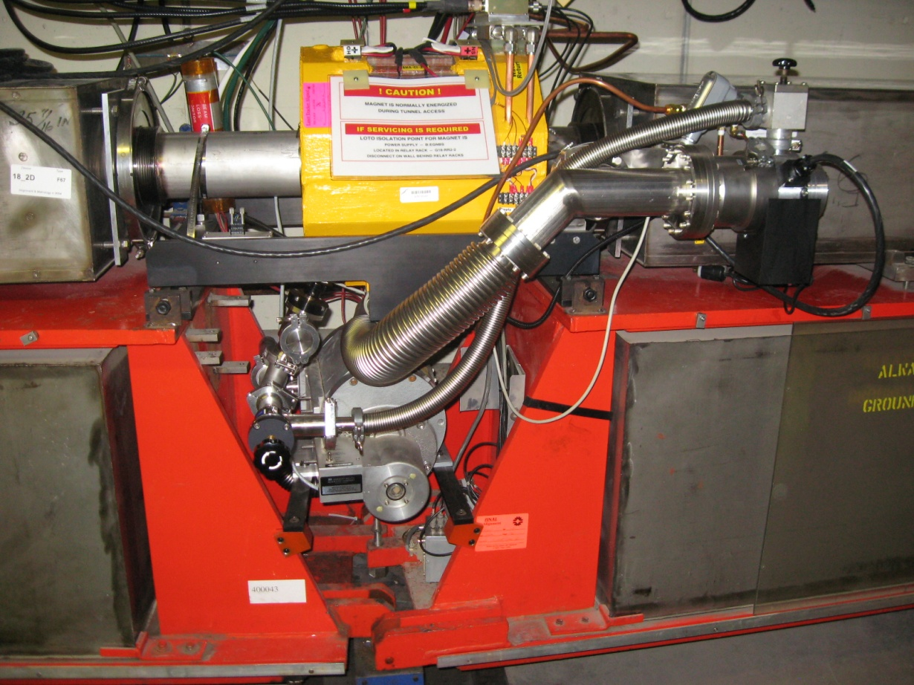
Booster
The Mechanical pumps in the tunnel are obselete. MSD funds in the past two years have replaced 4 turbo pumps out of the 24. These are ~8K each or 160K

Slide 16
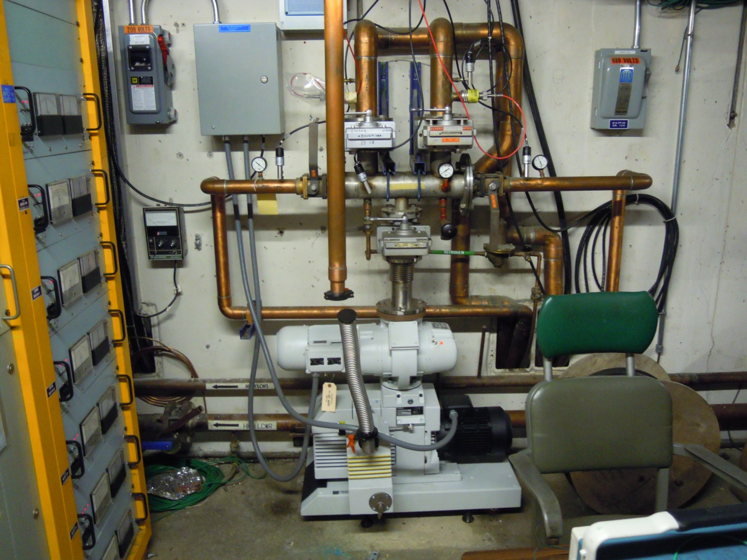
Booster
The Roots Blower stations in the fan rooms are obsolete. Two have been replaced by MSD funds. One is dead and the last is a cobbled spare. Two will need to be purchased ~25K

Slide 17
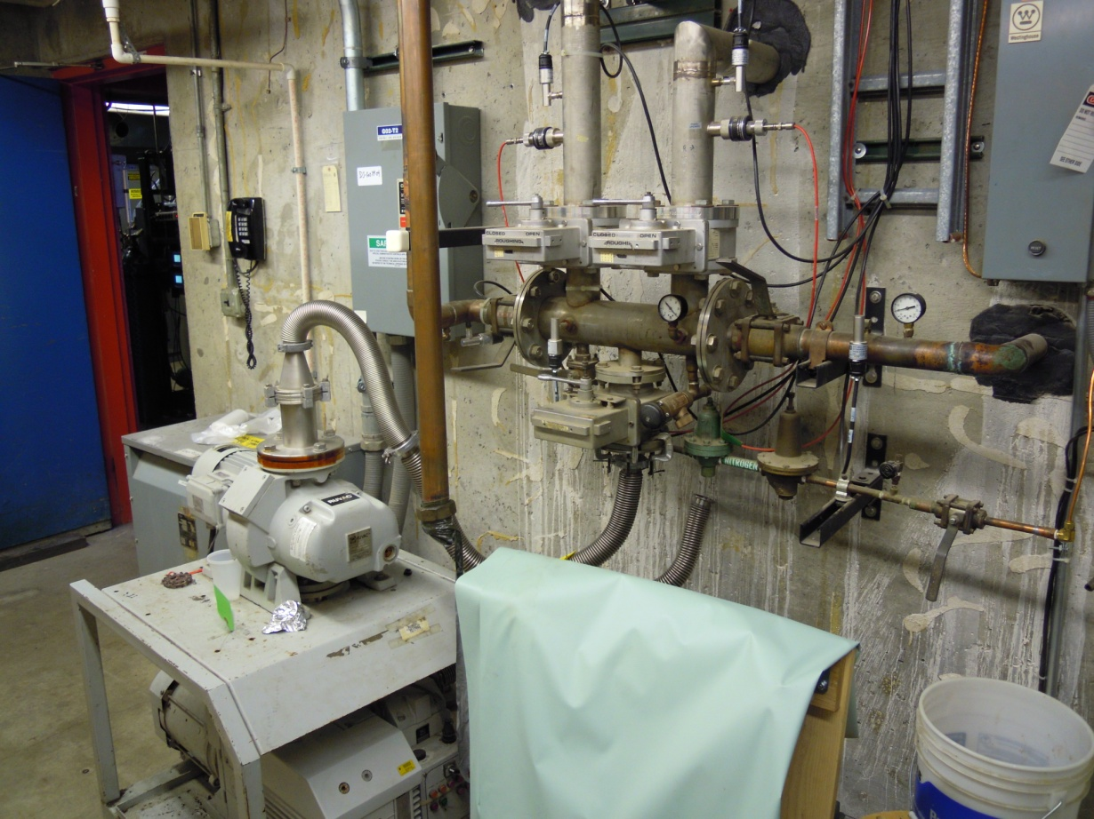
Booster
Example of cobbled together Roots blower station ~ 13K

Slide 18
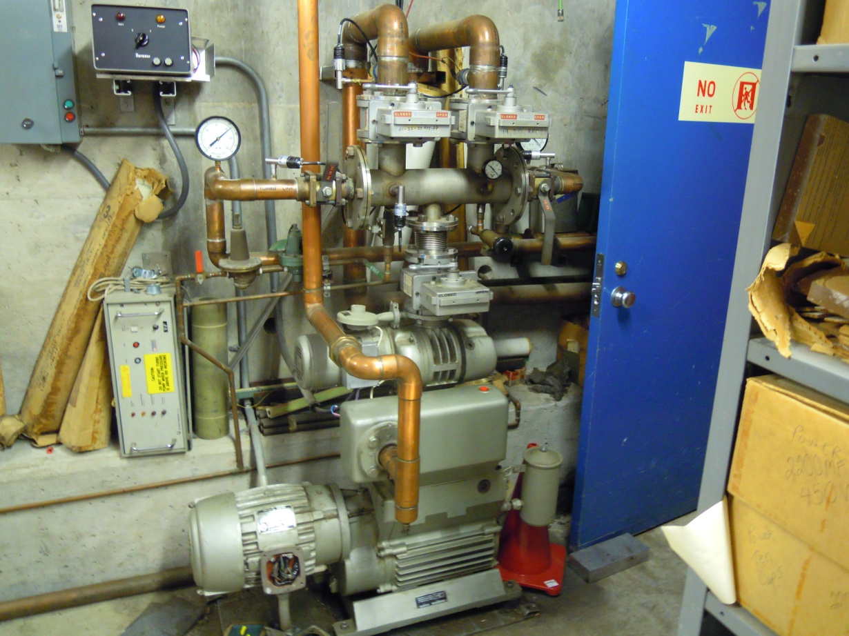
Booster
This is the last 40 year old station in Booster ~13 K to replace

Slide 19
Booster
In many cases over the years vacuum leaks were patched over with glyptol, and vacuum epoxy. There is currently a three page list of these. They should all be fixed correctly before the tunnel gets too hot. I cannot estimate the cost of this.

Slide 20
Thank you for your attention

