Slide 1
PIP and the Booster Notch Bob Zwaska October 12, 2011 PIP Meeting

Slide 2
Introduction
Making the Booster notch causes losses
With improvements in cycle efficiency, now a significant fraction of Booster losses
Doubling the throughput requires ~ halving the losses
Notching losses need to be reduced or eliminated\
Can’t be done by tuning
This is a significant piece of the path towards meeting the PIP goals
3-stage process to address notch losses:
Notcher relocation: partially control notch loss
Magnetic cogging: make notch at start of cycle
Linac notching: move notch out of the Booster

Slide 3
The Notch
84 RF buckets
around circumference
Extraction kicker has risetime of ~ 40 ns
Negligible space between buckets with bunch rotation
Beam lost at 8 GeV during extraction
Instead, beam is removed at 400 MeV
Reduces energy lost 20x
Notcher is an extra extraction kicker magnet with short PFL at Long 5
An additional Nocker cleans up the notch
Notch
Booster

Slide 4
Cogging
Main Injector
Circulating Beam
Extraction on notch
Notch must be coincident with kicker pulse
Booster must be aligned with MI beam
However:
Accelerators are only synchronized with cogging
Cogging aligns the azimuthal position of the notch with beam in the MI
Requires the notch to be made later in the cycle (~ 5 ms)
Booster
Notch
84 RF
buckets
Notes:
Do not discuss septum

Slide 5
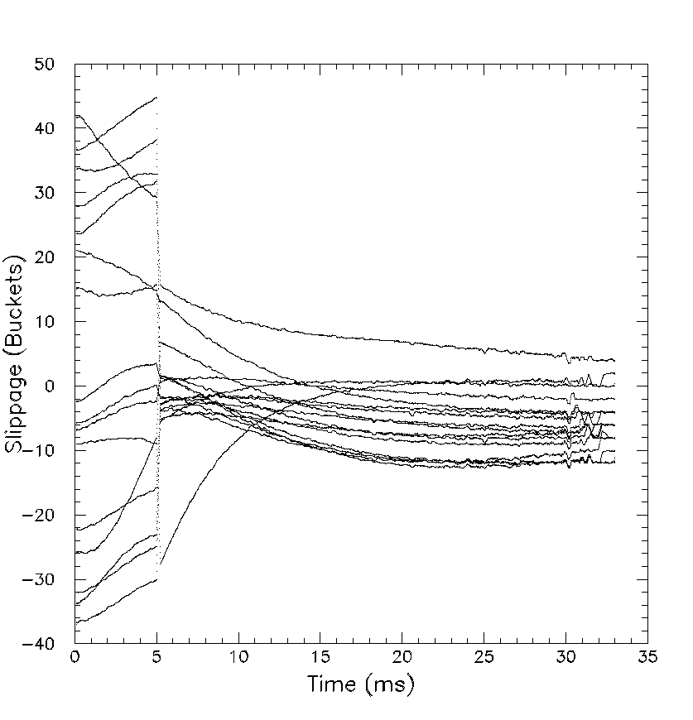
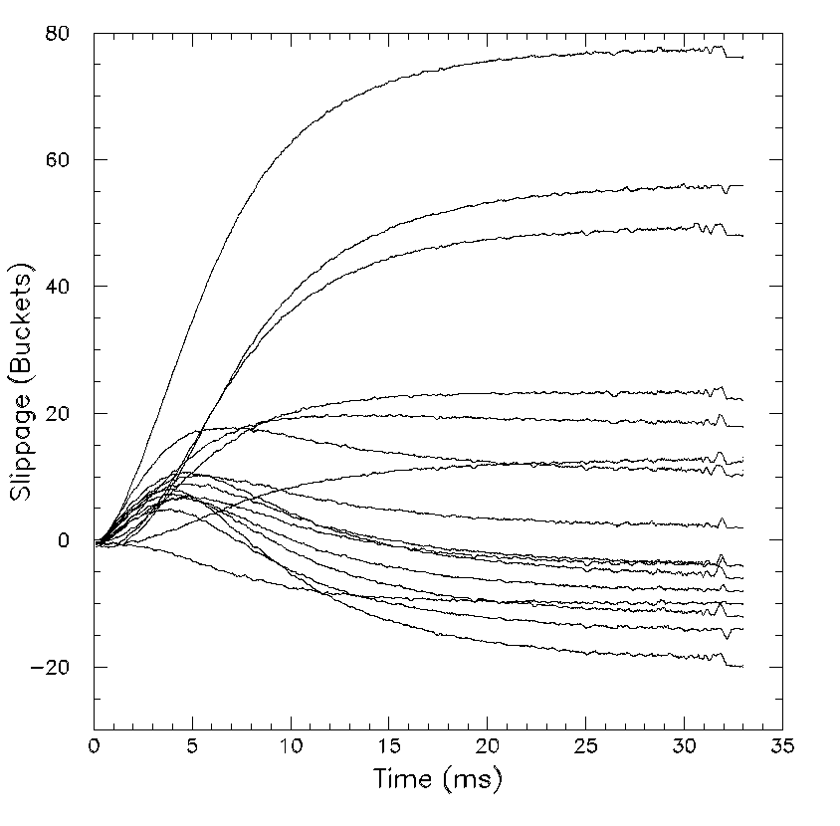
Predictive Notching
Delay creation of the notch 5 ms for cogging
Use information from that initial period
Make notch anticipating further slippage
Reduces bucket range by a factor of 5
Feedback takes care of the rest
w/o correction and w/ correction
~ 90 buckets
Notch
~ 20 buckets
Sample

Slide 6
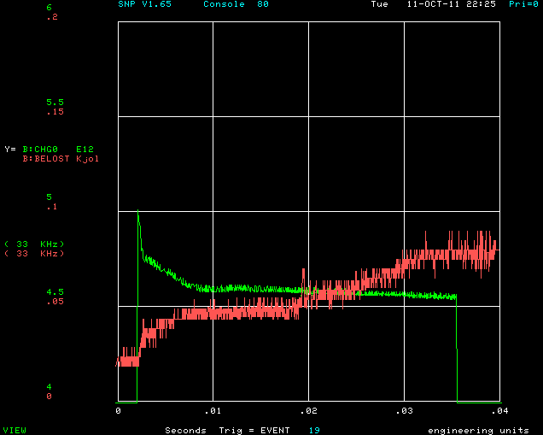
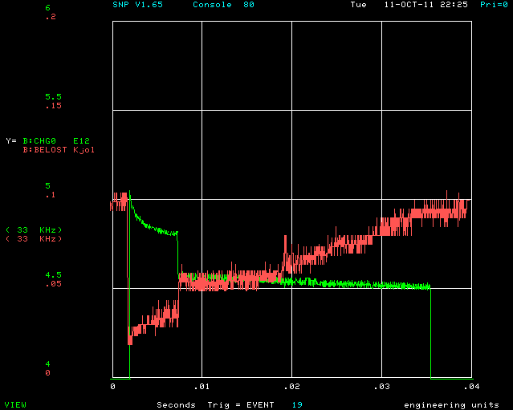
Losses
About 3 % of the beam is notched out
2.x buckets ~ 0.2e12
~ 20 J / notch -> @ 15 Hz 300 W
About 30 % of the total power lost in the Booster

Slide 7
1st Step: Notcher Relocation
In present location, the notcher fires the beam into a gradient magnet
Mostly inescapable result of Booster lattice
Few gradient magnets are heating up, damage possible
Scheme to relocate notcher to long 13
Presentation by V. Sidorov two weeks ago
Also work by Drohzdin, Lebedev, Tropin – talks in future
Notched beam will be mostly collimated there
However, the loss will still be in the Booster, and not totally contained
This will protect our magnets and be important in future schemes as well

Slide 8
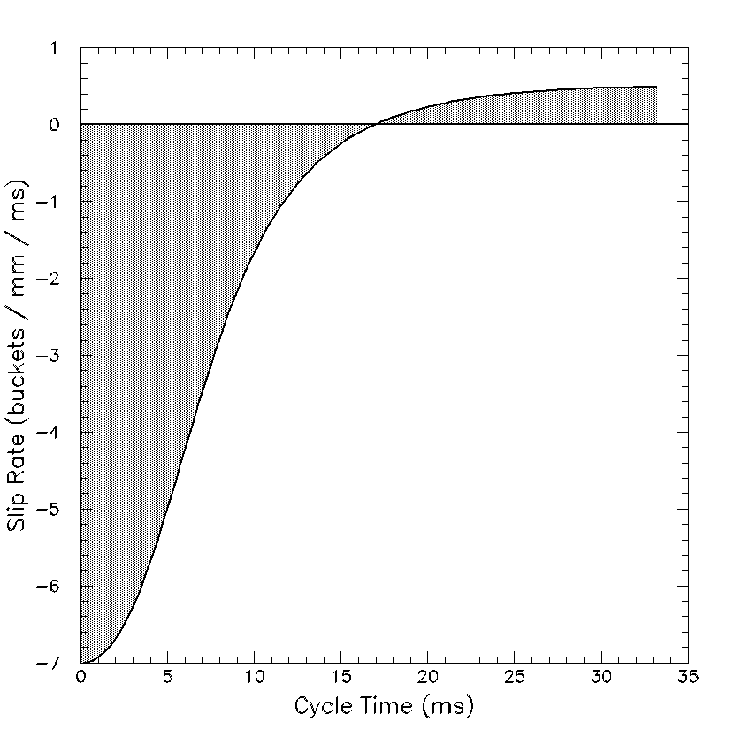
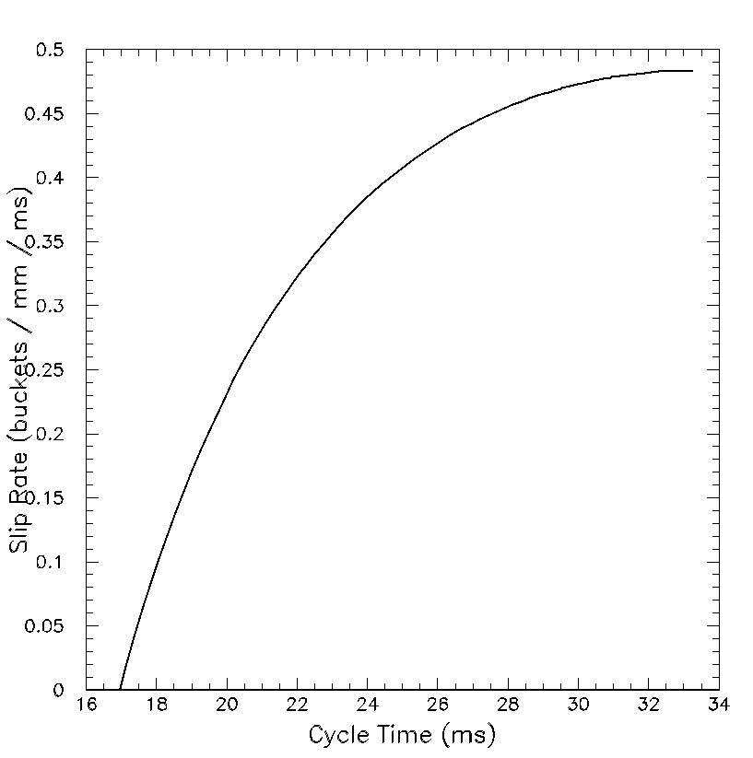
RF Cogging
ΔC
Present cogging system uses RF to force slippage in the beam
Induced slippage scales with radial offset
Rates of ~ 1 kHz/mm
Not enough to cog unless we make the notch 5 ms into the cycle
Earlier notches, or linac notches are not compatible with the present cogging system
Δr
Calculation

Slide 9
2nd Step: Magnetic Cogging
New Booster correctors allow the possibility of cogging magnetically
New correctors are substantially stronger and faster than previous ones
Magnetic cogging works by using feedback to change the horizontal dipoles in all (or a large fraction) of the correctors
The orbit remains constant, in contrast to RF cogging
The momentum of the central orbit changes
Aperture is not an issue, only corrector strength
Much stronger at the start of the cycle
Can deal with the notch in an arbitrary location
May still need RF cogging late in the cycle – a hybrid system
This will immediately allow notching earlier in the cycle, reducing power loss
Also a prerequisite for any linac notching to work
Kiyomi Seiya is working on this – presentation in future

Slide 10
3rd Step: Linac Notching
Making the notch in the Linac
Similar concept as Booster, but the notch has to be made for every turn added to the Booster
Typically would be 10-12 65 ns notches spaced 2.2 us apart
Moves the loss entirely out of the Booster
Requires timing and probably needs to be integrated into the cogging module
Even thought the notch will pre-exist the beam in the Booster, cogging will need to know where it is, and can possibly have a preferred position
Some spreading of the beam will occur before capture in the Booster, but this will be a small amount
Notcher/nocker can still fire to clean up notch, but cause many fewer losses in the Booster

Slide 11
Several Options for Linac Notching
Electrostatic notching
Pulser in the pre-acc (LEBT, maybe MEBT)
Tested by Doug Moehs several years ago
Had issues with long tail
Not clear if it was neutralization, poor matching, or RF loading in the Linac
Deflector Kicker
Probably can’t charge up for multiple notches – would need a deflector for each notch
Magnetic notching
Kicker in the linac (higher-energy)
Can’t charge up the PFN fast enough between notch pulses
Laser notching
Use laser to remove electrons from the beam
Convert H⁻ to H⁰
Separate with magnets and direct H⁰ into a dump
At low energy this might not even be necessary
Dave Johnson has been investigating this
Based on experience with laser profile monitor
Initial thoughts look reasonable, Dave will present in future

Slide 12
An Example System
Linac beam is notched out by pulsed laser in the 400 MeV line
12 successive notches of 65 ns, separated by 2.2 us
Remove > 90% of the beam in the notch
Notched beam directed into dump at floor
Notched pulses are injected on top of eachother into the Booster and capture by the RF
Notcher and nocker fire, cleaning out the notch entirely
Notched beam lost in collimator at Long 13, and it is only 10 % of what we had before
Cogging system takes over the synchronization using initially the corrector magnets, and finally the RF position feedback
This scheme reduces losses in the Booster by ~ 30%

Slide 13
Summary
With the present notching scheme, at 15 Hz we would be putting 300 W of losses into the Booster from the notch alone
This loss would be localized in a few gradient magnets
We have a 3-stage approach to eliminating the losses from the notch
Modify the notcher arrangement in the Booster
Long shutdown
Cog with the corrector magnets
Under study now
Make the notch in the Linac
Still looking at options

Slide 14
PIP and the Booster Notch Bob Zwaska October 12, 2011 PIP Meeting

