Slide 1
Booster Alignment & Magnet Moves
Kiyomi Seiya

Slide 2
Aperture scan
B75 : Aperture scan program with new corrector
Kent Triplet, Alex Waller
BPM data from B40 to B:HPXXX, B:VPXXX
Sharon Lackey
Data taking and offline analysis
Dean Still, Kiyomi Seiya
Analysis of Alignment data
Data in August, 2009
B. Oshinow
Analysis
Jim Lackey, Kiyomi Seiya
Lattice calculation
MAD input
Jim Lackey, Kiyomi Seiya
B104 Booster model –MAD with alignment error
Bill Marsh

Slide 3
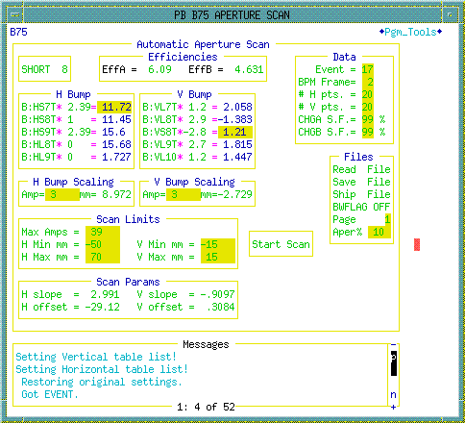
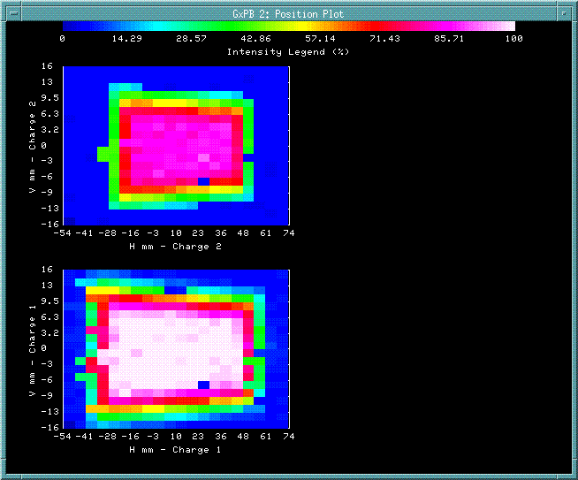
Aperture scan @ injection : B75
with new correctors
B:CHGB(@ext.)/B:TCHGA(before Booster)
5BUMP
3BUMP
Scale factor
corrector vs BPM
B:CHGA(@inj.)/B:TCHGA(before Booster)

Slide 4
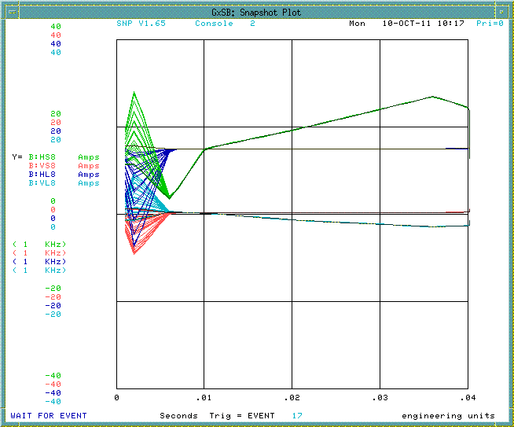
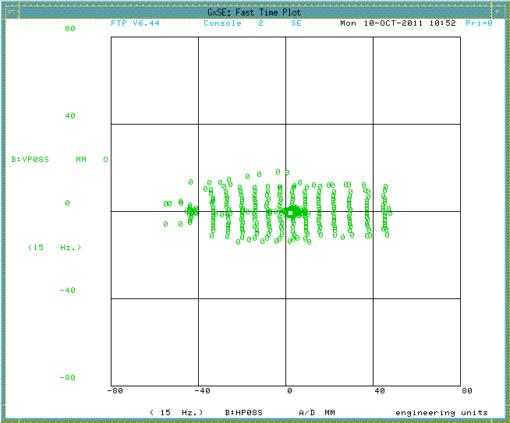
Re-calibration corrector current - BPM
Corrector current
H & V BPM data from B40 @ 2.33msec (8turns ave.)
Corrector current and BPM data were taken by ACL script.
Calculated scale factor.

Slide 5
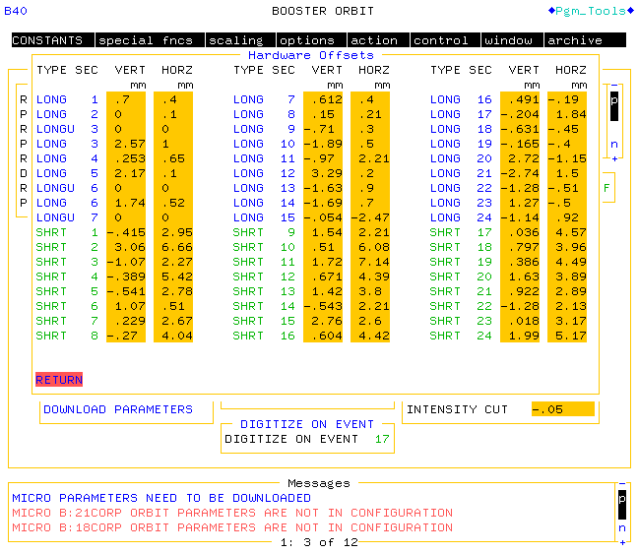
B:40 position offset from 5 years ago

Slide 6
Offline analysis: B75 + BPM
before correction
after
Scale factor change
after
BPM offset
correction

Slide 7
Aperture @ L14 – L23
Long-14
Long-15
Long-16
Long-17
Long-18
Long-20
Long-21
Long-22
Long-23

Slide 8
Horizontal Aperture @ L14 – L23
total
upper
center
lower

Slide 9
Vertical Aperture @ L14 – L23
total
upper
center
lower

Slide 10
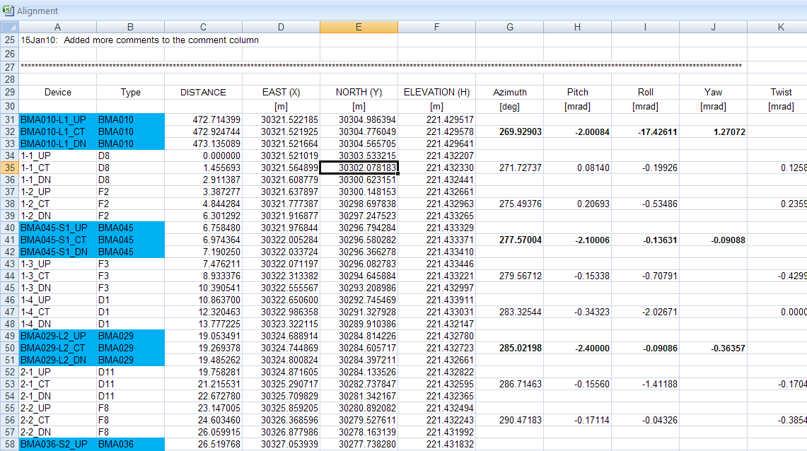
Analysis of Alignment data
Data in August, 2009 (O’Sheg )
F&D magnet * 48
RF * 19
New corrector *48
As found lattice(x,y,z) and no reference position for each component.

Slide 11
Ideal positions from design report
Corrector
+
BPM
(X,Y,Z) @center
D
RF
F
z
y
A
C
B
D
x
r_F=75.508566
r_D=75.434828
r_short=75.522538
r_long=75.347261

Slide 12
Radial positions for F & D magnets
r_F(design)=75.508566m+0.053inch
r_D(design)=75.434828m-0.040inch
need reference position for each component

Slide 13
Vertical error on F & D magnets
1[mm]

Slide 14
Vertical error on BPM
aperture
BPM Alignment error-long
BPM Alignment error-short
Center of the aperture

Slide 15
Lattice calculation with MAD
sa | drift |  | 0.11
CPS23 |  | corrector
sb | drift |  | 0.19
fmagu24 |  | FMAGU24 | 2.889612
miniS | drift |  | 0.5
dmagu24 |  | DMAGU24 | 2.889612
L24a | drift |  | 0.21
RF | drift |  | 2.35
L24b | drift |  | 0.12
RF | drift |  | 2.35
L24c | drift |  | 0.25
HP24L | drift |  | 0.095
VP24L | drift |  | 0.095
L24d | drift |  | 0.045
CPL24 |  | corrector
L24e | drift |  | 0.185
dmagd24 |  | DMAGD24 | 2.889612
miniS | drift |  | 0.5
fmagd24 |  | FMAGD24 | 2.889612
sc | drift |  | 0.6
Modified physical cell length = 19.7605 [m] for all 24 periods from original MAD.
Removed non existing components and replaced with drift with MAD.
Changed scale factor for the quad and skew quad on the new correctors from kquad= 0.02178 to 0.0025 and from ksquad = 0.00889 to 0.004.
The input file is in CVS lattice depository

Slide 16
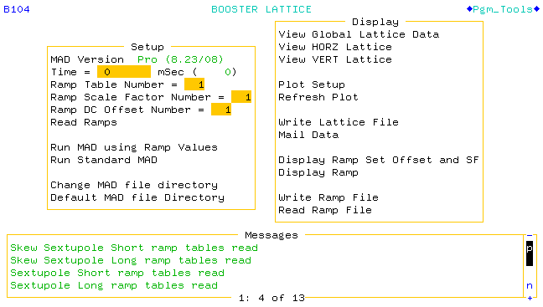
B104 BOOSTER lattice with alignment error
Review each magnet current on the input file.
ORBMP, DogLegs, corrector…
Add alignment error to the input file.
Add alignment error table to B104.

Slide 17
Future plans
Finish aperture scan. (50% left)
Make all tools to be available for operation.
B75 Aperture scan (analysis with corrections.)
Make references on alignment data sheet for easier data gathering.
B104 MAD (modify the input file and add alignment table)
Ask for one week study time and move magnet at one location before shutdown.
Based on the results from alignment and aperture scan
Predict move, Move, Verify the move.

