Slide 1
Solid State Driver Upgrade Update
1kW Solid State Amplifiers
  32 have been tested and calibrated.
  50 have been built so far.
    Small heat sinks for the remainder have arrived.
    Large heat sinks should be in later this week.
  Takes about 1 day/amplifier to test and calibrate
    All 84 amplifiers should be checked out by the end of April.

Slide 2
Solid State Driver Upgrade Update
Relay Racks
  5 have been built so far
    The PO for the remainder of what’s needed should have been ordered.
  Grid Bias Supplies
    All 20 have been built and tested.
  Issues with Station 1 installation
    Found an unsoldered connector on the Fanout Cable going to the SSD Relay Rack.
    Still issues with phasing the station in, still unclear why there’s such a big difference between 1 and 5 station-station phase compared to station 2 and 6 .
    Weeklong shutdown should allow us to correct this.

Slide 3
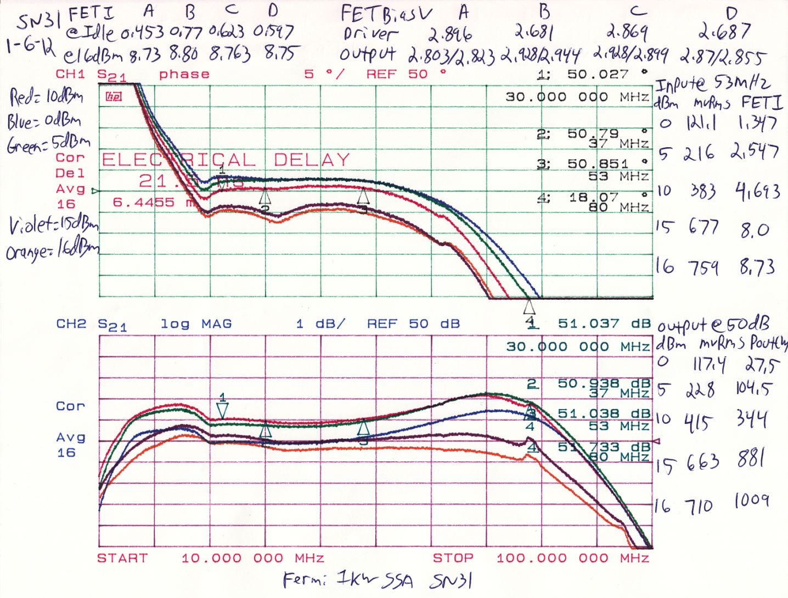
Frequency Response of Typical Amplifier

Slide 4
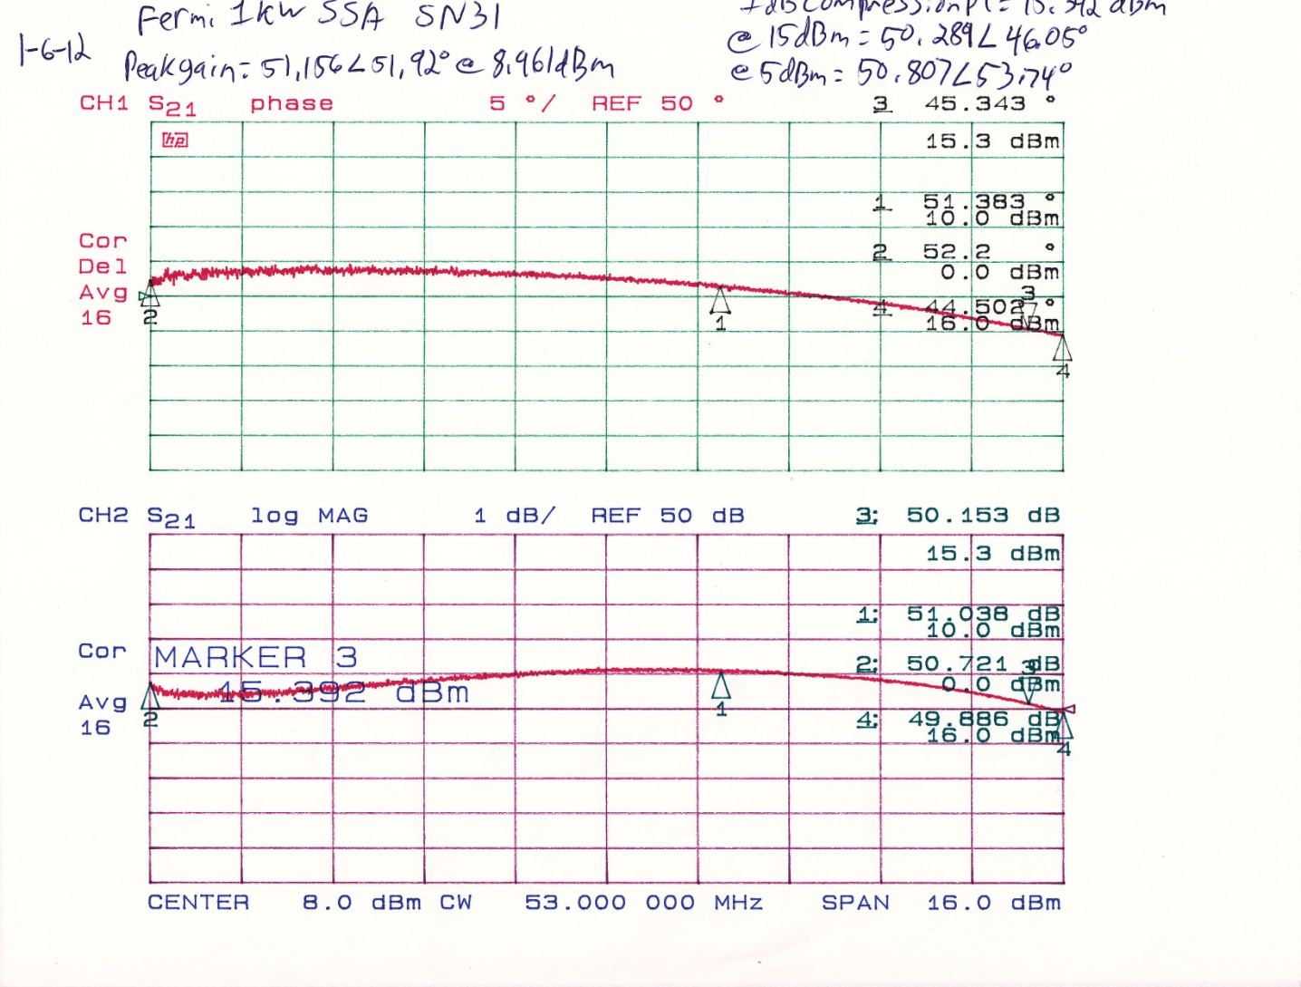
Measurement of 1dB compression point

