Slide 1
Substation L1/ MCC L1 Update
March 21st, 2012

Slide 2
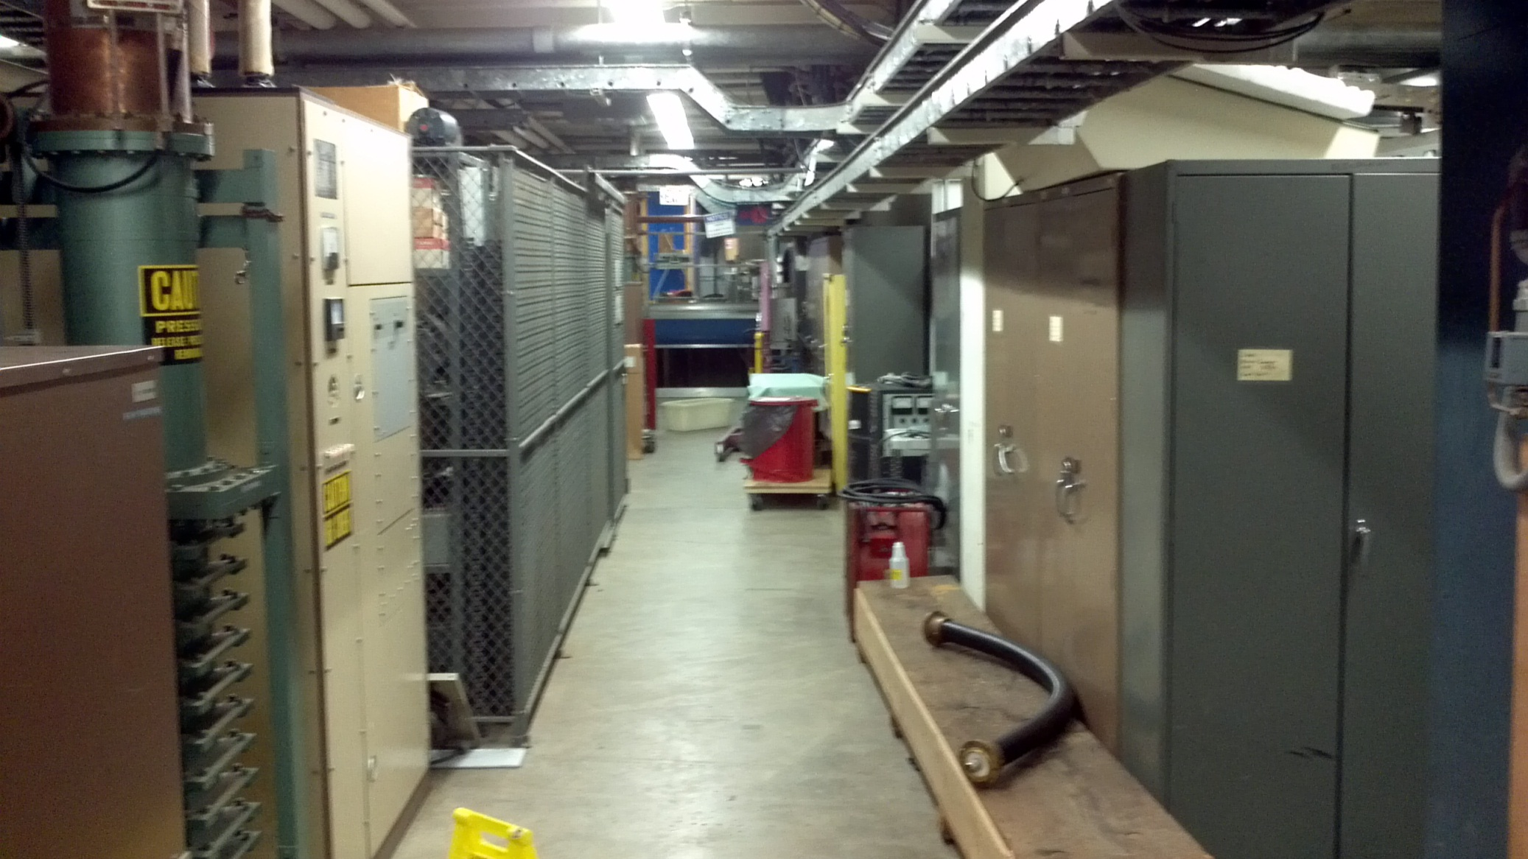
Current Location
Hydraulic Lift
Located in Alcove

Slide 3
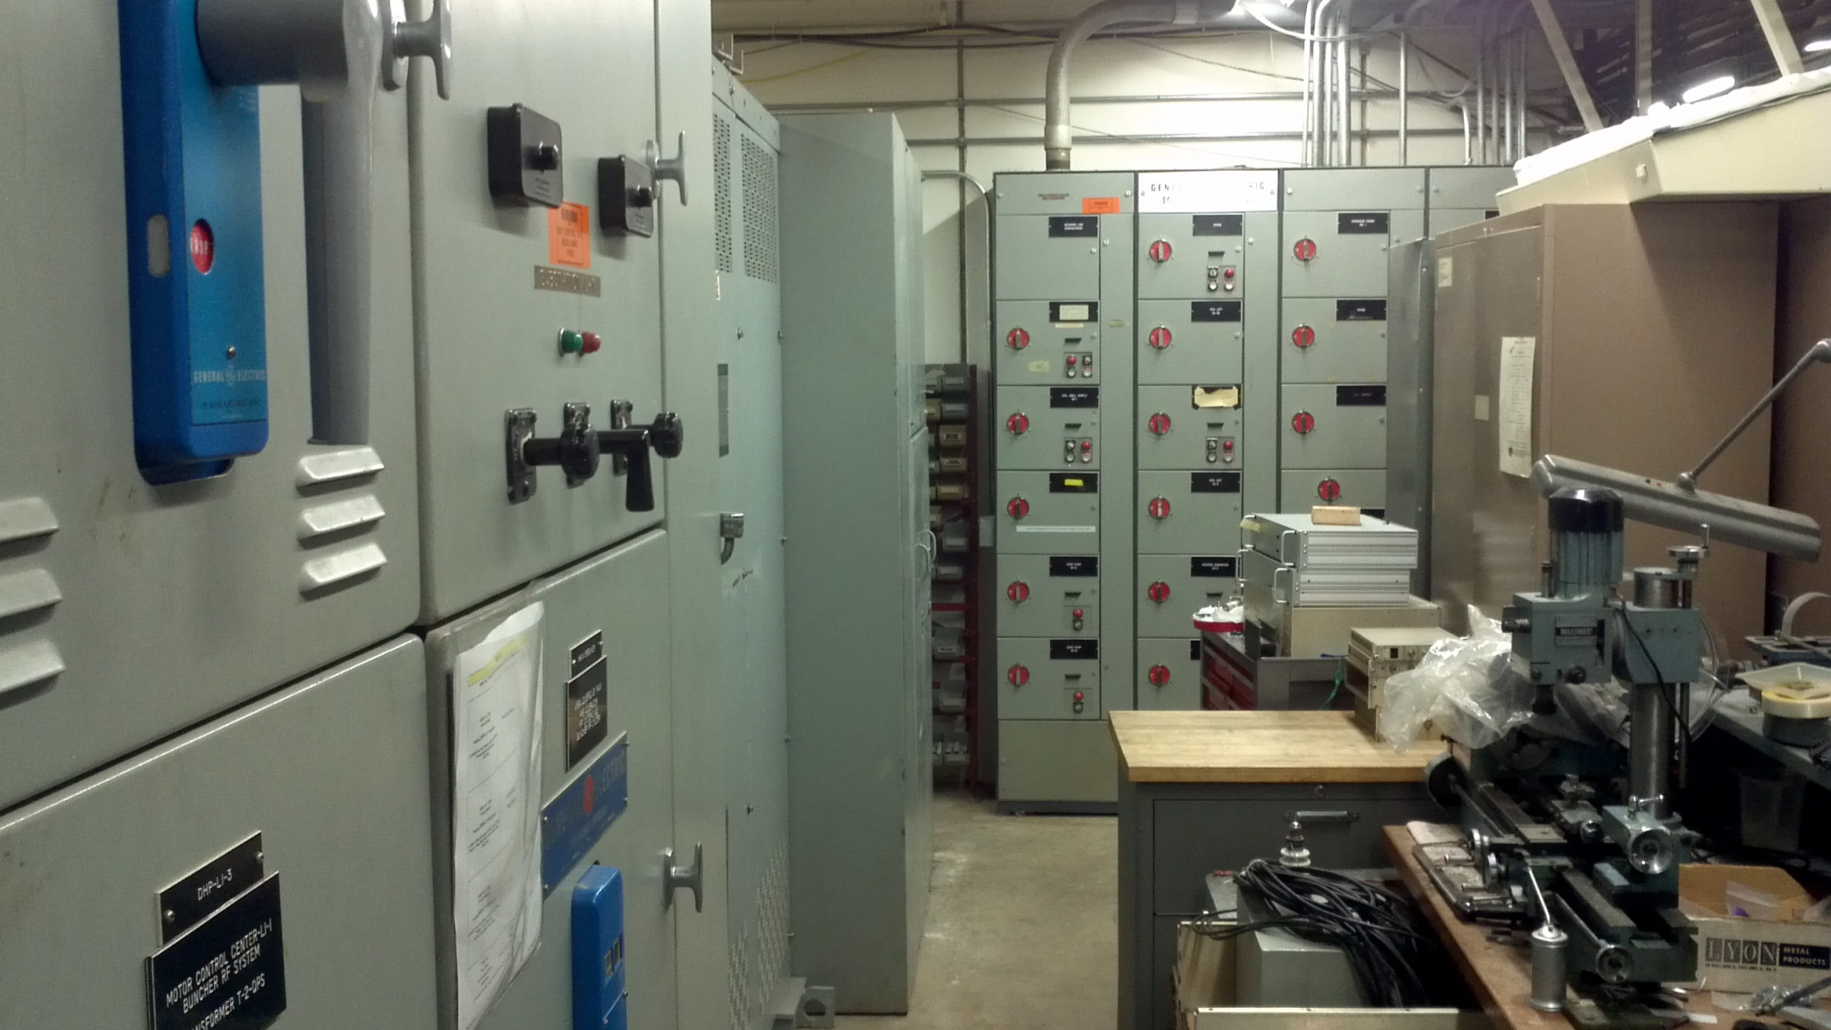
Equipment Layout

Slide 4
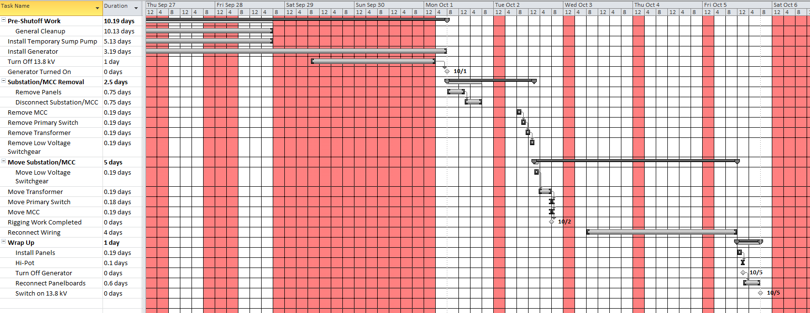
Project Schedule

Slide 5
Project Schedule
General Cleanup 2-3 weeks prior to shutdown of substation
Generator will arrive one week before shutdown (if used)
Temporary electrical power will be setup the weekend prior regardless of whether or not a generator is used
Office Lights
Office Receptacles
Security Camera
Fire Detection Panels
Emergency Lights
Exit Signs
Crane
Hydraulic Lift
Sanitary Lift Station
Overhead Door
What Will What Will Not
be Powered be Powered
Heat
Air Conditioning
All other MCC loads
Welding Receptacles
Hall Receptacles

Slide 6
No Generator Plan
“Siphon” power from panel DHP-L2-2 or DHP-L3-4
Cable will be run in cable trays
4 conductor 350 mcm cable is heavy (~7 lbs./ft.) and will need an open area to lay
Use cable trays as much as possible for load wiring
If on the floor, cable bridges will be used in walkways to prevent tripping
Setup temporary panel board(s)
Run cable to individual loads (DHP panels, MCC loads)
DHP panels will be locked out and tagged out
Group lockbox
MCC loads will have configuration control locks
We will check current prior to using any MCC loads to ensure they will not trip off during operation
Schedule will be the same as the generator, except that we will have power all day

Slide 7
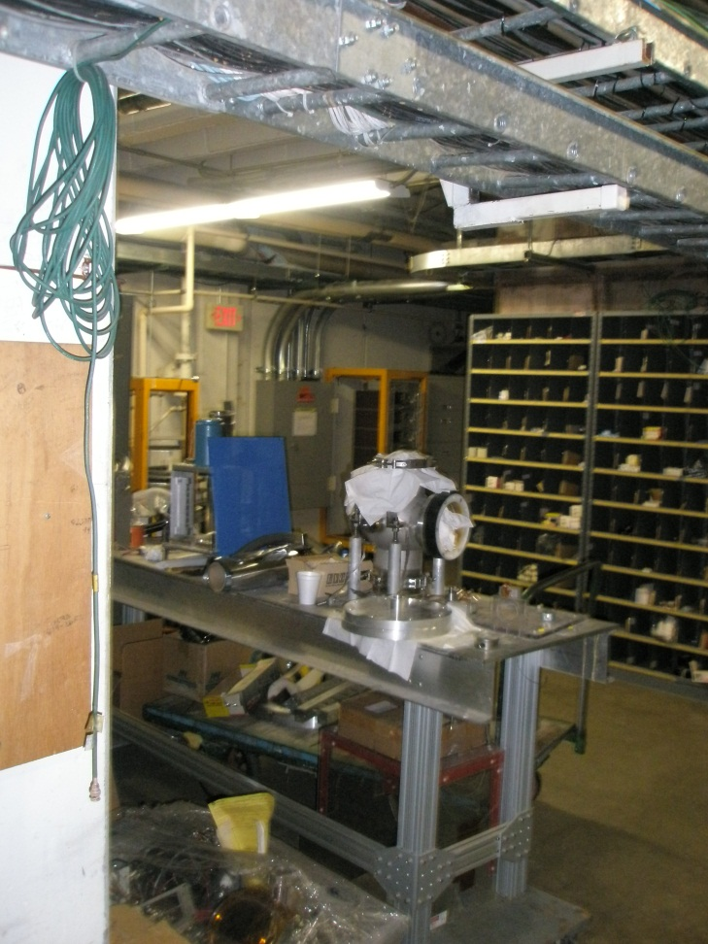
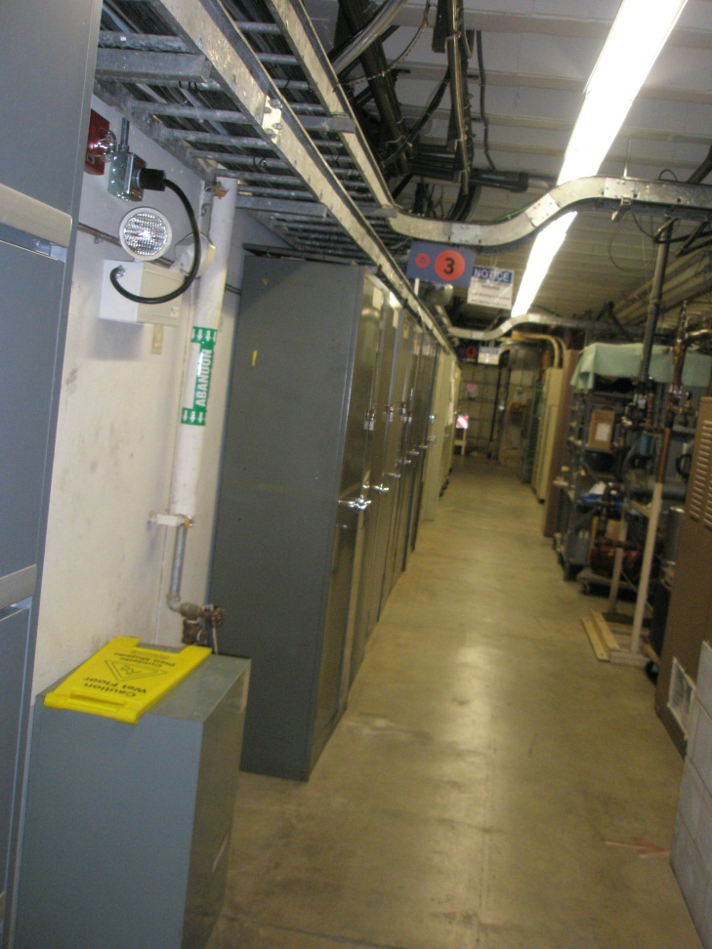
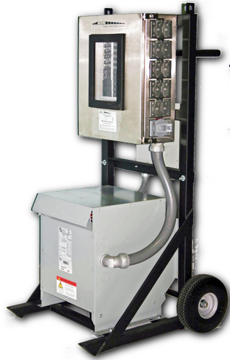
No Generator Plan Pictures

Slide 8
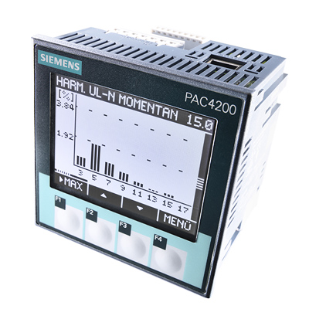
Substation L1
Contract awarded to Federal Pacific February 10th, 2012
Waiting for approval drawings
Cost: $164,853
Due By: June 20, 2012
Profibus Network
Remote monitoring
Remote operation
Replaceable trip units
Allows for proper coordination of breakers
Cost in the hundreds of dollars
Advanced Local Monitoring
Current meter on primary switch
Panel meter capable of power factor measurements, harmonics, etc.
Features of New Substation
Source: www.siemens.com

Slide 9
Scheduling
One week install time
May need to be 10-12 hour days to accomplish this
One day Riggers
Crew of 6-8
One week of electricians
Crew of 2

Slide 10
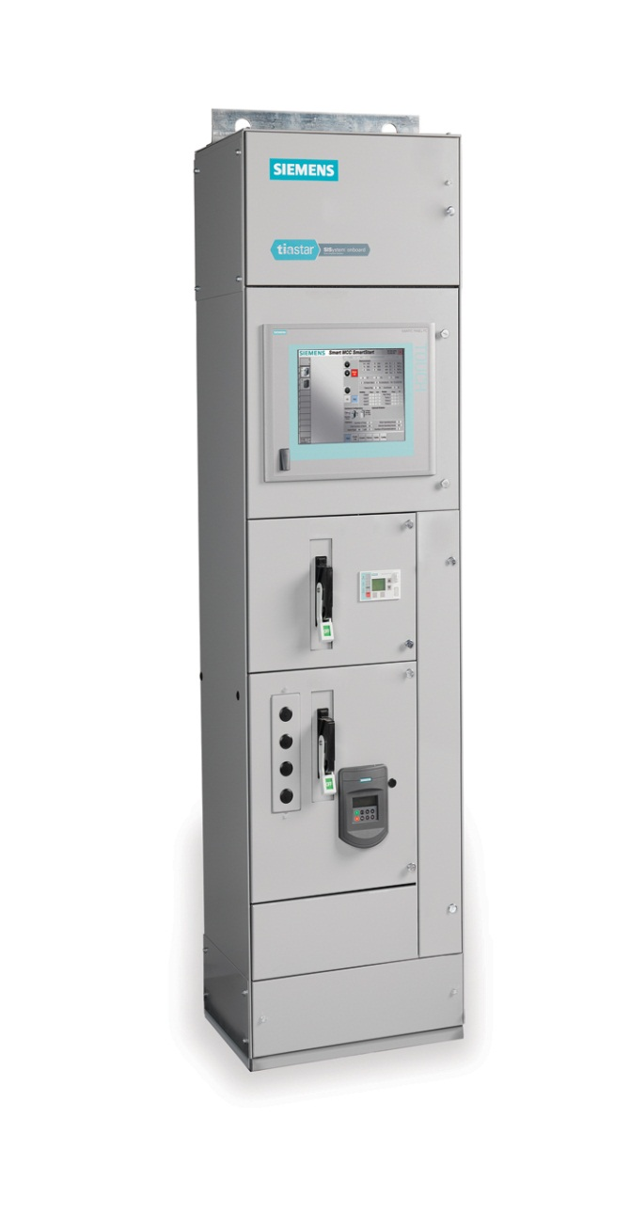
MCC L1
Req. placed
Waiting for bids
Cost: ~ $50,000
Due By: August 1st, 2012
Siemens Tiastar Smart Start
Profibus Network
Remote/Local Monitoring
FLA, under/over current, status messages, input/output data, on, off
HMI/PLC used to control loads
Used to monitor and control 4 WL breakers used in Substation L1
This will require in house programming
Features of New MCC
Source: Siemens

Slide 11
Scheduling
Will be installed when Substation L1 is installed
One day install time
Budgeted two to be safe
Several loads will need to be powered when power is turned off
Crane, Overhead Door, Lift Station, Sump Pumps, Hydraulic Lift
Sump pumps will be handled by temporary sump pumps

Slide 12
Installation Costs
1 Crew of Riggers (6-8 men)
1 Day: $12k
1 Week of Electricians
$100/manhour x 2 electricians x 40 hours = $8,000
$100/manhour x 2 electricians x 40 hours + $150/manhour x 2 electricians x 20 hours= $14,000
Generator
$5,400 For a Month Rental
$2,000/day Diesel
$1,400 For a Panelboard (x2-?)
Several Hundred Feet of Cable to Individual Loads
House Power
$1,400 For a Panelboard (x2-?)
250 ft. of 4 Conductor 350 MCM Cable (In Storage, Unsure of length)
Several Hundred Feet of Cable to Individual Loads
 | Cost
Generator | ~ 53k
No Generator | ~ 35k

Slide 13
Commissioning
Visual Inspection
Hi-Pot
Disconnect panel boards from temporary power
Reconnect panel boards
DHP-L1-1 will be turned on first
Fire alarms
Lighting
Etc.
DHP-L1-2
DHP-L1-3

Slide 14
What Will Become of the Removed Equipment?
Transformer will be kept as a spare
Currently have 1 spare for 8 transformers (5 – high rise, 3 – LINAC)
Transformer will be examined to make sure it is in good working order
Will be stored in Booster parking lot
Will be placed on a truck the same day it is removed to avoid excess rigger fees
Breakers
Will be rebuilt and tested
Used as spares
Primary Switch
Will be rebuilt and tested
Used as a spare

Slide 15
Future
Create Site Wide Monitoring Network
Intranet
LINAC
Profibus
Booster
Profibus
Cross Gallery
Profibus
LINAC Profibus Section 1 (This Install)
LINAC Profibus Section 2 (MCC L2) $65k
Booster Profibus West
(Specifications Written)
Booster Profibus East
(Specifications Written)
Substation CG-1
(Specification Written) $200k
PIP Project
????
PIP Project
PIP Project
PIP Project
Note: attempting to move
CG-1 budget to operations
cost

Slide 16
Future
Costs
MCC L2 ~ $65k
CG-1 ~ $200k
Install Times
MCC L2 ~ 2 Days Electricians, 1 Day Riggers
CG-1 ~ 1 Week Electricians, 1 Day Riggers
Affected Entities
MCC L2
Chilled Water to Linac
Heaters
Sump Pump
Air Compressors
CG-1
Main Control Room
Cross Gallery Motor Control
High Bay
MAC Room
Computer Room

