Slide 1
Studies on the 704 MHz Five-Cell Superconducting RF Cavity
Puneet Jain
Presentation at FermiLab
June 5, 2012

Slide 2
Overview
Bead-pull HOM Measurements
Analysis of the Microphonics Data
Thermal Calculations for Fundamental Power Coupler
Analysis of the Electron Cloud Measurement Technique at KEK B-factory

Slide 3
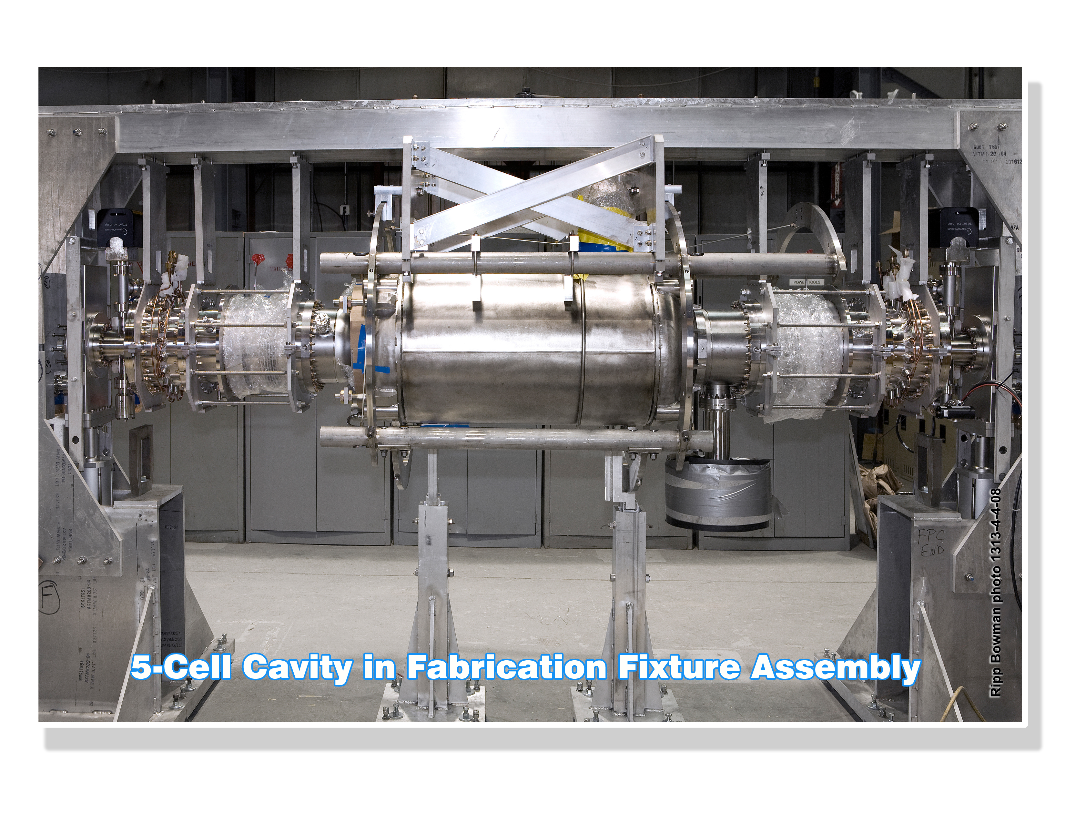
Introduction
BNL is developing SRF technology for high current beams.
Develop a 704 MHz five-cell SRF cavity, highly damped for HOMs and can efficiently accelerate electrons and protons at high β.
A similar cavity, called the BNL1 cavity, which has been tested repeatedly, has a well known performance.
The current cavity, BNL3, builds upon this experience and improves upon it. It will be installed in the ERL for CeC and the planned eRHIC.

Slide 4
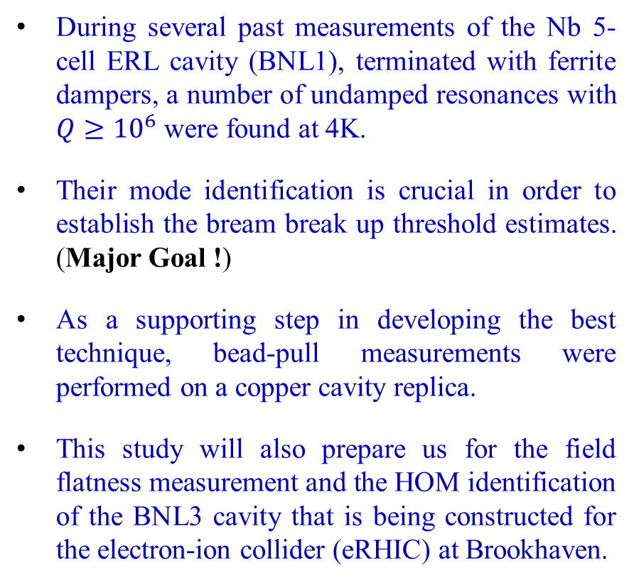
Motivation
During several past measurements of the Nb 5-cell ERL cavity (BNL1), terminated with ferrite dampers, a number of undamped resonances with $Q≥{10}^{6}$ were found at 4K.
Their mode identification is crucial in order to establish the bream break up threshold estimates. (Major Goal !)
As a supporting step in developing the best technique, bead-pull measurements were performed on a copper cavity replica.
This study will also prepare us for the field flatness measurement and the HOM identification of the BNL3 cavity that is being constructed for the electron-ion collider (eRHIC) at Brookhaven.
f [GHz] | Q
1.22008 | 0.920×10⁶
2.14764 | 5.504×10⁶
2.14831 | 1.307×10⁶
2.32984 | 2.292×10⁶
2.34421 | 0.908×10⁶
2.45578 | 1.025×10⁶
2.74324 | 0.620×10⁶
2.90829 | 0.406×10⁶
High-Q modes in the BNL ERL at 4K

Slide 5
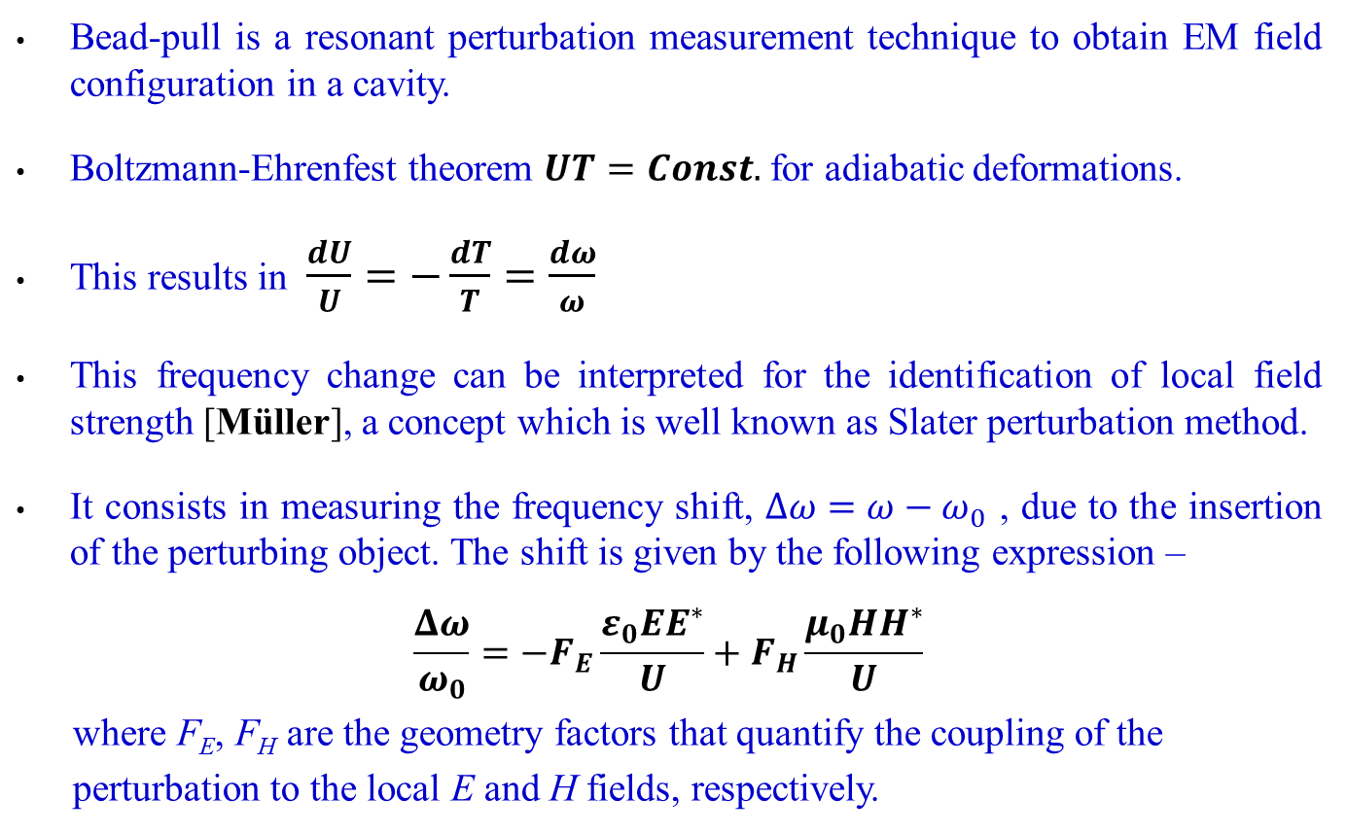
What is Bead-pull ?
Bead-pull is a resonant perturbation measurement technique to obtain EM field configuration in a cavity.
Boltzmann-Ehrenfest theorem $UT=Const.$ for adiabatic deformations.
This results in $\frac{dU}{U}=−\frac{dT}{T}=\frac{dω}{ω}$
This frequency change can be interpreted for the identification of local field strength [Müller], a concept which is well known as Slater perturbation method.
It consists in measuring the frequency shift, $Δω=ω−ω_{0}$ , due to the insertion of the perturbing object. The shift is given by the following expression –
$$\frac{Δω}{ω_{0}}=−F_{E}\frac{ε_{0}EE^{∗}}{U}+F_{H}\frac{μ_{0}HH^{∗}}{U}$$
where F_{E}, F_{H} are the geometry factors that quantify the coupling of the
perturbation to the local E and H fields, respectively.

Slide 6
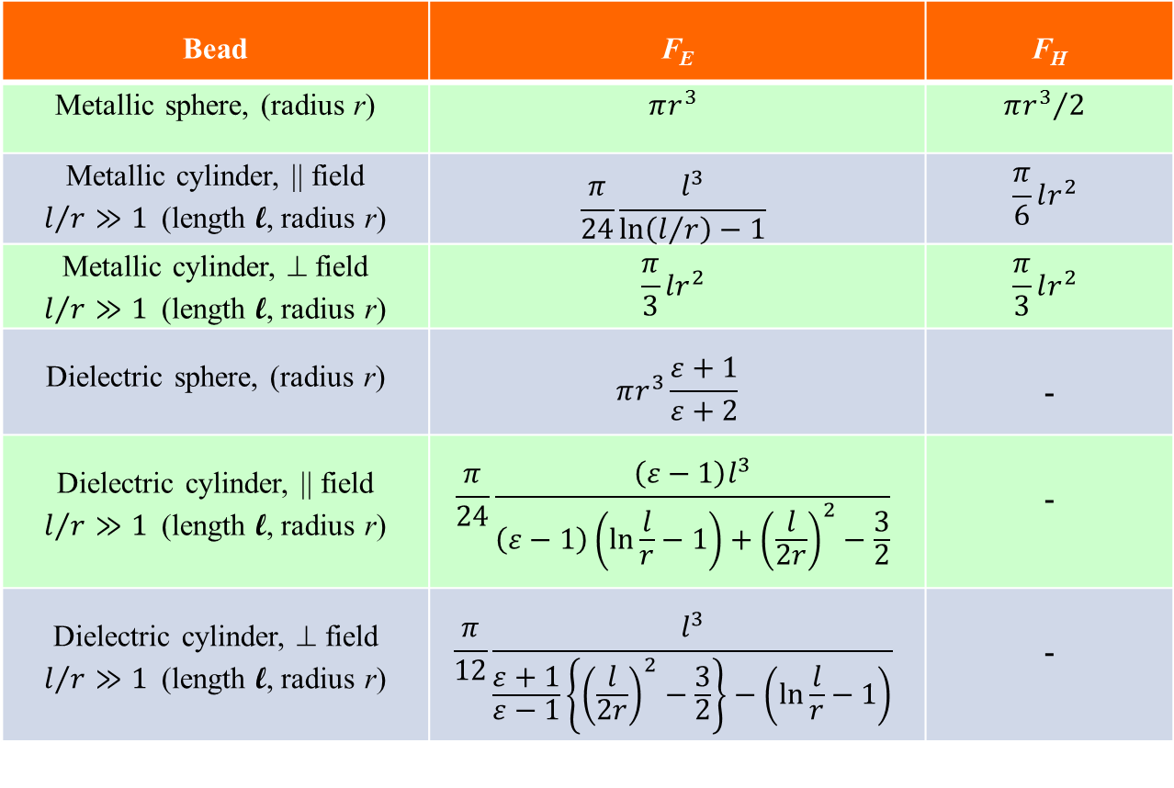
Perturbation Factors
Bead | F_{E} | F_{H}
Metallic sphere, (radius r) | $$πr^{3}$$ | $${πr^{3}}/2$$
Metallic cylinder, || field $l/{r≫1}$(length l, radius r) | $$\frac{π}{24}\frac{l^{3}}{\ln\left(l/r\right)−1}$$ | $$\frac{π}{6}lr^{2}$$
Metallic cylinder, ⊥ field $l/{r≫1}$(length l, radius r) | $$\frac{π}{3}lr^{2}$$ | $$\frac{π}{3}lr^{2}$$
Dielectric sphere, (radius r) | $$πr^{3}\frac{ε+1}{ε+2}$$ | -
Dielectric cylinder, || field $l/{r≫1}$(length l, radius r) | $$\frac{π}{24}\frac{\left(ε−1\right)l^{3}}{\left(ε−1\right)\left(\ln{\frac{l}{r}}−1\right)+{\left(\frac{l}{2r}\right)}^{2}−\frac{3}{2}}$$ | -
Dielectric cylinder, ⊥ field $l/{r≫1}$(length l, radius r) | $$\frac{π}{12}\frac{l^{3}}{\frac{ε+1}{ε−1}\left\{{\left(\frac{l}{2r}\right)}^{2}−\frac{3}{2}\right\}−\left(\ln{\frac{l}{r}}−1\right)}$$ | -

Slide 7
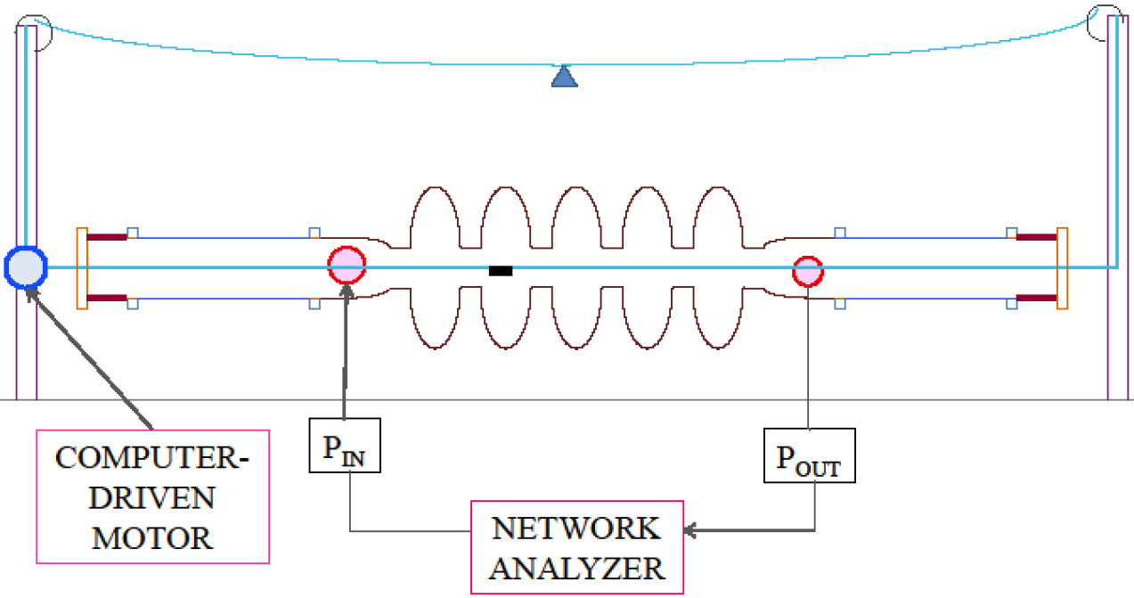
Bead-pull Setup (1)
  A bead-pulling assembly was constructed on the BNL1 cavity copper prototype:
  Pulley-mounted driver motor to move a small bead along a string inside the cavity
  Network analyzer for the excitation and detection of S₂₁ signals across the cavity
  X-Y translation stages for precise on and off-axis alignment of the string
  Measuring changes in amplitude or phase of a resonance at a single frequency as the bead traverses the cavity gives information on the fields inside.
  Goals:
  Measurement of the field
  flatness for the fundamental
  accelerating mode
  Field profile analysis for
  high-Q HOMs seen in the
  cold ERL cavity but not yet
  identified
  (dipole, quadrupole etc.)
Schematic of bead-pull assembly

Slide 8
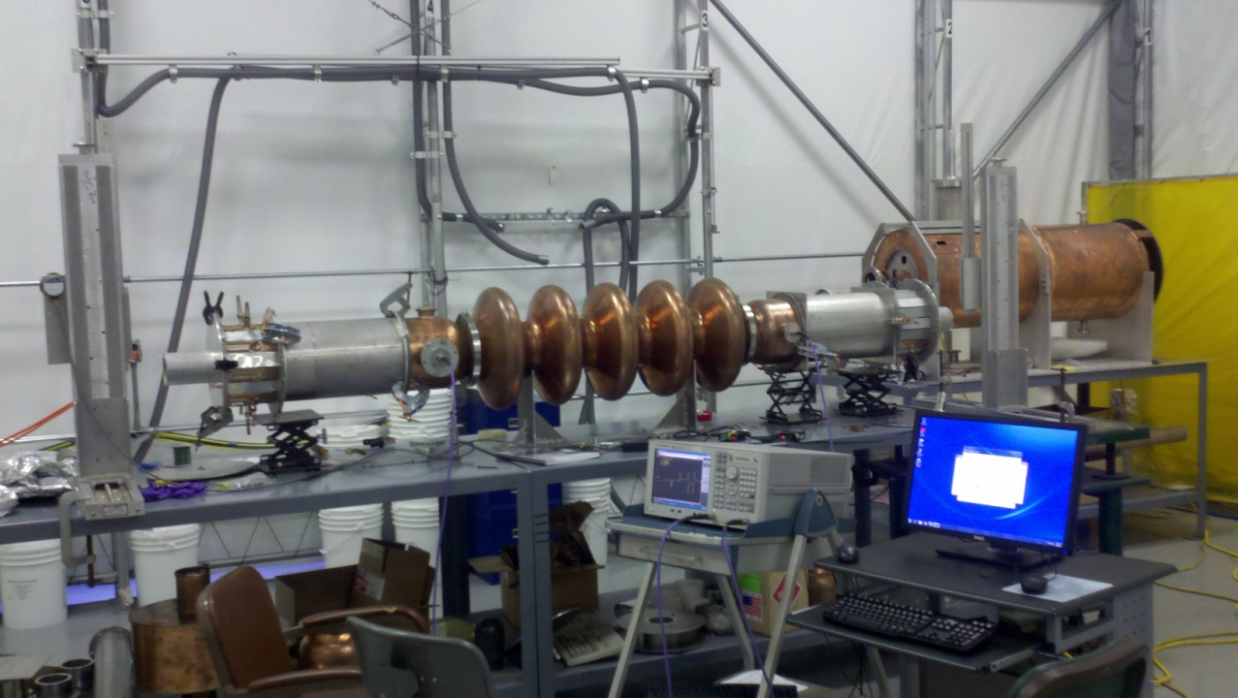
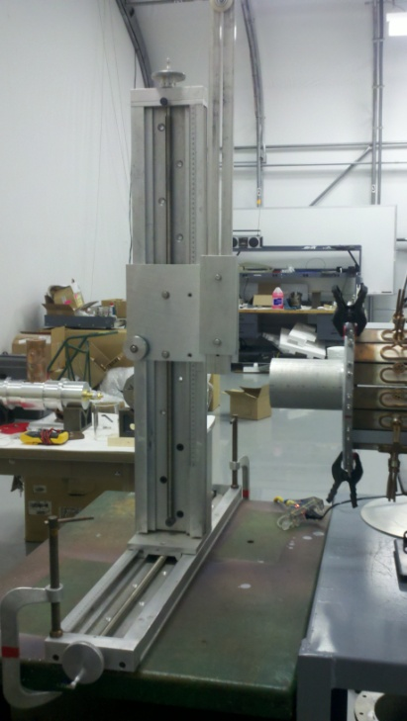
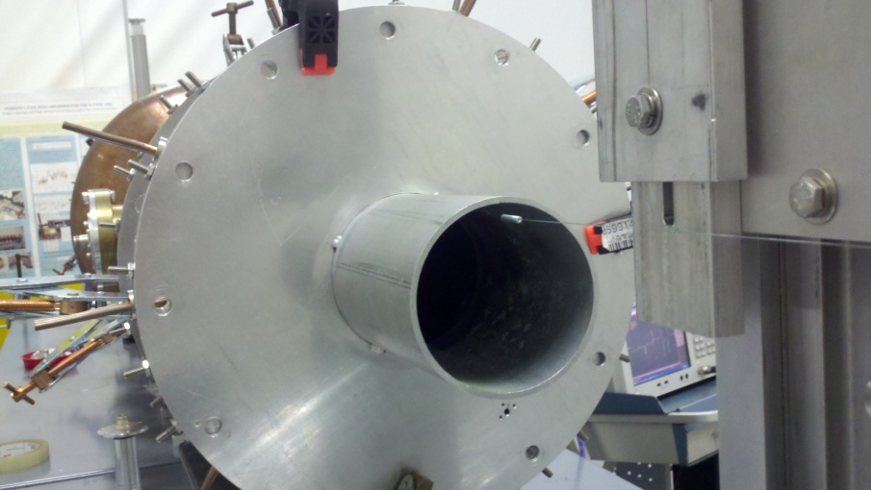
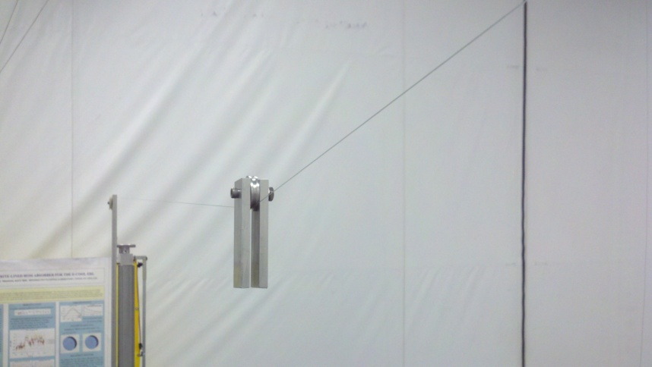
Bead-pull Setup (2)
The full assembly
X-Y translation stage
The bead entering the end of the beam tube
Free hanging weight maintains sufficient string tension

Slide 9
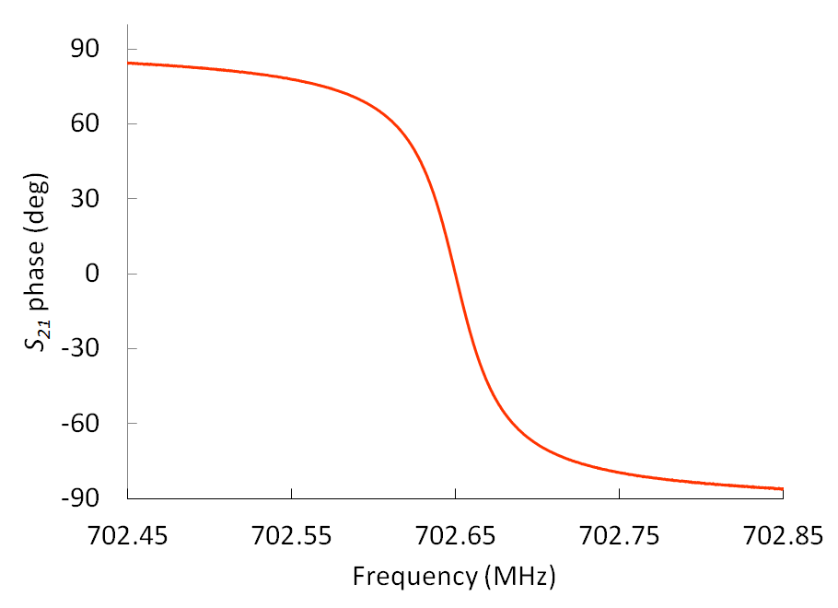
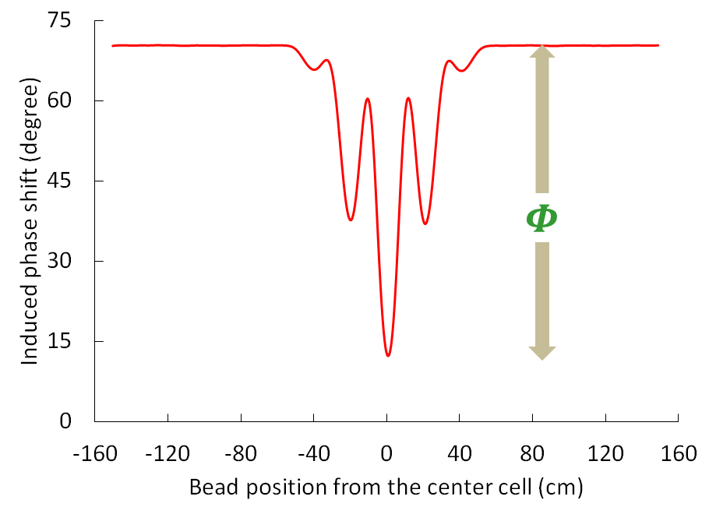
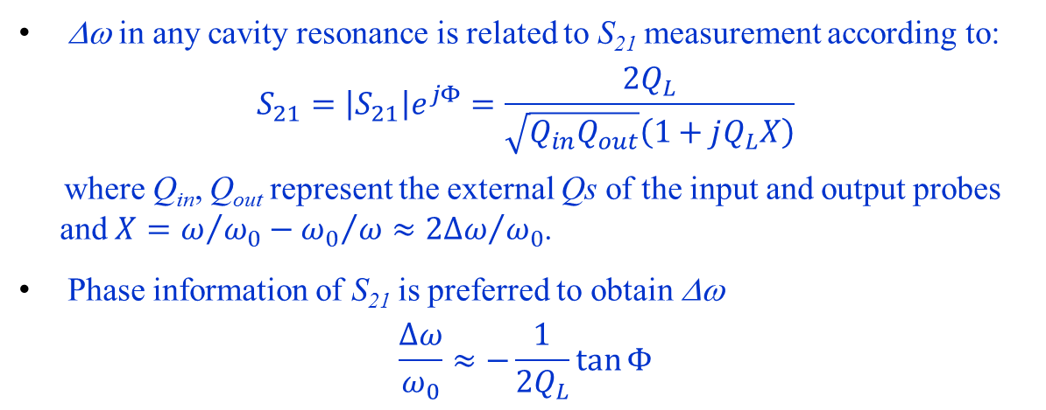
Measurement Technique (1)
Δω in any cavity resonance is related to S₂₁ measurement according to:
$$S_{21}=\left|S_{21}\right|e^{jΦ}=\frac{2Q_{L}}{\sqrt{Q_{in}Q_{out}}\left(1+jQ_{L}X\right)}$$
where Q_{in}, Q_{out} represent the external Qs of the input and output probes
and $X=ω/{ω_{0}}−{ω_{0}}/ω≈{2∆ω}/{ω_{0}}$.
Phase information of S₂₁ is preferred to obtain Δω
$$\frac{Δω}{ω_{0}}≈−\frac{1}{2Q_{L}}\tan{Φ}$$

Slide 10
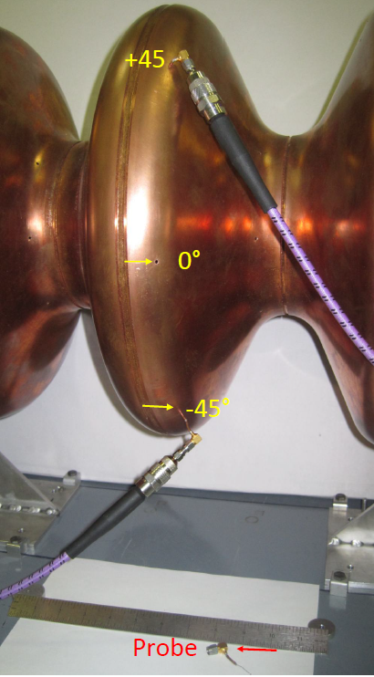
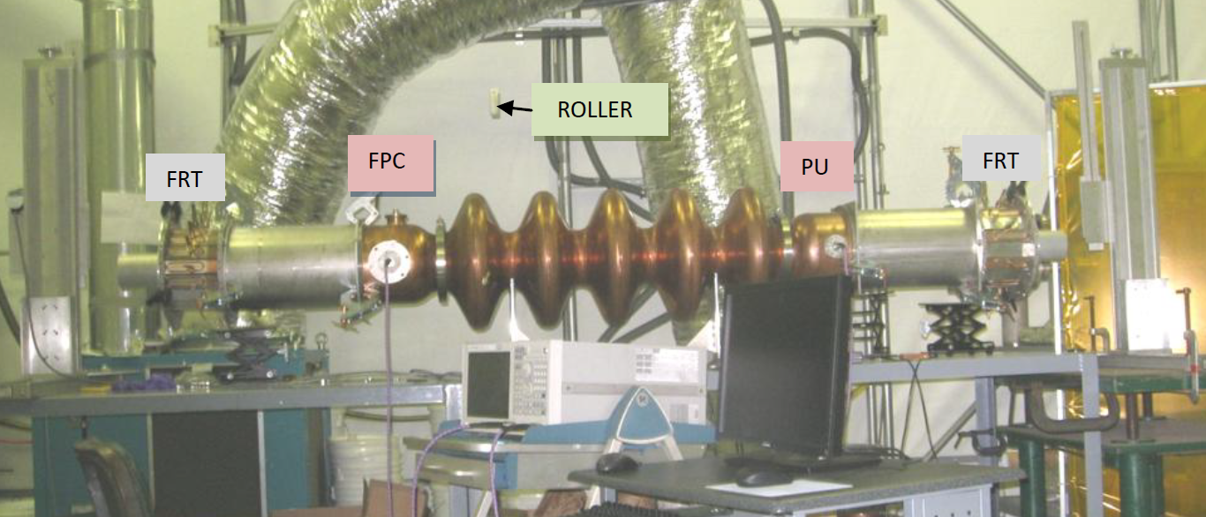
Measurement Technique (2)
Coupling to a resonance with a NWA can be obtained across the FPC and the PU probe, or through small holes drilled into the cavity cells.

Slide 11
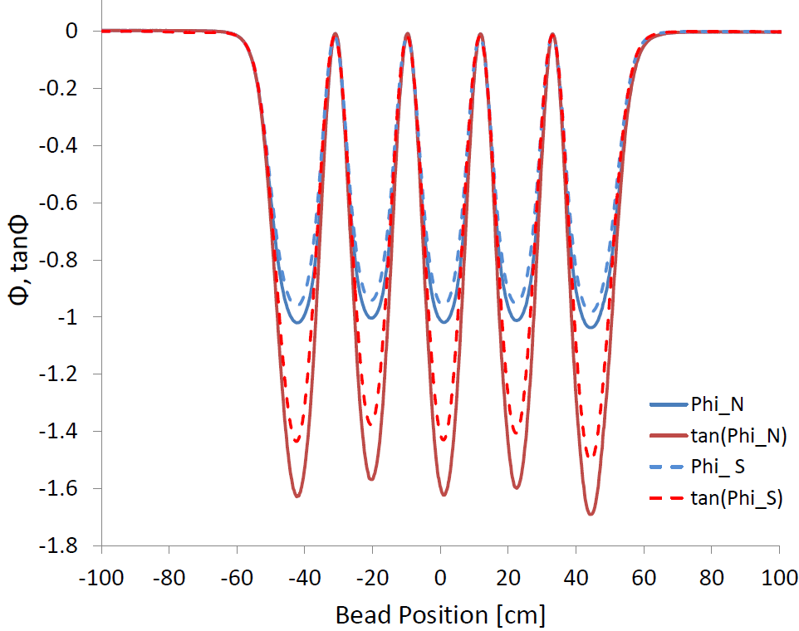
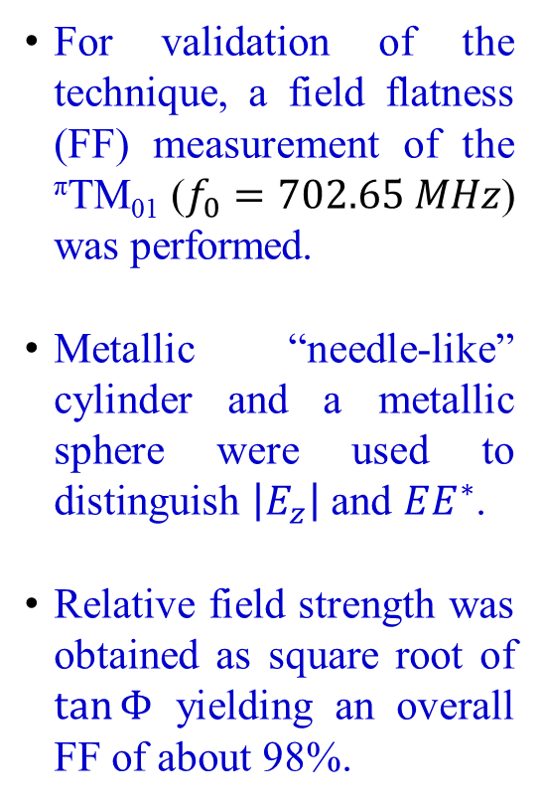
Fundamental Mode Field Flatness
For validation of the technique, a field flatness (FF) measurement of the ^{π}TM₀₁ ($f_{0}=702.65 MHz$) was performed.
Metallic “needle-like” cylinder and a metallic sphere were used to distinguish $\left|E_{z}\right|$ and $EE^{∗}$.
Relative field strength was obtained as square root of $\tan{Φ}$ yielding an overall FF of about 98%.

Slide 12
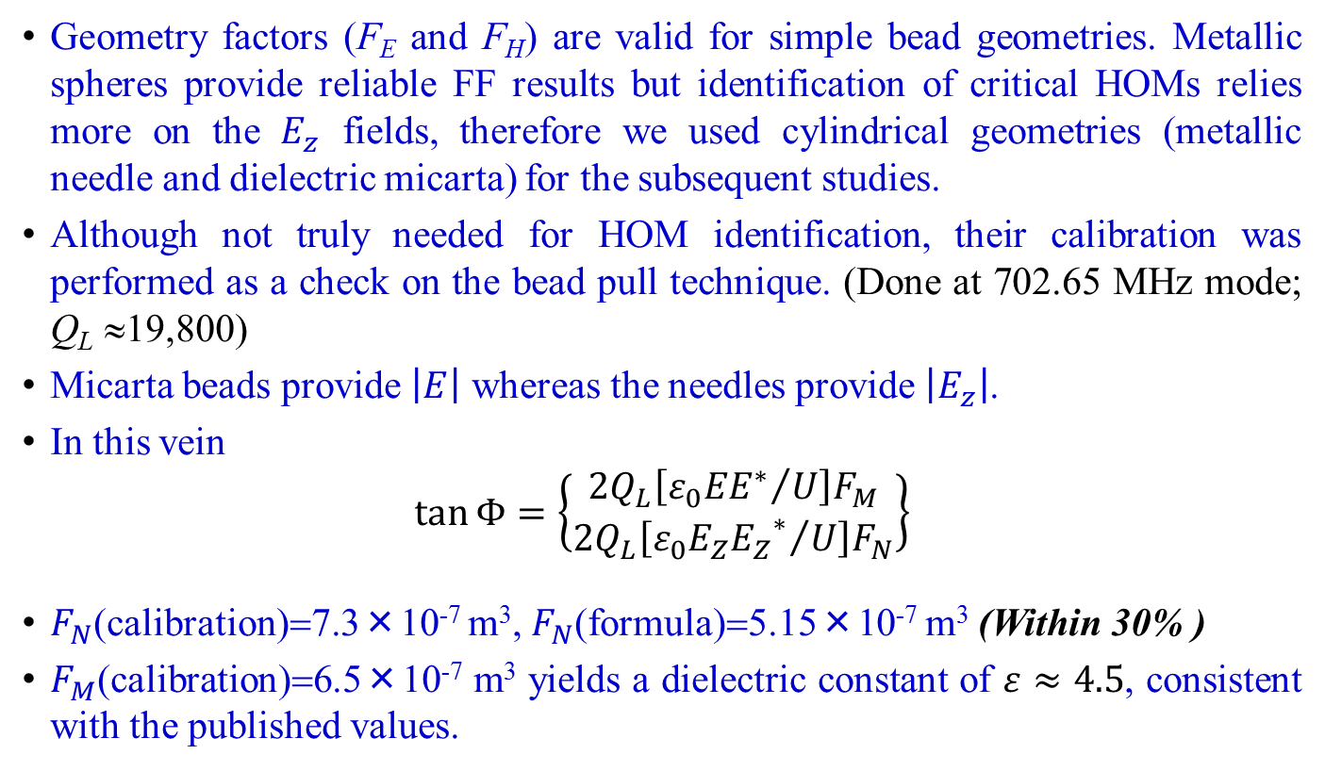
Calibration of the Perturbing Beads (1)
Geometry factors (F_{E} and F_{H}) are valid for simple bead geometries. Metallic spheres provide reliable FF results but identification of critical HOMs relies more on the $E_{z}$ fields, therefore we used cylindrical geometries (metallic needle and dielectric micarta) for the subsequent studies.
Although not truly needed for HOM identification, their calibration was performed as a check on the bead pull technique. (Done at 702.65 MHz mode; Q_{L} ≈19,800)
Micarta beads provide $\left|E\right|$ whereas the needles provide $\left|E_{z}\right|$.
In this vein
$$\tan{Φ}=\left\{\begin{aligned}2Q_{L}\left[{ε_{0}{EE}^{∗}}/U\right]F_{M} \\ 2Q_{L}\left[{ε_{0}E_{Z}{E_{Z}}^{∗}}/U\right]F_{N}\end{aligned}\right\}$$
$F_{N}$(calibration)=7.3×10⁻⁷ m³, $F_{N}$(formula)=5.15×10⁻⁷ m³ (Within 30% )
$F_{M}$(calibration)=6.5×10⁻⁷ m³ yields a dielectric constant of $ε≈4.5$, consistent with the published values.

Slide 13
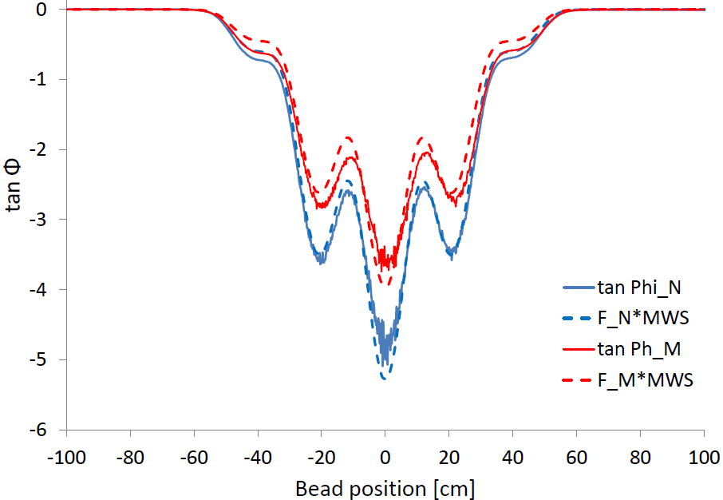
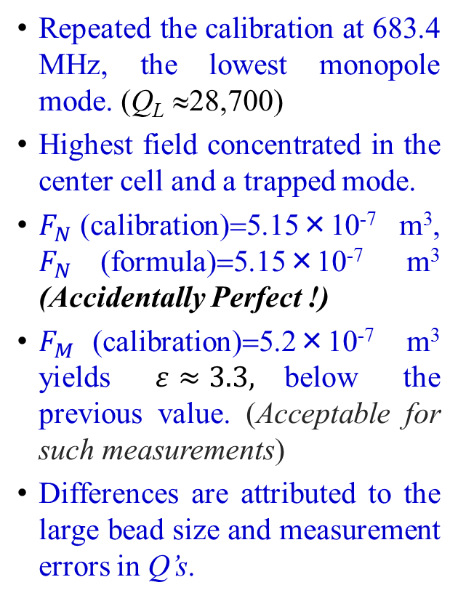
Calibration of the Perturbing Beads (2)
Repeated the calibration at 683.4 MHz, the lowest monopole mode. (Q_{L} ≈28,700)
Highest field concentrated in the center cell and a trapped mode.
$F_{N}$(calibration)=5.15×10⁻⁷ m³, $F_{N}$(formula)=5.15×10⁻⁷ m³ (Accidentally Perfect !)
$F_{M}$(calibration)=5.2×10⁻⁷ m³ yields $ε≈3.3,$below the previous value. (Acceptable for such measurements)
Differences are attributed to the large bead size and measurement errors in Q’s.

Slide 14
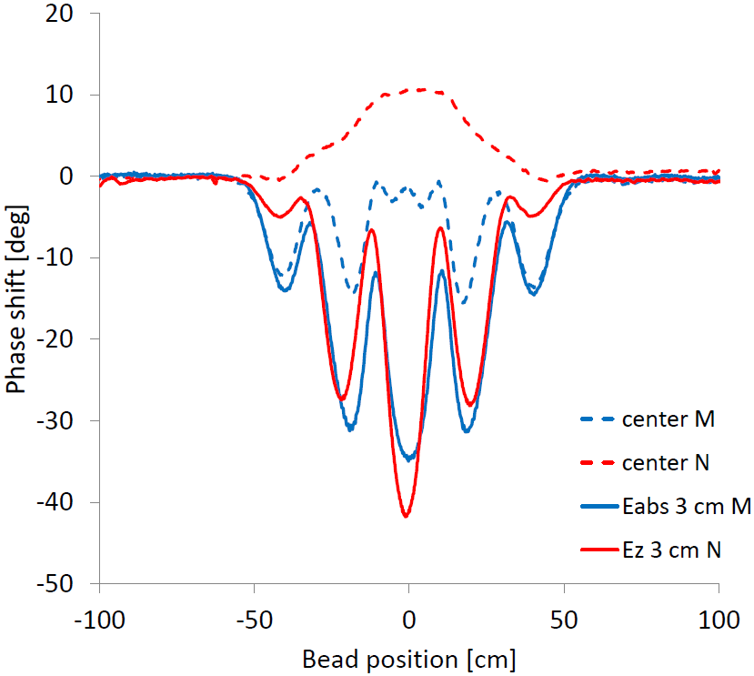
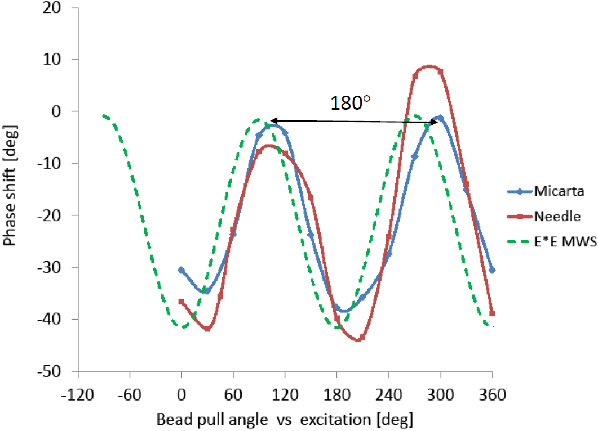
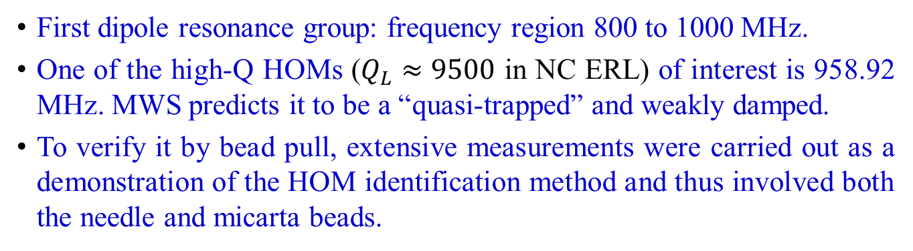
Bead-pull Measurements in the Dipole Group
First dipole resonance group: frequency region 800 to 1000 MHz.
One of the high-Q HOMs ($Q_{L}≈9500$ in NC ERL) of interest is 958.92 MHz. MWS predicts it to be a “quasi-trapped” and weakly damped.
To verify it by bead pull, extensive measurements were carried out as a demonstration of the HOM identification method and thus involved both the needle and micarta beads.

Slide 15
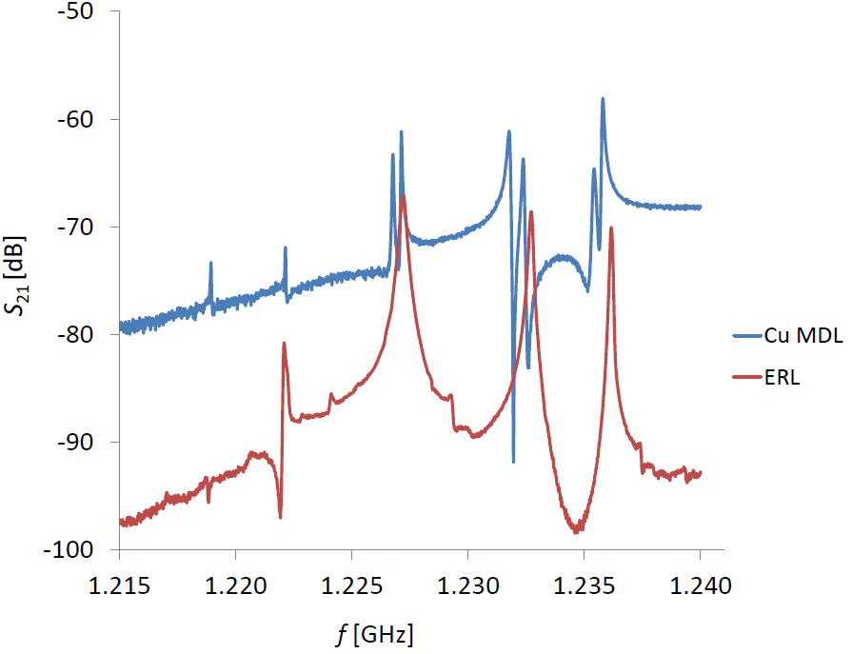
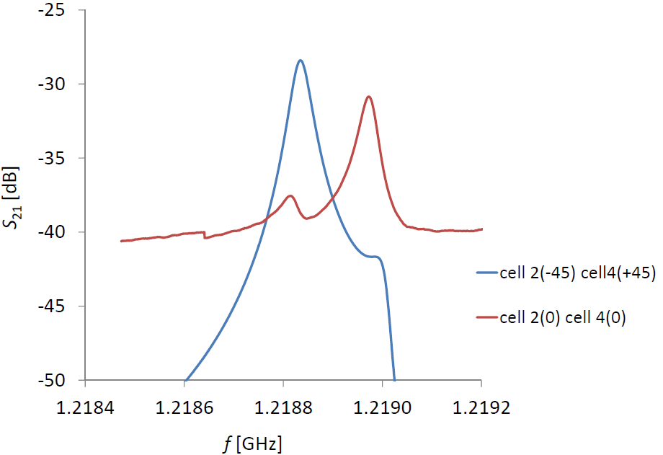
Resonances in the Quadrupole Group (1)
The high-Q 1.22008 GHz mode, the first in a family of 5 resonances between 1.215 and 1.24 GHz, found in the ERL was barely visible. This motivated us to verify it by bead pull.
Copper-cavity model showed “splitting” of this mode into two distinct frequencies (1.21881 and 1.21896 GHz) and polarization angles. The split resonances could be due to asymmetry in the cavity (slight ellipticity or different beam tube lengths).

Slide 16
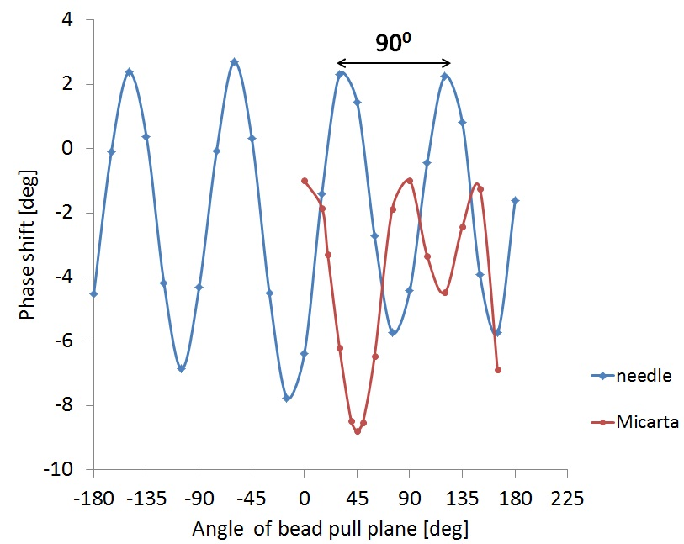
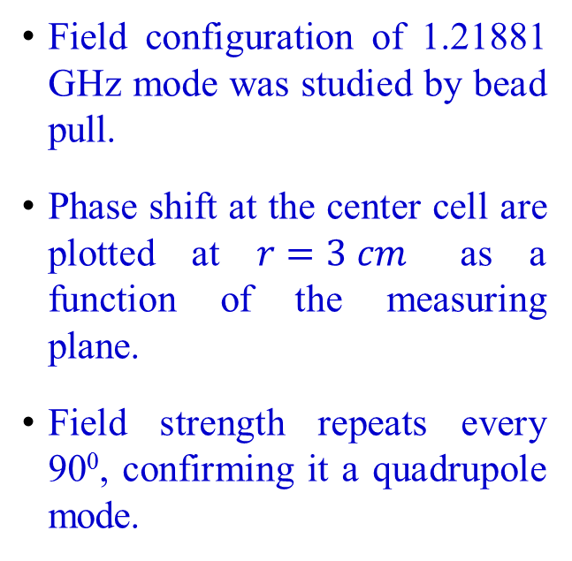
Resonances in the Quadrupole Group (2)
Field configuration of 1.21881 GHz mode was studied by bead pull.
Phase shift at the center cell are plotted at $r=3 cm$ as a function of the measuring plane.
Field strength repeats every 90⁰, confirming it a quadrupole mode.

Slide 17
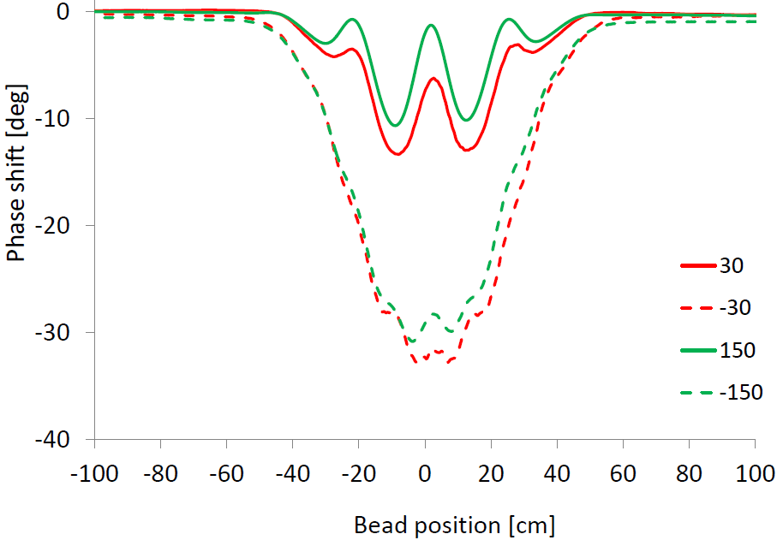
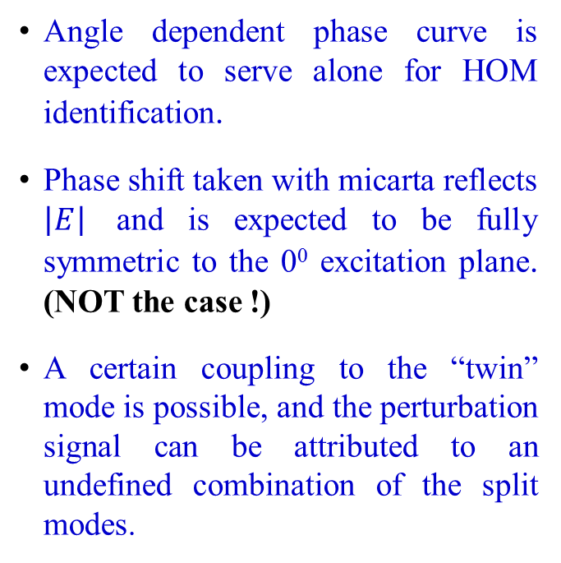
Azimuthal Angle Puzzle
Angle dependent phase curve is expected to serve alone for HOM identification.
Phase shift taken with micarta reflects $\left|E\right|$ and is expected to be fully symmetric to the 0⁰ excitation plane. (NOT the case !)
A certain coupling to the “twin” mode is possible, and the perturbation signal can be attributed to an undefined combination of the split modes.

Slide 18
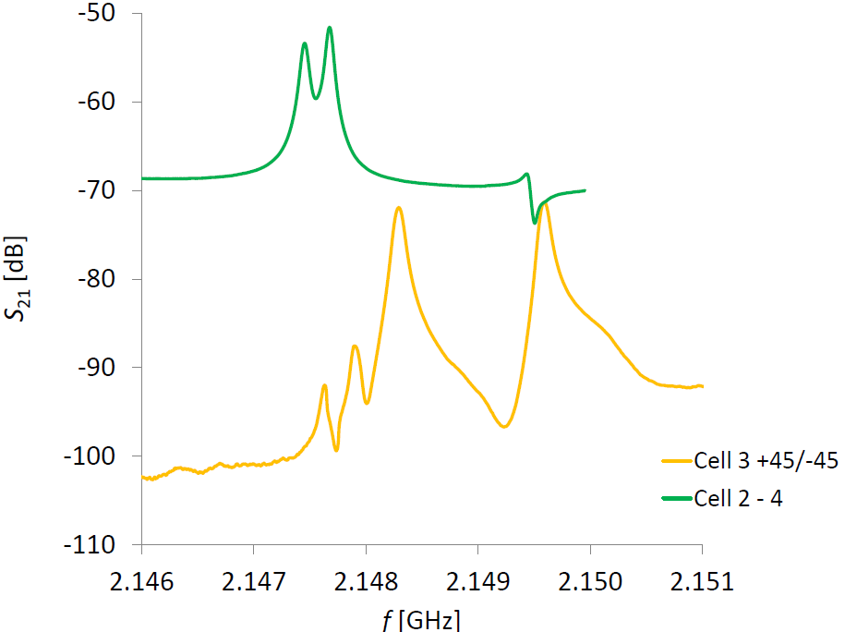
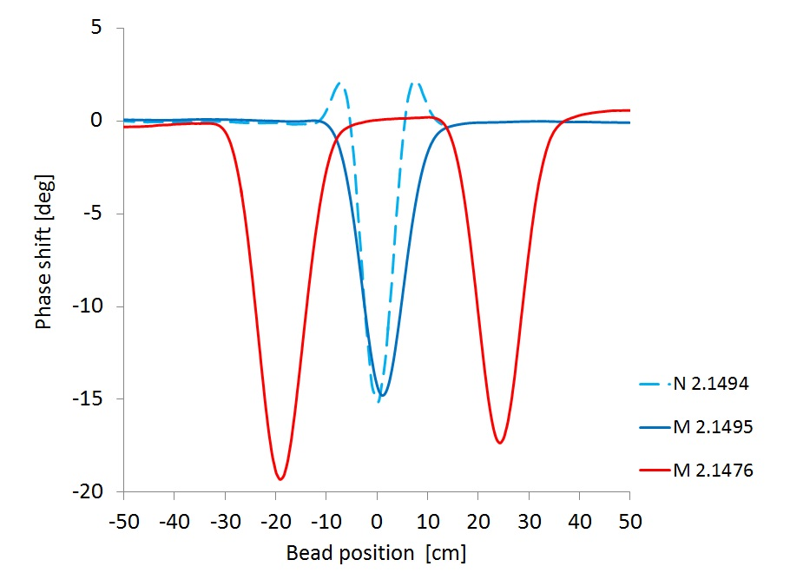
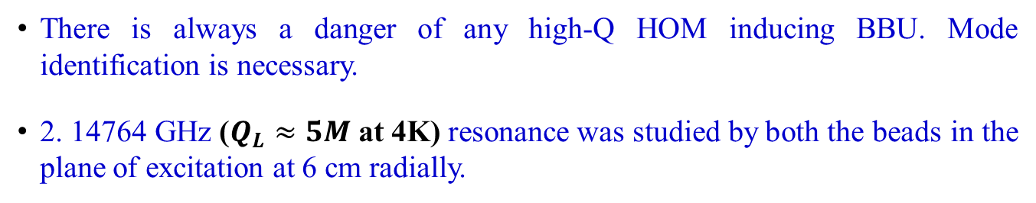
Identification of High-Q Resonances (1)
There is always a danger of any high-Q HOM inducing BBU. Mode identification is necessary.
2. 14764 GHz ($Q_{L}≈5M$ at 4K) resonance was studied by both the beads in the plane of excitation at 6 cm radially.

Slide 19
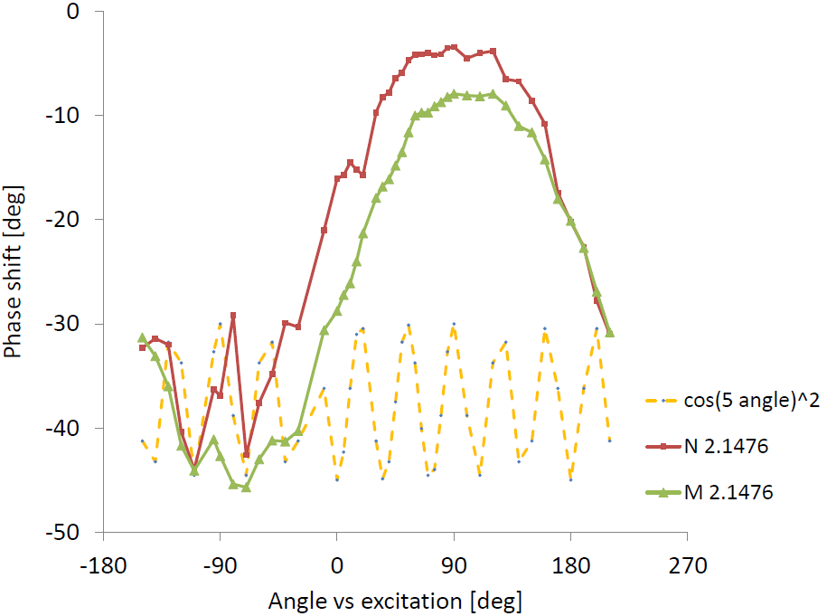
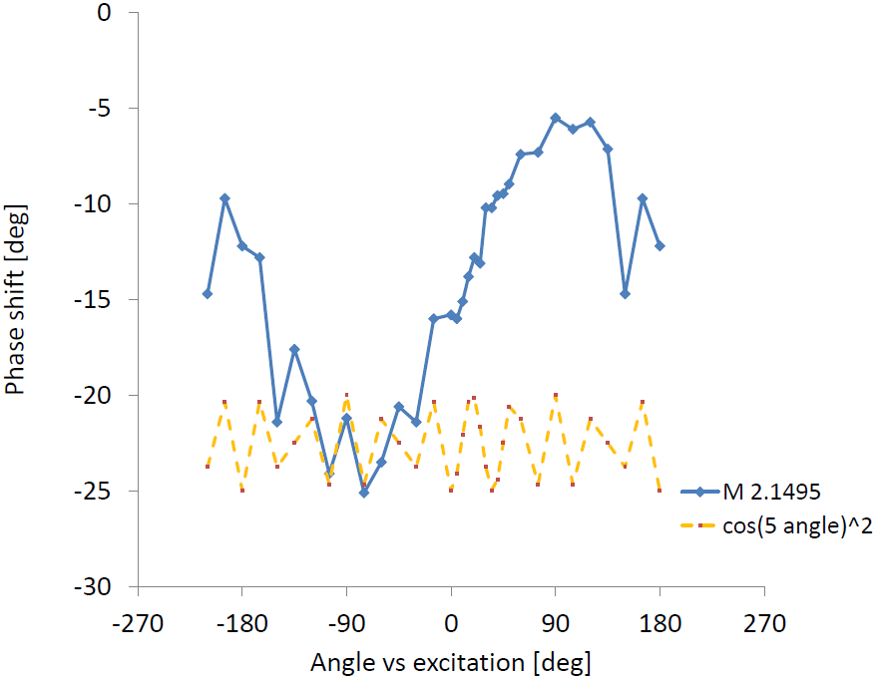
Identification of High-Q Resonances (2)
The frequency values of these high-Q resonances are fully consistent with the simulation results indicating a decapole pattern. (Confirmed !)
The only explanation of the strong distortion is the azimuthal angle “conundrum” found in all trapped modes.

Slide 20
Summary
Multi-cell accelerating cavities are prone to exhibit trapped HOMs, which could be the source of BBU instabilities.
Bead pulling method proved to be one of the crucial methods next to the computer simulations for HOM identification.
Beam-tube resonances, the TE₁₁ modes (750 MHz, 1024 MHz) and a hidden sextupole resonance at 1618 MHz were also identified.
(Revised manuscript in preparation)

Slide 21
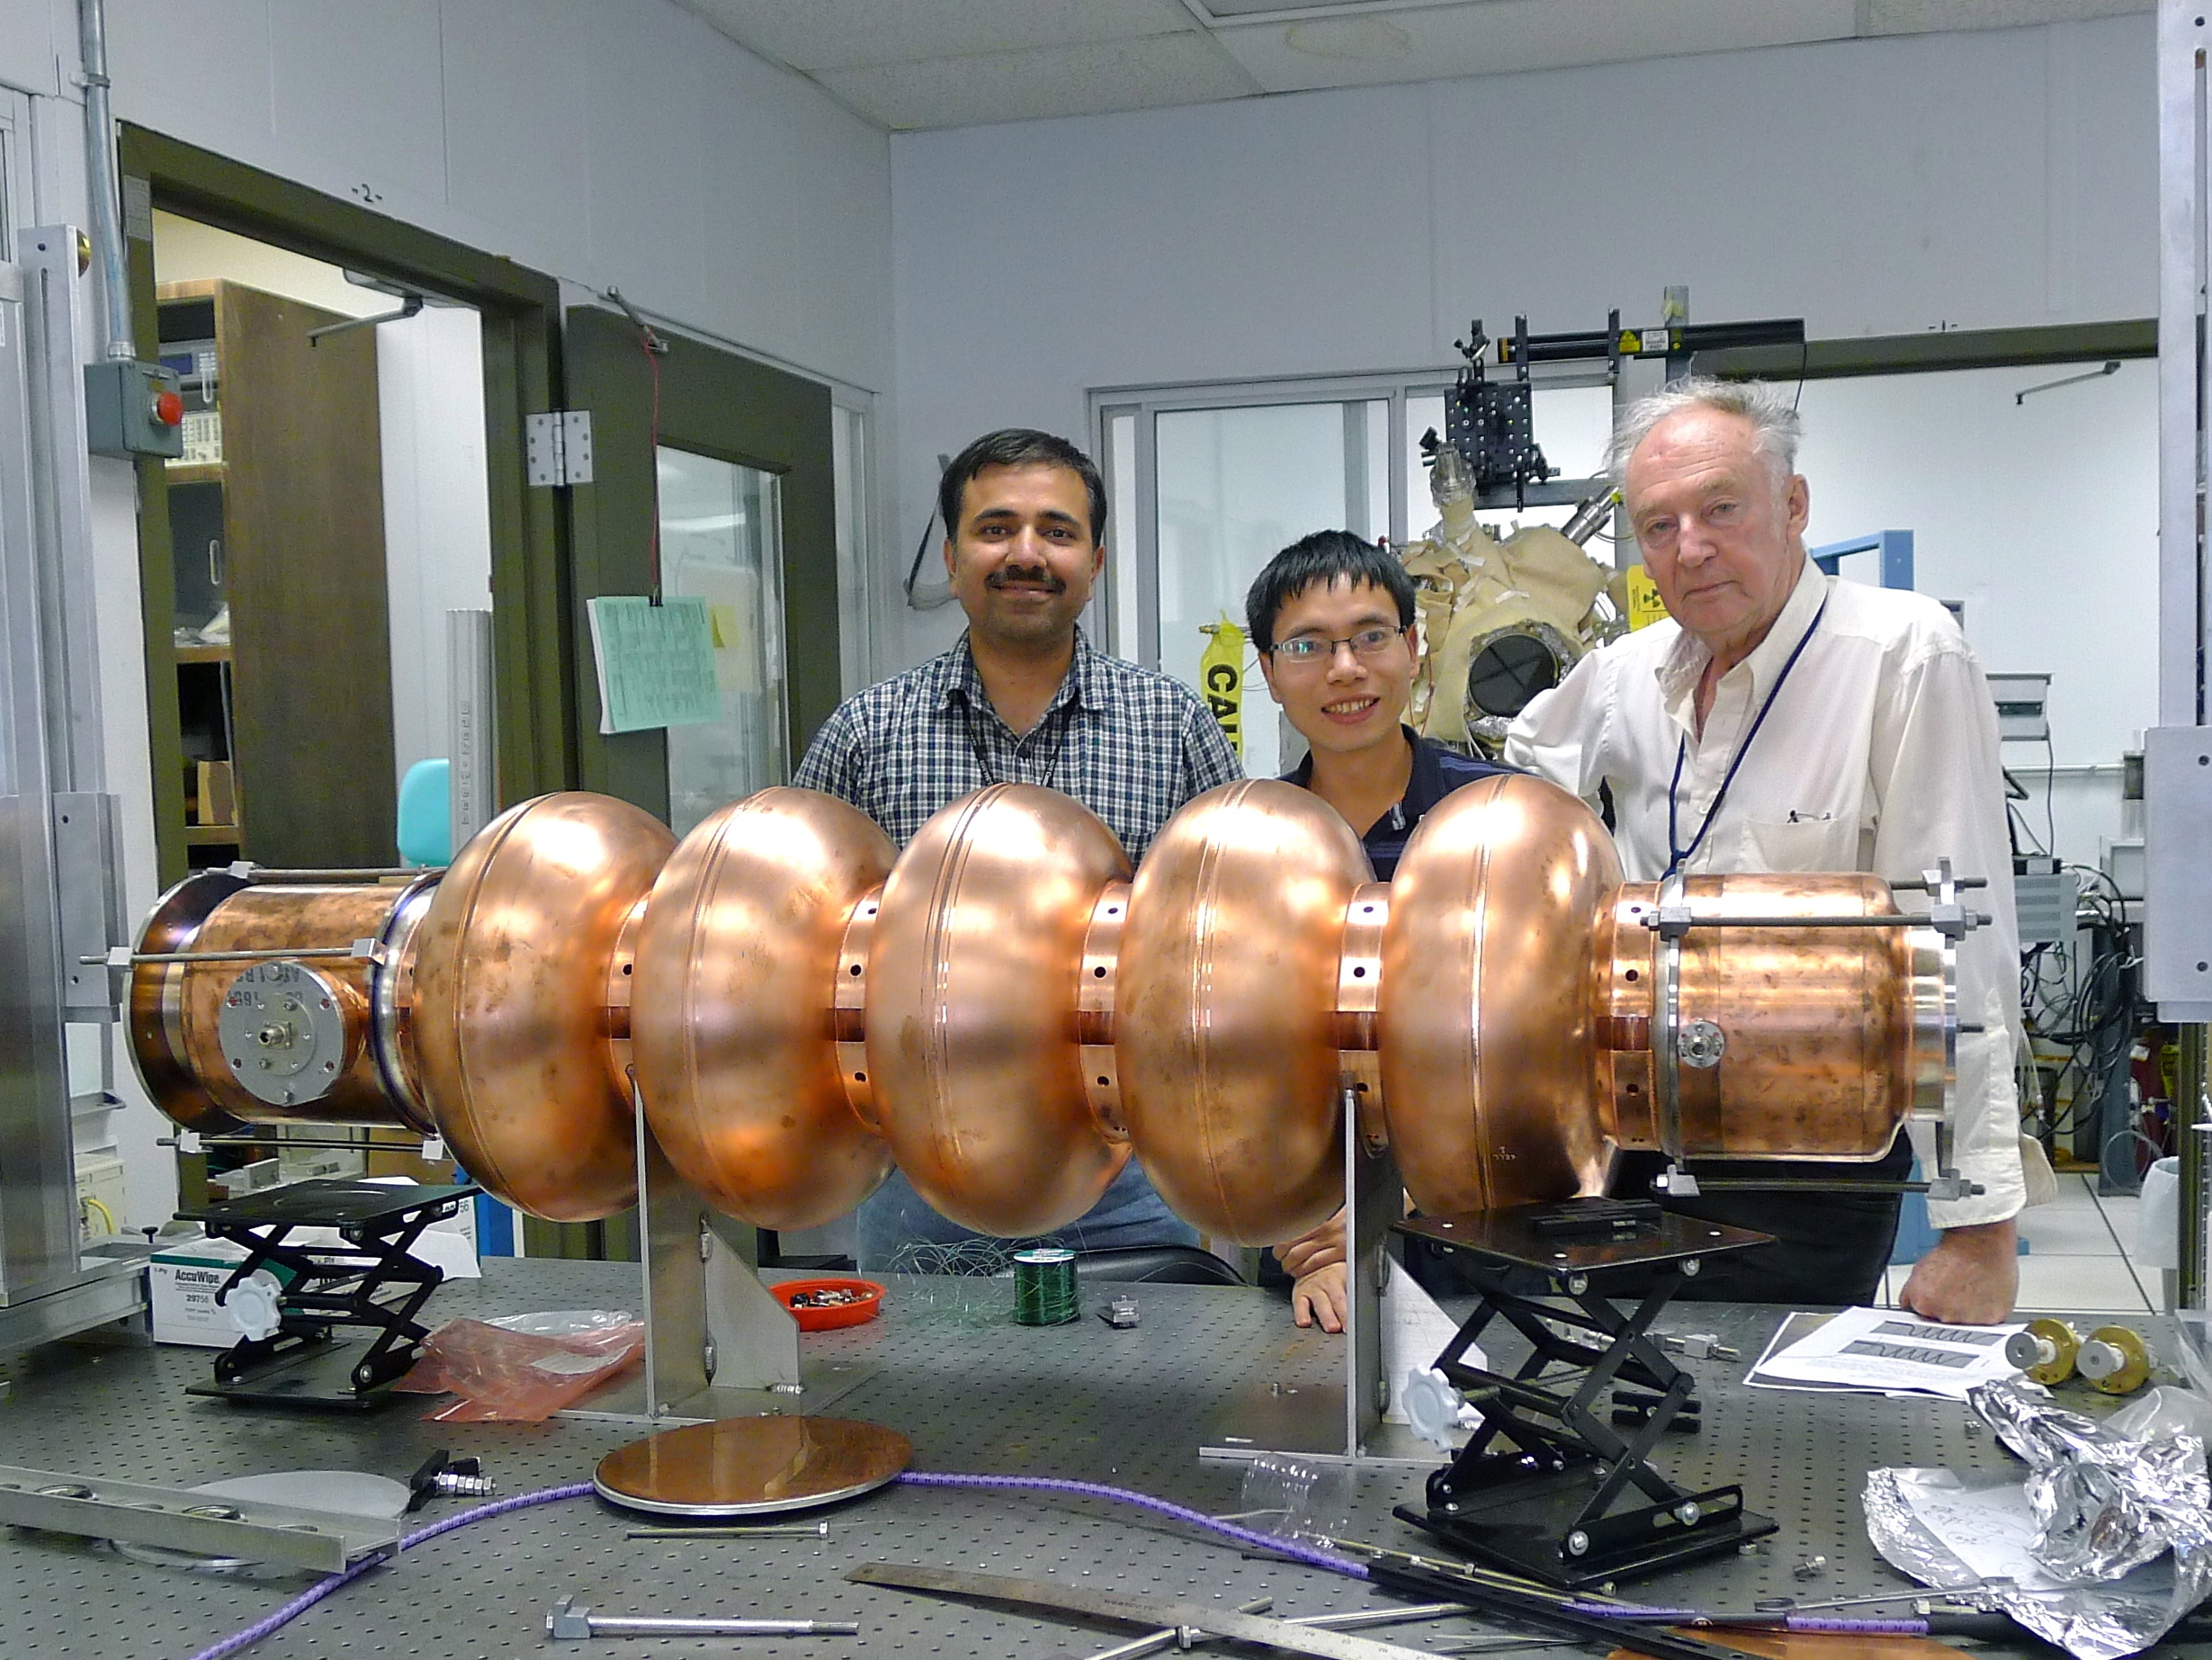
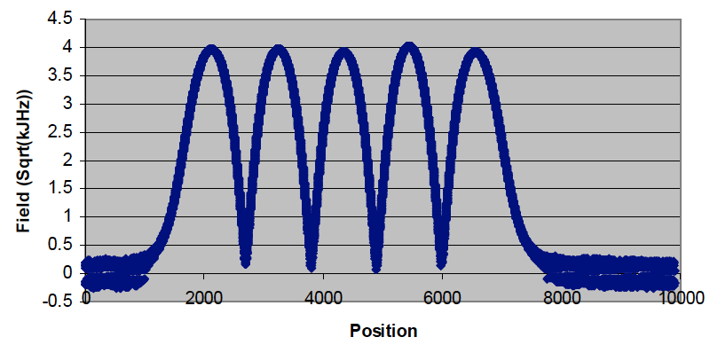
The BNL3 copper cavity prototype
Cavity was fabricated by AES.
Tuned to specs (98.5% field flatness).
Acceptance measurements are finished:
Detailed HOM studies under way.

Slide 22
Plan
Bead-pull HOM Measurements
Analysis of the Microphonics Data
Thermal Calculations for Fundamental Power Coupler
Analysis of the Electron Cloud Measurement Technique at KEK B-factory

Slide 23
Motivation
During a test run in October 2010, a shift in the resonance noise and its subsequent amplification was recorded. (Strange phenomenon!)
This phenomenon was concurrent with the level of liquid helium (LHe) present in the tube connecting the ballast and helium tanks.
Understanding the cause of the moving microphonics was the motivation for this study, which will help in designing a better cryostat.

Slide 24
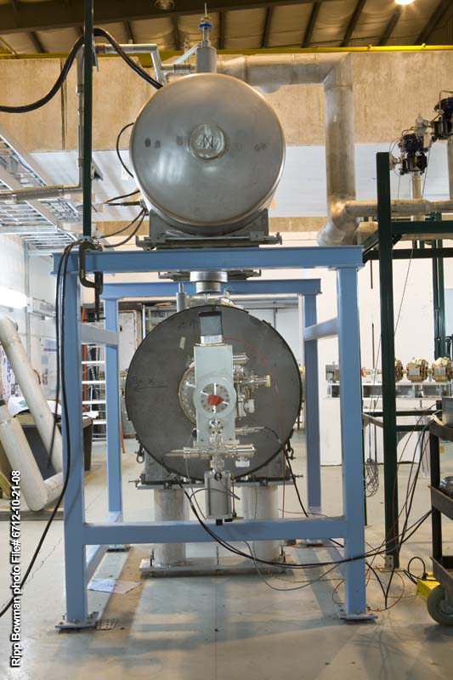
Description of the Experiment
Ballast tank was filled with LHe at 4K. 2K superfluid bath was produced by pumping down the pressure.
LHe probe inside the ballast tank revealed that the tank was almost empty.
At that time the RF was turned ON.
Cavity is run with a phase lock loop (PLL), which locks the RF to the cavity resonant frequency.
PLL follows the cavity resonant frequency, an FFT of the PLL error gives a spectrum of the microphonics in the cavity.
Each FFT was done on one-seconds worth of data.

Slide 25
Movie of Noise Frequency Drift

Slide 26
Experimental Observations
During the phenomenon the cavity temperature varied from 1.98K to 1.88K.
A microphonics noise, observed at 30 Hz, was present at all times. (Source: mechanical vibrations originating from cryopump)
When RF was turned ON, a microphonics noise initiated at some frequency, was observed to begin drifting at 16 Hz towards higher frequencies. This drifting stopped when it hit the 30 Hz line, got amplified by more than five times.
Clear indication of a resonance condition.

Slide 27
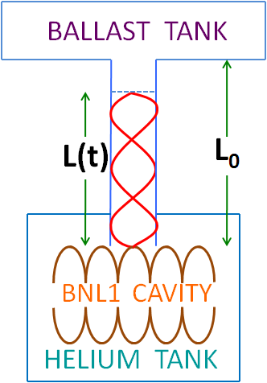
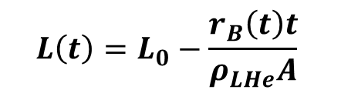
Data Analysis (1)
Proposed an m^{th}-mode resonance formed by second sound in LHe. (Similar to a pipe organ)
Resonance column was possibly excited by gushing in of LHe into the tube. (marked by impulsive noise)
Resonance structure is formed in the tube connecting both the tanks. With the LHe boil off, the resonance column decreases and so does the resonant frequency.
$$L\left(t\right)=L_{0}−\frac{r_{B}\left(t\right)t}{ρ_{LHe}A}$$

Slide 28
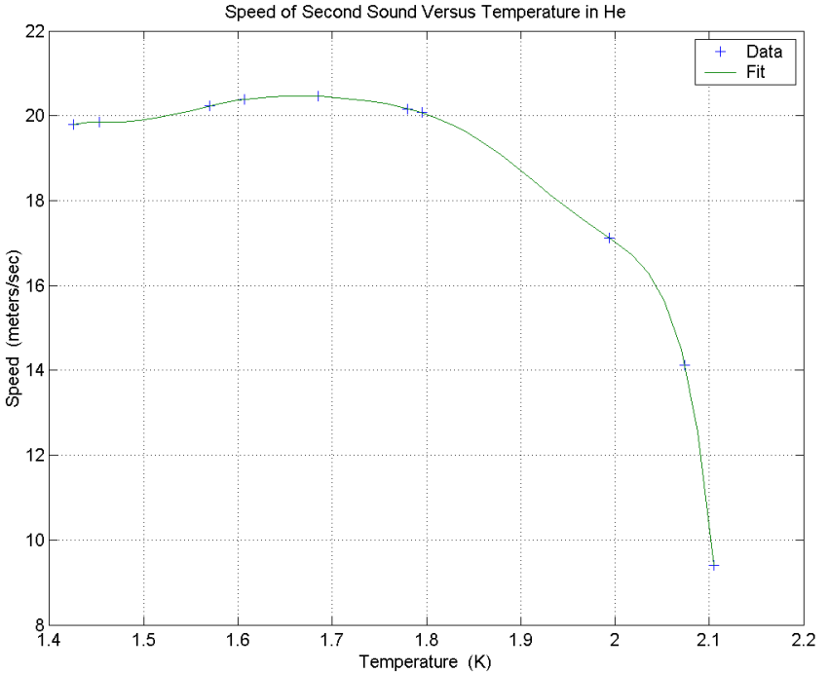
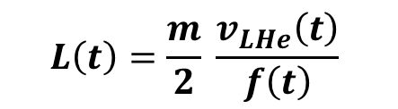
Data Analysis (2)
$$L\left(t\right)=\frac{m}{2} \frac{v_{LHe}\left(t\right)}{f\left(t\right)}$$

Slide 29
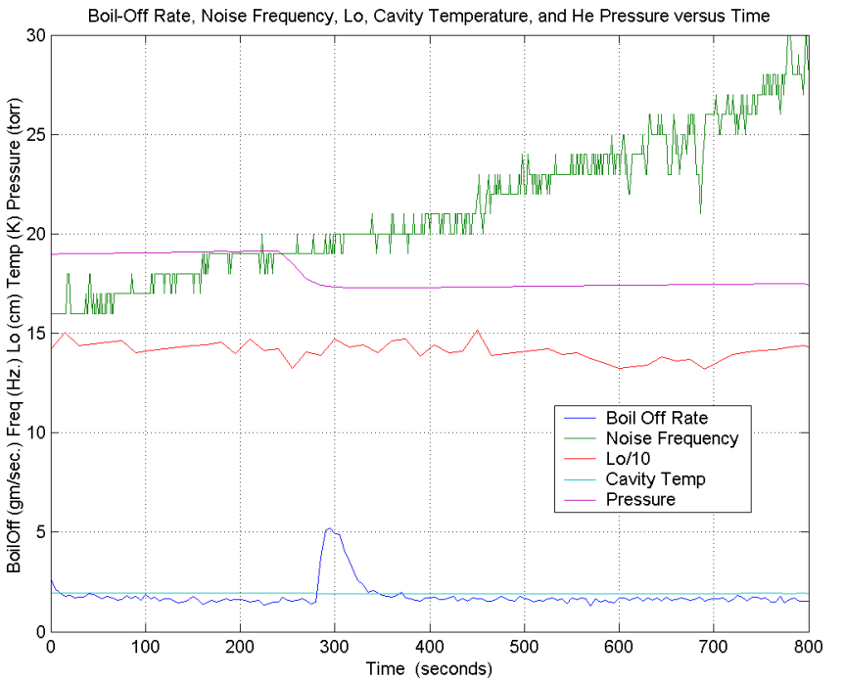
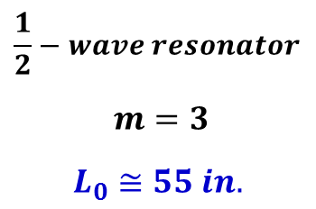
Data Analysis (3)
$$\frac{1}{2}−wave resonator$$
$$m=3$$
$$L_{0}≅55 in.$$

Slide 30
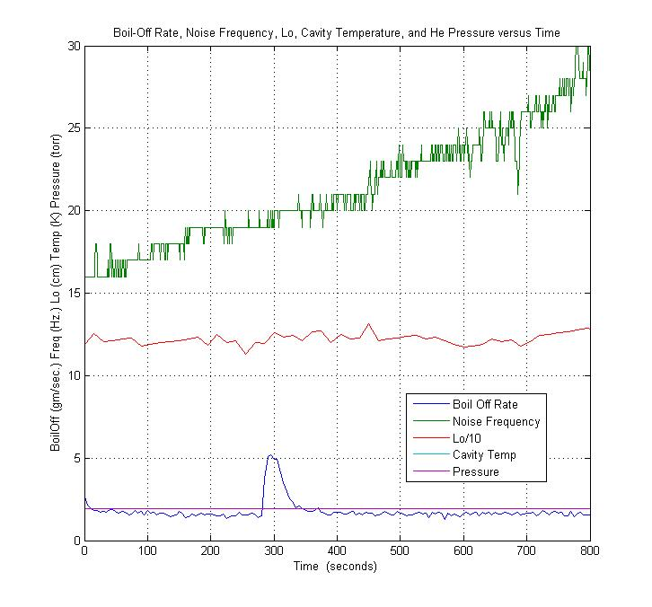
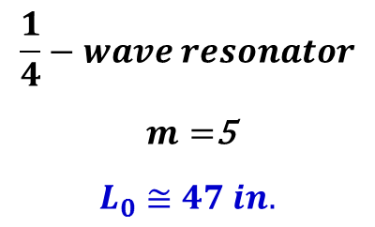
Data Analysis (4)
$$\frac{1}{4}−wave resonator$$
$m=$5
$$L_{0}≅47 in.$$

Slide 31
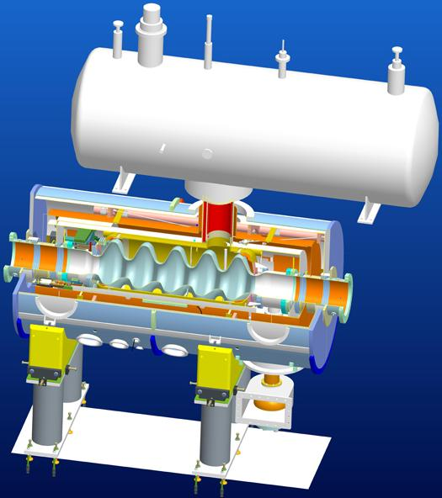
Summary
Both, the third harmonic of a half-wave resonator and the fifth harmonic of a quarter-wave resonator negate the assumption that the length of the connecting tube is the only resonance column.
Are the values of the constant L₀ a coincidence?
What excites the resonating column?
(Ref.: Proc. of IPAC 2011; Jain et al.)

Slide 32
Plan
Bead-pull HOM Measurements
Analysis of the Microphonics Data
Thermal Calculations for Fundamental Power Coupler
Analysis of the Electron Cloud Measurement Technique at KEK B-factory

Slide 33
Motivation
The BNL3 cavity will be fed by a high power RF amplifier using a coaxial FPC, which delivers 20 kW of RF power to the cavity.
FPC also interconnects different temperature layers in the accelerating module.
A key design aspect is to take into account the heat losses dissipated on the surface of the conductor by RF fields + static heat load.
The requirement of minimum heat losses in the cryostat from FPC for cavity’s performance was the motivation for a systematic study on thermal calculations for FPC.

Slide 34
Simulation Model
L = 26.8 cm
SS – thickness = 1.5 mm
15 μm Cu Coating
r₀ = 3.785 cm
WATER-COOLED Cu IC
T(x=0) = 5 K
T(x=L) = 300 K

Slide 35


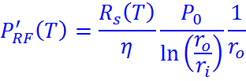
1-D model of heat transfer by conduction

Slide 36
Temperature dependent thermal conductivities
Cu ---
(Ref.: Proc. of LINAC 2004; Dohlus, Kostin and Möller)
Cu + SS ---
SS ---

Slide 37
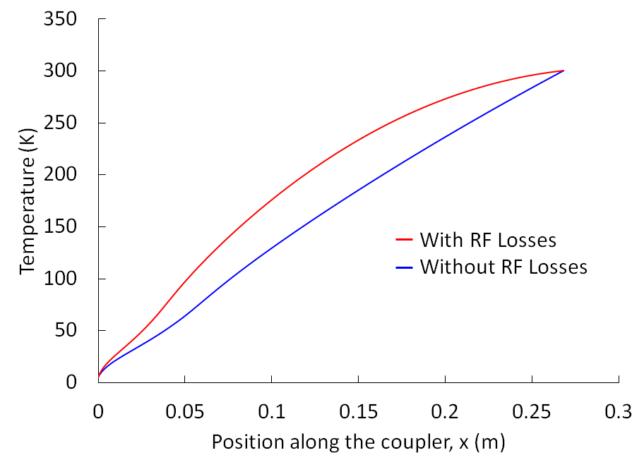
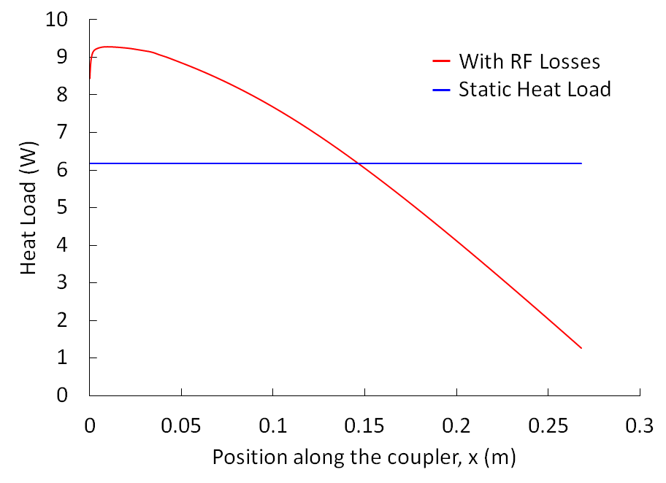
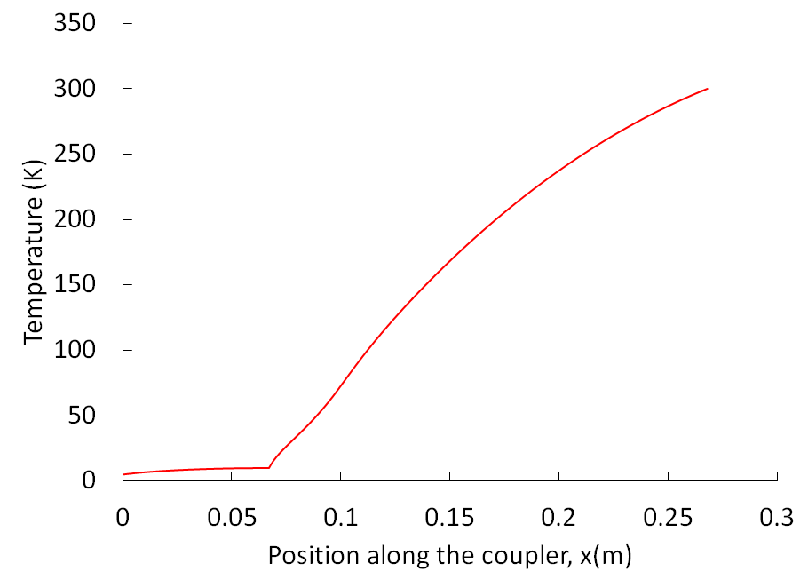
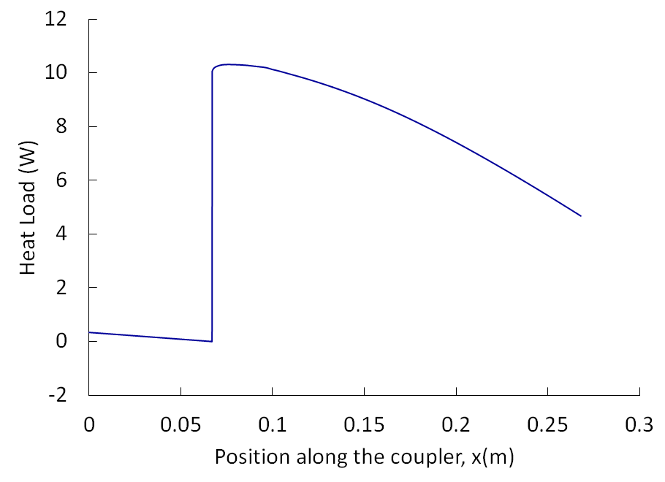
Simulation Results (1)
No Thermal Intercept
Point-like
Thermal Intercept

Slide 38


Design of Real Thermal Intercept
T_{in, HeG}
T_{out, HeG}
$$\dot{m}=\frac{\dot{Q}}{C_{p}.∆T_{gas}}=\frac{12.5 W}{5.2 J/{\left(g.K\right). \left(10−6\right)K}}=0.6 g/s$$
$$l=\frac{\dot{Q}}{h.πD.ΔT}=\frac{12.5 W}{160\frac{W}{m^{2}.K}. \left(0.24 m\right).(4 K)}≅0.08 m$$

Slide 39


Simulation Results (2)

Slide 40
Summary
Thermal calculations of temperature and heat load distributions on FPC model are well understood by a simplified simulation model.
Requirements on the helium gas flow rate and heat removal coefficient are moderate and can be easily achieved.
A detailed analysis of the thermal calculations in 2-D is in progress.
(Ref.: Proc. of IPAC 2012; Jain et al.)

Slide 41
Plan
Bead-pull HOM Measurements
Analysis of the Microphonics Data
Thermal Calculations for Fundamental Power Coupler
Analysis of the Electron Cloud Measurement Technique at KEK B-factory

Slide 42

Numerical analysis of the measurement of electron cloud density near the beam at KEKB Low Energy Ring
KEK B-factory is an e⁻-e⁺ collider
LER : 3.5 GeV e⁺, HER : 8 GeV e⁻
A large collection of electrons can be formed in LER. Accumulation and multiplication of low-energy, background electrons leading to a very large number inside the beam chamber is termed as the Electron Cloud.
Primary Source : Photoelectrons
(Synchrotron Radiation)
Secondary Source : SEY
(beam-electron interaction)

Slide 43





Schematic of electron multiplication
$$ρ=15.9 m$$
$$φ=94 mm$$
$$E_{x,y}$$
$$γ$$
Bunch spacing 6 ns
$$7eV$$

Slide 44





Secondary Buildup (1)
$$δ_{max}$$
$$E_{0,max}$$
$$δ\left(E_{0}, θ_{0}\right)= \frac{I_{s}}{I_{0}}$$
$$δ_{max}= δ\left(E_{0,max}, 0\right)$$
SEY vs. primary electron energy

Slide 45



Secondary Buildup (2)
Furman-Pivi model (PRST-AB, 5, 124404)
PE
RE
SE
Model : Phenomenological fits
$$δ= δ_{e}+ δ_{r}+ δ_{ts}$$
Input ingredients of the model are the $δ$ and the ${dδ}/{dE}$.
These are represented by most general fitting parameters.
Ref: H. Seiler, Jour. of App. Phys., 54, R1 (1983)

Slide 46


Method of the measurement of EC density (1)
Measure EC current above E_{thresh} (eV_{b}) by using RFA located on wall.
High-energy component originated from a region near the beam.
Detection of energetic electrons provides information of a region near the beam where they stayed at the time of interaction. This region defines observed volume ($V_{obs}$).
Assumption - Energetic electrons occupying a region near the bunch are stationary before kick; hit the wall in a single bunch pass.
Ref: Kanazawa et al. (PAC 2005)

Slide 47




Method of the measurement of EC density (2)
$Δp=\frac{2r_{e}}{r}N_{b}m_{e}c$
$eV_{b}=\frac{Δp^{2}}{2m_{e}}$ (defines r_{bias})
$V_{obs, S}\left(V_{b}\right)=Aπ$ r_{bias}²
A (Acceptance of monitor)= 1.95×10⁻³ m
Observed Volume

Slide 48


Analysis of the measurement (1)

Slide 49


Analysis of the measurement (2)

Slide 50

Analysis of the measurement (3)

Slide 51

40 bunch pass
y [m]
x [m]

Slide 52
Summary
Our detailed analysis showed that the shape of V_{obs} near the beam is highly deformed by the horizontal velocity distribution of electrons; nevertheless the analytic formalism can be applied to obtain the EC density.
According to this analysis and the data taken in KEKB LER, EC density is determined to be 1×10¹² m⁻³ in drift region without solenoid field at 1mA within an accuracy of 10%. A density of 5×10¹¹ m⁻³ is (roughly) a threshold value for single bunch instability to occur for KEKB beam parameters. This work will contribute to develop the mitigation techniques against the EC in the planned Super KEKB.
(Ref.: Jpn. J. Appl. Phys. 49(2010) 116403; Jain et al.)

Slide 53
Acknowledgements
I. Ben-Zvi, H. Hahn, C. Schultheiss, S. Belomestnykh, W. Xu,
and other BNL C-AD colleagues
H. Fukuma, K. Kanazawa, K. Ohmi, S. Kurokawa (KEK)
M. Furman (LBNL), M. Pivi (SLAC), G. Dugan (Cornell)
Walter Schmeling from Physics Machine Shop in Dept.
of Physics & Astronomy, SBU
Thank You.

Slide 55



Resonances in the Quadrupole Group (1a)
Field configuration of 1.21881 GHz mode was studied by bead pull.
Beads were scanned at $r=3 cm$ at 0⁰ and 45⁰.

Slide 56




