Slide 1
Linac/400 MeV BPM System Status Nathan Eddy PIP Meeting 6/6/12

Slide 2
Motivation
Update existing RF electronics with Digital electronics
FPGA, ADC, Digital Signal Processing
Long term stability
Flexibility to modify system as needed
Implement calibration system to improve long-term stability
Implement phase measurement for Time of Flight/Energy measurement

Slide 3
Project Scope
Includes the processing of the BPM pickup signals to determine beam position through the duration of the Linac beam pulse
Compute position averages and deliver all of the position data to the ACNET control system every 66 ms (15HZ)
A limited number of BPM’s in the Linac and 400 MeV line will be required to deliver all of the position data samples to applications running in ACNET at the 15 Hz rate
Does not involve changing the BPM detectors or the cabling that comes up from the Linac enclosure.

Slide 4
Linac Section
Instrument all existing Linac BPMs
Total of 76 BPMs (2 plates/channels)
LE Linac (13)
Transition (6)
HE Linac (57)
Module 1 & 2 - 6 each (12)
Module 3-6 – 8 each (32)
Module 7 (9)

Slide 5
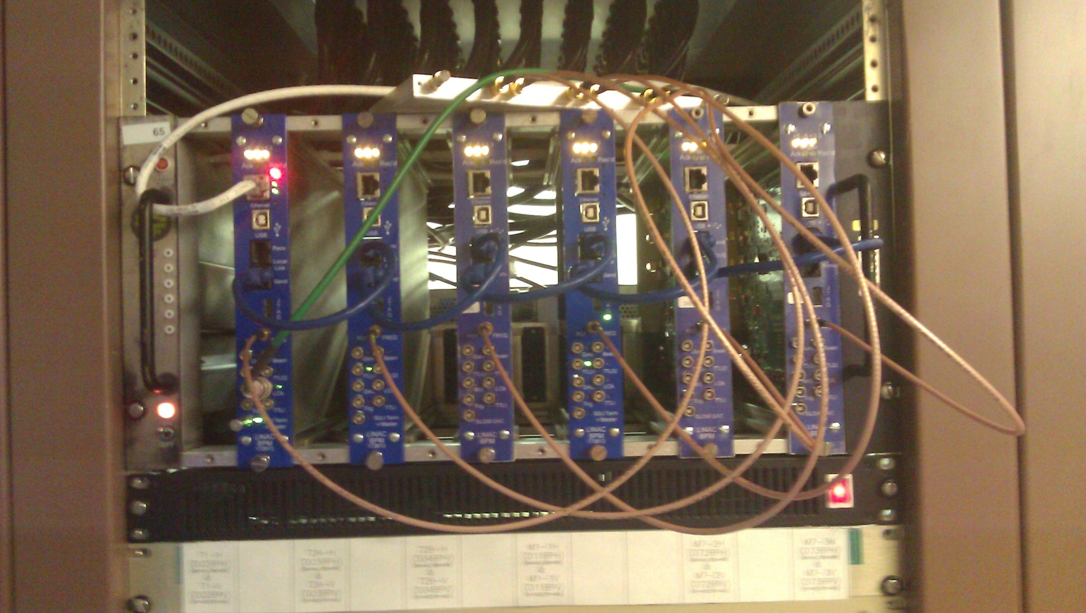
Test Installation Before Shutdown
Replaced one full crate before shutdown
6 Pickups – D02, D03, D04, D11, D72, D73,
Position, Intensity, and Phase readback to ACNET

Slide 6
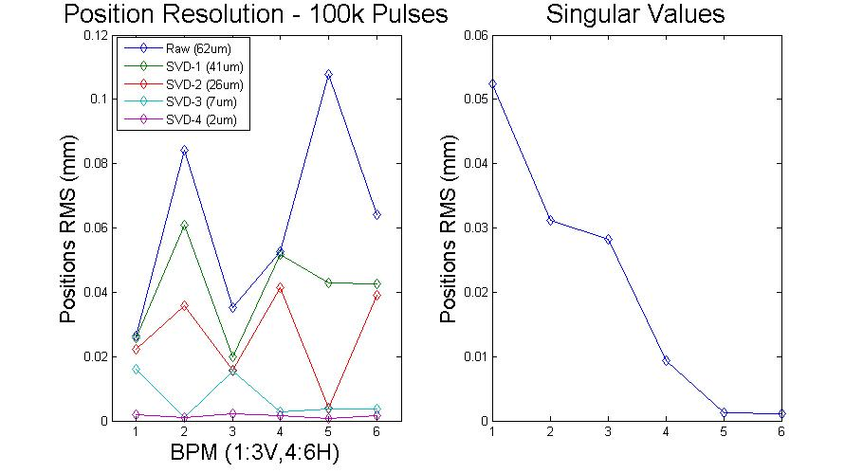
Position Resolution
SVD with only 6 position measurements (3H,3V)
Ideally expect up to 3 modes to correlate with initial trajectory & energy
With only 6 pickups, real noise sneaks into modes
Conservative estimate resolution < 40um

Slide 7
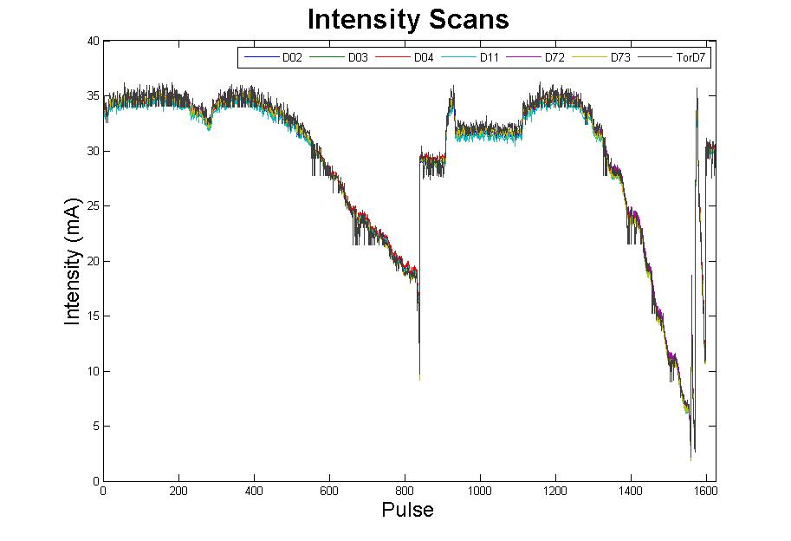
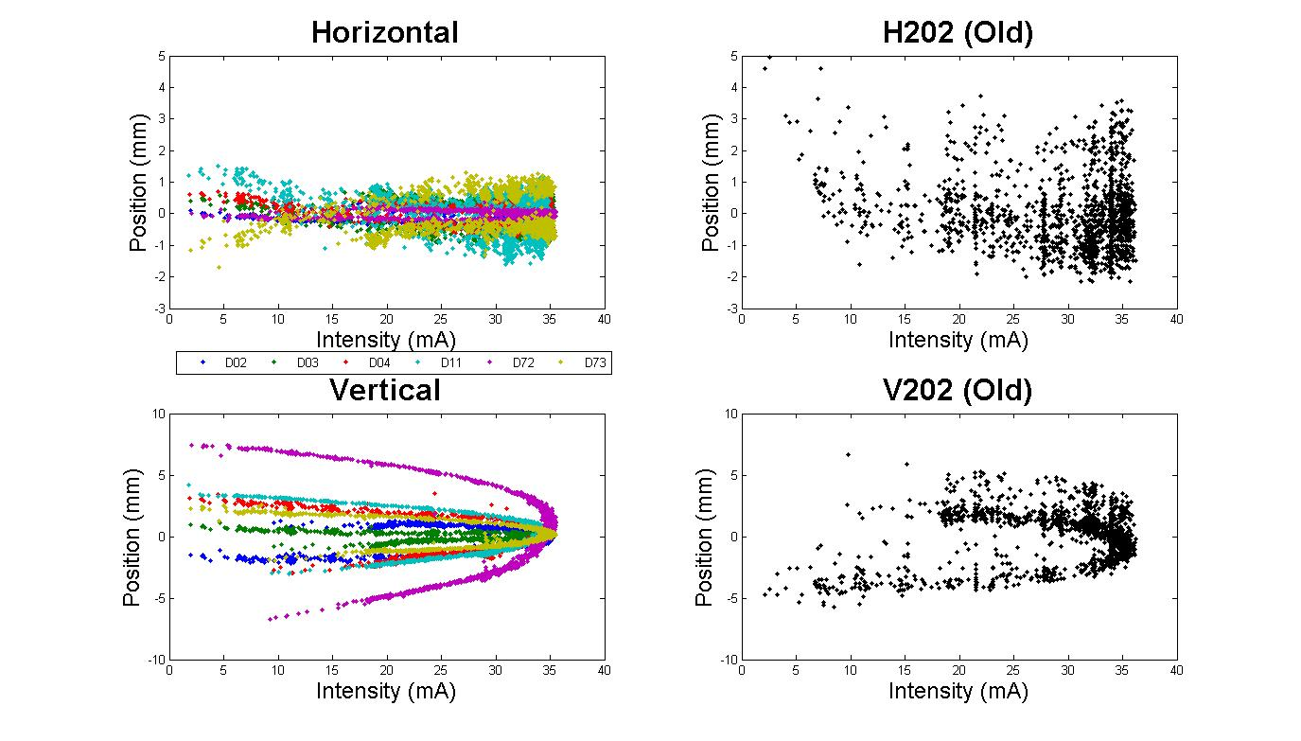
Intensity vs Position

Slide 8
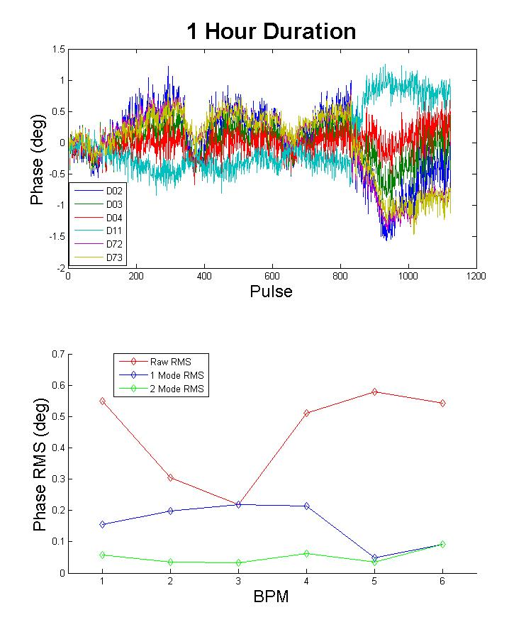
Phase Measurement

Slide 9
Production Board Status
Received first fully stuffed production board before shutdown for checkout
Found error in PCB
Require remaking 80 PCBs
Delay Assembly
$5k additional cost
$10k additional cost due to parts
10 Additional boards + Prototypes
New PCBs in production
Assembled boards ~1 month

Slide 10
Software Status
Provide average Position, Intensity, & Relative Phase over each beam pulse for every BPM @15Hz – in ACNET via linac controls
Have an OAC to perform setup and control
Read/Write all control registers
Synchronized waveform readback
Position, Intensity, Phase @3MHz
Calibration control
Basic functionality tested

Slide 11
Plan
Ready to replace LE bpms with existing boards
Provide ability for further beam testing
Will replace these boards with Production boards once available
Network connections done
Need to provide 805MHz
Will replace the rest of the crates as Production boards become available
Driven by board checkout
May rotate them through LE section for beam checkout
Expect all new boards installed by the end of the year

