Slide 1
Laser Notcher Status
Dave Johnson
PIP Meeting
June 26,2012

Slide 2
Laser Notcher Location Update
Relocated laser notcher from 400 MeV area to 750 keV MEBT just after the RFQ.
Smaller (shorter) interaction cavity
Laser system located close to interaction cavity
Does not require external H0 dump
Minimized beam line & magnet modifications
Laser system same as 400 MeV option
Same pulse energy (2mJ) fewer reflections

Slide 3
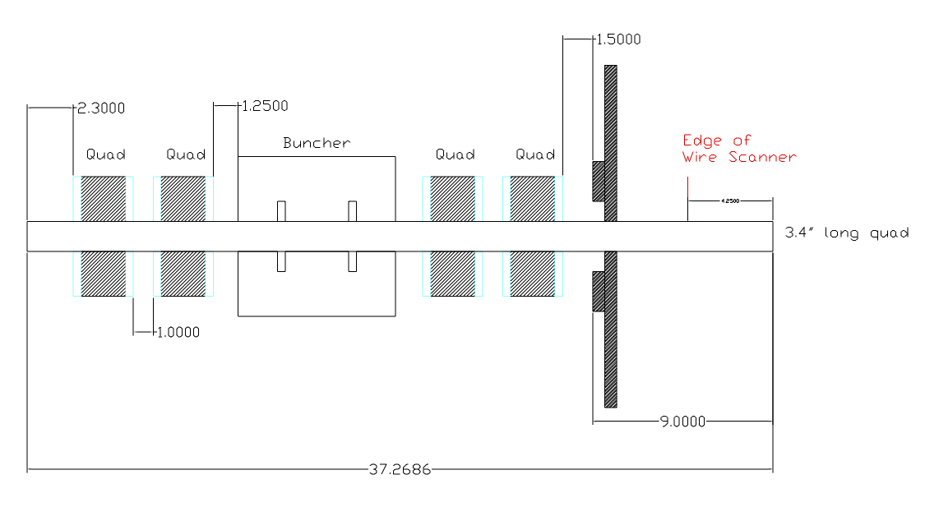
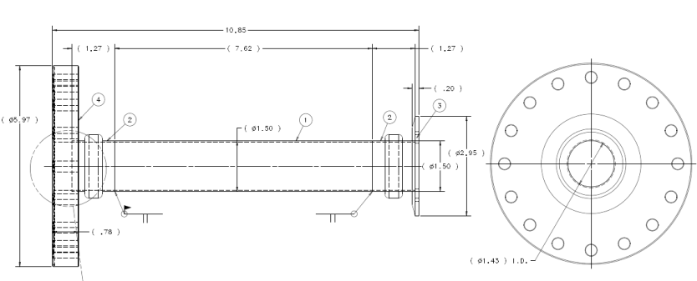
Laser Notcher in the 750 keV MEBT
Tank 1
Quads
RFQ
Laser Notcher
1.25 ns
9.6 mm

Slide 4
750 keV Notcher Insert Concept
1.92” (48.7 mm) Max
Register the mirror holder
to end of RFQ
Laser dump
9.5 mm
Bellows
HR mirrors
29.7 mm
Cavity diameter 33.77 mm
Cavity length 25.65 mm
H- envelope (<10 mm H&V)
Laser Beam
9.5 mm
AR viewport
Rectangular beam pipe
9.6 mm
RFQ flange
Plan View
1.1 mm
Reduce RFQ flange thickness from .5 to .3” OR increase thickness to create a laser transport through the flange

Slide 5
Program Goals
2012
Demonstrate the creation of low intensity optical pulses
David Johnson, Andrea Saewert, Vic Scarpine, Jinhao Ruan (consultant)
Build a prototype transverse pulse shaping system and optical cavity
Todd Johnson
Create a viable preliminary design for the vacuum chamber
John Sobolewski (M/S co-op) (Bradly Durant/Kevin Duel)
2013
Demonstrate the creation of optical pulses through the fiber amplifier chain
Integrate the final pulse generator into the system
Build a prototype vacuum chamber to integrate the optical cavity
2014
Build final vacuum chamber integrating the pulse shaping and optical cavity
Integrate final free space amplifier into system
Be ready for installation of system early in 2015.

Slide 6
Projected FY2012 Expenses
Modulator components $12,750
Photline
Seed source < $10 K
Innovative Photonics/NP Photonics
Optical components ~ $5K
Spherical/clynderical optics, mirrors, optical holders,etc
Misc. components ~ fewK
Chassis, fiber connectors, isolator, dc power supplies
Test equipment ~ $5K
Fast photodiode detector, IR scope,
Pulse generator ~$20K
Picosecond Technologies

