Slide 1
Booster Bias Supply & Test Stand
July 18th, 2012

Slide 2
Ferrite Bias Supply Upgrade
    New Transformer low bid by NWL at a price of $16,760.
    Expect to place order in October.
    SCR heat sink parts are ordered ($11,050), delivery due end of July.
New Ferrite bias Supplies
    One is fully functional.
    One is working but has a thermal problem that stills needs to be solved.
    Last one is 50% tested, finding numerous wiring errors.

Slide 3
New Booster RF Cavity Test Area
    Located in the Tev RF equipment gallery at F0
    Now cleared and ready for lead shields.
        To be installed later this week
    Can then immediately be used to store radioactive cavities as well as some disassembly work.
    Still Needed:
        Mounting of 480VAC disconnect
        Anode Power Supply

Slide 4
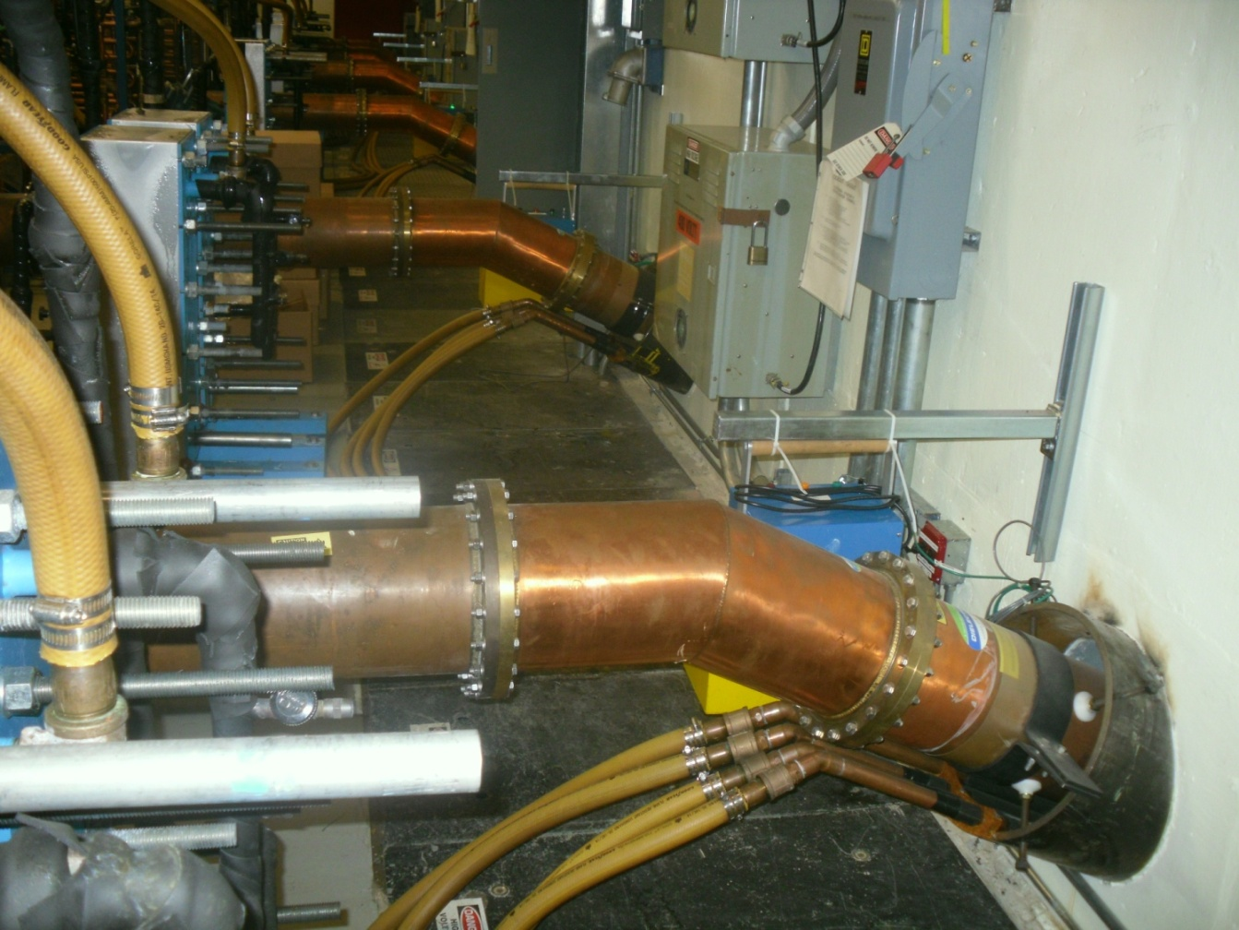

Slide 5
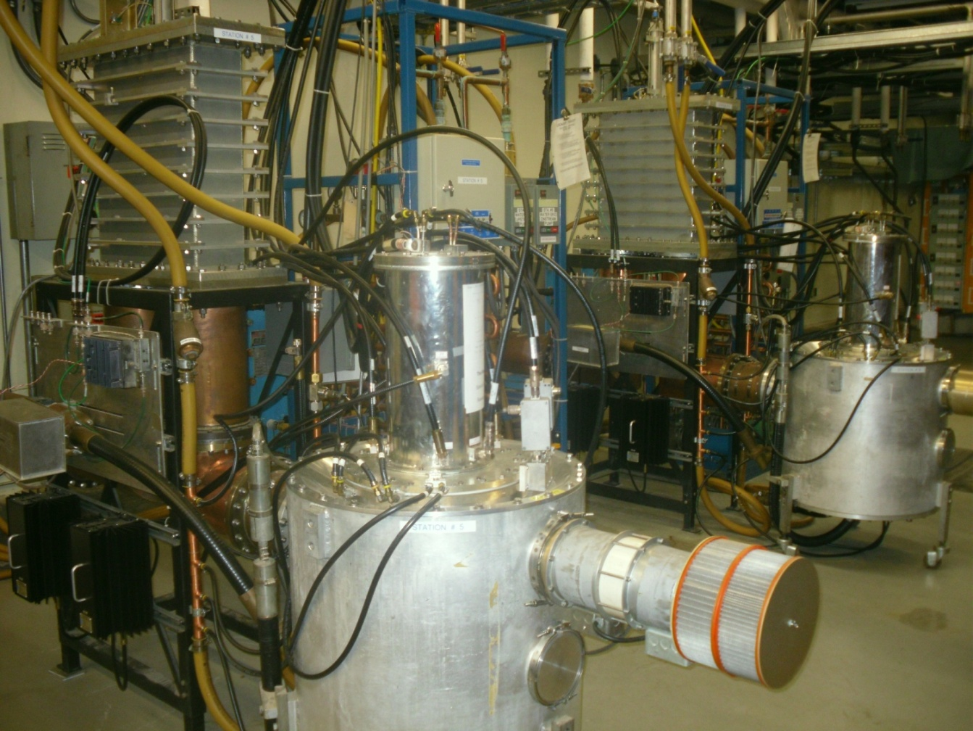

Slide 6
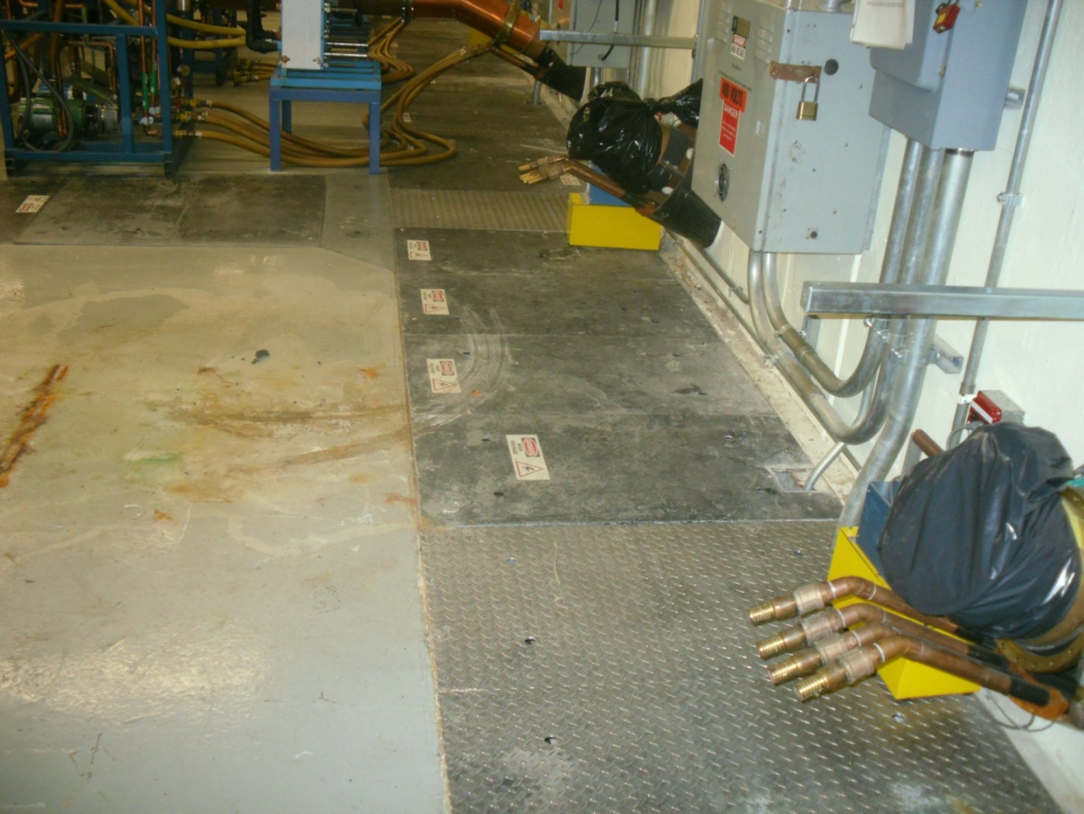

Slide 7
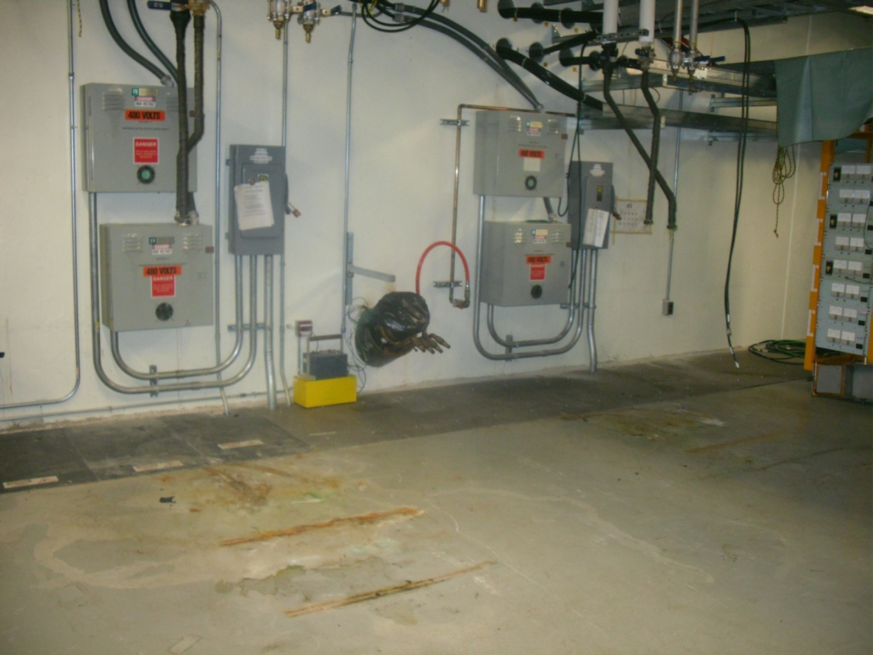

Slide 8
