Slide 1
Linac Laser Notcher Status
David Johnson and Todd Johnson
PIP Meeting
October 10, 2012
Beams doc 4237

Slide 2
Basic Components
Reminder: The purpose of the Linac Laser Notcher:
Reduce losses in Booster tunnel generated by the creation of the Notch
→Create notch at 750 keV
Utilize photo-neutralization (laser system to match temporal structure of H-
Prototype for fast bunch by bunch chopping system
Pulse Generator/timing system
Laser system update
Beam shaping update
Optical cavity update
Vacuum interface update
Control system (LabView?)

Slide 3
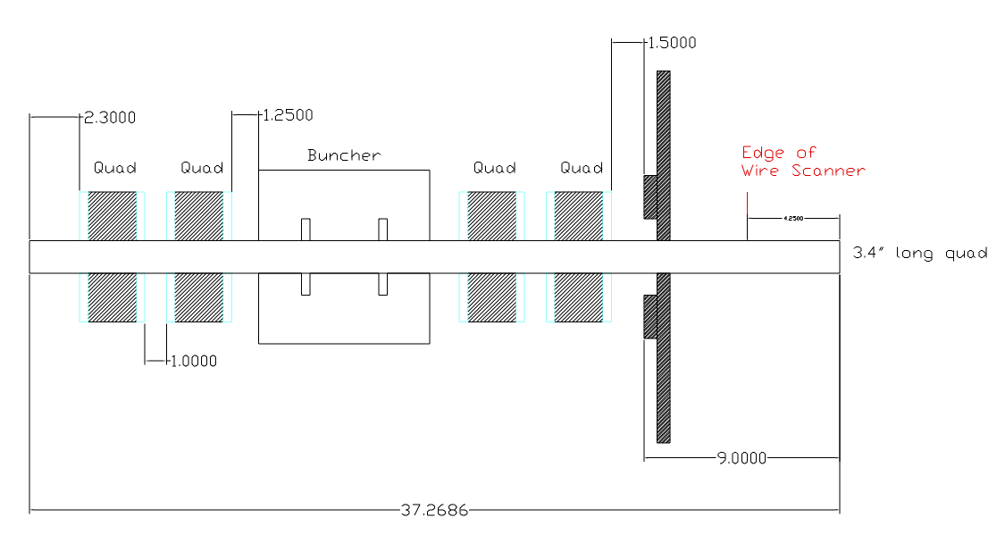
Location Status
Initial concept utilized 400 MeV area.
  Required significant beam line changes
  Required new H0 absorber (beam dump)
Back in April decided to focus on 750 keV
Laser Notcher

Slide 4
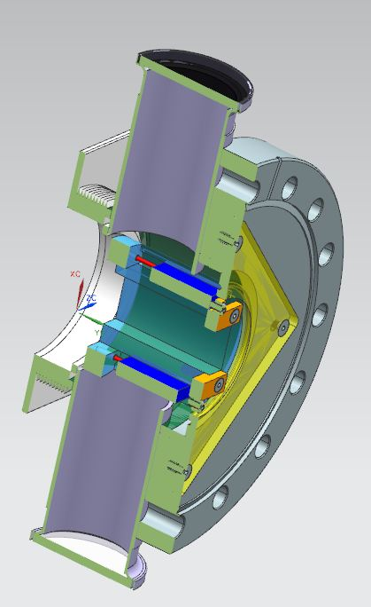
750 keV Notcher Insert Concept
(In flange option)
To reduce laser power: create laser pulse to match spatial and temporal structure of H- beam
And increase interaction time for photo-neutralization through use of zig-zag cavity.
1.92” (48.7 mm) Max
Laser Beam
RFQ flange
Laser dump
Register the mirror holder
to end of RFQ flange
9.6 mm
9.5 mm
HR mirrors
29.7 mm
1.1 mm
Cavity diameter 33.77 mm
Cavity length 25.65 mm
Bellows
Rectangular beam pipe
Plan View
AR viewport
MS co-op (John Sobolewski) started looking at potential designs of the vacuum system interface. To be continued at a low level effort by MS (co-op)/University collaboration, or other resource.

Slide 5
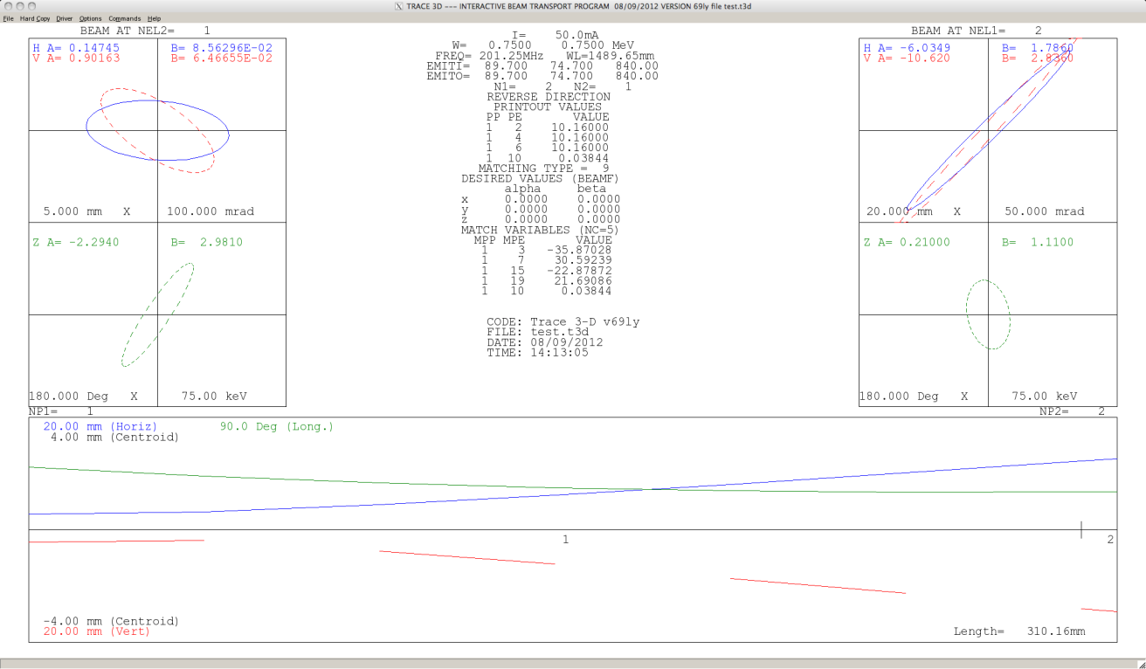
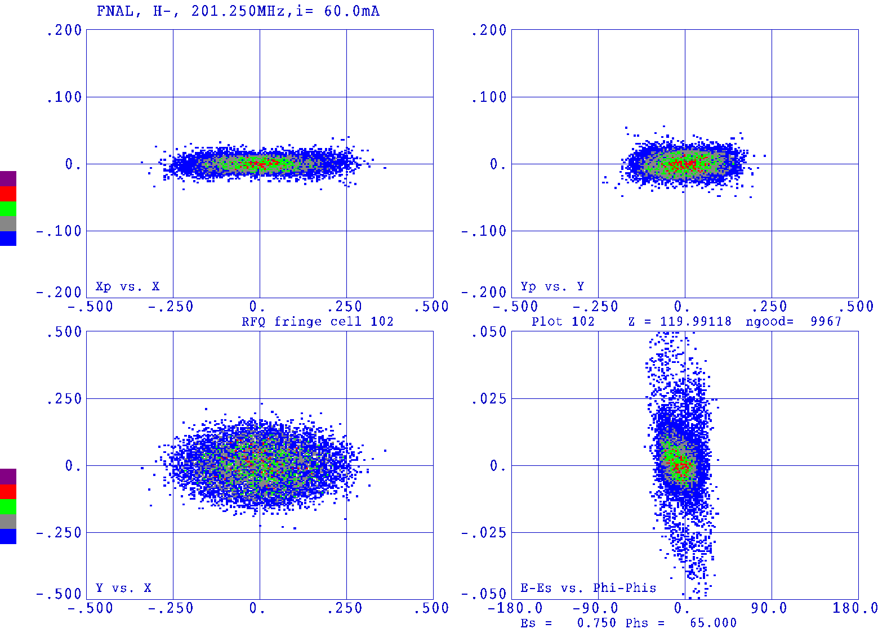
Expected Beam Dimensions
Trace 3D back calculation of beam size at exit of RFQ based upon emittance measurement at 178 kW power August 9, 2012 CY Tan.
Phase space simulation at end of RFQ (figure 4.40 of 750 KeV Upgrade Plan)
Laser beam vertical profile (1/e²) ~ 5 mm.
Initial design assumed that the vertical laser beam dimension of 1 cm.
Beam measurements indicate vertical laser size could be reduced to 6 mm
This is a variable parameter in the beam shaping optics.

Slide 6
Burst mode seed pulses to Fiber Amplifier followed by Free Space Amp
λ₁=1064nm
120 mW CW
SW=0.1 nm
Output modulator/Input fiber pre-amp:
201.25MHz pulses (1.25 ns pulse), 458kHz burst
10 GHz Mach-Zehnder
Modulator
L_{i}~1.8dB
Isolator
PM Fiber
Diode + TC
controlled
L_{ins} ~5dB
Pulse Generator
Amplifier, Timing
Line filter
Fiber Amp 2
Fiber Amp 1
Free
Space
Fiber Pre-Amp
*Notch 12 bunches -> 60 ns
10 notches/linac pulse
Clean up filter
 | E_{P} | P_{P} | P₂₀₀* | P₄₅₀*
FPA IN | 26 pJ | 21 mW | 5.3 mW | 1243uW
FPA OUT G= 20 dB | 2.6 nJ | 2.1 W | 0.53 W | 14.3 mW
FA 1 IN | 1.8 nJ | 1.4 W | 0.44 W | 10 mW
FA 1 OUT G=23 dB | 360 nJ | 288 W | 972W | 2.0 W
FA 2 IN | 300 nJ | 240 W | 60 W | 1.6 W
FA 2 OUT G=11.5 dB | 4.2 uJ | 3.4 kW | 1.1 kW | 23 W
FSA IN | 4.0 uJ | 3.1kW | 795 W | 22 W
FSA OUT G=27-29dB | 2.0 mJ 3.1 mJ | 1.6 MW 2.5 MW | 400 kW 630 kW | 11 kW 17 kW
Generate 24 us burst at 15 hz
15 Hz
Free Space Amp
Pockels cell
Grumman CEO DPSS OEM
TRANSPORT BEAM SHAPING OPTICS &
OPTICAL CAVITY
Updated 10/3/2012

Slide 7
The Plan (as of today)
Due to lack of major M&S funding for FY13, we accelerated purchases (with available FY12 funding) planed for FY13 and moved the schedule forward.
To date we have purchased:
  Seed laser and controller
  Modulator system (borrow pulse generator)
  First 2 stages of fiber amplifier system ***
  Fiber to free space port
  Beam shaping optics (532 nm and 1064 nm)
  Optical cavity components (532 nm and 1064 nm)
What would we like to accomplish this year (FY13) ?
  Certify operation and parameterize the following:
    Optical Pulse Generator
    1st two (of three) stages of the fiber amplifier system
    Beam shaping and transport optics with 532 nm laser
    Beam shaping and transport optics with the output of the (1st 2 stages) fiber amplifier system (IR)
    Prototype optical cavity (532 nm in fluorescent cell)
    Optical cavity with IR
  Demonstrate 15 Hz burst of the 201.25 MHz and 458 kHz QCW laser pulses with Pockels cell.

Slide 8
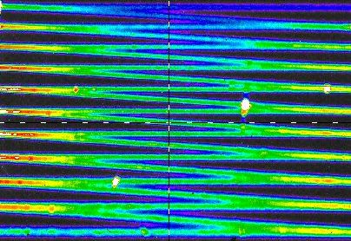
Beam shaping and optical cavity tests

Slide 9
Test setup
In order to evaluate the uniformity of the laser beam profile in the transverse cavity, a dye cell was employed. Water in a clear container is weakly doped with a fluorescent dye which absorbs 532nm from the test laser and re-emits at longer wavelengths, allowing any scattered portions of the primary beam to be filtered out and rejected from the analysis.

Slide 10
Two initial approaches:
Fill aperture with a “staircase” of overlapping elliptical gaussian beams to present a uniform optical field to the ion beam.
Utilize a “PiShaper”; an optical device which converts a gaussian profile beam to one with a flat-top profile, to produce a vertically uniform beam which fills the aperture.

Slide 11
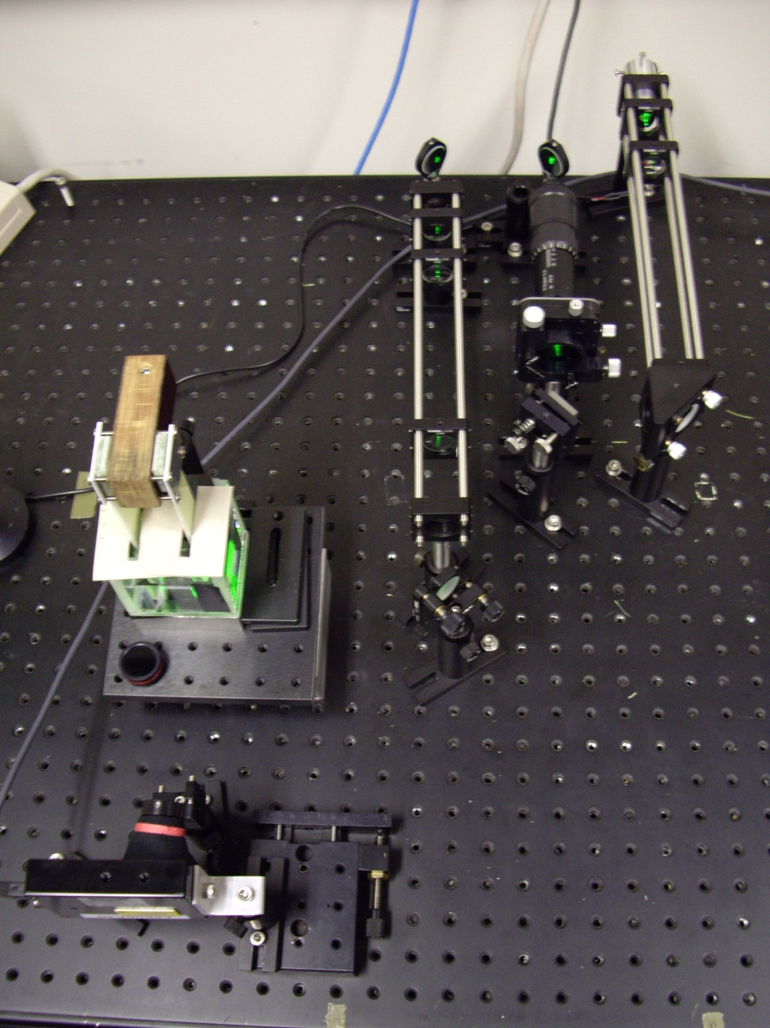
Dye cell test setup
Laser &
Telescopes
Dye Cell
Analyzing camera

Slide 12
Telescopes
The test optics consist of two variable magnification cylindrical telescopes and the PiShaper device.
The PiShaper function depends critically on proper input beam characteristics, so the first telescope is used to deliver an appropriately sized elliptical beam to the PiShaper. The second telescope is used to expand the 6mm output of the PiShaper to any desired vertical size up to 25mm.

Slide 13
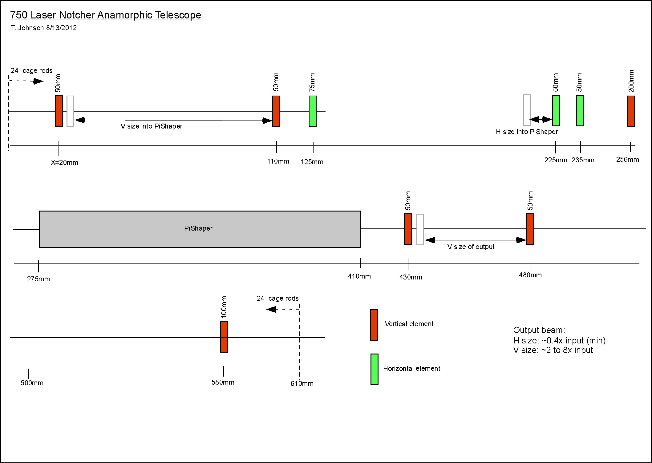

Slide 14
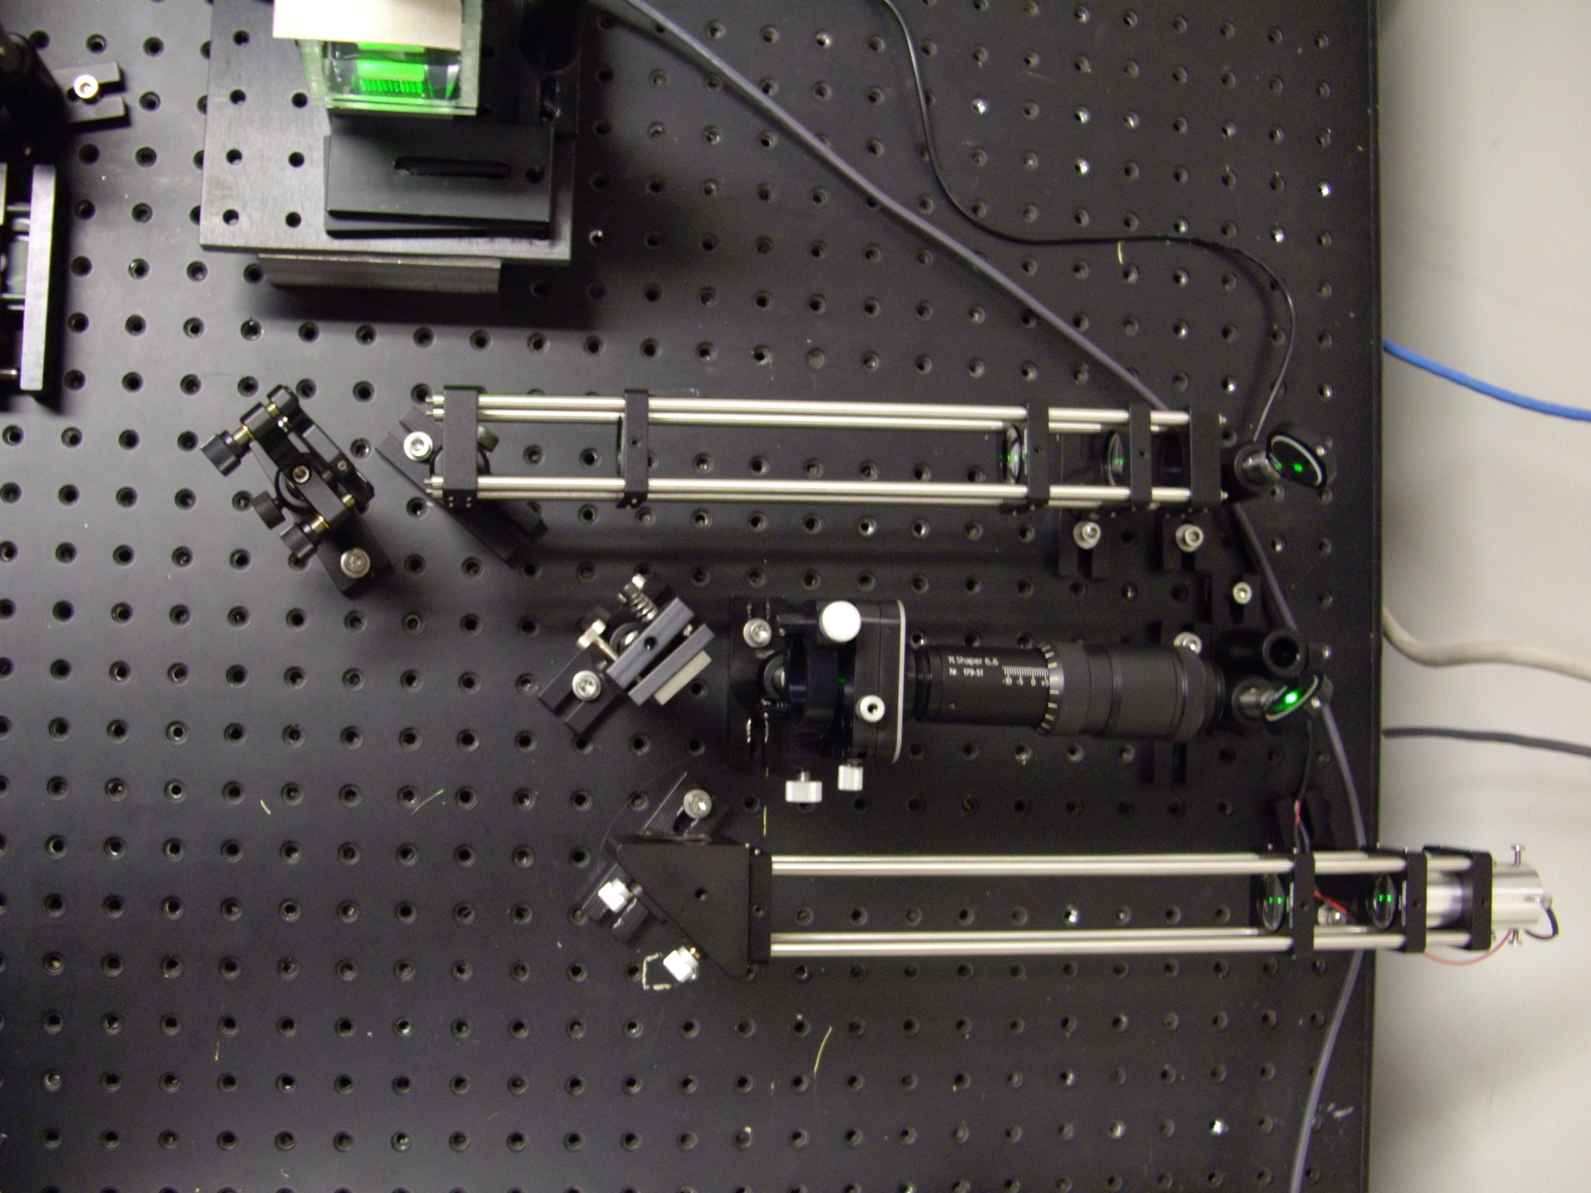
Dye Cell
Second telescope
PiShaper
532nM laser
First telescope

Slide 15
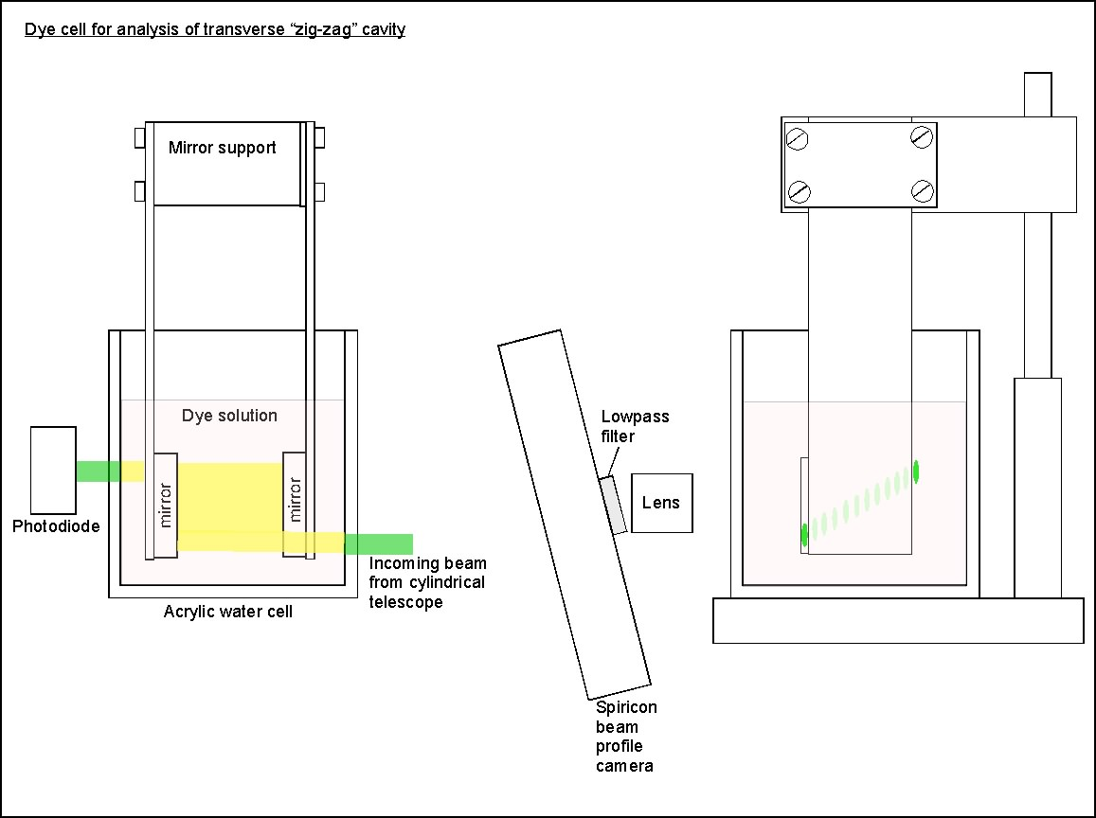
Dye cell detail

Slide 16
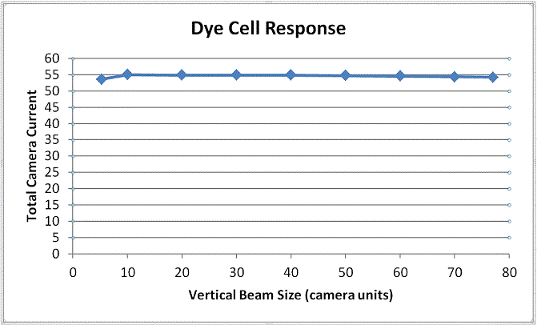
Response of the dye was tested to ensure linear behavior with varying primary beam intensity

Slide 17
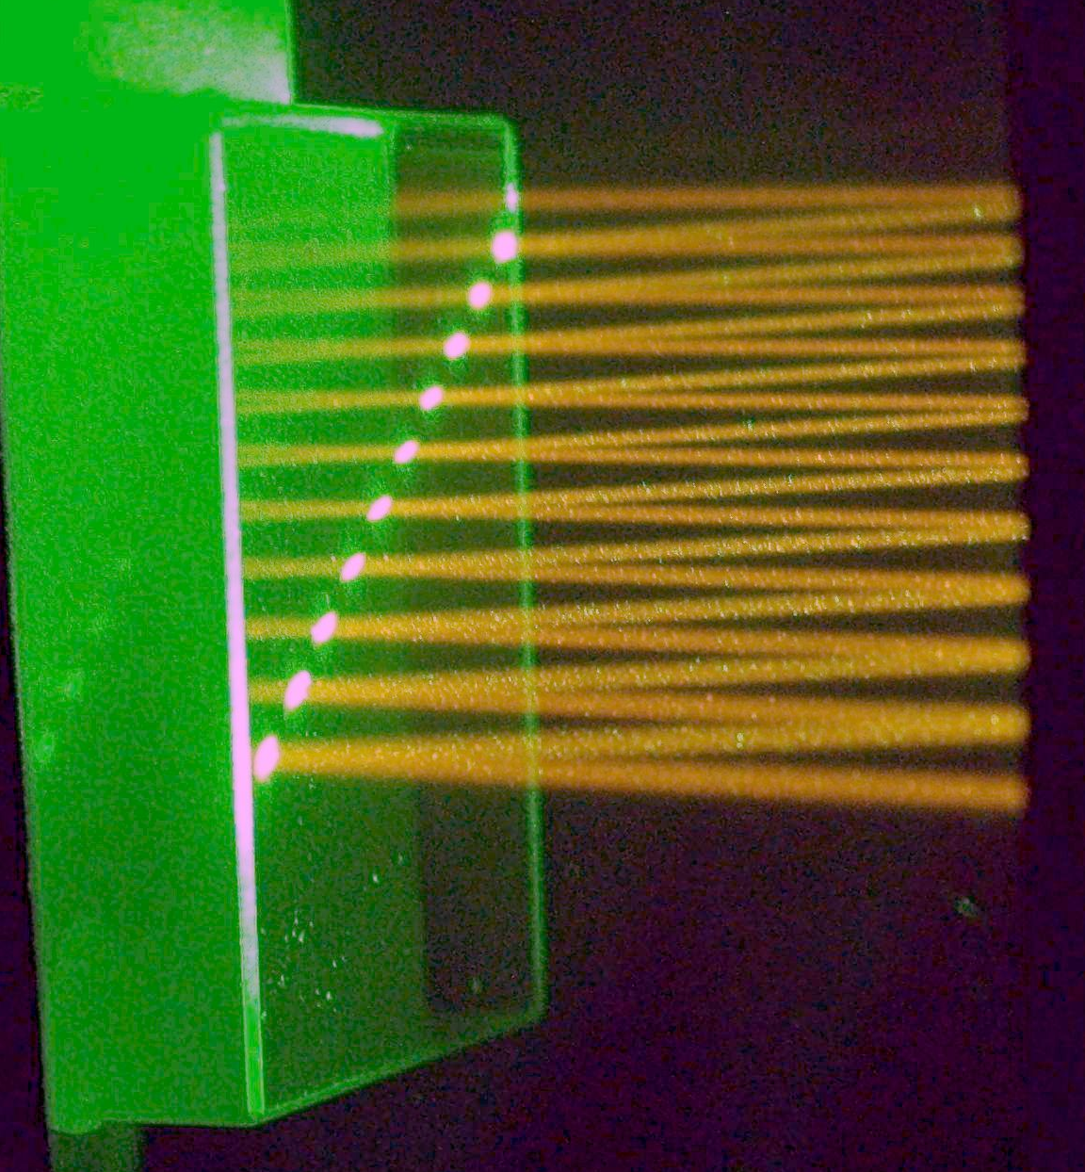
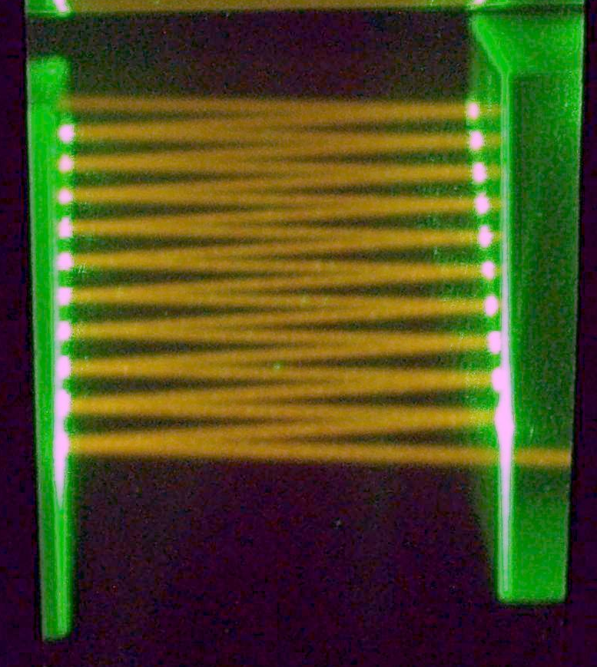
Aligning cavity mirrors in the dye cell with unexpanded beam

Slide 18
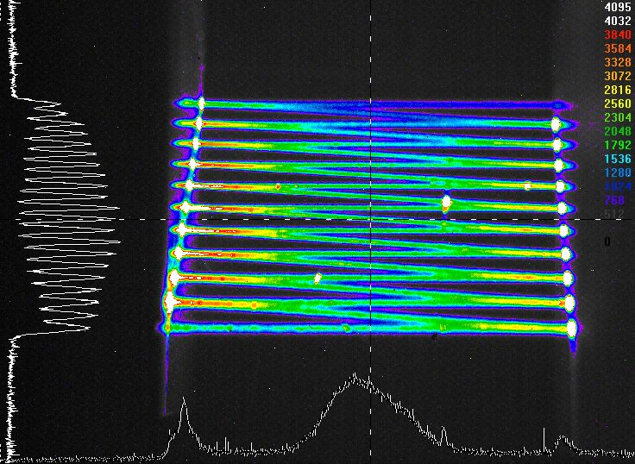
Profile of unexpanded staircase trajectory
(Spiricon camera with 600nM lowpass filter)

Slide 19
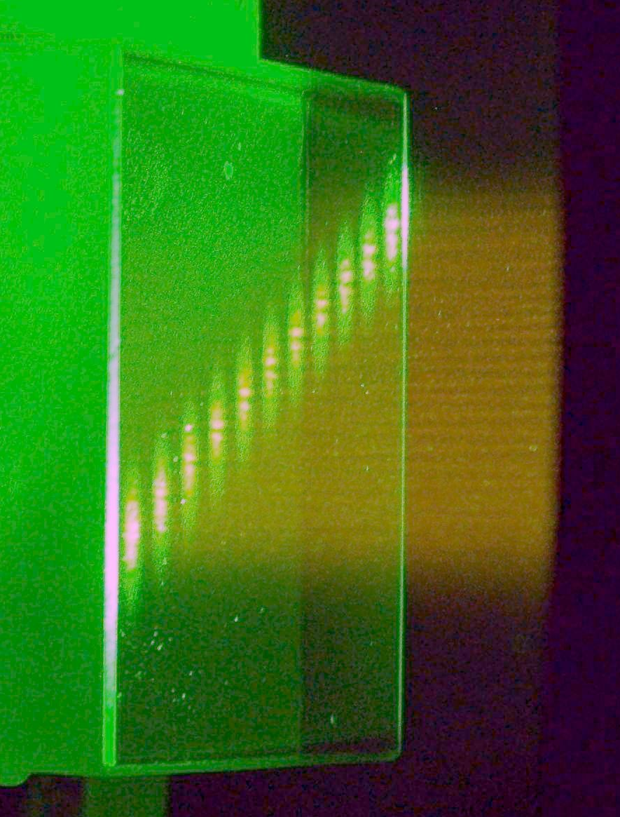
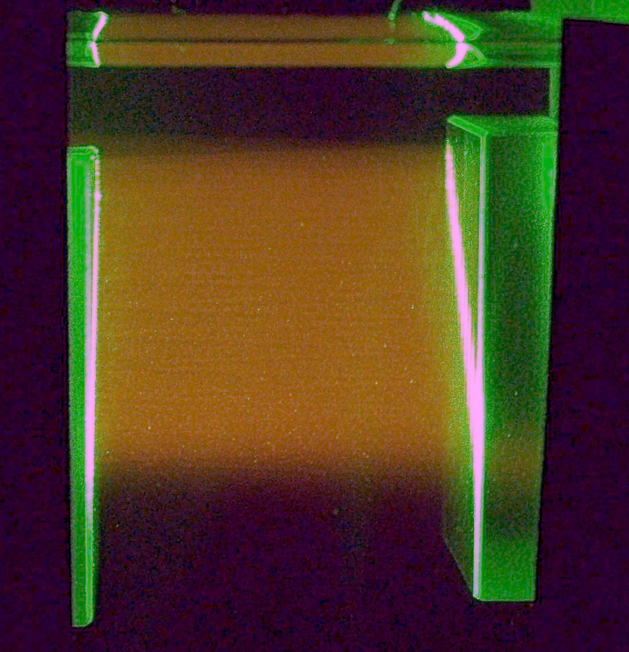
Beam expanded vertically with first telescope (no PiShaper)
and propagated in the overlapping staircase configuration

Slide 20
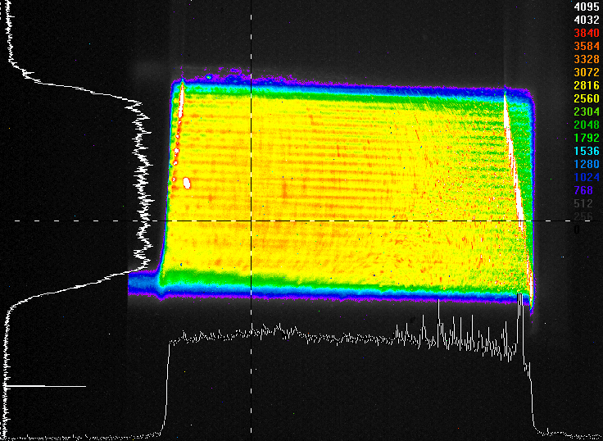
Resulting profile of staircase configuration
(Spiricon camera w 600nM lowpass filter)

Slide 21
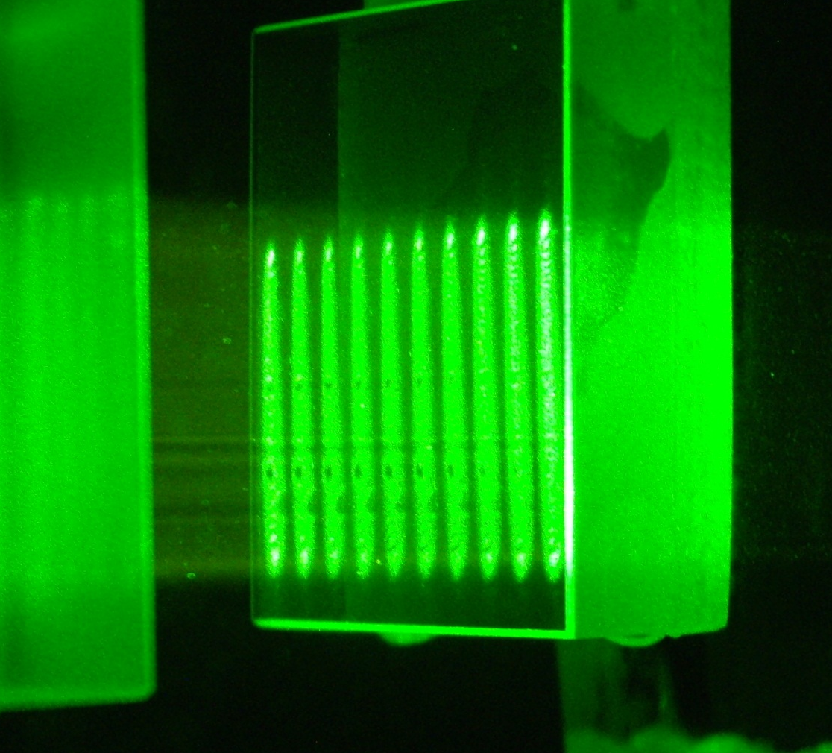
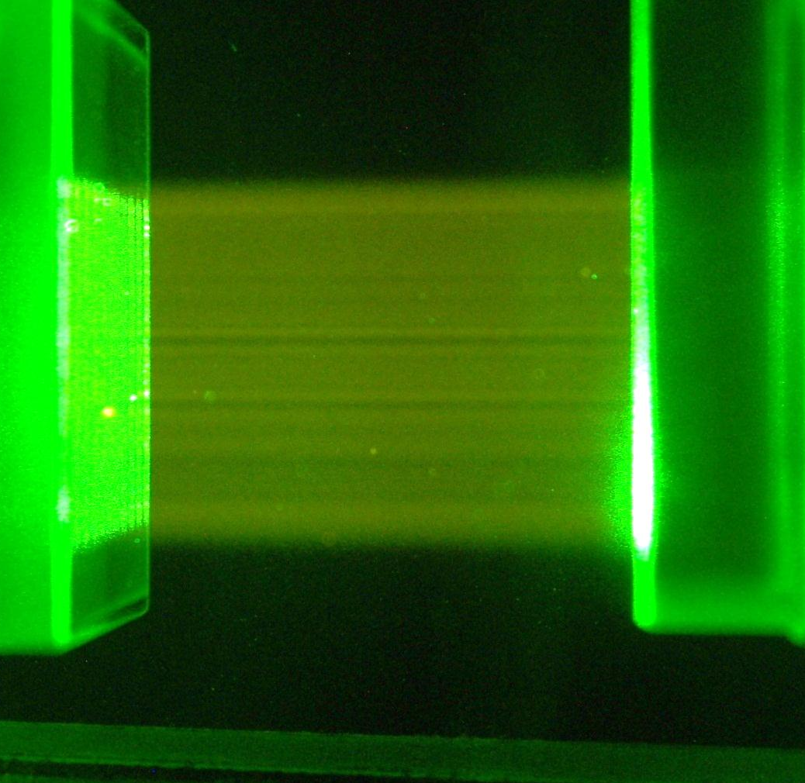
Beam expanded through both telescopes and processed with PiShaper

Slide 22
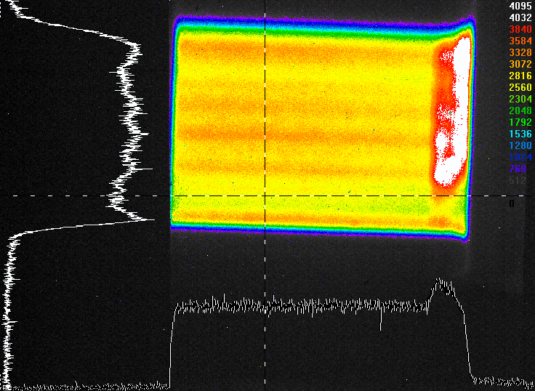
Profile of overlapping PiShaper output
(Spiricon camera with 600 nM lowpass filter)

Slide 23
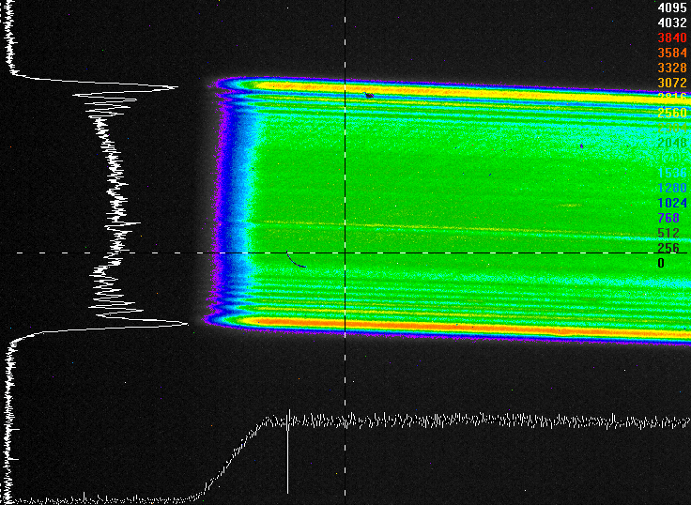
Single pass expanded PiShaper beam
(Fine adjustment of the input beam parameters will
reportedly remove much of the observed structure.)

Slide 24
Conclusions
                Variable beam shaping telescopes performed as expected.
                The PiShaper is very sensitive to input conditions. Additional tuning is needed to take full advantage of this device.
                Both methods of producing a vertically uniform optical field in the zig-zag cavity showed promising results.

