Slide 1
PIP Status Report
Linac Startup plans
12/05/2012

Slide 2
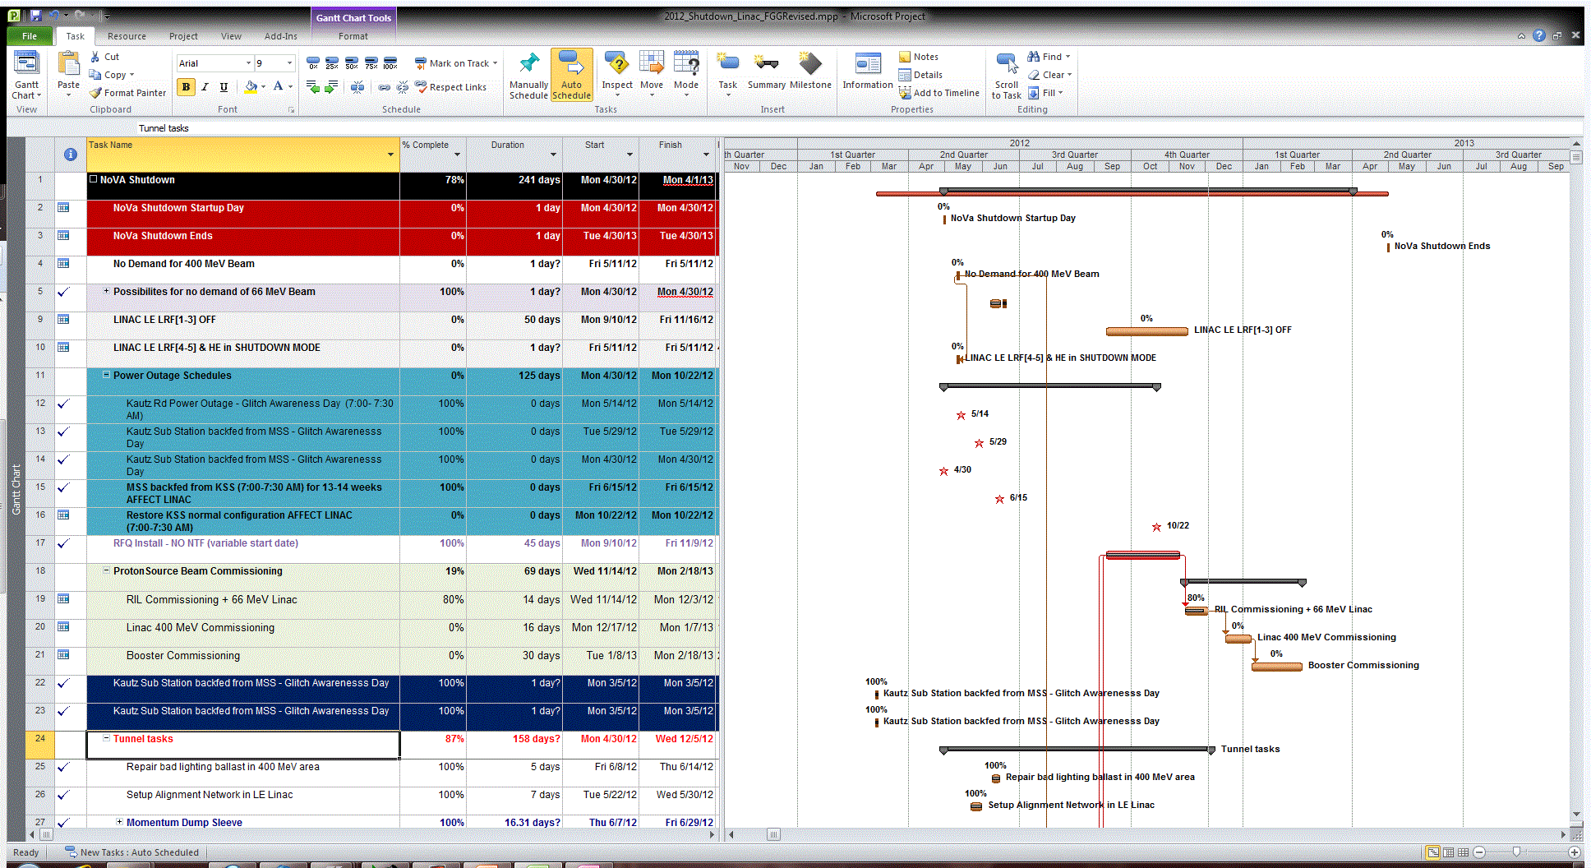
Linac Shutdown Activities
Active year for Linac…
HE shutdown started
with the lab shutdown
LE region stayed ON
  NTF patient treatment
  Detailed MP file developed
  ** 34 major tasks
  ** 600 lines of work description

Slide 3
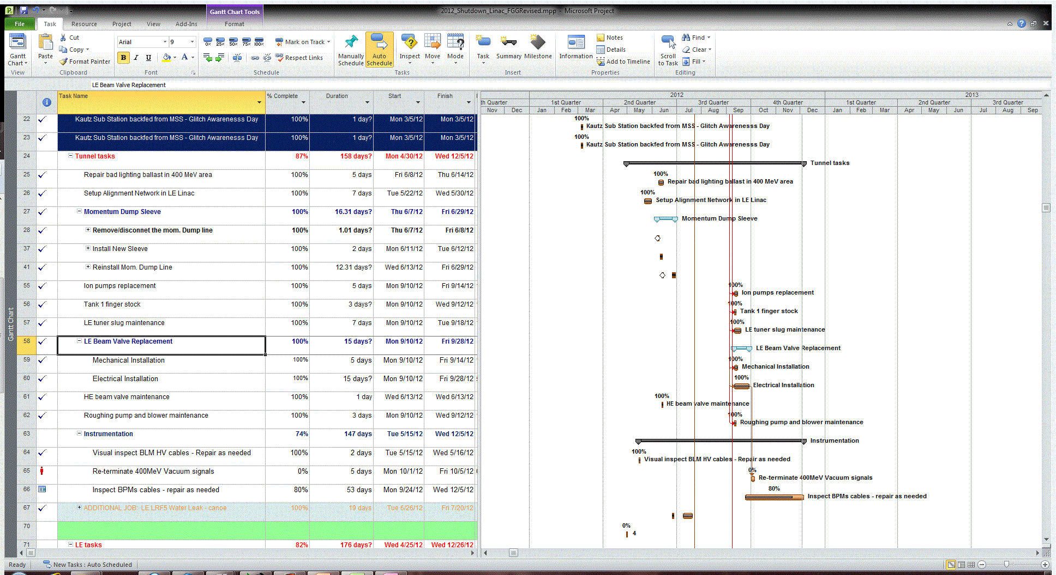
Linac Tunnel Activities

Slide 4
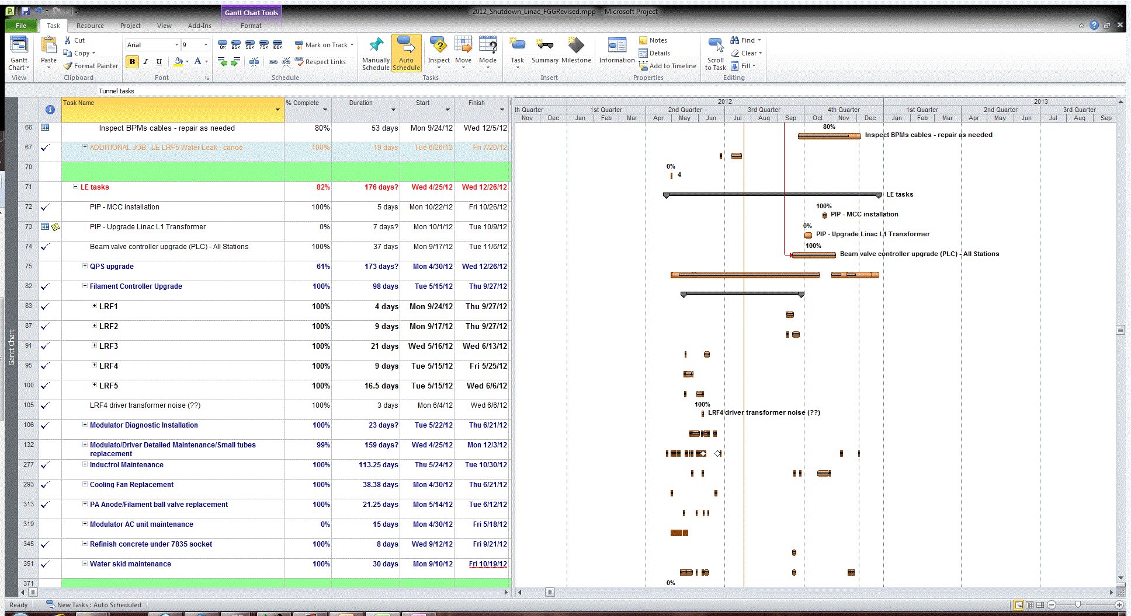
Linac Low Energy Activities

Slide 5
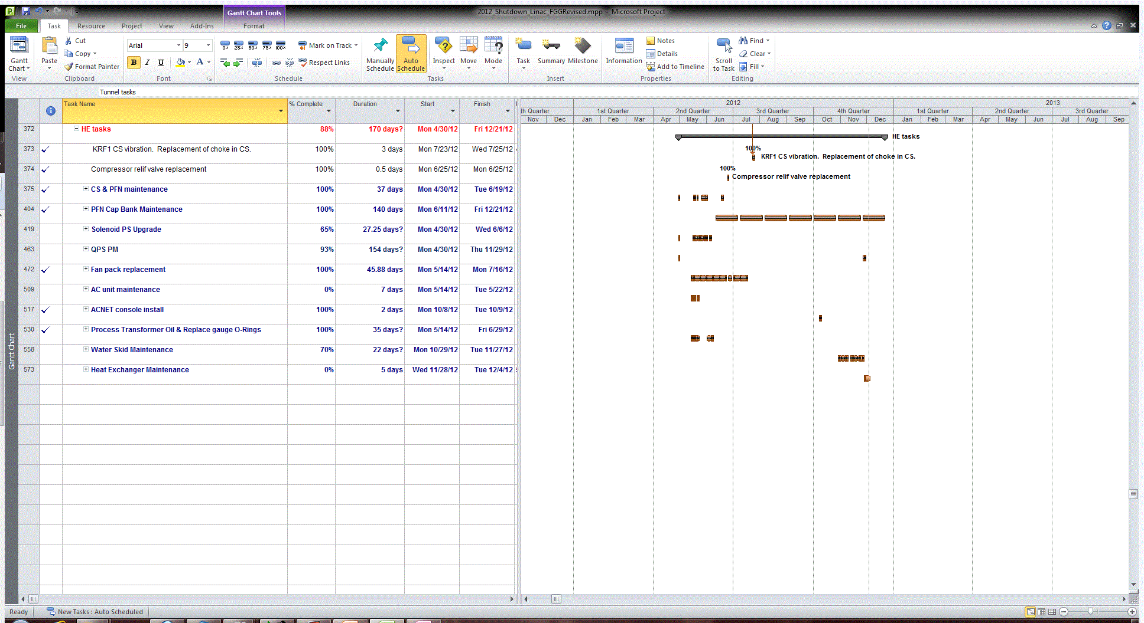
Linac HE Activities

Slide 6
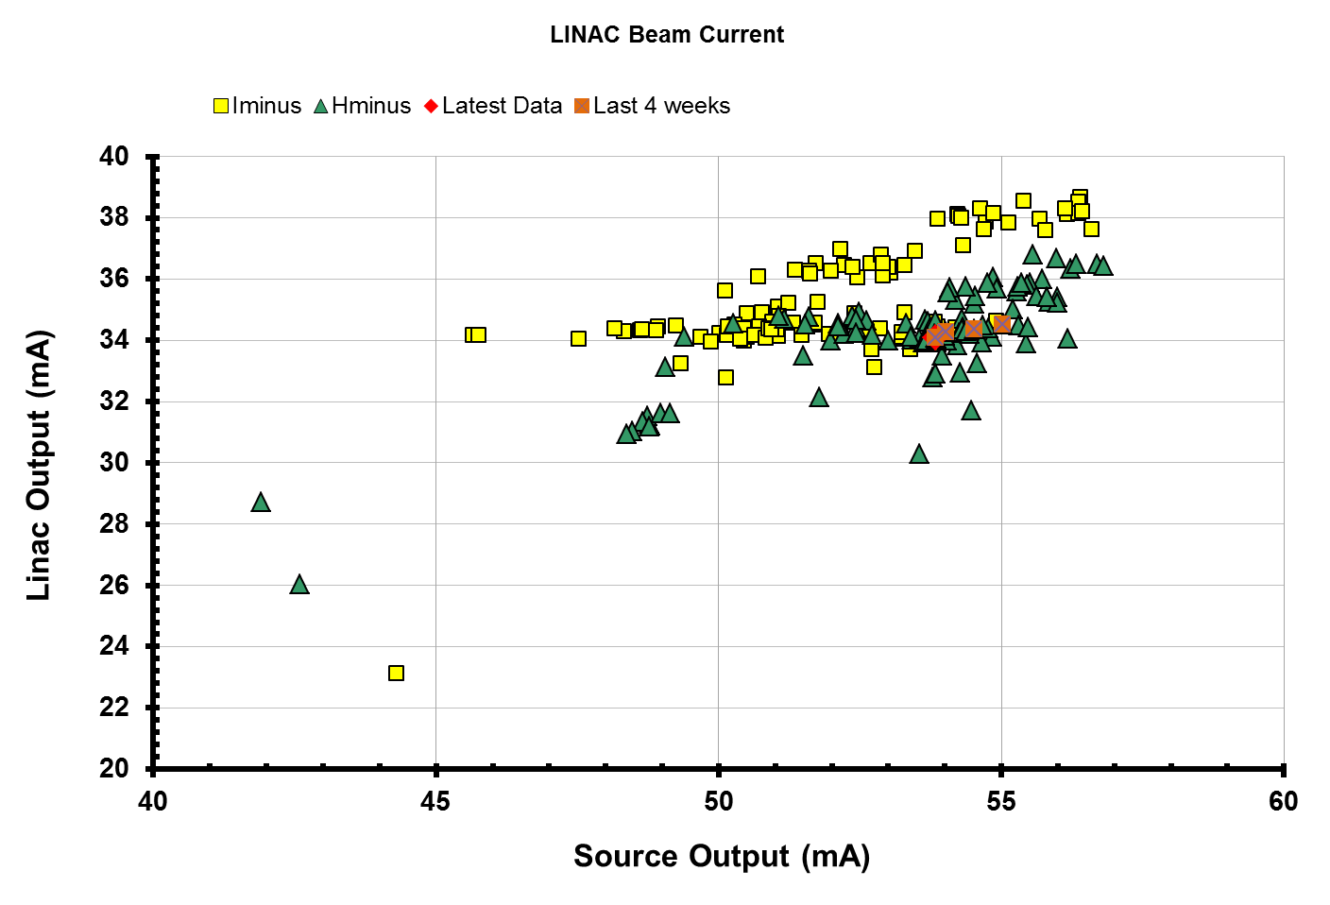
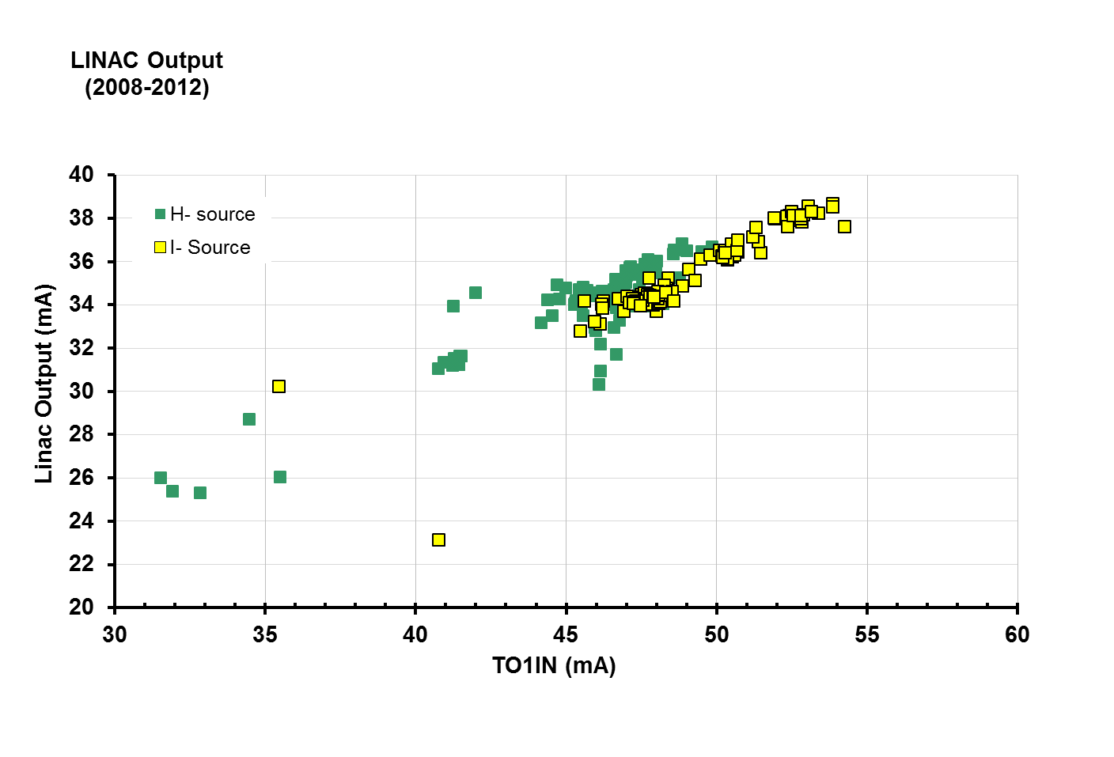
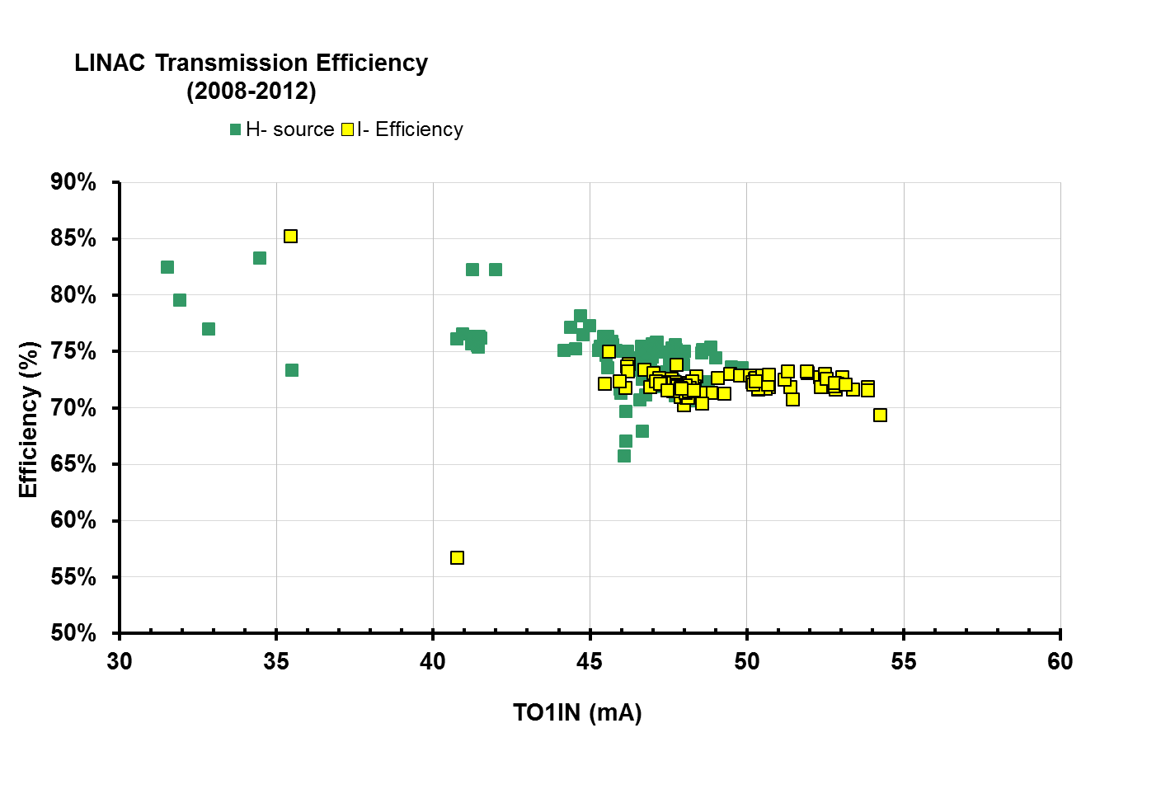
Linac Performance
Prior Shutdown 2012
Average
Input beam current: 48.5 mA
Output beam current: 35.0 mA
Efficiency: 72%
Peak Values
Input beam current: ~57 mA
Output beam current: ~38.7 mA
Efficiency: 74% (not at these peak values)
Nominal:
Beam current: 34.5 mA

Slide 7
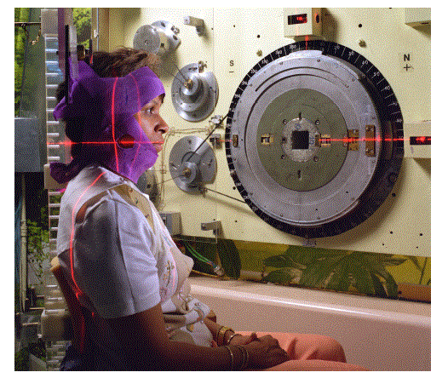
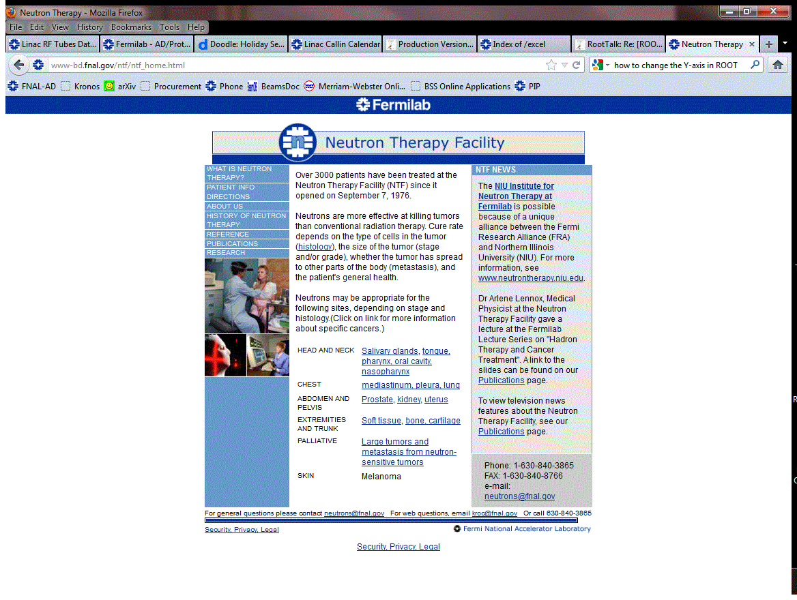
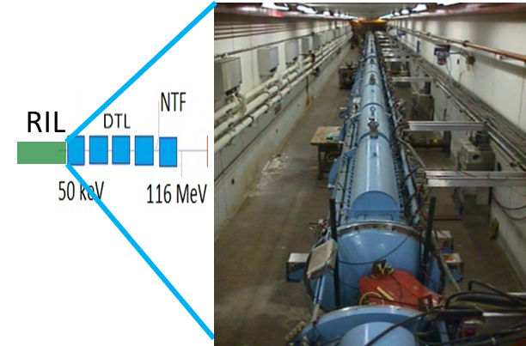
NTF at a Glance
Treatment occurs 3 times a week
Tuesday, Thursday and Friday
Time: 8:00 A.M. 11:30 A.M.
Treatment typically lasts 4 weeks
Not counting the setup time which takes
a couple of hours typically one week
prior the setup
Beam to NTF
extract at 66 MeV H⁻ beam, 15 Hz,
nominal Linac intensity (34.5 mA), 64 μsec macro pulse length
http://www-bd.fnal.gov/ntf/ntf_home.html

Slide 8
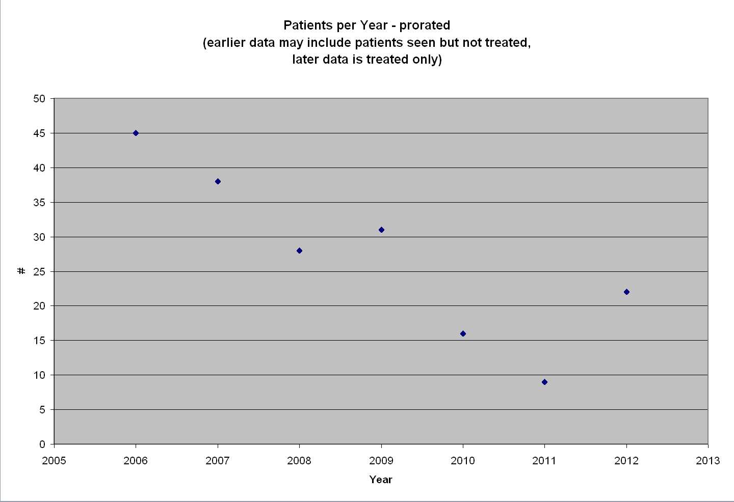
A glance at the NTF program
Courtesy of T. Kroc

Slide 9
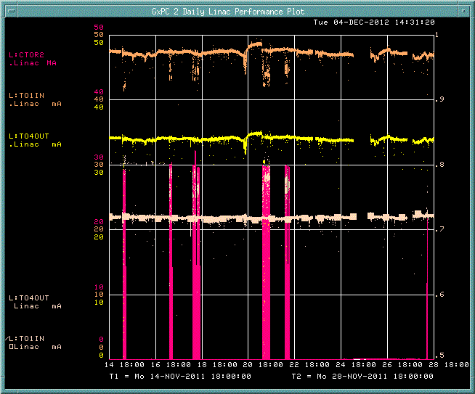
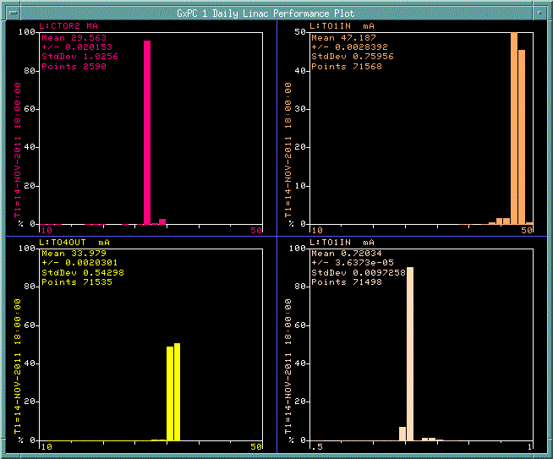
Typical NTF Beam
14-Nov-2011 – 28-Nov-2011
CTOR2 50
50
TO1IN 50
TO4OUT
TO4OUT/
TO1IN 0
1
0.9
0.8
.0.7
0.6
0.5
CTOR2
~ 30 mA
TO1IN
47.2 mA
TO4OUT
~ 34 mA
Eff
~ 72%

Slide 10
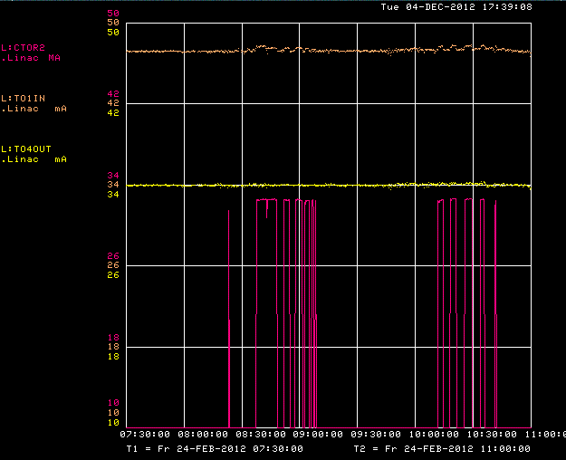
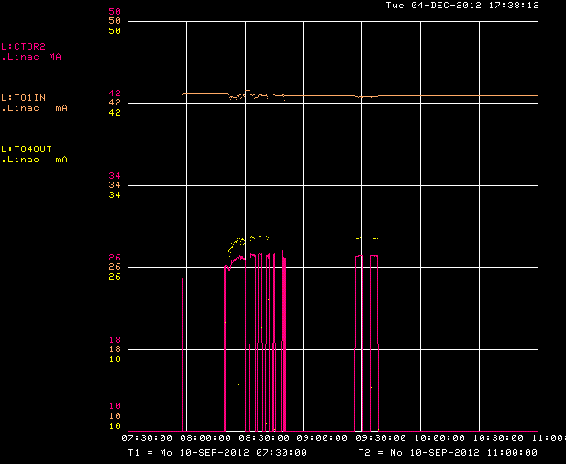
Lower Beam Intensity = Longer Treatment Time
On Feb. 24, 2012: CTOR2 = 32.5 mA The given dose was 0.765 MU Beam time was 2.23 min (0.343 MU/min) | On Sept. 10, 2012: CTOR2 = 27 mA The given dose was 0.909 MU Beam time was 3.67 min (0.248 MU/min)
Treatment times are inversely proportional,
but linear, to TLG percentage & beam current
Tom Kroc
Holding still
time causes
all the stress.
T. Kroc

Slide 11
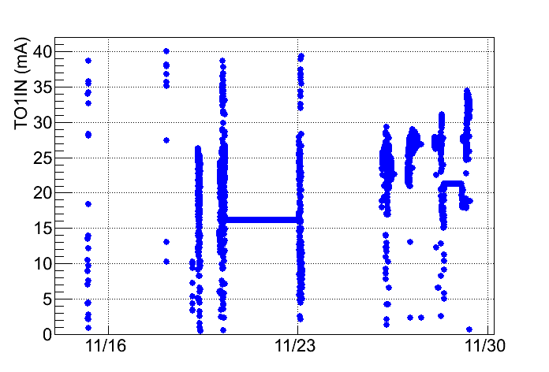
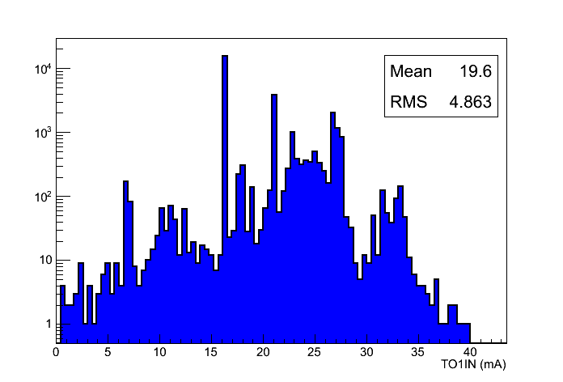
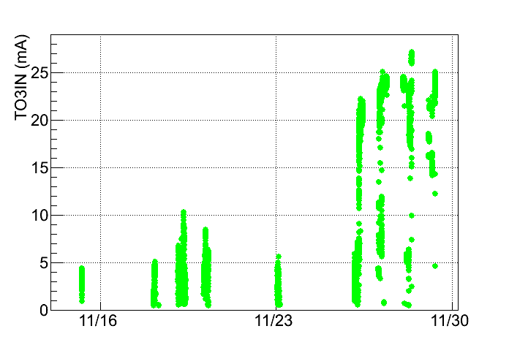
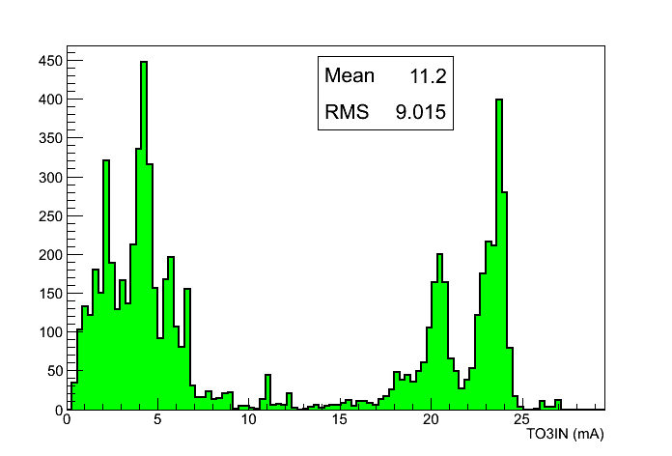
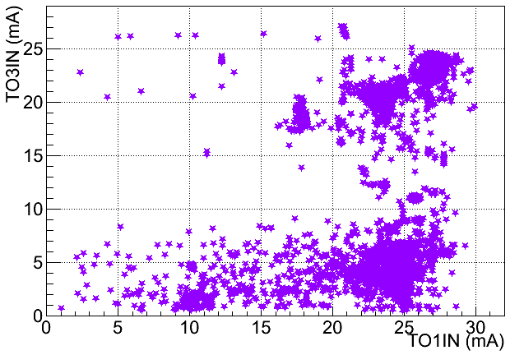
RIL & 66 MeV
Commissioning
RIL delivered 750 keV to entrance of DTL tk1
Nov 14th, first day of RFQ commissioning
    poor capture and transmission
    small intensity beam seen at 37.5 MeV (DTL tk3)
12 days later, a buncher phase scan was performed
    better matching into Linac
    transmission improved
  Initial beam study the beam pulse length and
  rep.rate set to 10 μsec long and 1 Hz, respectively
    to avoid possible accelerator components
    damage
rr
rr

Slide 12
NTF Schedule
NTF has been off since September 10, 2012 for RFQ Installation
Treatment schedule resumes December 11, 2012
  3 patients booked
  setup time occurring this week
NTF beam permit was revised and signed November 16, 2012
NTF staff is ready for resuming treatment
  … and so is RIL and Linac

Slide 13
Beam is making to NTF
Oct 2011 | Nov 2012

Slide 14
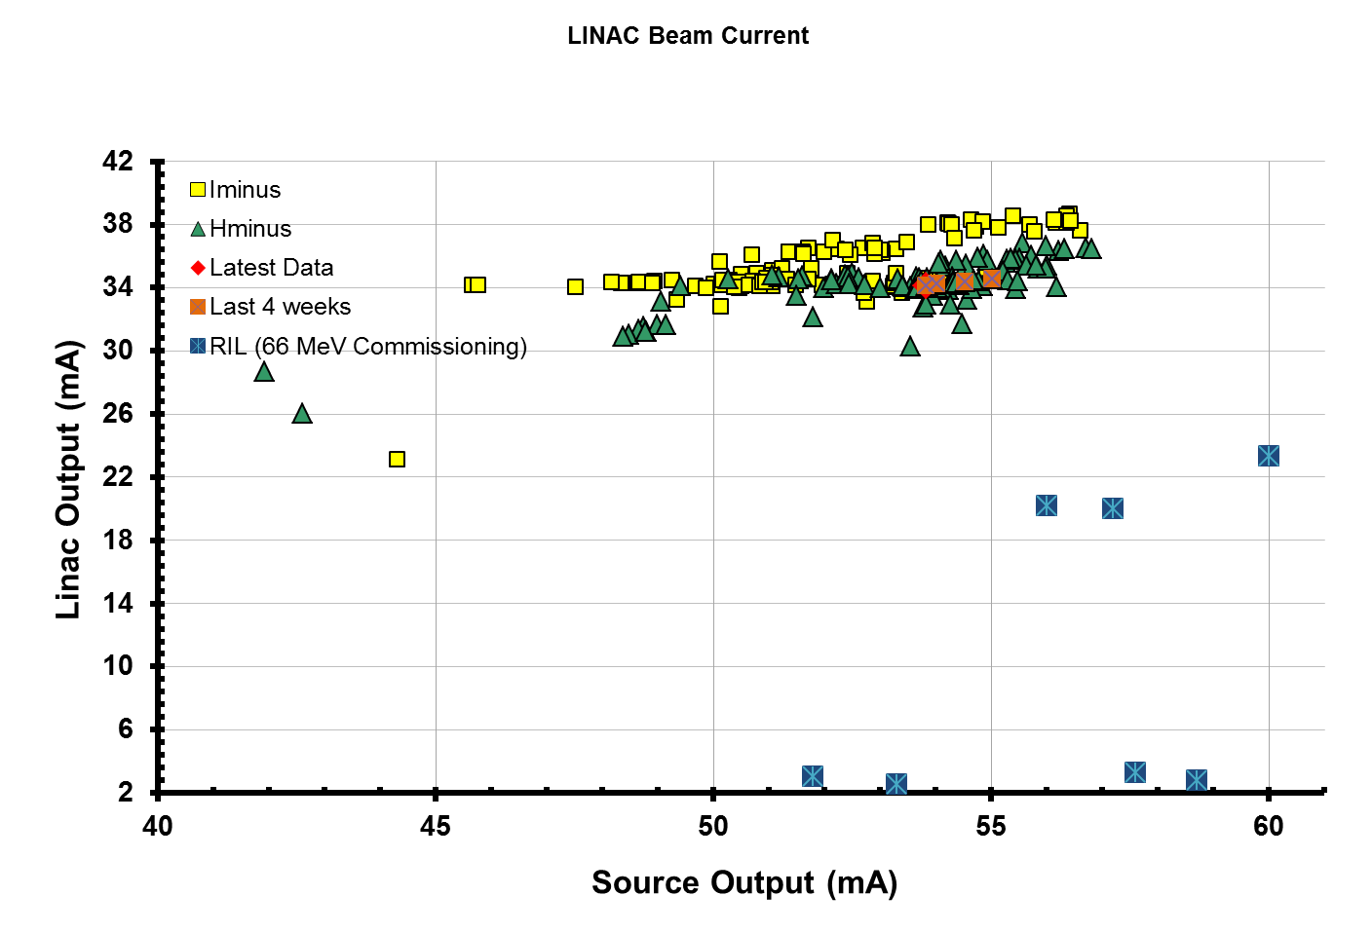
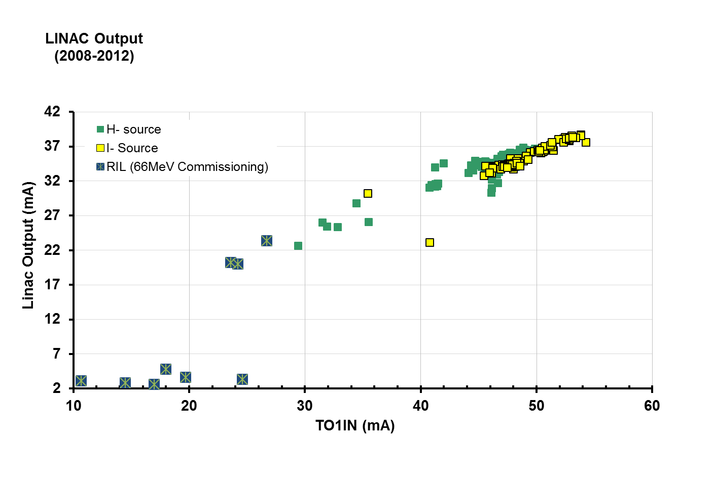
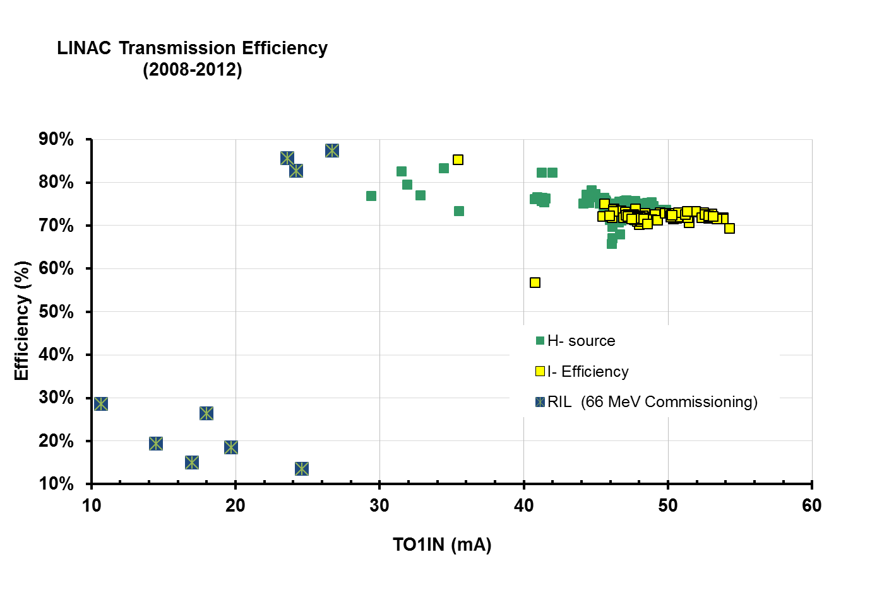
Linac Performance
RIL – 66 MeV Commissioning
Average
Input beam current: 24.7 mA
Output beam current: 21.8 mA
Efficiency: 88%
Peak
Input beam current: 27 mA
Output beam current: 23 mA
Efficiency: 90%
Nominal:
Beam current: 34.5 mA
Unofficial

Slide 15
LINAC 400 MeV Startup Schedule

Slide 16
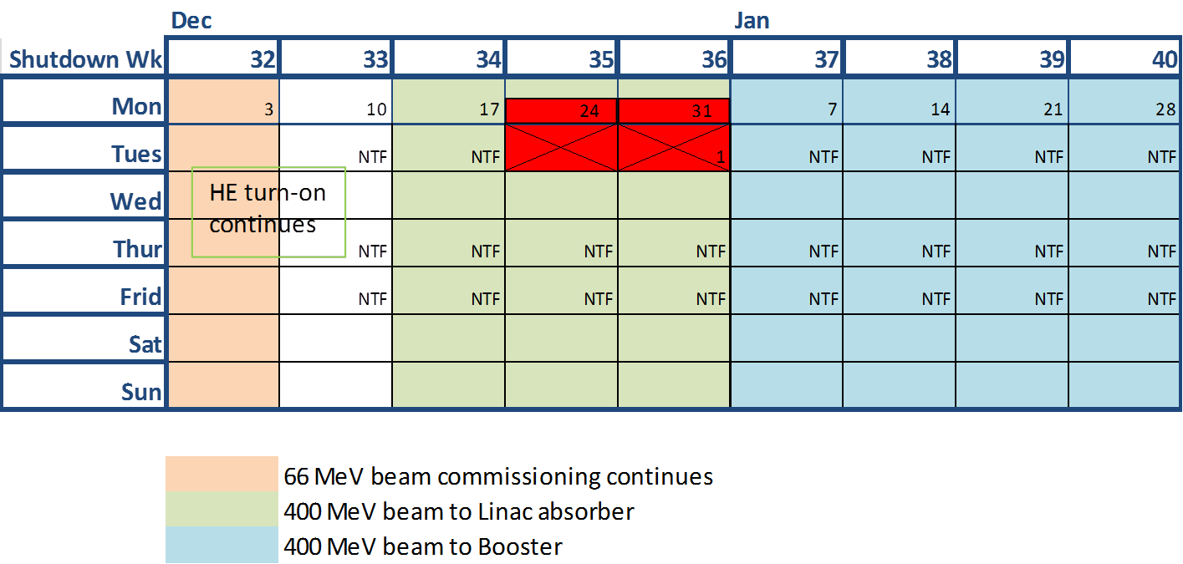
LINAC 400 MeV Startup
Studies Plan
Dec 17th 2012 – Jan 7th 2013 | 400 MeV beam commissioning (Linac absorber area)
 | Beam commissioning 23-34.5 mA, 10 μsec, 1-5 Hz Limited by beam losses, beam heating interceptive instruments studies will be performed by a small group
Beam diagnostic | Beam position monitors (new electronics/readout system) Multi Wire (new device installed at 400 MeV) Toroids (new electronics/readout system)
Turn-on & Commissioning Measurements | Transmission efficiency differential current meas. (toroids) Transverse matching beam size (wire scanners) Position measurements beam position (BPMs)
Feb 2013 … | Goal: beam study time schedule to take into account NTF treatment and to be negotiated among Booster study groups & Operations
After MI comes online | Goal: beam study time schedule to take into account NTF treatment or it can be performed parasitic or integrated into shift time

Slide 17
FIM

Slide 18
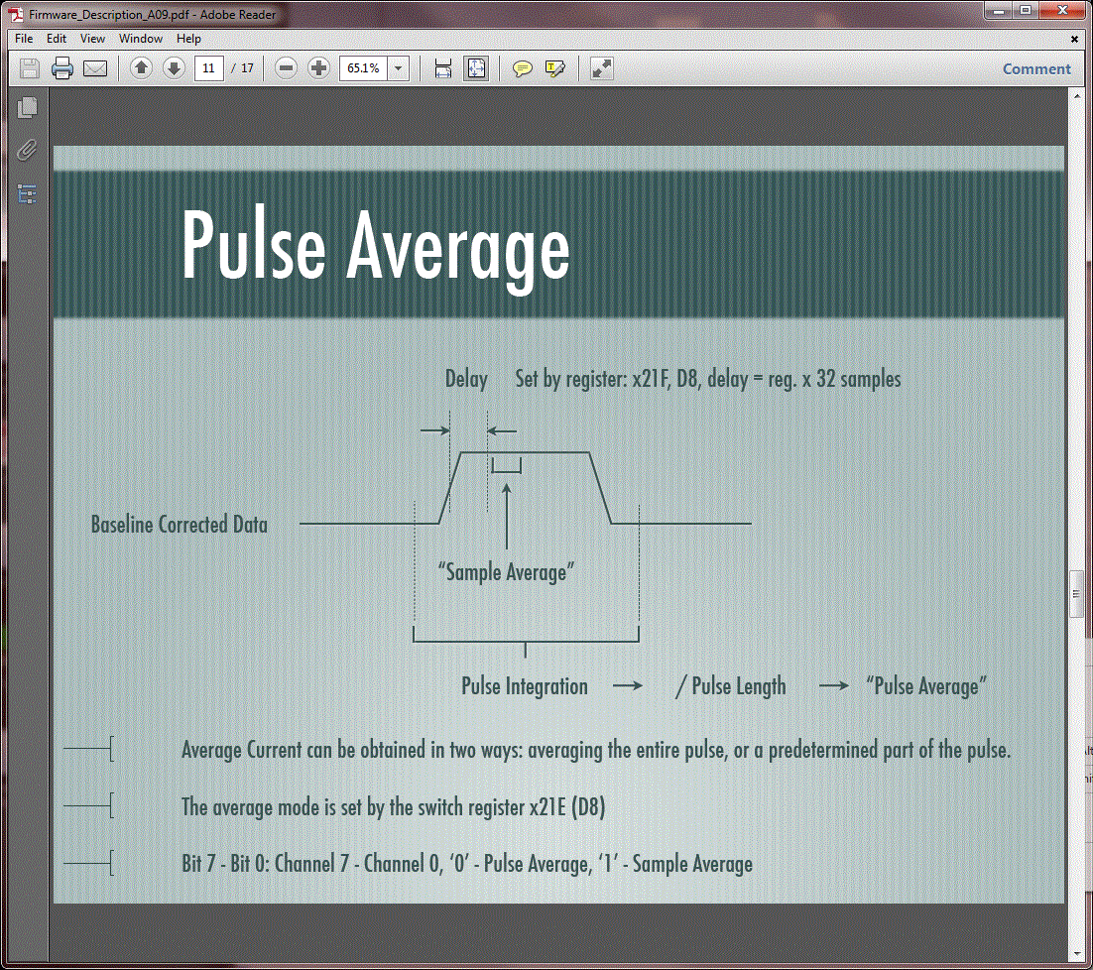
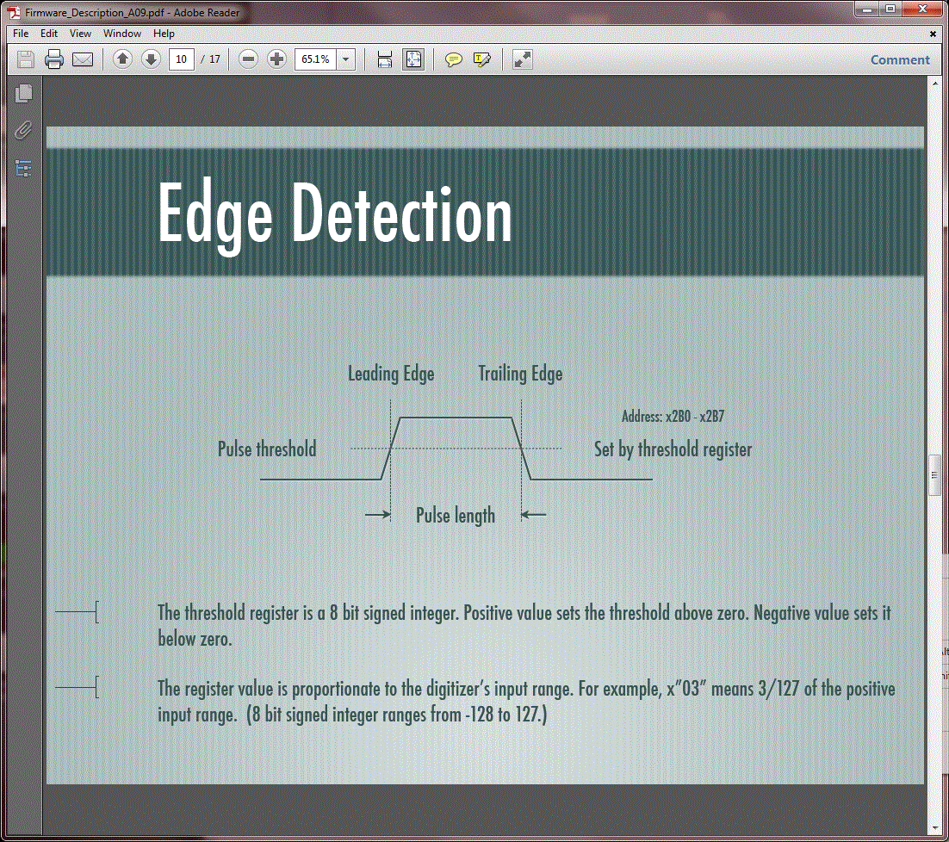
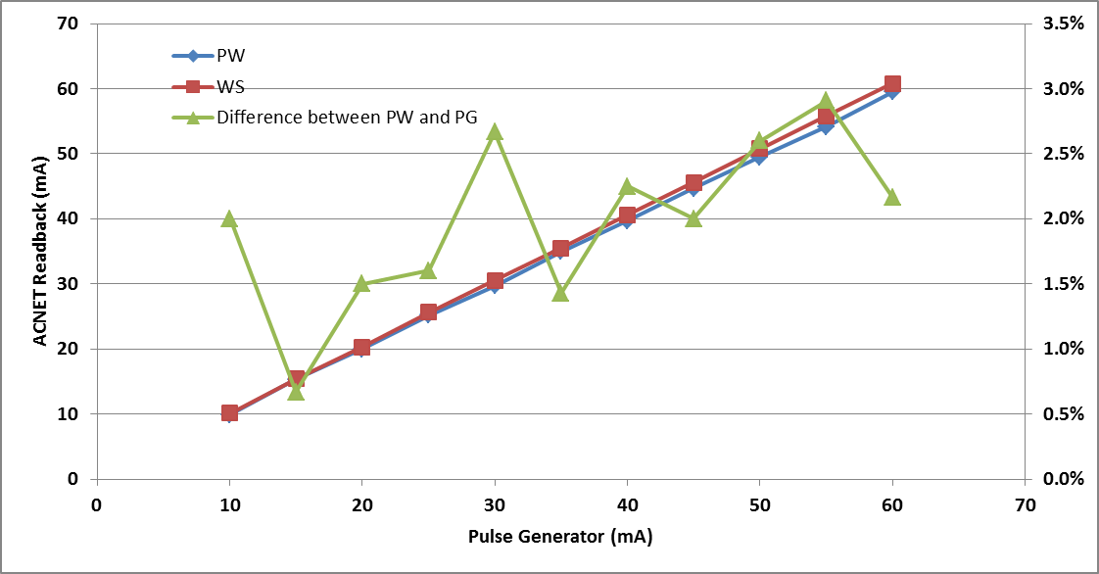
TO1IN Toroid Prototype Module
Two ways of calculating:
pulse width (PW) average or
window set (WS)
2% agreement is obtained
Threshold set at 10 mA

