Slide 1
Longitudinal Dynamics Studies in Fermilab Booster for PIP
Leonid Vorobiev
December 06, 2012

Slide 2
Motivation
PIP – Proton Imrovement Plan for Fermilab Booster
Significant intensity increase.
Injection at 0.4 GeV.
Injection at 1 GeV – 1st stage of Project X.
Different RF ramps.
Extraction (notching during injection or after acceleration)

Slide 3
Dynamics Simulation:
ESME (1D) → STRUCT and ORBIT (3D)
ORBIT (SNS dedicated) – storage ring. Accel. Modules devel.
Now: Longitudinal dynamics:
Dipole fields & RF voltage, as functions/tables. Net RF.
Acceleration: below critical energy, transition via critical energy, further acceleration.
Next Steps:
3D dynamics with SC (BL)+ Losses at given apertures + RF paraphasing (not a net RF voltage). Notched beam.
Extraction.

Slide 4
Booster acceleration specs
Given:
Circumference 474.2 m.
T_{min} =0.4 GeV T=8 GeV
B field in dipole magnets: B(n)=B_{o} + B₁×sin(π⋅n/N – π/2)
B_{o} = 0.223 T (at injection 400 MeV)
B₁ =0.175 T
B_{max} = B_{o} + B₁=0.39 T (at max energy 8 GeV)
RF net voltage:

Slide 5
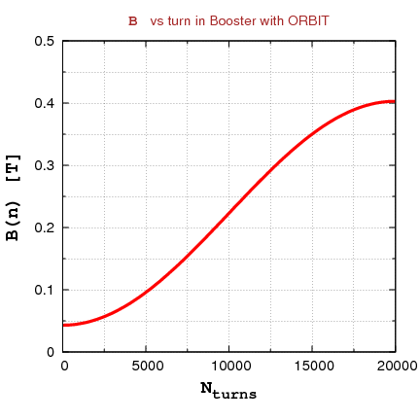
B field in dipoles

Slide 6
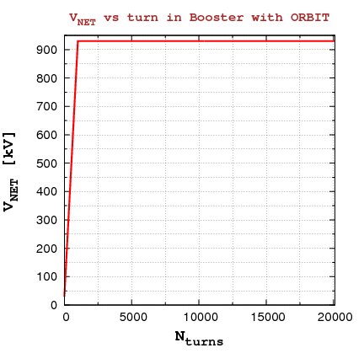
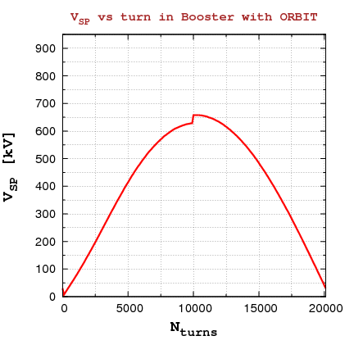
Accelerator Parameters time-dependencies

Slide 7
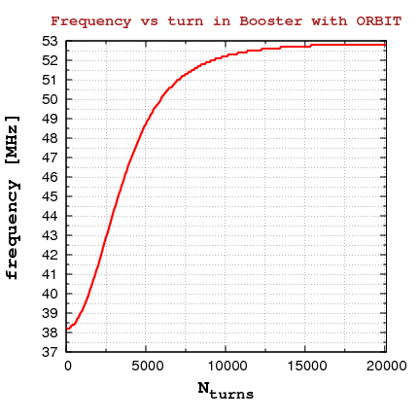
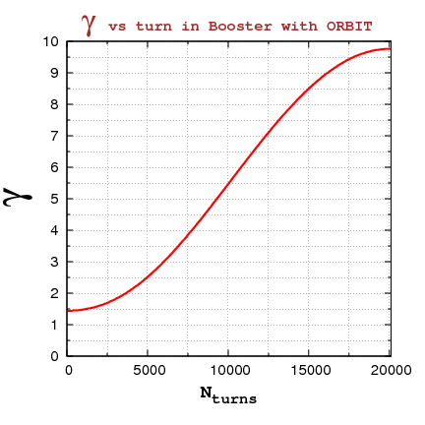
Accelerator Parameters time-dependencies

Slide 8
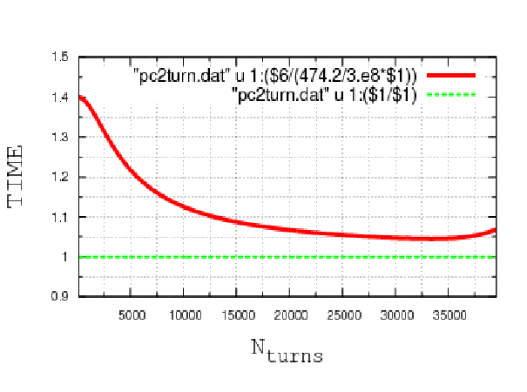
Time-dependencies: t (n)

Slide 9
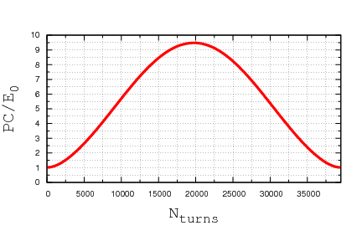
Time-dependency: pc versus turn number

Slide 10
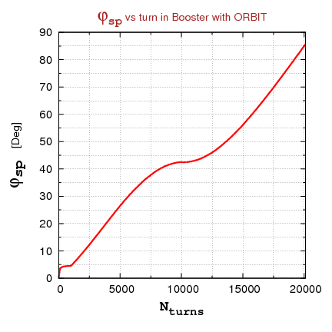
Phase of synch. Particle vs turn

Slide 11
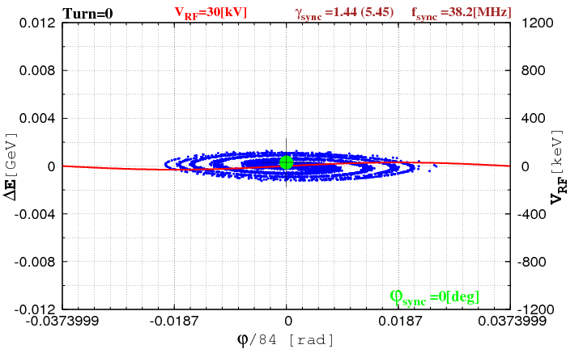
Full-cycle acceleration, passing transition E_{T}
For animation:
Use Full Screen
Press F5

Slide 12
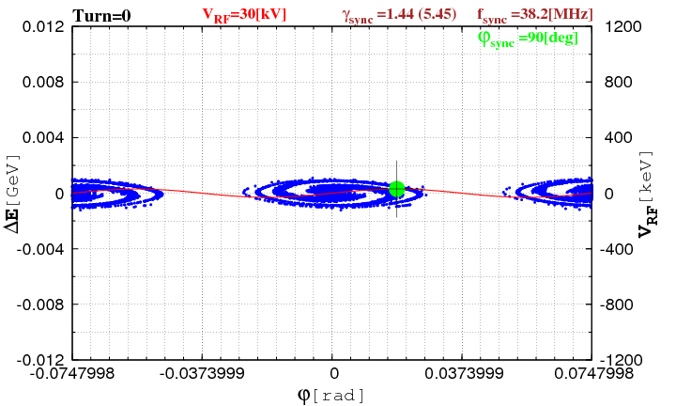
Full cycle, 3 bunches, passing transition E_{T}
For animation:
Use Full Screen
Press F5

Slide 13
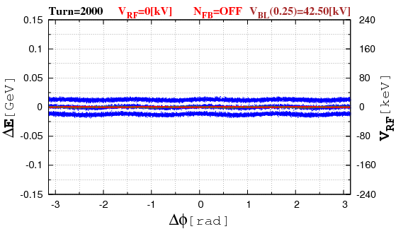
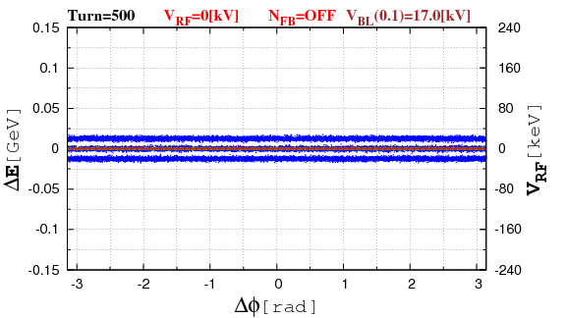
Illustration: Beam Loading (from mu2e)
For animation:
Use Full Screen
Press F5

Slide 14
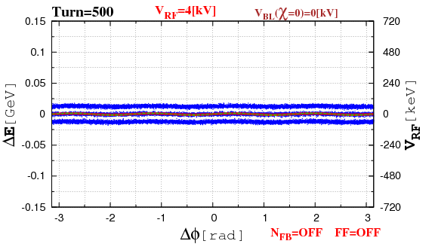
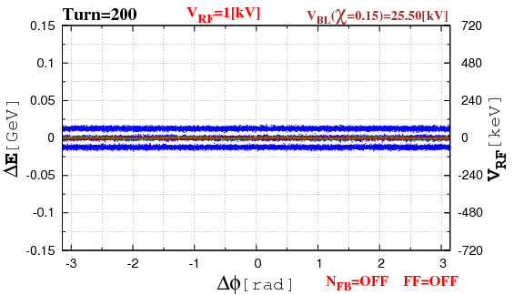
Illustration: Beam Loading (from mu2e)
For animation:
Use Full Screen
Press F5

Slide 15
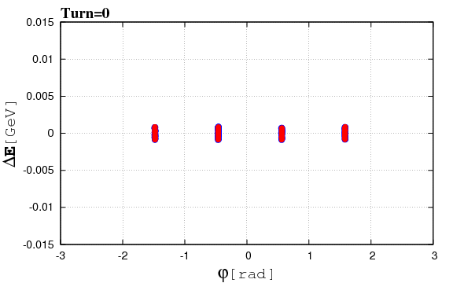
Illustration: Injection from Linac with Slippage from Project X
For animation:
Use Full Screen
Press F5

Slide 16
Summary
Full Cycle Acceleration:
below critical energy
transition via critical energy
further acceleration up to 8 GeV (extraction energy).
Animation movies:
Exact evolution of the synchronous particle.
RF jump over the transition energy E_T.
Preparation to include:
Beam loading effects, Phase Slippage, Beam notching
(as for Mu2e presentation in 2011 & Project X).

