Slide 1
Refurbished Booster RF
John Reid
December 12, 2012

Slide 2
4 Booster Cavities Refurbished to Date
S/N 2002 – Removed St 8 – August 2011 ?
Refurbishment started – August 26, 2011
Refurbishment completed – February 2012
Electrical testing completed – March 5, 2012
Installed in tunnel – April 2, 20212
S/N 1011 – Removed St 7 – May 21, 2012
Refurbishment started
Refurbishment completed – June 6, 2012
Electrical testing completed – July 18, 2012
Installed in tunnel -
S/N 1008 –Removed St 5 – June 14, 2012
Refurbishment started June 2012
Refurbishment completed Sept 6, 2012
Electrical testing completed Sept 24, 2012
Installed in tunnel – November 14, 2012
S/N 1017 – Removed St 6 – June 14, 2012
Refurbishment started – September 17, 2012
Refurbishment completed – October 29, 2012
Electrical testing completed – November 13, 2012
Installed in tunnel – November 14, 2012

Slide 3
Summary
Cavity S/N | Radiation | Tin Shims | Rework | Cone Cooling | Vacuum
 | Class | 0.005 | Flanges | Config | Work
2002 | 2 | Yes | No | Parallel | Yes
1011 | 3 | Yes | 3 | Series | No
1008 | 3 | Yes | 3 | Series | No
1017 | 2 | Yes | 3 | Series | No

Slide 4
Tuner Stem Temperatures
Cavity S/N | Cavity running on standard Booster curve at 15 Hz
 | Tuner | Anode | Anode | Anode | Anode
 | Stem Temp F | 15 kV | 18kV | 21 kV | 23.5 kV
2002
 | Back - Label | 130 | 140 | 160 | 160
 | Back - Probe | 124 | 138 | 155 | 165
 | Bottom - Label | 130 | 150 | 160 | 190
 | Bottom - Probe | 117 | 143 | 138 | 170
 | Front - Label | 130 | 140 | 160 | 180
 | Front Probe | 124 | 138 | 155 | 163
1011
 | Back - Label | 130 | 130 | 150 | 160
 | Back - Probe | 120 | 131 | 141 | 150
 | Bottom - Label | 130 | 130 | 150 | 150
 | Bottom - Probe | 112 | 121 | 136 | 142
 | Front - Label | 130 | 130 | 150 | 160
 | Front Probe | 119 | 131 | 133 | 146
1008
 | Back - Label | 130 | 130 | 150 | 160
 | Back - Probe | 120 | 128.5 | 144 | 150
 | Bottom - Label | 130 | 135 | 150 | 170
 | Bottom - Probe | 119 | 124.5 | 142 | 145
 | Front - Label | 130 | 140 | 160 | 170
 | Front Probe | 122 | 129 | 148 | 154
1017
 | Back - Label | 115 | 130 | 140 | 150
 | Back - Probe | 115 | 124 | 135 | 140
 | Bottom - Label | 110 | 115 | 130 | 130
 | Bottom - Probe | 104 | 110 | 120 | 120
 | Front - Label | 115 | 130 | 130 | 150
 | Front Probe | 112 | 116 | 124 | 132

Slide 5
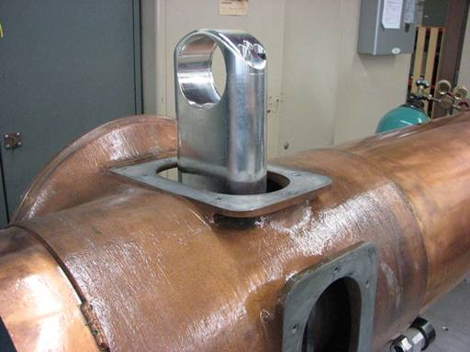
Fitting stem to cavity center flange

Slide 6
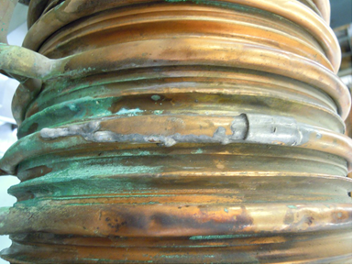

Slide 7
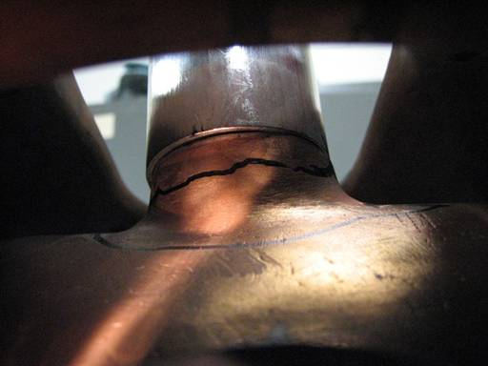
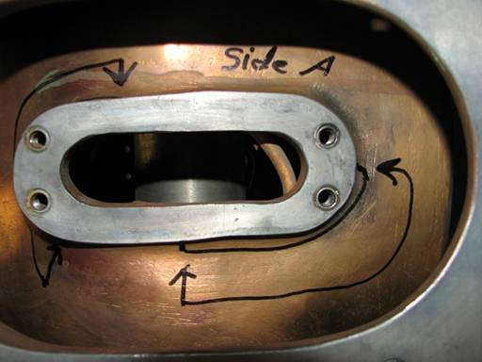
Area marked where stem does not fully contact cavity surface
Stem to cavity interface problem

Slide 8
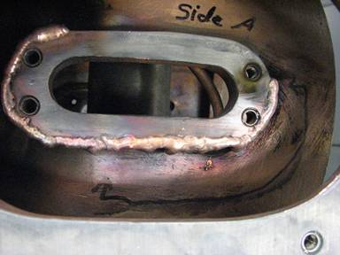
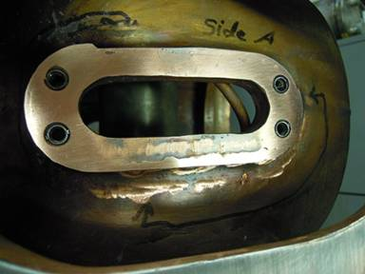
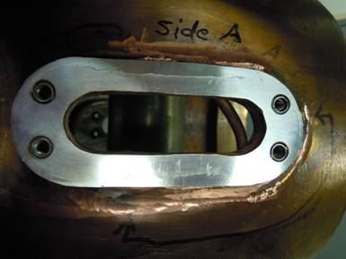
Added weld material to flange surface
Partial flange facing
Finished flange after resurfacing

Slide 9
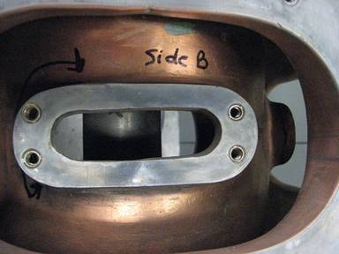
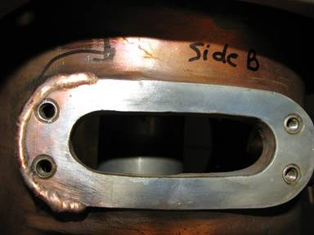
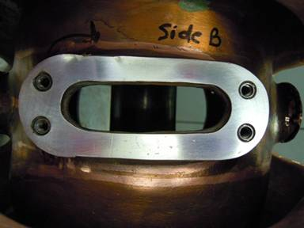
Original cavity flange surface
Added weld material to flange surface
Finished flange after resurfacing

Slide 10
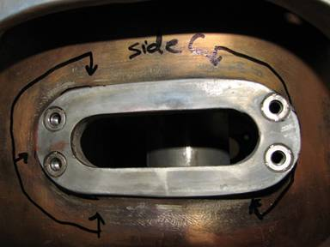
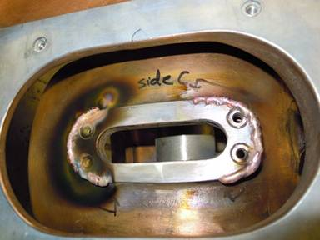
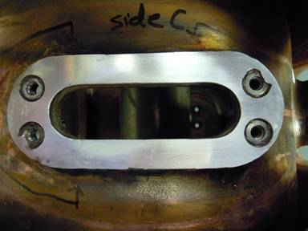
Added weld material to flange area
Original cavity flange surface
Finished flange after resurfacing

Slide 11
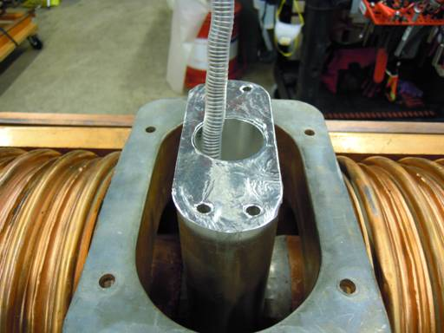
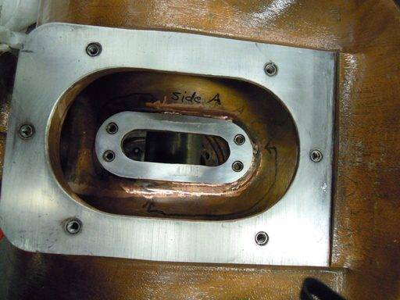
Finished mating Flange on Cavity
Finished tuner Flange

Slide 12
CONCLUSION
4 Cavities refurbished, tested, & installed
Between 50 % to 70 % of the cones had to be stripped and rebuilt due to burnt or damaged fingers.
Cavities from stations 1 and 3 (which will be cavities 5 & 6 to be refurbished) have been pulled from beam line and are waiting to be worked on.

