Slide 1
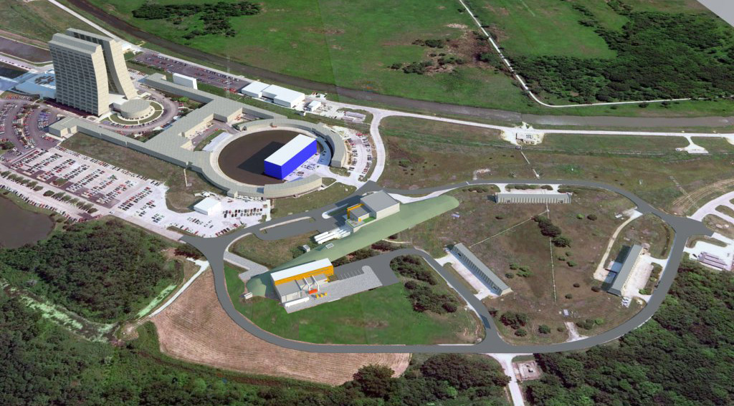
Muon Campus Plans
Mary Convery
Accelerator Division, Muon Department
1/10/13

Slide 2
Muon Campus layout

Slide 3
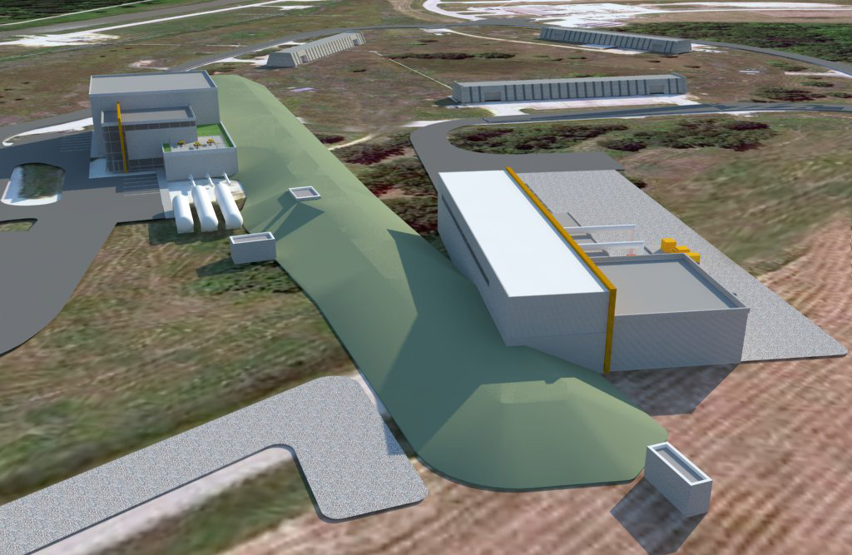
Looking toward the Muon Rings

Slide 4
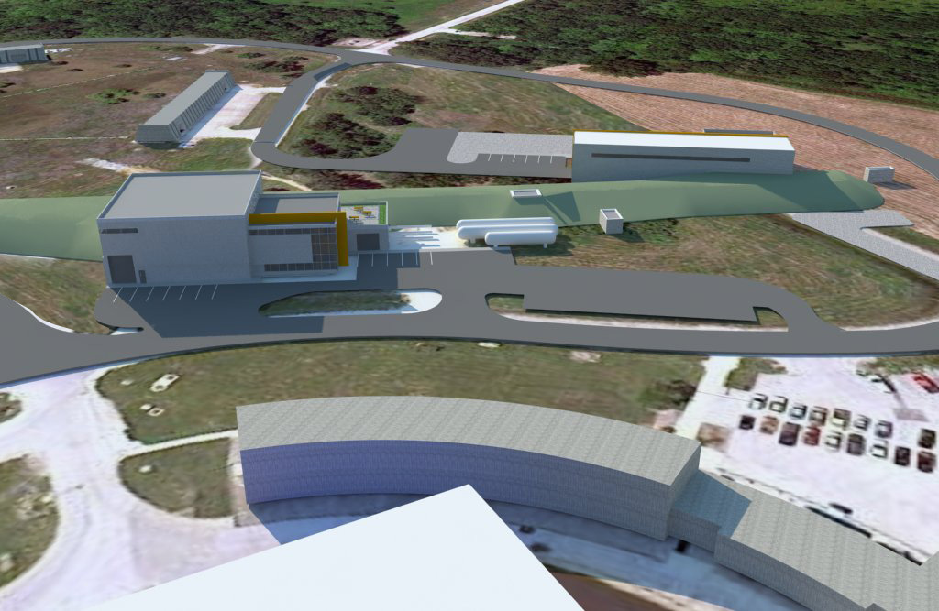
View from Wilson Hall

Slide 5
Thanks and disclaimers
Thanks in advance to everyone I “borrowed” content from
  including Russ Alber, Jerry Annala, Brendan Casey, Brian Drendel, Doug Glenzinski, Arkadiy Klebaner, Ioanis Kourbanis, Tom Lackowski, Nikolai Mokov, Jim Morgan, Hogan Nguyen, Chris Polly, Ron Ray, Dean Still, Steve Werkema, …
I have been involved with g-2 for a little over a year, and the broader Muon Campus planning for about 2 months
  I am not at all an expert on Mu2e

Slide 6
Mu2e

Slide 7
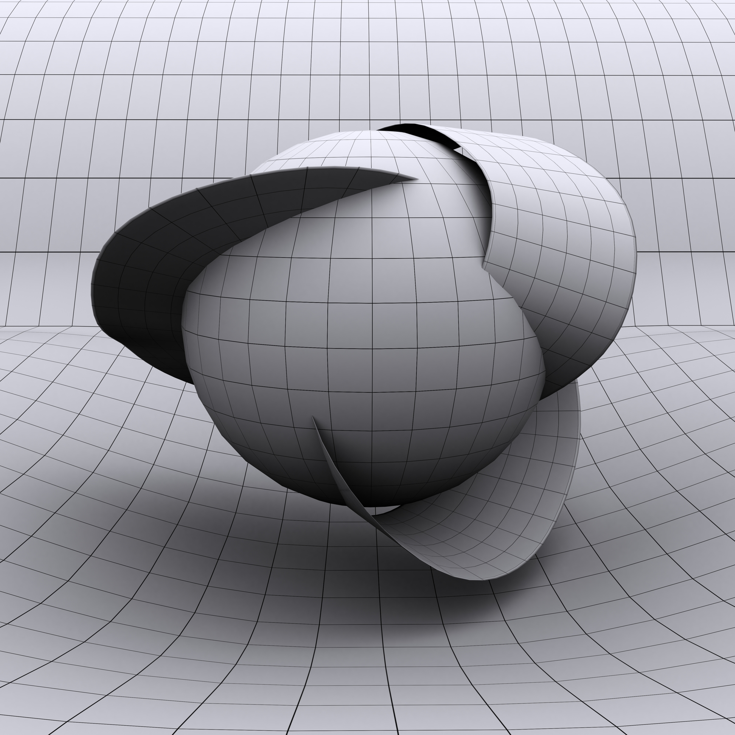
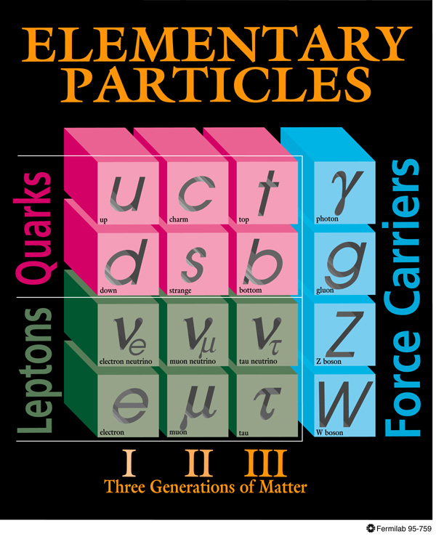
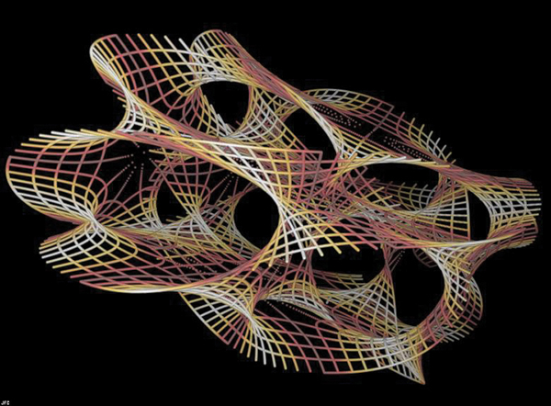
Mu2e
_
Muons regularly decay to electrons and neutrinos μ⁻→ e⁻ν_{e}ν_{μ}
Mu2e will search for charged lepton flavor violation (μN→eN)
  Neutrino flavor oscillations already observed
Conversion rate distinguishes between different theories
μ
e
?
Not Yet
Thought
Of
Extra Dimensions
p
n
n
~
~
~
~
n
~
~
~
~
~
~
~
Gauginos
p
p
Sleptons Squarks
χ
χ
~
~
~
n
Super Symmetry
Super Strings

Slide 8
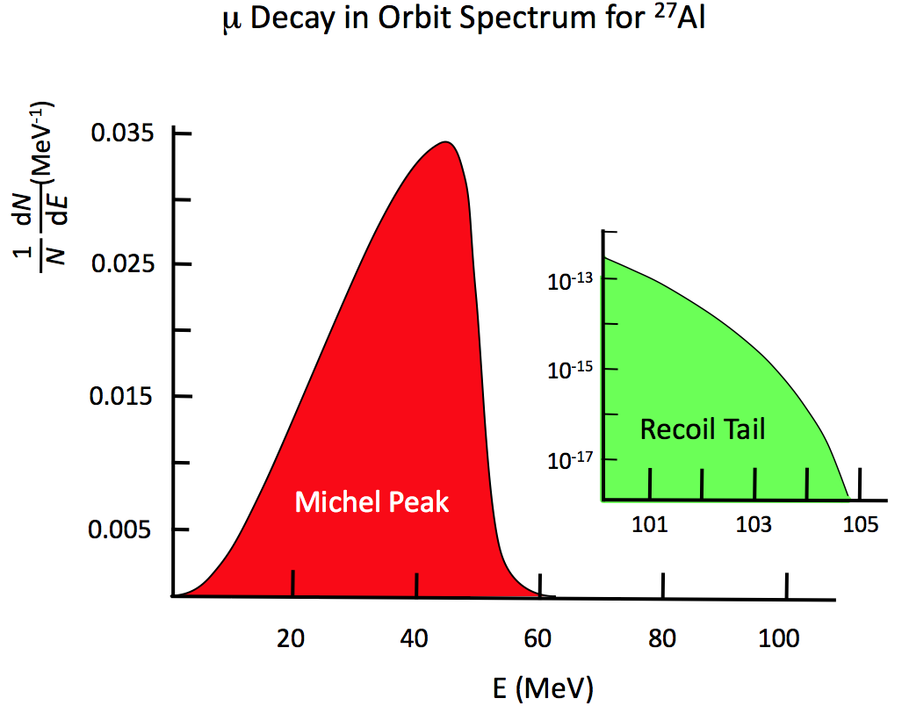
Mu2e
Generate beam of low-momentum μ⁻
Stop the muons in a target
  Aim to improve sensitivity by 10⁴ over previous experiments
  requires ~10¹⁸ stopped muons
Stopped muons are trapped in orbit around the nucleus
  Using Aluminum target (nucleus):
    characteristic time τ_{μ}^{Al}=864 ns
    conversion-electron energy 104.97 MeV
    (maximum decay-e energy 52.8 MeV)
Extinction system (AC dipole) to prevent prompt background from out-of-time protons hitting production target

Slide 9
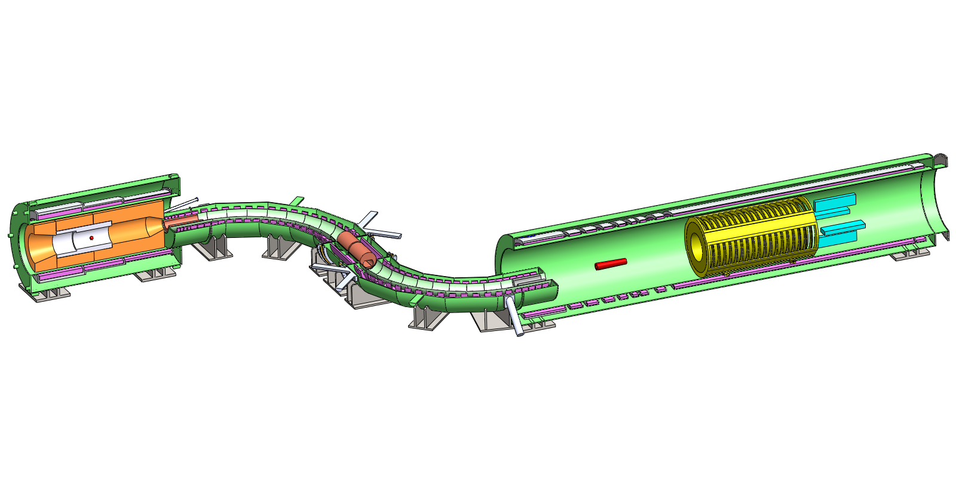
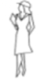
Mu2e Apparatus
Production
Solenoid
Detector
Solenoid
Transport
Solenoid
Production
Target
Stopping
Target
Tracker
Calorimeter
Collimators
about 75 feet end-to-end

Slide 10
Mu2e Apparatus
Production
Solenoid
Proton Beam
Detector
Solenoid
Transport
Solenoid
Production
Target
Stopping
Target
Tracker
Calorimeter
Collimators
Proton Beam delivered to the production target via the former Pbar beamlines followed by an external beamline

Slide 11
Mu2e Apparatus
Production
Solenoid
Detector
Solenoid
Transport
Solenoid
μ-, π-
Production
Target
Stopping
Target
Tracker
Calorimeter
Collimators

Slide 12
Mu2e Apparatus
Production
Solenoid
Detector
Solenoid
Transport
Solenoid
e−
Production
Target
Stopping
Target
Tracker
Calorimeter
Collimators

Slide 13
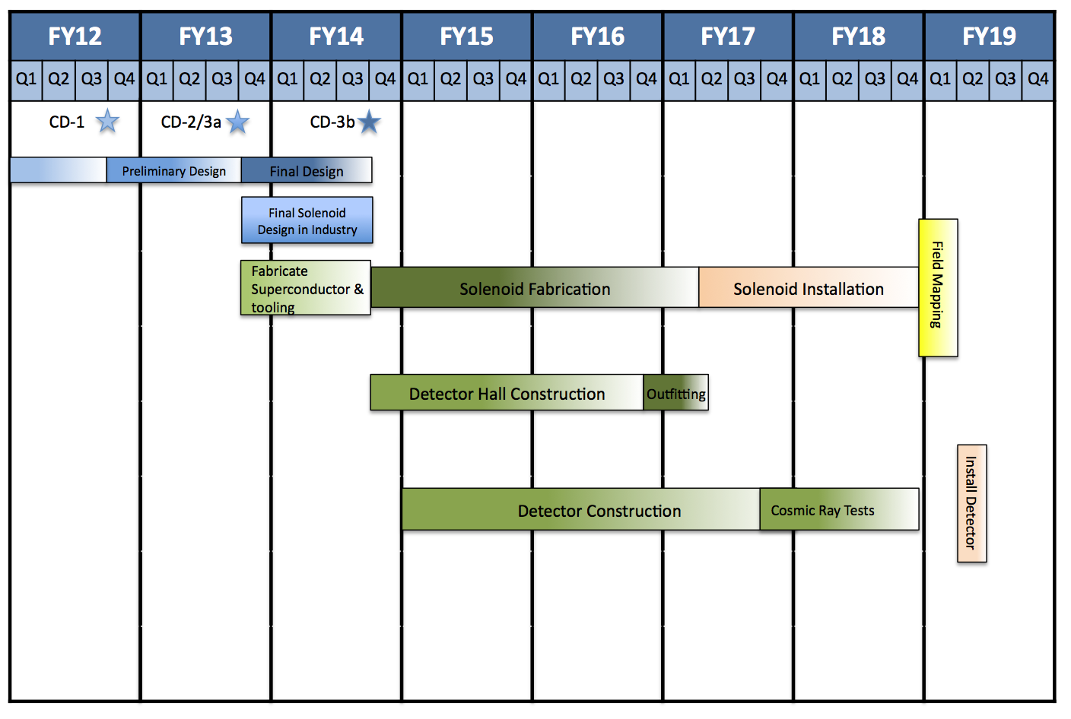
Mu2e schedule

Slide 14
g-2

Slide 15
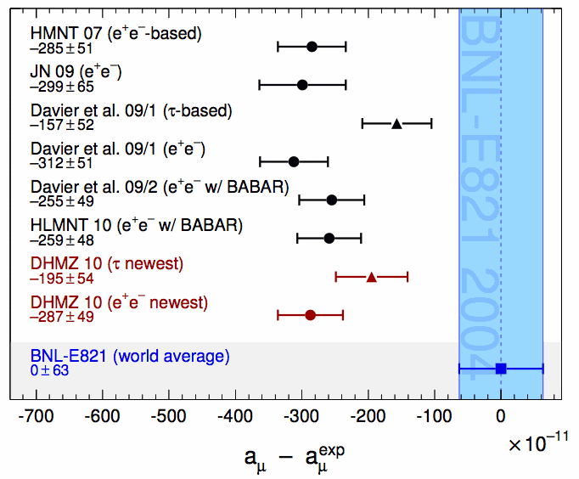

The anomolous magnetic moment and g-2
g≈2 but higher-order corrections
  QED, EW, hadronic, new physics?
proposed exp. precision
Currently ~3σ discrepancy between theory and experiment
New muon g-2 experiment at Fermilab expected precision could yield ~5σ
$$a=\frac{g−2}{2}$$

Slide 16
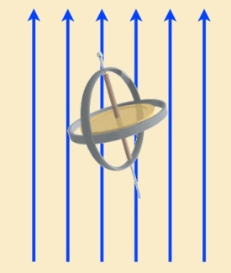
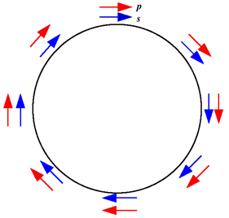
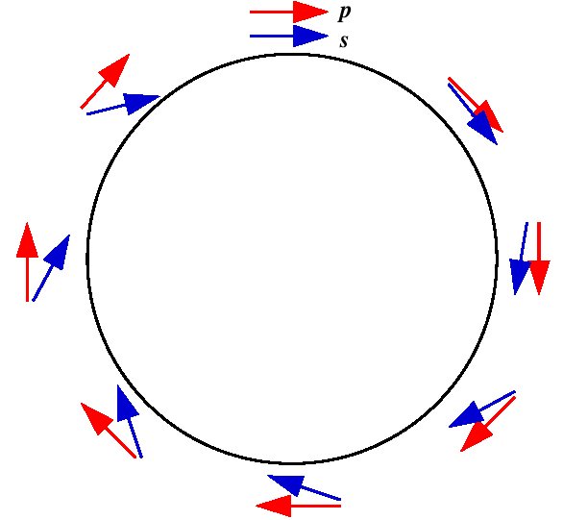



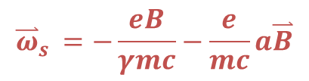
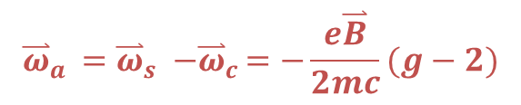
Measuring g-2
  Polarized muons in magnetic field precess with Larmor spin precession frequency
  Measure g-2 using cyclotron
  Requires precise measurements of $ω_{a }$ and of the magnetic field
$${\overset{⃑}{ω}}_{s }=−\frac{eB}{γmc}−\frac{e}{mc}a\overset{⃑}{B}$$
$$a=\frac{g−2}{2}$$
$${\overset{⃑}{ω}}_{c}=−\frac{e\overset{⃑}{B}}{γmc}$$
g = 2
g > 2
$${\overset{⃑}{ω}}_{a }{=\overset{⃑}{ω}}_{s }{−\overset{⃑}{ω}}_{c }=−\frac{e\overset{⃑}{B}}{2mc}(g−2)$$

Slide 17
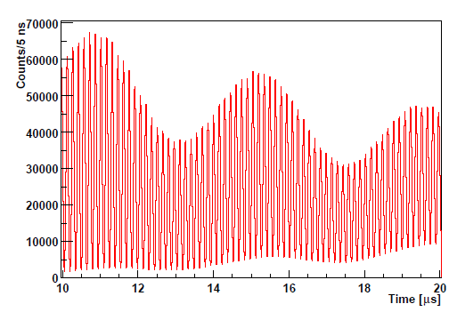



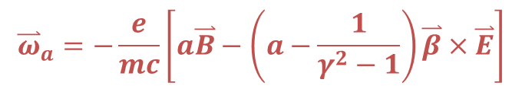
Measuring $ω_{a }$
One more trick:
  Polarized muons in storage ring with vertical focusing by electrical quadrupole field
  At magic momentum p_{μ} = 3.094 GeV/c (γ = 29.3), g-2 precession frequency ω_{a} independent of electric field
Distribution of decay electrons as function of time
$${\overset{⃑}{ω}}_{a}=−\frac{e}{mc}\left[a\overset{⃑}{B}−\left(a−\frac{1}{γ^{2}−1}\right)\overset{⃑}{β}×\overset{⃑}{E}\right]$$
$$ω_{a }$$
$$N\left(t\right)= N_{0}e^{−t/γτ}\left[1−A\cos\left(ω_{a}t+φ\right)\right]$$
$$ω_{c }$$
Intensity at a single detector station shortly after injection
Phys. Rev. D73 (2006) 072003

Slide 18
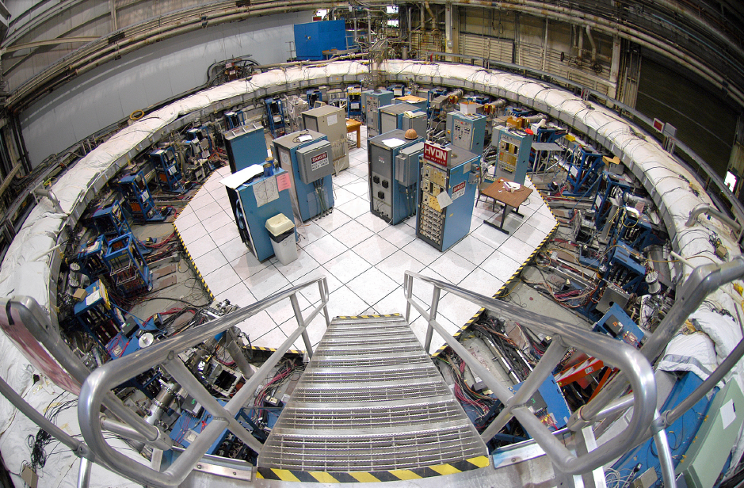
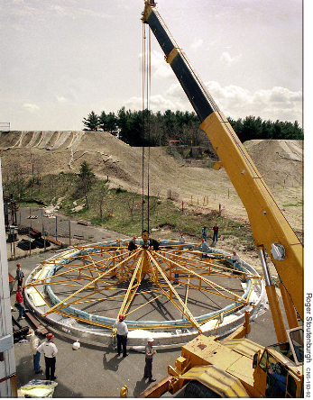
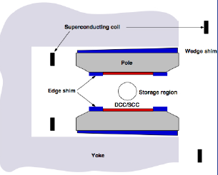
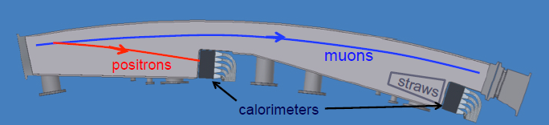
g-2 apparatus
Reusing storage ring from BNL g-2 experiment
New calorimeters and straw-tube tracking

Slide 19
Planned improvements
Rebunch high-intensity beam into multiple bunches to lower the instantaneous rate
Increase the detector segmentation to reduce the instantaneous rate in a given cell
Modify secondary beamlines to store as many muons from pion decays as possible
Remove pions and protons from muon beam to prevent hadronic flash in calorimeters
  Allows analysis of more (earlier) decay e+
  Longer beamline for pion decay
  Let heavier protons separate in time from pions/muons and kick them out
Improve beam dynamics in storage ring
Improve storage ring field uniformity and the measurement and calibration system

Slide 20
g-2 schedule
Preparing for CD1 review this spring
MC1 building complete early FY14
g-2 storage ring ships early FY14
Ring reassembly starting FY14
Cryo ready to cool ring early FY15
Ring magnetic field shimming starting mid FY15
Recycler and Muon beamline work FY14-15
New beamline enclosure beneficial occupancy mid FY15
Beam to g-2 early 2016

Slide 21
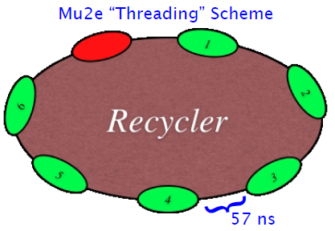
Beam to Mu2e
Beam to g-2
Primary (8 GeV) proton beam resonantly-extracted from Debuncher
Extinction of out-of-time beam
Original plan for increased flux involved “threading” Mu2e batches between NOνA batches, stacking proton bunches in Accumulator, and rebunching / resonant-extraction in Debuncher
Rebunch primary (8 GeV) protons so that rate in detectors is not too high, bunch length < ring revolution time of 147ns
Create 3.1 GeV secondary pions off a target
Beamline long enough for ~all pions to decay
Capture 3.094 GeV (“magic momentum” muons)
  aim for 40π acceptance
Limit secondary pions and protons making it into g-2 storage ring (cause “hadronic flash” in calorimeters)

Slide 22
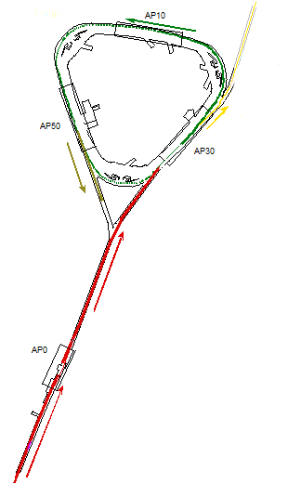
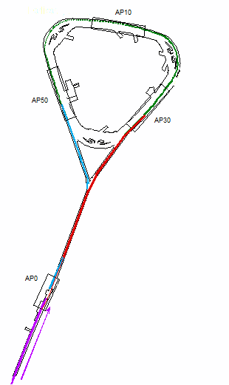
Original Mu2e and g-2 plans for former Pbar beamlines
stacked proton bunch to Debuncher
resonant extraction to Mu2e target
stacking of p bunches in Accumulator
new connection Debuncher to AP3
Abort
AP3 line connects to Accumulator
3.1 GeV secondaries to Debuncher (need high quad density to capture decay muons)
8 GeV protons to Accumulator
bring 40π beam back thru target bypass
8 GeV protons bypass target
to g-2 ring
8 GeV protons to target (rebunched in Recycler)

Slide 23
g-2 near Mu2e in “Muon Campus”
Locating g-2 experiment near Mu2e has advantages
  Both g-2 and Mu2e circulate in same direction
    No need to switch polarity, just energy
    Frees some magnets in AP2 line for reuse, no conflict with Mu2e plans for primary beam abort in AP2
    Can use Mu2e abort to remove proton contamination from g-2 secondary beam
  New building location also much better
    Old location jammed between road and berm
    Utility corridor to be rerouted
    Don’t have to pass g-2 secondary beam back through AP0
  Can share cryo and other infrastructure
  Time-dependent stray magnetic fields at g-2 ring smaller near Booster than near Main Injector

Slide 24
Mu2e Accelerator Task Force Cost Savings
6 → 2
Booster
Batches
Bypass Accumulator Ring
Re-bunch
in RR
Synergy with g-2
Eliminate kickers, RF, power, cooling loads
Reuse magnets
Reduced Shielding
Relaxed timing specs, no threading between NOvA batches
Trade Mu2e rate for run time (3 yrs running vs 1 yr)
Elimination of Accumulator removes almost every g-2/Mu2e conflict
Over $100M in savings in the combined program

Slide 25
Muon Campus beamline plan for Mu2e and g-2
p to Mu2e target
μ+ to g-2 ring
After ~5 turns, p separated in time from μ+, kick into abort
Primary abort for Mu2e
3 GeV p,π+,μ+
After ~5 turns essentially all π+ decayed
Extract μ+ for g-2
Resonant extraction for Mu2e
M3 line connects to Delivery Ring (Debuncher)
3 GeV p,π+,μ+ to Delivery Ring for g-2
8 GeV protons to Delivery Ring for Mu2e (target station bypass)
(where M2 line joins M3 line not yet finalized)
3 GeV p,π+,μ+ to M3 line for g-2 (“π decay line”)
8 GeV protons to target for g-2
8 GeV protons to M3 line for Mu2e

Slide 26
Shared infrastructure
Any shared infrastructure needs to be ready in time for g-2
  Make use of Accelerator Improvement Projects (AIPs) and General Plant Projects (GPPs)
  MC-1 building houses cryo refrigerators and beamline power supplies in addition to g-2 storage ring / future expts (GPP)
  Cryo work moves to AIP
  Extraction-line tunnel moves from Mu2e to GPP
  First part of extraction line moves from Mu2e to g-2
  Recycler work was on g-2 project (g-2 drives specs), later moved to AIP at recommendation of Mu2e CD-1 review committee
  Proton abort and other Delivery-Ring work moved to AIP
  P1, P2, M1 line 8-GeV aperture improvements moved to AIP
  Controls and common instrumentation(?) on g-2 project
Yes, partly this makes Mu2e look less expensive, but there is also a limit on the total cost of the Muon campus program

Slide 27
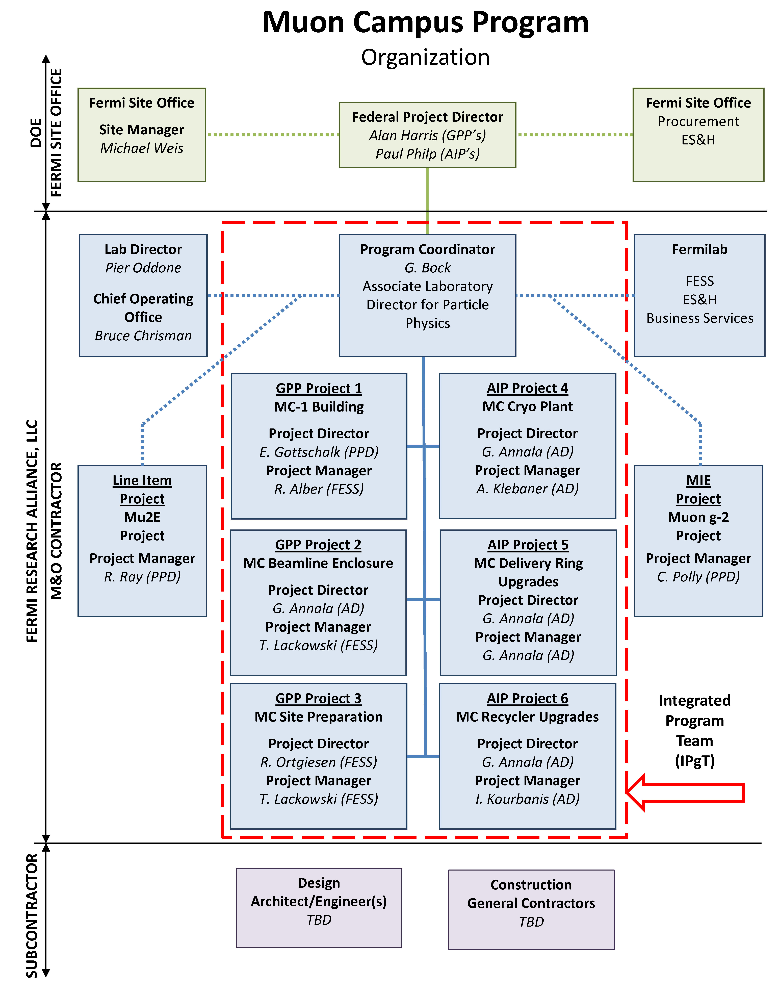
Recent modifications to Muon Campus plan
Program
Coordinator
M Convery
need additional AIP to cover costs?
likely scope change
AIP’s and GPP’s have hard cap at $10M

Slide 28
Packaging into AIPs/GPPs
Actually the packaging of the work is still in flux
  Except for MC1 building GPP which is already in progress
DOE recommendation resulted in acceleration of Mu2e civil construction schedule, had to shuffle work between Mu2e and other Muon Campus projects
AIPs and GPPs have a hard cap of $10M, don’t include conceptual design
  As designs are becoming more mature and in some cases work is pushed later, cost estimates indicate that the work may not fit in the planned packages
Internal AD review later this month to make sure nothing is missing between all these packages and to look for ways to reduce costs
Following the review, we will propose how to package the individual pieces into AIPs and GPPs

Slide 29
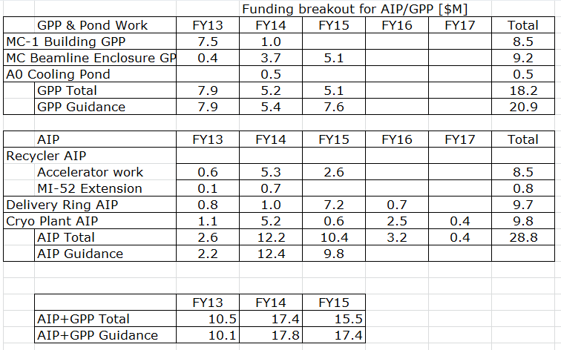
Rough funding plan for GPPs and AIPs
on critical path for g-2
longer lead time for RF
on critical path for g-2
The additional site power feeder that was part of site-prep GPP ($1M) is not included here, may be needed in 2017 or 2018

Slide 30
Protons to the Muon Campus

Slide 31
Protons available
Protons to Mu2e
Main Injector
Energy
{
Booster
Cycles
Protons to g-2
Protons to NOvA
Need 2 Booster cycles
to manipulate g-2 beam
in Recycler
Protons to MicroBooNE
(Mu2e and g-2 cannot run simultaneously)

Slide 32
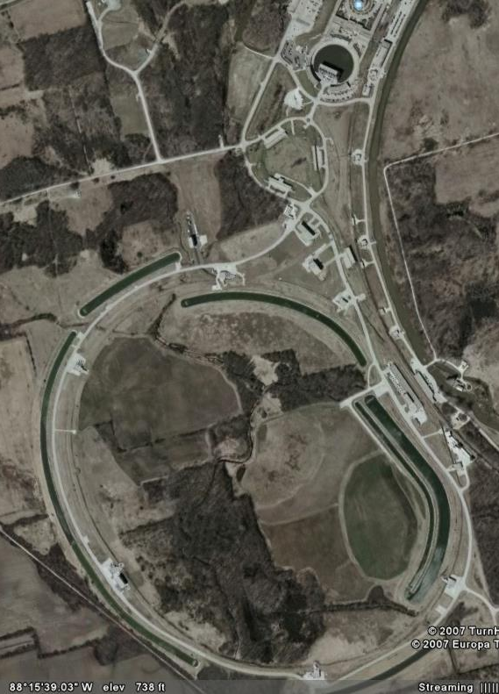
Re-bunching beam in Recycler
53 MHz bunches (4x10¹² protons) reformed into 4 bunches (1x10¹² protons) at 2.5 MHz
  Reduce pile-up in detector
  Build new cavities for 2.5MHz system
g-2 needs beam pulses out of Recycler not longer than ~100ns
  Muon storage ring revolution time 147ns
  Balance efficiency, momentum spread, and longitudinal extent
  Achieve pulses with 95% of beam within 120ns
Beam pulses should be separated by ~10ms for the muons to decay in the g-2 storage ring and data to be recorded
Mu2e specs are less stringent than g-2

Slide 33
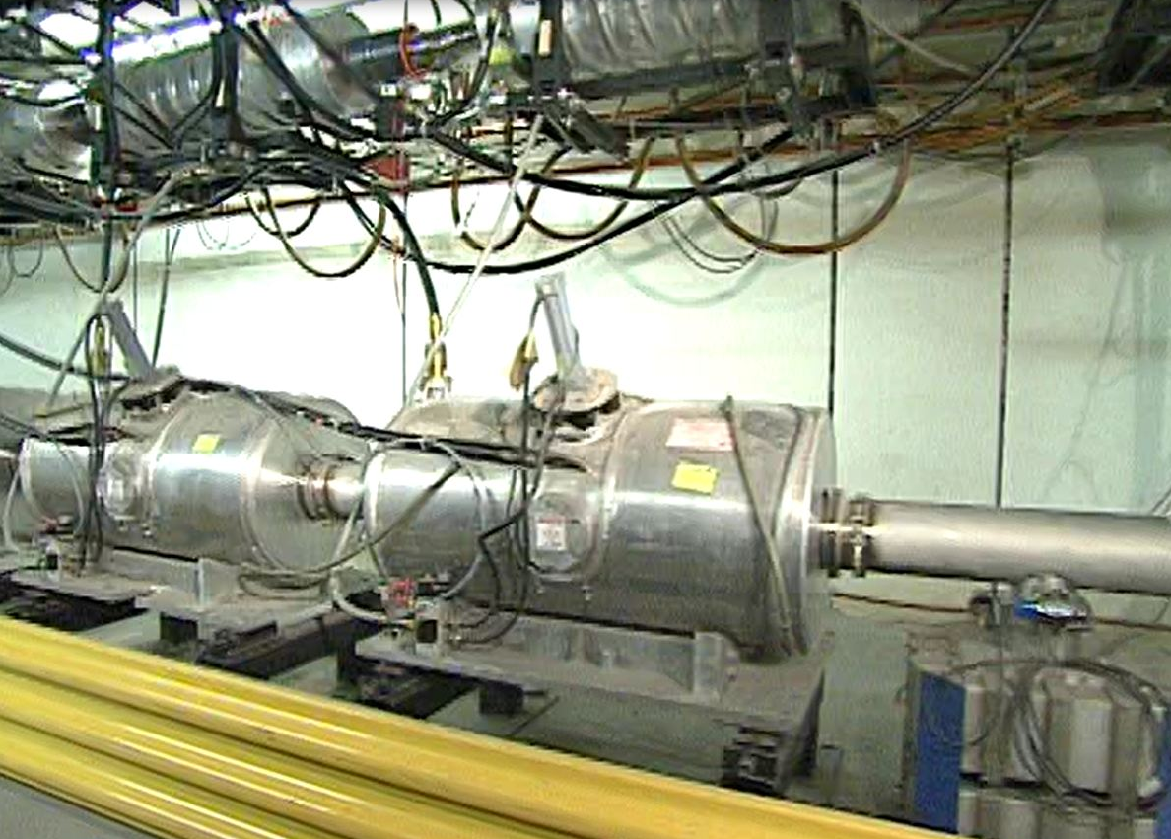
Recycler AIP
Allows 8 GeV proton beam to be rebunched in the Recycler and extracted to the P1 line for transport to experimental areas
  2.5 MHz RF for re-bunching beam
  Extraction kickers
  Beamline connection from Recycler to P1 line
  MI52 building extension for kickers (civil – move to separate FESS project?)
RF cavity production
  Cavities must have active cooling
  Reuse ferrites from MI coalescing cavities
  Labor intensive
  7 RF systems (cavities + PA’s) for Recycler
  2 cavities for Mu2e to be installed in the Delivery Ring
33

Slide 34
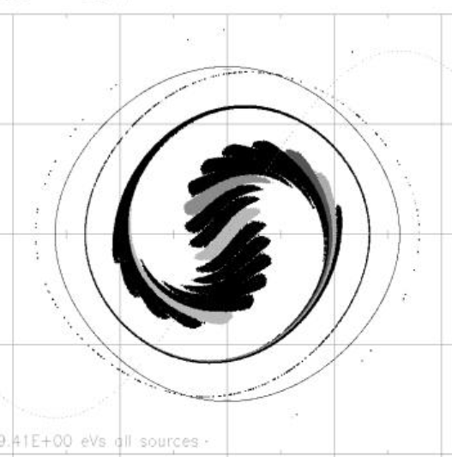
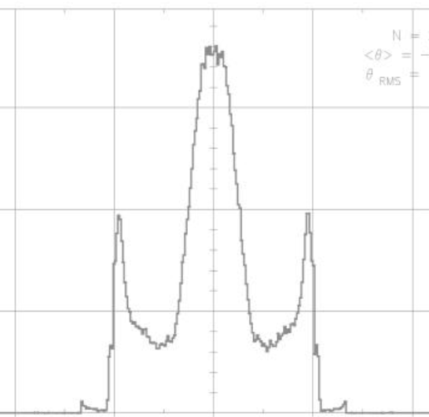
Simulation of rebunched beam
40
96
20
E-E0 (MeV)
RF voltage (kV)
Counts per bin
0
0
-20
95% contour
-96
120 ns
-40
-4 -2 0 2 4
-4 -2 0 2 4
phase (1 deg = 31 ns)
phase (1 deg = 31 ns)
95% capture efficiency, 95% of captured beam w/in 120ns

Slide 35
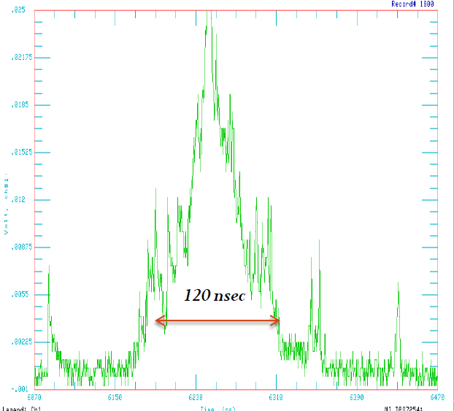
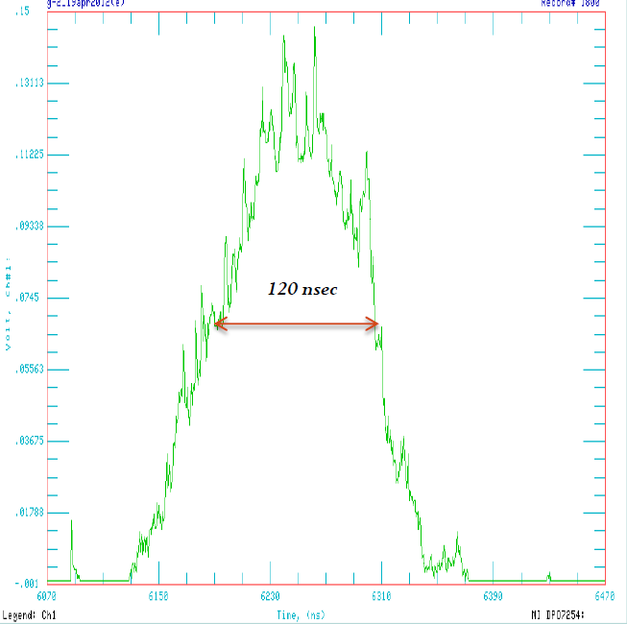
Beam distributions from test in Main Injector
1 Booster batch
~0.4x10¹²
10 Booster batches
~4x10¹²
Very good agreement between simulations and beam data at low intensities
Beam loading will be much less of an issue in Recycler

Slide 36
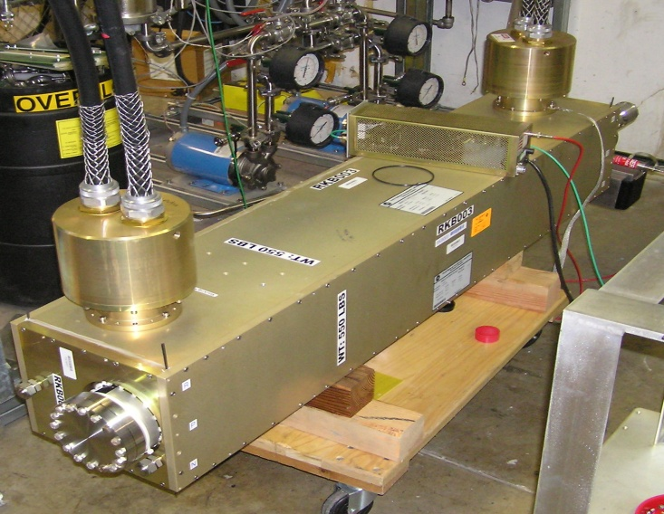
Recycler extraction kicker system
Kicker angle | 1.37 mrad
Flattop | 200 nsec
Field Rise Time | 120 nsec
Field Fall Time | 400 nsec
Average Rate | 12 Hz
Burst Rate | 100 Hz
ANU RKB Kicker Magnet
2 new kicker magnets of the new RKB style designed for ANU
Re-use the beam tubes from the recently decommissioned Recycler kicker magnets
Re-use the PFLs from the Recycler kickers
Build two new 25 Ohm loads capable of up to 250 W ave power
Fluorinert cooling skid to cool the loads
  Extend existing building at MI-52 for kicker power supplies

Slide 37
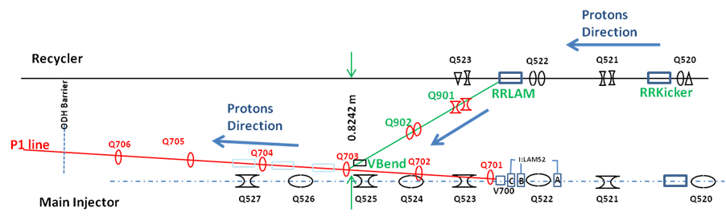
Transporting proton beam to Muon Campus
New connection from Recycler to P1 line

Slide 38
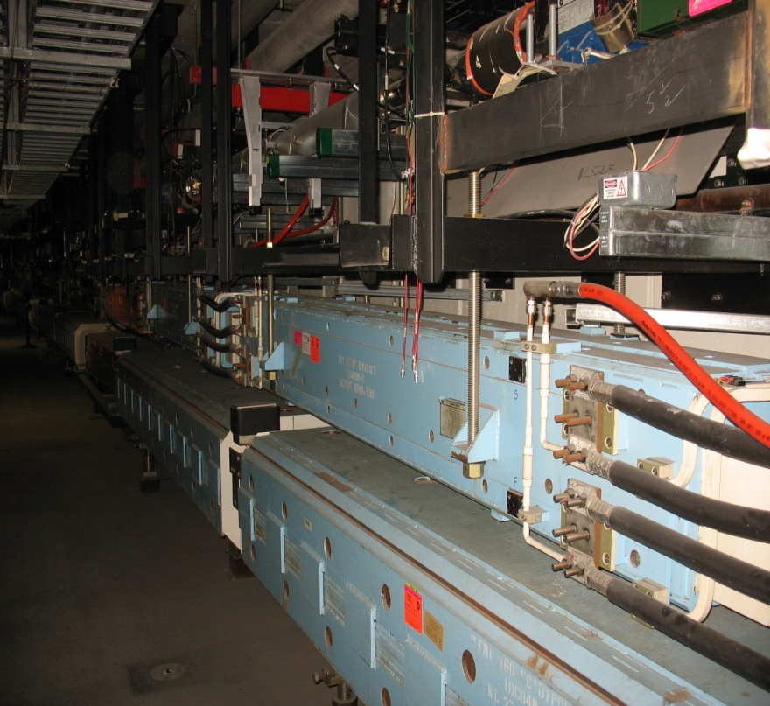
MI-52 Extraction Region
RR
P1 Line
MI

Slide 39
Muon Campus beamlines

Slide 40
New Mu2e and g-2 plans for former Pbar beamlines
p to Mu2e target
μ+ to g-2 ring
After ~5 turns, p separated in time from μ+, kick into abort
Primary abort for Mu2e
3 GeV p,π+,μ+
After ~5 turns essentially all π+ decayed
Extract μ+ for g-2
Resonant extraction for Mu2e
M3 line connects to Delivery Ring (Debuncher)
3 GeV p,π+,μ+ to Delivery Ring for g-2
8 GeV protons to Delivery Ring for Mu2e (target station bypass)
(where M2 line joins M3 line not yet finalized)
3 GeV p,π+,μ+ to M3 line for g-2 (“π decay line”)
8 GeV protons to target for g-2
8 GeV protons to M3 line for Mu2e

Slide 41
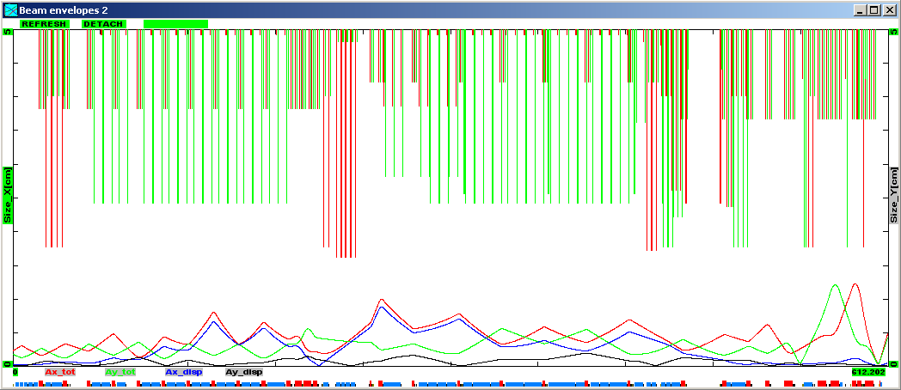
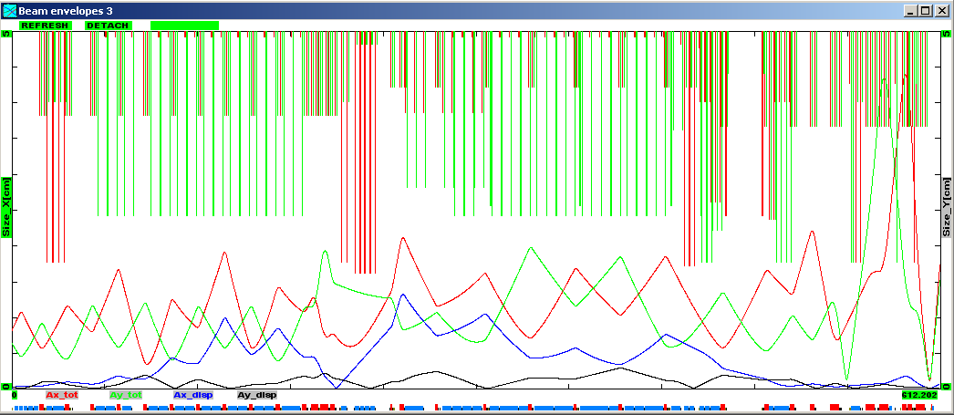
Aperture improvements in P1, P2, M1 lines
120 GeV Pbar production
MI to Target Station
need changes to final focus for g-2
8 GeV protons
RR to Target Station
MI-52 Lam. / V701 C-magnets (?)
V714 C-magnets
Tev. F0 Lambertsons
HV100 dipoles
HV102 dipoles
HT105 trim
F-17 C-Magnets

Slide 42
M2 and M3 lines
M2 line
  Secondary beamline for g-2
  Add quadrupoles to create a regular lattice with smaller β functions to capture more muons from decays
  Beamline magnets from BNL g-2 experiment, also from Accumulator
M3 line (target bypass section)
  Acceptable for Mu2e as is but must match to incoming M2 line for g-2
M2 to M3 connection
  Need connection that accommodates Mu2e 8 GeV proton beam down M3 while preserving small β functions for g-2

Slide 43
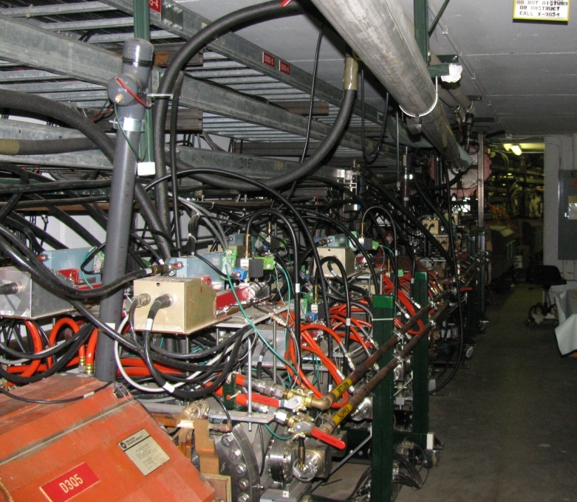
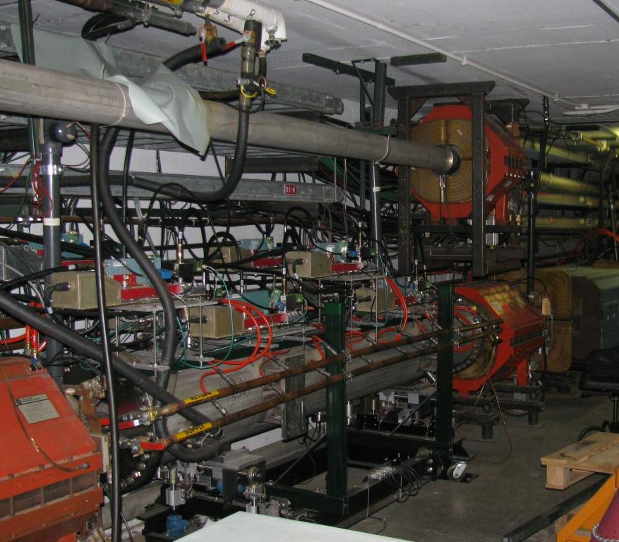
M3 line into Delivery Ring
New connection to Delivery Ring
  Two elevation changes and a 5° horizontal bend
  Confined area for magnet supports in area over Delivery Ring
  Need enough room between DR and M3 to allow use of existing pbar magnets
  Match injection into DR and acceptance must be at least 40π for g-2
AP3 line
Debuncher

Slide 44
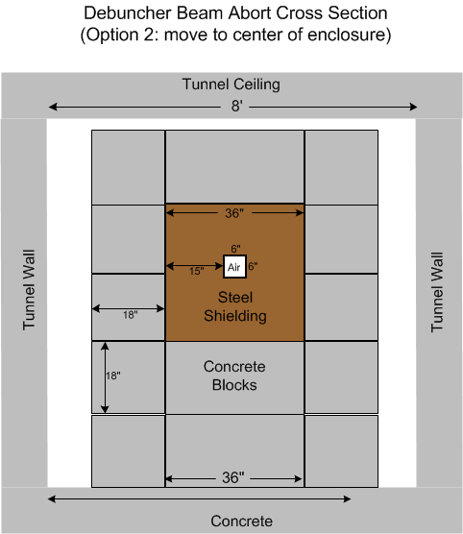
Delivery Ring Modifications
DR aperture improvements
  Removal of unneeded devices such as stochastic cooling tanks
DR abort
  Beam abort for Mu2e
  Proton removal for g-2
    Need a fast-rise kicker
Electrical infrastructure improvements

Slide 45
Delivery-Ring injection/extraction strategy
Keep injection and extraction regions separated (D30 straight)
Maximum flexibility between g-2 and Mu2e at least expense
  Reuse existing equipment
  New devices should be based on existing designs where practical
Work around Mu2e extraction devices
  Resonant extraction more difficult to design
  Requires use of Lambertson
  Placement of extraction channel defined by resonantly extracted beam
  Electrostatic septa added for Mu2e operation
Maximizing acceptance for g-2 (40π)
  Kicker placement
  Large vertical(horizontal) bump across injection(extraction) region
    Motorized quadrupoles (existing) used to create bump for g-2
  C-magnet used in addition to magnetic septum(Lambertson)
  Some specialized large aperture quads (existing)

Slide 46
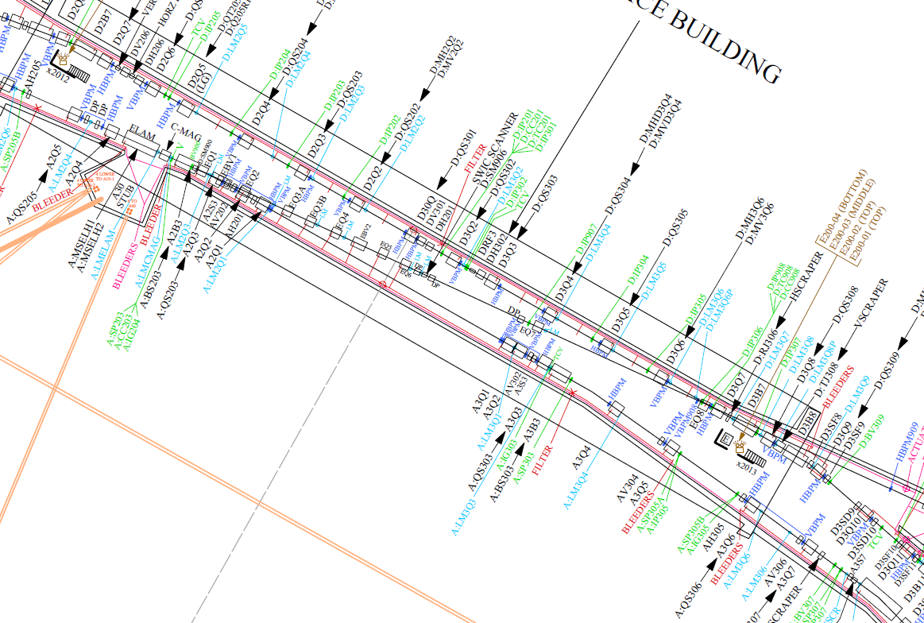
Extraction kickers
Injection kickers
Horizontal bend (5°)
Vertical bend
Extraction Lambertson
and C-magnet
Injection Septum
and C-magnet
Vertical bends
g-2 operation and Mu2e commissioning

Slide 47
Extraction septa (Mu2e)
Extraction kicker (g-2)
Injection kickers
Horizontal bend (5°)
Vertical bend
Extraction Lambertson
and C-magnet
Injection Septum
and C-magnet
Vertical bends
Dual running mode configuration

Slide 48
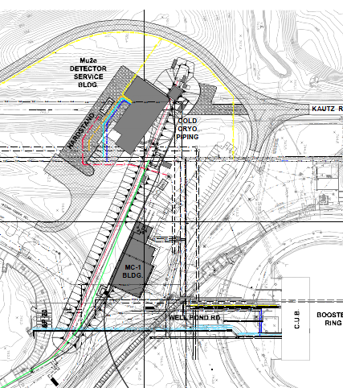
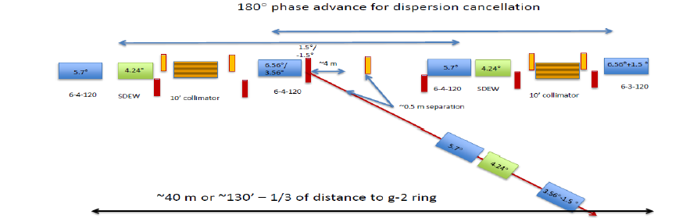
Extraction lines
M4 and g-2 beamline design in progress
g-2 line splits from M4 line in the middle of the left bends
Momentum collimation will be integrated into Left Bend
g-2 line is roughly 50 m long
Vertical dogleg will make elevation change to g-2 storage ring
  BNL magnets and other components will populate most of the g-2 line
Final focus and matching to Storage Ring will be designed in collaboration with Ring Team
Split between the M4 and g-2 lines

Slide 49
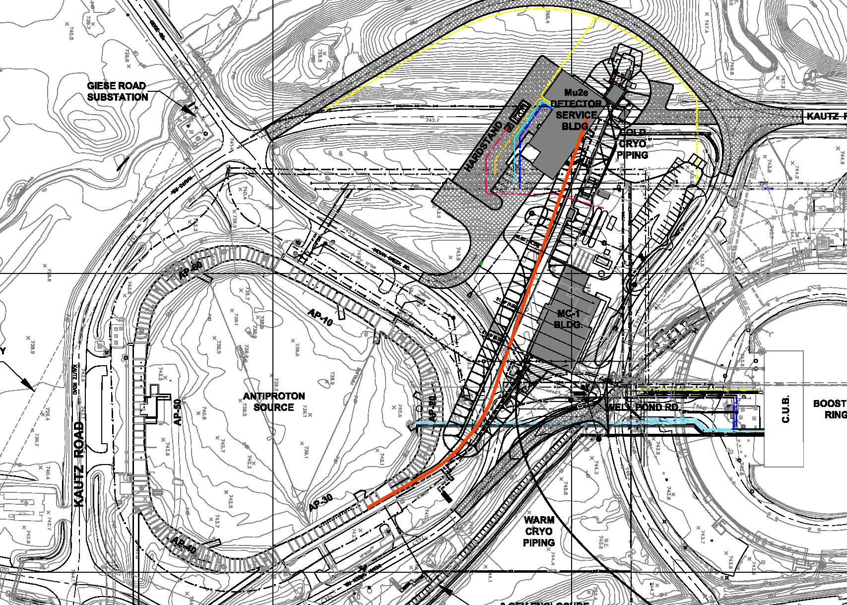
Beamline enclosure and site plan
Details depend on beamline lattice which is not complete yet

Slide 50
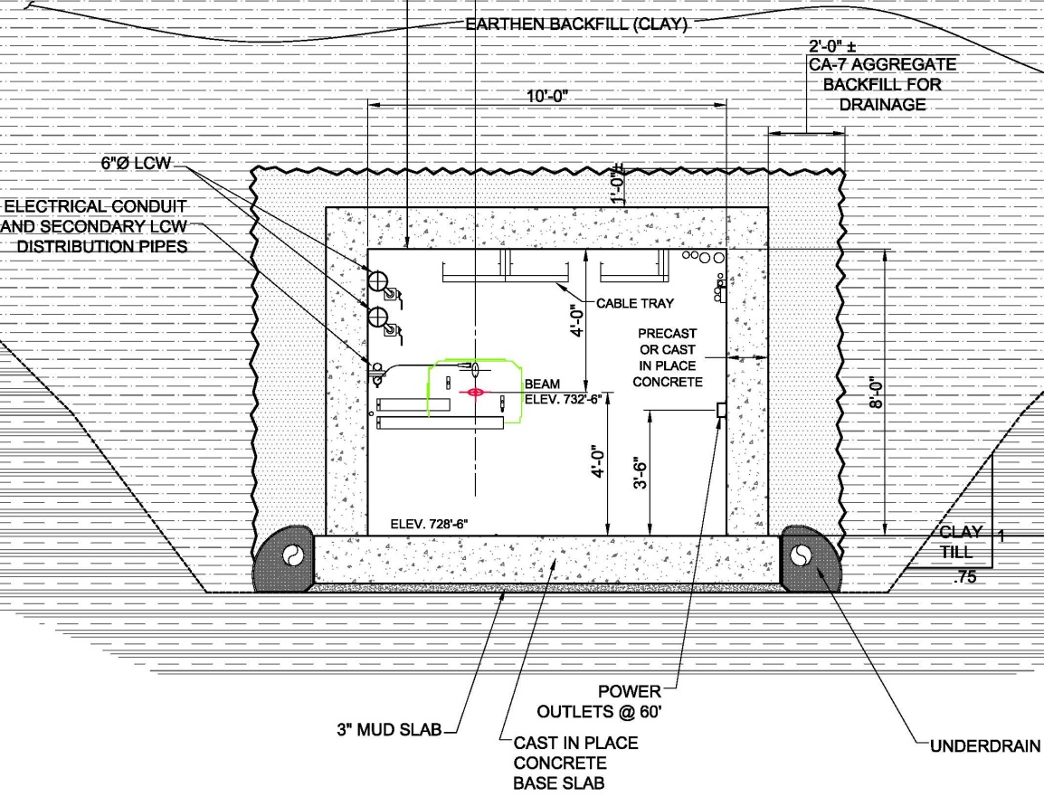
External beamline enclosure design
Main Injector type enclosure
  10 feet wide x 8 feet high (typical except near MC-1 where higher ceiling will be required.
  Painted walls and ceiling, sealed floor. Floor to have 3” cover over rebar to enable stand anchorage.
  Channel inserts walls and ceiling @ 8’ o/c. (no inserts 5’ from floor on aisle side)
Shielding
  16 feet of earth/concrete for M4 beamline. (w/ beamline 4’ from clg.)
  6 to 9 feet for g-2 beamline. Shielding needed within enclosure between MC-1 building and M4 / Delivery Ring.
Access for magnets is provided directly from Ring enclosure; lift provided for magnet installation. Shielded hatch provided for magnet installation / replacement.

Slide 51

Beamline enclosure timeline
CUMULATIVE

Slide 52
g-2 target station

Slide 53

g-2 target station
Use existing Pbar target station at AP0
Fermilab expertise, existing spares, and radioactivity of target vault make it desirable to maintain current setup as much as possible
  Rotating, air-cooled target
  Lithium lens for focusing
  Pulsed magnet for momentum selection
Simulations indicate that the current setup can deliver the desired yield of ~10⁻⁵ pion/POT
  Conducted beam tests to confirm

Slide 54


g-2 beam tests and simulations
Study plan
Expected number of particles
for 1x10¹² protons on target (g-2 single pulse)
Step from stacking to g-2 mode
120 | 8.9 | - | Stacking mode
120 | 3.1 | - | Change magnet strengths in secondary beamlines
8.9 | 3.1 | - | “reverse proton” mode beam to target
8.9 | 3.1 | + | Change polarity of lens, magnets in secondary beamline; g-2 mode
MARS simulation of target station
  g-2 mode: yield per POT: ~10⁻⁵ π+, ~2x as many protons, ~10⁻⁸ μ+
G4beamline simulation of start of pion decay line (C Yoshikawa, Muons Inc)
proton
mom.
(GeV)
secondary
mom.
(GeV)
charge
collimator
momentum-selection dipole

Slide 55

Results of beam test
Intensities track beam on target
Current monitor at beginning of AP2 line shows expected scaling from 120→8-/120 → 3-
Ion chamber at end of AP2 line shows order-of-magnitude agreement with predictions: 10⁹ particles for 120 → 3- and 10⁷ particles for 8 → 3- and 8 → 3+ per 10¹² protons on target
3
Intensity
Protons on target (10¹²)
Ion chamber at end of AP2 line
SEM at end of AP2 line
SEM at mid of AP2 line
2.25
1.5
0.75
0
Time
Beam profiles seen on Secondary Emission Monitors (SEMs)
Existing target and lens appear to provide sufficient yield
Smaller spot size on target will increase yield

Slide 56
Lithium lens in g-2 mode
Higher pulse rate, more complicated cycle than for stacking
Will need new power supplies for lithium lens and pulsed magnet
Begin cycle
End cycle
Bunch length
of 1 pulse
Lens pulse length 400 µsec
120 nsec
100Hz
30Hz
Pulse separation
Train propagation
920 msec
10 msec
97.8 msec
97.8 ms
822 ms
~
~
1
2
3
4
5
6
7
8
9
10
11
12
13
14
15
16
Pulse #
Cycle length 1.33 sec

Slide 57

Lithium lens modeling and testing
Lens ANSYS model predicts higher temperatures and stresses for g-2 but fatigue parameters are better
  Less difference between max and min stresses in cycle
  Can reduce stresses by reducing pressure of lithium “preload”
Currently pulse-testing lens in test stand at full gradient (230 T/m) and average 12 Hz repetition rate
  Running 24hrs/day
  Have integrated ~18M pulses
  Pulse lens for months or until we find its limits
back of power supply
lithium lens
in test stand

Slide 58
Cryogenics for g-2 and Mu2e experiments

Slide 59
Experiment Cryogenics Requirements
Cryogenic loads:
g-2 storage ring
  Liquefaction load – 1.4 [g/sec]
  Refrigeration load – 300 [W]
  LN2 Shield flow rate – 1.6 [g/sec]
The Cryogenic System shall support simultaneous steady state operation of both experiments, Muon g-2 and Mu2e. It shall provide for independent operation of the two experiments, including transient modes, e.g. warm-up, cooldown, etc.
It should be possible to connect and/or isolate Mu2e magnets from the transfer line while under cold conditions
Mu2e solenoids
  Liquefaction load – 0.8 [g/sec]
  Refrigeration load – 350 [W]
  LN2 Shield flow rate – 20 [g/sec]

Slide 60

Cryo compressor system
A0 compressors (four skids)
Each skid consists of the following:
  Two-stage oil injected screw compressor
  300 kW motor
  60 g/s capacity
  Compression from 1 atm to 20 atm
  Slide valve for capacity control
  6 kW oil pump
  Oil cooler heat exchanger
  Aftercooler heat exchanger
  Oil separator
  Oil removal system
  Entire system is contained on a single,
  fabricated steel base skid, oil removal
  on separate skid
Two-stage compound oil flooded
screw compressor Mycom 2016C

Slide 61

Piping headers
from A0

Slide 62

Refrigerator room

Slide 63

Refrigerator room (cont)

Slide 64

Transfer line

Slide 65

Transfer line (cont)

Slide 66
Cryo AIP timeline
2013
2014
2015
2016
2017
Plant and g-2
Mu2e distribution
g-2 cryo distribution
Mu2e cryo distribution
Compressors
Refrigerators
g-2
g-2
Mu2e
Engineering and design
Procurement and installation
Refurbishment and installation
Cooldown

Slide 67
MC-1 Building

Slide 68

MC-1 Building GPP
MC-1 building designed to house g-2 and future experiments, cryo system for g-2 and Mu2e, and power supplies for some beamline components
  80’ x 80’ high-bay with 30 T crane
  internal loading dock
  floor stable, load-bearing to 700 T
  good temperature control
  70’ x 70’ low-bay for staging, assembly, control room

Slide 69

MC-1 Building – Site Plan

Slide 70

MC-1 Building – First Floor Plan

Slide 71

MC-1 Building – Second Floor Plan

Slide 72

MC-1 Building – Cross Sections

Slide 73

MC-1 Building site prep in progress
Construction split into two packages to expedite construction
Goal of site prep package is to 1) relocate all utilities out of building excavation, and 2) perform all shutdown work during current shutdown
  Relocate/tap into utilities
  Relocate Well Pond Road (shutdown)
  Install cryo line supports and under-road piping (shutdown)

Slide 74

MC-1 Building
Building construction will be out for bid in next few months

Slide 75
A look ahead and conclusions

Slide 76

Muon Campus offers many advantages
Distinguishes between project-specific and more general upgrades, needed for g-2 and Mu2e this decade…opportunities for Stage 1 Project X
Allows GPP/AIP pieces to move forward quickly and meet the combined specifications and timelines
Recognized over $100M in savings in the total cost of the muon program, Mu2e run time extended to 3 years, added capability for muon g-2
76
Chris Polly, Muon g-2 Briefing, November 26, 2012

Slide 77

Possibilities for Muon Campus experiments using Project X
Mu2e upgrade, muon EDM experiments, …

Slide 78
Conclusions
Plans for accelerator and civil work needed to support g-2, Mu2e, and future Muon Campus experiments are maturing
Still determining how to best package the work into Projects: g-2, Mu2e, Accelerator Improvement Projects, and General Plant Projects
Shared infrastructure between Mu2e and g-2 as well as reuse of existing infrastructure enables us to do these projects for significantly lower cost
Aiming for g-2 beam in early 2016, Mu2e in 2019

