Slide 1
Linac Laser Notcher Status
David Johnson
Todd Johnson, Vic Scarpine, Andrea Saewert,
John Sobolewski
PIP Meeting
March 6, 2013
Beams Doc 4306

Slide 2
Laser Notcher System
Major Components of the system
Optical pulse generation
Fiber amplifier system (2 + 1 stages)
Macro pulse generation (at 15 Hz) (Pockels cell)
Free space laser amplifier
Laser transport and beam shaping / optical cavity
Vacuum chamber and integration into MEBT
Prototype using 3D printer in TD
Timing and controls

Slide 3
Burst mode seed pulses to Fiber Amplifier followed by Free Space Amp
λ₁=1064nm
120 mW CW
SW=0.1 nm
Output modulator/Input fiber pre-amp:
201.25MHz pulses (1.25 ns pulse), 458kHz burst
10 GHz Mach-Zehnder
Modulator
L_{i}~1.8dB
Isolator
PM Fiber
Diode + TC
controlled
L_{ins} ~5dB
Pulse Generator
Amplifier, Timing
Line filter
Fiber Amp 2
Fiber Amp 1
Measurement point
Free
Space
Fiber Pre-Amp
*Notch 12 bunches -> 60 ns
10 notches/linac pulse
Clean up filter
Generate 24 us burst at 15 hz
15 Hz
Free Space Amp
Pockels cell
Grumman CEO DPSS OEM
TRANSPORT BEAM SHAPING OPTICS &
OPTICAL CAVITY
Updated 10/3/2012

Slide 4
Status of the OPG and Fiber Amp
We set up the optical pulse generation/fiber amplifier system in the new A0 instrumentation laser laboratory.
We now have the seed laser and fiber amplifiers connected to the safety interlock system and have procedures in place and permission to operate the equipment on hand.
We have started characterizing the characteristics of the system using a borrowed pulse generator and scope/spectrum analyzer in the A0 lab.

Slide 5
OPG Fiber Amp Components
P.S. for RF Amp
Fiber Pre-amp
Diode/TEC power supply
Safety System interface
Modulator Bias Controller
Fiber Amp 1

Slide 6
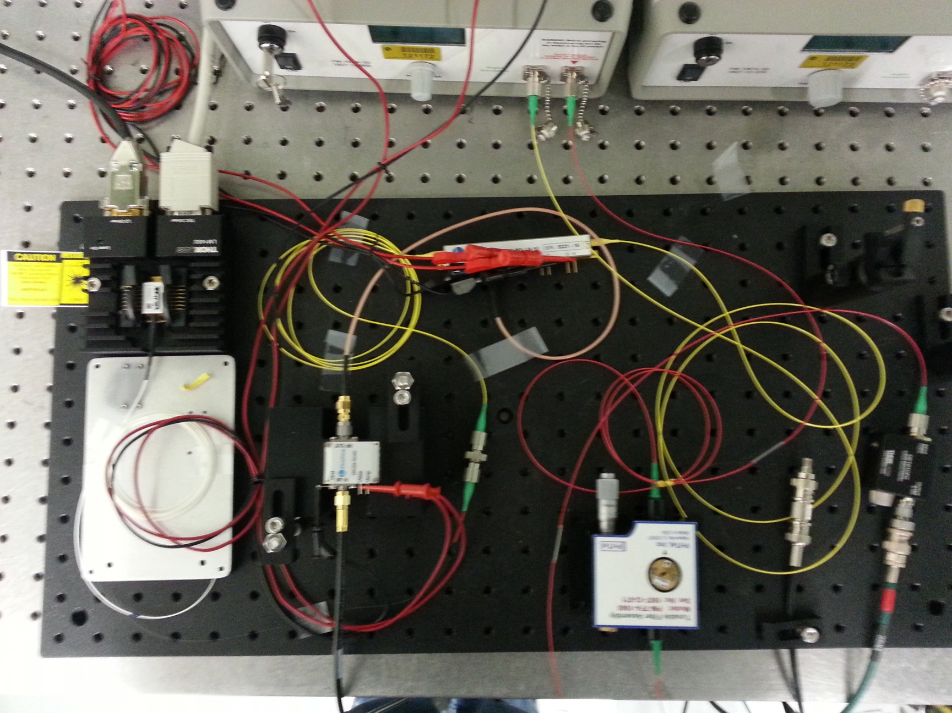
Optical components
All this to be mounted inside a chassis
Modulator
Seed Source
Photodiode
detector
RF Amp
FBG / isolator
& fiber holder
Narrow band
Optical filter

Slide 7
Current support equipment
Borrowed from Peter Preito
HP 8131A 500 MHz pulse generator
RF splitter
Instrumentation (Carl Lundberg)
Power supply for RF amplifier
Equipment in A0 Instrumentation laser lab (Vic Scarpine/Andrea Saewert)
Tektronix TDS7104 1 GHz/10 GS/s oscilloscope
Agilent 86142B Optical Spectrum Analyzer
Thorlab’s fiber coupled photodiode DET01CFC
Miscellaneous lab supplies…

Slide 8
200 MHz Laser Pulses
200 MHz pulses
* I didn’t have a blank floppy disk with me
450 kHz
200 MHz Laser pulses (1.25 ns flattop) out
of fiber pre-amp with (band pass filter included)
200 MHz pulsed from:
HP pulse generator input into
modulator RF amplifier
I need to add another pulser to trigger the HP
at 450 kHz to create the burst structure

Slide 9
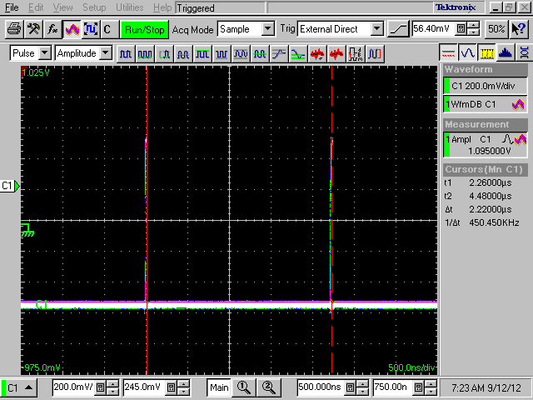
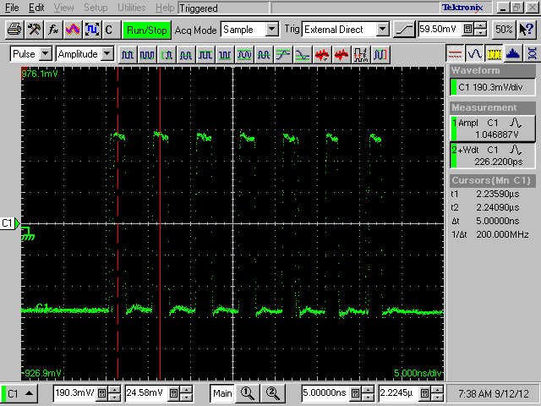
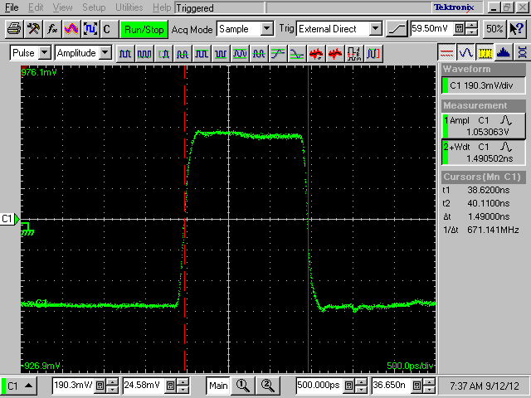
Picosecond Pulse Labs Model PSPL 12020 Screen Shots
Decreasing time/division
Burst rep rate of 450kHz
Seven 200MHz pulses
1.5ns FWHM pulse width

Slide 10
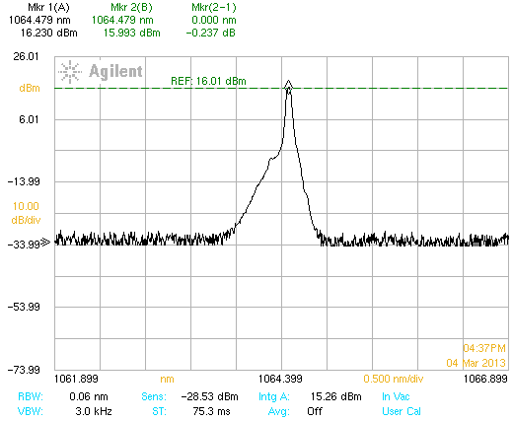
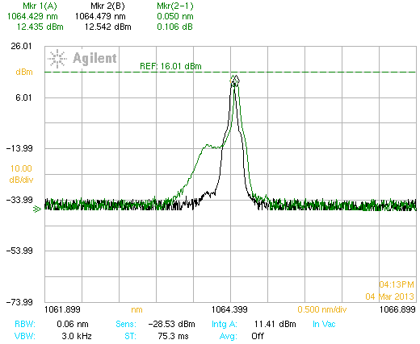
Seed Source
Factory Calibration
Seed source 50 mW with 1.6 dB isolator -> 34.75 mW
Measured 34.8 mW with Thorlabs PM20CH (15.4 dBm)
11.4 dBm
Measured power in seed source with OSA
Found: 11.4 dBm (13.8 mW) ---way too low ???
Installed user calibration based upon power meter.
This gives a closer result 15.26 dBm (33.5 mW) - <4%
User calibration
15.26 dBm
Line broadening of seed?

Slide 11
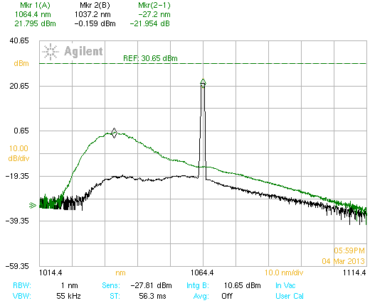
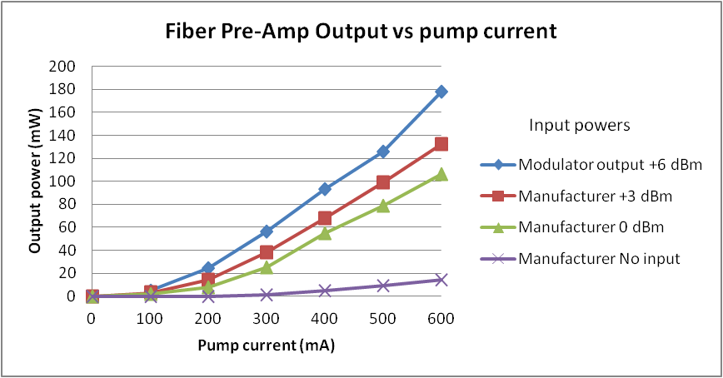
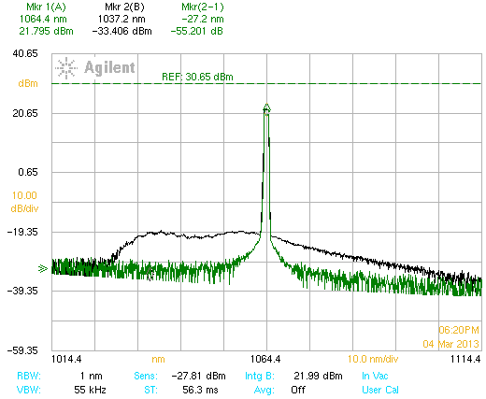
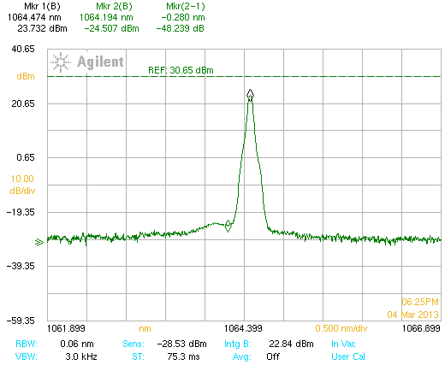
Modulator and Preamp
Pump 600 mA
Modulator
DC extinction ~ 25 dB
Seed on/off
Note: operating seed
at half power
Span 100 nm
Span 5 nm
22.8 dBm
~190 mW
(~ nJ pulse energy)
Spectrum from pre-amp thru the Band Pass filter

Slide 12
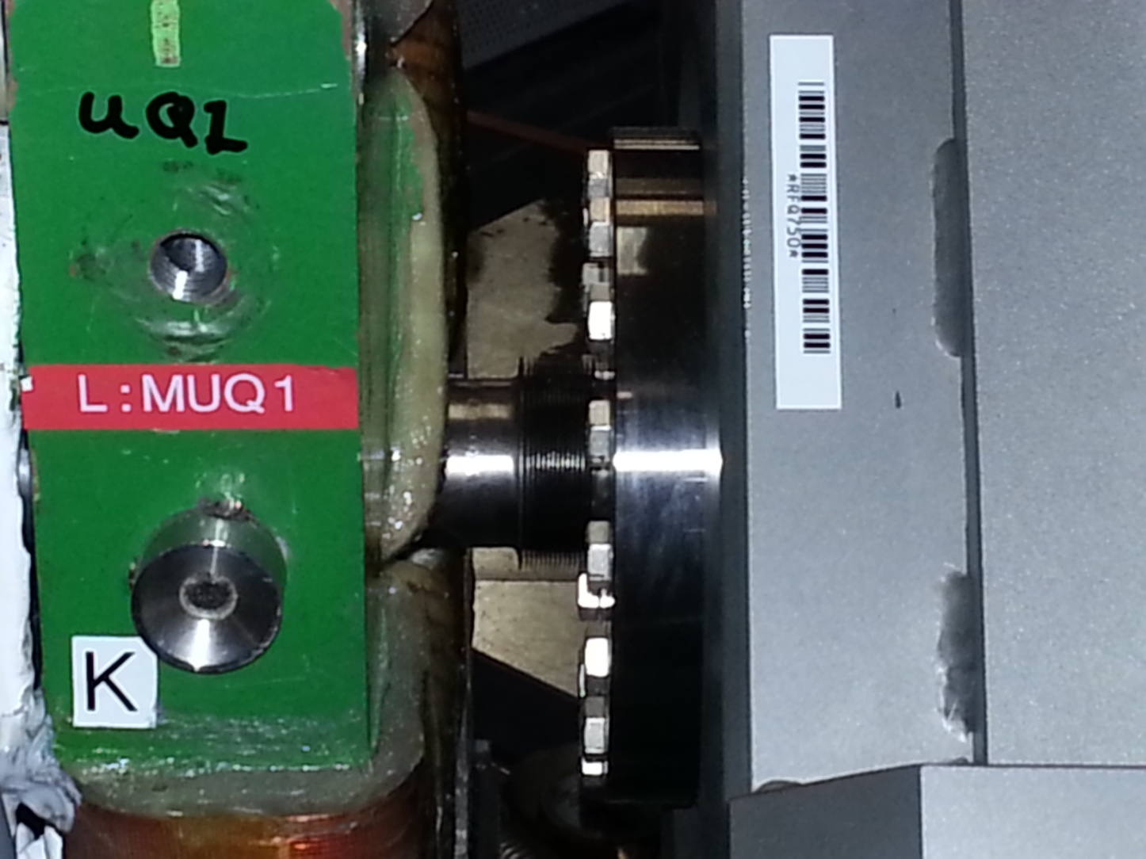
Vacuum chamber
Must fit in this space
The vacuum flange and beam pipe containing view ports and zig-zag cavity will prototyped using the 3D printer in TD.
Make new RFQ flange (thicker) with view port and internal optical cavity supports.

Slide 13
Summary
We have assembled and starting to characterize the first components for the Laser Notcher.
Will continue to learn how to operate the OPG and fiber amplifiers.
We would like to put the OPG equipment inside a chassis to protect fibers and get rid of external power supply for RF amplifier.
We will add another pulse generator to create 450 kHz burst.
The temporal pulse structure out of the borrowed pulse generator is not as uniform as needed, but will work till we get the final pulser.
We have not spent much time on the beam shaping optics since we demonstrated beam shaping and zig-zag cavity last fall. We need to add in an anamorphic prism pair to better shape the horizontal beam out of the piShaper to move forward with the design.
Todd has been working on the free space amplifiers at NML which are very similar to those we will be using next year for the final amplification stage.
John Sobolewski (MS co-op) is beginning to look at the vacuum holder for the optical cavity. We are planning to prototype this using the 3D printer.
This summer add in the Pockels cell to create 15 Hz burst of pulses.
By end of FY13 we should be ready to add new pulse generator, final fiber amplifier, and free space amplifier.

