Slide 1
Booster Bias Supply Upgrade
March 13, 2013

Slide 2
Three New Ferrite Bias Supplies
    Two are working and installed.
        One in MI station #5, one in Booster station #10.
    Last one is being checked in the test station at MI-60.
Ferrite bias Supply Upgrade
    First six transformers received.
    All SCR’s have been received.
    All heat sink parts received.
    First supply to be retrofitted now at MI-60.

Slide 3
    First six transformers received.
    First three not sealed completely.
        Have the epoxy to finish the job.
    Second set of three were sealed correctly.
    Modifications from previous order implemented.
    Only way to fully test one of them will be to install in existing supply.
        Plan is to start this when the last new bias supply is fully functional.
    Heat sink assembly.
    Need to braise 216 assemblies (3x6x12).
        Send them out for tin plating.
Assemble flexible copper straps.
Assemble SCR Package: heat sink, SCR, SCR clamp.

Slide 4
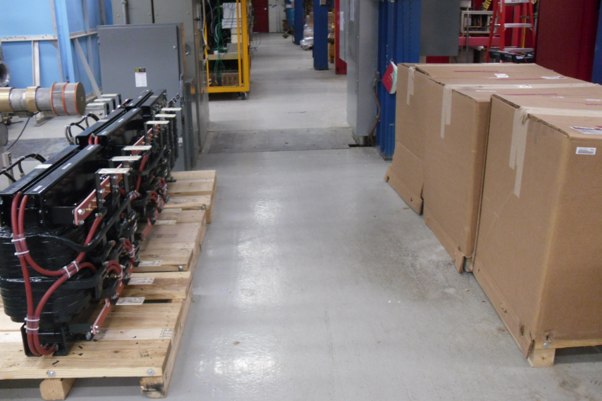

Slide 5
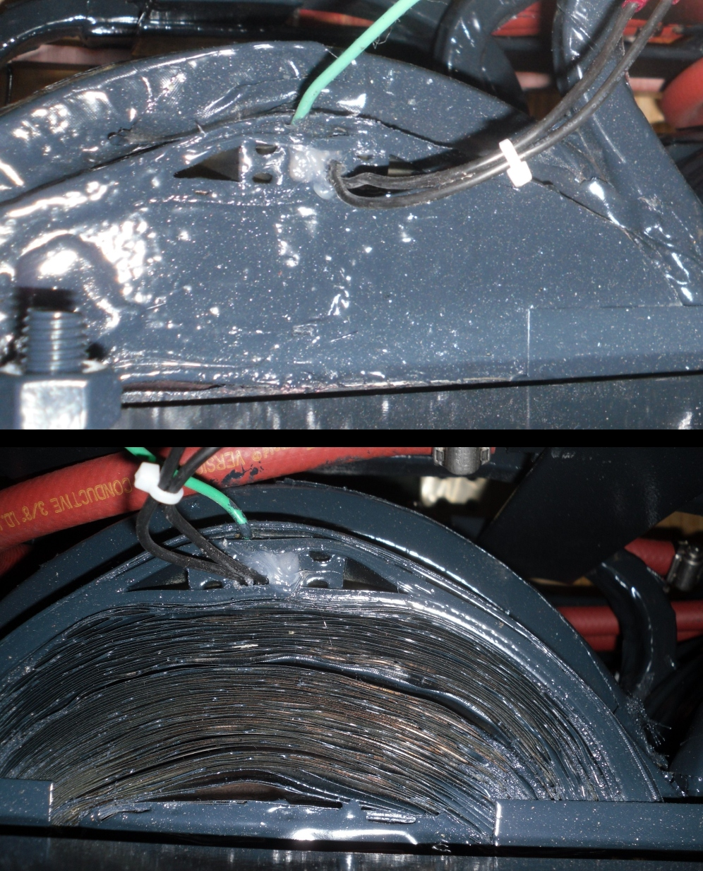

Slide 6
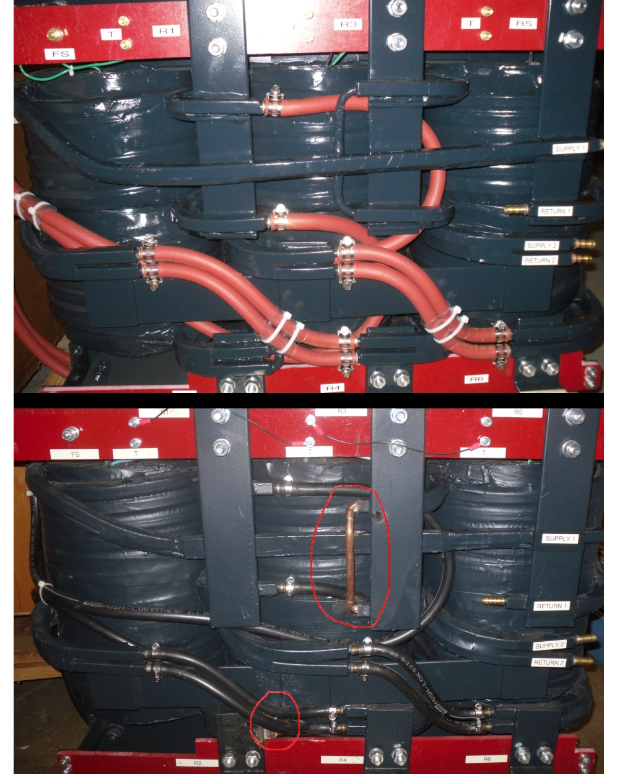

Slide 7
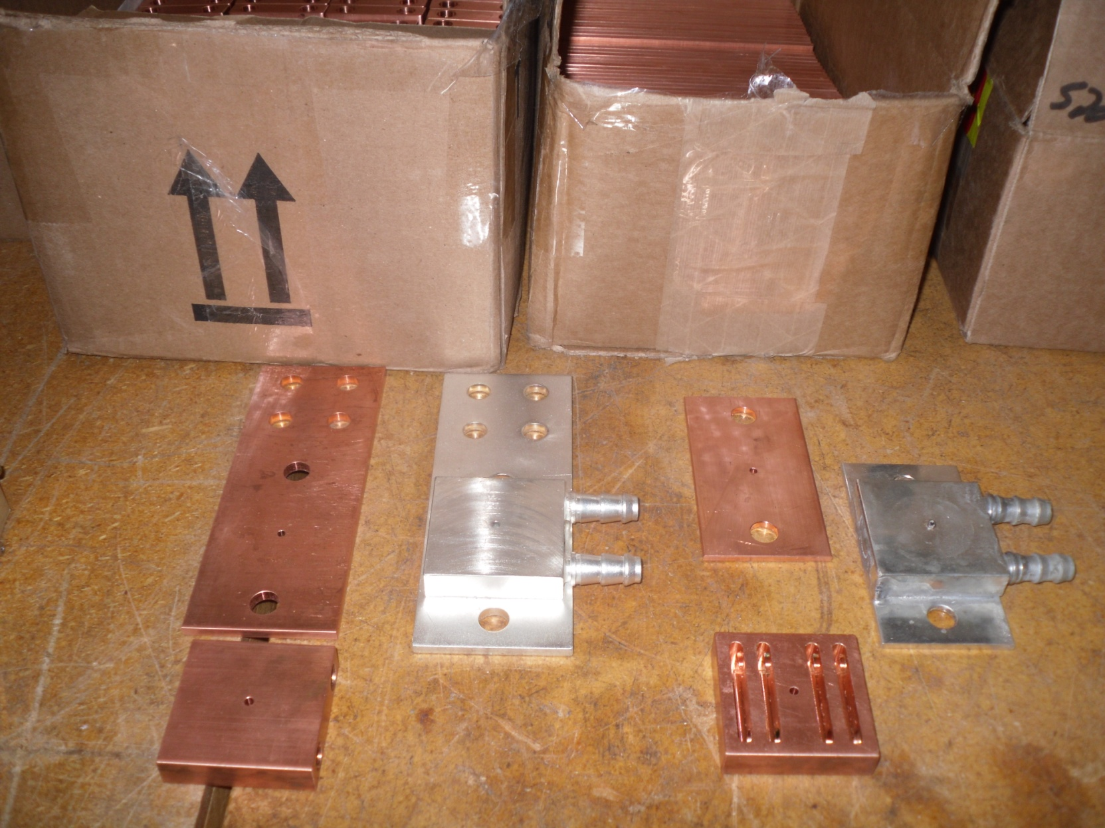

Slide 8
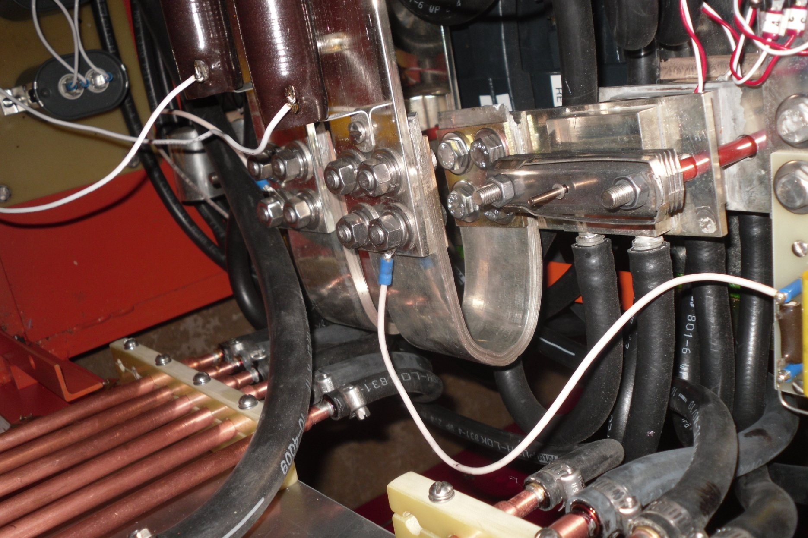

Slide 9
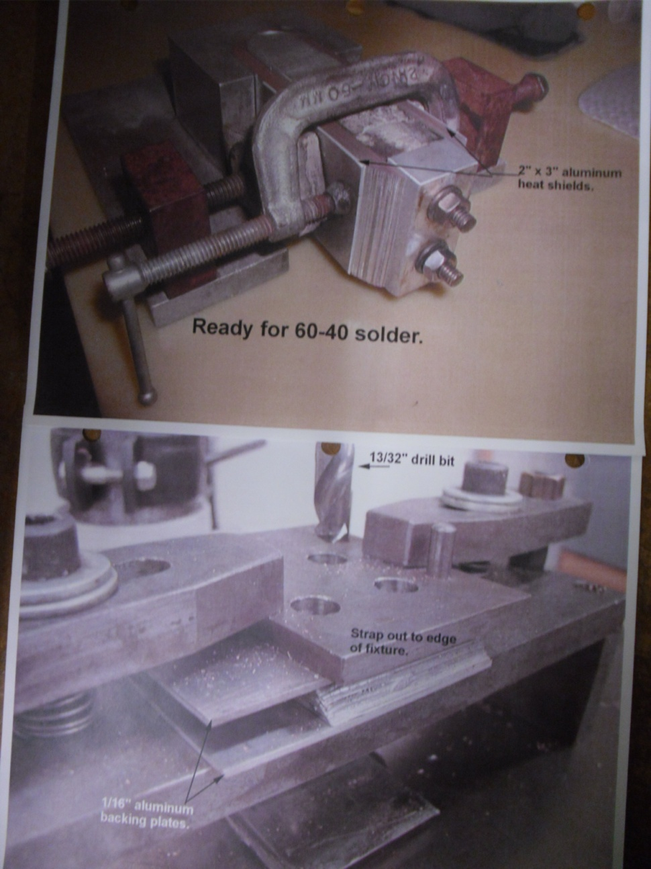

Slide 10
First retrofit of old style Mark I
    Determine how much of a tear down is necessary
    Mark I:
      Much smaller Transformer.
      Transformer is flipped 180 degrees from Mark III.
      Front and back half is separated by a wall.
      Different style (larger) active filter.
    Determine what new parts need to be machined.

Slide 11
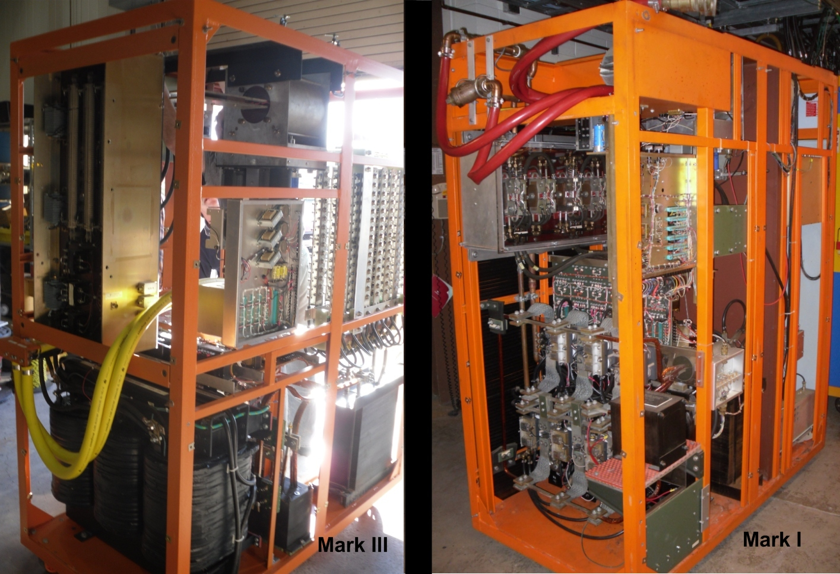

Slide 12
