Slide 1
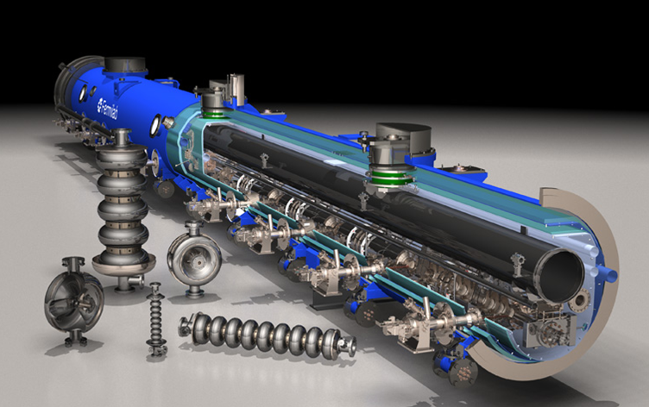
FNAL Superconducting RF Program
Sergei Nagaitsev

Slide 2
Context of SRF Activity at Fermilab
Fermilab’s SRF R&D effort increased dramatically in FY06 with emphasis on ILC and a new SRF based Proton Source ( Project X )
ILC SRF Program
  R&D on cavity gradient, quality factor, and manufacturing yield
  Construction of SRF cavity/CM process and test infrastructure
  Construction of 1300 MHz cryomodules for RF Unit test at New Muon Lab
  Development of US cavity vendors
  Augmented via large ($53.7 M) ARRA investment in late FY09 (all M&S, components from industry are still arriving)
Although ILC R&D formally ended in FY12, there is still substantial ongoing activity on 1.3 GHz technology
  Exploit ARRA spending (e.g. validate parts produced in U.S. industry)
  Benefits the pulsed linac for Project X
  Supports proposal to complete NML for AARD (ASTA)
Low beta cavity development began as the HINS Program

Slide 3
Context of SRF Activity at Fermilab
Adoption of a 3 GeV CW linac followed by a 3-8 GeV pulsed linac for Project X results in a very powerful intensity frontier accelerator complex… but presents new challenges
  Needs six different cavities optimized for changing velocity ( β ) of Protons
  Four different frequencies (162.5, 325, 650, 1300 MHz)
  Five of these cavities are completely new for Project X (vs 2 for SNS, 1 for CBEAF)
  Requires development of seven different styles of cryomodules
“flawless execution” of a ~ $ 1 B class DOE project based on these cavities and CM requires development of representative prototypes such that performance and costs are well understood
Requires a major R&D effort

Slide 4
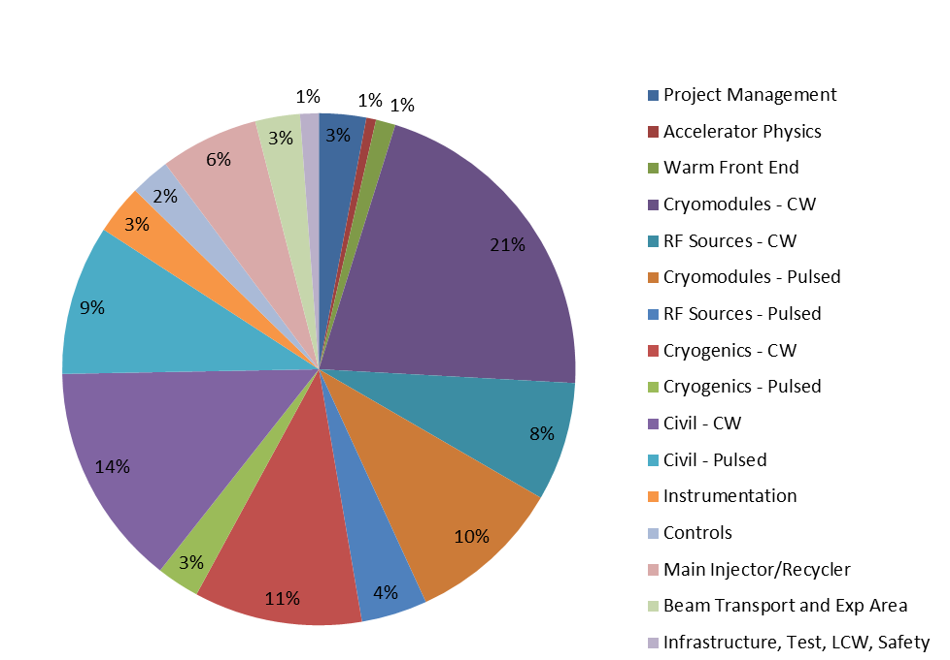
Project X Accelerator Costs Estimate – Full Scope thru 8 GeV
21%
10%
11%
3%

Slide 5
SRF Map for Project X
SRF part of PXIE
Project Cost Risk
H⁻
LEBT
RFQ
MEBT
HWR
SSR1
SSR2
β=0.6
β=0.9
1.3GHz ILC
RT (~15m)
CW
Pulsed
0-2.1 MeV
2.1-177 MeV
0.177-3 GeV
3-8 GeV
SRF Cavity Type | Freq, MHz | Energy(MeV) | Cav/mag/CM | CM type, length
HWR (β_{G}=0.11) | 162.5 | 2.1-11 | 8 /8/1 | scscscscscscscsc, 5.3m
SSR1 (β_{G}=0.22) | 325 | 11-38 | 16 /8/ 2 | csccsccsccsc, 4.8m
SSR2 (β_{G}=0.51) | 325 | 38-177 | 35 /21/ 7 | sccsccsc, 6.5m
LB 650 (β_{G}=0.61) | 650 | 177-467 | 30 /20*/5 | cccfdccc, 7.1m
HB 650 (β_{G}=0.9) | 650 | 467-1000 | 42 /16**/ 7 | cccccc, 9.5m (Stage1)
HB 650 (β_{G}=0.9) | 650 | 1000-3000 | 120/30**/ 15 | cccccccc, 11.2m (Stage 2)
ILC 1.3 (β_{G}=1.0) | 1300 | 3000-8000 | 224 / 28/ 28 | ccccfcccc, 12.6m (Stage 3)
* 5 warm and 5 SC doublets. ** All doublets and correctors are warm
Non-PXIE = 451 cavities/
62 cryomodules
5

Slide 6
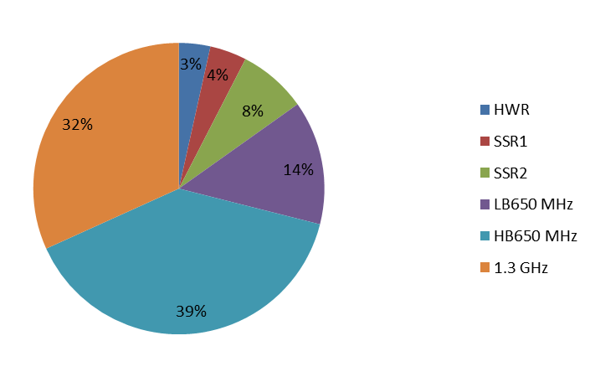
Project X Cryomodule Cost Estimate –
Full Scope thru 8 GeV
While important technically, cavities and CM being developed for PXIE represent only 7% of ~ $500 M Project X Cavity and CM Costs
3%
4%
PXIE
650 MHz CW Cavities represent more than half the costs and dominate the Project X cryogenic heat load
Comparison only! 2010 cost estimate, direct $ (no overheads), no contingency, etc.

Slide 7
Current SRF Program Activities
  Project X: Cavity and Cryomodule Development
    162.5 HWR (ANL)
    325 MHz SSR
    650 MHz Elliptical (LE and HE)
    1300 MHz: Elliptical, beta = 1
    Project X pulsed, ILC, and AARD
  Development of cavity and CM industrial base
  Continued SRF Infrastructure Construction
    VTS 2/3, HTS-2, the CryoModule Test Facility (CMTF ) which hosts PXIE and includes large cryo system
    Pulsed CM beam test facility at New Muon Lab
  Basic Operations of SRF Infrastructure (Cryo & RF)
  SRF materials program (Cavity Qo, cavity processing & yields)
  International collaborations (DESY, KEK, India, UK, …)

Slide 8
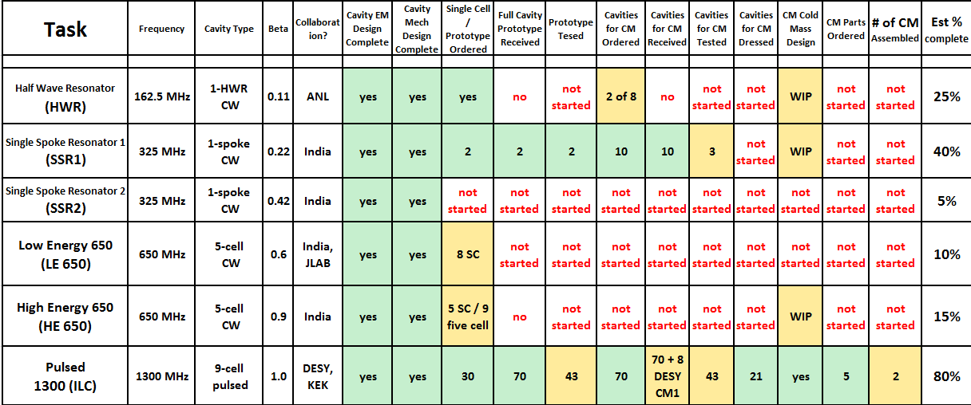
Project X Cavity and CM development
Lots of cavity and cryomodule development remains to lower Project risks

Slide 9
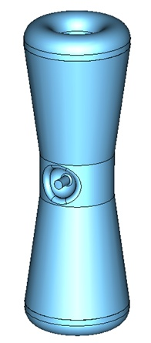
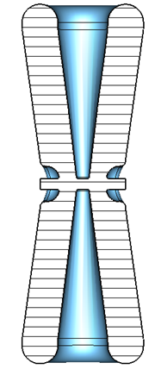
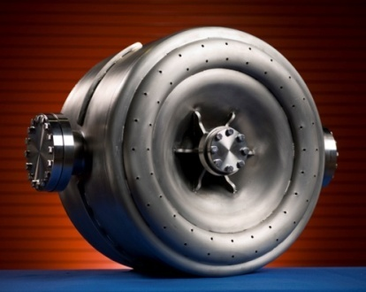
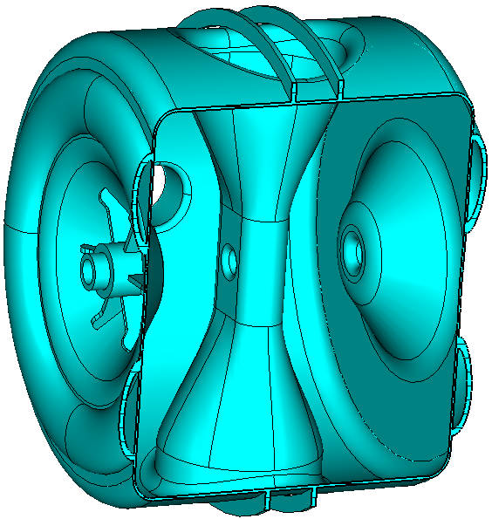
162.5 and 325 MHz Cavities
Three designs cover the beta range 0.07 → 0.52
HWR ( β = 0.11 ) Half Wave Resonator (ANL)
  Cavity design complete, ordering parts, CM design in progress
  Very similar to cavities & CM already manufactured by ANL
  Optimize to achieve tight packing in PX front end
SSR1 ( β = 0.22 ) Single Spoke Resonator
  Started under HINS program and is therefore more advanced
  Two prototypes have been fabricated by industry, processed in collaboration with ANL, and tested at Fermilab
  Two cavities in fabrication at IUAC-Delhi ( Fall 2011 )
  Ten cavities fabricated by US industry (all arrived, 3 tested)
  One cavity dressed with He vessel, coupler tuner
  Processing and tests in progress
SSR2( β = 0.51 )
  EM and Mechanical design complete
  Possible prototype in FY14 as WFO for
  Korean RISP Project
PXIE

Slide 10
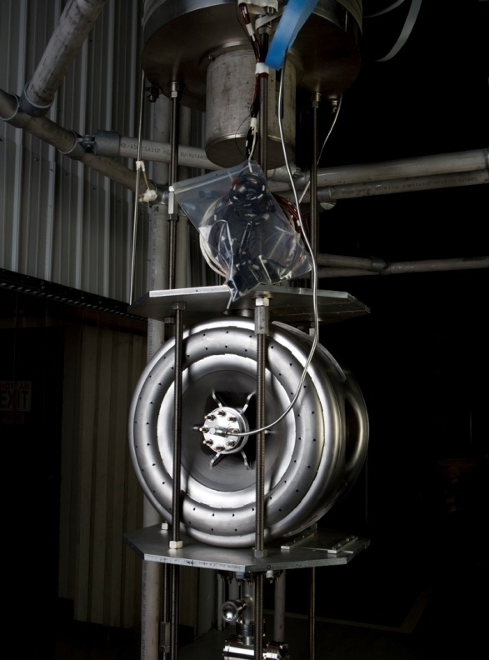
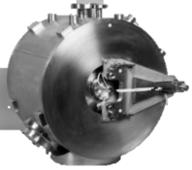
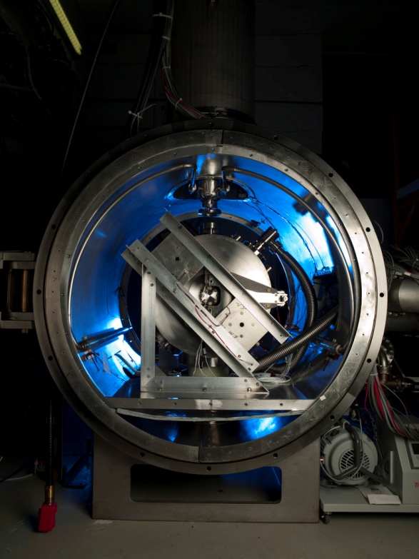
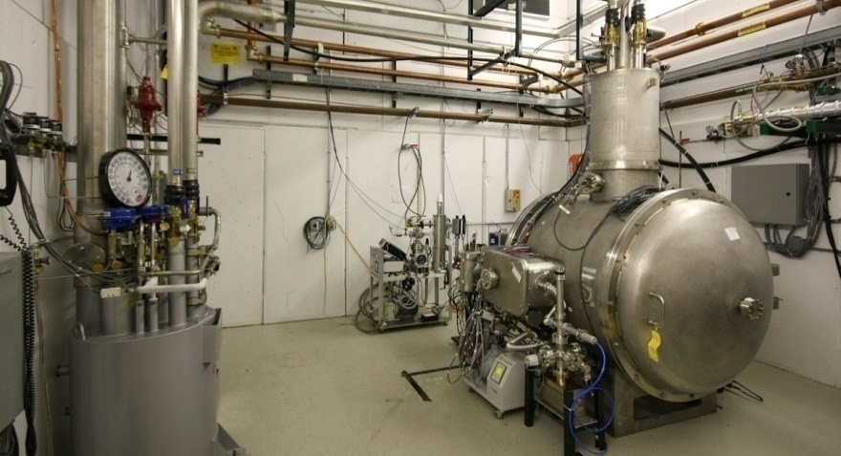
325 MHz Test Infrastructure
VTS
Bare
Dressed
STC
SSR-1 prototypes were tested in the VTS-1 vertical dewar (normally used for 1.3 GHz cavity testing ) with the addition of new electronics and tooling.
Spoke Test Cryostat completed and used for 4 K testing of “dressed” 325 MHz single-spoke resonators.
Upgrades for 2 K operation in process
Tests of first dressed cavities at 2 K planned in June of 2013
Dressed SSR-1 prototype prepared for testing in HTS
Includes RF couplers, tuners, and magnetic shielding

Slide 11
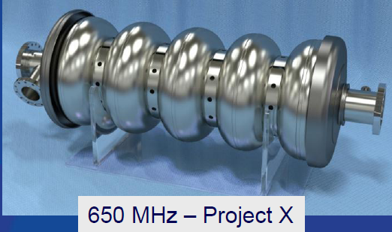
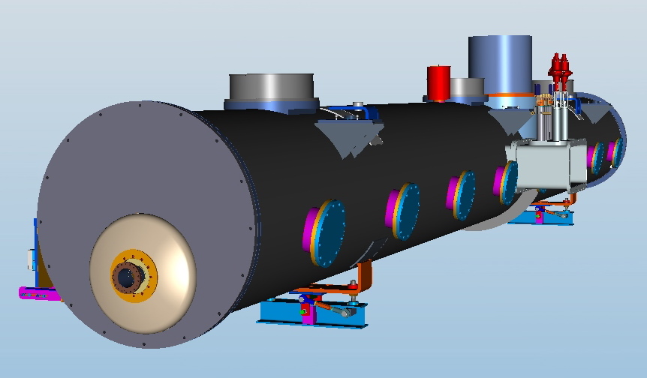
  650 MHz Cavity Development
650 MHz cavities and cryomodules are cost drivers for Project X
  Actively studying cost reduction methods and Q₀ improvement
Initial EM & Mechanical design of β = 0.6 & 0.9 five-cell cavities were based on scaled ILC design… now refining this exploring cavity cell shapes
High cavity forces cause difficulties for ILC blade tuner ➔ exploring end tuner
Goal is also to reduce df/dp (pressure sensitivity)
Need to develop tuners, couplers, He vessels, magnetic shielding, etc
Scaled Tesla cavity prototypes ordered
CW CM conceptual design in progress
  stand-alone 8-cavity cryomodule
  Overall length: ~12 m, 48 “ O.D.

Slide 12
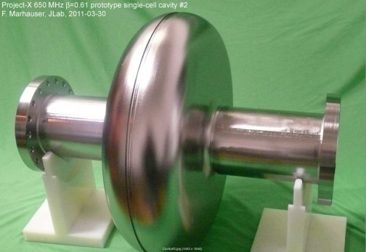
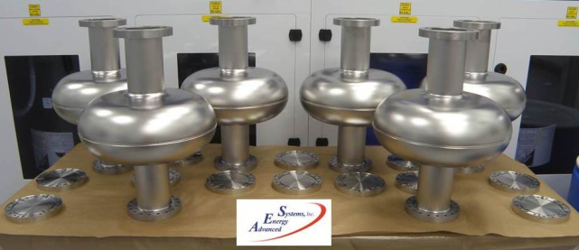
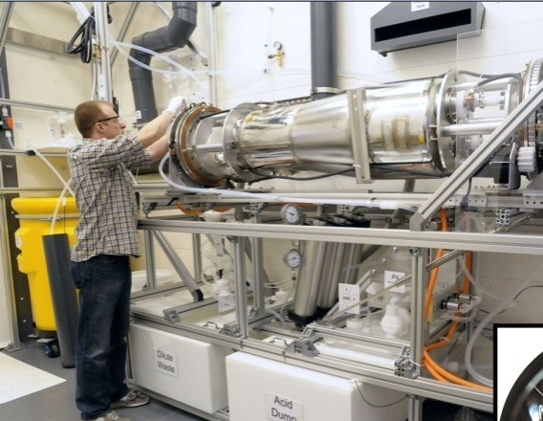
650 MHz Cavity 1st Prototypes
Readiness for Processing & Testing
Prototypes fabricated:
  Single-cell β = 0.6: 2 prototypes@JLab, 6 ordered industry
  Single-cell β = 0.9: 5 cavities from industry testing started
  Nine 5-cell β = 0.9 cavities ordered from industry
  Prototypes at both β are being fabricated in India
Infrastructure modifications: for 650 MHz in process
    FNAL: Vertical Test Stand: Electronics, amplifier, etc
    FNAL: Cavity handling & HPR tooling, etc.
    FNAL: Optical inspection system modifications
    ANL: New electro-polishing tool
    Industry: EP/BCP capability in US industry

Slide 13
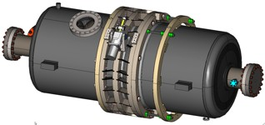
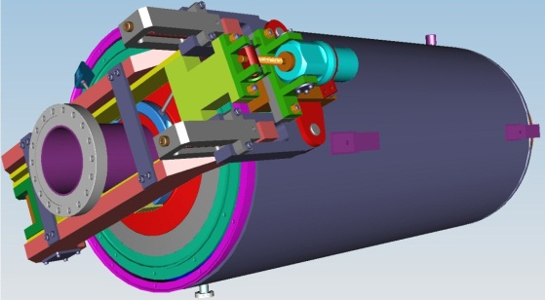
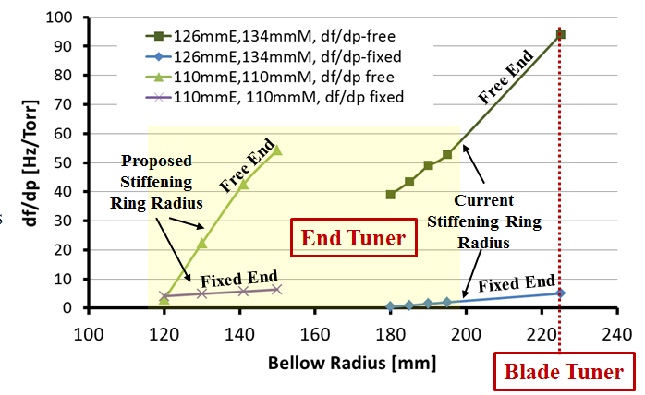
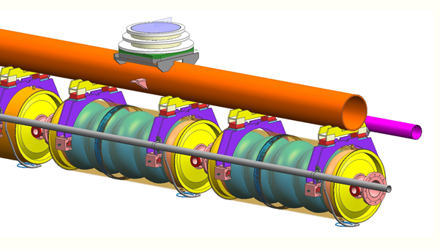
650 MHz CW Cavities and CMs are a design challenge
  Modification of cryomodule design developed for ILC
  …but must accommodate large (250 W) heat loads at 2 K
Lots of detailed engineering remains
⬅Blade Tuner
End Tuner ➔
Stiffening rings located to minimize dF/dP while maintaining tunability
Working on detailed CM engineering design and 3D models of 650 MHz CM
Collab with India

Slide 14
1300 MHz Development for ILC and PX
Driven by ILC SRF Goals:
    S0 >35 MV/m bare cavities
    S1 31.5 MV/m dressed cavities in a ILC Cryomodule
    S2 Beam test of full ILC RF unit (CM, klystron, modulator)
  But all of this benefits the 3-8 GeV pulsed linac for Project X
Accomplishments:
  Improved cavity gradients and yield
  ANL/FNAL EP facility: world class throughput & yield
  70 cavities ordered, many from U.S., 43 VTS tested, 20 cavities dressed
  CM1 assembled (DESY kit) and cold test complete
  Installing CM2, 1st high gradient U.S. Cryomodule (ave 31.5 MV/M = goal)
  Parts for 4 more 1.3 GHz cryomodules purchased ( ARRA funds)
  Extensive 1300 MHz infrastructure operational

Slide 15
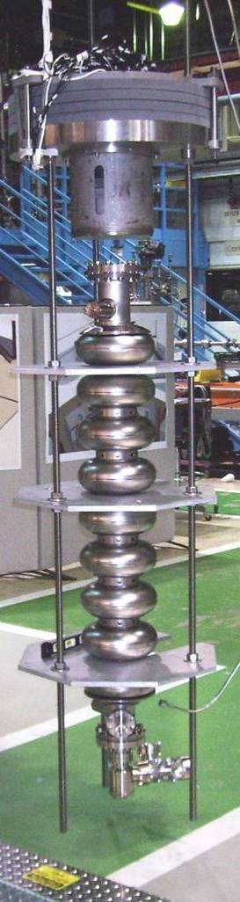
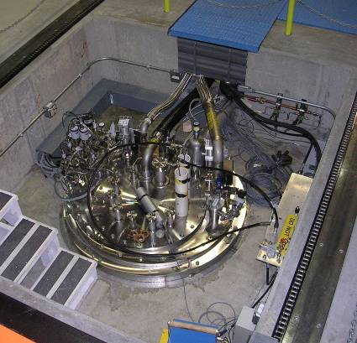
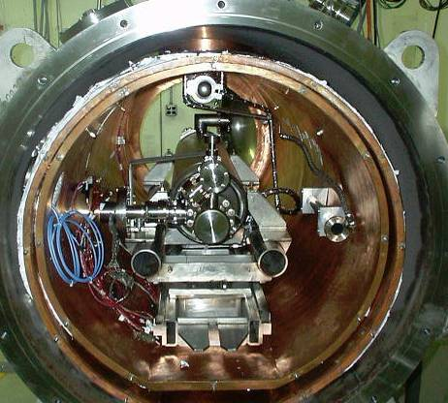
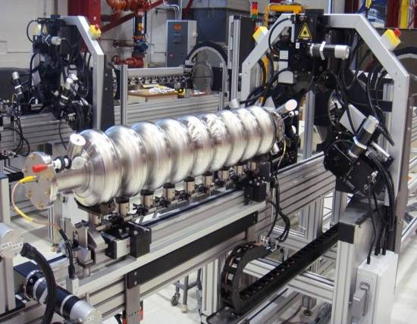
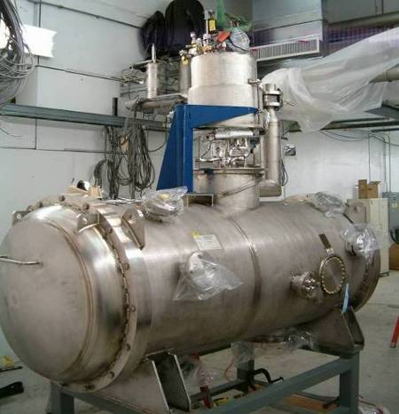
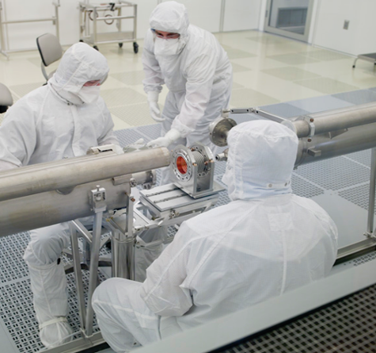
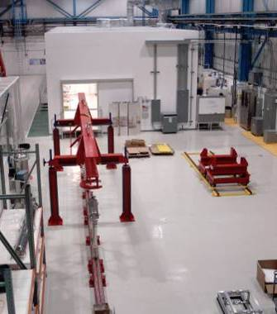
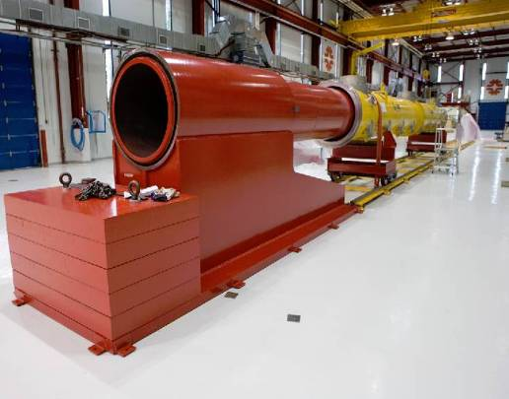
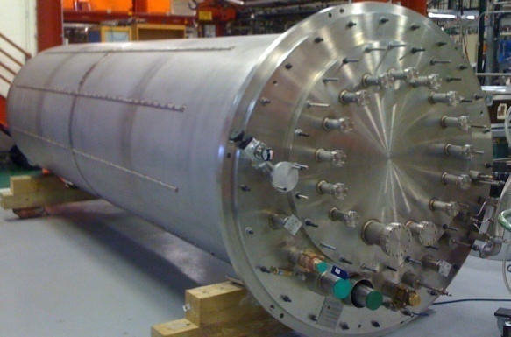
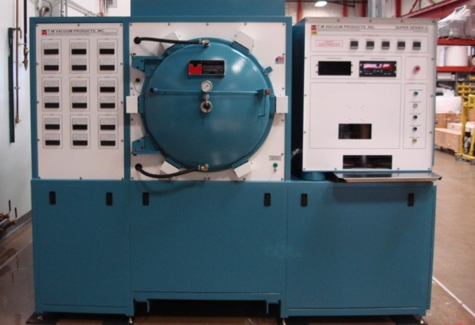
Vacuum Oven for 1300 MHz
New FNAL SRF infrastructure
Cavity tuning machine
VTS
HTS
VTS
String Assembly
MP9 Clean Room
VTS2 Dewar
Final Assembly

Slide 16
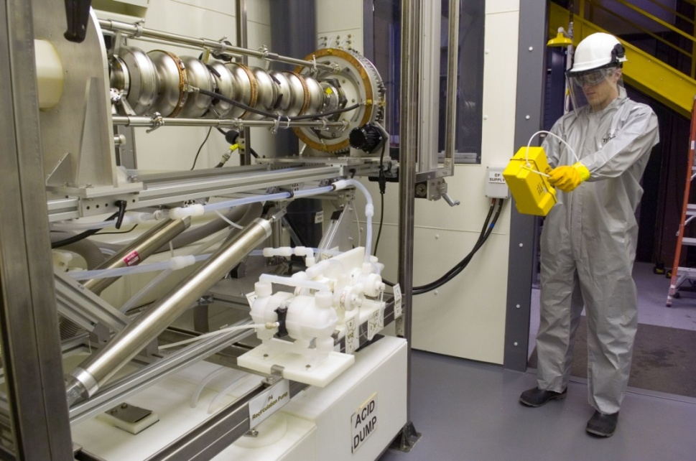
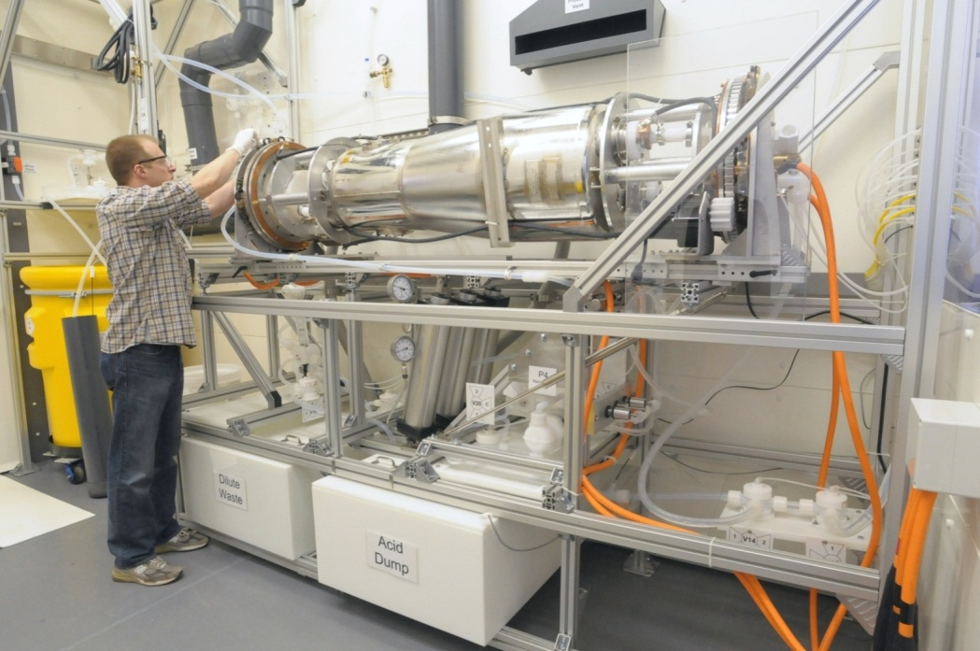
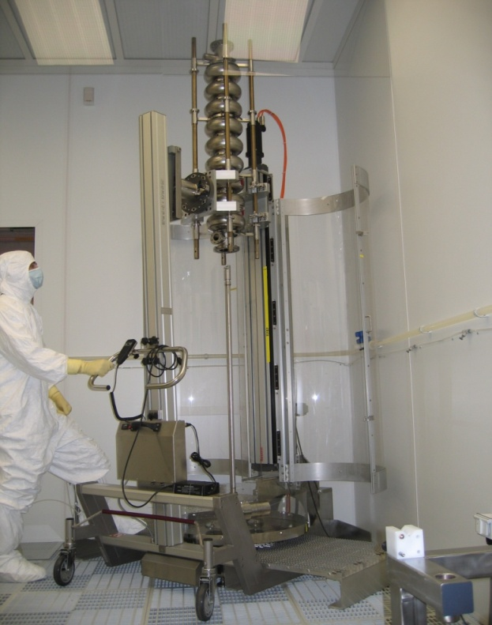
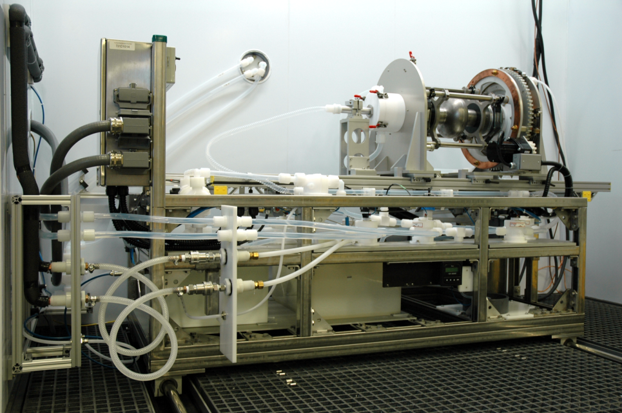
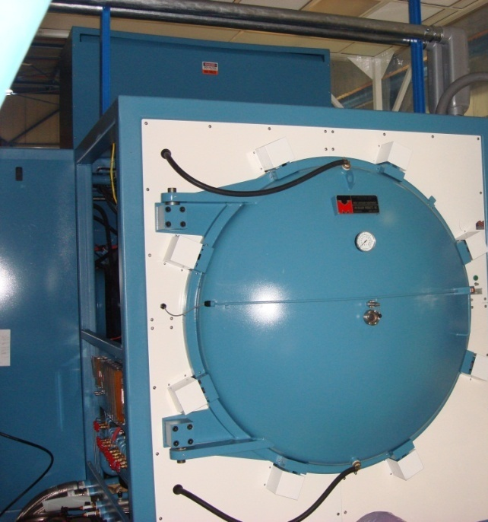
ANL/ FNAL cavity processing infrastructure
EP tool for ¼ wave HWR, and 650 MHz cavities at ANL
EP tool for 1300 MHz at ANL
New EP tool at FNAL
HPR and clean Rooms
Large Vacuum Oven
for 650 MHz + SSR

Slide 17
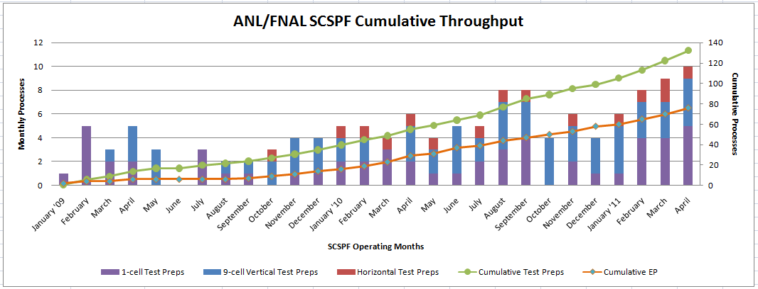
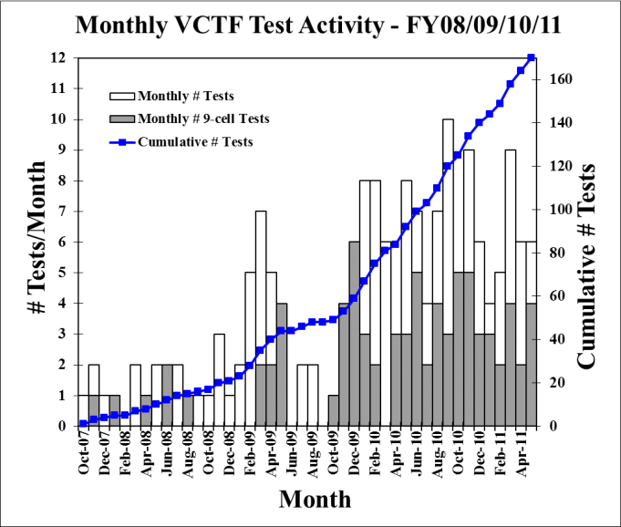
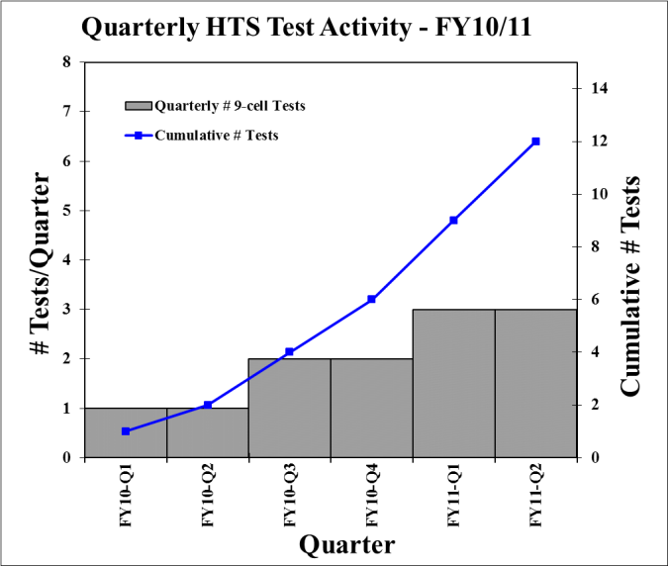
SRF operations
ANL/FNAL EP Processing
VTS
HTS
“SRF Operations” pays basic operating costs of these facilities
Also for operations of CAF, STF, CMTF, NML, CPL, ovens, etc
17

Slide 18
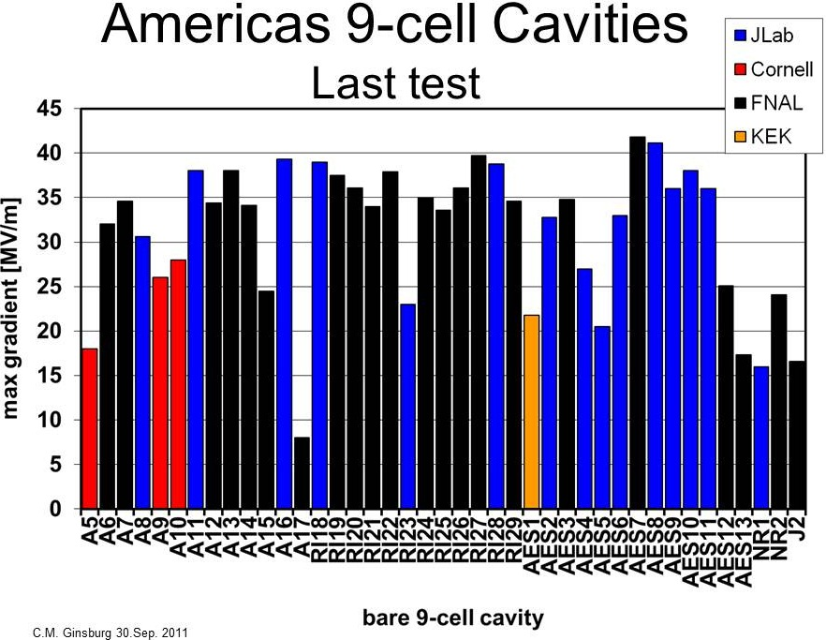
ILC
PX
Pits in EB weld HAZ
New vendor

Slide 19
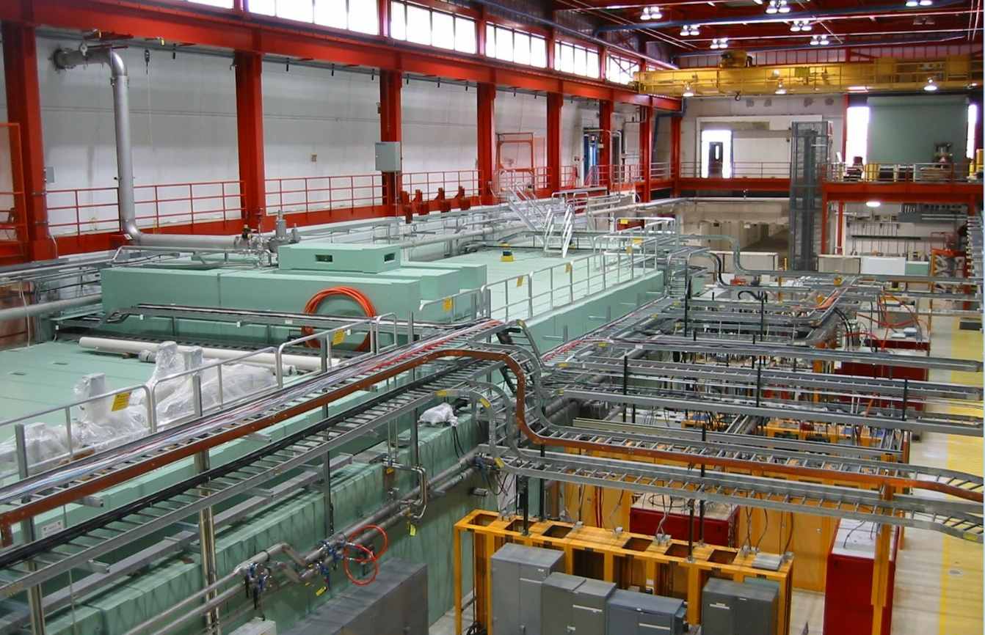
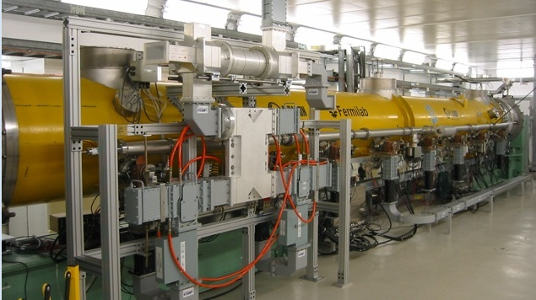
NML: RF unit test of CM for PX pulsed linac
1st Cryomodule Tests now complete

Slide 20
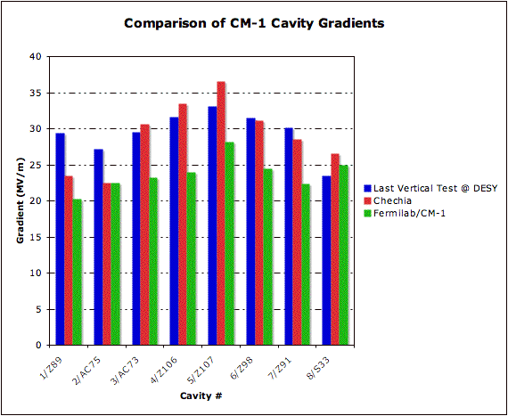
Cryomodule CM1 Performance at NML - Gradient
1st 1.3 GHz CM in U.S.
8 cavities operated at 2K for ~ 1 yr
RF from single klystron
Demonstrated excellent LLRF and Lorentz force detuning control
Ave gradient 24 MV/m
Problems:
  Several cavities showed excess heating… not understood (DESY also sees this)
  One tuner motor failure
Repair for use in ASTA
 | 1 | 2 | 3 | 4 | 5 | 6 | 7 | 8 | Mean
CM-1 Peak Gradient | 20.2 | 22.5 | 23.2 | 24* | 28.2 | 24.5 | 22.3 | 25 | 23.7
*RF-limited

Slide 21
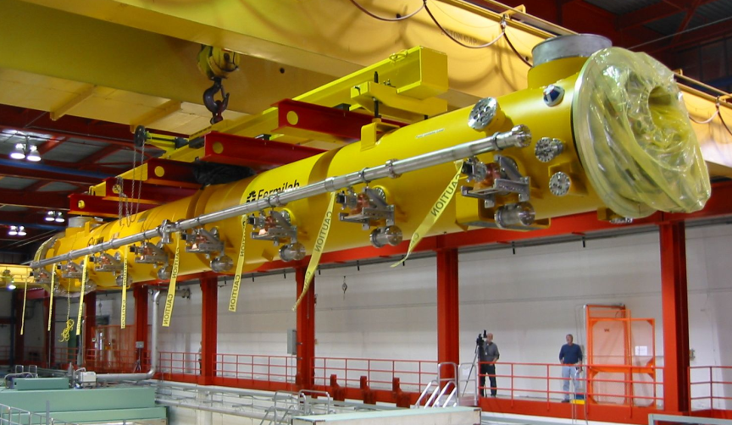
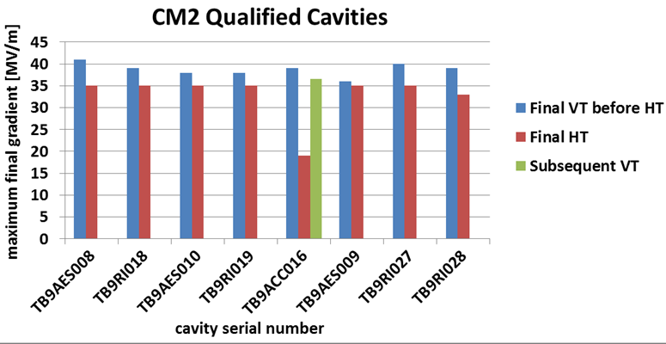
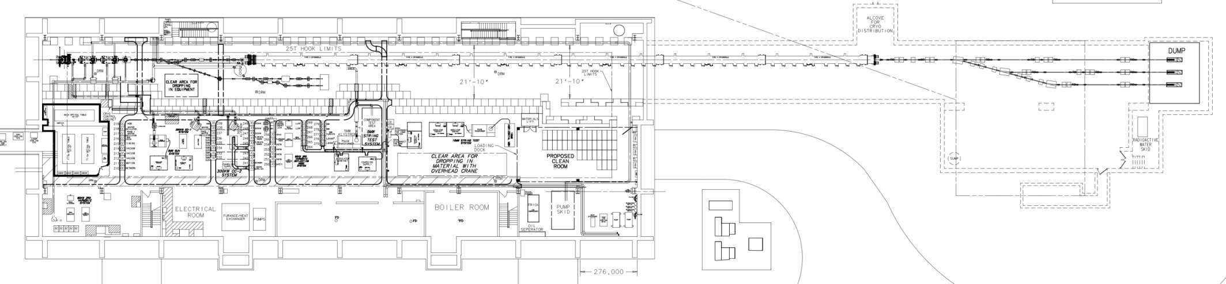
NML Status
CM2 installation
Swapped for CM2, high gradient CM, U.S. Processed Cavities
Injector operational in FY13
Phase 1 NML Building
Capture Cavity II operational
New Underground Tunnel Expansion
NML has been invaluable in gaining experience building & operating an SRF accelerator
1) Superfluid refrigeration systems; 2) CM assembly 3) leaks! 4) sub atmospheric pressure control 5) High power RF systems 6) LLRF control of multiple cavities 7) Lorentz force compensation
Completion of the proposed ASTA accelerator would provide important experience for Project X

Slide 22
Summary
An SRF CW linac starting at the low energy extreme of 2.1 MeV enables a powerful intensity frontier Physics Program
  But requires development of a full suite of cavities and cryomodules corresponding to the changing velocity (beta) of the protons
Project X Injector Experiment (PXIE) is a very important to mitigate technical risks of using SRF in the PX FE
However, the bulk of the project costs will be for 650 and 1300 MHz cavities and cryomodules (not part of PXIE)
  Important to have a U.S. industry ready to manufacture cavities, cryomodule parts.
  Need to build prototypes to understand costs
  Dynamic losses associated with the 650 MHz CW cavities dominate the cryogenic heat load ➔ Improved cavity Qo can save $$$
Extensive SRF infrastructure in operation and used effectively
  But more is required for 650 MHz cavity and CM testing
  …and to support of PXIE (e.g. CMTF infrastructure)

Slide 23
Summary (2)
RF unit test facility at NML (ASTA) can also be a powerful new asset that will yield valuable operational experience
Extensive national and international collaborations on SRF
  PASI collaboration opportunities identified (next slide)

Slide 24
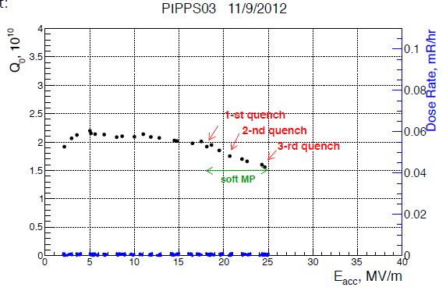
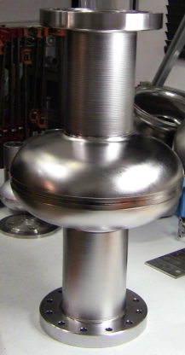
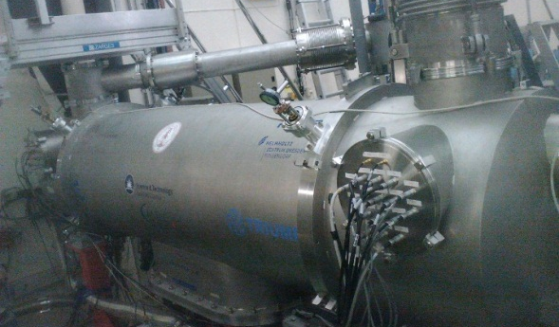
UK – FNAL collaboration areas to date
SRF Processing:
  Single-cell 1.3GHz Shakespeare cavity EP processed and tested at FNAL:
    Achieving 25 MV/m at 1.5 x 10¹⁰ without FE.
SRF Cryomodules:
  New CM installed on ALICE in Jan13, plan to start testing from mid-Apr13:
    CW tests identified to support FNAL PXIE R&D.
LHC Crab Cavity R&D:
  LHC-CC CM development reviewed at FNAL in Dec12.
  US-LARP to identify LHC-CC areas of collaboration.

