Slide 1
Status of Profile Monitors @ Fermilab
11 June 2013
Jim Zagel & Randy Thurman-Keup

Slide 2
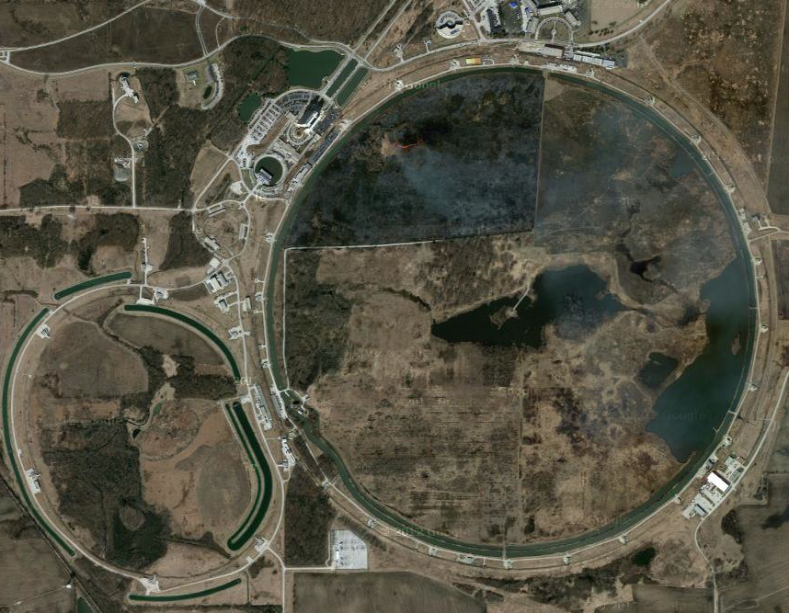
IPM’s in the Tev ERA
Booster Long 5
Antiproton Source
Debuncher
Main Injector MI-10
Tevatron E0

Slide 3
IPM Basic Types
Booster (400MeV – 8 GeV)
  Electrostatic 10KV Clearing Field (Good at injection.)
Main Ring Original (8 GeV -150GeV)
  Electrostatic 30KV Clearing Field (Good at injection.)
Recycler Ultra High Vacuum (8 GeV)
  Electrostatic 30KV Clearing Field, e-11 Torr vacuum.
Main Injector Mark-II (8 GeV -150GeV)
  Permanent Magnetic Field 1KG and 10KV Clearing Field.
Tevatron (150 GeV – 1 TeV)
  Electro Magnet 1 KG and 10KV Clearing Field.

Slide 4
IPM Concept
Magnet with vertical B field
Cathode
Electron Suppression Grid
Ions
Field shaping electrodes
Beam
(into page)
Ionization Happens
Electrons
Wire mesh gate
Microchannel Plate (MCP)
Anode strips
250 μm to 1.5mm spacing

Slide 5
Why the Magnetic Field
Ions - E field only
Ion / electron paths
with E and B field
Electrons - E and B field

Slide 6
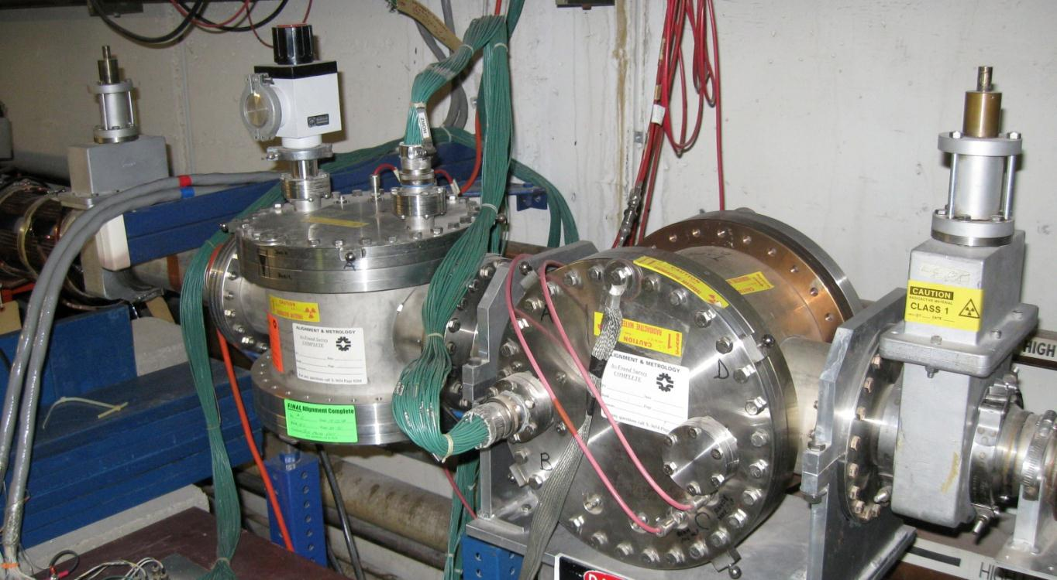
Booster
Horizontal and Vertical co-located in Long 5

Slide 7
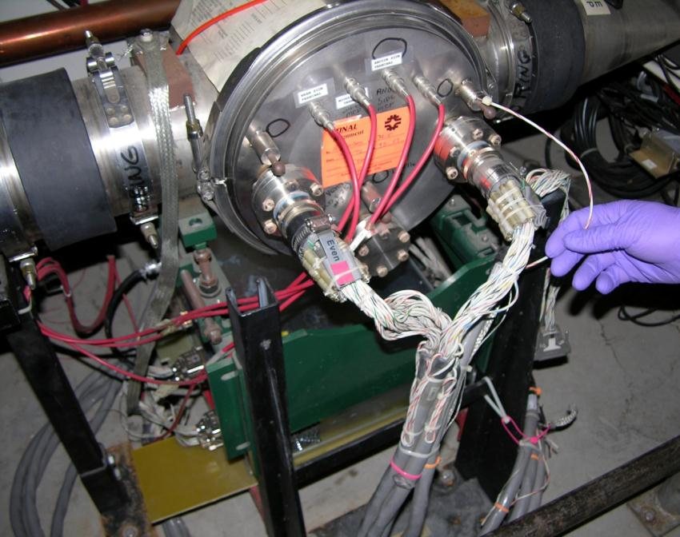
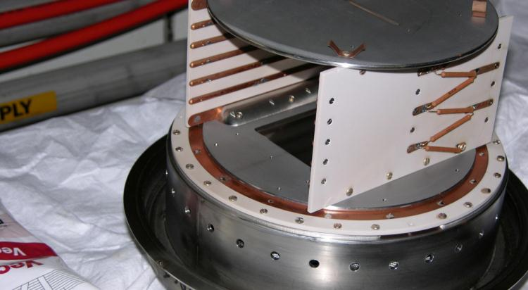
Main Ring/MI Original
Vertical at Q103
Also a Horizontal at Q102

Slide 8
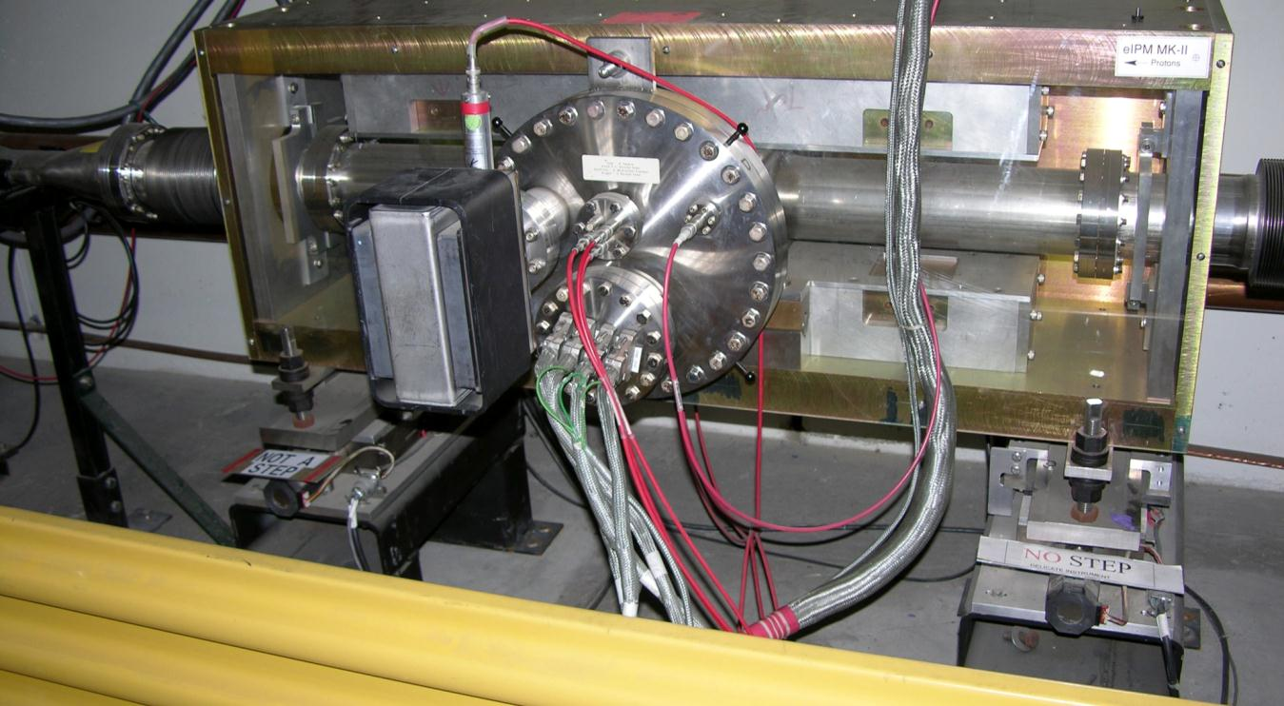
Main Injector Mark-II
Horizontal Measurement Permanent Magnet at Q104
Independent up and downstream +/- 25mm in horizontal plane for alignment and MCP Exposure

Slide 9
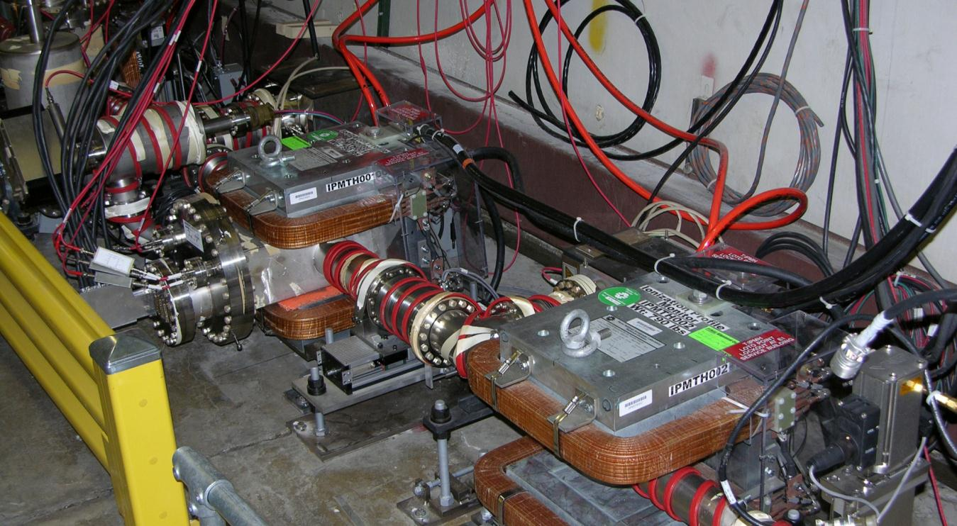
Tevatron
Measured 36 Proton and 36 Anti-Proton bunches per turn using QIE Chips in tunnel.
Horizontal Detector
Horizontal Correction Magnet

Slide 10
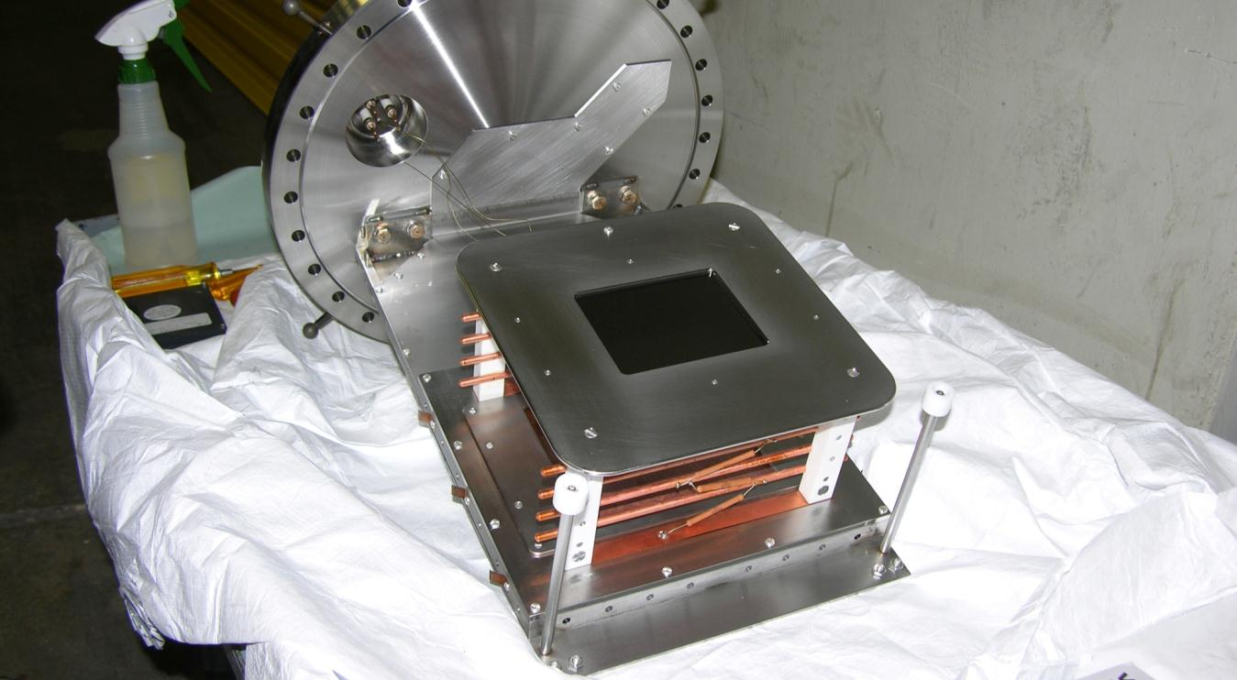
Mark-II, and Tevatron Internals
Tray design for quick extraction for MCP replacement, assures accurate realignment.

Slide 11
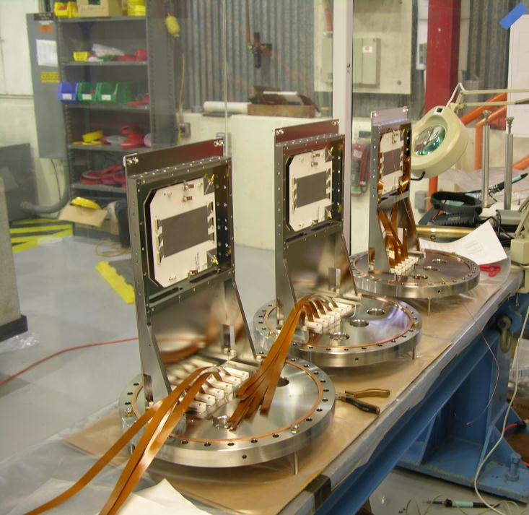
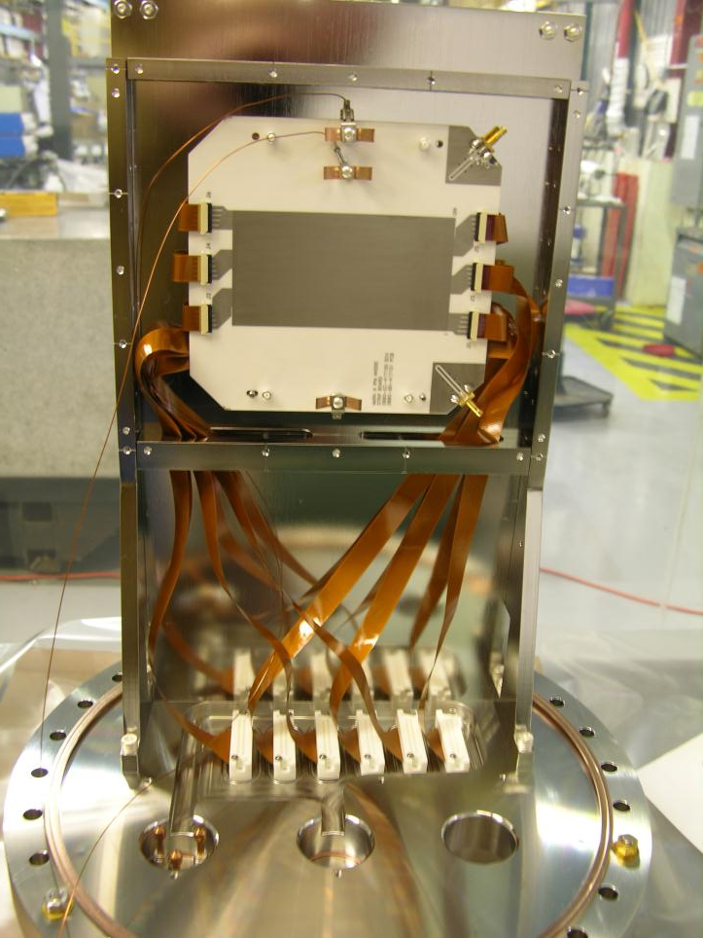
Mark-III Internals Under Construction

Slide 12
Mark-III IPM
Magnet with vertical B field
Cathode
Electron Suppression Grid
Ions
Field shaping electrodes
Beam
(into page)
Ionization Happens
Electrons
Wire mesh gate
Microchannel Plate (MCP)
Anode strips 500 μm

Slide 13
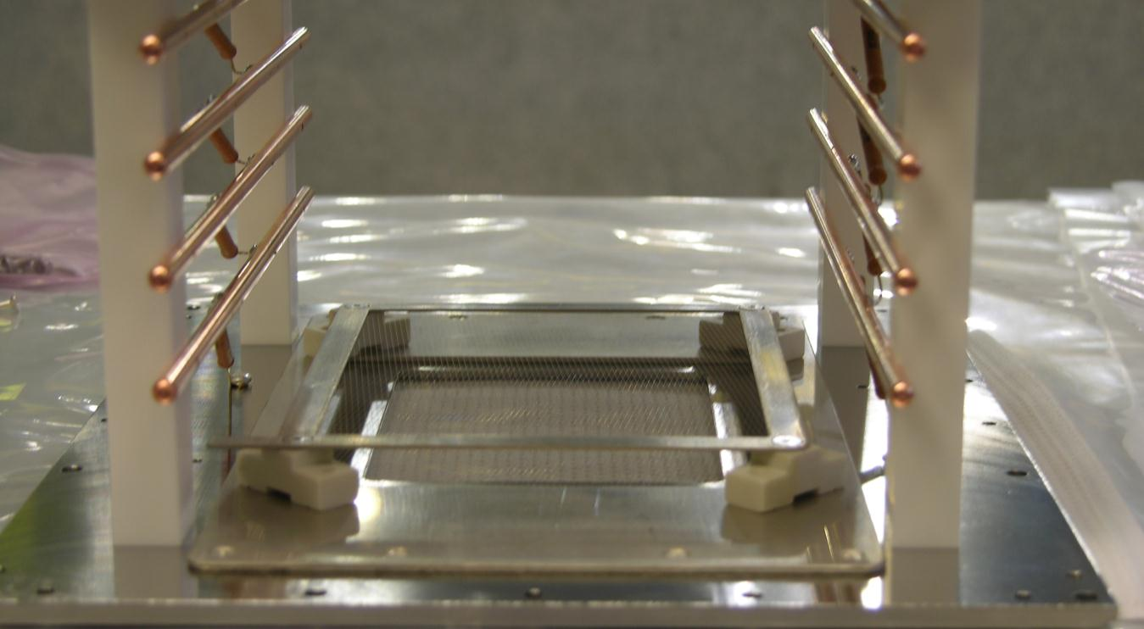
Mark-III Control Grid

Slide 14
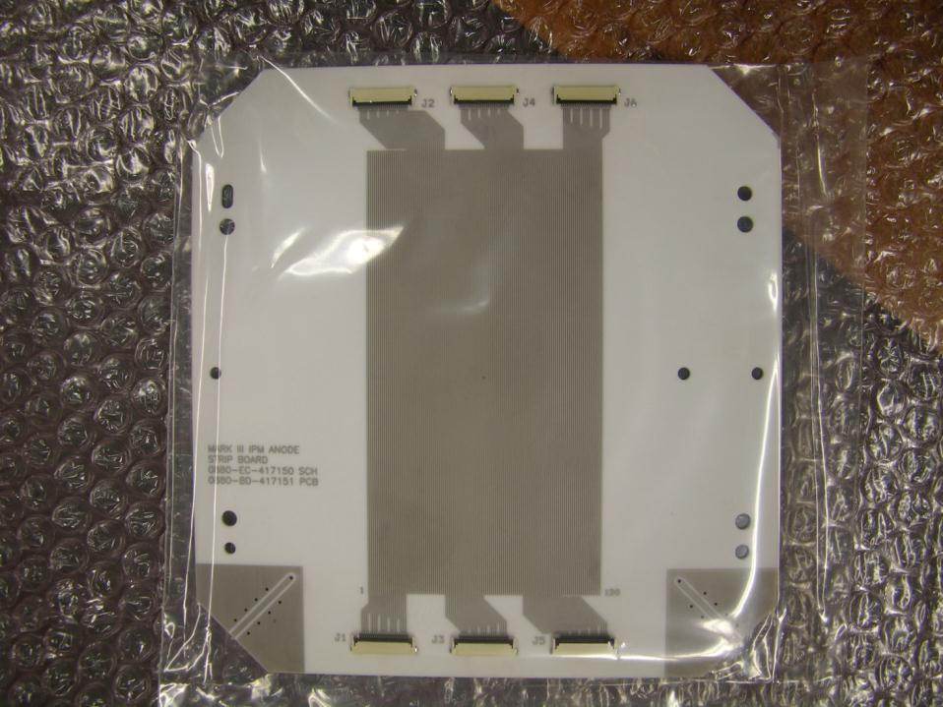
Anode Strip Board
Ceramic with mass terminated connectors.
  80% copper, 20% space.
Booster
  Beam sigma 4.5 mm
  60 Strips at 1.5 mm
  1.2E12 to 4.5E12 protons
Main Injector/Recycler
  Beam sigma 4.5 - 1.5 mm
  120 Strips, pitch 0.5 mm
  MI up to 6 booster batches
  RR slip stack up to 12 batches
  RR max intensity 5E13
Tevatron
  Beam sigma 1.5 mm
  128 strips, pitch 0.25 mm

Slide 15
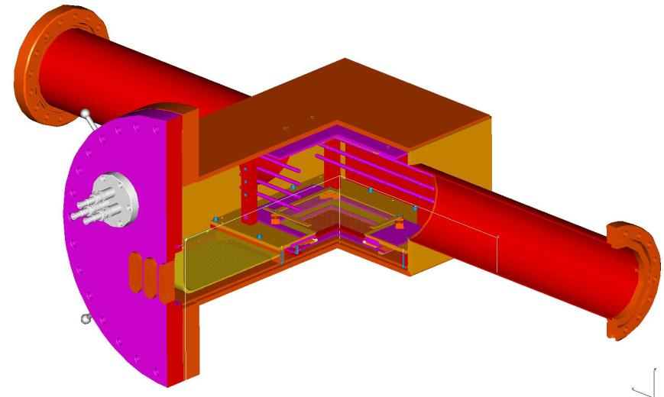
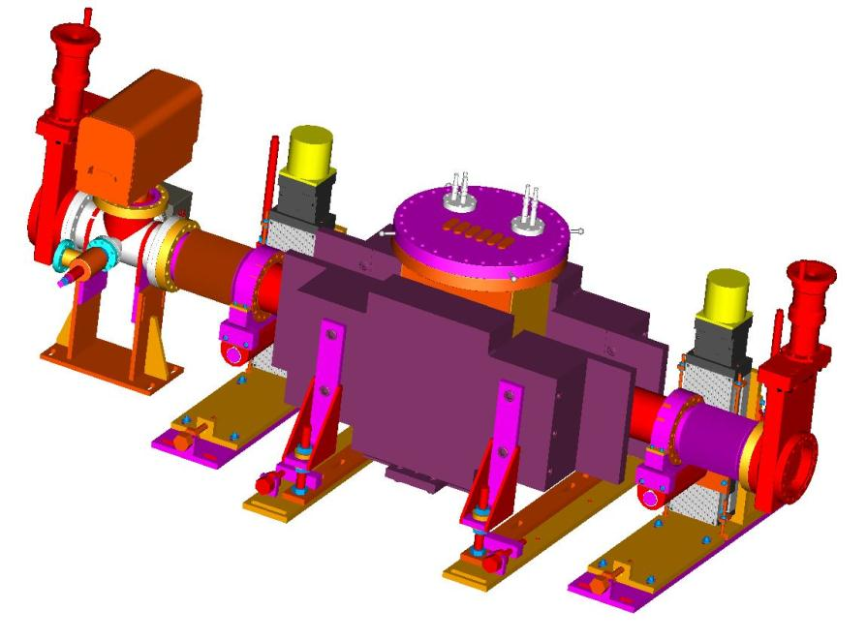
Mark-III Model
Vacuum Vessel with Instrument
Now being assembled for installation.
Typical vertical installation.
Same magnet and internals for both horizontal and vertical.
The vacuum vessel moves in the plane of the measurement, while the magnet is fixed.

Slide 16
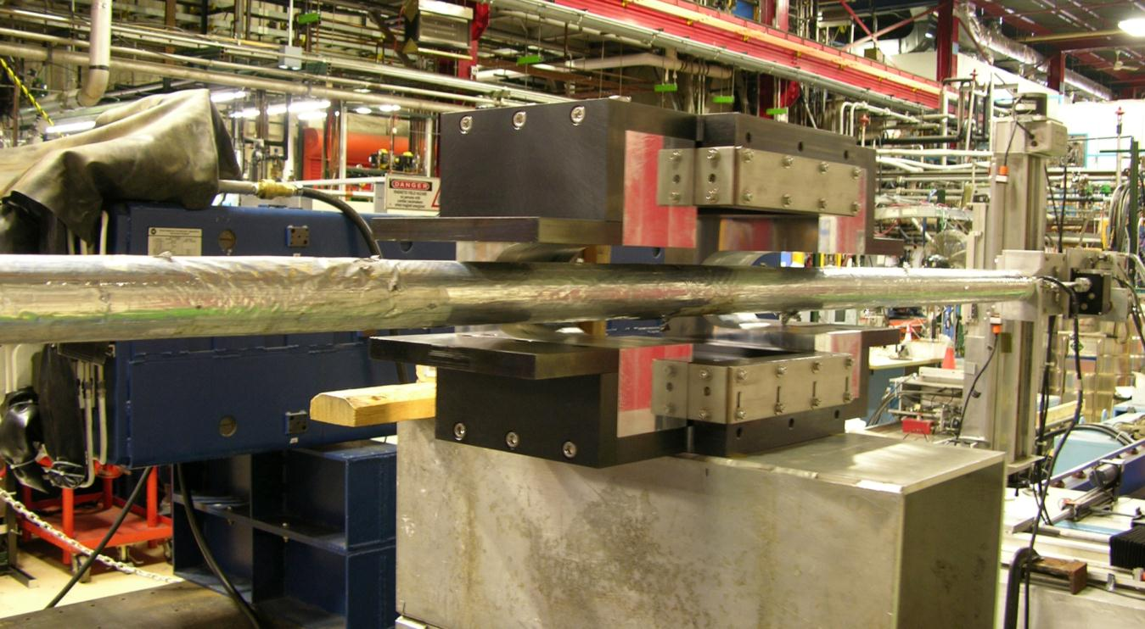
Main Injector Mark-III Magnet
Magnet MIIPM001 on measurement stand for integral field map.
Similar to Mark-II but smaller.
1KG center field and half correction up and downstream,
Local 3 bump shunted, so beam sees close to zero integrated field.

Slide 17
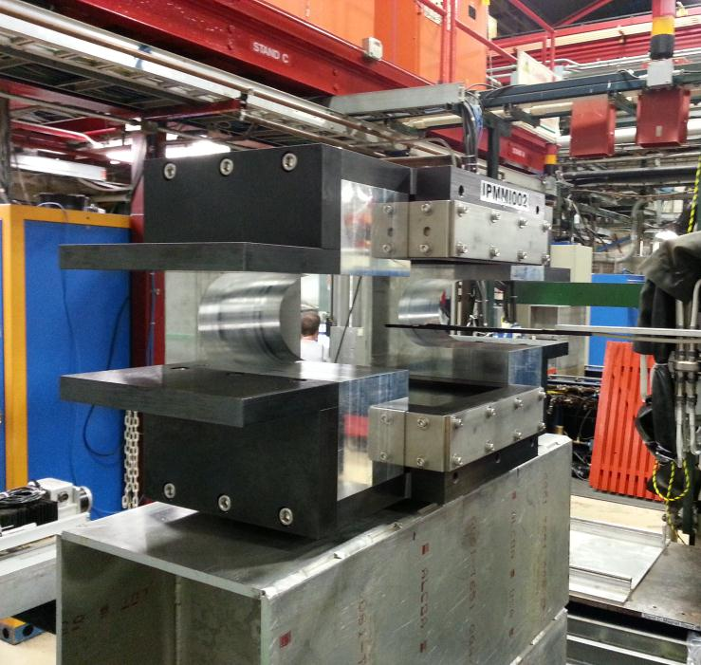
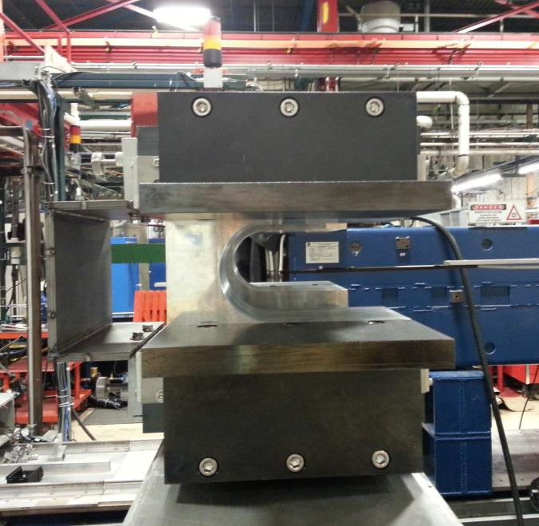
MARK-III Magnet
Mounted on measurement stand
for field quality map.
Hall Probe shown.
31.5”
4.25”
14”

Slide 18
MI Orbit Perturbation
Measured magnet integrated field is -0.001T-m
Maximum displacement around the ring for the measured field integral is
For the Main Injector ρm ≈ 27 T-m
and the maximum β is 50, Tune, ν is 0.43,
D ≈ 0.001 m

Slide 19
Magnet Measurements
B Field Line
Maximum
Deviation

Slide 20
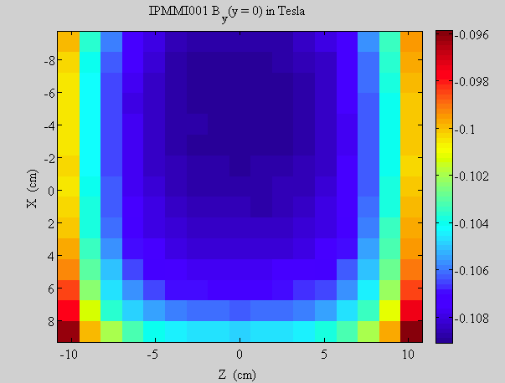
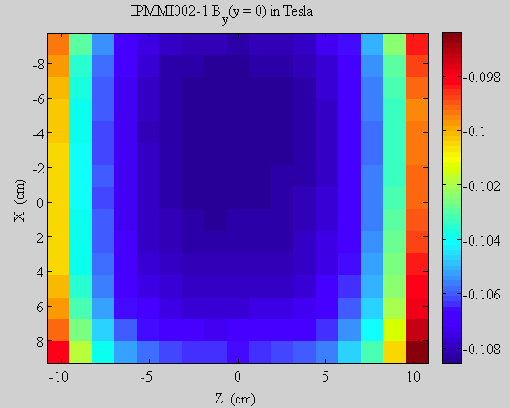
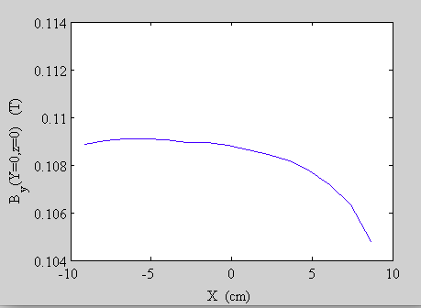
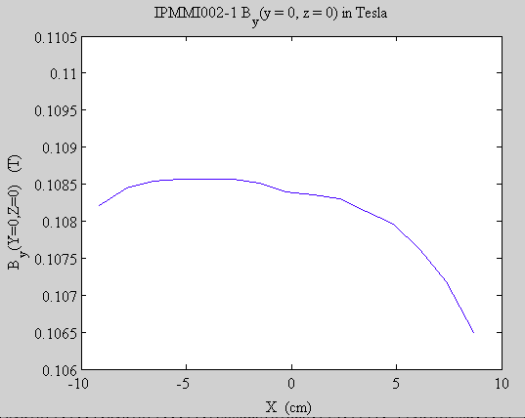
Magnet Measurements
IPM Active Region
Old Shunt
New Shunt
0.004 T
0.002 T

Slide 21
Magnet Measurements
B Field Line
Deviation from top to bottom
Average value of 200 μm could be hall probe rotation; corresponds to ~0.1 degrees

Slide 22
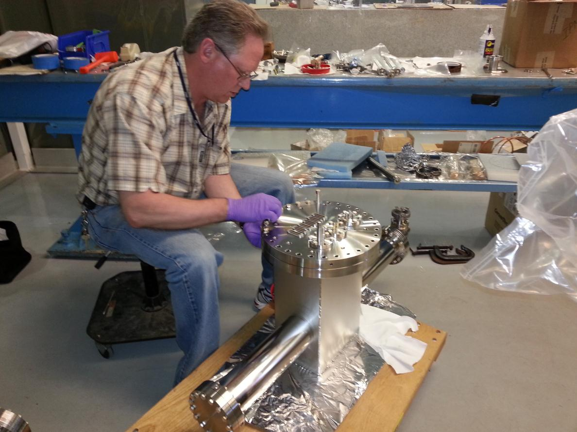
Mark-III Vacuum Vessel

Slide 23
IPM New Installation’s
New Main Injector
  Magnetic Mark-III vertical at Q103
  Mark-II internal parts will eventually be retrofitted.
New Recycler Magnetic Mark-III
  Horizontal at Q104
  Vertical at Q103
Booster
  Will have 2 – 30KV Electrostatic cans available

Slide 24
IPM Measurement Capability
All Systems
  Turn by turn measurements.
    Turns could be averaged for any accuracy desired.
  Used for injection tuning/matching.
    Routinely used for first 500 turns to see injection oscillations.
    Sigma measurements anywhere in the cycle.
  Collected 65K samples @ 1 per revolution
    Booster 19900 turns for a full cycle.

Slide 25
IPM Measurement New Features
New Main Injector
  Higher speed 16 channel digitizers 80MHz
    multiple sample each batch for better accuracy/sample
    Allows for digital filtering of signals on A/D
  96 Channels to be sampled using new Brian Fellenz 20 channel preamp module.
  Control Grid to gate off electrons for unmeasured batches
    Should significantly increase MCP life time.
  2000 samples at either
    1 Batch per revolution
    Spread across all batches for about 300 turns

Slide 26
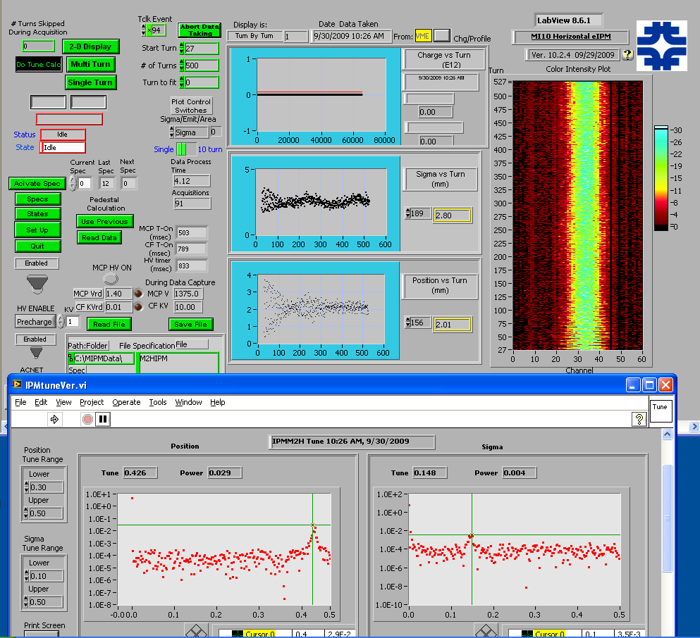
Typical Data Display
Main Injector:
Injection tuning study.
Showing injection oscillations for the first 300 turns.

Slide 27
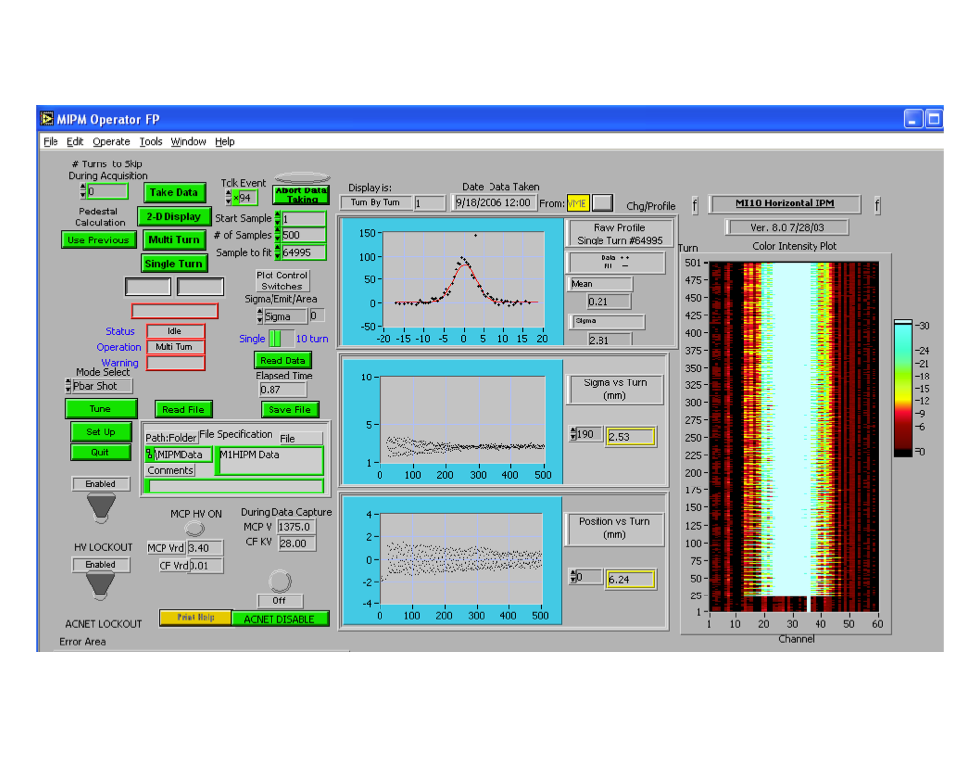
Typical Data Display cont’d
Main Injector
P-Bar injection tuning.

Slide 28
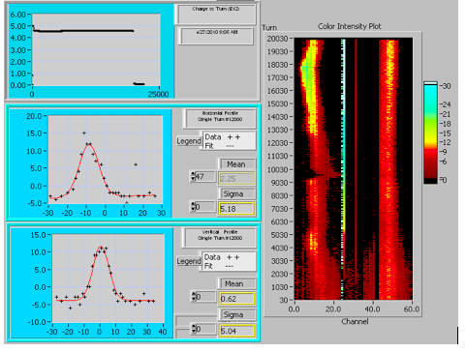
Typical Data Display
Last
Booster LabView Front End
Main Injector Console Application
Horizontal Vertical
Top left trace indicates intensity.
Bottom left 2 plots –
can plot sigma and position,
or individual turn profiles.

Slide 29
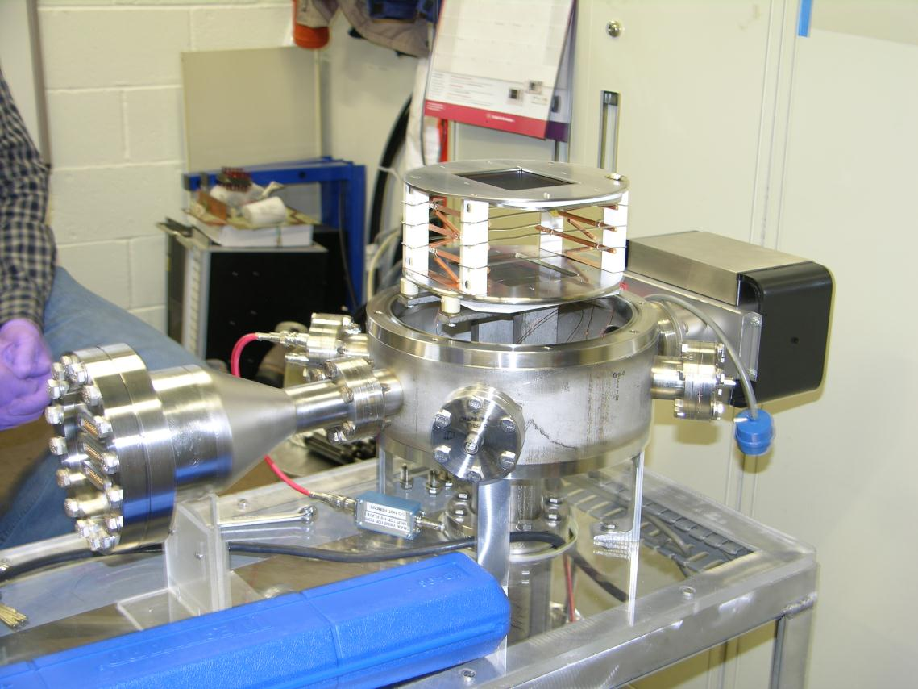
MCP Test Chamber
Facility to scan MCPs for suitability and look at areas of reduced gain

Slide 30
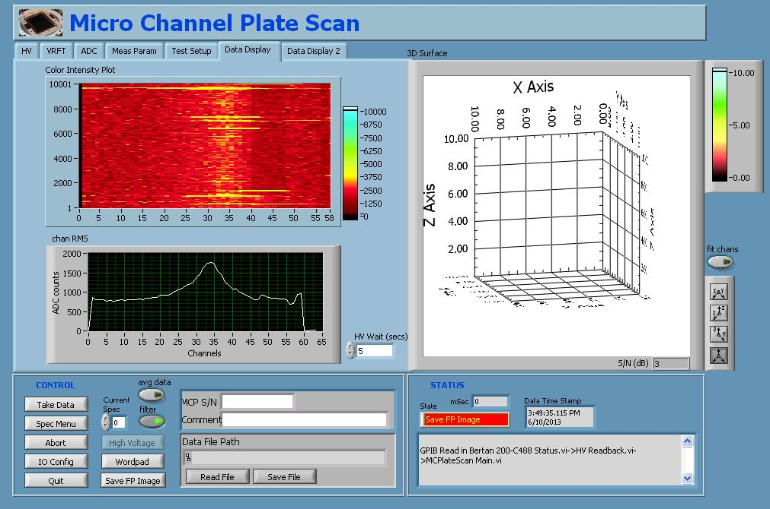
Test Chamber Measurements

Slide 31
The Players
Instrumentation
  Dave Slimmer, Carl Lundberg, Jim Galloway, Brian Fellenz,
  Dan Schoo, John VanBogaert, Alexei Semenov
Main Injector, etc…
  Bruce Brown, Denton Morris, Jim Volk
Mechanical Support
  Matt Alvarez, Tom McLaughton, Dave Tinsley, Kevin Duel,
  Linda Valerio, Eric Pirtle, Jim Wilson, James Williams,
  Sali Sylejmani, Scott McCormick, Debbie Bonifas, Tom Lassiter
Technical Division
  David Harding, Oliver Kiemschies, Bill Robotham,
  Vladimir Kashikhin, Bill Robotham, Michael A. Tartaglia,
  Mark D Thompson, Gueorgui Velev, Dana Walbridge

Slide 32

Intermission

Slide 33
Gated IPM Concept
Problem with MCP is short lifetime
  Plate is using up lifetime whenever beam is in the machine and the IPM voltage is on
  Voltage takes a while to raise and lower
Would like to be able to gate the charge to preserve the MCP
  Stop the electrons and ions from reaching the MCP
  Allow the electrons and ions an escape path from the IPM active region
    i.e. no Penning traps

Slide 34
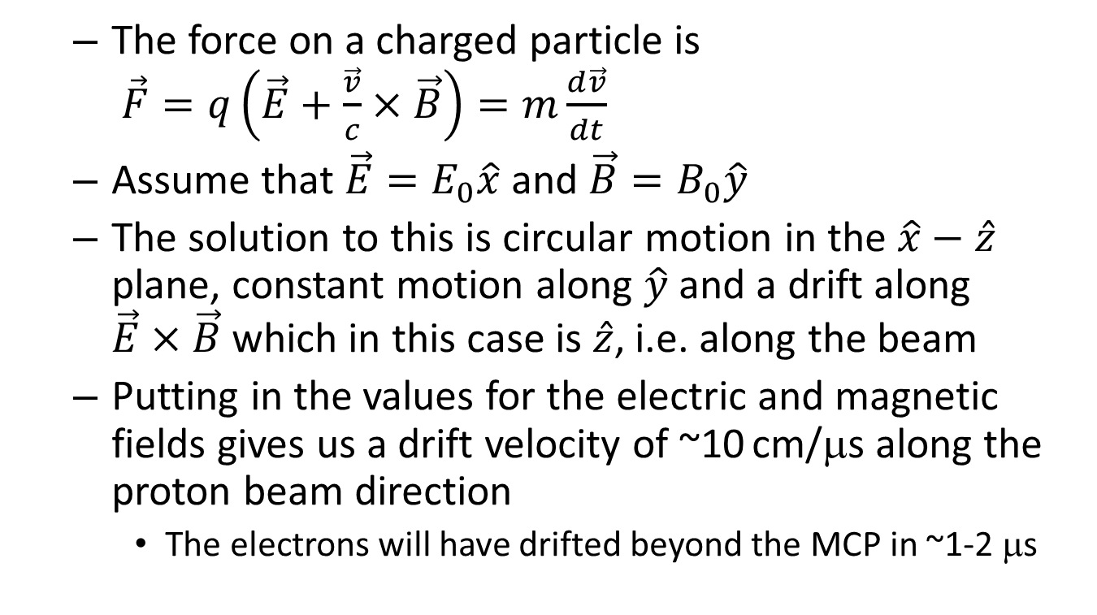
Gated IPM Concept
  The force on a charged particle is
  $\vec{F}=q\left(\vec{E}+\frac{\vec{v}}{c}×\vec{B}\right)=m\frac{d\vec{v}}{dt}$
  Assume that $\vec{E}=E_{0}\hat{x}$ and $\vec{B}=B_{0}\hat{y}$
  The solution to this is circular motion in the $\hat{x}−\hat{z}$ plane, constant motion along $\hat{y}$ and a drift along $\vec{E}×\vec{B}$ which in this case is $\hat{z}$, i.e. along the beam
  Putting in the values for the electric and magnetic fields gives us a drift velocity of ~10 cm/μs along the proton beam direction
    The electrons will have drifted beyond the MCP in ~1-2 μs

Slide 35
MATLAB Simulation
Simulation tracks particles through arbitrary E and B fields
Uses interpolation to obtain the fields at any point from previously calculated field distributions
Propagates using a relativistic formula
Invert

Slide 36
Matlab Simulation
Once the acceleration is determined, a discrete evaluation of the differential equation of motion is used to step the particles
The magnetic and electric fields are handled separately
  Magnetic contribution to the motion is only applied to the components perpendicular to the B field
  Magnitude of the velocity perpendicular to the B field is forced to be preserved, since the B field does no work
    This in particular helps with the tight spirals along the field lines

Slide 37
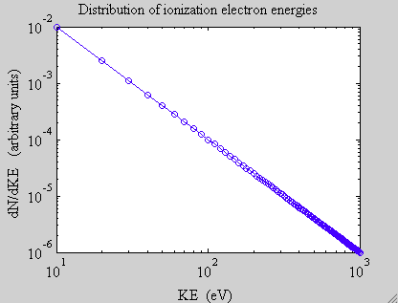
Matlab Simulation
The electric and magnetic fields of the bunch are calculated before hand for various bunch parameters
  Shifted as a function of time to represent the moving beam
Electric field of IPM from a 2-D Poisson calculation
Magnetic field from 3-D magnet
model
Ionized particle distributions are
random in emission angle with
1/E² energy distribution

Slide 38
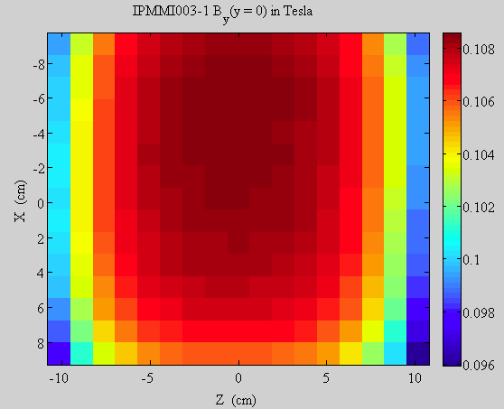
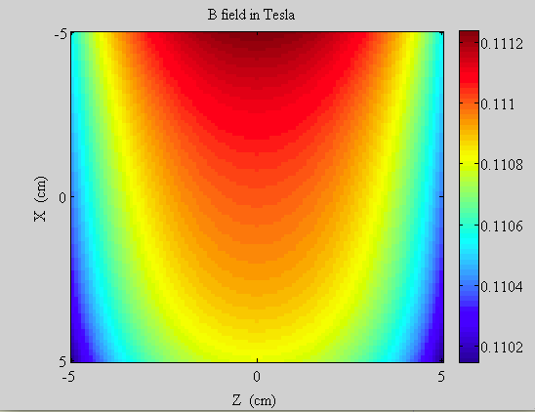
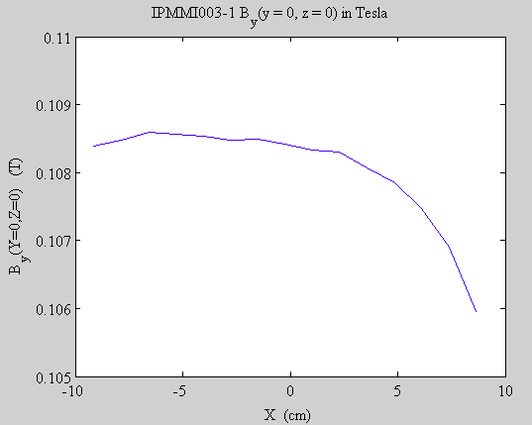
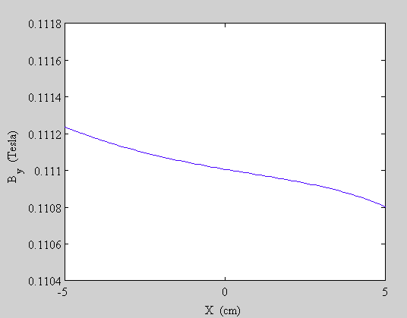
Magnetic Field in Simulation
Measured
Model
0.0005 T
0.0004 T

Slide 39
Gated-on IPM
Magnet with vertical B field
ON
E Field ~ 100 kV/m
Cathode
B Field ~ 1 kg
Electron Suppression Grid
Field shaping electrodes
Wire mesh gate
Microchannel Plate (MCP)
Electrons spiral
down helically
Anode strips

Slide 40
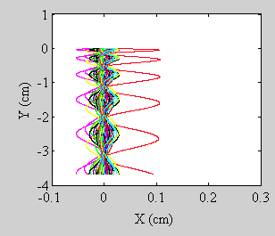
Gated-on IPM
Anode Strip
Particles originating from single point
(resolution contribution)
Elapsed time ~ 1.7 ns

Slide 41
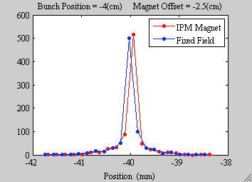
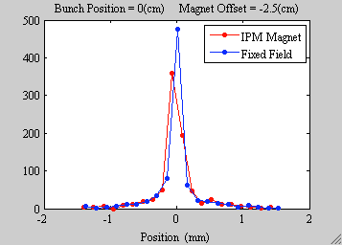
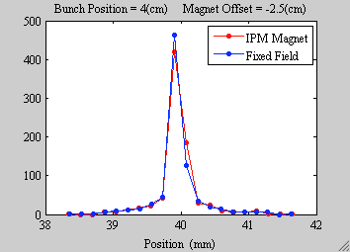
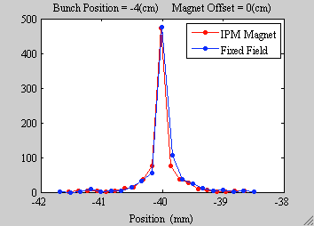
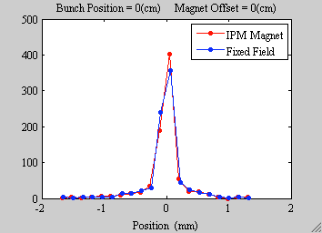
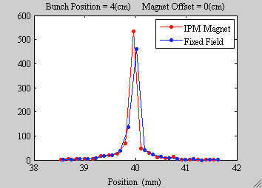
Gated-on IPM
Particles originating from single point
(resolution contribution)
Bunch offset refers to x

Slide 42
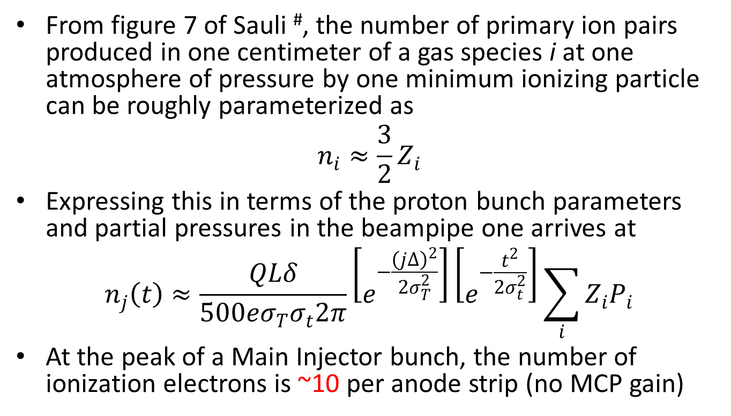
Gated-on Expected Signal
From figure 7 of Sauli #, the number of primary ion pairs produced in one centimeter of a gas species i at one atmosphere of pressure by one minimum ionizing particle can be roughly parameterized as
$$n_{i}≈\frac{3}{2}Z_{i}$$
Expressing this in terms of the proton bunch parameters and partial pressures in the beampipe one arrives at
$$n_{j}\left(t\right)≈\frac{QLδ}{500eσ_{T}σ_{t}2π}\left[e^{−\frac{{\left(j∆\right)}^{2}}{2σ_{T}^{2}}}\right]\left[e^{−\frac{t^{2}}{2σ_{t}^{2}}}\right]\sum_{i}{Z_{i}P_{i}}$$
At the peak of a Main Injector bunch, the number of ionization electrons is ~10 per anode strip (no MCP gain)
#F. Sauli, “Principles of Operation of Multiwire Proportional and Drift Chambers”, CERN 77-09, 3/5/77.

Slide 43
Gated-off IPM
Magnet with vertical B field
OFF
E Field ~ 10 kV/m
Cathode
B Field ~ 1 kg
Electron Suppression Grid
Field shaping electrodes
Wire mesh gate
Microchannel Plate (MCP)
Electrons
propagate into
or out of the page
Anode strips

Slide 44
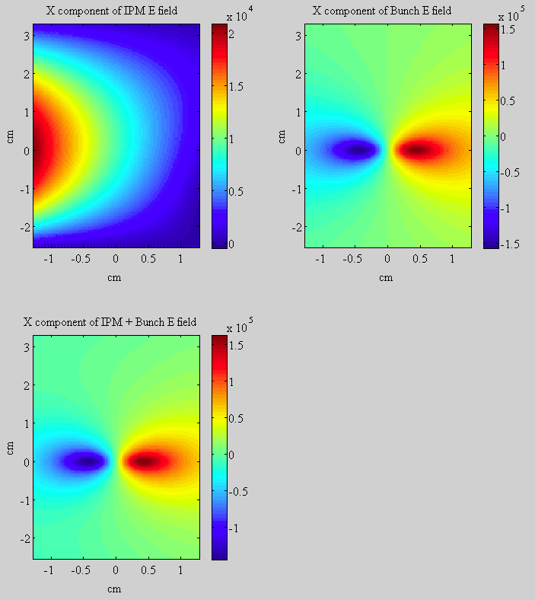
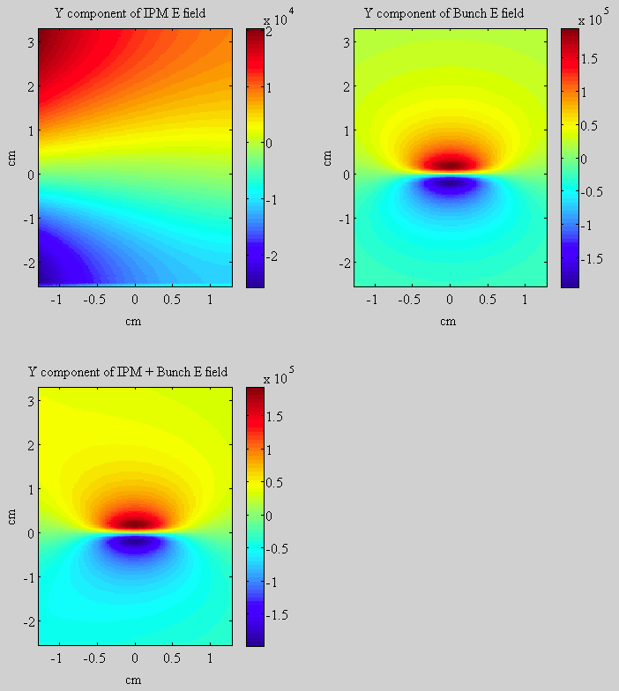
Gated-off Fields
X Component of E field
Y Component of E field

Slide 45
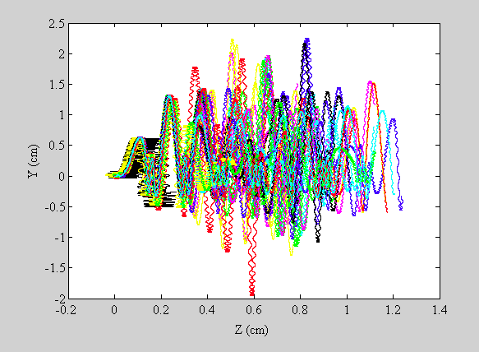
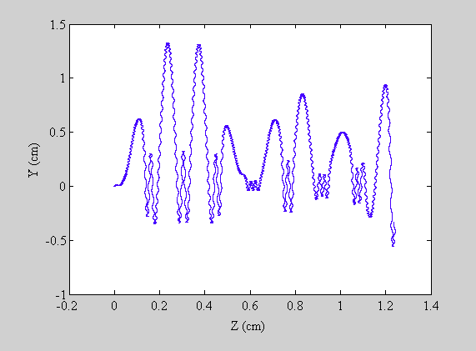
Gated-off Motion
Electrons drift along beam direction
Single particle
Particle origination point

Slide 46
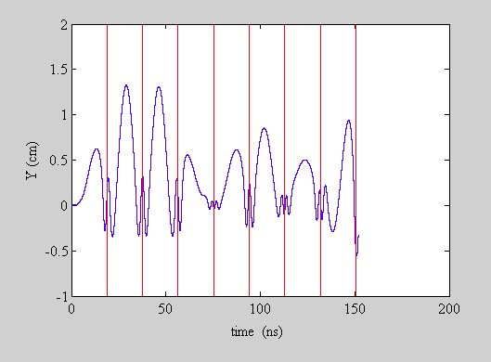
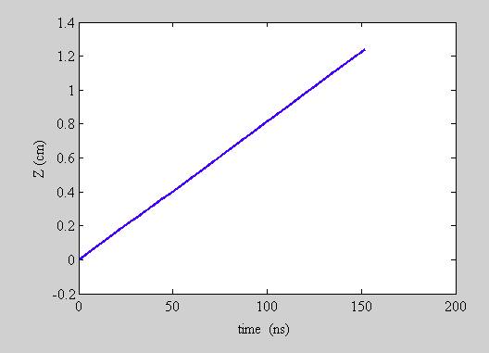
Gated-off Behavior
What happens when electrons
reach the end of the field region?
Drift Velocity
1.2 cm / 150 ns = 8 cm/μs
Compared to
10 cm/μs analytically estimated
Y motion vs time
Bunch Centers

Slide 47
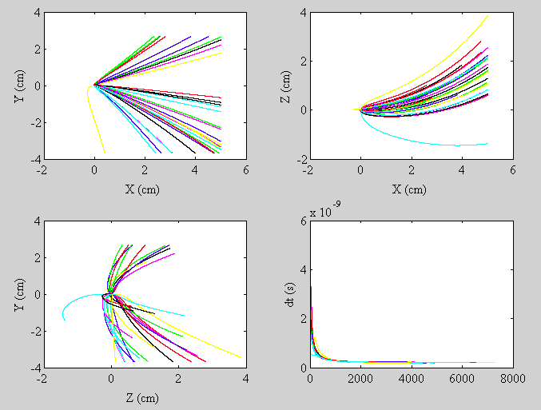
Gated-off Ion Paths
Elapsed time is ~1.5 μs
Initially appears ok, since
ions do not go much beyond
the gating grid
-- However --
Secondaries from ion
impacts on gating grid could
be a problem

Slide 48
Electron Beam Profiler
Increasing beam power in MI/RR implies the need for non-invasive instrumentation
  Electron beam deflection technique is one choice (working implementation at SNS)
Electron beam is deflected by electric
and magnetic fields of the protons
Deflection
Angle
Electron beam
Proton beam out of page
Deflection vs. Angle provides information about the proton beam transverse profile

Slide 49
Techniques for Main Injector
Various techniques for measuring deflection
  Fast scan through peak of bunch (similar to SNS)
    Requires fast deflector (< 1 ns sweep time)
  Slow scan, akin to flying wires (most likely solution for Nova)
    Position the beam and record the maximum deflection as the beam passes by
      Leave the electron beam stationary
      Sweep the beam along the proton direction
        Obtain longitudinal distribution
Collaborating with Wim Blokland at SNS who has done simulations of the various techniques

Slide 50
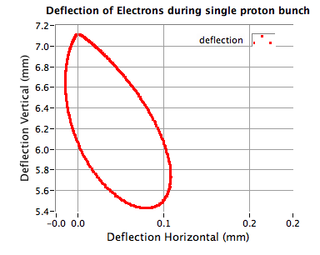
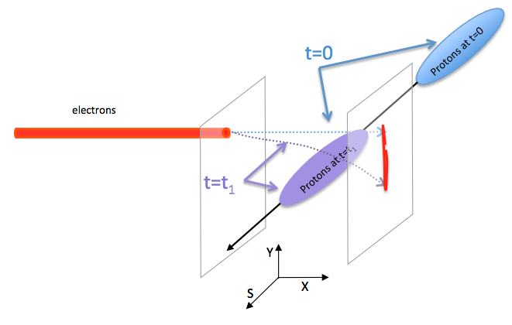
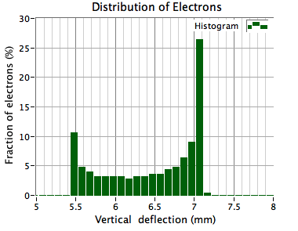
Electron Deflection
Slow electron sweep
Position the electron beam
Record the deflection of a bunch
Move the electron beam and repeat
Plots courtesy of Wim Blokland

Slide 51


Electron Deflection Simulation
Step the electron beam through the proton beam and record maximum deflections
Derivative of deflection vs. position is nominally beam profile
Derivative
Plots courtesy of Wim Blokland

Slide 52


Alternative Deflection Scheme
Electron Sweep
Sweep the electron beam along the proton bunch
Sweep duration coincides with the duration of the proton bunch
Beam Simulated Transverse σ = 3 mm
Meas. Simulated Transverse σ = 3.5 mm
Beam Sim. Longitudinal σ = 2 ns
Meas. Sim. Longitudinal σ = 2.3 ns

Slide 53

Simulated Camera Image
Camera frames are ~30 ms
Main Injector cycle is ~1 s
Need to step many times per frame to accumulate data fast enough for measurement
  Complicated to extract each step

Slide 54

Electron Beam Device
Ion Gauge
Optical Breadboard
~ 60 cm x 150 cm
Ion Pump
60 KeV Electron Gun
Kimball Physics
Beam Valve
Electrostatic Deflector
Elliptical Main Injector
beampipe
Ion Gauge
Pneumatic
Insertion Device
with OTR Stainless
Steel Mirror
Optic components box
Phosphor Screen
P47, 400 nm, 60 ns decay(?)

Slide 55
Optics
Two optical paths: OTR screen and Phosphor screen with some shared elements
OTR screen is inserted at location of proton beam (sans proton beam) and used
to focus the electron beam and measure the electron beam spot size
Lens on
moving
stage
45 Degree
Mirror
Stationary
Lens
Filters and
polarizers
Image Intensifier
(Hamamatsu)
SS Mirror
Lens on
moving
stage
45 Degree
Mirror on
moving stage
45 Degree
Mirror
Phosphor
screen
45 Degree
Mirror
Camera
Objective
CID Camera
Megarad version

Slide 56


Devices
Kimball Physics up to 60 KeV
(we will use up to 15 KeV)
6 mA, pulsed, 1 μs to DC
LaB₆ cathode, 100 μm spot size
15 cm long ‘circular’ plates
~2.5 cm diameter
Electrostatic Deflector
Thermionic Electron Gun
Plates
Solenoid and
steering magnets
Cathode

Slide 57

Test Stand at NWA
Optical Transition Radiation Screens
Electron Gun
Faraday Cup
Lens / Digital
Camera Imaging
Systems

Slide 58
Gun Tests
Gun has internal solenoid
  Scanned beam through waist
  at first screen
Scanned beam sizes from Ce:YAG screens (1 μA beam)
Scanned beam sizes from OTR screens
(1 mA beam)

Slide 59




Test of Electrostatic Deflector
~120 V
Deflecting Voltage vs. Deflector Length
Deflector Pulse
80 ns
500 V
Deflector Pulse
15 cm long plates
~190 V

Slide 60


Electrostatic Deflector Test
Short sweep
Effect is similar proton bunch passing by
Longer sweep
Bright part off screen
Beam size not uniform
  Possibly due to poor pulse quality

Slide 61


Magnetic Fields in Tunnel
Need to shield beamline
First attempt will be mu metal
Electron beam
Quad busses
3500 A
5 gauss
B_{x}
0 g
B_{y}
Dipole busses
9000 A

Slide 62


Electron Beam Profiler
Would like to install as soon as possible
But…
  Priority is “Very Low” (to put it politely)
  Relies on the “kindness of strangers”

Slide 63

Strangers (and not so strangers)
Instrumentation
  Amber Johnson, Carl Lundberg, Jim Galloway, Jim Fitzgerald, Peter Prieto, Pierpaolo Stabile, Andrea Saewart, Dave Slimmer, Dehong Zhang, Brian Fellenz, Alex Lumpkin
Mechanical Support
  Wade Muranyi, Brad Tennis, Elias Lopez, Debbie Bonifas,
  Scott McCormick, Ryan Montiel, Sali Sylejmani, Tom Lassiter,
  James Williams, John Sobolewski, Matt Alvarez, Kevin Duel
Summer Students
  Paul Butkovich, Khalida Hendricks, Danila Nikiforov
Others
  Charles Thangaraj, Dave Burk,
  Dennis Schmitt

Slide 64
Extras

Slide 65

Optics
Phosphor screen
Image Intensifier

Slide 66


Optical Transition Radiation
Electron energy low
  Broad angular distribution
  Mirror should be 15° instead of 45°
Light yield over the 2 ms electron pulse
(E. Bravin, private communication)
Initial beam images determined to be blackbody
  No polarization
  Intensity increased nonlinearly with duration
  Damage to stainless steel mirror observed

Slide 67







Wire Tests
Wire to simulate proton beam
e Beam pulsed on for 40 μs
Wire pulsed for 20 μs
Half the time the beam is deflected
0V
50V
100V
150V
200V
250V
300V

