Slide 1
Update of Booster Alignment & Magnet Moves
August 21, 2013
Bill Marsh, Bill Pellico, Kiyomi Seiya, Dean Still, Kent Triplett Alex Waller

Slide 2
Status
Moved four magnets at L16
Aperture scan and orbit measurements before and after move.
Applications for aperture scan, B75 and Java. (A. Waller)
Aperture scan at period 5 -24. (Operation)
Orbit smooth at 7 break points with B80. (W. Marsh, K. Triplett)

Slide 3
Magnet move 4
Four magnets were realigned on Aug. 6, 2013
15-3 upstream: 0mm 15-3 downstream: +0.6mm
15-4 upstream: +0.7mm 15-4 downstream: +1.3mm
16-1 upstream: -1.3mm 16-1 downstream: -1.3mm
16-2 upstream: -1.3mm 16-2 downstream: -1.3mm
+5mm
0
-5mm
#1
#2
#3
#4
#5
#6
#7
#8
#9
#10
#11
#12
D F F D D F F D
D F F D D F F D
D F F D D F F D
D F F D D F F D
D F F D D F F D
D F F D D F F D
1.3 mm
+5mm
0
-5mm
#13
#14
#15
#16
#17
#18
#19
#20
#21
#22
#23
#24
D F F D D F F D
D F F D D F F D
D F F D D F F D
D F F D D F F D
D F F D D F F D
D F F D D F F D
1.3 mm

Slide 4
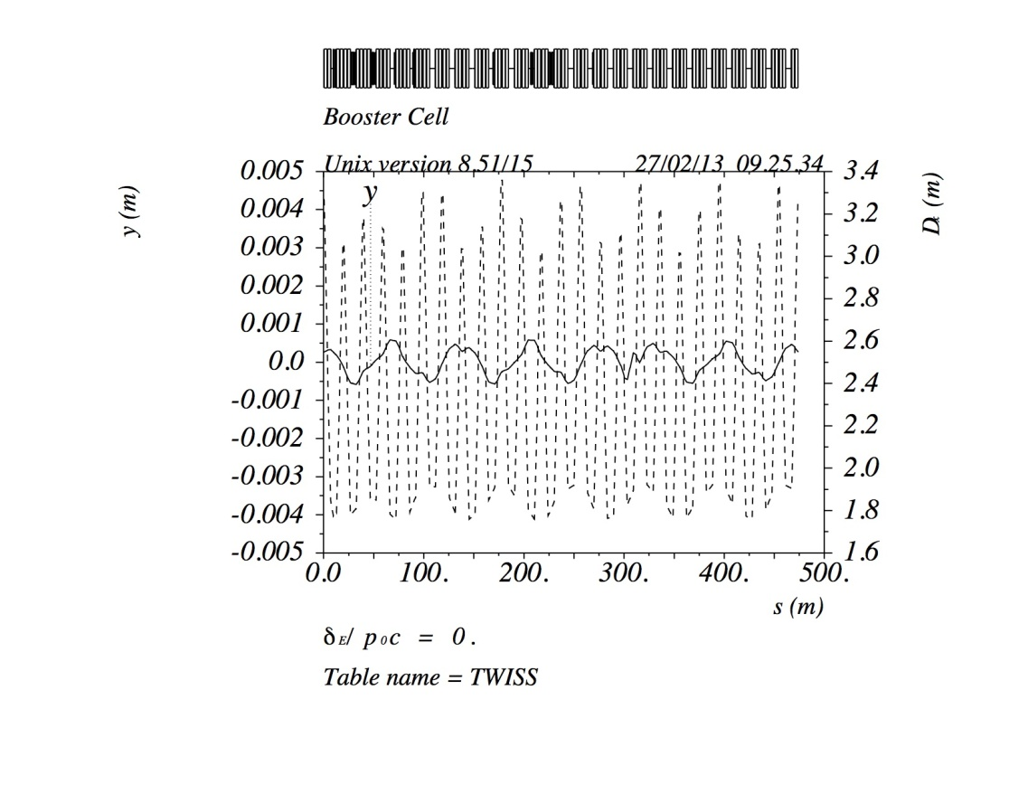
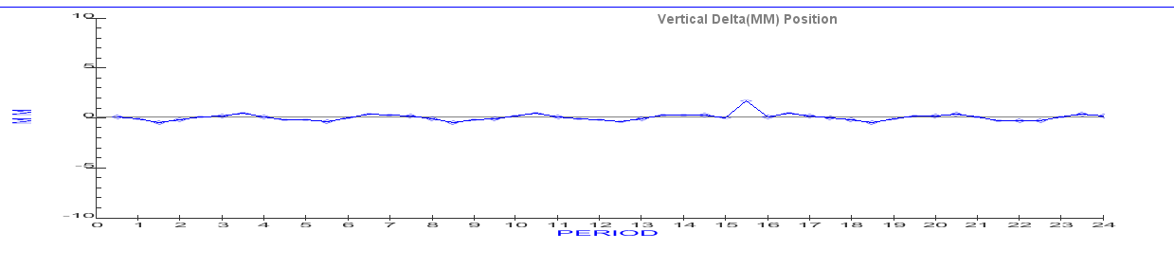
Orbit difference before and after Move4 (simulation)
MAD
+/-0.6mm
Magnet Move program

Slide 5
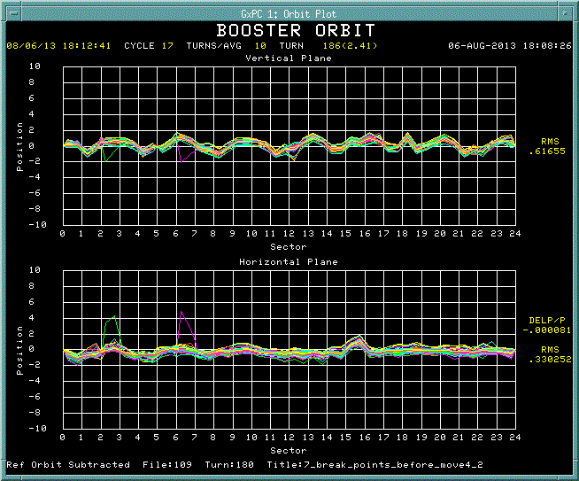
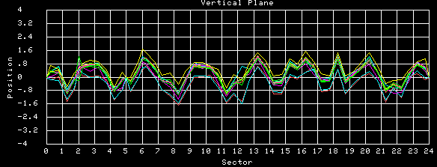
Orbit difference before and after Move4 (measurement)
Vertical
Horizontal
+/-0.8mm

Slide 6
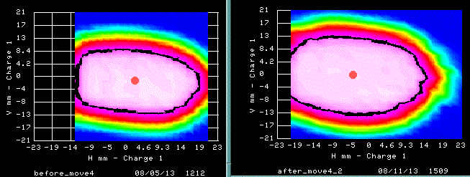
Aperture scan at L16
Before Move4
After Move4

Slide 7
Current vertical alignment at RF section (period 14 – 24)

Slide 8
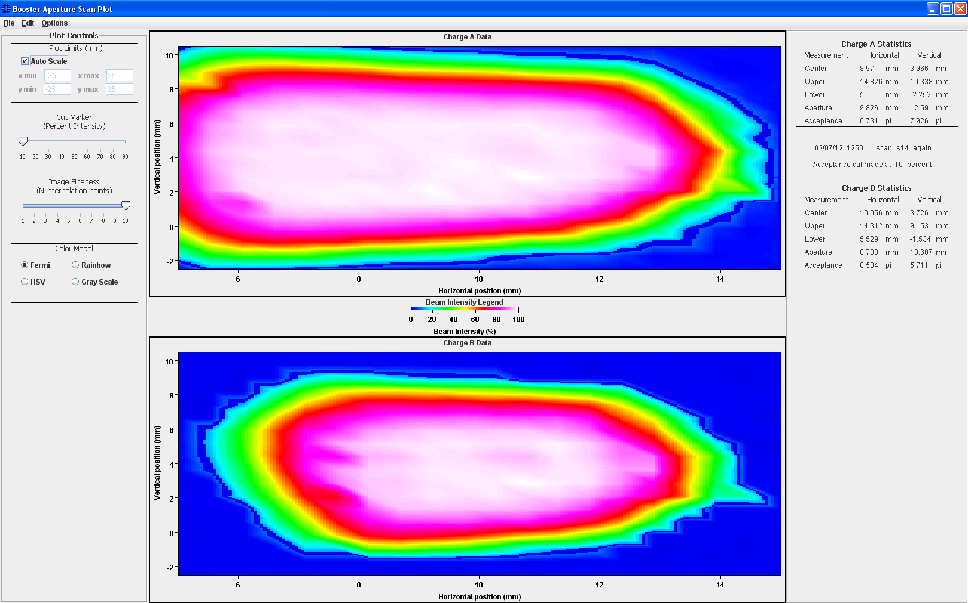
Aperture plot and analysis on Java

Slide 9
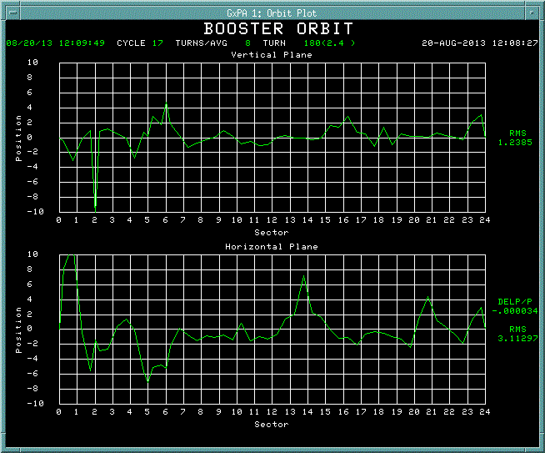
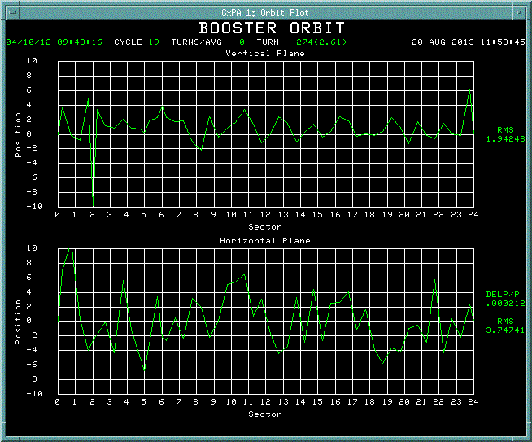
Orbit at injection
August, 2013
April, 2012 ($19 operation cycle)

Slide 10

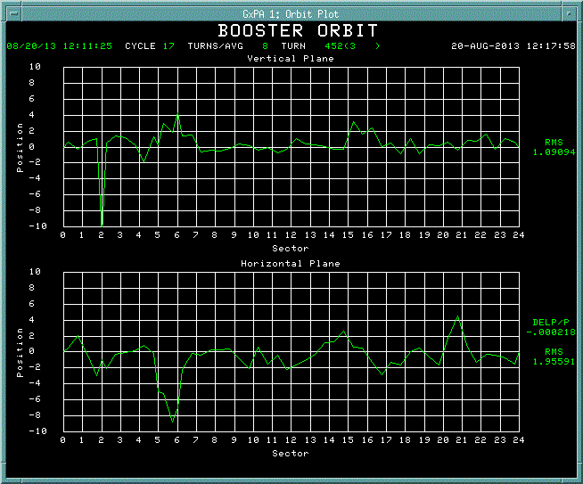
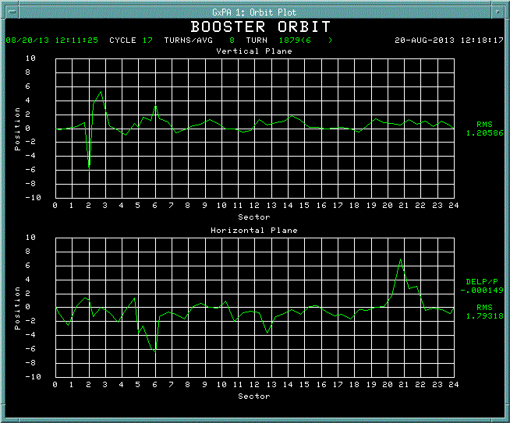
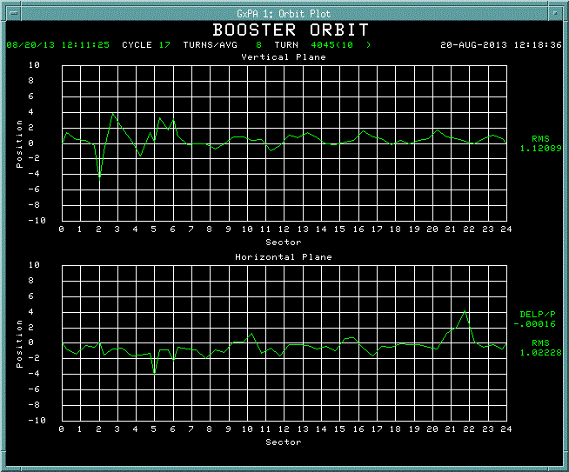
Orbit smooth with B80 at 7 break points
2.4msec
3.0msec
6.0msec
10msec

Slide 11
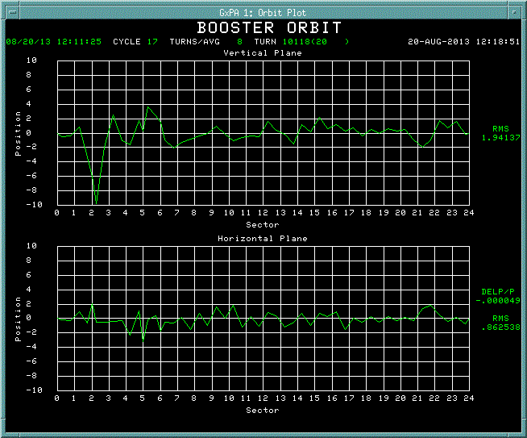

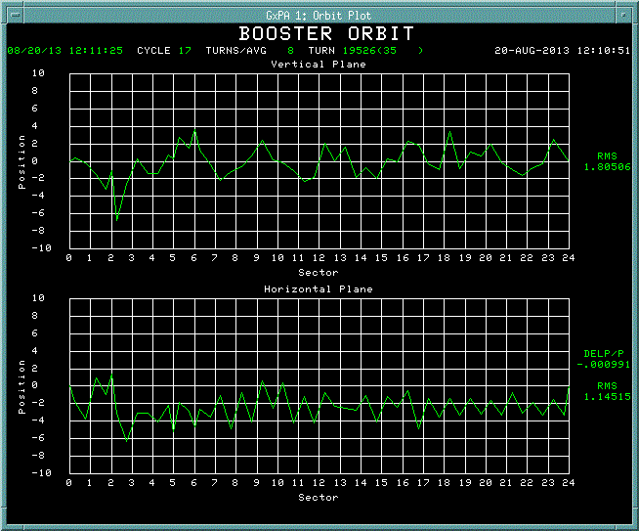
Orbit smooth at 7 break points (cont.)
20msec
32msec
35msec

Slide 12
Plan
Orbit smooth with new desired positions
Magnet move
-Vertical: L11, L16
-Horizontal: next long shutdown

