Slide 1
Ion Source Update

Slide 2
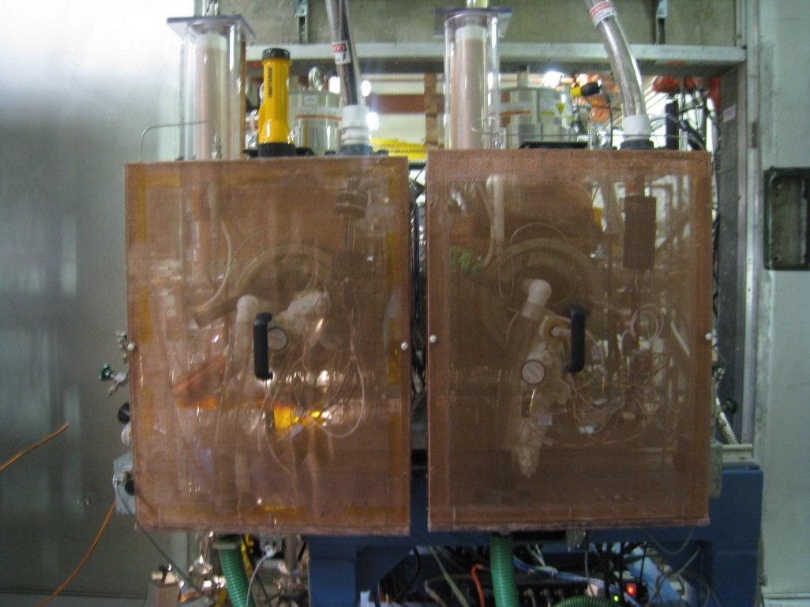
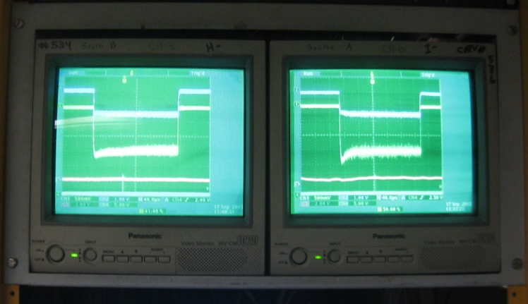
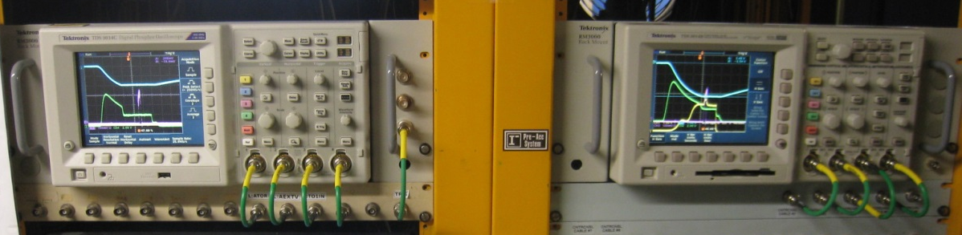
We now have 2 running sources
Source B has been running since the first part of June
Both sources have been modified extensively since startup
We have used both sources for operation
Swapped sources using the slide
Several issues remain to be solved, the most important is reducing the extractor spark rate and the effects of sparking

Slide 3
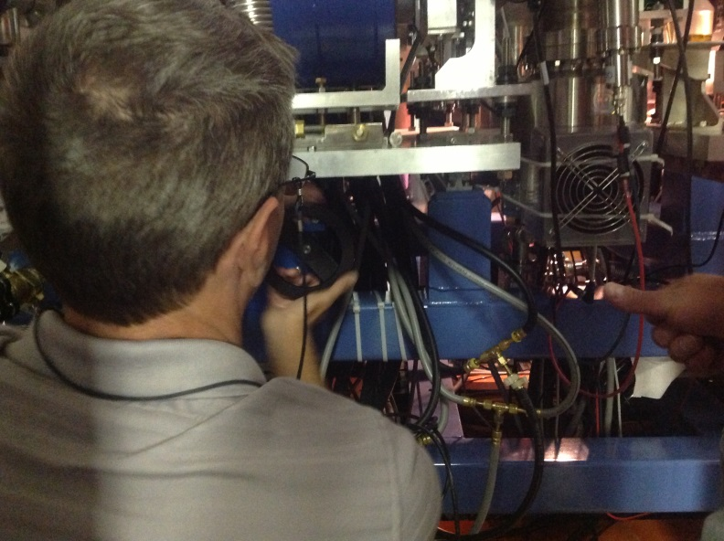
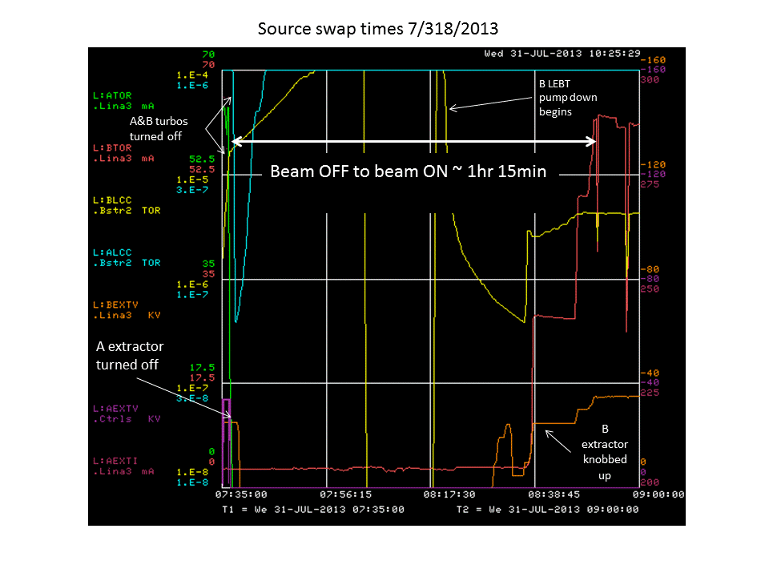
To date we have swapped sources using the slide 3 times.
The turbo manufacturer claims that the turbos can tolerate up to 1G of motion while spinning.
Leaving the turbos spinning we were able to have a Beam OFF to Beam ON time of about 1hr 15min. (note: most of this time was spent replacing an LEBT turbo).
Should be able to swap in much less time in the future

Slide 4
Extractor Sparking
Single biggest issue that we need to overcome
Several things seem to contribute to spark rates
  Damage to source parts (materials)
  Paschen curve
  Cesium control
  Magnetic field

Slide 5
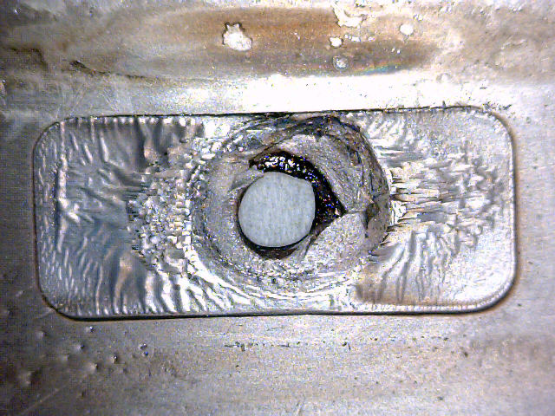
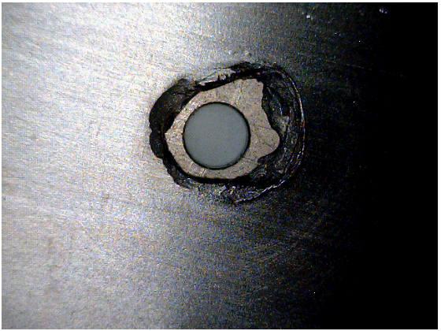
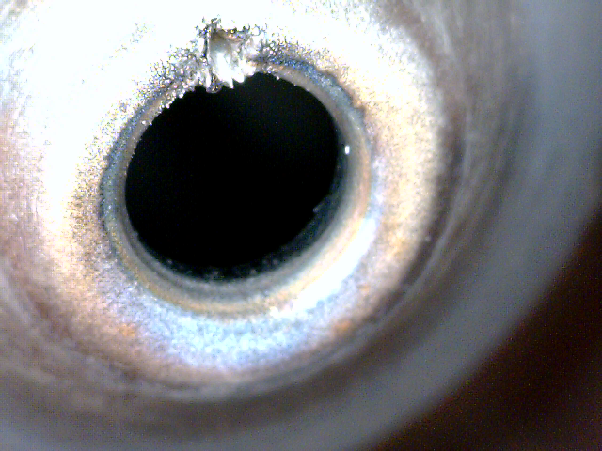
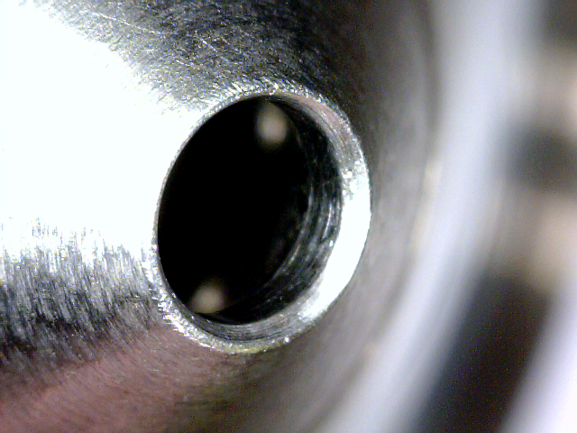
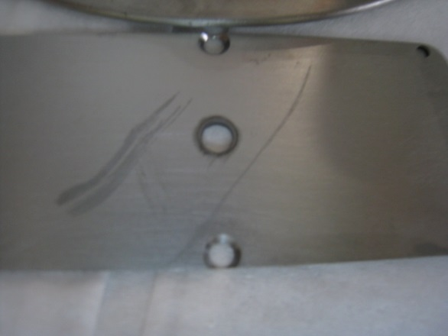
Extractor spark rates: (materials)
Materials play a big role, once the damage is done there is nothing left to do other that pull the source and fix it.
Original extractor cone tip made out of molybdenum
Energy of spark would cause damage that would lead to the need to pull the source and fix
BNL uses tungsten for cone tips. They sent us one to try out. Big improvement in eliminating the damage from sparking
Original inner anode cover plate made out of titanium
Severe case of erosion increased the aperture from 0.125in to 0.25in !
Once again BNL (“ahead of the curve”) sent us a molybdenum cover plate which has clearly solved the erosion problem
0.25in
0.125in

Slide 6
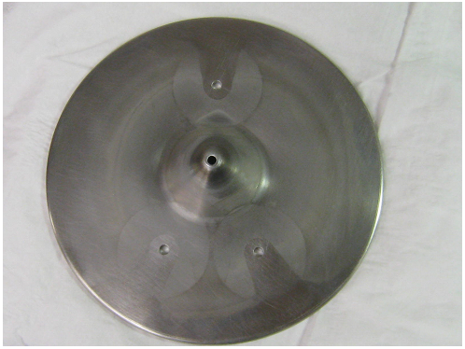
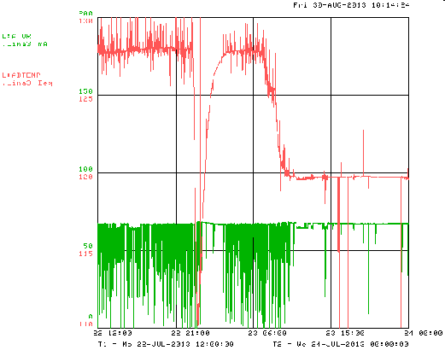
Extractor spark rates: (Paschen curve/cesium control)
Increased gas pressure seems to help reduce the spark rates.
Removed one of the source cube turbos
Pressure was in the low 10^-6 Torr, now in the low 10^-5 Torr
Lower cesium boiler temp seems to help reduce the spark rate.
However, if lowered too far, the H- production goes down

Slide 7
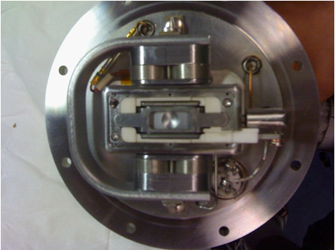
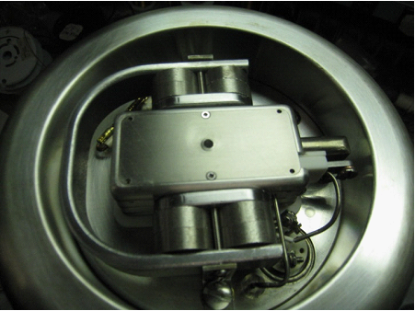
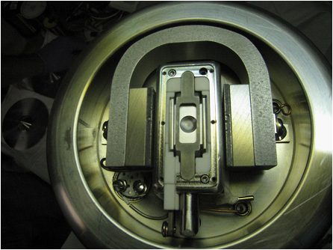
Extractor spark rates: (magnetic field)
Magnetic field plays a big role in both confinement and sweeping away co-extracted electrons
Magnetrons prefer 1kG for proper operation
Original magnets were marginal to start with and ended up too low (~700G) when warmed up.
Redesigned the magnets and yoke with the help of Jim Volk

Slide 8
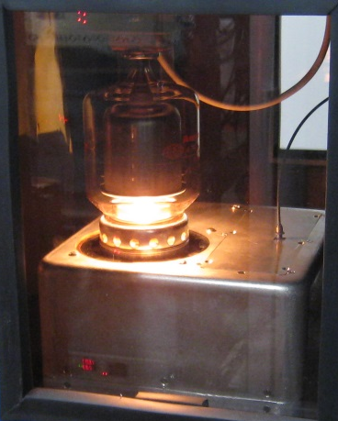
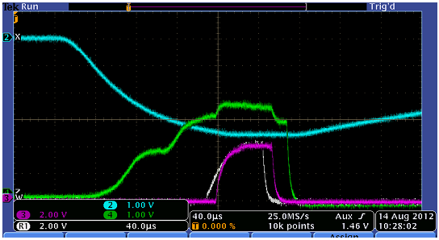
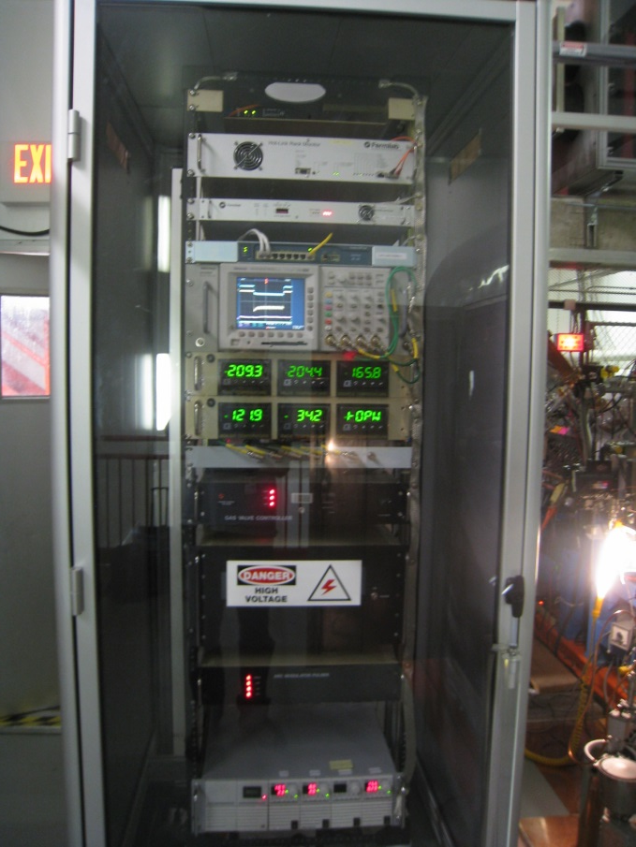
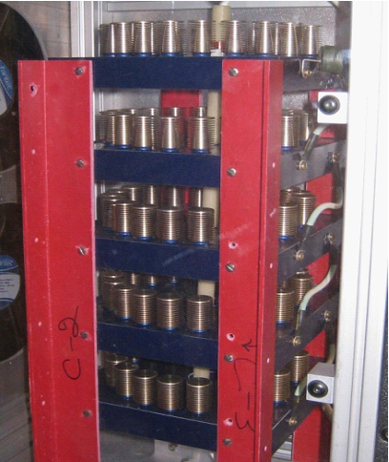
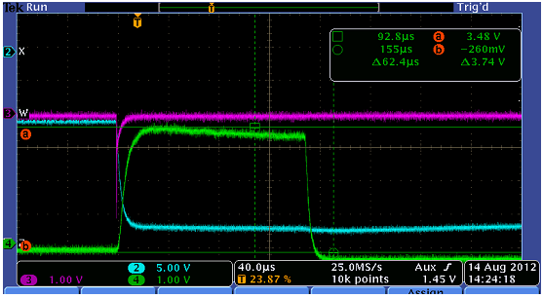
Future plans
During most extractor sparks the HV HRM needs to be rebooted causing the loss of many 15Hz pulses
Plan to remove HRM, install fiber communication, move HRM on the ground side
Replace voltage regulated arc modulator with current regulated modulator
Replace current vacuum tube based extractor pulser with solid state DTI switches (like the ones used for the chopper)
Tubes need replaced every 3 months so there will be a cost savings
Faster rise time means that we will be able to have a shorter arc current PW which will reduce the duty factor by about 43% which should improve source lifetime
Rise time 150μs
HRM
Rise time 9μs
Arc modulator

Slide 9
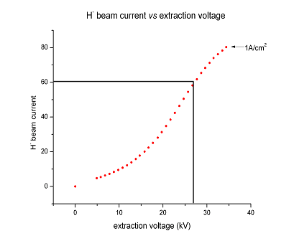
Future plans
2 stage extraction
Beam perveance shows that for 27kV we get around 60mA of H- on the LEBT toroid for a certain arc current
Current extraction scheme: extractor voltage = acceleration voltage. Allows source to run in space charge limited regime
Plan to try a voltage divider to lower the extractor voltage while keeping the total accelerating voltage the same.
Hopefully reduce spark rate with lower voltage on the gap
Current extraction scheme
2 stage extraction scheme

Slide 10
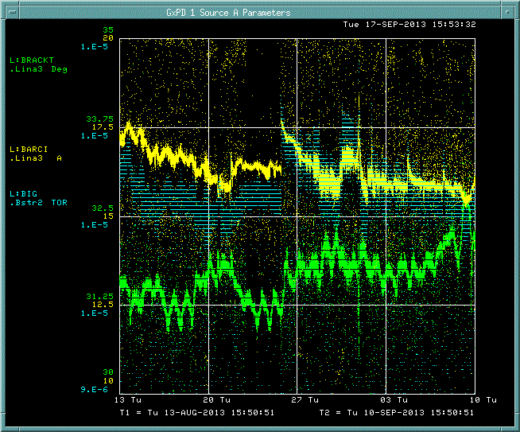
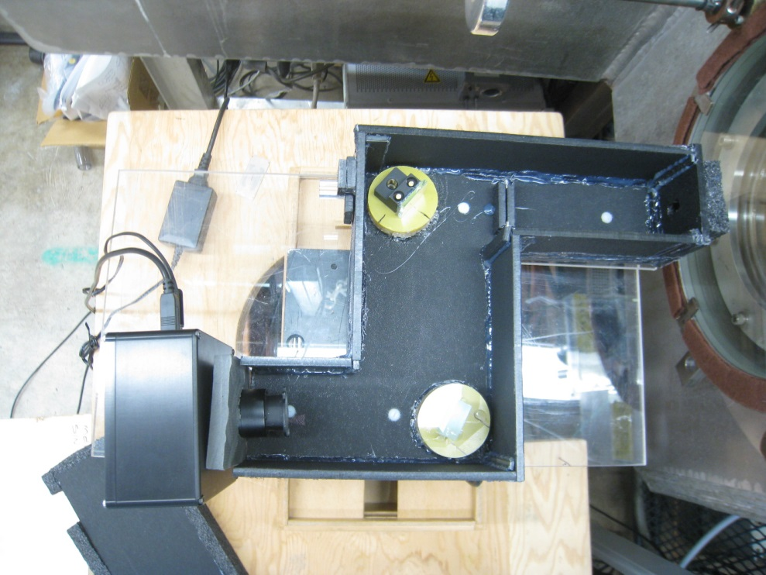
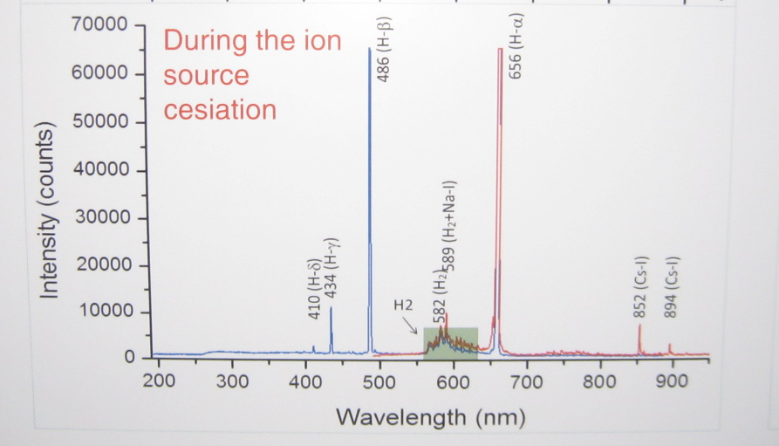
Future plans
Spectrometer to look at the cesium to hydrogen ratio to help with tuning
Replace current piezoelectric gas valve
Poor temperature stability
Hard to calibrate
SNS RF ion source

Slide 11
Conclusion
Both sources are now operational
Sliding mechanism works well
High extractor spark rates still the biggest problem
Lots of tuning done to improve source operation
Several changes made to reduce both the spark rate and the affects of sparking
  chokes, series resistors, re-routed extractor pulser cable, grounding etc…
Several more changes planed for the near future

