Slide 1
PIP Budget/Schedule Status Ken Domann 10/23/13

Slide 2
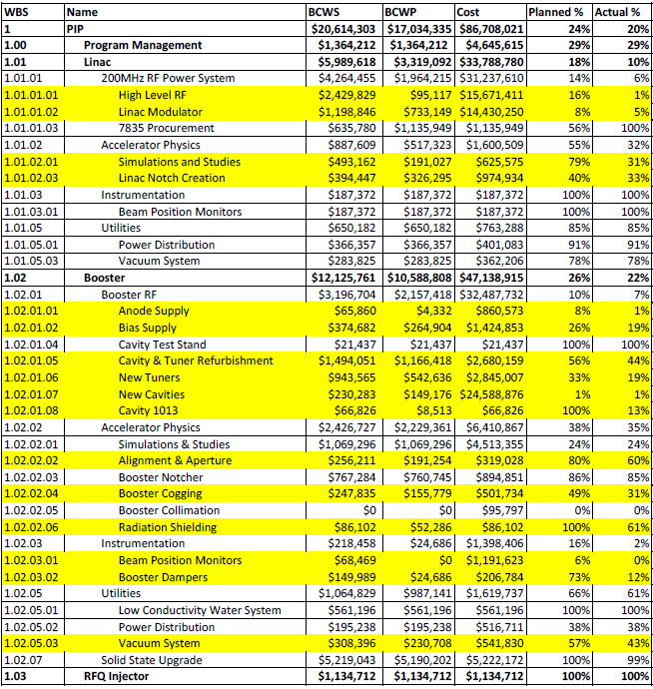
% Complete to WBS Level 4 (Yellow >= 10% Late)

Slide 3
Milestone Status (9/1/13 – 2/28/14) (Red > 3 months late)

Slide 4
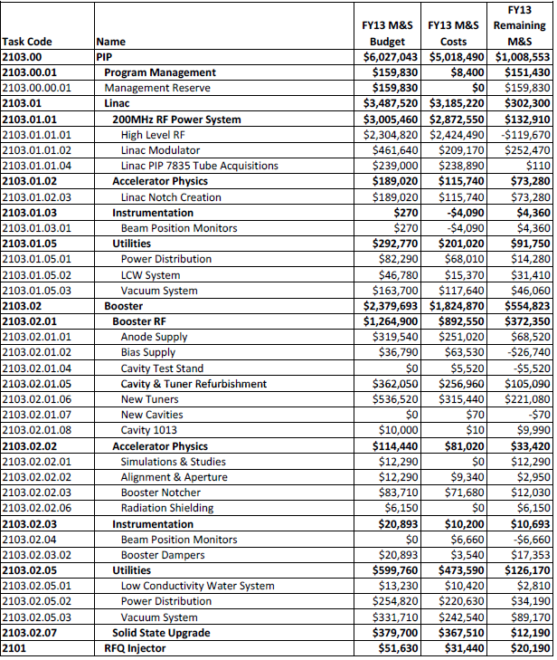
FY13 M&S Budget Usage (w/OH)

Slide 5
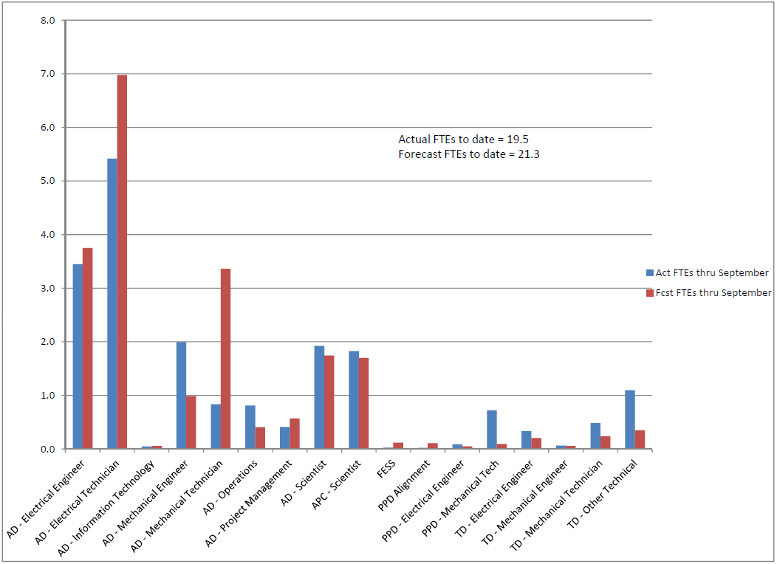
FY13 To-date FTEs by OHAP – Fcst vs Act

Slide 6
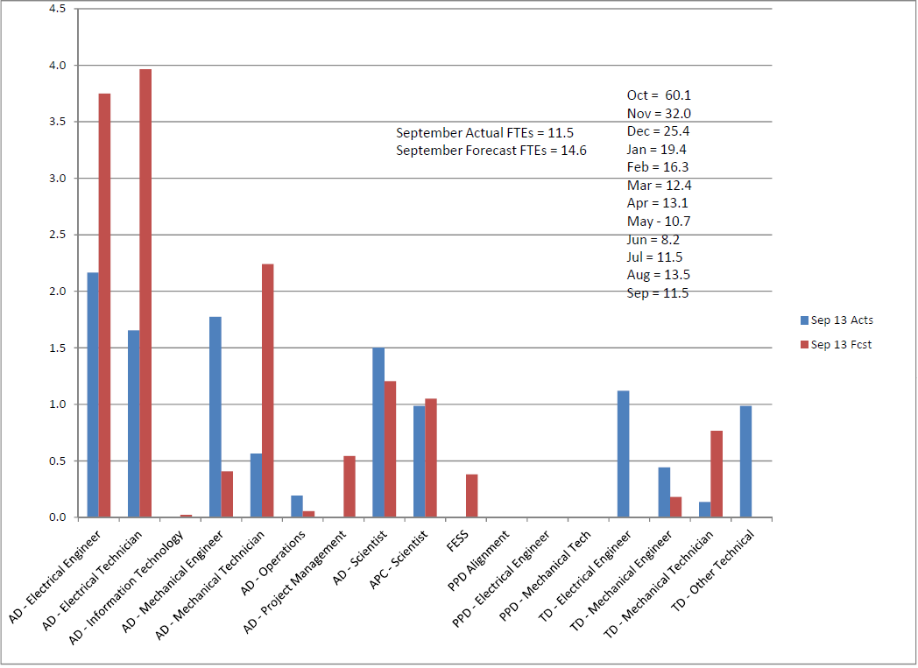
FY13 Monthly FTEs by OHAP – Fcst vs Act

Slide 7
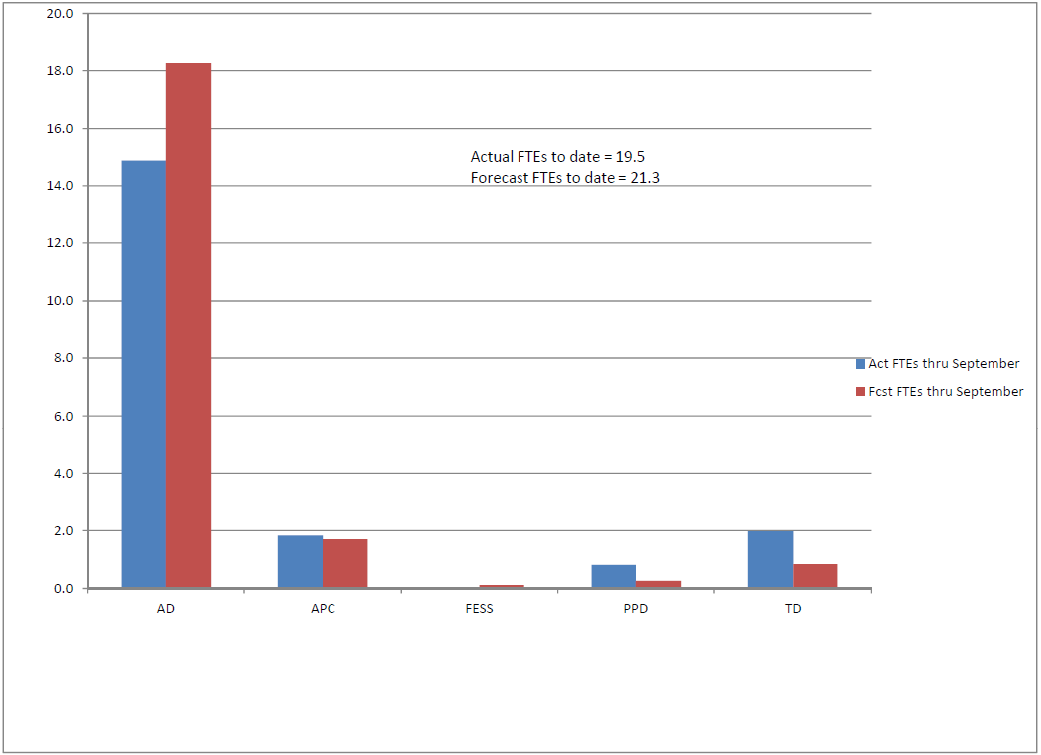
FY13 To-date FTEs by Div – Fcst vs Act

Slide 8
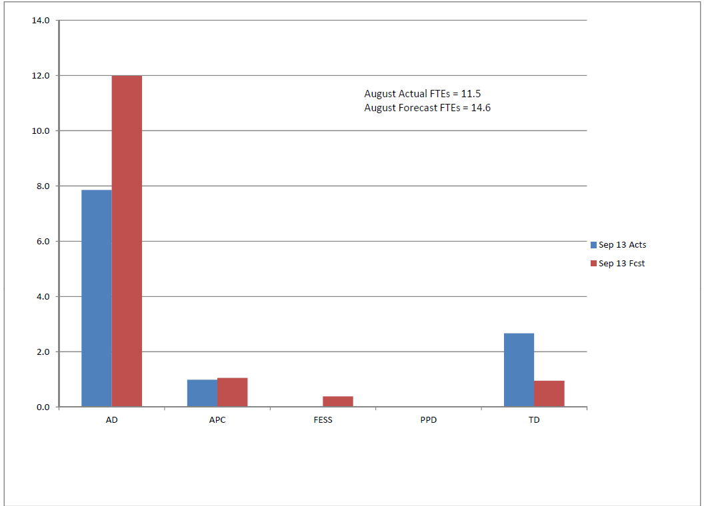
FY13 Monthly FTEs by Div – Fcst vs Act

Slide 9
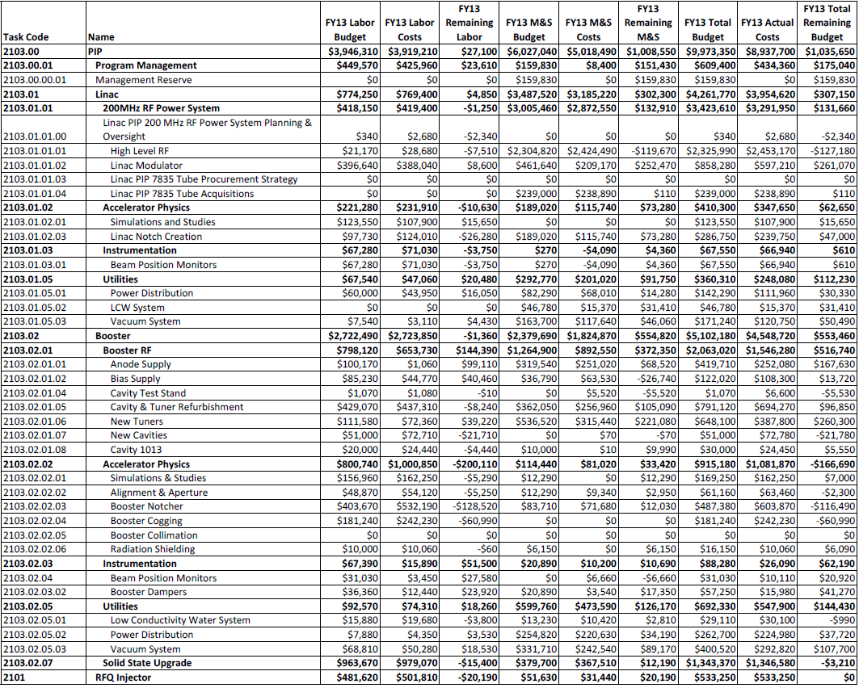
FY13 Budget thru September 2013

