Slide 1
STATUS OF noker pulser for Short magnetS
C. C. Jensen
December 4, 2013

Slide 2
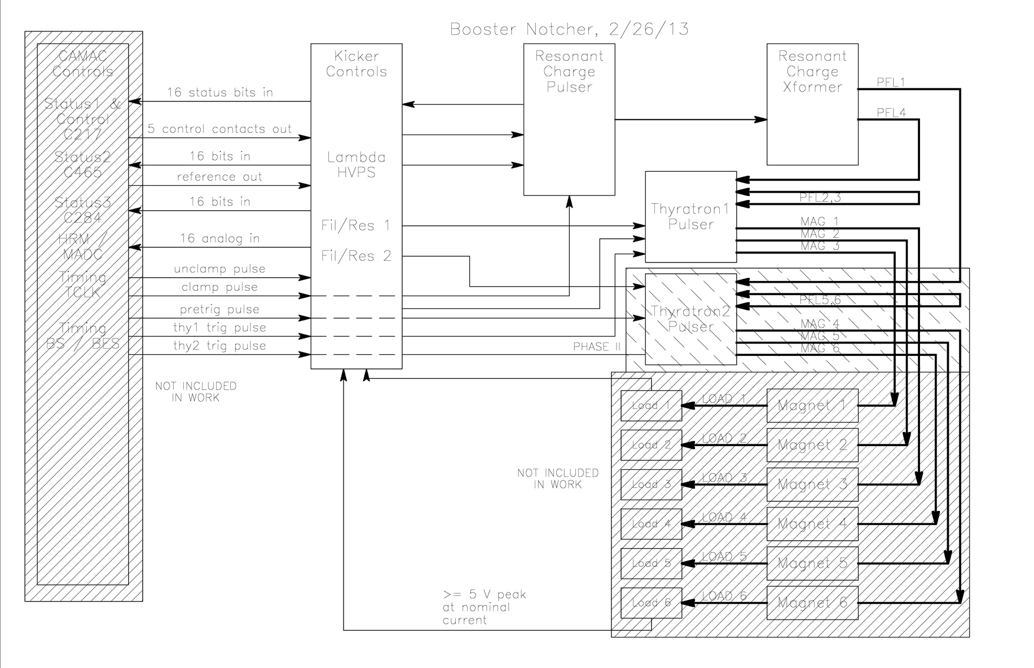
Overview

Slide 3
Plan
Still Under Discussion
Phase I (existing magnets)
Test new controls and resonant charger with one and two new pulsers into EE support resistive load.
Install controls, one pulser and resonant charger in place of Nok B for one magnet
Remove Nok A and Nok C and use new pulser with all three existing long magnets
Phase II (short magnets installed)
Install second pulser, one driving two existing long magnets and other driving two short magnets
Fairly complicated. Various combinations of number of pulsers and number of types of magnets, not all allowed.

Slide 4
ISSUES
Need a specification for pulse length, amplitude(s) and operating modes.
Not enough loads for all 6 short magnets
Could build simpler version of latest ANU loads w/o cooling
Manpower is spotty, a lot of waiting for someone else
Don’t have a schedule or sense that this is urgent
Need to determine how to generate resonant charging trigger
Can only have one resonant charge trigger per cycle
Need to determine how to generate charge trigger
When to start charging capacitor? End of previous cycle seems only option now.

Slide 5
Pulser Status
Thyratron assembly mechanical parts in hand
Thyratron enclosure still waiting on leak checking
Thyratron sub assembly is complete
Final assembly of filament / reservoir and trigger circuits to continue after leak checking

Slide 6
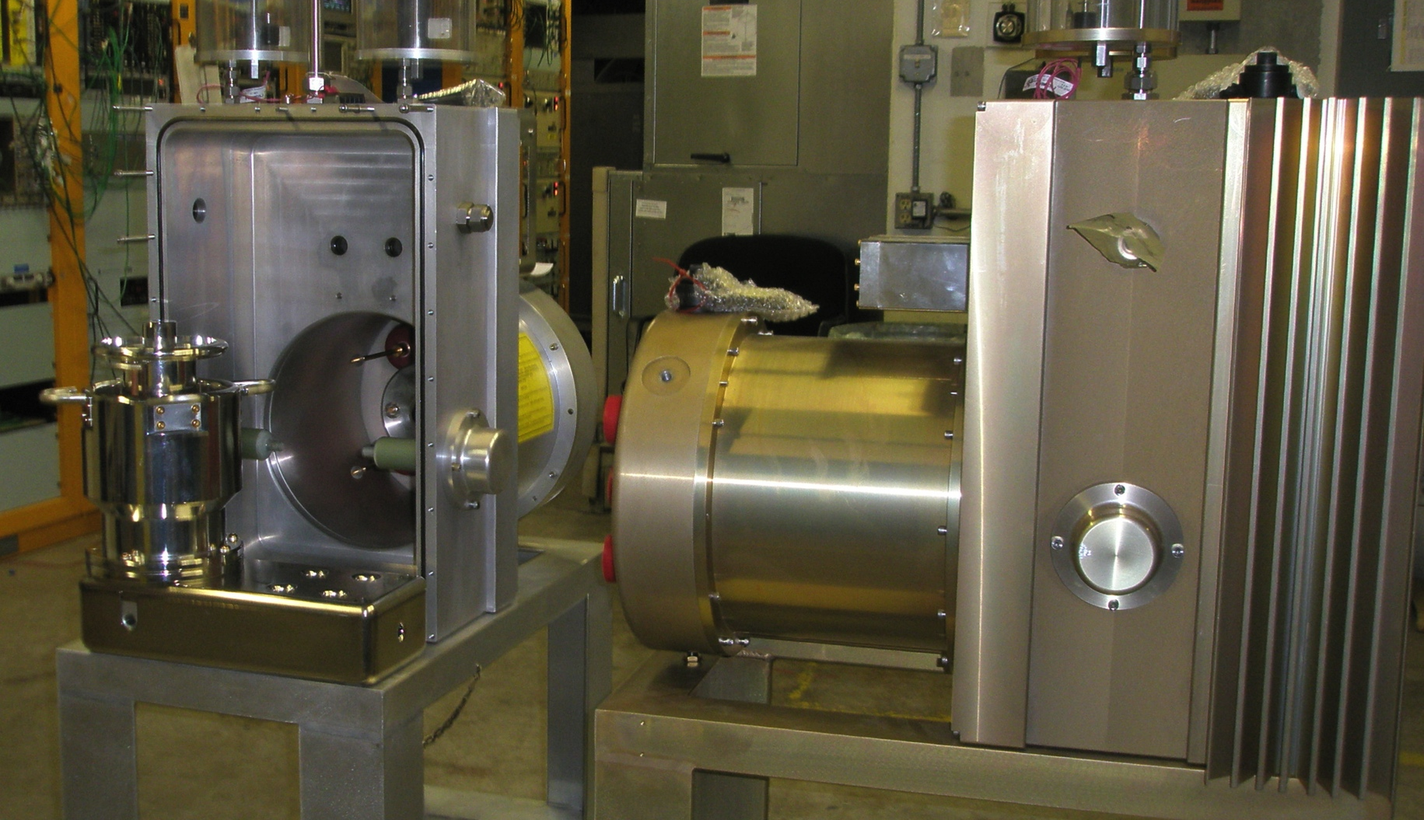
Pulser Status

Slide 7
Resonant charger Status
Assembly is complete
Everything was built same as ANU kickers
Only have 2 nF PFL capacitance instead of 32 nF
Have assembled 0.5 uF low voltage capacitor
Have to test with short load cables and 0.5 uF capacitor
May have to order a few parts related to safety discharge circuit
Kept same discharge resistor (500 k) and same thyratron bias network (5 M) so droop on PFL is much faster
Depends on delay and jitter from timing system

Slide 8
internal Control Status
Control boards are missing some parts
These are spare boards and are not holding up project
Cables internal to control rack are done
Cables from control rack to thyratron pulser have just started assembly
Cables from control rack to external controls have just started assembly
Ferrite cores for EMI have recently arrived

Slide 9
External Control Status
CAMAC cards for status are present
Database entries have not been made, need to decide device names
Most NIM cards for timing exist
Need an additional Gate card in short term

Slide 10
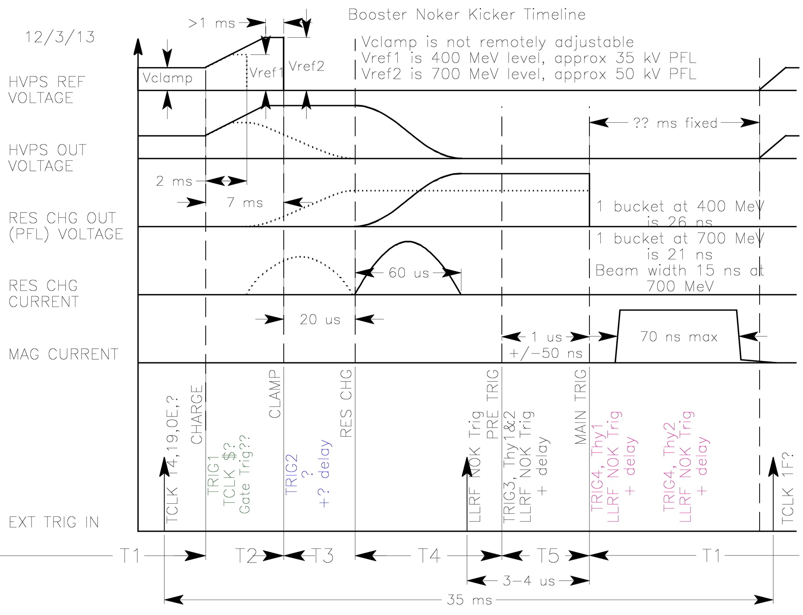
External Control Status

