Slide 1
Status of cogging
December 4, 2013
Creig Drennan, Bill Pellico, Kiyomi Seiya, Kent Triplett, Alex Waller

Slide 2
Cables to 48 correctors from LLRF room
(K. Triplett, D. Dick)
LLRF Room
G16-RR2-1
G14-RR5-1
G11-RR7-1
+A IN
A
OUT
1
A
OUT
2
A
OUT
3
+B IN
B
OUT
1
B
OUT
2
B
OUT
3
East Gallery
BLLRF-4
Module
1
2
3
4
5
6
7
8
1
2
3
4
5
6
7
8
1
2
3
4
5
6
7
8
A IN
PP-D
A
OUT
3
B
OUT
3
BACK PP-2
A
OUT1
B
OUT
1
BACK PP-2
A
OUT
2
B
OUT
2
BACK PP-2
A
OUT1
8
A
OUT2
7
H(S,L) 16 ~ 19
V(S,L) 16 ~ 19
H(S,L) 12 ~ 15
V(S,L) 12 ~ 15
H(S,L) 08 ~ 11
V(S,L) 08 ~ 11
B IN
6
B
OUT1
5
H(S,L) 20 ~ 23
V(S,L) 20 ~ 23
H(S,L) 24 ~ 03
V(S,L) 24 ~ 03
H(S,L) 04 ~ 07
V(S,L) 04 ~ 07
B
OUT2
4
A
OUT
3
B
OUT
3
A
OUT
1
B
OUT
1
A
OUT
2
B
OUT
2
FRONT PP
BACK PP-2
BACK PP-2
BACK PP-2
16
15
14
13
1
2
3
4
5
6
7
8
1
2
3
4
5
6
7
8
1
2
3
4
5
6
7
8
+A IN
A
OUT
1
A
OUT
2
A
OUT
3
+B IN
B
OUT
1
B
OUT
2
B
OUT
3
West Gallery
G21-RR4
G21-RR4-2
G24-RR4-1
G04-RR0-6

Slide 3
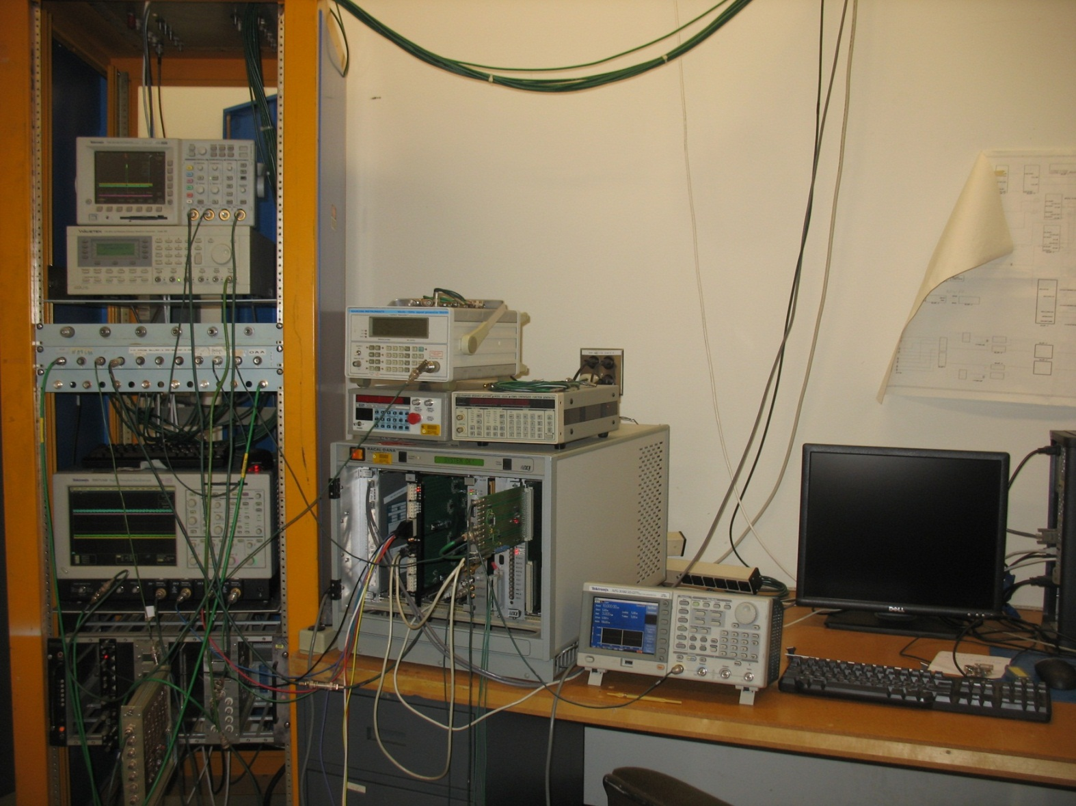
Test stand at LLRF room
(K. Triplett, T. Boes)

Slide 4
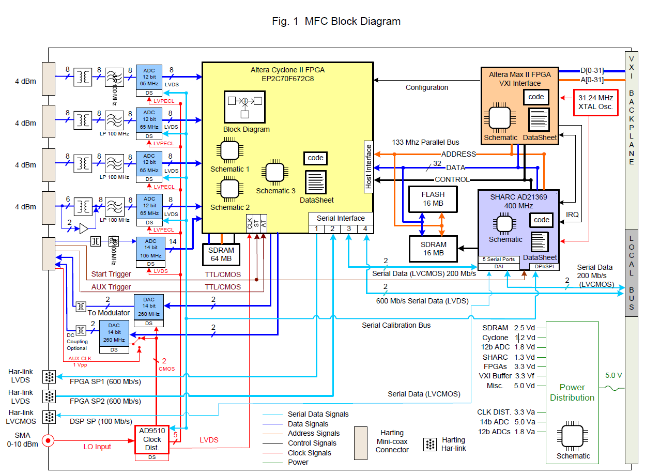
MFC board (AD/LLRF)
TCLK decoder on FPAG (AD/Control)
ADC
FPGA
DSP
DAC

Slide 5
MFC board I/O (1)
(C. Drennan)
DIGITAL INPUT
TCLK
Bdot
Booster RF pulse
MI RF pulse
OAA
DIGITAL OUTPUT
Trigger to nocher
DAC OUTPUT
Offset to corrector
RPOS
RF
To
pulse
Digital I/O
To
Harting connector
(LVDS)
4 channel outputs with 0-700mV
Buffer amp
gain
offset

Slide 6
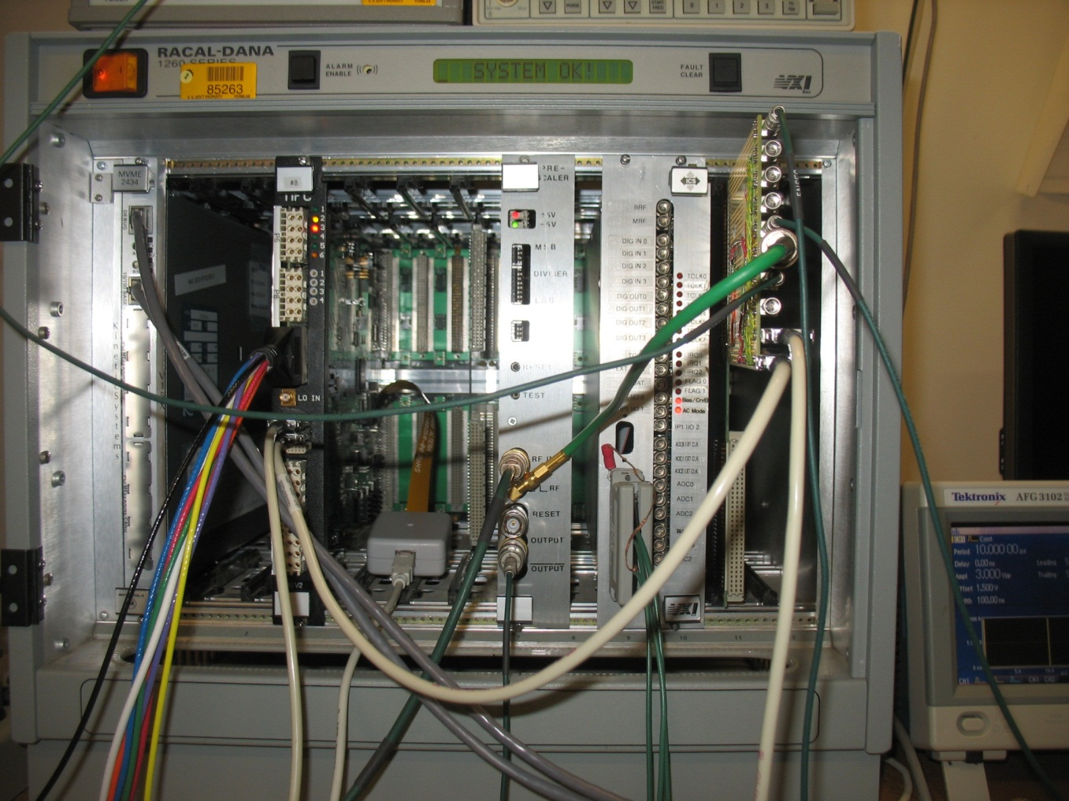
MFC board I/O (2)
RF
To
pulse
Digital input
To
Harting connector

Slide 7
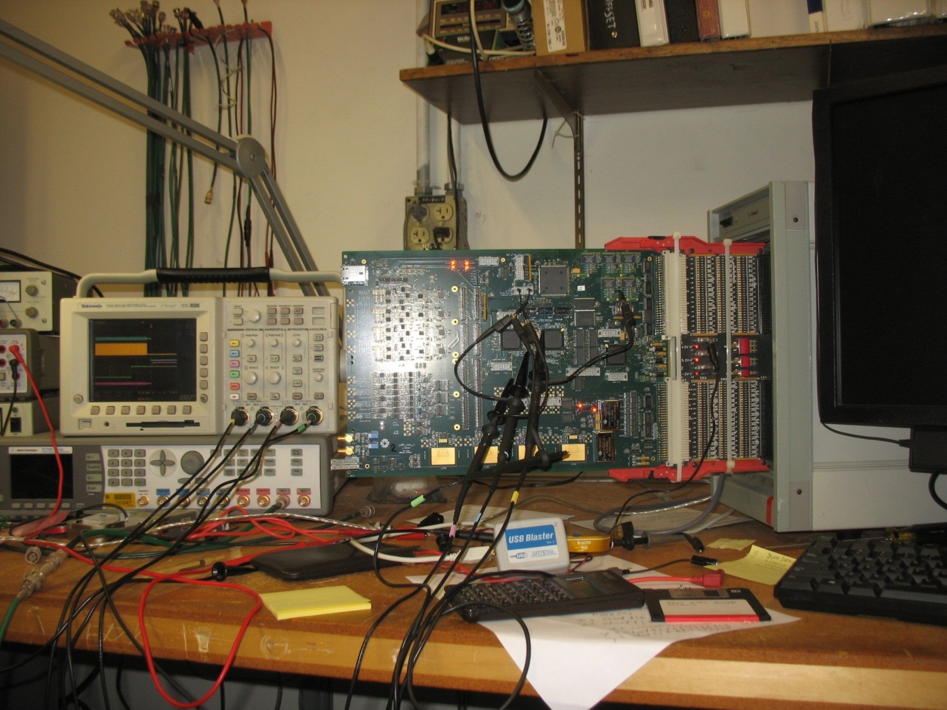
New Booster LLRF board
(C. Drennan)

Slide 8
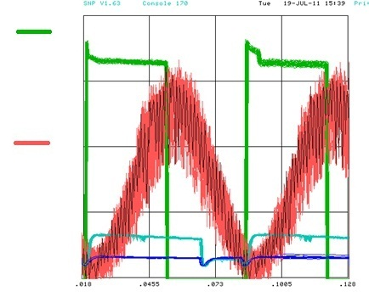
Booster cycle
1st pulse
2nd pulse
Intensity
B field
Notch @ 400μsec
@ 7msec
The notch was created at 7msec for the 2-12th pulse.
Creating the notch at lower energy can reduce beam loss in the Booster.

Slide 9
Total bucket counts during Booster cycle
The bending field in the Booster, injection energy, timing, rf feedback …..are changing
from pulse to pulse and bucket position at extraction is not constant.

Slide 10
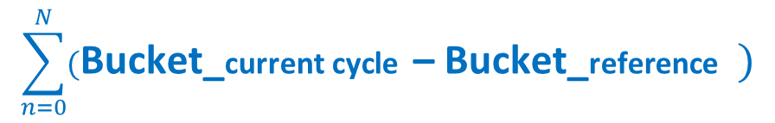
$$\sum_{n=0}^{N}{(\text{Bucket}\text{_}\text{current} \text{cycle} \text{– }\text{Bucket}\text{_}\text{reference} )}$$
Difference of bucket count between reference cycle and a cycle with B field error.
Final bucket position

Slide 11
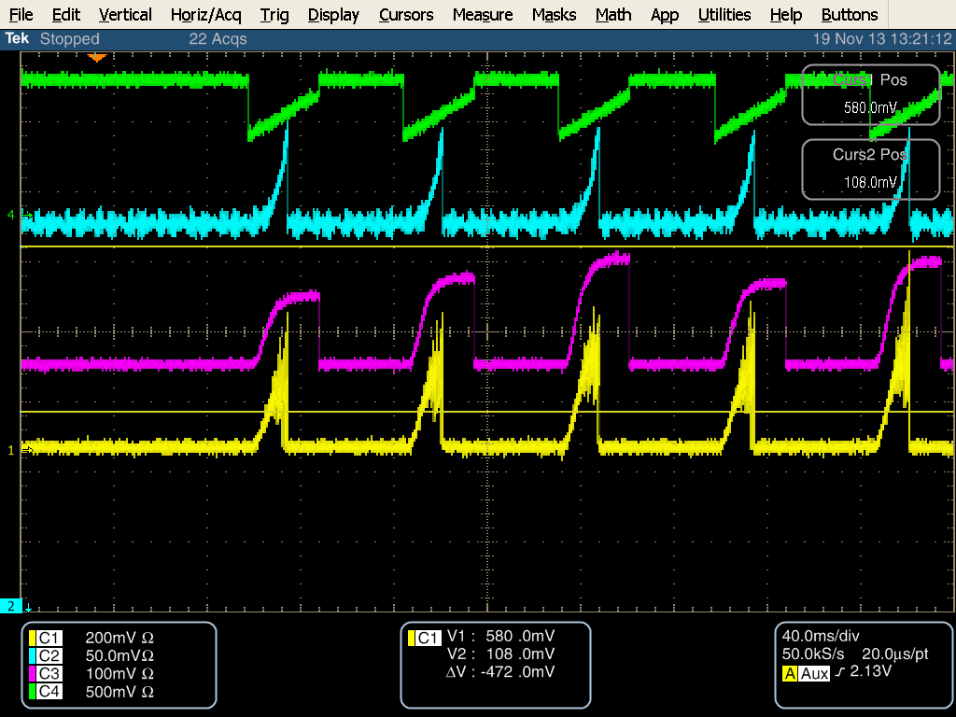

DAC output on $19
Turn Number
$$\sum_{n=0}^{N}{∆Bucket}$$

Slide 12
Beam study on $17
$12 $17 $17 $17 $17
57 bucket /div

Slide 13


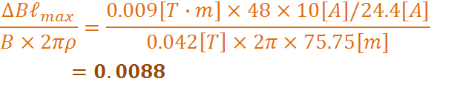
Magnetic cogging
B+dB
Fixed with RPOS feedback
Changed by dipole corrector
Dipole corrector: 0.009[T-m] @ 24.4[A]
(Assuming 10[A] change )
B field error ~1% can be compensated.
Keeps the orbit centered and saves aperture.
Has two feedback loops for frequency and RPOS .

Slide 14
Beam study on $17(1)
w/o dipole corrector
with

Slide 15
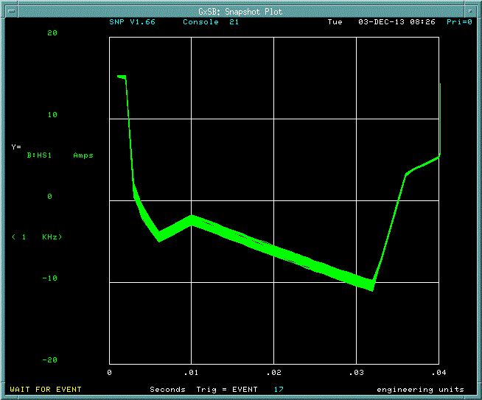
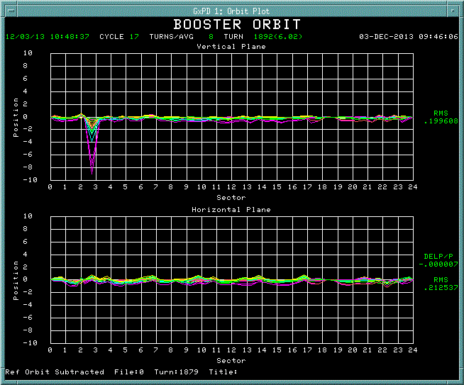
Beam study on $17(2)
Corrector current
Orbit difference

Slide 16
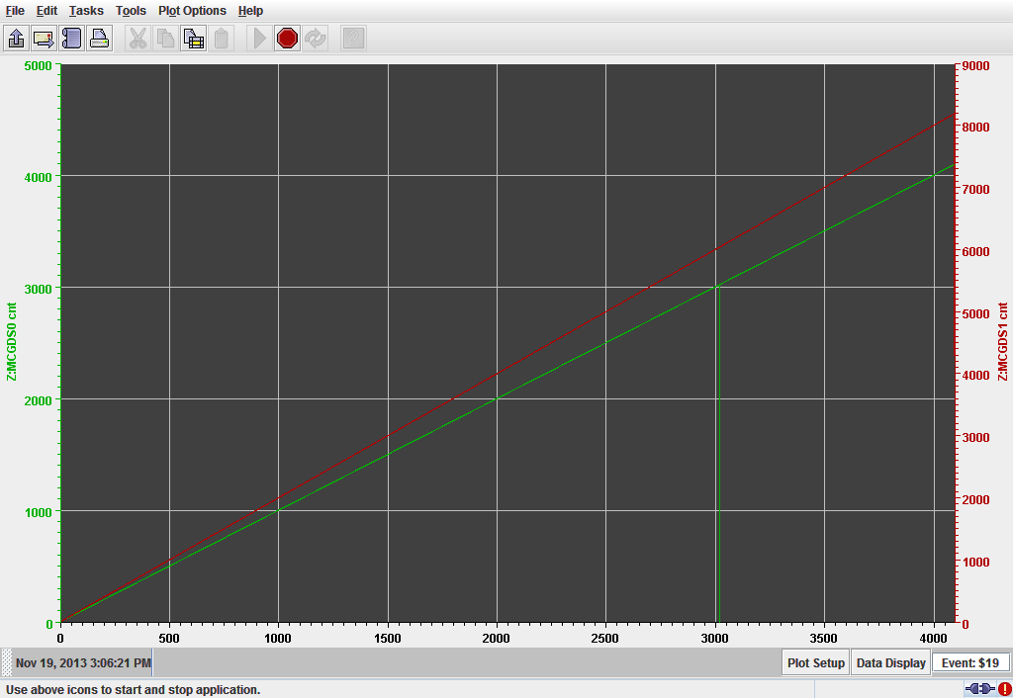
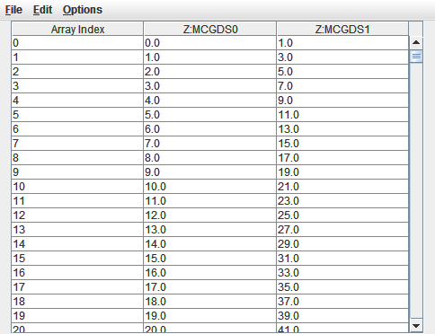
Data on JAVA application
(A. Waller)
4 array data from memory

Slide 17
Δbuckets compensation
with RPOS cogging and Magnetic cogging

Slide 18
Plans
Beam studies on $17 and optimize gain.
Combine MCOG( before transition) and RCOG (after) on MFC board.
Creating the notch at 1msec.

