Slide 1

Proton Improvement Plan
PIP
Feb 4, 2014
William Pellico
Bob Zwaska

Slide 2
Outline
This talk will focus on Proton Improvement Plan’s (PIP) recent work and management. Historical reference will be given to help give perspective of where we were and where we are going.
Initialization
  Why do we need PIP
  Goals
First two years
Present Effort
Plans
Management and Controls
  PIP structure
  PIP controls
  PIP planning

Slide 3
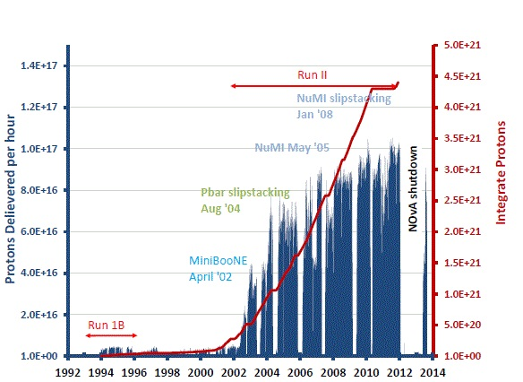
Proton Source Historic Proton Flux

Slide 4
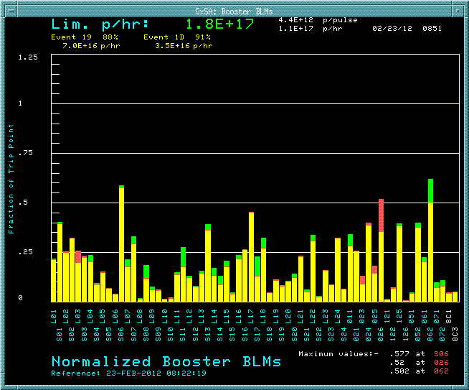
Beam loss limits were set at levels with personnel safety (ALARA) first – flux output increases came with efficiency….
(from ~68% to over 90%)
Booster Collimators FY04
Booster Low Level/Damping FY04
New Booster Injection Line FY FY06
Removal of L13 Extraction Region FY07
Linac Quad PS FY07
Linac Low Energy Low Level FY08
New Ramped Correctors FY09
A ten-fold increase in hourly rates, lower loses and higher uptime. The flux ramp-up for the intensity frontier took time, money and labor….
Almost 8 years of effort before the PS was able to exceed beam requests.
Loss Limit

Slide 5
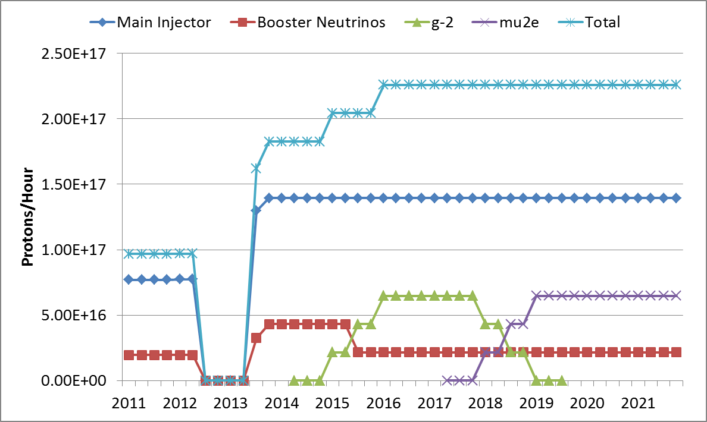
Requested Proton Flux
Adjusting to program planning
120 GeV ν
LBNE
NOvA Shutdown
g-2
Mu2e
8 GeV ν

Slide 6
Proton Source Task Force 2010
Proton Source Workshop 2010
Booster 15 Hz Operation
2015
PIP Begins
2011
PIP Design Handbook & Project Controls 2012
RFQ Injector & Booster RF Solid State Complete
2013
Linac High Power RF System Completed
2019
Project Complete
2019
End of Proton Plan Effort
S. Henderson (and DOE)
If we make a commitment to the physics program, we must deliver on that commitment
Conversely, we should not make plans for the experimental program if they’re not supported by plans for delivering the beam
Failure to deliver on today’s programmatic commitments jeopardizes tomorrow’s plans
This planning process serves very important functions of 1) developing a path to achieve the program goals we have already signed up for, 2) providing a basis for realistic planning going forward
Therefore
  I view the completion of the PIP, and our execution of it as an urgent, extremely high-priority activity
  I have made the completion of the PIP a priority for AD management
  I will commit to working at the Directorate level to funding a plan of reasonable scope.

Slide 7
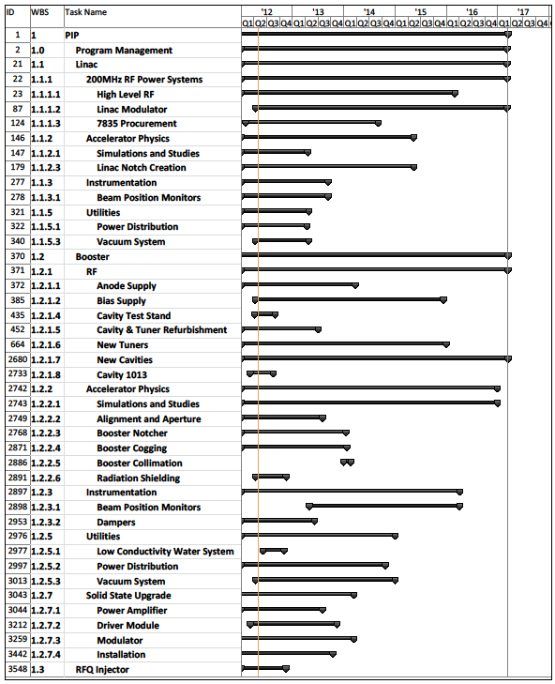
PIP – Original schedule
An aggressive 5 year plan
31 initial level 4 projects
Lots of documentation, controls, meetings and presentations
Work –
Can be divided into 3 parts:
Reliability/Viability
Flux
Cycle Repetition Rate
Lots has changed
Bob will give details ….

Slide 8
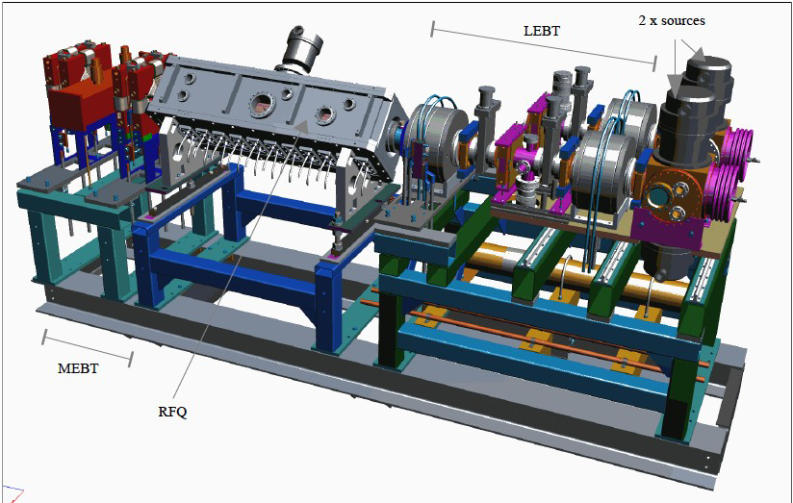
RFQ Injector Line (RIL)
Ongoing projects:
Gas valve replacement
2 stage extraction
DTI extractor pulsers
Fiber optic links to HV rack
Spectrometer looking at Cs to H ratio
Cs handling (change boiler to accept Cs without ampule)
Better heaters (right now the heaters are too interactive)
Current regulated arc modulator
Optical spectrometer installed for Cs monitoring in the plasma. Will be operational soon.
First PIP task to be completed: FY12
In house expertise: Ion Sources, RFQs, novel chopping, LE beam dynamics & compact beam elements
Effort to reduce high extractor spark rates:
Improved materials (molybdenum inner anode cover plates, tungsten extractor cone tips, titanium outer anode cover plate)
New magnets and Yoke
Better understanding of Cs flow rates
  Monitoring of source body and Cs tube temperatures
Operations:
We have swapped sources 3 times
  with practice could be <20min
Adjusting tuning parameters
Future RIL Talk

Slide 9
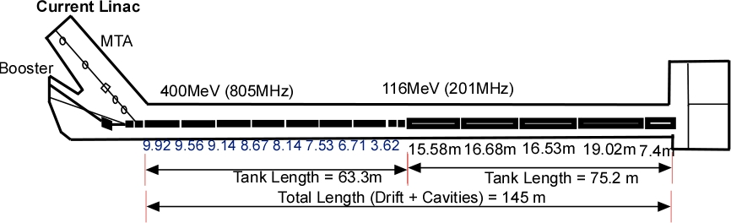
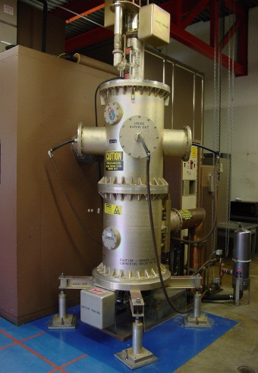
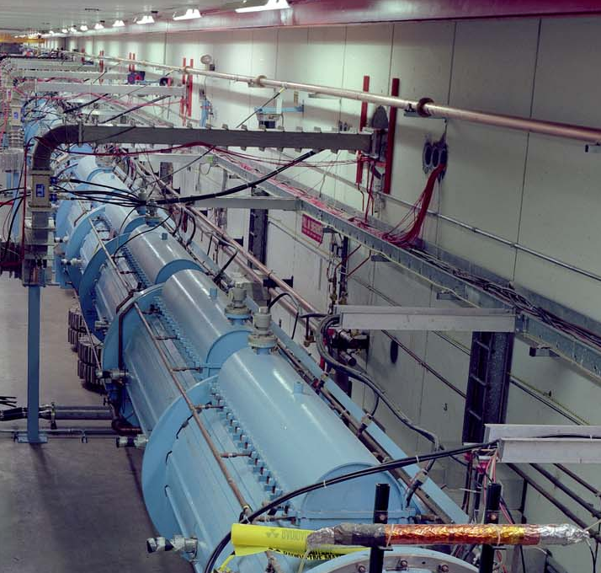
PIP - Linac
Linac PIP
Modulator &
7835 Tube Socket
RFQ
  Flux
    Laser Notching
    Beam Physics
    Upgraded diagnostics/software
      BPMs
      Toroids
  Vulnerability
    Modulators, Driver Solid State RF source
    Burle 7835 tube system
    Utilities
      Vacuum (Roughing stations, pumps, valves…)
      LCW (pumps, plumbing)
      Power (transformers, MCC, breakers, distribution)
Triode RF systems
Low Energy Linac

Slide 10
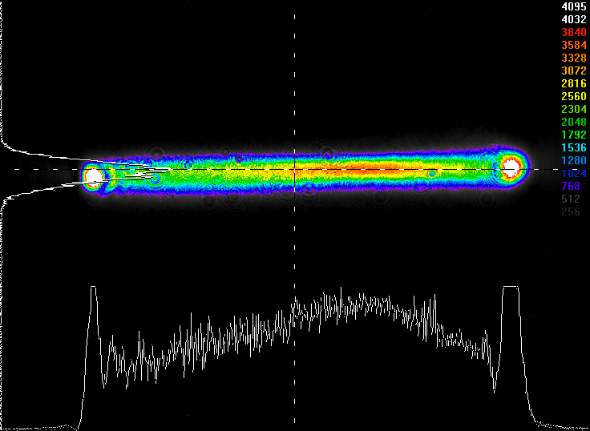
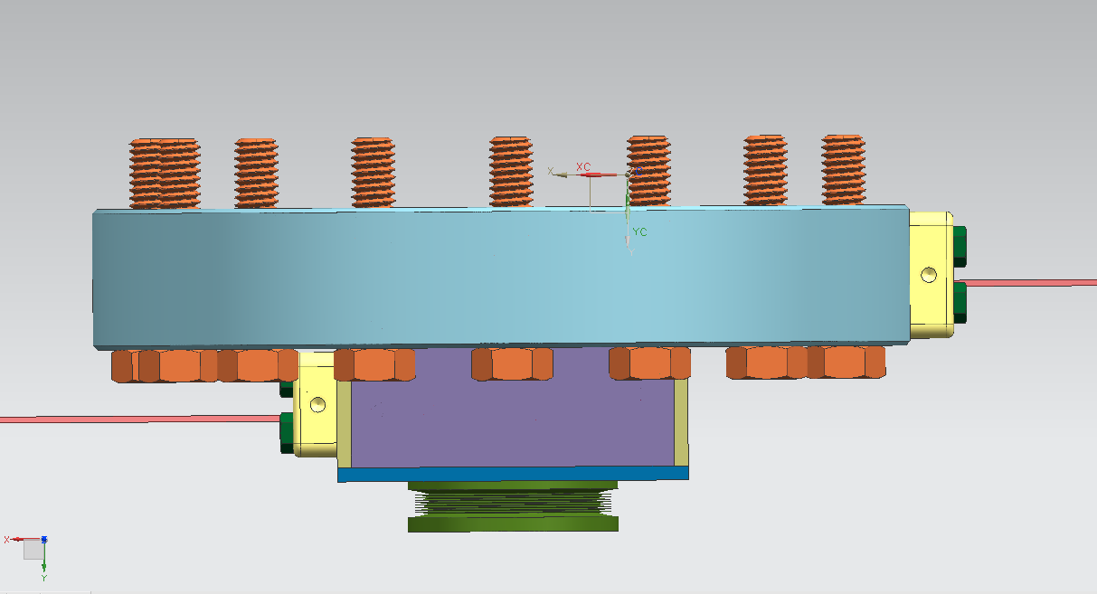
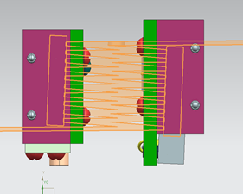
Laser Notching (After RFQ – 750 KeV)
Progressing in a Pre-Acc notching
Working of timing electronics
Vacuum chamber complete
Final assembly – FY14 Q1
Upcoming talk D. Johnson
Testing of beam shaping optics
200 MHz pulses
Attach to RFQ
450 kHz
Beam
Laser IN
Laser OUT
Interface with MEBT

Slide 11
Linac Beam Physics
Goals: To obtain accurate on line Linac model from RFQ injector to Booster injection (foils).
Generate beam envelope (Twiss-Parm) - emittance and efficiency
TRACEWIN, TOUTATIS, PARMILA, PARMTEQM and MAD
Optimize quad settings, loss reduction and ability to find new settings when a quad fails inside DTL tank.
PIP Linac Physics work has made big improvements and continues to add to previous efforts
Not done – accurate model still not completed

Slide 12
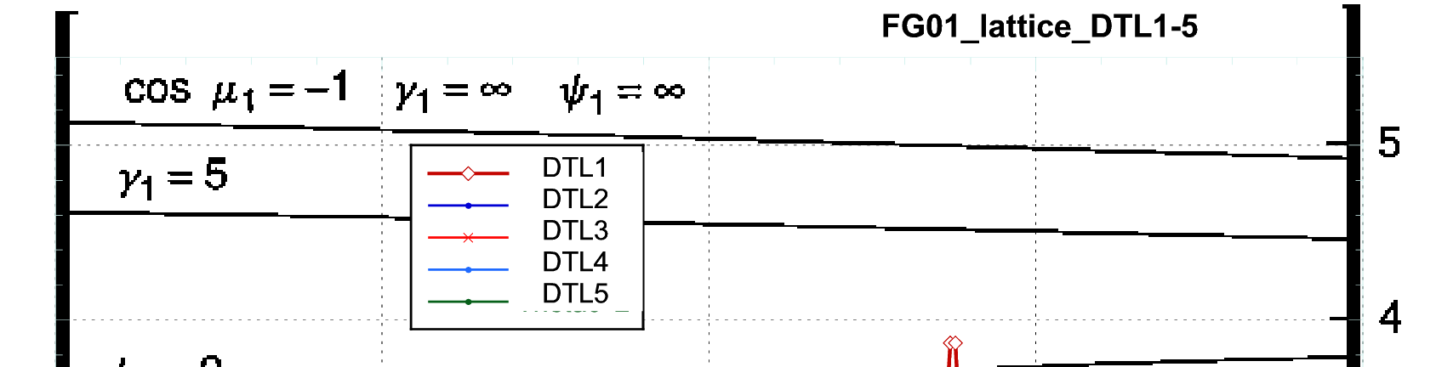
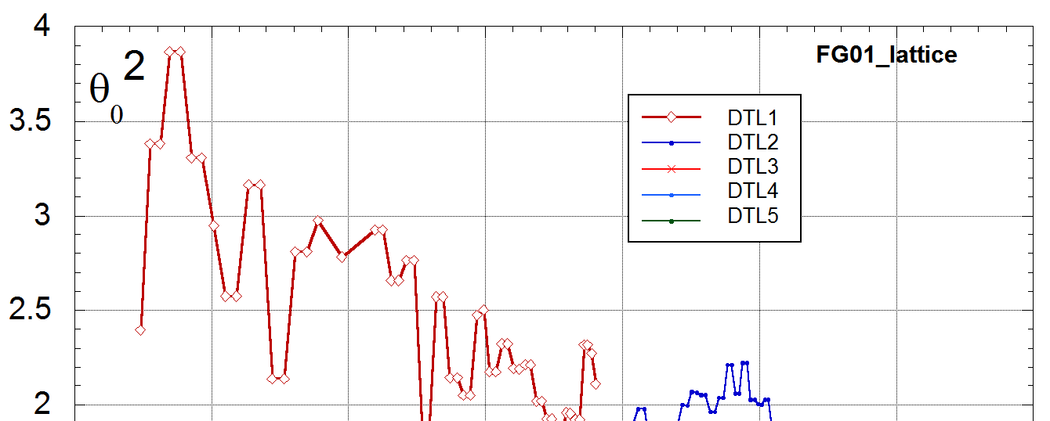
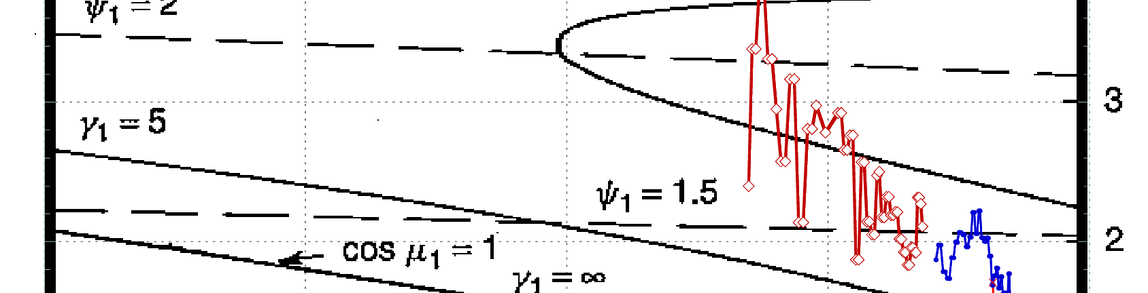
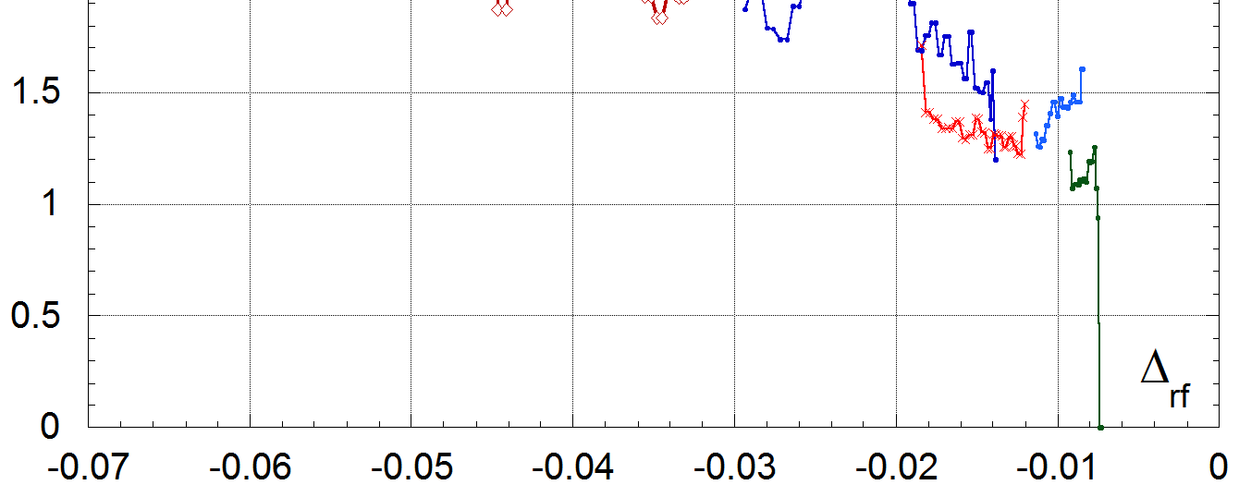
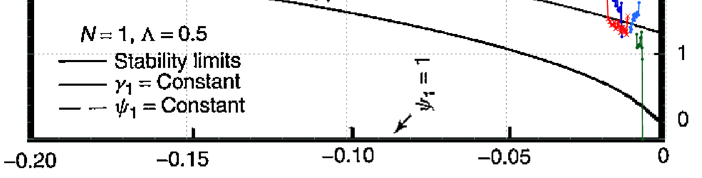
Linac optics is difficult – DTL Tank (especially 1) issues
The task seems nearly impossible (many issues): alignment of elements, lack of diagnostics, steering issues, quad strengths & tank modeling (inter-tank).
Quad strengths - stability diagrams

Slide 13
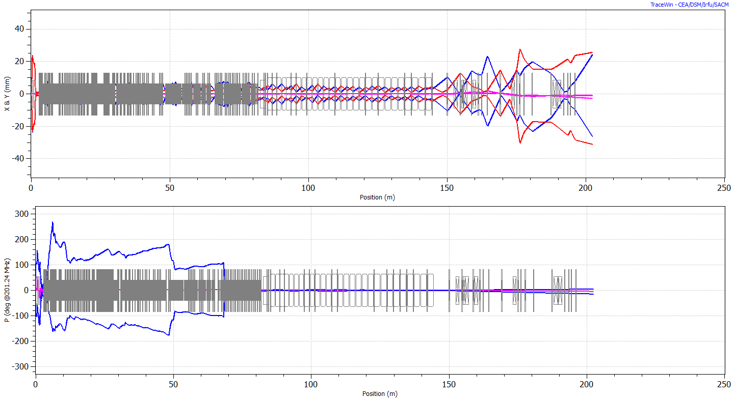
Envelopes along the Linac + transfer line
Work continues to try and match actual performance with design.
Transverse Optics (envelope)
Longitudinal Optics (envelope)

Slide 14
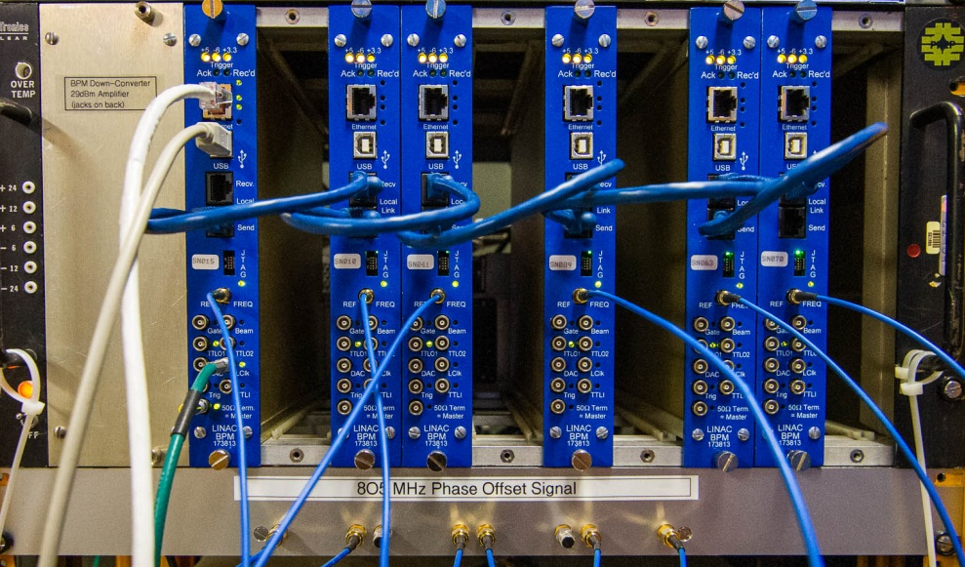
Linac Diagnostics BPM and Toroid upgrade completed
The new digital BPM system is commissioned:
ACNET and Java applications
Hardware/Diagnostics software
Provide average Position, Intensity, & Relative Phase over each beam pulse for every BPM @15Hz
15 Crates – over 60 BPMs

Slide 15
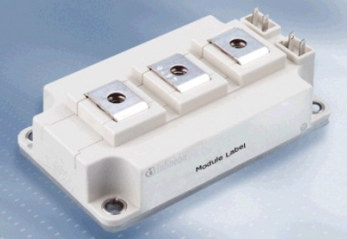
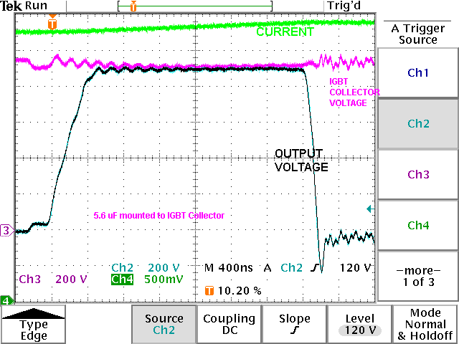
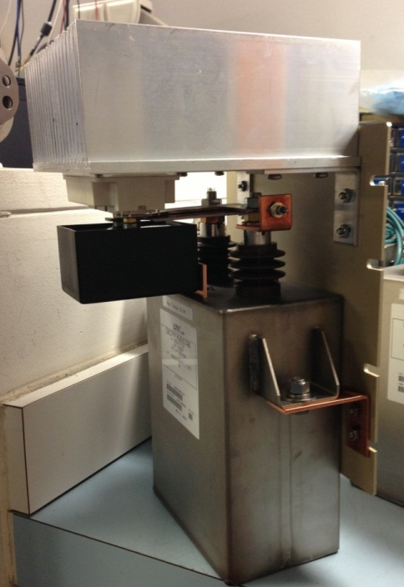
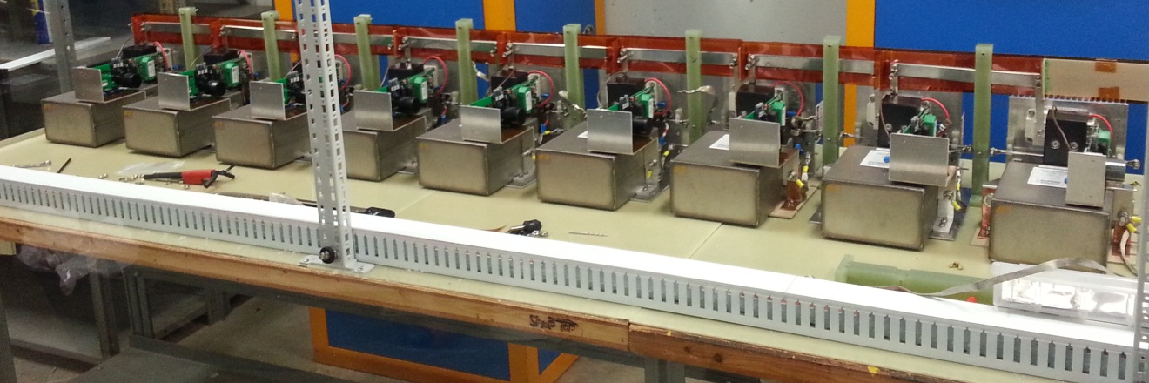
Modulators – From tube based to solid state
The Linac DTL 7835 tube modulator is ~45 years old and is increasing difficult to maintain. Rebuild and replace (old or obsolete parts) was considered but a fully modern system was decided.
Designs being considered:
In house IGBT (EE/PS dept)
SLAC – Marx generator
Testing Underway - Future Talk
IGBT
Voltage Transients Test
IGBT, Snubber, and Main Storage Capacitor
9-cell construction

Slide 16
Linac 200 MHz Power Systems
7835 triode
The high power RF 7835 tube is a Linac vulnerability with reliability issues. This has been a concern for many years for FNAL and other laboratories. After considering several options which looked at cost, labor, schedules and risk, a plan was developed and approved by laboratory management.
The buildup of a 4 year 7835 inventory
To design and build a new solid state modulator (keep 7835)
Replace tube systems in driver with Solid State when possible
Investigate 7835 replacement
  Investigate LANL option
  Investigate Klystron option
    Budget and plan for prototype with eventual system option

Slide 17
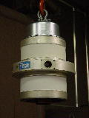

Linac High Power
Present
7835
7835 socket
The purchase of a 200 MHz Klystron has just been completed. The device will arrive in FY15 and then tested. This will be the first of its kind and will need to be fully tested before proceeding.
Some key specs:
5 MW Single Beam Klystron
450µs pulse
~19 feet
(F. Garcia, A. Moretti led effort – scheduled talk)

Slide 18
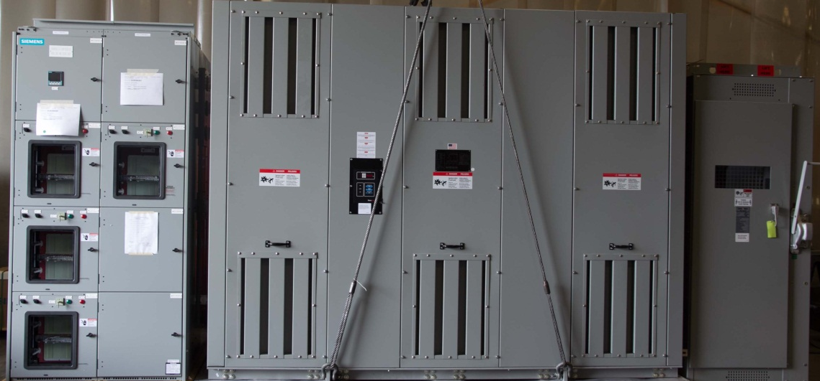
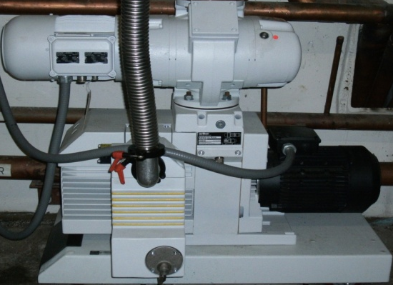
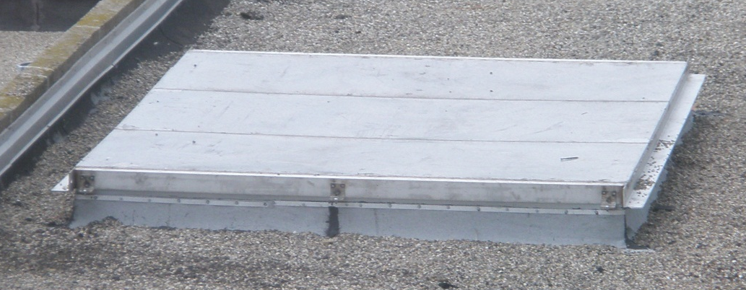
Linac Utilities
The Linac power distribution system is under powered, has obsolete parts and is largely buried in the Linac lower gallery – new system will replace only part of present system.
Critical vacuum systems update such as the LE roughing stations – along with flanges and valves.
Substation Enclosure >18,000 lbs
Will be lowered through hatch (FY15?)
Updated Roughing Pumps
Linac Roof Hatch

Slide 19
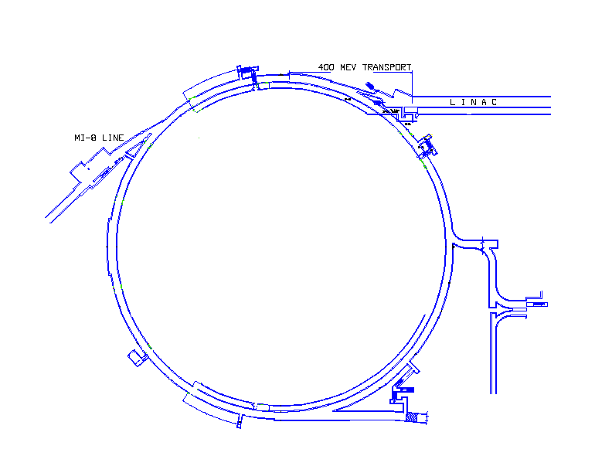
Booster PIP
15 Hz operation
  RF cavity refurbishment
  Bias Supplies
  Anode Supplies
Flux
  Beam Physics
    Optics and Alignment
    Cogging
  Notch System
  Collimation
  RF Harmonic
  Dampers
  Shielding
Reliability
  RF Solid State
  Low Level Upgrades
  RF Cavities and tuners
  Utilities (LCW, Power Systems, Vacuum)
  BPMs
Many tasks have multiple benefits - Reliability, Flux, 15Hz operation but also skills and accelerator technology
Booster

Slide 20
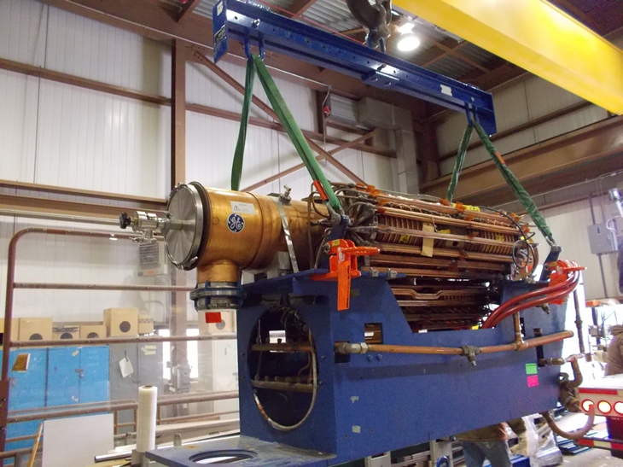
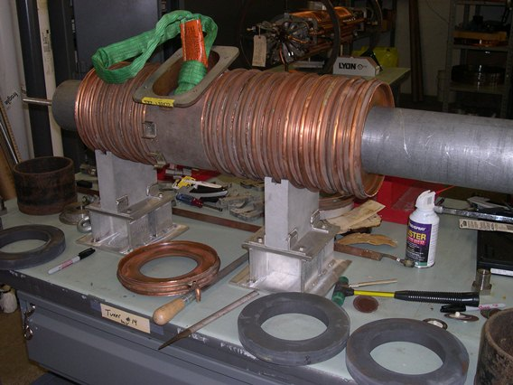
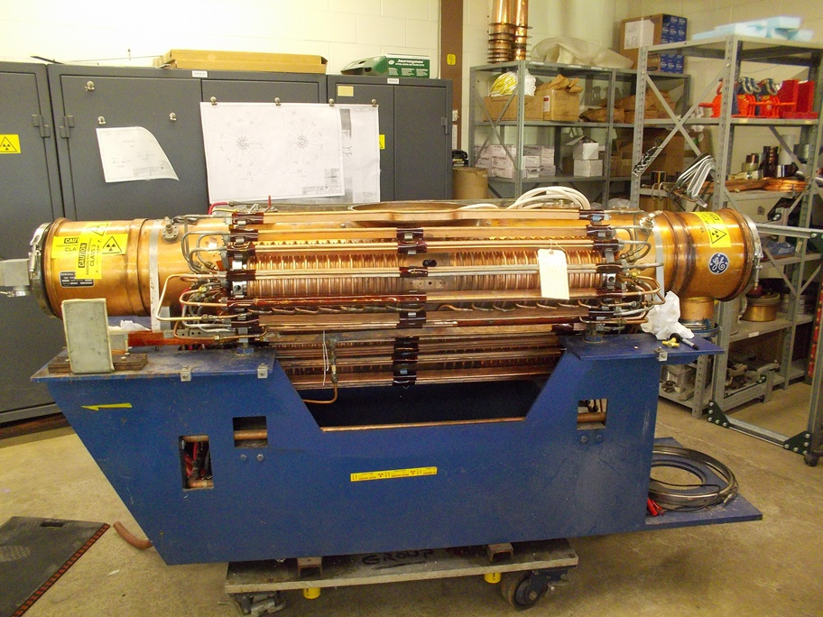
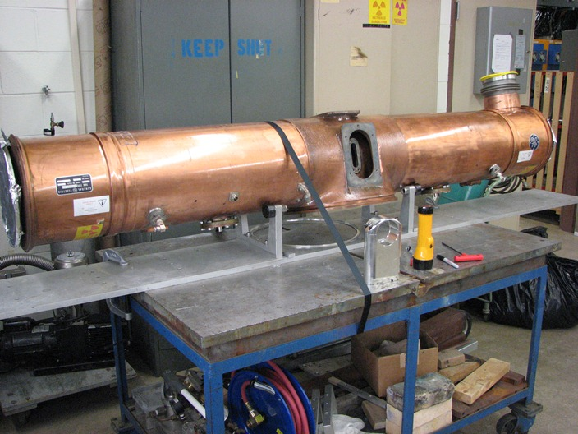
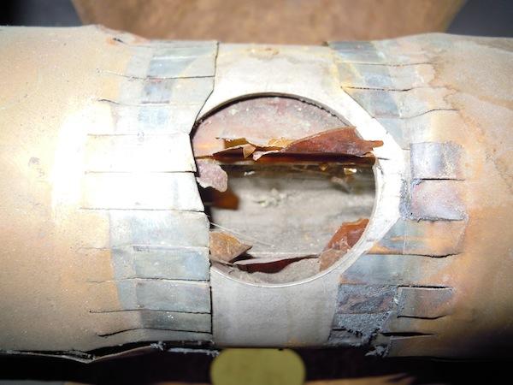
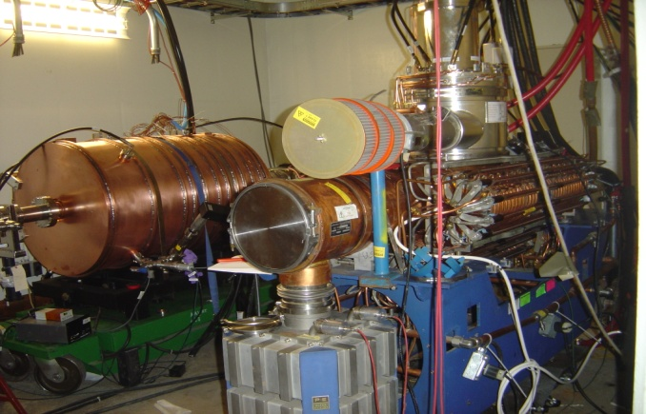
Booster PIP - Refurbishment of 40 year old cavities (facelift)
Weeks
Cool-down
Rebuild - Cones & Tuners
Re-Assemble
Remove Tuners
Rebuild Stems/Flanges
Testing
Cavity Removal
Cavity Removal - Stripping
Tuners Rebuild
Rebuild and Test

Slide 21
Refurbishment - continued
Fun Facts
You need all cavities in tunnel to be refurbished before higher rep rate operations
After refurbishment is completed – higher flux will require time
After refurbishment is completed – the cavities will still be OLD
There is likely to be failures as cavities are run harder
Talk at later date by Matt Slabaugh and John Reid

Slide 22
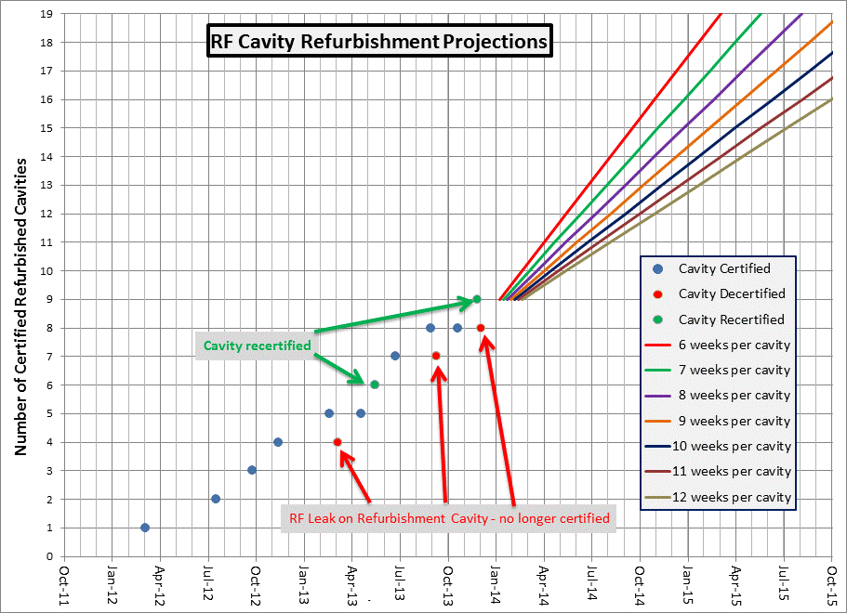
Booster PIP - Cavity Refurbishment Timeline
Presently we are at a 9-10 week per cavity rate:
The refurbishment rate has been consistent with allotted labor.

Slide 23
Anode Supplies and Bias Supplies (15 Hz operation)
Anode
Modern
Refurbishment
Bias
Transformer
Heat Sinks
LCW
Power Distribution
Solid State Drive System
East gallery complete
West gallery supplies work underway but slow – will be finished FY15
Design is nearly complete
Install this summer both
anode supplies: (EE / RF Dept.)
Completed
Completed
Completed

Slide 24
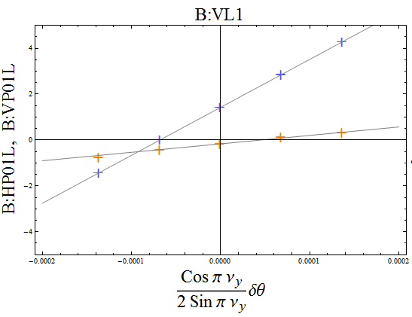
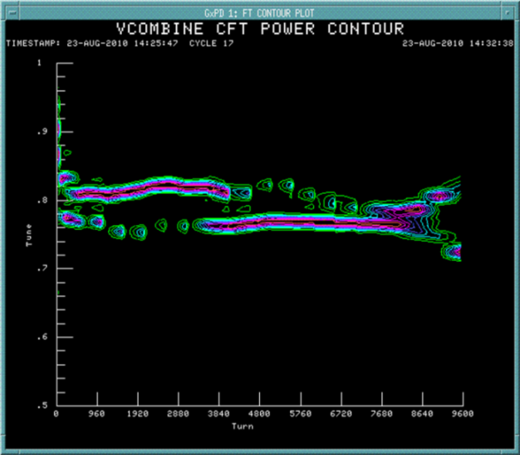
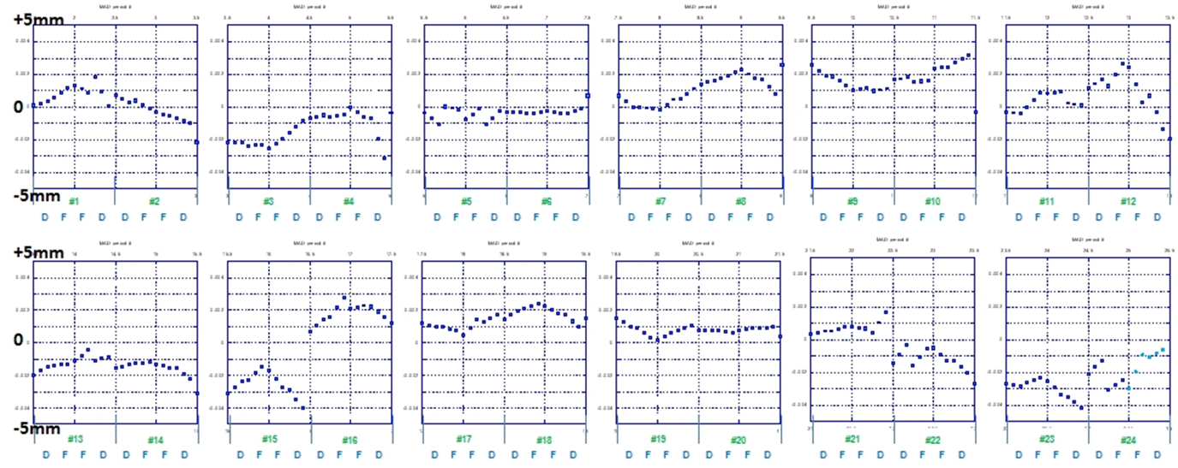
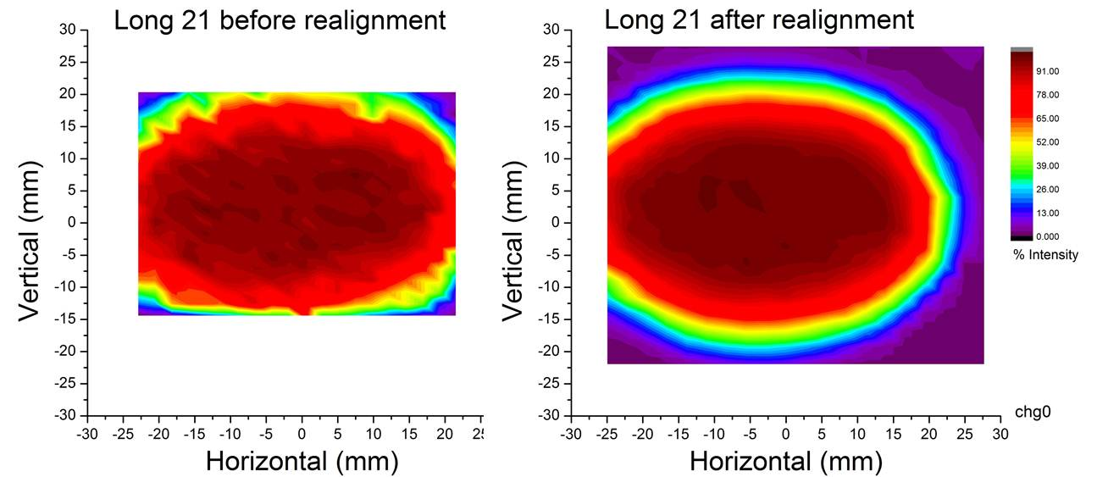
Beam Physics – Aperture, Tunes, Beta Beating, Coupling, Chromaticity and Orbit Control
Tune Control Through Cycle
Better tune control at high energy
Orbit response
Improve acceptance with goal of reducing beam loss
Two magnets were realigned prior to 2012 shutdown as a bench test to verify procedure
5 mm
0
-5 mm
Upper
Lower

Slide 25
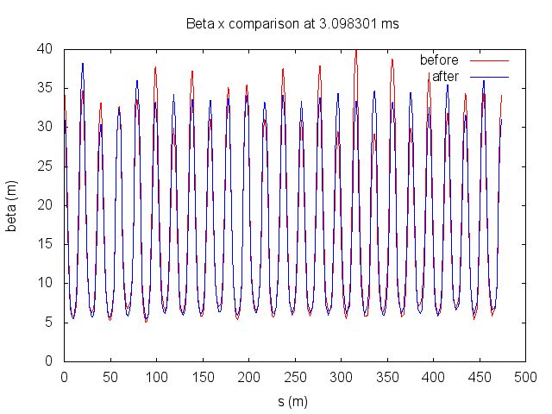
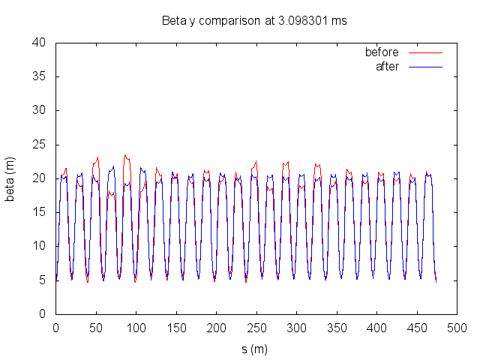
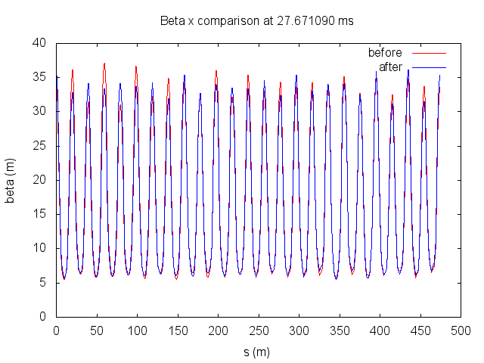
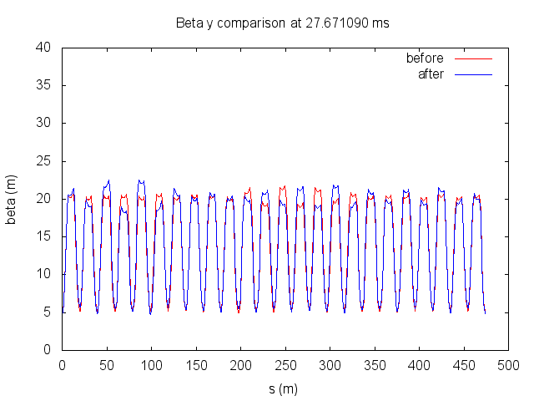
LOCO corrections – making progress on Booster Beta corrections
At injection
Y- Beta
H - Beta
At extraction
Y- Beta
H - Beta

Slide 26
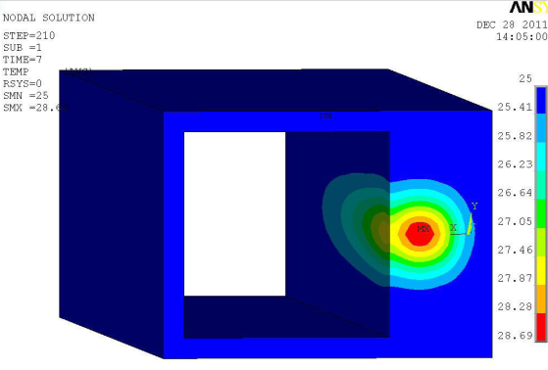
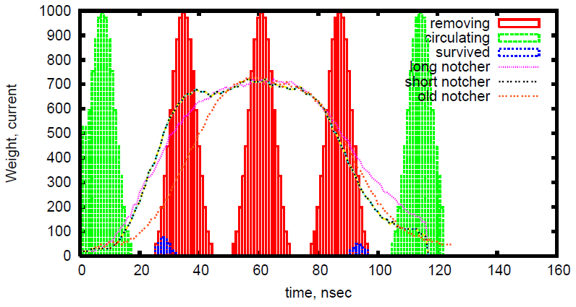
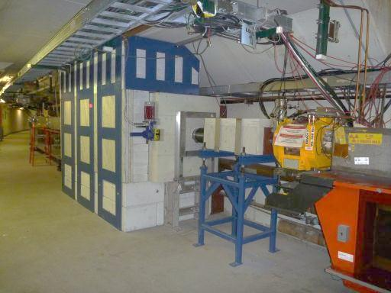
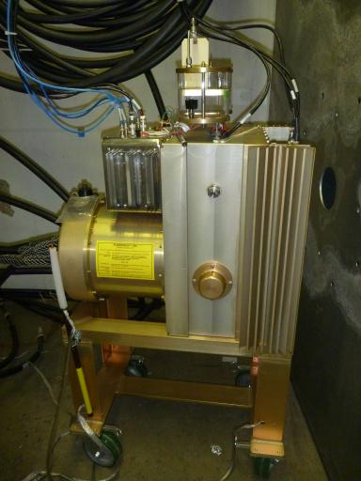
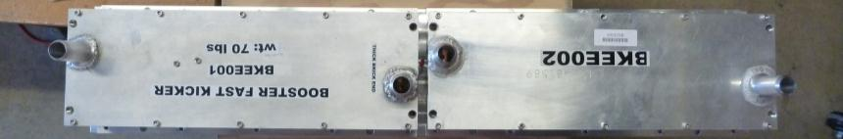
Booster PIP – Notcher & Absorber
The new absorber system is working well. Building of new PS and short kickers underway.
Power Loss
Bunches Removed
Absorber
The above plot shows current notch simulation
Shorter kickers will have faster rise times, cleaner notch and reduced kick on circulating beam.
Testing complete of 4 short kickers – 2 more later
New pulser
NOvA style
Booster Short Kickers – drop in replacements
1.1 Meter

Slide 27
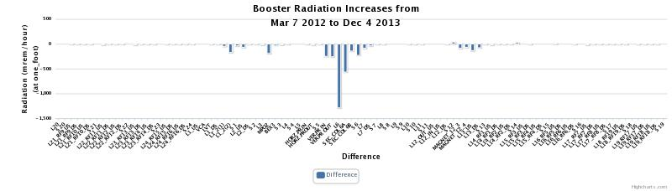
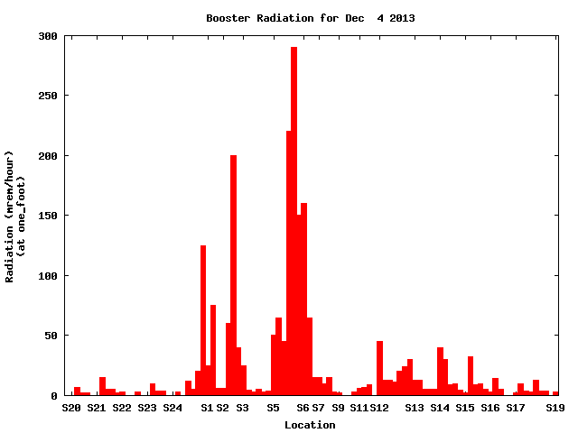
PIP – Booster Notcher & Absorber Continued
1500mr
Rad Survey Data
Dec 2013
The two plots show the difference between two rad surveys after running similar flux for a week. The new system has greatly reduced residual activation in several areas of Booster.
The new absorber system directs the beam to an absorber – old system was not designed for high flux and the kicked beam ‘notch’ into collimators was uncontrolled
Collimators
New Absorber

Slide 28
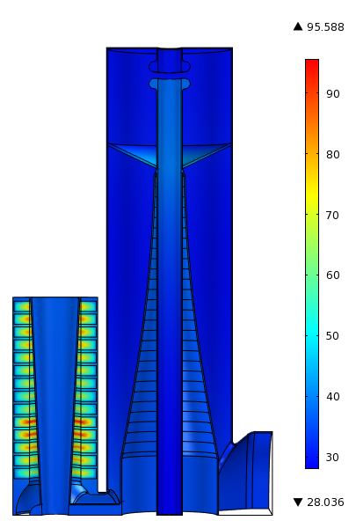

Booster PIP - New Cavities and Harmonic Cavity
Specifications for Design of New Accelerating Cavities for the Fermilab Booster underway with testing of current cavities to confirm modeling.
Harmonic cavity work is underway to help with beam capture, transition and possibly extraction.
  Based upon work at TRIUMF and LANL
  Simulations look promising
  University interest – Illinois Institute of Technology
55 KV,15Hz
Split Image view of Booster Cavity
Magnetic loss density (100 kV)
Thermal Profile (F)

Slide 29


PIP – Booster Solid State Upgrade Completed
With the completion of the SS upgrade, the Booster RF power system can now cycle at 15 Hz. Other expected benefits include higher uptime, lower exposure, ability to do beam loading compensation and lower operating cost by ~1M/year
Started in 2004 (1 cavity only) completed only after PIP initiated

Slide 30







Booster Utilities
Replacing Original Equipment
Vacuum:
Turbos, Roughing Stations, Ion pumps and Valves
2 Utility Substations (1000kva) Breakers & MCC
Roughing Station (1 of 4)
LCW: Valves, New plumbing, Pumps, Hoses, Bypasses in galleries and general repairs
New LCW Return System
Accessible Filtering
Isolation Valve
Isolation Valve

Slide 31

Booster Shielding
Goal – 2.7E17 p/hour
A Booster shielding assessment is underway:
Several rounds of scans have been performed
First round of analysis completed
Preparing for another set of measurements – based upon earlier results
Need to finish by FY15
Assessment Beam Parameters
Shielding Requirements
Longitudinal Shielding Summary
Transverse Shielding Summary
Labyrinths and Penetrations
Air Activation
Ground Water and Surface Water
Soil Activation
Muons
Residual Dose Rates
Active Shielding Controls

Slide 32


Slide 33
What is a project?
Angst of what is, and what is not a “project”
  Jargon of “project-lite”
DOE O 413.3b applies to only a very narrow subset of projects
  Large “acquisition of capital assets”, or construction projects
In general (outside of DOE-world), projects are efforts with a temporary existence and specific goals
  PIP is a project! (by any conventional definition)
So, how does PIP fit into our understanding of projects from DOE?
  PIP is supported by operations and applies to existing machines
  Previously, this may have been termed a campaign or program
Regardless of the above, PIP must implement a project management methodology to be successful, though not specifically covered by 413.3b
This will be an interesting (subjectively) study of how to manage a major project outside 413.3b

Slide 34
Managing PIP
Developed useful processes that are familiar, though different than 413.3b
  PIP Project Management Plan
    c.f. Project Execution/Implementation Plans
  PIP Design Handbook
    c.f. CDR / TDR
  Cost/Schedule
    Bottoms-up RLS
  Reporting
    Regular reports
    PMGs
Had input from lab management, DOE, project

Slide 35
PIP Development Timetable
August 2010 | Task Force Report
December 2010 | Proton Source Workshop
February 2011 | Proton Source Improvement Plan Proposal
August 2011 | 1st Proton Improvement Plan Manager Meeting
October 2011 | Proton Improvement Plan FY12 M&S Uploaded
January 2012 | Proton Improvement Plan Design Handbook
 | Proton Improvement Plan Management Plan
 | Proton Improvement Plan RLS Baselined
June 2012 | 1st Proton Improvement Plan Quarterly Report
August 2012 | 1st Proton Improvement Plan PMG

Slide 36

Report
Analyzed risks within the proton source
  Experts considered every system for reliability and maintainability through 2025
  Identified many vulnerabilities, assessed risk and costs of upgrades
  http://beamdocs.fnal.gov/AD-public/DocDB/ShowDocument?docid=3660
15 Hz pulse items were identified at this point, but the issues of increased flux were specifically not addressed
  Future users were still not so clear, nor how to pay for upgrades

Slide 37
Proton Source Workshop, Dec 2010
Discuss reliability, longevity, 15 Hz, and flux for two days
  https://beamdocs.fnal.gov/AD-private/DocDB/DisplayMeeting?conferenceid=114
  50 participants
  25 presentations
Combined with the task force report to produce the Proton Source Improvement Plan
  https://beamdocs.fnal.gov/AD-private/DocDB/ShowDocument?docid=3781
  Initial selection of scope for what would become PIP
PIP would eventually start that next fall (FY2012)
  Worked out how to manage the project
  Scope was refined, particularly for consideration of flux

Slide 38

PIP Project Management Plan
Derived from implementation and execution plans
  https://beamdocs.fnal.gov/AD-private/DocDB/ShowDocument?docid=4052
Spells out the basic practices for the project
Still run the project off of this document

Slide 39

PIP Design Handbook
Similar to CDR or TDR
  https://beamdocs.fnal.gov/AD-private/DocDB/ShowDocument?docid=4053
Has a description of scope for every item in the project and some estimates of cost and schedule

Slide 40
PIP Organization
Proton Improvement Plan
Bill Pellico
Bob Zwaska, Deputy
Ken Domann, Project Controls
Valeri Lebedev, Senior Physicist
Booster
Keith Gollwitzer
200 MHz RF Power System
Fernanda G. Garcia
High-Level RF
Jim Steimel
Linac Modulator
Trevor Butler
7835 Procurement Fernanda G. Garcia
Instrumentation
Craig Drennan
Utilities
Matthew Gardner
Power Distribution
Ryan Crawford
RF
John Reid
Anode Supply
Ryan Crawford
Bias Supply
Pat Sheahan
New Tuners
Matt Slabaugh
New Cavities
Tom Kubicki
Cavity 1013
Matt Slabaugh
John Reid
Accelerator Physics
Bob Zwaska
Booster Collimation
Valeri Lebedev
Radiation Shielding
Bill Pellico
Alignment & Aperture
Kiyomi Seiya
Booster Notcher
Salah Chaurize
Low-Conductivity Water System
David Hixson
Power Distribution
Ryan Crawford
Vacuum System
Dave Augustine
Solid State Upgrade
John Reid
Power Amplifier
Steve Kotz
Driver Module
Tom Kubicki
Cavity Test Stand
Pat Sheahan
John Reid
Linac Notch Creation
Dave Johnson
Simulations & Studies
Valery Kapin
Accelerator Physics
Valeri Lebedev
Vacuum System
Dave Augustine
Modulator
Rene Padilla
Installation
Rene Padilla
Steve Kotz
Instrumentation
Craig Drennan
Dampers
Nathan Eddy
Utilities
Todd Sullivan
Booster Cogging
Kiyomi Seiya
Beam Position Monitor
Nathan Eddy
Simulation & Studies
Bob Zwaska
Linac
Fernanda G. Garcia
Cavity & Tuner Refurb.
Matt Slabaugh
RFQ Injector
C. Y. Tan
Beam Position Monitor
Nathan Eddy
31 Subprojects
8 complete as of today

Slide 41
Within the Larger Organization
Director
N. Lockyer
Associate Director for Accelerators
S. Henderson
Legend
AAC
Reporting
Resources
PIP / Proton PMG
Advisory
Accelerator Physics Center
Computing Sector
Particle Physics Division
Technical Division
Accelerator Division
S. Nagaitsev, Head
Stakeholder Experiments
Proton Improvement Plan
Project Manager
B. Pellico
Deputy Project Manager
B. Zwaska
PIP Management Board
External Collaborators
WBS 1.1
Linac
F. G. Garcia
WBS 1.2
Booster
K. Gollwitzer
WBS 1.3
RFQ Injector
C. Y. Tan

Slide 42
Project Management Board
Stays in constant communication over all aspects of the process
  Technical – financial – managerial
Composed of project “office” & L2s
  Pellico, Zwaska, Domann, Lebedev, Garcia, Gollwitzer
    All part-time
    Team approach allows us to stand in for each other
  Previously also: Tan, Evans-Peoples, Convery (Webber)
Small, consistent group eases flow of information

Slide 43
Communications
Email lists
  PIP: proton_improvement_plan@fnal.gov
    Open list to anyone interested
  PMB: pip_management_board@fnal.gov
Regular Meetings
  PMB meets every week “briefly”
  General project/technical ~ biweekly
  Specific technical ~ biweekly
  AD management biweekly
  Financial monthly
  Lab PMG quarterly
Elog
Quarterly report submitted to lab management & DOE

Slide 44

PIP Documentation/Web
PIP Web Page:
Meetings
  Management
  Task Status
Documents
  Technical
  Managerial
Personnel
  Org Chart
  Email Subscription
Calendar
  Events
Upcoming Meeting Status
http://www-ad.fnal.gov/proton/PIP/PIP_index.html

Slide 45
Project Schedule - RLS
We currently have 31 subprojects being managed
  Most tasks have multiple charge codes
  Every task was reviewed, baselined, fully burdened and entered into the PIP RLS
Tasks were categorized then inputted into the RLS
    Present RLS has 2020 lines
  M&S
  Labor (by name, if possible)
  Milestones
  Constraints (engineering, external, funding)
Progress is reported monthly by individual tasks

Slide 46
RLS – Status Reporting
Last Monday of Reporting Month
Distribute status requests to L4 managers
First Monday of Next Month
Return status reports to L2 managers
Second Monday of Next Month
L2 managers assemble submit collated status reports to project controls
Middle of Month
Project controls processes reports and updates schedule
Wednesday Previous to the Last Monday of the Month
Present project schedule and budget summaries at PIP meeting
Reporting period of 1 month
  Balance between keeping up-to-date and overworking the system

Slide 47
RLS – Tracking Progress
Budget Reports
  Issued on a monthly basis from AD Headquarters
  Used to load M&S and SWF actuals into RLS
  Each month actual and status values are computed and compared to the schedule (EVMS quantities)
Effort Reports
  Issued on a weekly basis from AD Headquarters
  Compare labor effort to plan and verify SWF charges (people reporting appropriately)
  Determine FTE % to compare to labor allocations
    Useful in discussions with departments and divisions about labor
    Getting labor matrixed in to the project is often complicated and/or difficult
All reported at a monthly project-wide meeting

Slide 48
PIP Labor usage in FY2013
Example

Slide 49
Budgeting
A great difficulty for PIP has been how to account for budget and how the funding profile is managed
Budget methodology:
  PIP (with lab & DOE guidance) was initially budgeted with direct M&S and FTE counts
    Note: division budgets are in direct dollars
  Next iteration was with burdened M&S and FTE counts
  Finally, we settled on a TPC-like number of burdened M&S and SWF
Funding profile further complicated
  Translation between budget types was not obvious
  Profile changes several times a year
    We have to adjust schedule continuously
  What was initially a 5-yr project now appears to be 7 or 8
Financial support provided through the AD division office
  Meet on a regular basis and take part in all divisional and lab-wide budgeting exercises
  Budget authority list established for different level managers

Slide 50
Reviews
Various scales of technical reviews applied to efforts
  Major items get specific reviews with external panels
    For example: RFQ, L13 Absorber, klystron, cavities, …
  Numerous internal reviews of subprojects
    At specific or project-wide meetings
  Individual items are subject to engineering reviews, usually within their departments
Schedule and budget reviews held periodically within the project, usually by the PMB
  RLS was recently completely updated – review is pending

Slide 51

Collaboration
Technical coordination with other labs:
  BNL on RFQ Injector
  LANL on 200 MHZ power amplifiers
  SLAC on klystrons and modulators
  ANL on several items
Ideally, would collaborate with interested institutions from experiments
  Distributed a list with ~ 40 topics for collaboration to all relevant experiments
    Effort nature: Scientific, Technical, or Machining
  Some initial interest expressed
  A few pieces built at Virginia Tech
    Now hampered by DOE “loan” rules
  Few more collaboration items on the table, but has not really developed without a model / system for involvement

Slide 52
Conclusion
PIP has been proceeding since it’s startup in FY12
  Project structure built to suit
  Issues with funding have required flexibility and delays in the final PIP completion date
Several technical achievements already complete in the project
  RFQ, Solid-State, Notch Absorber, Utilities
  Laboratory prioritization will continue to be the determining factor in what PIP does and completion dates
  New Cavities
  Klystrons
  Linac Modulators

Slide 53
Upcoming PIP talks
Date | Speaker | Title
03/25/2014 | CY Tan, Fermilab | TBA
03/04/2014 | Matt Slabaugh & John Reid Fermilab | TBA
02/25/2014 | Linda Valerio, Ryan Schultz & Joe DeMarco Fermilab | Laser Welded Beam Tube: Testing & Application
02/18/2014 ** LOCATION: Curia II ** | Trevor Butler & Fernanda G. Garcia Fermilab | TBA
02/11/2014 | Dave Johnson, Fermilab | Linac Laser Notcher Project in the Proton Improvement Plan
02/06/2014 ** DATE: Thursday LOCATION: Curia II ** | Dan Bollinger, Fermilab | 35 Years of H⁻ Ions at Fermilab 03/25/2014

Slide 54
Xtra Slides

Slide 55


RFQ Injector Line
Beam currents
Operations since last May
Shows that we have used both sources
Lots of extractor sparking initially
Yellow = Source B Green = Source A
Note: HRM resets represent extractor sparks
Source B running well for 40 days with very little sparking < 2 sparks a day.
Higher arc current, cathode and body temps
Lower gas pressure
Increased arc current to `20A
Onset of sparking caused by gas pressure
Able to recover

Slide 56



Linac Beam Operations
Linac efficiency is higher with new source but we are/will be running at lower currents (RFQ design)

Slide 57


Dual Temp System
Booster Linac
02/04/2014 08/13/2011

