Slide 1
Linac Laser Notcher Project in the Proton Improvement Plan (PIP)
David Johnson, Todd Johnson, John Sobolewski, Fred Mach, Kevin Duel, Andrea Saewert
February 11, 2014
Accelerator Physics and Technology Seminar

Slide 2
Topics
Booster Notching
Current Booster Notching System
Laser Notching (concepts and benefits)
Location of current notching experiment
Photoneutralization
Requirements/Techniques for Laser Notching System
Laser System – design and status
Beam Shaping
Optical Cavity
Installation concept
Current Plans
Issues
Cost/Schedule
Summary

Slide 3
Booster Notching
Booster utilizes multi-turn injection of H- ions where the Linac pulse length is determined by N*τ_{REV} .
A “notch” must be created in the continuous Booster bunch structure to allow for the rise time of the extraction kicker. We need approx 40-50 ns notch.
Current technique is to use fast kickers in the Booster to remove a section of the Booster beam (40-50 ns out of ~2.2 μs) at an energy of 400 to 700 MeV and deposit it in a shielded absorber in the ring.
New system installed 2013… commissioning underway…..
→Next slide….

Slide 4
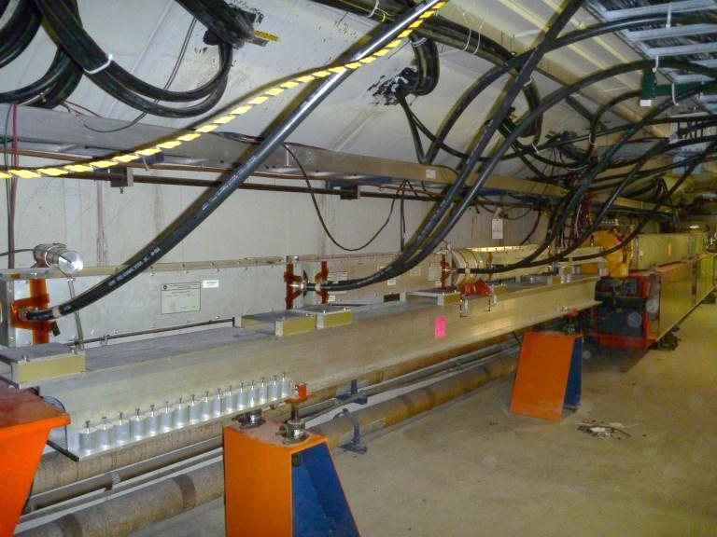
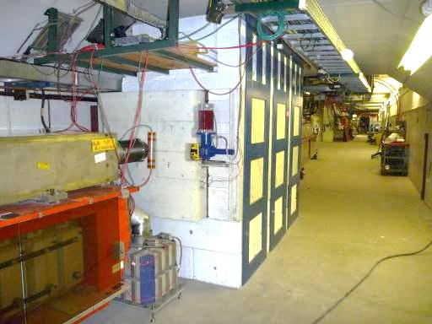
New Booster Notcher Tunnel Devices
Pictures courtesy of Salah Chaurize
Installed just this last shutdown (2013)
Commissioning underway
Kickers - Long 12
Since the Booster must increase its
throughput (x2) to satisfy new demands…
Absorber Long 13
We would like to create notches outside the Booster tunnel at an energy low enough to eliminate the activation of components entirely (i.e. 750 keV, the energy of the Linac RFQ). This is the basis of this presentation…

Slide 5
Laser Notching of Linac H-
Concept/History:
Removal of weakly bound outer electron by photodetachment using appropriate laser wavelength, temporal and spatial profile.
Concept proven by Ray Tomlin (circa 2001). Next slide…
Additional notcher proposals were described in 2005 by Xi Yang to notch the linac beam at the Booster injection RF frequency (FN-0765-AD) and at the revolution frequency utilizing a pumped recirculating cavity (FN-0767-AD). Neither of these proposals were implemented.
Most recently proposed by Bob Zwaska and further developed with input from a number of Fermilab colleagues , laser experts, and manufacturers.
Benefits:
Laser pulses may be formed to match bunch pattern (broad band
Fast rise time (may be tailored to individual bunches)
Doesn’t require high power pulsers /delay lines to create ns pulses
System can have a reasonably small footprint
Advances laser technology for accelerator applications (laser stripping, laser notching, laser chopping, photoinjector, laser diagnostics, etc…
++++

Slide 6
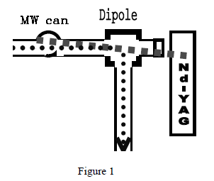
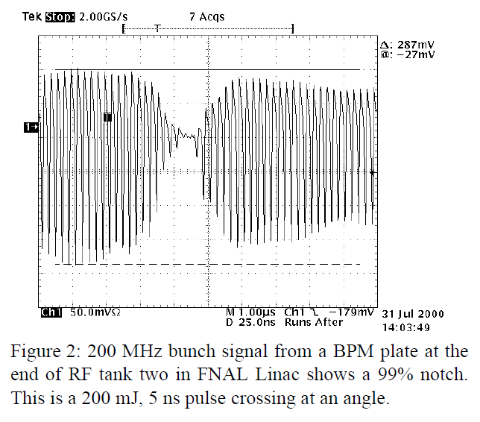
First Laser Notching Experiment
In 2001, Ray Tomlin reported on a successful experiment to create notches in the CW linac beam in the H- 750 keV beam line and have this notch survive at Booster injection.
He created a 25 ns notch utilizing a 200 mJ 5 ns laser pulse.
To create multiple notches in the linac pulse he
proposed a
“4 pass bow-tie cavity some 665 meters
long (with a storage time of 2.22 μs)”. Large Pockels
cells would shuttle the laser to and from the delay line.
A disk gain section would restore optical losses.
Average laser pulse energy of 103 mJ
Peak power of ~20 MW to strip 99.9% of the ions.
This was not implemented.

Slide 7
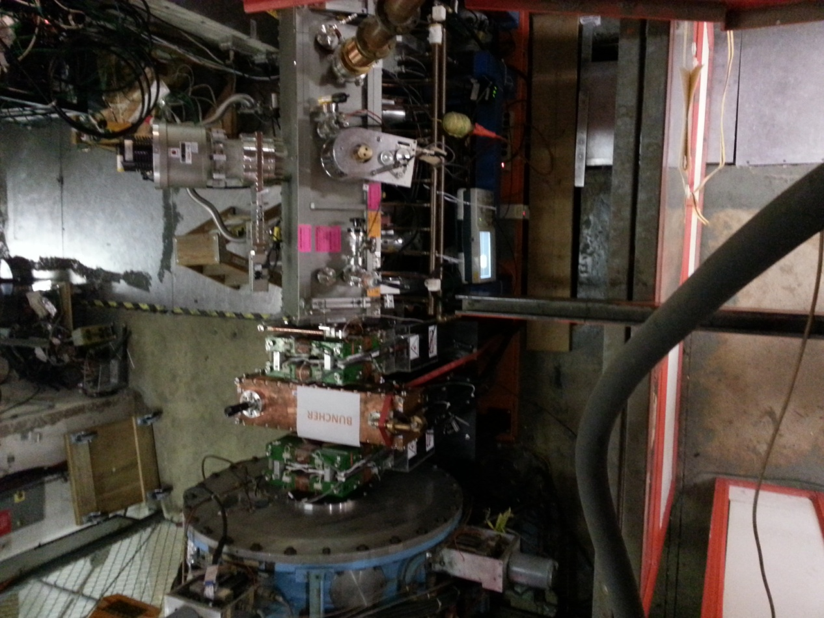
Location of Linac Notcher in PIP Era
Move loss due to notching OUT of the Booster tunnel
Minimum transverse size – bunched at 201.25 MHz
MEBT
RFQ

Slide 8
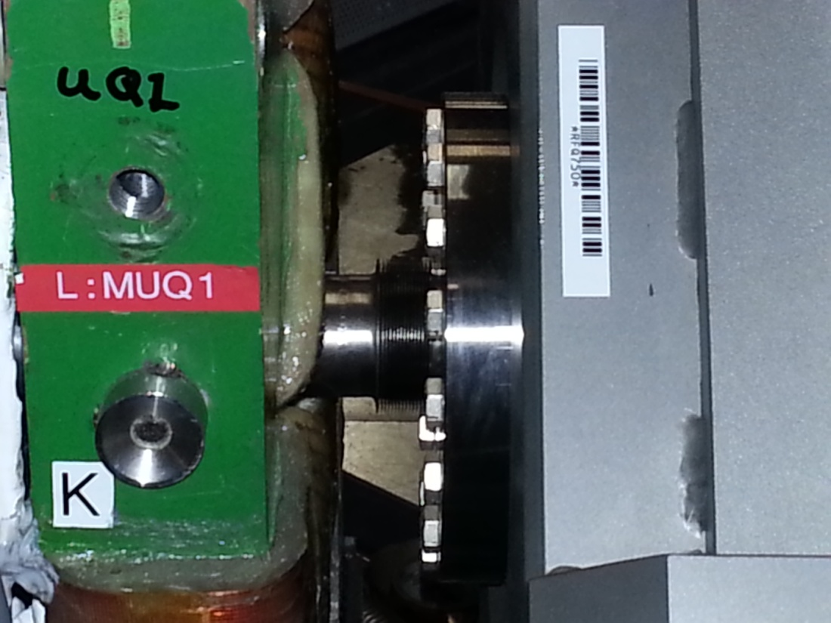
Location of Notcher
Must fit in this space

Slide 9
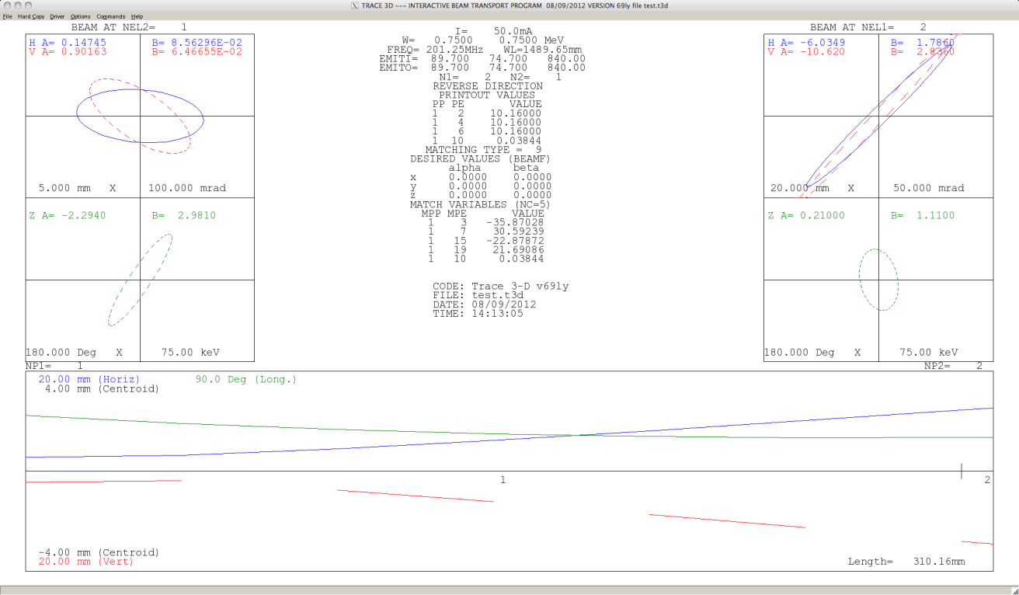
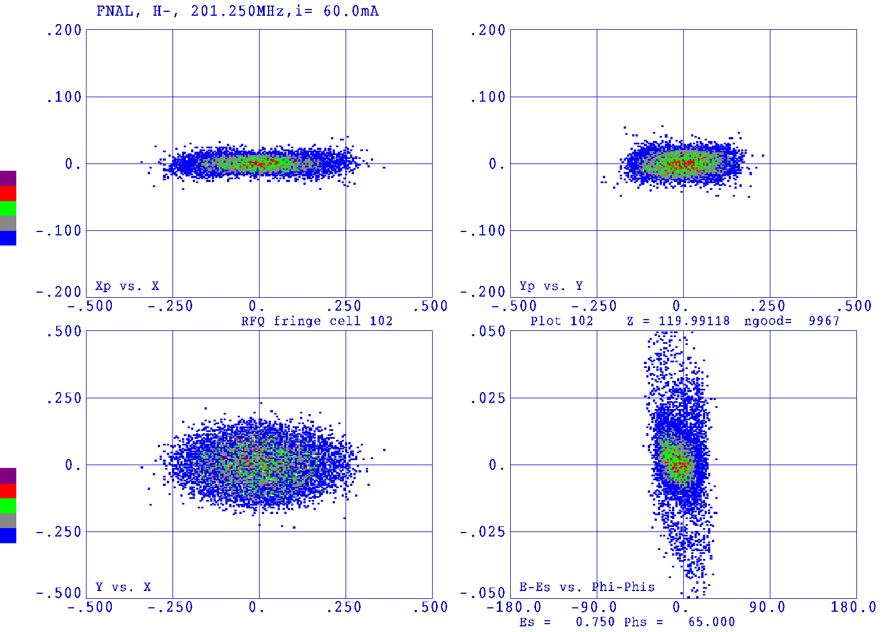
Expected Beam Dimensions
Phase space simulation at end of RFQ (figure 4.40 of 750 KeV Upgrade Plan)
Trace 3D back calculation of beam size at exit of RFQ based upon emittance measurement at 178 kW power August 9, 2012 CY Tan.
Laser beam vertical profile (1/e²) ~ 5 mm.
Initial design assumed that the vertical laser beam dimension of 1 cm.
Beam measurements indicate vertical laser size could be reduced to 6 mm

Slide 10
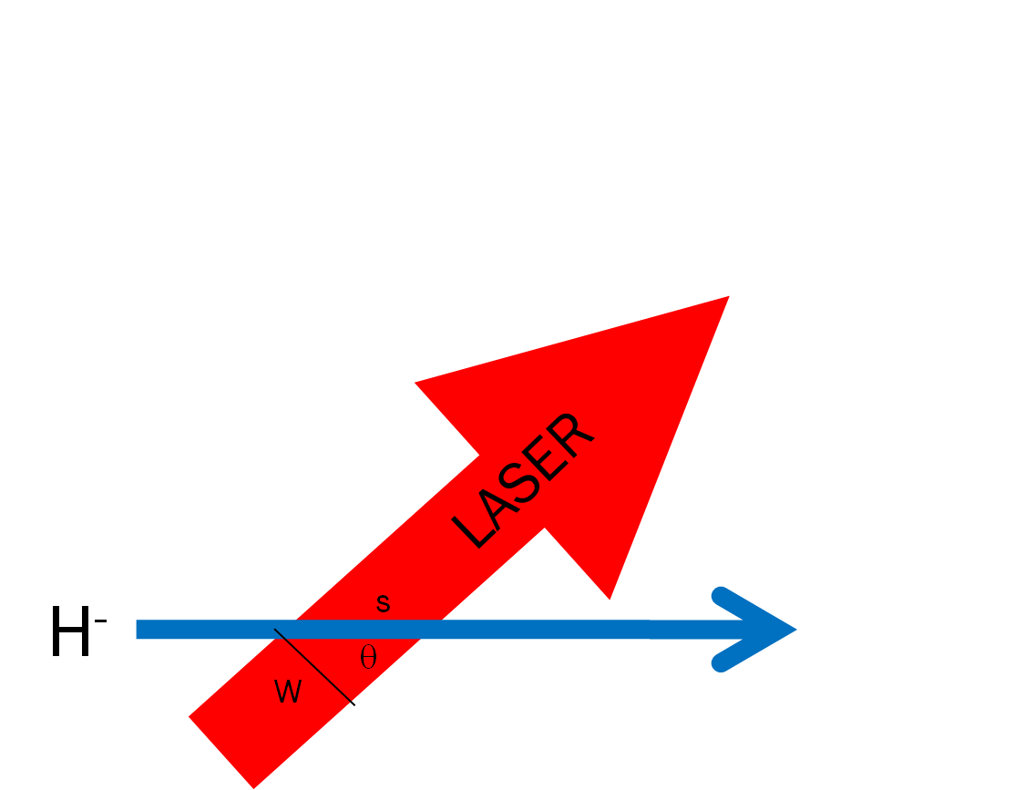
Photoneutralization (1)
The fraction of electrons that are detached from the moving H- ions is:
The photon flux (generated by the laser)
in the lab frame [photons/cm²/sec]
The photon flux in the lab frame is transformed into the
rest frame of moving ion as:
The interaction (crossing) time is just the ion path length/ ion velocity
The neutralization factor for an ion crossing on axis
of the laser beam may be written in terms of lab frame parameters
For θ ~ 90º term -> ~γ

Slide 11
Linac Beam Bunch Structure
~22-25 us
15 Hz macro pulse rep rate
MACRO
67 ms
2.2 us
450 kHz “notch” spacing
MINI (11 turns)
24.2 us (~ 11 Booster turns)
~bunch length
~5 ns (bunch spacing)
200 MHz bunch spacing
MICRO
10-12*5ns = 50 -60 ns
2.2 us

Slide 12
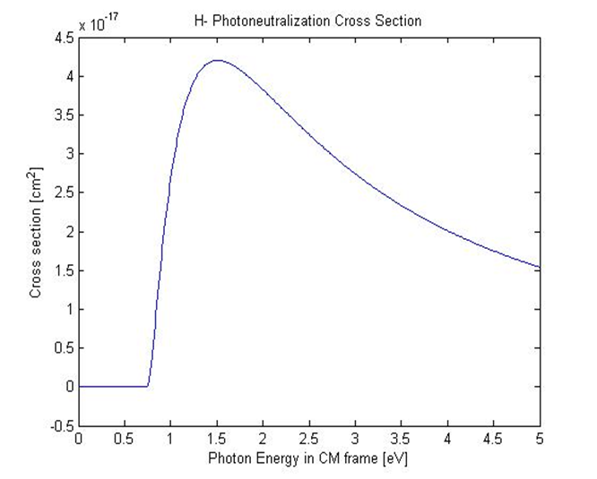
Photoneutralization (2)
fixed
To maximize the neutralization probability->maximize the product
To maximize
increase pulse energy -> minimize
reduce pulse length -> bunch length
reduce laser spot size -> ion size
Cross section 3.66x10⁻¹⁷ cm²
20-30 mJ
~1J
Assume:
Laser size 0.6x6mm
Rest frame energy 1.16 eV for
1064 nm laser
Assume:
Laser size 0.6x6mm
To maximize τ for a given H- ion energy
increase horizontal laser beam size or
increase the number of laser interactions
with the ion bunch
1.5 ns
60 ns

Slide 13
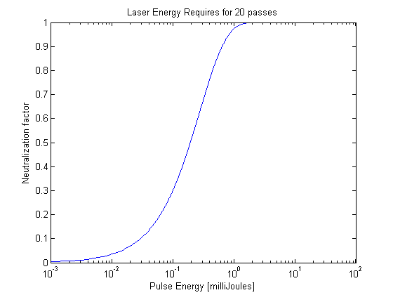
Reduction of Pulse Energy
To reduce the required pulse energy we can effectively increase the interaction time by utilizing an optical cavity such that the laser interacts with the ion beam multiple times.
H-
R. Shafer , 1998 BIW
Linear cavity (zig-zag)
2 mJ for 99.92%
Laser follows ion to interact many times (increase τ)
Cavity length proportional to number of interactions
Laser pulse length = notch length
Cavity dimensions determined by ion velocity and bunch spacing
Reduces required laser pulse energy by ~ number of interactions
20 reflections
Assume mirror reflectivity 99.95%

Slide 14
Requirements and Technique of Laser Notching of H-
Requirements
All ions in bunch should see the same photon density
The 201.25 MHz laser pulses must be phased with the RFQ
The laser pulse length > bunch length
Uniform temporal profile
The burst of 201.25 MHz pulses must match the Booster inj rev. freq.
The 450 kHz burst must have appropriate timing within the linac pulse
The pulse energy should neutralize > 99% of ions in each bunch
Technique
Utilize a CW seed laser and wave-guide modulator to create required laser pulse pattern (both 200 MHz and 450 kHz) at low pulse energies (pJ)
Amplify pulse pattern using a three-stage fiber amplifier (nJ to uJ)
Further amplify using a free-space solid state amplifier (mJ)
Create a spatially uniform photon beam
Insert laser pulse into a linear zig-zag interaction cavity where the laser reflections inside the cavity match the ion velocity
to reduce required pulse energy by the number N of reflections in the cavity.

Slide 15
Burst mode seed pulses to Fiber Amplifier followed by Free Space Amp
λ₁=1064nm
120 mW CW
SW=0.1 nm
Output modulator/Input fiber pre-amp:
201.25MHz pulses (1.25 ns pulse), 458kHz burst
10 GHz Mach-Zehnder
Modulator
L_{i}~1.8dB
Isolator
PM Fiber
Diode + TC
controlled
L_{ins} ~5dB
Pulse Generator
Amplifier, Timing
Line filter
Fiber Amp 2
Fiber Amp 1
Free
Space
Fiber Pre-Amp
*Notch 12 bunches -> 60 ns
10 notches/linac pulse
Clean up filter
Generate 24 us burst at 15 hz
Pulsed at 15 Hz
15 Hz
Free Space Amp
AOM
Grumman CEO DPSS OEM
TRANSPORT BEAM SHAPING OPTICS & OPTICAL CAVITY

Slide 16
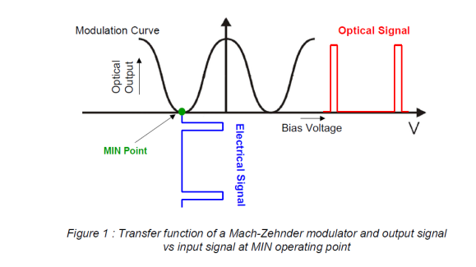
Optical Pattern Generator
Pulse on/off extinction 30 dB
Input: 100 mW CW
Output: 54 pJ (1.5 ns/200 MHz)
294 uW avg power at 450 kHz

Slide 17
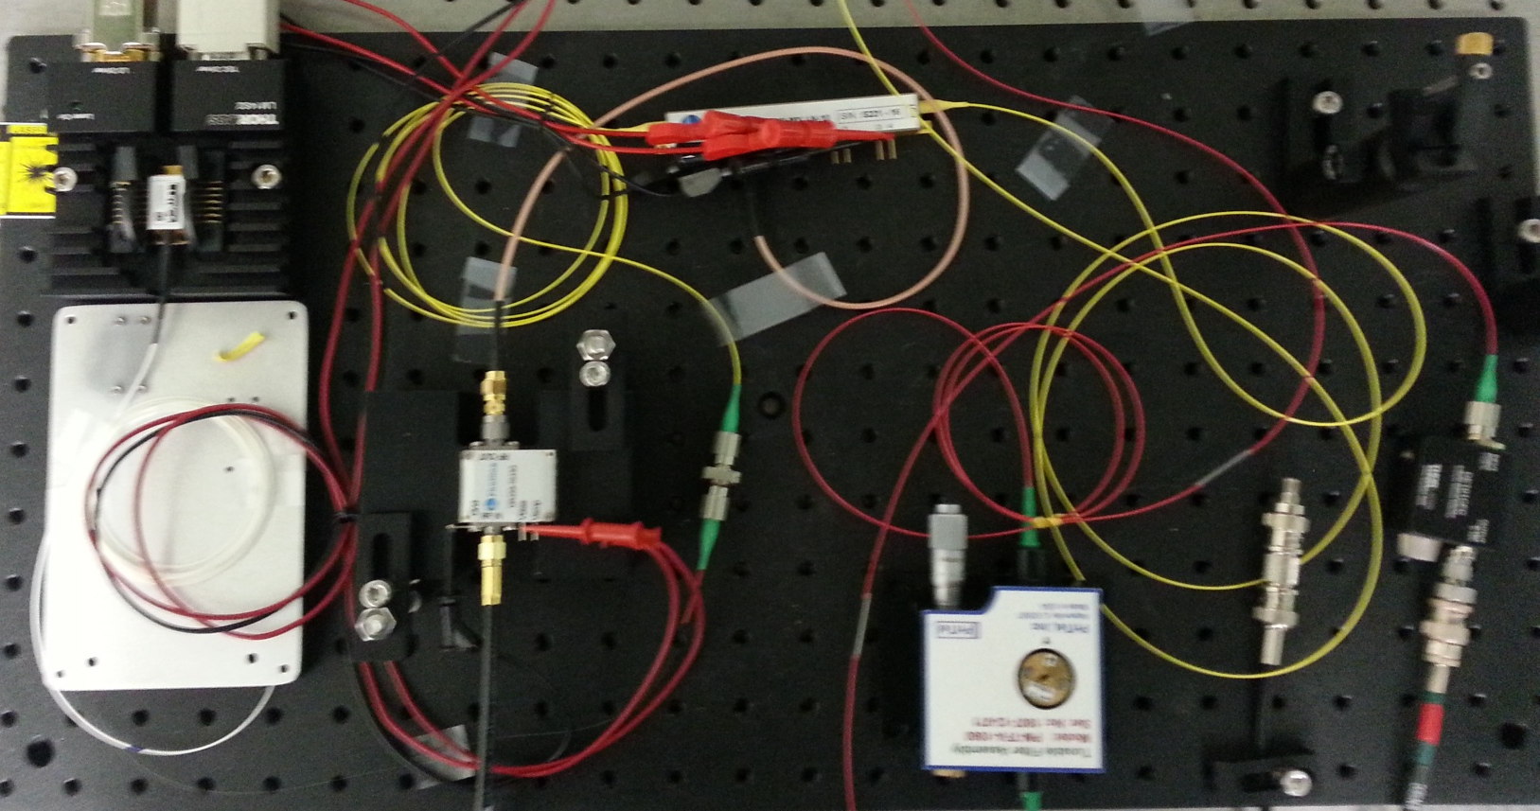
OPG Fiber Amp Components on Bench
P.S. for RF Amp
Fiber Pre-amp
Diode/TEC power supply
Safety System interface
Modulator Bias Controller
Fiber Amp 1

Slide 18
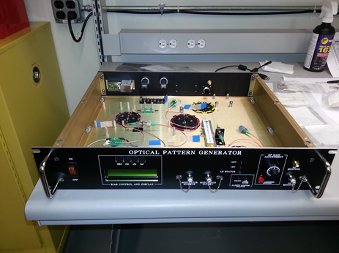
New OPG module
Andrea Saewert

Slide 19
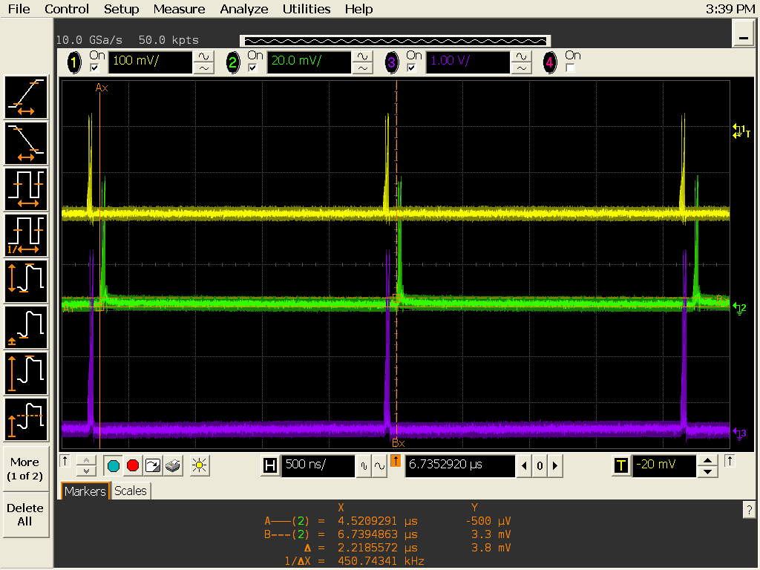
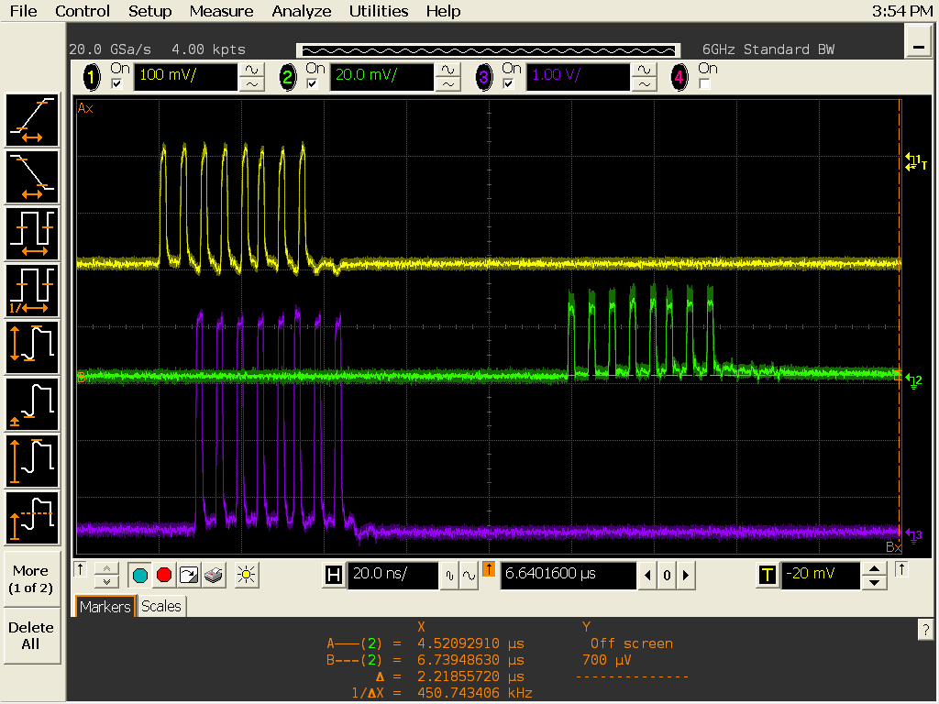
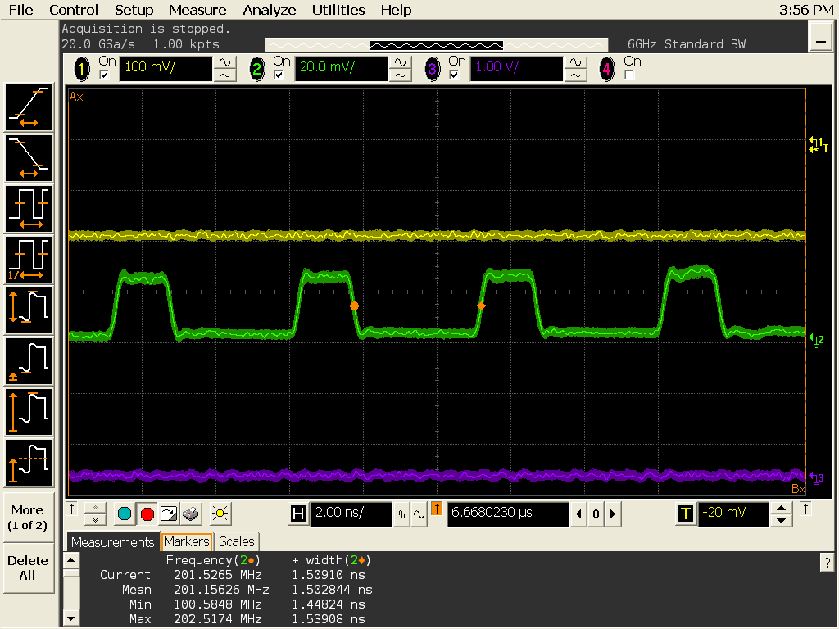
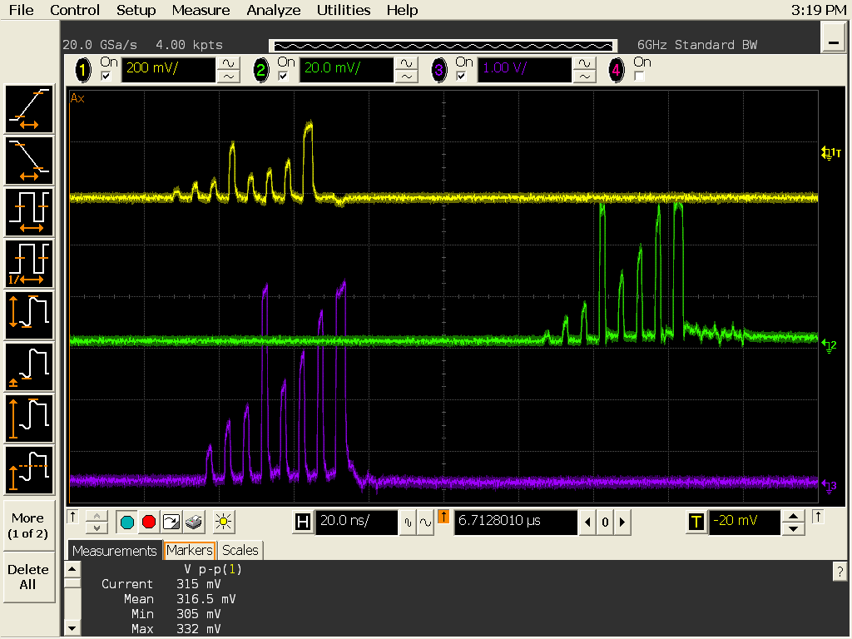
Optical Pattern Generation
Yellow- AWG
Purple- RF Amp out
AWG: Chase Scientific DA12000 & CG6000 module
Green – signal form 1.2 GHz (free-space)PD →laser pulses out of fiber pre-amplifier
450.75 kHz burst of 201 MHz pulses
One set of 201.25 MHz pulses
Individual 201.25 MHz temporally uniform pulses
Pre-distortion of EOM pulses

Slide 20
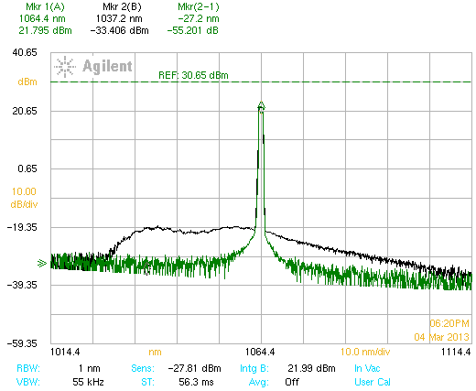
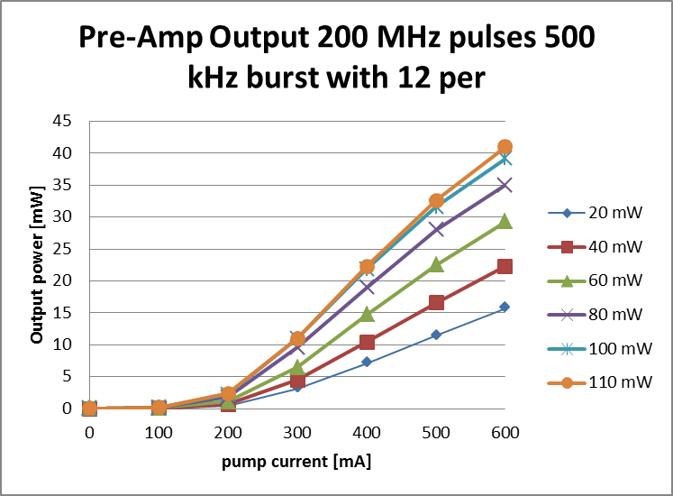
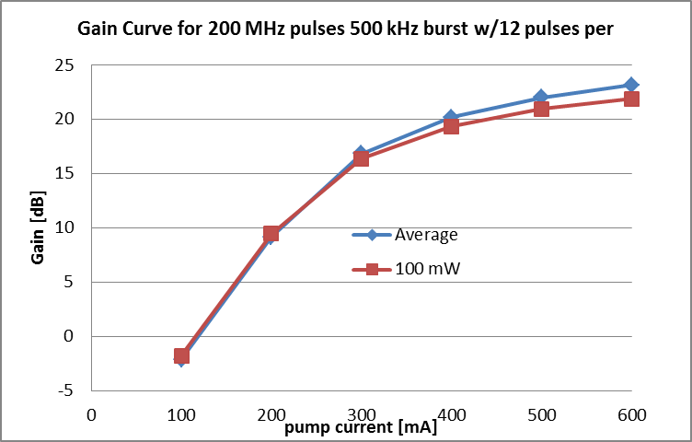
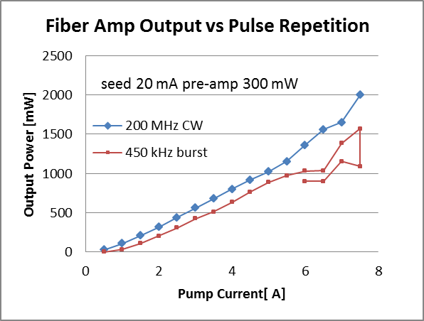
Fiber Pre- Amplifier System
PriTel
Gain 17.2 dB
Output 385 nJ
2 W
amp
Input 54 pJ
294 μW
Gain 23 dB
filter
Output 100 pJ
590 μW
Gain fiber is Yb doped
6mm core/125 um cladding
System to be re-package in 19” rack mount with
Computer control/readback and “auto shutdown” for YbFA-33 amplifier.

Slide 21
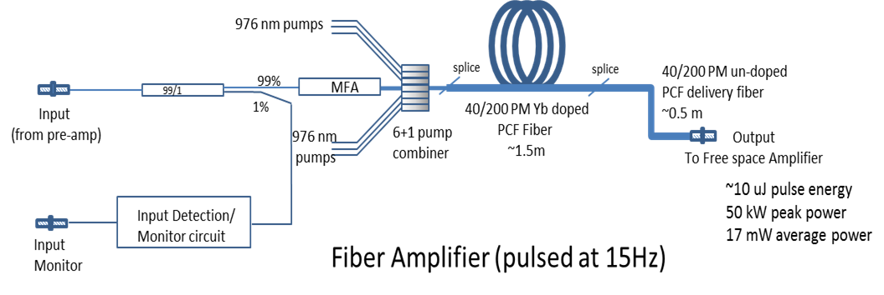
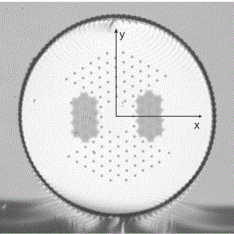
Fiber Amplifier System
Optical Engines
System on order- due for delivery later this month.
Input 363 nJ 1.96 W
Gain: 14.5 dB
Output to include mode
stripper (to remove any pump
light) and optics to match
into first FS amp.
Single mode, single polarization
Small NA (~0.03)
Large mode area
High peak power levels
High pump absorption (~10 dB/m)
High reliability
Micrograph of PCF fiber

Slide 22
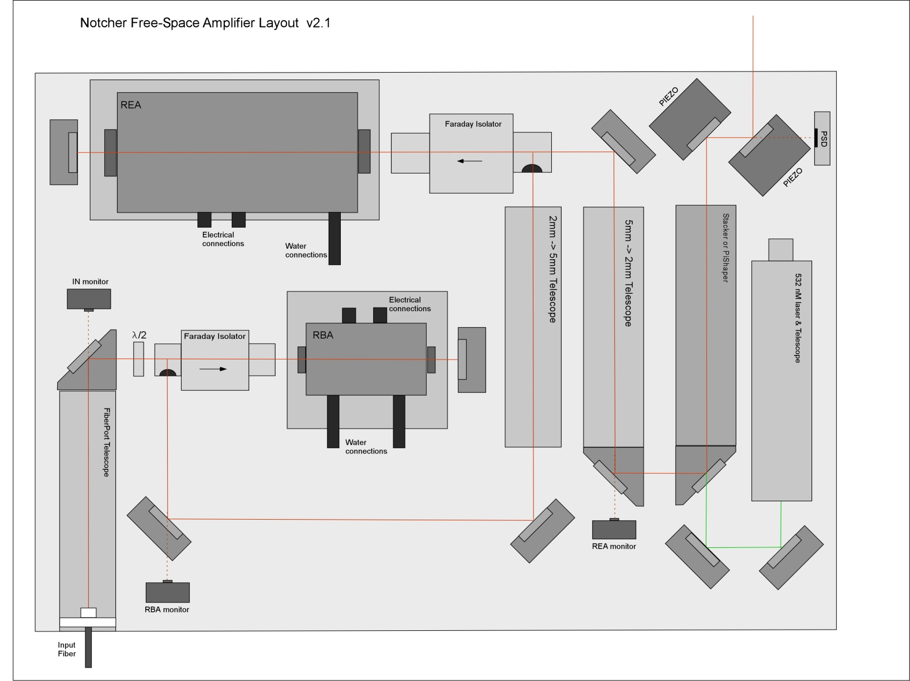
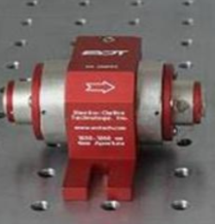
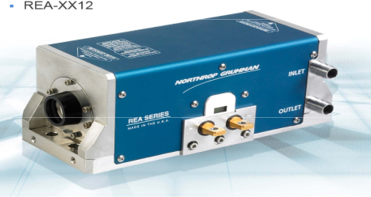
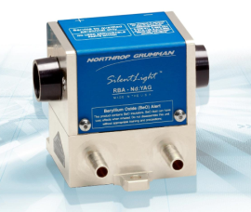
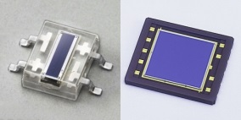
Free Space Amplifier System
Current design -> could change depending of fiber amp performance
Pulsed at 15 Hz
Gain: ~ 23 dB (total for both modules)
Output: 2 mJ 10 kW (450 kHZ) 3.2 mW (15 Hz)
To Optical
Cavity
80
Faraday Isolator
to protect previous
stage and aid in
double pass operation.
9
Class 4 laser system
Difficult to operate
with lid off
Need to heavily
instrument
1D & 2DPSD
Input: 10 uJ 55W (450 kHz) 16 mW (15 Hz)

Slide 23
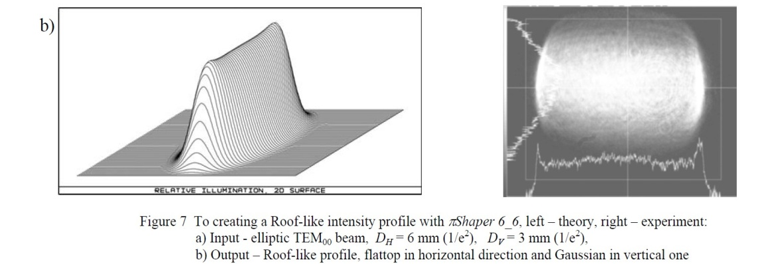
Beam Shaping (modification of the transverse beam profile in the optical cavity)
We would like to demonstrate > 99% neutralization efficiency for all ions in the bunch, therefore we would like all ions to “see” the same photon flux regardless of their transverse amplitude. (i.e roof-top laser profile)
The vertical size of the laser beam should be ~ > 6σ of the ion bunch or about 6 mm (the horizontal size should be < 1 mm
We have investigated two techniques to create this roof-top profile through the interaction cavity.
πShaper – refractive beam shaping optics
Beam stacker – splitting a Gaussian beam into H and V polarized beams with a birefringent crystal, a technique proposed by Todd Johnson

Slide 24
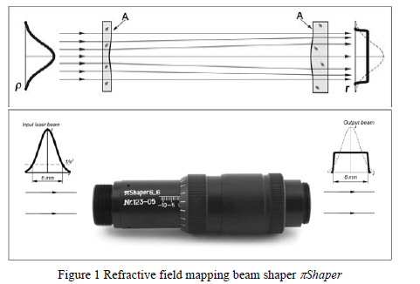
πShaper (AdIOptica GmbH)
Refractive optical system
Output beam is free of aberration
Collimated output beam
Resulting beam profile is stable over large distance
Galilean design

Slide 25
Beam Shaping w/ πShaper… the layout
Cylindrical telescope
532nm diode
Input πShaper
πShaper
Output πShaper
Output Anamorphic prism

Slide 26
πShaper Propagation
Intensity distribution varies with distance due to diffraction effects.
For visible light and flattop beam diameter of 6 mm the distance where the deviation in uniformity doesn’t exceed +/-10% is about 200-300mm.
This distance is inversely proportional to wavelength -> for 1064 nm we should expect only 120 to 180 mm.

Slide 27
πShaper Propagation
We think this would work, but…
We would like to do better that this for propagation of a uniform profile….

Slide 28
Beam Stacker Concept (Todd Johnson)
Based upon a birefringent
crystal where the index of
refraction is dependent on
polarization
Here the half-wave plate
rotates linear polarized
beam to 45º and the crystal
displaces V pol and H pol
remains un-deflected.

Slide 29
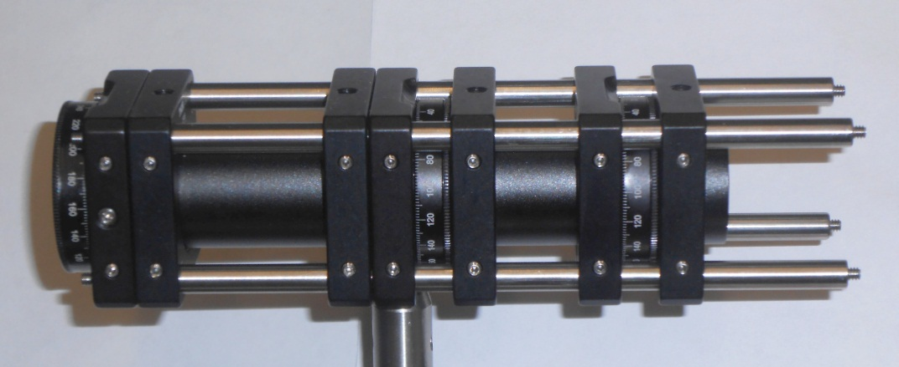
Layout of the Beam Stacker

Slide 30
Telescope to Match Diode to Stacker
We use CW diode to test the beam stacker concept.
Ultimately the input to the Stacker will be from the Free Space Amplifier.
Since the output of the Free Space Amplifier will have a 1/e² diameter
of 5.1 mm we will need a telescope to match the stacker.

Slide 31
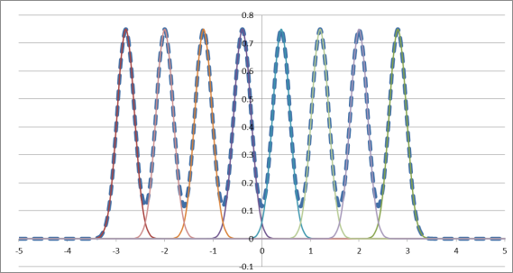
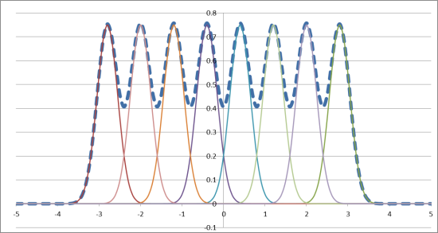
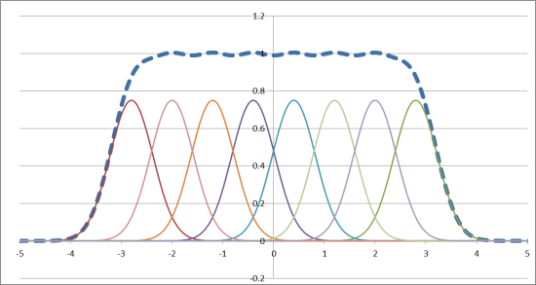
Beam Stacker – merging beamlets

Slide 32
Beam Stacker - Propagation
Represents 6 mm
vertical dimension
with constant intensity

Slide 33
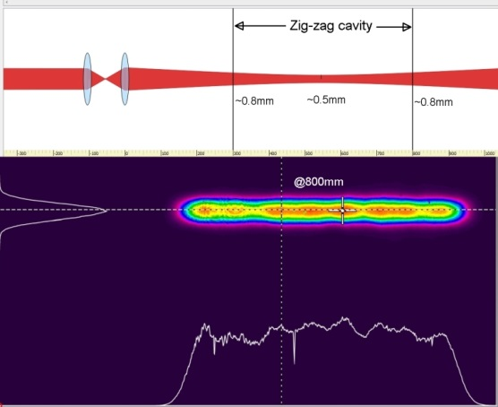
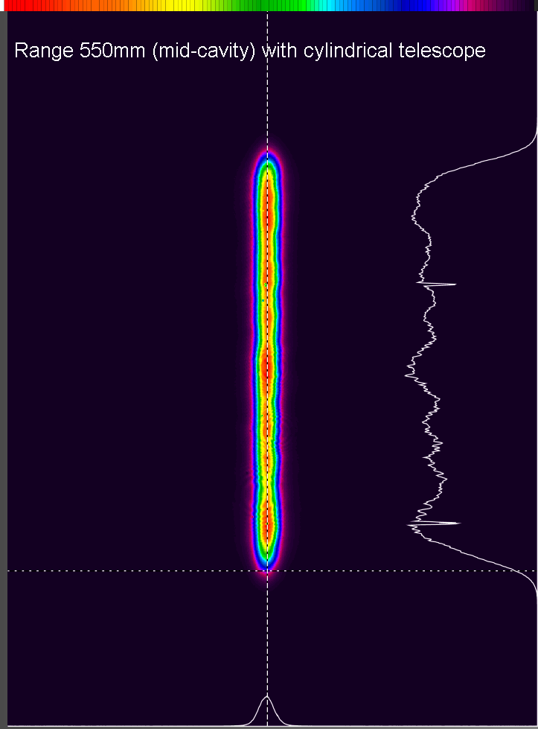
Add Cylindrical Telescope to Stacker

Slide 34
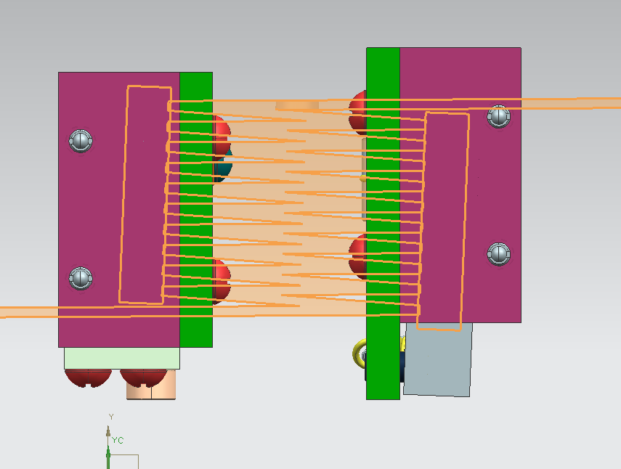
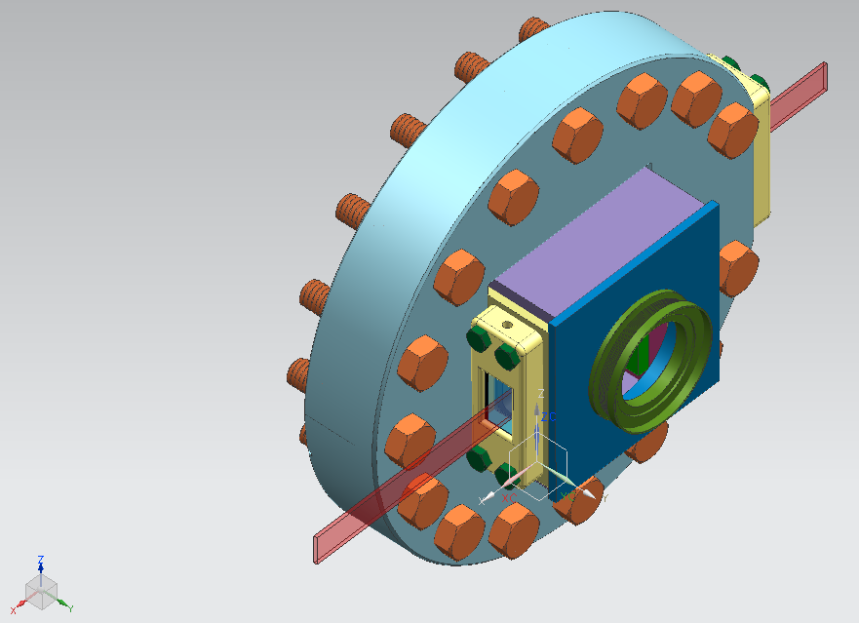
Optical Cavity
John Sobolewski and Fred Mach
Mirror separation matched to ion velocity
H⁻
Mirrors at 2.288º wrt H- beam
showing 21 interactions
Laser Input
Laser output to dump

Slide 35
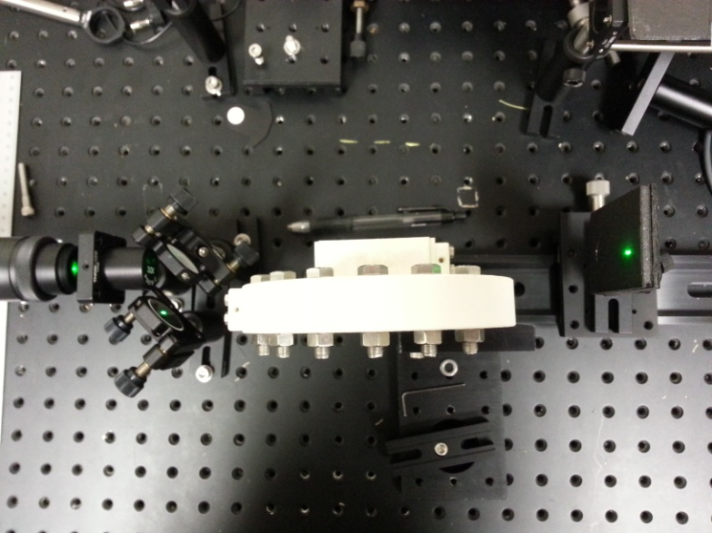
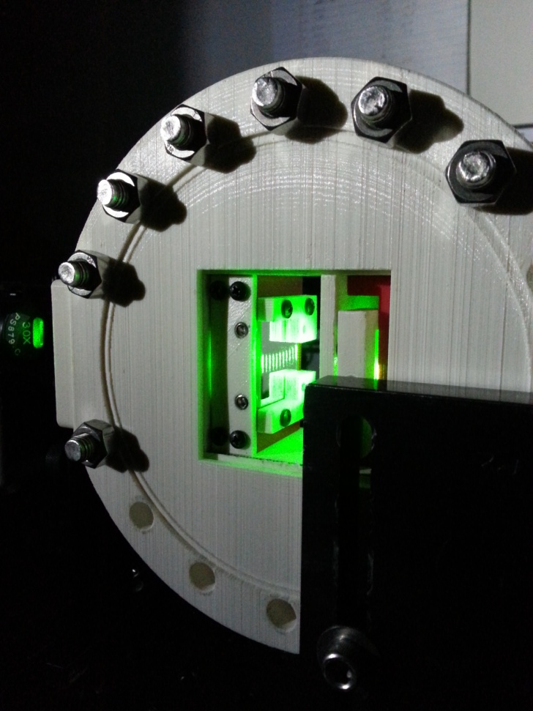
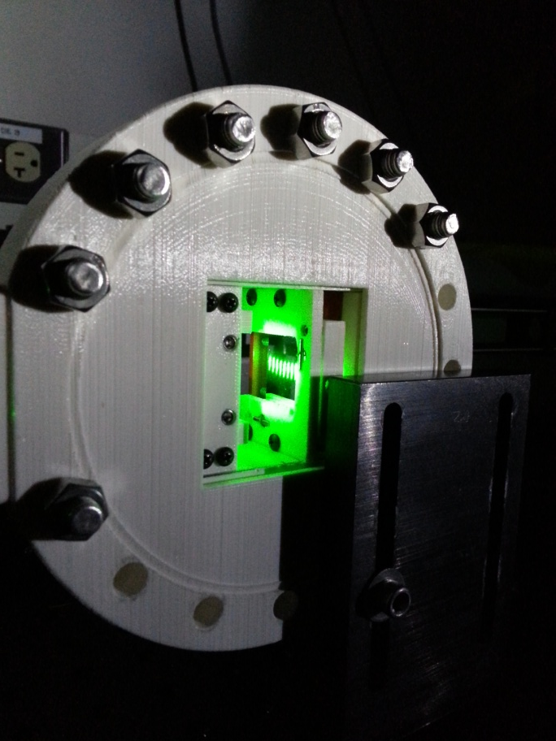
Optical cavity tests
Test set-up
Fixed mirror
Moveable mirror

Slide 36
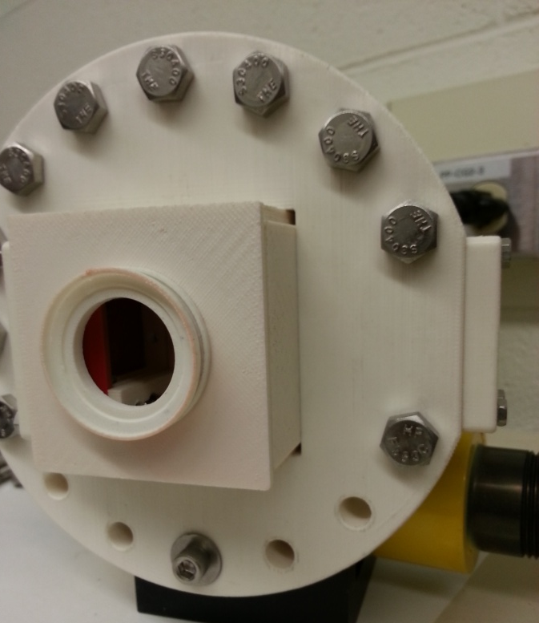
Optical Cavity prototype
We printed a 3D model to test design
This was very useful as it pointed out several
improvements/modifications to the design.

Slide 37
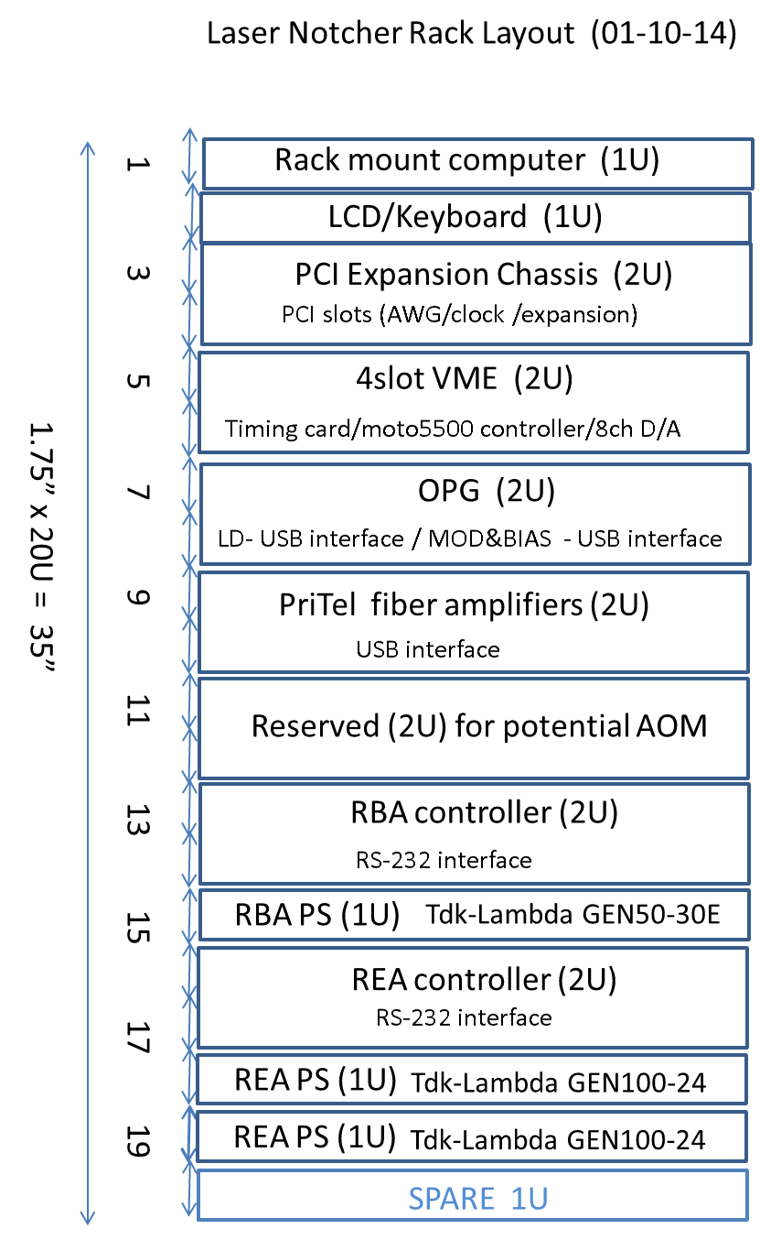
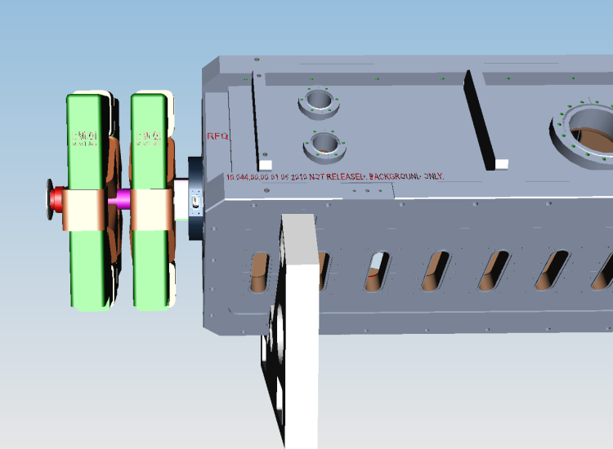
Installation
……. Currently set for April 2015
Optics Box sits on top of rack
Free space laser
completely enclosed
Issues:
Moveable for MEBT maintenance
Electrical requirements
Cooling requirements
Effects of ion source sparking

Slide 38
Near term Plans
Goal complete laser in LAB end of FY14
Finish packaging OPG and test end of Feb
Repackage Fiber pre-amps(s) end of Feb
Receive Fiber Amplifier end of Feb
Test Fiber stages with OPG mid March
Determine FA output to determine FS
Finalize design of Free Space Amplifier end March
Order components for amplifier (14 week delivery for amp modules)
Continue optimization of Beam Shaping on going
Start diagnostics electronics design May
Finalize mechanical design of Optical Cavity
Generate manufacturing prints mid April
Construct optics box stand and relay rack mid March
Continue discussion on timing system

Slide 39
Issues
Notch survivability in Booster (see next slides)
Start of RF capture
Capture parameters
Not achieving design pulse intensity (next slides)
Reliability of system
Impact of ion source sparks on electronics - TBD
Portability and alignment
Pre-distortion of laser pulses for fiber and DPSS stages
Impact of optical cavity in quad fringe field
Estimation shows it to be not a problem
Simulation electron trajectories by Vladimir Kashikhin

Slide 40
200 MHz bunches in Booster
Chandra Bhat
Evolution of 200 MHz bunches
during 17 turn injection
Assume full energy spread
of injected beam +/- 0.6 MeV
Momentum Spread*
$$\frac{dp}{p}=\frac{1}{β^{2}}\frac{dE}{E}$$
$$\frac{dp}{p}=0.18\%$$
*Measured value in Booster
Total time ~ 53 ms
injection

Slide 41
Evolution of the Notch in Booster
Total of 17 turns injected
over ~ 34 us
Total time ~ 53 μs
of simulation

Slide 42
Neutralization vs Pulse Energy
Design value

Slide 43
Budget
WBS | TASK | M&S* | contingency
.01.02.03.01 | Initial Design | $0
.01.02.03.02 | Optical Pulse Generator | $35,000 | $6,000
.01.02.03.03 | Fiber Amplification Stage | $100,000 | $16,000
.01.02.03.04 | Free-Space Amplification and optics | $160,000 | $40,000
.01.02.03.05 | Optical cavity and vacuum chamber* | $20,000 | ---
.01.02.03.06 | Beam shaping/transport/diagnostics | $25,000 | $5,000
.01.02.03.07 | Timing and Controls | $24,000 | $10,000
.01.02.03.08 | Installation | $18,000 | $6,000
.01.02.03.09 | R&D Lab supplies and materials | $7,750 | ----
 | TOTAL (*unburdened) | $389,750 | $83,000
“Contingency” numbers are amounts above what we “expect” to spend
in each of the Tasks… but then there are unforeseen expenses
We have obligated ~$192K to date. The next largest purchase will be for
the free-space amplifier and associated optical components (est. to be ~< $100K).

Slide 44
Schedule

Slide 45
Summary
We have described our motivation for moving the process of notching outside the Booster tunnel.
We have described the requirements for the laser system to create the notches.
We have described the laser system design to accomplish the goal of creating notches.
We have described the status of the components and system.
We have the front-end laser system with the final fiber amplifier on order and are in the process of R&D on beam shaping and working on the final design of the optical cavity.
We would like to have laser system operational in lab by end FY14.
The current plan is to install the system in Q2 of Fy15.

Slide 46
Acknowledgements
Dave Baird
Dan Bollinger
Ken Domann
Fernanda Garcia
Mike Kucera
Ray Lewis
Bill Pellico
Peter Prieto
Matt Quinn
Jinhao Ruan
Jamie Santucci
Vic Scarpine
C.Y. Tan
Bob Zwaska

Slide 47
Thank you

Slide 48
Laser Parameters
Laser Parameter Requirements entering interaction chamber:
Laser Energy 2.0 [mJoules]
Pulse length 1.500000e+03 [ps]
Spot size: H 0.0600 [cm] V 0.6000 [cm]
Laser beam area 3.600000e-02 [cm^2]
Lab Frame Photon wavelength 1064.00 nm
Lab Frame Photon Energy 1.868068e-19 [J] 1.165139e+00 [eV]
Photons per pulse 1.070625e+16
Photon rate 7.137500e+24 [photons/sec]
Photon fluence 2.973958e+17 [photons/cm^2]
Photon flux 1.982639e+26 [photons/cm^2/sec]
Laser Peak pulse power 1.333333e+00 [MW]

Slide 49
Optical Cavity Parameers
Distance between crossings 1.188000e-01 [cm]
Distance between reflections on mirror 2.376000e-01 [cm]
distance laser travel between crossing 1.487310e+00 [cm]
cavity radius 1.486124e+00 [cm]
cavity diameter 2.972247e+00 [cm]
Incident angle 2.288880e+00 [degrees]
Crossing angle 87.71 [degrees]
Lorentz Factor 9.992022e-01
Rest frame photon energy 1.164210e+00 [eV]
Rest frame wavelength 1.064850e+03
Cross section in rest frame 3.660952e-17 [cm2]

Slide 50
Laser/cavity Parameters
crossing time 5.015246e-11 [sec]
Number of passes 20.000000
Photon flux in H- rest frame 1.981057e+26 [p/cm^2/sec]
Mirror Reflectivity 9.995000e-01
Average Neutralization factor per interaction 3.024028e-01
Total Neutralization 9.992551e-01
Multipass insertion length 2.257200e+00 [cm]
Total laser path length 5.651779e-01 [m]

Slide 51
DPSS output for pump timing

Slide 52
Cavity in Quad fringe field

Slide 53
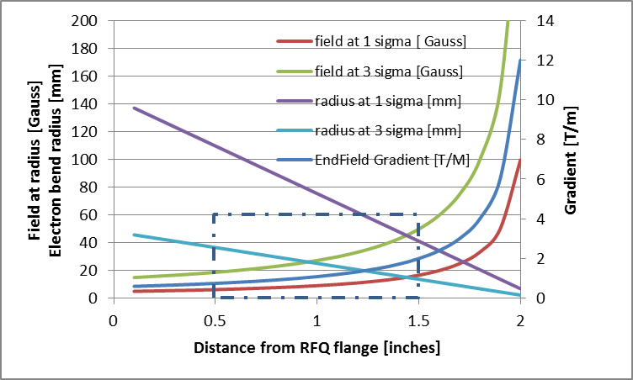
Electron in fringe field
K.E. (H-) 750 keV
Electron energy 409 eV
Velocity 1.198E7 m/s
Electron bend radius in field B r →$(\frac{m}{e})\frac{1}{B}v_{e}$
H⁻ 1σ ~ 0.83 mm -> 3σ < ~ 2.5 mm
Field at particle amplitude -> G*amplitude
5 mm
~30 mm
mirrors
First quad in doublet is
H focusing for H⁻ and e⁻
Assume end-field shape
is the same as between
pole tips

